Slide 1
Distributed Computing Systems
Project 4 – Dragonfly Wings
Extending the Dragonfly Game Engine with Networking
Due date: Sunday, February 28th, 11:59pm

Slide 2
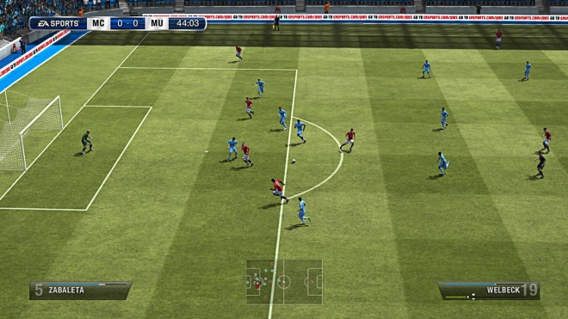
Overview
network
One game world – the pitch
But more than one copy – each client has own!
Each client does own computations (ball moves left)
How to keep game world synchronized?
(Advanced: what about latency? scalability? cheating?)

Slide 3
Project 4 Synopsis
Goals
Understand implications of distributing shared, virtual world on multiple computers
Realize implementation of distributed system
Acquire familiarity with networking for game engine
Gain experience using fundamental networking code
Objectives
Implement distribution of state in virtual world
Extend single player game to two player, networked game with client-server architecture
Design and implemented network functionality for game engine
Implement networking (TCP/IP) socket code from scratch
Extend Dragonfly with network support
Create two player, 2d game using game engine

Slide 4
Outline
Overview
Project
Game engine
Dragonfly extensions
Hints
Experiments
Hand In
Grading

Slide 5
Dragonfly Overview
Text-based game engine
Primarily to teach about game engine development
But full-featured (graphics animation, collisions, audio, input/output) → can make real games!
Does not provide networking support
(That’s the goal of this project!)
(High-level architecture slide next)

Slide 6
Dragonfly Overview
GAME CODE
Saucer: hit()
Hero: kbd()
Star: eventHandler()
GameOver: step()
DRAGONFLY
DrawCharacter
InsertObject
LoadSprite
GetKey
MoveObject
SendEvent
COMPUTER PLATFORM
Allocate memory
Clear display
File open/close
Get keystroke

Slide 7
Tutorial Overview
\
~==-
/
____
/_o__\
Good overview of Dragonfly through tutorial
Setup development environment for building
Work through tutorial making game – Saucer Shoot
Get used to Dragonfly
2D (text-based graphics) game engine
From game programmer’s perspective
In this project, you both game programmer (Saucer Shoot 2) and engine programmer (networking)
Learn enough about game to extend to two-player version

Slide 8
What is a “Text-based” Game?

Slide 9
Why Text-based Graphics?
Conceptually easy
(x,y) location, all cells
Platform independent (mostly)
Simple Fast Multimedia Library (SFML) ported many platforms
Linux, Mac (homebrew and XCode), Windows (Visual Studio)
Reduce temptation to spend time on art
“Programmer art” is ok!

Slide 10
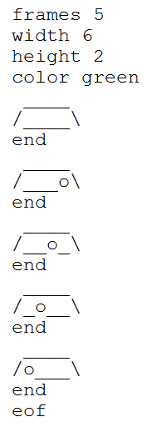
Text-based Graphics - Sprites
Animations stored in Sprite file
Read in by engine before use
Sprite file with fixed format
Note, must be exact (spaces)
Included sprites (sprites.zip) all work with tutorial
Note, if doing your own may need to “debug” art
If doesn’t load, see “dragonfly.log” for messages
Dragonfly does 30 updates/second (→ can potentially change frame each update)
Use Object setSpriteSlowDown() if slower

Slide 11
Tutorial
Saucer Shoot
Online: http://dragonfly.wpi.edu/tutorial/
Work through start to finish
“Cook-book” like, but with some explanations
Need resources/assets
Sprite package (sprites.zip)
Sound package (sounds.zip)
Also available is source code if stuck (gameX.zip)
Internal understanding not necessarily needed
That is whole other class!
Basic external understanding expected
Needed when extending Saucer Shoot game

Slide 12
A 10,000-Foot View of Game Code
Startup game engine
Initialize graphics, input devices, file logging
Populate world with objects
Player object (Hero), Enemies (Saucers), Decorations (Stars)
Run game
Move objects, get input, send events to objects (e.g., collisions), draw screen (objects draw themselves)
Game engine does most of this work!
Shutdown

Slide 13
Core Attributes of Engine in Tutorial
Startup
Managers – how invoked
Objects – these need to by synchronized across computers!
Made once (Hero, Stars)
Made many times (Saucers, Bullets, Explosions)
Events
Built-in: Keyboard, Collision
Custom: Nuke
Not explicit, but also
Debugging (own code)
Reading (and using) logfiles

Slide 14
Development Platforms
Can be developed on common desktop development environments
Linux (Debian-based has SFML package)
Note: Can use CCC cs4513 machine
Windows (Visual Studio 2013)
Note, if have VS 2015 can use VS 2013 project
MacOS (homebrew or XCode)

Slide 15
Development Environment
Tools and Libraries
Environment
C++ compiler
Standard C++ libraries
Simple and Fast Multimedia Library (SFML)
Project development software (e.g., make or IDE)
Debugger (e.g., gdb or ddd)
Dragonfly Engine
Download zip and extract
SFML
Linux
sudo apt-get install libsfml-dev
Windows
Download zip and extract
Mac
Download tgz and extract

Slide 16
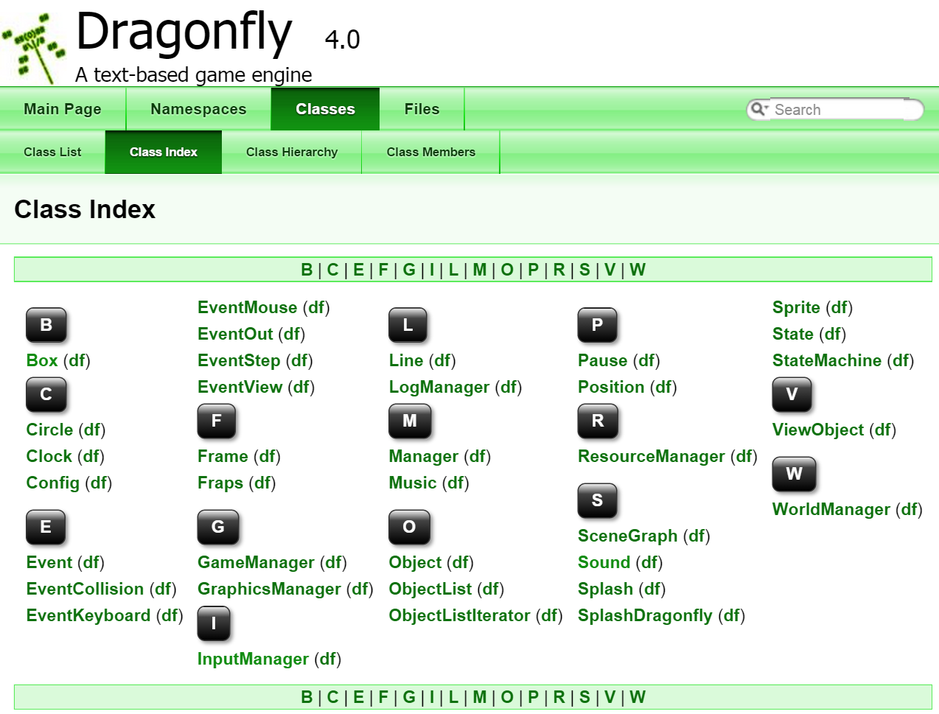
Dragonfly Documentation
Documentation
http://dragonfly.wpi.edu/documentation/

Slide 17
Outline
Overview (done)
Dragonfly extensions (next)
Network Manager
Network Events
Hints
Experiments
Hand In
Grading

Slide 18
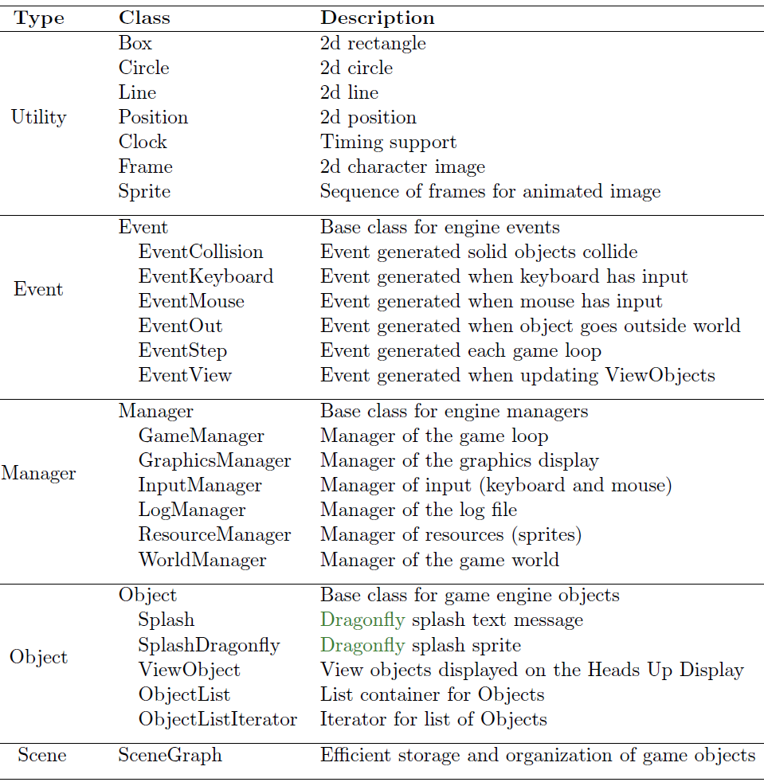
Dragonfly Classes
+ Sound, Music
Add Manager
Add Event
(Add Sentry)

Slide 19
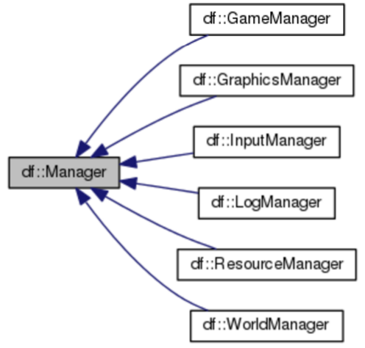
Managers
Support systems that manage crucial tasks
Handling input, Rendering graphics, Logging data
Networking
Startup and shutdown explicitly
GameManager
NetworkManager
Only makes sense to have one
Singleton
df::NetworkManager

Slide 20
Managers: C++ Singletons
Idea
Generally only 1 makes sense
Need global access
→ Singleton (design pattern)
Compiler won’t allow creation (so have only 1)
Singleton s; // not allowed
Instead:
Singleton &s= Singleton::getInstance();
Guarantees only 1 copy of Singleton will exist
→ Use for Network Manager
class Singleton {
private:
Singleton();
Singleton(Singleton const &copy);
Singleton&(Singleton const &assign);
public:
static Singleton &getInstance();.
};
// Return the one and only instance of the class.
Singleton &Singleton::getInstance() {
// A static variable persists after method ends.
static Singleton single;
return single;
};

Slide 21
Manager.h
namespace df {
class Manager {
private:
std::string type; // Manager type identifier .
bool is_started; // True when started successfully.
protected:
// Set type identifier of Manager.
void setType(std::string type);
public:
Manager();
virtual ~Manager();
// Get type identifier of Manager.
std::string getType() const;
// Startup Manager.
// Return 0 if ok, else negative number.
virtual int startUp();
// Shutdown Manager.
virtual void shutDown();
// Return true when startUp() was executed ok, else false.
bool isStarted() const;
};
} // end of namespace df
Notes:
Base class
Other managers inherit (e.g., Network Manager)
virtual ensures derived calls used

Slide 22
Network Manager (1 of 2)
// NetworkManager.h
// Manage network connections to/from engine.
#ifndef __NETWORK_MANAGER_H__
#define __NETWORK_MANAGER_H__
// System includes.
#include <string.h>
// Engine includes.
#include "Manager.h"
#define DRAGONFLY_PORT "PICK NUMBER HERE" // Default port.
namespace df {
class NetworkManager : public Manager {
private:
NetworkManager(); // Private since a singleton.
NetworkManager(NetworkManager const&); // Don't allow copy.
void operator=(NetworkManager const&); // Don't allow assignment.
int sock; // Connected network socket.
public:
// Get the one and only instance of the NetworkManager.
static NetworkManager &getInstance();
// Start up NetworkManager.
int startUp();
// Shut down NetworkManager.
void shutDown();
// Accept only network events.
// Returns false for other engine events.
bool isValid(std::string event_type) const;

Slide 23
Network Manager (2 of 2)
// Block, waiting to accept network connection.
int accept(std::string port = DRAGONFLY_PORT);
// Make network connection.
// Return 0 if success, else -1.
int connect(std::string host, std::string port = DRAGONFLY_PORT);
// Close network connection.
// Return 0 if success, else -1.
int close();
// Return true if network connected, else false.
bool isConnected() const;
// Return socket.
int getSocket() const;
// Send buffer to connected network.
// Return 0 if success, else -1.
int send(void *buffer, int bytes);
// Receive from connected network (no more than nbytes).
// If peek is true, leave data in socket, else remove.
// Return number of bytes received, else -1 if error.
int receive(void *buffer, int nbytes, bool peek = false);
// Check if network data.
// Return amount of data (0 if no data), -1 if not connected or error.
int isData() const;
};
} // end of namespace df
#endif // __NETWORK_MANAGER_H__

Slide 24
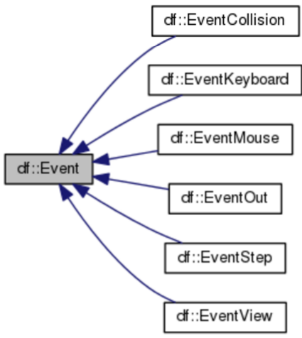
Dragonfly Events
Built-in events derive from base class
Game programmer can define others
e.g., “nuke”
Use for network event (EventNetwork)
df::EventNetwork

Slide 25
Event.h
#include <string>
const std::string UNDEFINED_EVENT "df::undefined";
class Event {
private:
std::string event_type; // Holds event type.
public:
// Create base event.
Event();
// Destructor.
virtual ~Event();
// Set event type.
void setType(std::string new_type);
// Get event type.
std::string getType() const;
};

Slide 26
EventNetwork.h
// A "network" event, generated when a network packet arrives.
#ifndef __EVENT_NETWORK_H__
#define __EVENT_NETWORK_H__
#include "Event.h"
namespace df {
const std::string NETWORK_EVENT = "df::network";
class EventNetwork : public Event {
private:
int bytes; // Number of bytes available
public:
// Default constructor.
EventNetwork();
// Create object with initial bytes.
EventNetwork(int initial_bytes);
// Set number of bytes available.
void setBytes(int new_bytes);
// Get number of bytes available.
int getBytes() const;
};
} // end of namespace df
#endif // __EVENT_NETWORK_H__

Slide 27
Using Events
Objects register with appropriate Manager
Engine knows about built-in events
All user-defined events go to World Manager
But! → engine won’t know about network events
Build special Sentry object that checks network
(Next Slide)
When network data, create network event using onEvent() method
Any interested game Objects get event
Objects must explicitly register with NetworkManager
NetworkManager &network_manager = NetworkManager::getInstance();
network_manager.registerInterest(this, df::NETWORK_EVENT)

Slide 28
Sentry.h
//
// Sentry
//
// Poll NetworkManager for incoming messages, generating network // events (onEvent()) when there are complete messages available.
#ifndef __SENTRY_H__
#define __SENTRY_H__
#include "Object.h"
namespace df {
class Sentry : public Object {
private:
void doStep(); // Called for each step event.
public:
Sentry();
int eventHandler(const df::Event *p_e);
};
} // end of namespace df
#endif // __SENTRY_H__

Slide 29
Using Sentry
After starting up NetworkManager, create Sentry object
new df::Sentry
Sentry polls NetworkManager for network data
When int of data, check if amount == total data
Expects first byte of message to be message size (see Messages slides below)
If so, send EventNetwork to interested Objects
NetworkManager &network_manager = NetworkManager::getInstance();
EventNetwork en;
network_manager.onEvent(&en);

Slide 30
Client and Host Objects
Host object (derived from Object) runs on server
Client object (derived from Object) runs on client
Host game started first, whereupon Host (using the NetworkManager) readies computer for connection
Client game started next, where Client (also using NetworkManager) starts after and connects to Host
Each game step, Host checks all game objects to see which ones are new (their Object id's are modified)
Synchronized via NetworkManager
Client receives object data over network, updating Objects
Host receives keystrokes sent by Client, generating network events to game objects (e.g., the Client Hero) to handle

Slide 31
Two-player Game Startup
Start Dragonfly
GameManager startUp()
Start NetworkManager
NetworkManager startUp()
Start Sentry
new Sentry()
If “host” → Start Host
new Host
Else → Start Client
new Client

Slide 32
Extending Tutorial Game – Saucer Shoot 2 (1 of 3)
Need core gameplay only (e.g., hunting Saucers)
No GameStart and GameOver
Nukes also optional
Once connected, can go right to gameplay
Once Hero dies, can exit
Note: additional features (e.g., GameStart) for Miscellaneous points (below)
Add additional code (and sprites/sounds, if needed)
Networking from independent computers (a distributed system)
Two-player (one can play on Host)

Slide 33
Extending Tutorial Game – Saucer Shoot 2 (2 of 3)
Possible functionality
Simultaneous Heroes (same side, opposite sides)
Second player controls Saucer(s)
Your own clever idea!
Many decisions for multiplayer game
How player actions are transmitted to the server
How inconsistencies between client and server game states are resolved
What Objects are synchronized and how often
Key aspect – how to “send” an Object from one computer to another (next topic, after screenshot)

Slide 34
Extending Tutorial Game – Saucer Shoot 2 (3 of 3)

Slide 35
Serializing (Marshalling) Objects
// Object class methods to support serialization
// Serialize Object attributes to single string.
// e.g., "id:110,is_active:true, ...
// Only modified attributes are serialized (unless all is true).
// Clear modified[] array.
virtual string serialize(bool all = false);
// Deserialize string to become Object attributes.
// Return 0 if no errors, else -1.
virtual int deserialize(std::string s);
// Return true if attribute modified since last serialize.
bool isModified(enum ObjectAttribute attribute) const;
Derived classes (e.g., game objects) need to (de)serialize own attributes.
(See helper functions next slide)
Note! You may not need to do this – only if derived objects have attributes that need synchronizing
Call parent methods

Slide 36
Utility Functions for Serializing
// Convert integer to string, returning string.
std::string toString(int i);
// Convert float to string, returning string.
std::string toString(float f);
// Convert character to string, returning string.
std::string toString(char c);
// Convert boolean to string, returning string.
std::string toString(bool b);
// Match key:value pair in string in str, returning value.
// If str is empty, use previously parsed string str.
// Return empty string if no match.
std::string match(std::string str, std::string find);

Slide 37
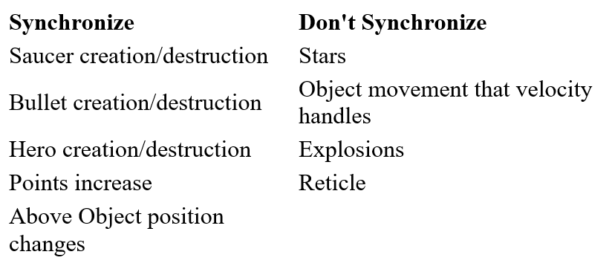
Synchronizing Objects (1 of 2)
Only synchronize important objects and events (e.g., Hero destruction vs. Stars moving)

Slide 38
Synchronizing Objects (2 of 2)
Generally, only Host creates/destroys
Except for Explosion
Generally, Host and Client move and animate
Except for Client Hero (see below)
Client player Hero → get player 2 input
Could update ship and synchronize
But if not allowed, need to “roll back” state
Instead, send keystrokes to server
Let server move all Objects and send to client

Slide 39
Messages
Suggested message structure
First item is int
Has size of entire message (including int)
Client can “peek” at data, not pulling all from socket until size bytes available
At least one complete message
After pulling message, Host/Client can check type and take appropriate actions
Host → Client format different than Client → Host

Slide 40
Messages – Host to Client
HEADER (HC_HEADER_SIZE):
+ size is one int
+ message type is another int
if NEW then
+ next int is object type
else UPDATE
+ next int is object id
REST is serialized Object data (string)
Note, if Object not modified, nothing to send
Host sends game objects to Client
Objects are one of
New (need to be created)
Updated (some attributes changed)
Deleted
Client will take action appropriate to type
delete
new Object (check type)
For new and update
deserialize() based on attributes
Could add “game over” type
#define HC_HEADER_SIZE 3 * sizeof(int)
// Types of messages from Host to Client
enum HostMessageType {
ADD_OBJECT,
UPDATE_OBJECT,
DELETE_OBJECT,
};

Slide 41
Messages – Client to Host
Client sends player commands to Host
Messages are one of
Keyboard
Mouse
Client will take action appropriate to type
If KEY
→ invoke kbd() on Client Hero
If MOUSE
→ invoke mouse() on Client Hero
HEADER (CH_HEADER_SIZE):
+ size is one int
+ message type is another int
if KEYBOARD then
+ next int is key
else MOUSE
+ next int is mouse-x
+ next int is mouse-y
#define CH_HEADER_SIZE 2 * sizeof(int)
// Types of messages from Host to Client
enum ClientHostMessageType {
KEY,
MOUSE,
};

Slide 42
Outline
Overview (done)
Dragonfly extensions (done)
Hints (next)
Experiments
Hand In
Grading

Slide 43
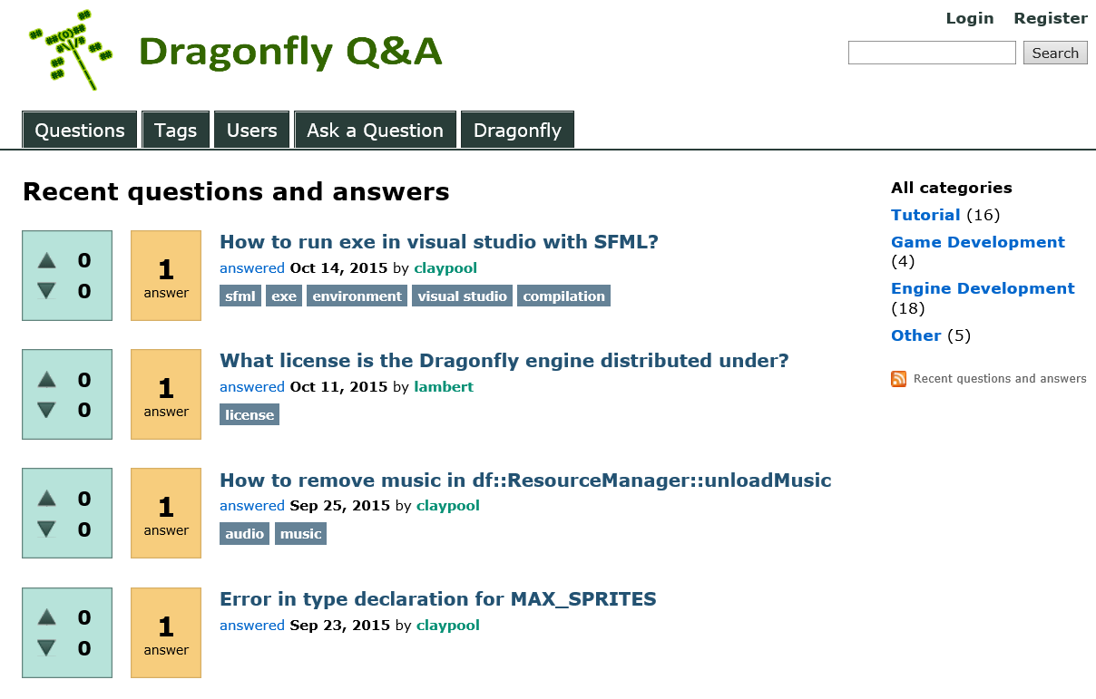
Dragonfly Question-Answer
http://alpheus.wpi.edu/dqa/

Slide 44
The LogManager - Functionality
Manages output to log file (“dragonfly.log”)
Upon startup → opens file (erasing old content)
Upon shutdown → closes file
Printf() style output via writeLog(). E.g.,
writelog(“Player is moving”)
writelog(“Player is moving to (%d,%d)”, x, y)
Can set log level of LogManager (via setLogLevel()) and messages to control verbosity when logging. E.g.,
writelog(3, “Player is moving”)

Slide 45
Using the LogManager (1 of 2)
// Get singleton instance of LogManager.
LogManager &log_manager = LogManager::getInstance();
// Example call with 1 arg.
log_manager.writeLog(
“NetworkManager::connect(): Socket is open");
// Example call with 2 args.
log_manager.writeLog(
“NetworkManager::receive(): read %d bytes”, bytes);
// Call with 3 args.
log_manager.writeLog(
“Hero::kbd(): Hero is at is position (%d, %d)", x, y);

Slide 46
Using the LogManager (2 of 2)
Tip #2!
When calling writeLog() include information:
Class name
Method name
// Sample logfile output:
07:53:30 Log Manager started
07:53:31 GraphicsManager::startUp(): Current window set
07:53:31 GraphicsManager::startUp(): max X is 80, max Y is 24

Slide 47
Once-only Header Files
"Redeclaration of class ClassName...“?
When header included first time, all is normal
Defines FILE_FOO_SEEN
When header included second time, FILE_FOO_SEEN defined
Conditional is then false
So, preprocessor skips entire contents → compiler will not see it twice
// File foo.h
#ifndef FILE_FOO_SEEN
#define FILE_FOO_SEEN
// The entire foo file appears next.
class Foo{ … };
#endif // !FILE_FOO_SEEN

Slide 48
Protocols and Sockets
(recommended) TCP – stream oriented, may have part of a message
Check that header arrives, header has message size, then check that full message arrives
(optional) UDP – frame boundaries (e.g., message) preserved, but message may be lost
If matters (could ignore), use sequence numbers to detect
Non-blocking
Don’t want to hang
Get byte count (peek) before pulling examining
Windows versus Mac/Linux? Mostly same, but some exceptions
(next slide)

Slide 49
Linux/Mac vs. Windows
Linux/Mac
Windows
// Header files
#include <netdb.h>
#include <netinet/in.h>
#include <sys/ioctl.h> // for ioctl()
#include <unistd.h> // for close()
#include <sys/socket.h>
// System calls
close()
ioctl() // check num bytes, non-block
sigaction() // if do signals
// Flags
MSG_DONTWAIT // peek recv()
// Types
socklen_t
// Header files
#include <WinSock2.h> #include <WS2tcpip.h>
// System calls
closesocket()
ioctlsocket() // check num // bytes, non-blocking
Multi-platform? (Optional – can be misc points)
#if defined(_WIN32) || defined(_WIN64)
Should be able to isolate all in NetworkManager

Slide 50
Single-host Testing
Can test via localhost
Both games will record keystrokes (Dragonfly notes when key is pressed)
Instead, game can check if mouse inside window (focus follow mouse)
// Check if mouse outside game window.
sf::RenderWindow *p_win = df::GraphicsManager::getInstance().getWindow();
sf::Vector2i lp = sf::Mouse::getPosition(*p_win);
if (lp.x > df::Config::getInstance().getWindowHorizontalPixels() ||
lp.x < 0 ||
lp.y > df::Config::getInstance().getWindowVerticalPixels() ||
lp.y < 0) {
// Outside window so don't capture input.
} else {
// Inside window so don't capture input.
}

Slide 51
Defined Roles – Host or Client
Helpful for single code-base game to “know” if Host or Client
// Role class - Indicate whether game is Host or Client.
#ifndef __ROLE_H__
#define __ROLE_H__
class Role {
private:
Role(); // Private since a singleton.
Role (Role const&); // Don't allow copy.
void operator=(Role const&); // Don't allow assignment.
bool is_host; // True if hosting game.
public:
// Get the one and only instance of the Role.
static Role &getInstance();
// Set host.
void setHost(bool is_host = true);
// Return true if host.
bool isHost() const;
};
#endif // __ROLE_H__

Slide 52
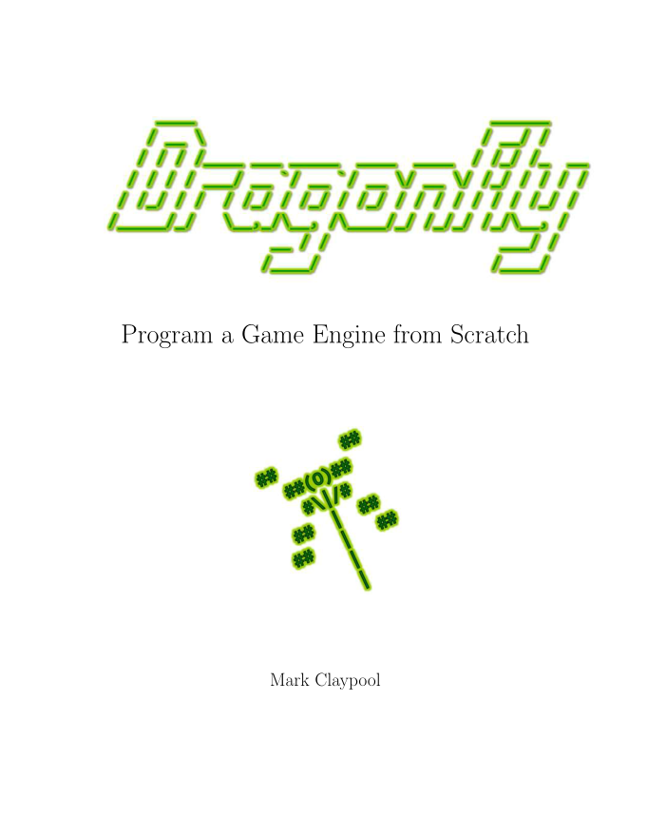
Dragonfly Book
The book Dragonfly - Program a Game Engine from Scratch guides programmers through the implementation of a full-featured, 2d, text-based game engine.
If interested:
Order for cost (see me)
Borrow from IMGD student

Slide 53
Outline
Overview (done)
Dragonfly extensions (done)
Hints (done)
Experiments (next)
Hand In
Grading

Slide 54
Experiments (1 of 3)
When done (networking and Saucer Shoot 2)
Measure:
1) network data rate from server to client
2) network data rate from client to server
3) in-game round trip time
Consider in-game aspects
Data rate over time (e.g., game beginning, middle, end)
Gameplay during measurements
Number of Objects in game (e.g., more saucers as time progresses)
Player actions (e.g., frantic moving and shooting)
Note! Want for game traffic, not X

Slide 55
Experiments (2 of 3)
Network data rates
Instrumenting code to write data out to logfile each packet sent/received
Analysis on packet sizes, packet rates and bitrates
At least one graph of network bitrate (e.g., Kb/s) over time
In-game round trip time
Timing when player inputs a key until action on screen
Logfile messages placed at right points in client code
Analysis on average, min and max
System call gettimeofday() for system time
Multiple measurements

Slide 56
Experiments (3 of 3)
Design - describe experiments
a) how instrumented/measured
b) number of runs
c) system conditions
d) any other relevant details
Results - depict results clearly
Tables and/or graphs
Statistical analysis where appropriate
Analysis - interpret results
What the results mean
e.g., scalability to more players?
Playability over networks?
Any subjective analysis

Slide 57
Outline
Overview (done)
Dragonfly extensions (done)
Hints (done)
Experiments (done)
Hand In (next)
Grading

Slide 58
Hand In (1 of 2)
Source code package
All code necessary to build your engine modification (well-structured, commented)
Any other support files, including .h files.
Makefile or Project file
You do NOT need to turn in any Dragonfly headers or libraries
Game code for Saucer Shoot 2:
All code necessary to build your game (well-structured, commented)
Sprites (including all “default” sprites)
A Makefile
README.txt file explaining:
Platform
How to compile and run
Where “extra” points
Experiment document (PDF)

Slide 59
Hand In (2 of 2)
Clean and zip up
Turn in via Instruct Assist
Due at mid-night (11:59pm)

Slide 60
Grading
Networking Support 30%
Socket-based code
Integrated with Dragonfly as Manager
Saucer Shoot 2 60%
Networking
Distributed Object synchronization
Enhanced gameplay for 2nd player
Experiments 5%
Design, Results, Analysis
Miscellaneous 5%
Flexibility in grading
“Extra” points can apply to any section
See detailed grading guide on project Webpage for detailed breakdown

Slide 61
Grading Rubric
90-100 The submission clearly exceeds requirements. The functionality is fully implemented and is provided in a robust, bug-free fashion. Full client-host synchronization is evident in the game. Gameplay is effective and fun for two players. All code is well-structured and clearly commented. Experiments effectively test all required measurements. Experimental writeup has the three required sections, with each clearly written and the results clearly depicted.
89-80 The submission meets requirements. The basic functionality is implemented and runs as expected without any critical bugs. Client-host synchronization is effective, but there may be occasional visual glitches that are not critical to gameplay. Gameplay is effective for two players. Code is well-structured and clearly commented. Experimental writeup has the three required sections, with details on the methods used and informative results.
79-70 The submission barely meets requirements. Functionality is mostly implemented, but may not be fully implemented and/or may not run as expected. Client-host synchronization provides occasional visual glitches, some may be critical to gameplay. Gameplay supports two players, but to a limited extent. Code is only somewhat well-structured and commented. Experiments are incomplete and/or the writeup does not provide clarity on the methods or results.
69-60 The project fails to meet requirements in some places. Networking support is missing critical functionality or robustness. The engine may crash occasionally. The game does not support complete or robust gameplay for two players. Code is lacking in structure or comments. Experiments are incomplete and the writeup does not provide clarity on the methods or results.
59-0 The project does not meet core requirements. The networking extensions cannot compile, crashes consistently, or is lacking many functional features. The game does not compile or does not support two player interaction. Code is only lacking structure and comments. Experiments are incomplete with a minimal writeup.

Slide 62
Previous Results
CS4513
D-term 2014
Mark Claypool. Teaching Network Game Programming with the Dragonfly Game Engine, Syllabus Journal - Special Issue on Teaching with and about Video Games, Vol. 4, No. 1, 2015. Online at: http://www.cs.wpi.edu/~claypool/papers/dragonfly-networking/
Grades

Slide 63
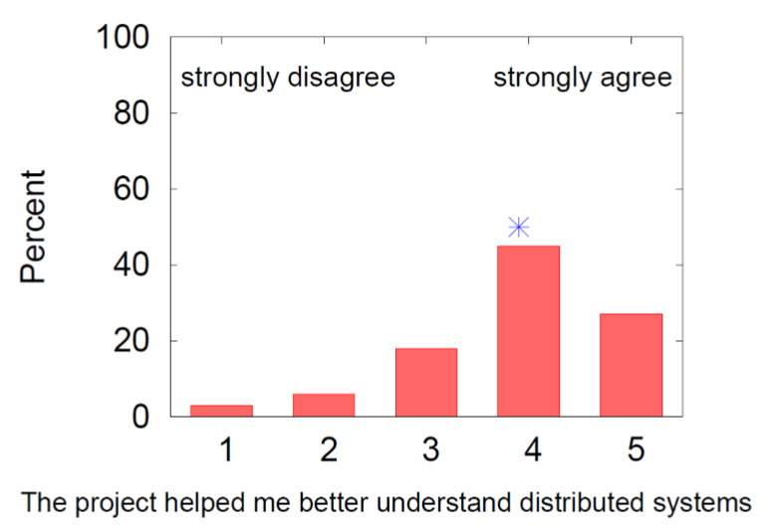
Distributed Systems

Slide 64
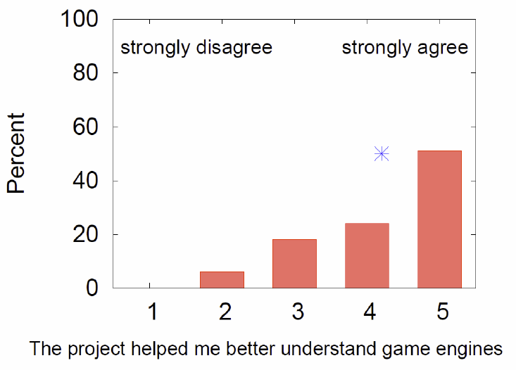
Game Engines

Slide 65
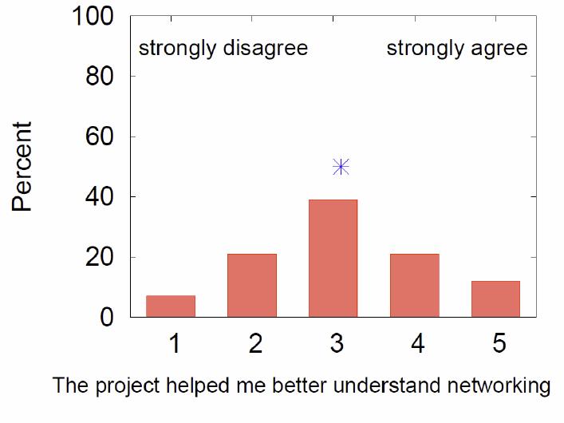
Networking

Slide 66
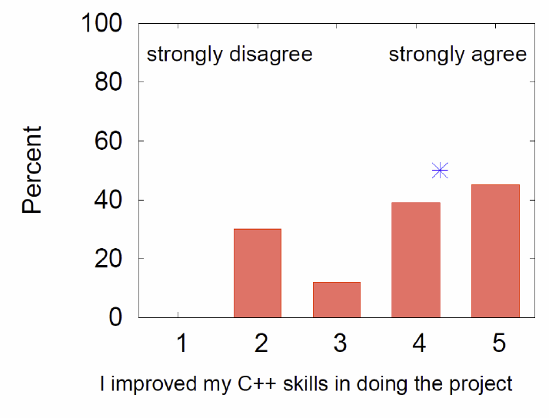
C++

Slide 67
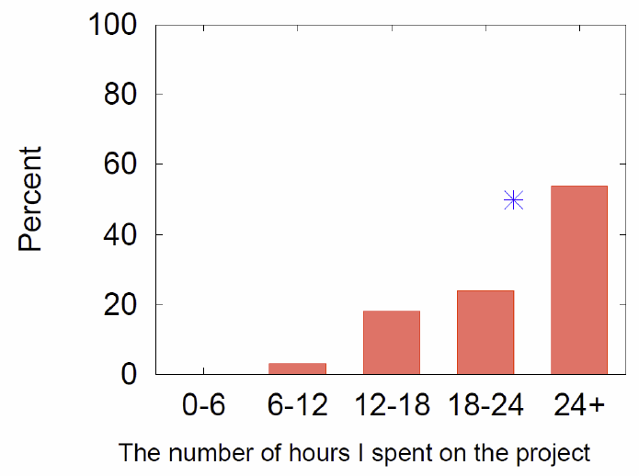
Hours Spent

