Slide 1
File System Design for an NFS File Server Appliance
Dave Hitz, James Lau, and Michael Malcolm
Technical Report TR3002
NetApp
2002
http://www.netapp.com/us/library/white-papers/wp_3002.html
(At WPI: http://www.wpi.edu/Academics/CCC/Help/Unix/snapshots.html)

Slide 2
Introduction
In general, appliance is device designed to perform specific function
Distributed systems trend has been to use appliances instead of general purpose computers. Examples:
routers from Cisco and Avici
network terminals
network printers
For files, not just another computer with your files, but new type of network appliance
→ Network File System (NFS) file server

Slide 3
Introduction: NFS Appliance
NFS File Server Appliances have different requirements than those of general purpose file system
NFS access patterns are different than local file access patterns
Large client-side caches result in fewer reads than writes
Network Appliance Corporation uses Write Anywhere File Layout (WAFL) file system

Slide 4
Introduction: WAFL
WAFL has 4 requirements
Fast NFS service
Support large file systems (10s of GB) that can grow (can add disks later)
Provide high performance writes and support Redundant Arrays of Inexpensive Disks (RAID)
Restart quickly, even after unclean shutdown
NFS and RAID both strain write performance:
NFS server must respond after data is written
RAID must write parity bits also

Slide 5
WPI File System
CCC machines have central, Network File System (NSF)
Have same home directory for cccwork2, cccwork3…
/home has 10,113 directories!
Previously, Network File System support from NetApp WAFL
Switched to EMC Celera NS-120
→ similar features and protocol support
Provide notion of “snapshot” of file system (next)

Slide 6
Outline
Introduction (done)
Snapshots : User Level (next)
WAFL Implementation
Snapshots: System Level
Performance
Conclusions

Slide 7
Introduction to Snapshots
Snapshots are copy of file system at given point in time
WAFL creates and deletes snapshots automatically at preset times
Up to 255 snapshots stored at once
Uses copy-on-write to avoid duplicating blocks in the active file system
Snapshot uses:
Users can recover accidentally deleted files
Sys admins can create backups from running system
System can restart quickly after unclean shutdown
Roll back to previous snapshot

Slide 8
User Access to Snapshots
Example, suppose accidentally removed file named “todo”:
CCCWORK3% ls -lut .snapshot/*/todo
-rw-rw---- 1 claypool claypool 4319 Oct 24 18:42 .snapshot/2011_10_26_18.15.29/todo
-rw-rw---- 1 claypool claypool 4319 Oct 24 18:42 .snapshot/2011_10_26_19.27.40/todo
-rw-rw---- 1 claypool claypool 4319 Oct 24 18:42 .snapshot/2011_10_26_19.37.10/todo
Can then recover most recent version:
CCCWORK3% cp .snapshot/2011_10_26_19.37.10/todo todo
Note, snapshot directories (.snapshot) are hidden in that they don’t show up with ls (even ls -a) unless specifically requested

Slide 9
Snapshot Administration
WAFL server allows sys admins to create and delete snapshots, but usually automatic
At WPI, snapshots of /home. Says:
3am, 6am, 9am, noon, 3pm, 6pm, 9pm, midnight
Nightly snapshot at midnight every day
Weekly snapshot is made on Saturday at midnight every week
→ But looks like every 1 hour (fewer copies kept for older periods and 1 week ago max)
claypool 168 CCCWORK3% cd .snapshot
claypool 169 CCCWORK3% ls -1
home-20160121-00:00/
home-20160122-00:00/
home-20160122-22:00/
home-20160123-00:00/
home-20160123-02:00/
home-20160123-04:00/
home-20160123-06:00/
home-20160123-08:00/
home-20160123-10:00/
home-20160123-12:00/
…
home-20160127-16:00/
home-20160127-17:00/
home-20160127-18:00/
home-20160127-19:00/
home-20160127-20:00/
home-latest/

Slide 10
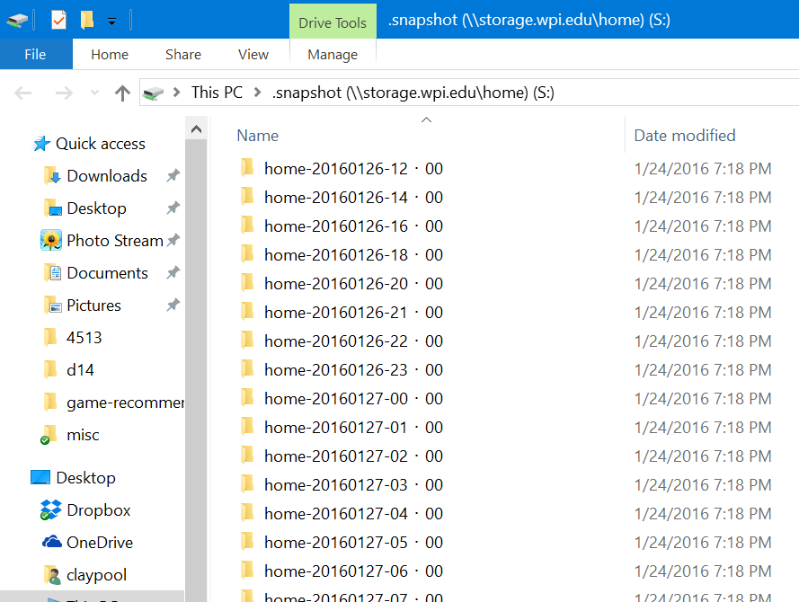
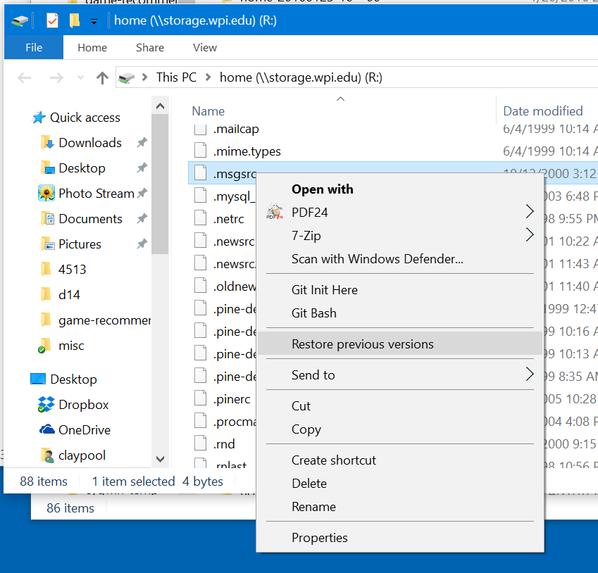
Snapshots at WPI (Windows)
Mount UNIX space (\\storage.wpi.edu\home), add \.snapshot to end
Note, files in .snapshot do not count against quota
Can also right-click on file and choose “restore previous version”

Slide 11
Outline
Introduction (done)
Snapshots : User Level (done)
WAFL Implementation (next)
Snapshots: System Level
Performance
Conclusions

Slide 12
WAFL File Descriptors
Inode based system with 4 KB blocks
Inode has 16 pointers, which vary in type depending upon file size
For files smaller than 64 KB:
Each pointer points to data block
For files larger than 64 KB:
Each pointer points to indirect block
For really large files:
Each pointer points to doubly-indirect block
For very small files (less than 64 bytes), data kept in inode itself, instead of using pointers to blocks

Slide 13
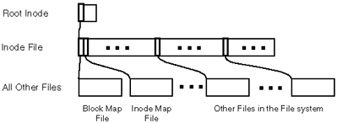
WAFL Meta-Data
Meta-data stored in files
Inode file – stores inodes
Block-map file – stores free blocks
Inode-map file – identifies free inodes

Slide 14
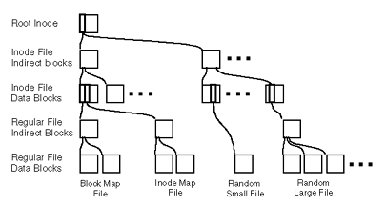
Zoom of WAFL Meta-Data (Tree of Blocks)
Root inode must be in fixed location
Other blocks can be written anywhere

Slide 15
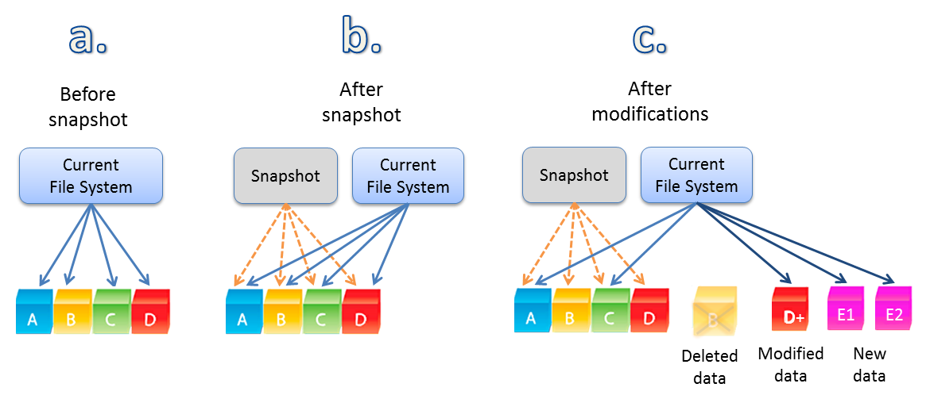
Snapshots (1 of 2)
Copy root inode only, copy on write for changed data blocks
Over time, old snapshot references more and more data blocks that are not used
Rate of file change determines how many snapshots can be stored on system
Notes:
SoftNAS Cloud™ Features 5

Slide 16
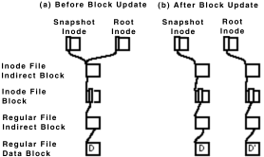
Snapshots (2 of 2)
When disk block modified, must modify meta-data (indirect pointers) as well
Batch, to improve I/O performance

Slide 17
Consistency Points (1 of 2)
In order to avoid consistency checks after unclean shutdown, WAFL creates special snapshot called consistency point every few seconds
Not accessible via NFS
Batched operations are written to disk each consistency point
Like journal
In between consistency points, data only written to RAM

Slide 18
Consistency Points (2 of 2)
WAFL uses NVRAM (NV = Non-Volatile):
(NVRAM is DRAM with batteries to avoid losing during unexpected poweroff, some servers now just solid-state or hybrid)
NFS requests are logged to NVRAM
Upon unclean shutdown, re-apply NFS requests to last consistency point
Upon clean shutdown, create consistency point and turnoff NVRAM until needed (to save power/batteries)
Note, typical FS uses NVRAM for metadata write cache instead of just logs
Uses more NVRAM space (WAFL logs are smaller)
Ex: “rename” needs 32 KB, WAFL needs 150 bytes
Ex: write 8 KB needs 3 blocks (data, inode, indirect pointer), WAFL needs 1 block (data) plus 120 bytes for log
Slower response time for typical FS than for WAFL (although WAFL may be a bit slower upon restart)

Slide 19
Write Allocation
Write times dominate NFS performance
Read caches at client are large
Up to 5x as many write operations as read operations at server
WAFL batches write requests (e.g., at consistency points)
WAFL allows “write anywhere”, enabling inode next to data for better perf
Typical FS has inode information and free blocks at fixed location
WAFL allows writes in any order since uses consistency points
Typical FS writes in fixed order to allow fsck to work if unclean shutdown

Slide 20
Outline
Introduction (done)
Snapshots : User Level (done)
WAFL Implementation (done)
Snapshots: System Level (next)
Performance
Conclusions

Slide 21
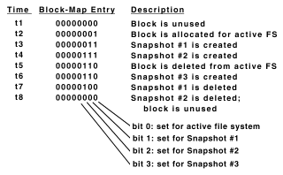
The Block-Map File
Typical FS uses bit for each free block, 1 is allocated and 0 is free
Ineffective for WAFL since may be other snapshots that point to block
WAFL uses 32 bits for each block
For each block, copy “active” bit over to snapshot bit

Slide 22
Creating Snapshots
Could suspend NFS, create snapshot, resume NFS
But can take up to 1 second
Challenge: avoid locking out NFS requests
WAFL marks all dirty cache data as IN_SNAPSHOT. Then:
NFS requests can read system data, write data not IN_SNAPSHOT
Data not IN_SNAPSHOT not flushed to disk
Must flush IN_SNAPSHOT data as quickly as possible
flush
IN_SNAPSHOT
Can be used
new

Slide 23
Flushing IN_SNAPSHOT Data
Flush inode data first
Keeps two caches for inode data, so can copy system cache to inode data file, unblocking most NFS requests
Quick, since requires no I/O since inode file flushed later
Update block-map file
Copy active bit to snapshot bit
Write all IN_SNAPSHOT data
Restart any blocked requests as soon as particular buffer flushed (don’t wait for all to be flushed)
Duplicate root inode and turn off IN_SNAPSHOT bit
All done in less than 1 second, first step done in 100s of ms

Slide 24
Outline
Introduction (done)
Snapshots : User Level (done)
WAFL Implementation (done)
Snapshots: System Level (done)
Performance (next)
Conclusions

Slide 25
Performance (1 of 2)
Compare against other NFS systems
How to measure NFS performance?
Best is SPEC NFS
LADDIS: Legato, Auspex, Digital, Data General, Interphase and Sun
Measure response times versus throughput
Typically, servers quick at low throughput then response time increases as throughput requests increase
(Me: System Specifications?!)

Slide 26
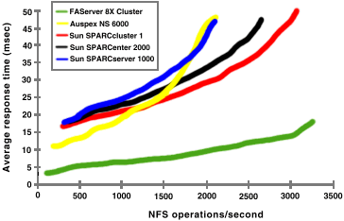
Performance (2 of 2)
(Typically, look for “knee” in curve)
best through-put
best response time
Notes:
+ FAS has only 8 file systems, and others have dozens
- FAS tuned to NFS, others are general purpose

Slide 27
NFS vs. Newer File Systems
MPFS = multi-path file system
Used by EMC Celerra
Remove NFS server as bottleneck
Clients write directly to device

Slide 28
Conclusion
NetApp (with WAFL) works and is stable
Consistency points simple, reducing bugs in code
Easier to develop stable code for network appliance than for general system
Few NFS client implementations and limited set of operations so can test thoroughly
WPI bought one ☺

