Slide 1
CS4513 Distributed Computing Systems
C-term 2016
Mark Claypool

Slide 2
Topics
Background
Admin Stuff
Motivation
Objectives
Class material!

Slide 3
Professor Background (Who am I?)
Mark Claypool (professor, “Mark”)
Professor, Computer Science
Professor, Interactive Media and Game Development
Systems guy
Research interests
Network games
Multimedia performance
Congestion control (protocols, AQM)
Wireless networking

Slide 4
Student Background (Who are you?)
Year?
Major?
Background
cs3013?
cs3516?
cs4516?
Platform of Choice?
Language of Choice?
Expertise (low 1 to 5 high)?
C/C++
Java
Unix
Other?

Slide 5
Syllabus Stuff
http://www.cs.wpi.edu/~cs4513/c16
Class: Tu, Fr 2-3:50pm
TAs: Salah Ahmed
Office hours:
TA: TBA, FLA22
Prof: TBA, FLB24b
Or by appointment
Email
claypool@cs.wpi.edu (me)
cs4513-staff@cs.wpi.edu (me + TA)
cs4513-all@cs.wpi.edu (class)

Slide 6
Text Book
OS Book from cs3013
File systems
Research papers
Links
Learned
Read by you
Presented by me
Tested for exam
May be “recommended” papers/links

Slide 7
Range of Topics
File Systems
Distributed File Systems
The Web
Network Games
Misc
Peer-to-Peer File Sharing
Cloud Computing
Communication
Architectures
Synchronization
Virtualization
Performance

Slide 8
Course Structure
Recommended background
Operating Systems (cs3013)
Computer Networks (cs3516)
Good programming skills (required)
Grading
Exams (50%)
Projects (50%)

Slide 9
Exams
2 exams
50% of grade
Non-cumulative
In-class
Closed-note, Closed-paper, Closed-friend

Slide 10
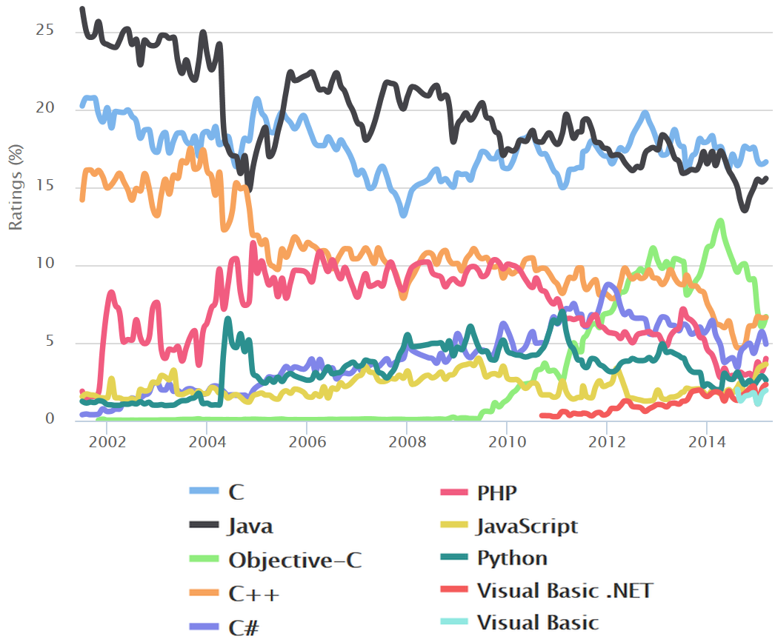
Projects (1 of 3)
Implementation in Linux (or Cygwin on Windows)
Implementation in C/C++ (some Java option)
TIOBE index
Search engine hits for +“<language> programming”
Reddit post, /r/dataisbeautiful
https://www.reddit.com/r/dataisbeautiful/comments/2ku7bm/popularity_of_programming_languages_based_on/

Slide 11
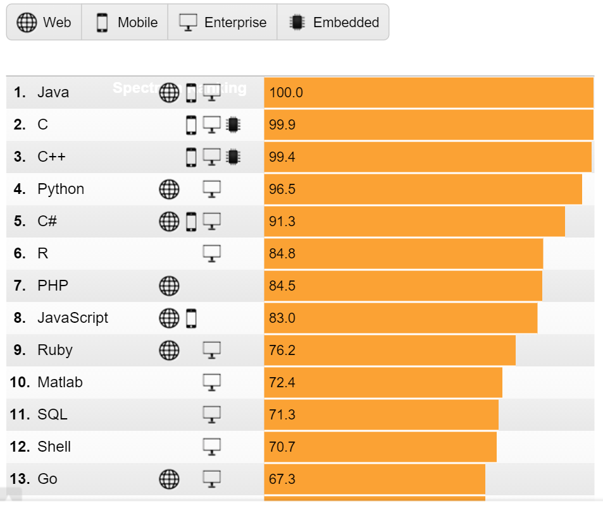
Projects (2 of 3)
“What are the most popular programming languages? The only honest answer: It depends.”
S. Cass “The 2015 Top Ten Programming Languages”,
IEEE Spectrum,
July 2015
Weights and app so you can try
http://spectrum.ieee.org/computing/software/the-2015-top-ten-programming-languages/

Slide 12
Projects (3 of 3)
All are done solo (no groups)
Topics
Proj 1 – Files
Proj 2 – Distributed shell
Proj 3 – File/Media sharing
Proj 4 – Network game (text based)
(BS/MS) – Cloud computing

Slide 13
Slides
On the Web (maybe after class)
Powerpoint and PDF
Caution! Don’t rely upon the slides alone! Use them as supplementary material
(come to class)

Slide 14
Timeline
http://www.cs.wpi.edu/~cs4513/c16/timeline.html
Estimate of assignment dates
Use it to help plan

Slide 15
BS/MS Credit
May be taken for graduate credit
Need to be admitted to BS/MS program
Written permission via approval form
Need “B” or better on all projects and exams
May get 1 more graduate credit
Register 1/6th ISP
Additional programming project (Cloud Game)

Slide 16
Goals and Objectives
Goals
Objectives
Understand the principles of file systems from the operating system perspective.
Gain experience writing distributed systems code.
Understand the issues in distributing a shared, virtual world on multiple computers.
Realize the implementation of a distributed system.
Gain knowledge of communication, architectures, synchronization and virtualization as they pertain to distributed systems.
Implement utilities that make extensive use of system calls pertaining to file systems.
Design and implement a distributed system from scratch.
Implement functionality for a networked game engine.
Implement the distribution of state in a virtual world.
Demonstrate an understanding of Web, peer-to-peer and file systems as distributed systems.

Slide 17
Why This Class?
WPI CS requirements
Gotta take something in Systems
Gotta take five 4000-level courses
Can get BS/MS credit
Distributed systems are the future
The Network is the Computer, The Cloud, Mobility and Wireless
Distributed Systems are cool!
Algorithms, Networks, Hardware…
Programming
The more you do, the better a computer scientist/software engineer you become
Fun!

