Slide 1
Distributed Computing Systems
Distributed File Systems

Slide 2
Distributed File Systems
Early networking and files
  Had FTP to transfer files
  Telnet to remote login to other systems with files
But want more transparency!
  local computing with remote file system
Distributed file systems → One of earliest distributed system components
Enables programs to access remote files as if local
  Transparency
Allows sharing of data and programs
Performance and reliability comparable to local disk
Notes:
Andres Tanenbaum and Maarten Van Steen, “Distributed Systems: Principles and Paradigms”, http://www.cs.vu.nl/~ast/books/ds1/

Slide 3
Outline
Overview (done)
Basic principles (next)
  Concepts
  Models
Network File System (NFS)
Andrew File System (AFS)
Dropbox

Slide 4
Concepts of Distributed File System
Transparency
Concurrent Updates
Replication
Fault Tolerance
Consistency
Platform Independence
Security
Efficiency
Notes:
Andres Tanenbaum and Maarten Van Steen, “Distributed Systems: Principles and Paradigms”, http://www.cs.vu.nl/~ast/books/ds1/

Slide 5
Transparency
Illusion that local/remote files are similar. Includes:
Access transparency — a single set of operations. Clients that work on local files can work with remote files.
Location transparency — clients see a uniform name space. Relocate without changing path names.
Mobility transparency — files can be moved without modifying programs or changing system tables
Performance transparency — within limits, local and remote file access meet performance standards
Scaling transparency —increased loads do not degrade performance significantly. Capacity can be expanded.
Transparency
Concurrent Updates
Replication
Fault Tolerance
Consistency
Platform Independence
Security
Efficiency

Slide 6
Concurrent Updates
Changes to file from one client should not interfere with changes from other clients
  Even if changes at same time
Solutions often include:
  File or record-level locking
Transparency
Concurrent Updates
Replication
Fault Tolerance
Consistency
Platform Independence
Security
Efficiency
Notes:
Andrew Tanenbaum and Maarten Van Steen, “Distributed Systems: Principles and Paradigms”, http://www.cs.vu.nl/~ast/books/ds1/

Slide 7
Replication
File may have several copies of its data at different locations
  Often for performance reasons
  Requires update other copies when one copy is changed
Simple solution
  Change master copy and periodically refresh other copies
More complicated solution
  Multiple copies can be updated independently at same time needs finer grained refresh and/or merge
Transparency
Concurrent Updates
Replication
Fault Tolerance
Consistency
Platform Independence
Security
Efficiency
Notes:
Andrew Tanenbaum and Maarten Van Steen, “Distributed Systems: Principles and Paradigms”, http://www.cs.vu.nl/~ast/books/ds1/

Slide 8
Fault Tolerance
Function when clients or servers fail
Detect, report, and correct faults that occur
Solutions often include:
  Redundant copies of data, redundant hardware, backups, transaction logs and other measures
  Stateless servers
  Idempotent operations
Transparency
Concurrent Updates
Replication
Fault Tolerance
Consistency
Platform Independence
Security
Efficiency
Notes:
Andrew Tanenbaum and Maarten Van Steen, “Distributed Systems: Principles and Paradigms”, http://www.cs.vu.nl/~ast/books/ds1/

Slide 9
Consistency
Data must always be complete, current, and correct
File seen by one process looks the same for all processes accessing
Consistency special concern whenever data is duplicated
Solutions often include:
  Timestamps and ownership information
Transparency
Concurrent Updates
Replication
Fault Tolerance
Consistency
Platform Independence
Security
Efficiency
Notes:
Andrew Tanenbaum and Maarten Van Steen, “Distributed Systems: Principles and Paradigms”, http://www.cs.vu.nl/~ast/books/ds1/

Slide 10
Platform Independence
Access even though hardware and OS completely different in design, architecture and functioning, from different vendors
Solutions often include:
  Well-defined way for clients to communicate with servers (protocol)
Transparency
Concurrent Updates
Replication
Fault Tolerance
Consistency
Platform Independence
Security
Efficiency
Notes:
Andrew Tanenbaum and Maarten Van Steen, “Distributed Systems: Principles and Paradigms”, http://www.cs.vu.nl/~ast/books/ds1/

Slide 11
Security
File systems must be protected against unauthorized access, data corruption, loss and other threats
Solutions include:
  Access control mechanisms (ownership, permissions)
  Encryption of commands or data to prevent “sniffing”
Transparency
Concurrent Updates
Replication
Fault Tolerance
Consistency
Platform Independence
Security
Efficiency
Notes:
Andrew Tanenbaum and Maarten Van Steen, “Distributed Systems: Principles and Paradigms”, http://www.cs.vu.nl/~ast/books/ds1/

Slide 12
Efficiency
Overall, want same power and generality as local file systems
Early days, goal was to share “expensive” resource → the disk
Now, allow convenient access to remotely stored files
Transparency
Concurrent Updates
Replication
Fault Tolerance
Consistency
Platform Independence
Security
Efficiency
Notes:
Andrew Tanenbaum and Maarten Van Steen, “Distributed Systems: Principles and Paradigms”, http://www.cs.vu.nl/~ast/books/ds1/

Slide 13
Outline
Overview (done)
Basic principles (next)
  Concepts
  Models
Network File System (NFS)
Andrew File System (AFS)
Dropbox

Slide 14
File Service Models
Upload/Download Model
Remote Access Model
Read file: copy file from server to client
Write file: copy file from client to server
Good
  Simple
Bad
  Wasteful – what if client only needs small piece?
  Problematic – what if client doesn’t have enough space?
  Consistency – what if others need to modify file?
File service provides functional interface
  Create, delete, read bytes, write bytes, …
Good
  Client only gets what’s needed
  Server can manage coherent view of file system
Bad
  Possible server and network congestion
    Servers used for duration of access
    Same data may be requested repeatedly
Notes:
Paul Krzyzanowski, CS 417 Distributed Systems, Rutgers, Fall 2013.
http://www.cs.rutgers.edu/~pxk/417/notes/content/08-nas-slides-6pp.pdf

Slide 15
Semantics of File Service
Sequential Semantics
Session Semantics
Read returns result of last write
Easily achieved if
  Only one server
  Clients do not cache data
But
  Performance problems if no cache
  Can instead write-through
    Must notify clients holding copies
    Requires extra state, generates extra traffic
Relax sequential rules
Changes to open file are initially visible only to process that modified it
Last process to modify file “wins”
Can hide or lock file under modification from other clients
Notes:
Paul Krzyzanowski, CS 417 Distributed Systems, Rutgers, Fall 2013.
http://www.cs.rutgers.edu/~pxk/417/notes/content/08-nas-slides-6pp.pdf

Slide 16
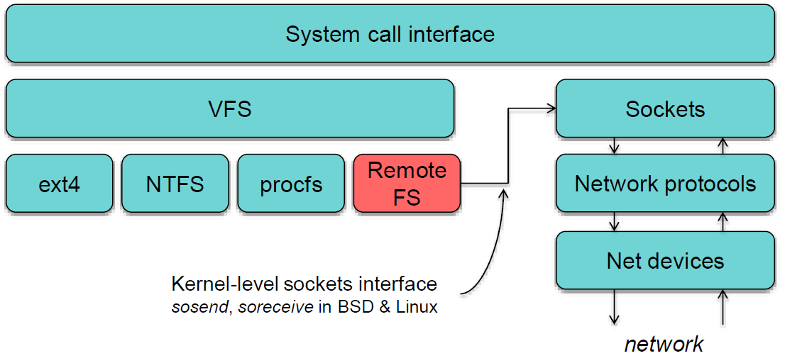
Accessing Remote Files (1 of 2)
For transparency, implement client as module under Virtual File System (VFS)
(Additional picture next slide)
Notes:
Paul Krzyzanowski, CS 417 Distributed Systems, Rutgers, Fall 2013.
http://www.cs.rutgers.edu/~pxk/417/notes/content/08-nas-slides-6pp.pdf

Slide 17
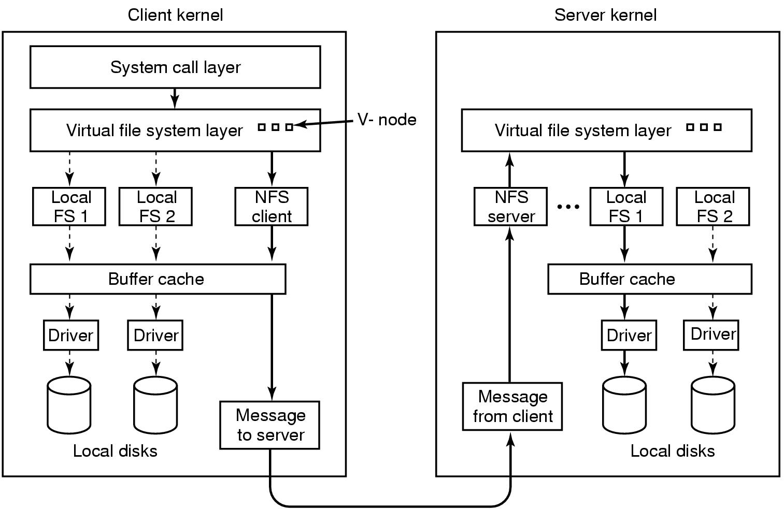
Accessing Remote Files (2 of 2)
Virtual file system allows for transparency

Slide 18
Stateful or Stateless Design
Stateful
Stateless
Server maintains client-specific state
Shorter requests
Better performance in processing requests
Cache coherence possible
  Server can know who’s accessing what
File locking possible
Server maintains no information on client accesses
Each request must identify file and offsets
Server can crash and recover
  No state to lose
No open/close needed
  They only establish state
No server space used for state
  Don’t worry about supporting many clients
Problems if file is deleted on server
File locking not possible
Notes:
Paul Krzyzanowski, CS 417 Distributed Systems, Rutgers, Fall 2013.
http://www.cs.rutgers.edu/~pxk/417/notes/content/08-nas-slides-6pp.pdf

Slide 19
Caching
Hide latency to improve performance for repeated accesses
Four places:
  Server’s disk
  Server’s buffer cache (memory)
  Client’s buffer cache (memory)
  Client’s disk
Client caches risk cache consistency problems
Notes:
Paul Krzyzanowski, CS 417 Distributed Systems, Rutgers, Fall 2013.
http://www.cs.rutgers.edu/~pxk/417/notes/content/08-nas-slides-6pp.pdf

Slide 20
Concepts of Caching (1 of 2)
Centralized control
Keep track of what files each client has open and cached
Stateful file system with signaling traffic
Read-ahead (pre-fetch)
Request chunks of data before needed
Minimize wait when actually needed
But what if data pre-fetched is out of date?
Notes:
Paul Krzyzanowski, CS 417 Distributed Systems, Rutgers, Fall 2013.
http://www.cs.rutgers.edu/~pxk/417/notes/content/08-nas-slides-6pp.pdf

Slide 21
Concepts of Caching (2 of 2)
Write-through
All writes to file sent to server
  What if another client reads its own (out-of-date) cached copy?
All accesses require checking with server
Or … server maintains state and sends invalidations
Delayed writes (write-behind)
Only send writes to files in batch mode (i.e., buffer locally)
One bulk write is more efficient than lots of little writes
Problem: semantics become ambiguous
  Watch out for consistency – others won’t see updates!
Write on close
Only allows session semantics
If lock, must lock whole file
Notes:
Paul Krzyzanowski, CS 417 Distributed Systems, Rutgers, Fall 2013.
http://www.cs.rutgers.edu/~pxk/417/notes/content/08-nas-slides-6pp.pdf

Slide 22
Outline
Overview (done)
Basic principles (done)
Network File System (NFS) (next)
Andrew File System (AFS)
Dropbox

Slide 23
Network File System (NFS)
Introduced in 1984 (by Sun Microsystems)
  First was 1970’s Data Access Protocol by DEC
  But NFS first to be used as product
  Developed in conjunction with Sun RPC
Made interfaces in public domain
  Request For Comment (RFC) by Internet Engineering Task Force (IETF) – technical development of Internet standards
  Allowed other vendors to produce implementations
Internet standard is NFS protocol (version 3)
  RFC 1913
Still widely deployed, up to v4 but maybe too bloated so v3 widely used

Slide 24
NFS Overview
Provides transparent access to remote files
  Independent of OS (e.g., Mac, Linux, Windows) or hardware
Symmetric – any computer can be server and client
  But many setups have dedicated server
Export some or all files
Must support diskless clients
Recovery from failure
  Stateless, UDP, client retries
High performance
  Caching and read-ahead

Slide 25
Underlying Transport Protocol
Initially NFS ran over UDP using Sun RPC
Why UDP?
  Slightly faster than TCP
  No connection to maintain (or lose)
  Reliable send not issue
    NFS is designed for Ethernet LAN (relatively reliable)
  UDP has error detection but no correction
    NFS retries requests upon error/timeout

Slide 26
NFS Protocols
Since clients and servers can be implemented for different platforms, need well-defined way to communicate → Protocol
  Protocol – agreed upon set of requests and responses between client and servers
Once agreed upon, Apple Mac NFS client can talk to a Sun Solaris NFS server
NFS has two main protocols
  Mounting Protocol - Request access to exported directory tree
  Directory and File Access Protocol - Access files and directories (read, write, mkdir, readdir … )

Slide 27
NFS Mounting Protocol
Request permission to access contents at pathname
Client
  Parses pathname
  Contacts server for file handle
Server
  Returns file handle: file device #, inode #, instance #
Client
  Create in-memory VFS inode at mount point
  Internally point to r-node (for remote/RPC) for remote files
    Client keeps state, not server
Soft-mounted – if client access fails, throw error to processes. But many do not handle file errors well
Hard-mounted – client blocks processes, retries until server up (can cause problems when NFS server down)

Slide 28
NFS Architecture
In many cases, on same LAN, but not required
  Can even have client-server on same machine
Directories available on server through /etc/exports
  When client mounts, becomes part of directory hierarchy
File system mounted at /usr/students is sub-tree located at /export/people in Server 1, and file system mounted at /usr/staff is sub-tree located at /nfs/users in Server 2
Notes:
Coulouris, Dollimore, Kindberg and Blair, Distributed Systems: Concepts and Design, 5th ed.
© Pearson Education, 2012 .

Slide 29
Example NFS exports File
File stored on server, typically /etc/exports
# See exports(5) for a description.
/public 192.168.1.0/255.255.255.0 (rw,no_root_squash)
Share folder /public
Restrict to 192.168.1.0/24 Class C subnet
  Use ‘*’ for wildcard/any
Give read/write access (rw)
Allow root user to connect as root (no_root_squash)

Slide 30
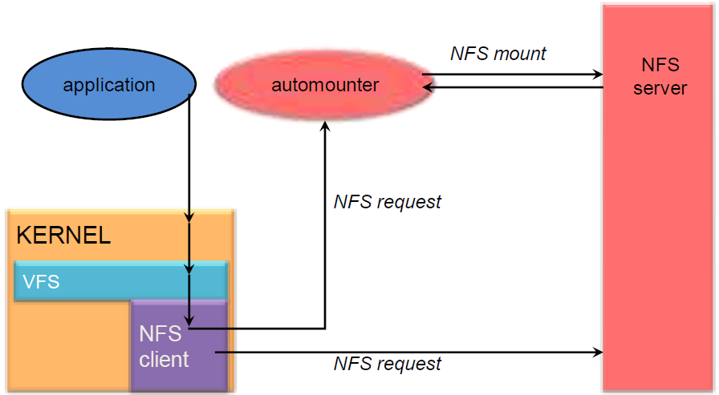
NFS Automounter
Automounter – only mount when access empty NFS-specified dir
  Attempt unmount every 5 minutes
  Conserve local resources if users don’t need
  Avoids dependencies on unneeded servers when many NFS mounts

Slide 31
NFS Access Protocol
Most file operations supported from client to server (e.g., read(), write(), getattr())
  But doesn’t support open() and close()
First, client performs lookup RPC
  Gets RPC handle for connection/return call
  Successful call gets file handle (UFID) and attributes
  Note, not like open() since no information stored on server
On, e.g., read() client sends RPC handle, UFID and offset
Allows server to be stateless, not remember connections
  Better for scaling and robustness
However, typical Unix file system can lock file on open(), unlock on close()
  If doing with NFS must run separate lock daemon

Slide 32
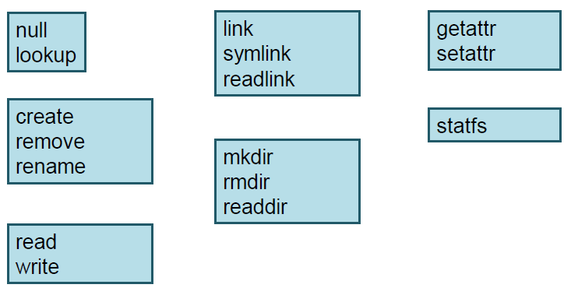
NFS Access Operations
NFS has 16 core operations (v2, v3 added six more)

Slide 33
NFS Caching - Server
Keep file data in memory as much as possible (avoid slow disk)
Read-ahead – get subsequent blocks (typically 8 KB chunk) before needed
Server supports write-through (data to disk immediately when client asks)
  Performance can suffer, so another option only when file closed, called commit
Delayed write – only put data on disk in batch when using memory cache
  Typically every 30 seconds

Slide 34
NFS Caching - Client
Reduce number of requests to server (avoid slow network)
Cache – read(), write(), getattr(), readdir()
Can result in different versions at client
  Validate with timestamp
  When contact server (local open() or new block), invalidate block if server has newer timestamp
Clients responsible for polling server
  Typically 3 seconds for file
  Typically 30 seconds for directory
Send written (dirty) blocks every 30 seconds
  Flush on close()

Slide 35
Improve Read Performance
Transfer data in large chunks
  8K bytes “typical” default (that used to be large)
  Common Linux default 32K
Read-ahead
  Optimize for sequential file access
  Send requests to read disk blocks before requested by process
Generally → tune NFS performance
  Many possibilities - server threads, network timeout, cache write, cache sizes, server disk layout …
  “Best” depends upon system and workload

Slide 36
Problems with NFS
File consistency (if client caches)
Assumes clocks are synchronized
No locking
  Separate lock manager needed, but adds state
No reference count for open files
  Could delete file that others have open!
File permissions may change
  Invalidating access

Slide 37
NFS Version 3
TCP support
  UDP caused more problems (errors) on WANs or wireless
  Realized all traffic from one client to server can be multiplexed on one connection
    Minimizes connection setup cost
Large-block transfers
  Negotiate for optimal transfer size
  No fixed limit on amount of data per request

Slide 38
NFS Version 4
Adds state to system
Supports open() operations since can be maintained on server
Read operations not absolute, but relative, and don’t need all file information, just handle
  Shorter messages
Locking integrated
Includes optional security/encryption

Slide 39
Outline
Overview (done)
Basic principles (done)
Network File System (NFS) (done)
Andrew File System (AFS) (next)
Dropbox

Slide 40
Andrew File System (AFS)
Developed at CMU in 1980’s (hence the “Andrew” from “Andrew Carnegie”)
  Commercialized through IBM to OpenAFS (http://openafs.org/)
Transparent access to remote files
Using Unix-like file operations (creat(), open(), …)
But AFS differs markedly from NFS in design and implementation…

Slide 41
General Observations Motivating AFS
For Unix users
  Most files are small, less than 10 KB in size
  read() more common than write() - about 6x
  Sequential access dominates, random rare
  Files referenced in bursts – used recently, will likely be used again
Typical scenarios for most files:
  Many files for one user only (i.e., not shared), so no problem
  Shared files that are infrequently updated to others (e.g., code, large report) no problem
Local cache of few hundred MB enough for working set for most users
What doesn’t fit? → databases – updated frequently, often shared, need fine-grained control
  Explicitly, AFS not for databases

Slide 42
AFS Design
Scalability is most important design goal
  Distributed file systems generally have more users than other distributed systems
Key strategy is caching of whole files at clients
  Whole-file serving – entire file and directories
  Whole-file caching – clients store cache on disk
    Typically several hundred
    “Permanent” in that written to local disk, so still there if rebooted

Slide 43
AFS Example
Process at client issues open() system call
Check if local cached copy
  Yes? then use. Done.
  No? then proceed to next step.
Send request to server
Server sends back entire copy
Client opens file (normal Unix file descriptor, local access)
read(), write(), etc. all apply to copy
When close(), if local cached copy changed, send back to server

Slide 44
AFS Questions
How does AFS gain control on open()or close()?
What space is allocated for cached files on clients?
How does AFS ensure cached copies are up-to-date since may be updated by several clients?

Slide 45
AFS Architecture
Vice – implements flat file system on server
Venus – intercepts remote requests, pass to vice
  Vice provides for directory structure, relative location, working directory

Slide 46
System Call Interception in AFS
Kernel mod to open() and close()
If remote, pass to Venus

Slide 47
Cache Consistency
Vice issues callback promise with file
If server copy changes, it “calls back” to Venus processes, cancelling file
  Note, change only happens on close of whole file
If Venus process re-opens file, must fetch copy from server
  Note, if client already had open, will still proceed
If reboot, cannot be sure callbacks are all correct (may have missed some)
  Checks with server for each open
Note, versus traditional cache checking, AFS far less communication for non-shared, read-only files
(Flow diagram next slide)

Slide 48
Implementation of System Calls in AFS

Slide 49
Update Semantics
No other access control mechanisms
If several workstations close() file after writing, only last file will be written
  Others silently lost
Clients must implement concurrency control separately
If two processes on same machine access file, local Unix semantics apply (i.e., generally none, unless processes explicitly lock)

Slide 50
AFS Misc
1989: Benchmark with 18 clients, standard NFS load
  Up to 120% improvement over NFS
1996: Transarc (acquired by IBM) Deployed on 1000 servers over 150 sites
  96-98% cache hit rate
Today, some AFS cells up to 25,000 clients (Morgan Stanley)
OpenAFS standard: http://www.openafs.org/

Slide 51
Other Distributed File Systems
SMB: Server Message Blocks, Microsoft (Samba is a free re-implementation of SMB). Favors locking and consistency over client caching.
CODA: AFS spin-off at CMU. Disconnection and fault recovery.
Sprite: research project in 1980’s from UC Berkeley, introduced first journaling file system.
Amoeba Bullet File Server: Tanenbaum research project. Favors throughput with atomic file change.
xFS: SGI serverless file system by distributing across multiple machines for Irix OS.

Slide 52
Outline
Overview (done)
Basic principles (done)
Network File System (NFS) (done)
Andrew File System (AFS) (done)
Dropbox (next)

Slide 53

Dropbox Overview (1 of 3)
Client runs on desktop
Copies changes to local folder
  Uploaded automatically
  Downloads new versions automatically
Huge scale – 100+ million users, 1 billion files/day
Design
  Small client, few resources
  Possibility of low-capacity network to user
  Scalable back-end
  (99% of code in Python)
Notes:
Some from:
http://www.cs.rutgers.edu/~pxk/417/notes/content/09-dfs-slides.pdf
https://blogs.dropbox.com/tech/2014/07/streaming-file-synchronization/

Slide 54
Dropbox Overview (2 of 3)
Motivation most Web apps high read/write
  e.g., Twitter, Facebook, reddit 100:1, 1000:1, +
Everyone’s computer has complete copy of Dropbox
  Run daemon on computer to track “Sync” folder
Traffic only when changes occur
  Results in file upload : file download about 1:1
  Huge number of uploads compared to traditional service
Uses compression to reduce traffic

Slide 55
Dropbox Overview (3 of 3)
DropBox
Daemon
Check for updates (e.g., stat())
Upload file (e.g., send())

Slide 56
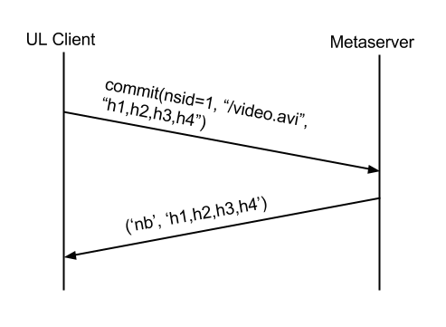
Dropbox Upload (1 of 3)
Client attempts to “commit” new file
  Breaks file into blocks, computes hashes
  Contacts Metaserver
Metaserver checks if hashes known
If not, Metaserver returns that it “needs blocks” (nb)

Slide 57
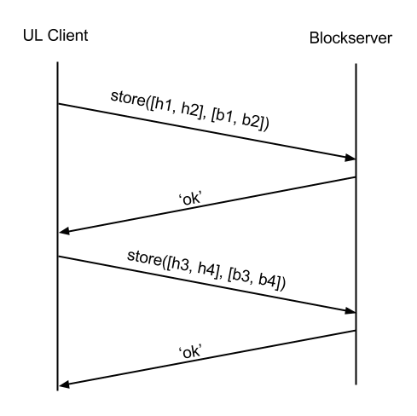
Dropbox Upload (2 of 3)
Client talks to Blockserver to add needed blocks
Limit bytes/request (typically 8 MB), so may be multiple requests

Slide 58
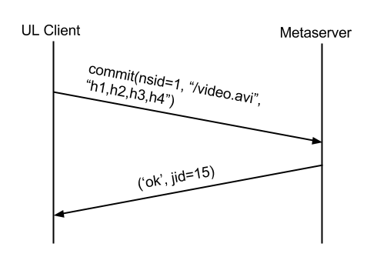
Dropbox Upload (3 of 3)
Client commits again
  Contacts Metaserver with same request
This time, ok

Slide 59
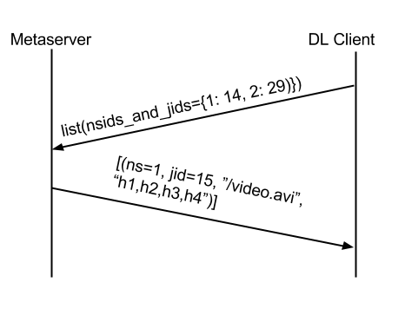
Dropbox Download (1 of 2)
Client periodically polls Metaserver
  Lists files it “knows about”
Metaserver returns information on new files

Slide 60
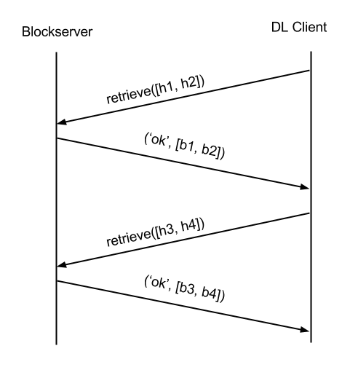
Dropbox Download (2 of 2)
Client checks if blocks exist
  For new file, this fails
Retrieve blocks
Limit bytes/request (typically 8 MB), so may be multiple requests
When done, reconstruct and add to local file system
  Using local filesystem system calls (e.g., open(), write()…)

Slide 61
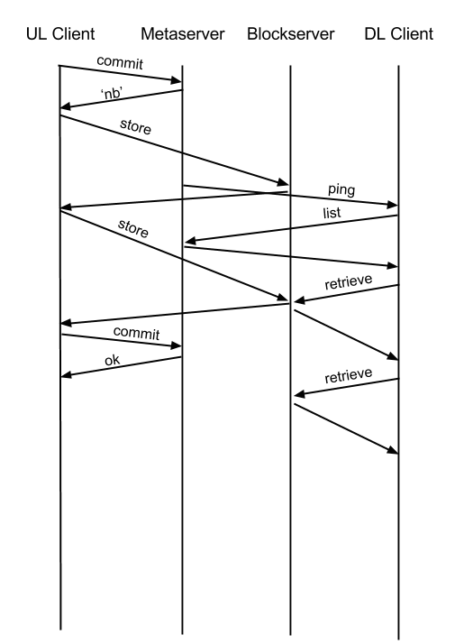
Dropbox Misc – Streaming Sync
Normally, cannot download to another until upload complete
  For large files, takes time “sync”
Instead, enable client to start download when some blocks arrive, before commit
  Streaming Sync

Slide 62
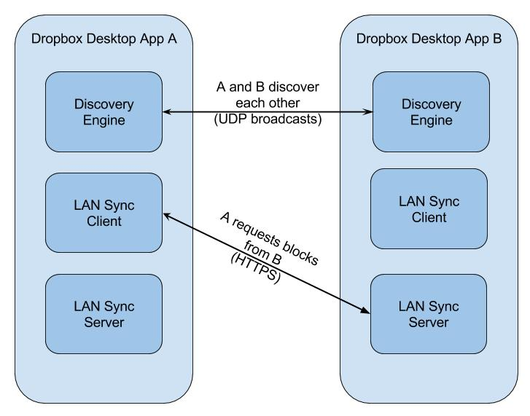
Dropbox Misc – LAN Sync
LAN Sync – download from other clients
Periodically broadcast on LAN (via UDP)
Response to get TCP connection to other clients
Pull blocks over HTTP

Slide 63
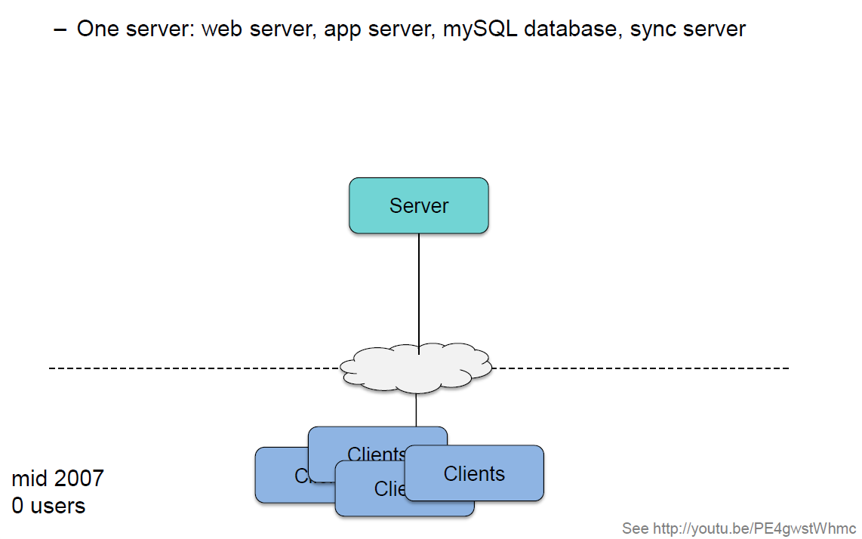
Dropbox Architecture – v1
Notes:
Paul Krzyzanowski, CS 417 Distributed Systems, Rutgers, Fall 2013.

Slide 64
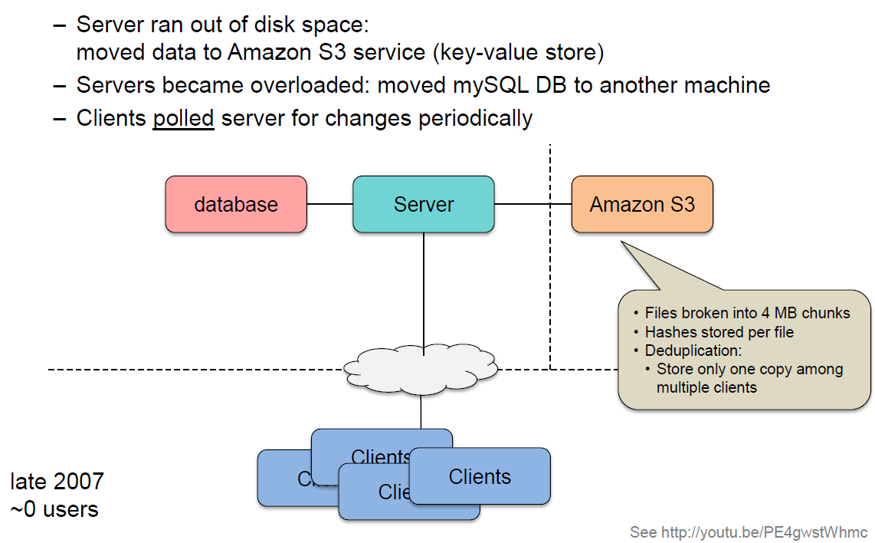
Dropbox Architecture – v2
Notes:
Paul Krzyzanowski, CS 417 Distributed Systems, Rutgers, Fall 2013.

Slide 65
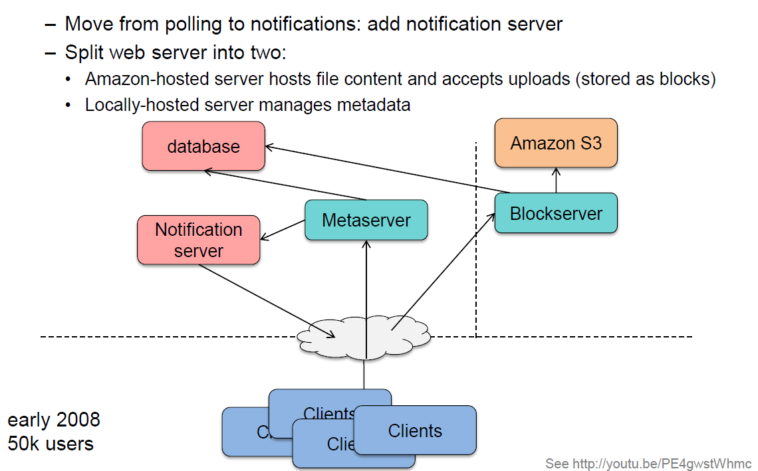
Dropbox Architecture – v3
Notes:
Paul Krzyzanowski, CS 417 Distributed Systems, Rutgers, Fall 2013.

Slide 66
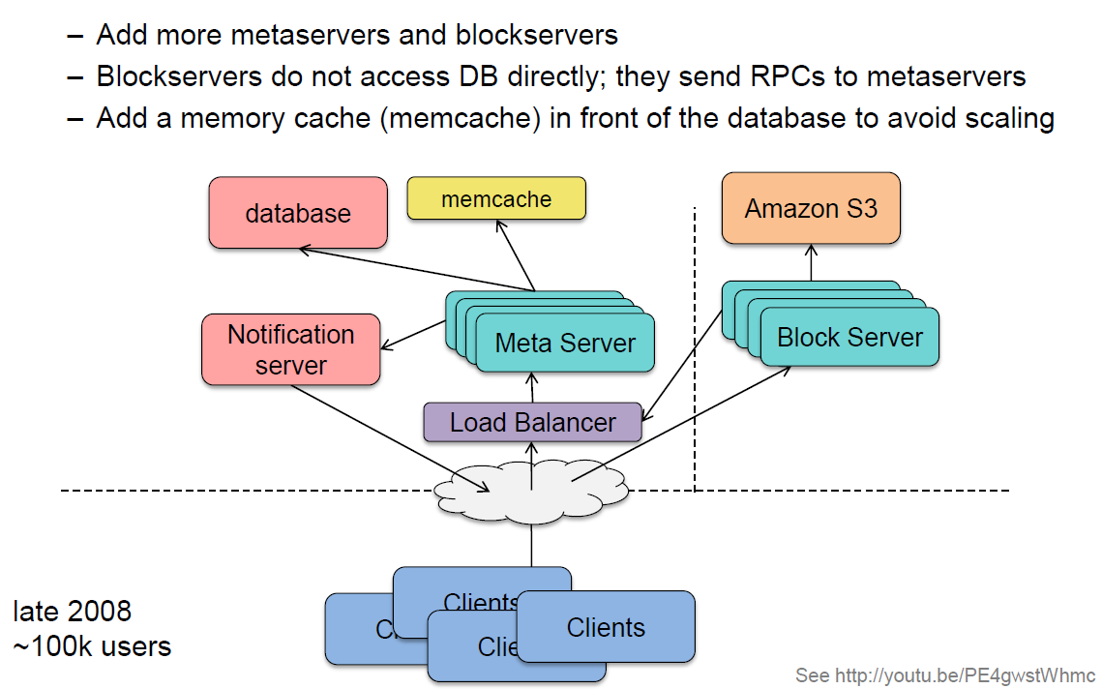
Dropbox Architecture – v4
Notes:
Paul Krzyzanowski, CS 417 Distributed Systems, Rutgers, Fall 2013.

Slide 67
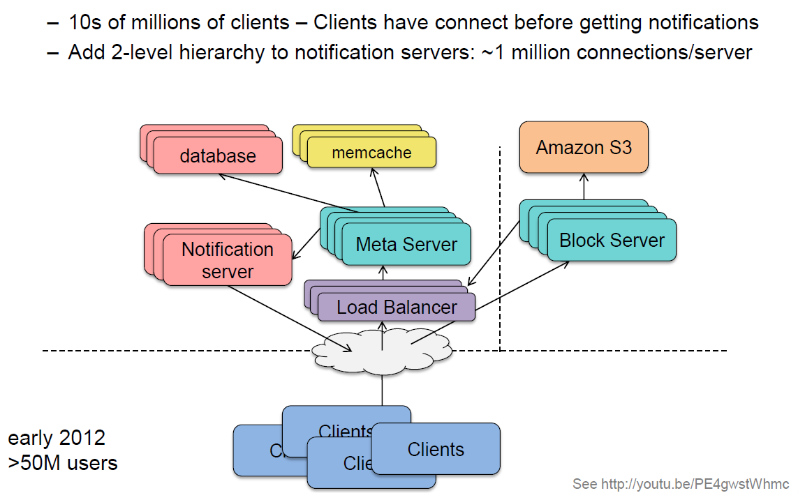
Dropbox Architecture – v5
Notes:
Paul Krzyzanowski, CS 417 Distributed Systems, Rutgers, Fall 2013.

Slide 68
Bit Bucket

Slide 69
File System Functions
Abstraction of file system functions that apply to distributed file systems
Most use set of functions derived from Unix (next slide)
Notes:
Coulouris, Dollimore, Kindberg and Blair, Distributed Systems: Concepts and Design Edn. 5
© Pearson Education 2012

Slide 70
UNIX File System Operations
filedes = open(name, mode)
Opens an existing file with given name.
filedes = creat(name, mode)
Creates a new file with given name.
Both operations deliver file descriptor referencing open
file. The mode is read, write or both.
status = close(filedes)
Closes open file filedes.
count = read(filedes, buffer, n)
Transfers n bytes from file referenced by filedes to buffer.
count = write(filedes, buffer, n)
Transfers n bytes to file referenced by filedes from buffer.
Both operations deliver number of bytes actually transferred
and advance read-write pointer.
pos = lseek(filedes, offset,
Moves read-write pointer to offset (relative or absolute,
whence)
depending on whence).
status = unlink(name)
Removes file name from directory structure. If file
has no other names, it is deleted.
status = link(name1, name2)
Adds new name (name2) for file (name1).
status = stat(name, buffer)
Gets file attributes for file name into buffer.
Notes:
Coulouris, Dollimore, Kindberg and Blair, Distributed Systems: Concepts and Design Edn. 5
© Pearson Education 2012

Slide 71
File Service Architecture
Client computer
Server computer
Directory service
Application
Application
program
program
Flat file service
Client module
Notes:
Coulouris, Dollimore, Kindberg and Blair, Distributed Systems: Concepts and Design Edn. 5
© Pearson Education 2012

Slide 72
File Service Architecture
Flat file service
  Implement operations on the files
  Manage unique file identifiers (UFIDs) – create, delete
Directory service
  Mapping between text names and UFIDs
  Create, delete new directories and entries
  Ideally, hierarchies, as in Unix/Windows
Client module
  Integrate flat file and directory services under single API
  Make available to all computers

