Slide 1
Distributed Computing Systems
Overview of Distributed Systems
Andrew Tanenbaum and Marten van Steen, Distributed Systems – Principles and Paradigms, Prentice Hall, c2002.

Slide 2
The Rise of Distributed Systems
Computer hardware prices falling, power increasing
  If cars did same, Rolls Royce would cost 1 dollar and get 1 billion miles per gallon (with 200 page manual to open door)
Network connectivity increasing
  Everyone is connected with “fat” pipes, even when moving
It is easy to connect hardware together
  Layered abstractions have worked very well
Definition: a distributed system is
  “A collection of independent computers that appears to its users as a single coherent system”

Slide 3
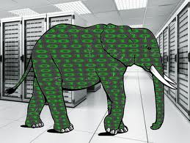

Why Distributed Systems?
Big data - large pools of data captured, communicated, aggregated, stored, and analyzed
Google processes 20 petabytes of data per day
E.g., data-intensive app: astronomical data parsing
Big data continues to grow:
  In mid-2010, information universe 1.2 zettabytes
  2020 predictions 44x more at 35 zettabytes
Applications are becoming data-intensive.
Ying Lu, UNL, CSCE990 Advanced Distributed Systems Seminar
http://cse.unl.edu/~ylu/csce990/notes/Introduction.ppt
Notes:
3

Slide 4
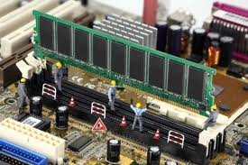
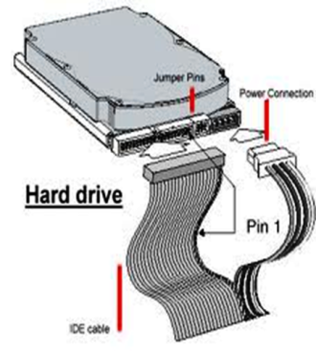
Why Distributed Systems?
L1
Cache
L2 Cache
L3 Cache
Main Memory
16KB- 64KB, 2-4 cycles
512KB- 8MB, 6-15 cycles
4MB- 32MB, 30-50 cycles
2GB- 16GB, 300+ cycles
Hard Drive
1-5 TB, 3 billion+ cycles
Individual computers have limited resources compared to scale of current problems & application domains:
  Caches and Memory:
Notes:
4

Slide 5

Why Distributed Systems?
  2. Processor:
  Number of transistors integrated on single die has continued to grow at Moore’s pace
  Chip Multiprocessors (CMPs) are now available
P
P
P
P
P
L1
L1
L1
L1
L1
Interconnect
L2
L2 Cache
A single Processor Chip
A CMP
Notes:
5

Slide 6
Why Distributed Systems?
  Processor (continued):
  CPU speed grows at rate of 55% annually, but mem speed grew only 7%
P
P
P
P
P
L1
L1
L1
L1
L1
Interconnect
L2
L2 Cache
Memory
Memory
P
Processor-Memory speed gap
M

Slide 7
Why Distributed Systems?
    Even if 100s or 1000s of cores are placed on CMP, challenge to deliver stored data to cores fast enough for processing
10000 seconds (or 3 hours) to load data
P
P
P
P
L1
L1
L1
L1
Interconnect
A Data Set
of 4 TBs
L2 Cache
Memory
4 100MB/S IO Channels

Slide 8
Why Distributed Systems?
Distributed systems to the rescue!
Only 3 minutes to load data
P
100
Machines
P
Splits
L1
L1
L2
L2
Memory
Memory
A Data Set (data)
of 4 TBs

Slide 9
But this brings new requirements
A way to express problem as parallel processes and execute them on different machines (Programming Models and Concurrency).
A way for processes on different machines to exchange information (Communication).
A way for processes to cooperate with one another and agree on shared values (Synchronization).
A way to enhance reliability and improve performance (Consistency and Replication).
A way to recover from partial failures (Fault Tolerance).
A way to protect communication and ensure that process gets only those access rights it is entitled to (Security).
A way to extend interfaces so as to mimic behavior of another system, reduce diversity of platforms, and provide high degree of portability and flexibility (Virtualization)

Slide 10
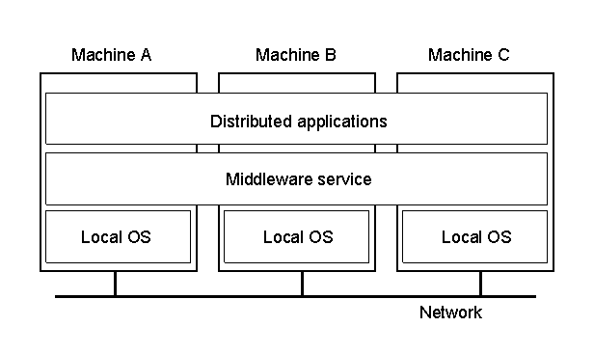
Depiction of a Distributed System
Examples:
The Web
Processor pool
Shared memory pool
Airline reservation
- Network game
- The Cloud
Distributed system organized as middleware. Note middleware layer extends over multiple machines.
Users can interact with system in consistent way, regardless of where interaction takes place (e.g., RPC, memcached, …
Note: Middleware may be “part” of application in practice

Slide 11
Outline
Overview (done)
Goals (next)
Software
Client Server
The Cloud

Slide 12
Goal - Transparency
Transparency | Description
Access | Hide differences in data representation and how a resource is accessed
Location | Hide where a resource is located
Migration | Hide that a resource may move to another location
Relocation | Hide that a resource may be moved to another location while in use
Replication | Hide that a resource may be copied
Concurrency | Hide that a resource may be shared by several competitive users
Failure | Hide the failure and recovery of a resource
Persistence | Hide whether a (software) resource is in memory or on disk
(Different forms of transparency in distributed system)

Slide 13
Goal - Scalability
As systems grow, centralized solutions are limited
  Consider LAN name resolution (ARP) vs. WAN
Concept | Example
Centralized services | A single server for all users
Centralized data | A single on-line telephone book
Centralized algorithms | Doing routing based on complete information
Ideally, collect information in distributed fashion and distribute in distributed fashion
But sometimes, hard to avoid (e.g., consider money in bank)
Challenges: geography, ownership domains, time synchronization
Scaling techniques? → Hiding latency, distribution, replication (next)

Slide 14
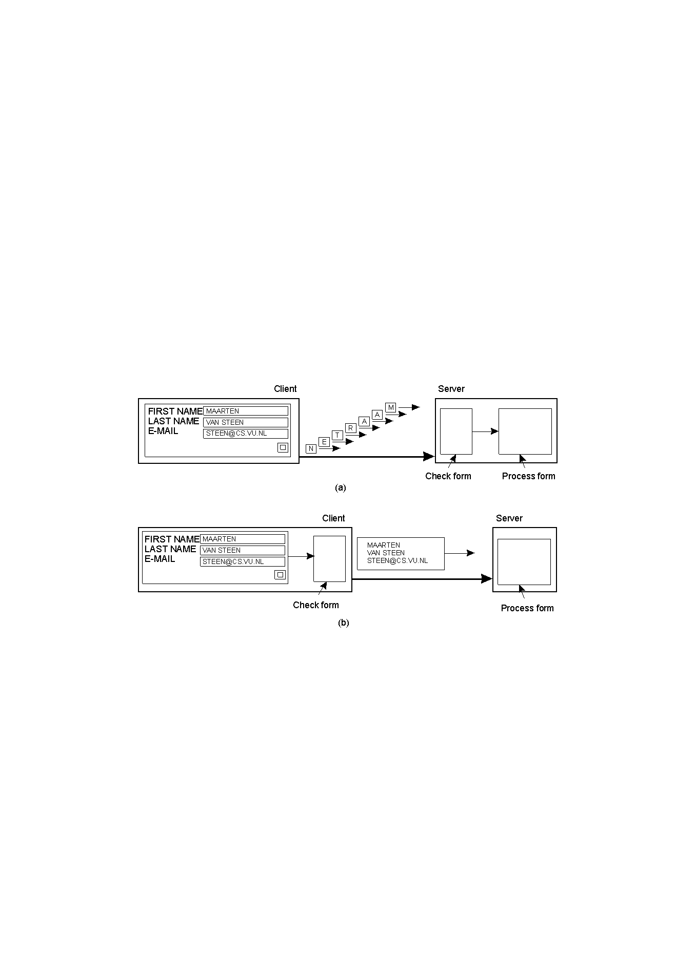
Scaling Technique: Hiding Communication Latency
Especially important for interactive applications
If possible, do asynchronous communication – continue working so user does not notice delay
- Not always possible when client has nothing to do
Instead, can hide latencies

Slide 15
Scaling Technique: Distribution
Spread information/processing to more than one location
1.
Root DNS Servers
2.
com DNS servers
org DNS servers
edu DNS servers
3.
?
yahoo.com
DNS servers
pbs.org
DNS servers
poly.edu
DNS servers
umass.edu
DNS servers
amazon.com
DNS servers
Client wants IP for www.amazon.com (approximation):
Client queries root server to find .com DNS server
Client queries .com DNS server to get amazon.com DNS server
Client queries amazon.com DNS server to get IP address for www.amazon.com

Slide 16
Scaling Technique: Replication
Copy of information to increase availability and decrease centralized load
  Example: File caching is replication decision made by client
  Example: CDNs (e.g., Akamai) for Web
  Example: P2P networks (e.g., BitTorrent) distribute copies uniformly or in proportion to use
Issue: Consistency of replicated information
  Example: Web browser cache or NFS cache – how to tell it is out of date?

Slide 17
Outline
Overview (done)
Goals (done)
Software (next)
Client Server
The Cloud

Slide 18
Software Concepts
System | Description | Main Goal
DOS | Tightly-coupled operating system for multi-processors and homogeneous multicomputers | Hide and manage hardware resources
NOS | Loosely-coupled operating system for heterogeneous multicomputers (LAN and WAN) | Offer local services to remote clients
Middleware | Additional layer atop of NOS implementing general-purpose services | Provide distribution transparency
DOS (Distributed Operating Systems)
NOS (Network Operating Systems)
Middleware
(Next slides)

Slide 19
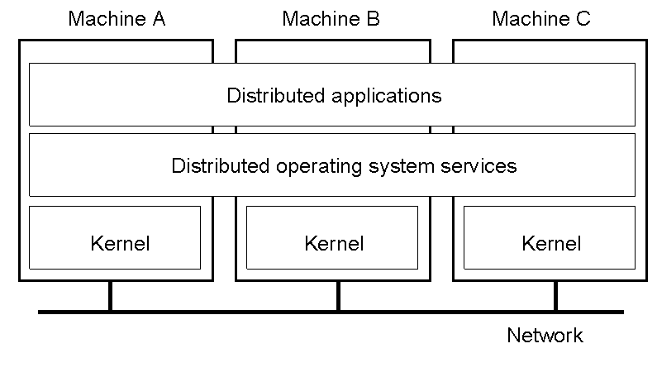
Distributed Operating Systems
Typically, all hosts are homogenous
But no longer have shared memory
  Can try to provide distributed shared memory
    But tough to get acceptable performance, especially for large requests
  → Provide message passing

Slide 20
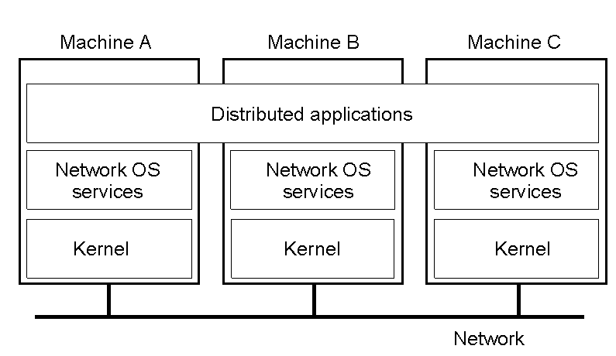
Network Operating System (1 of 3)
OSes can be different (Windows or Linux)
Typical services: rlogin, rcp
  Fairly primitive way to share files

Slide 21
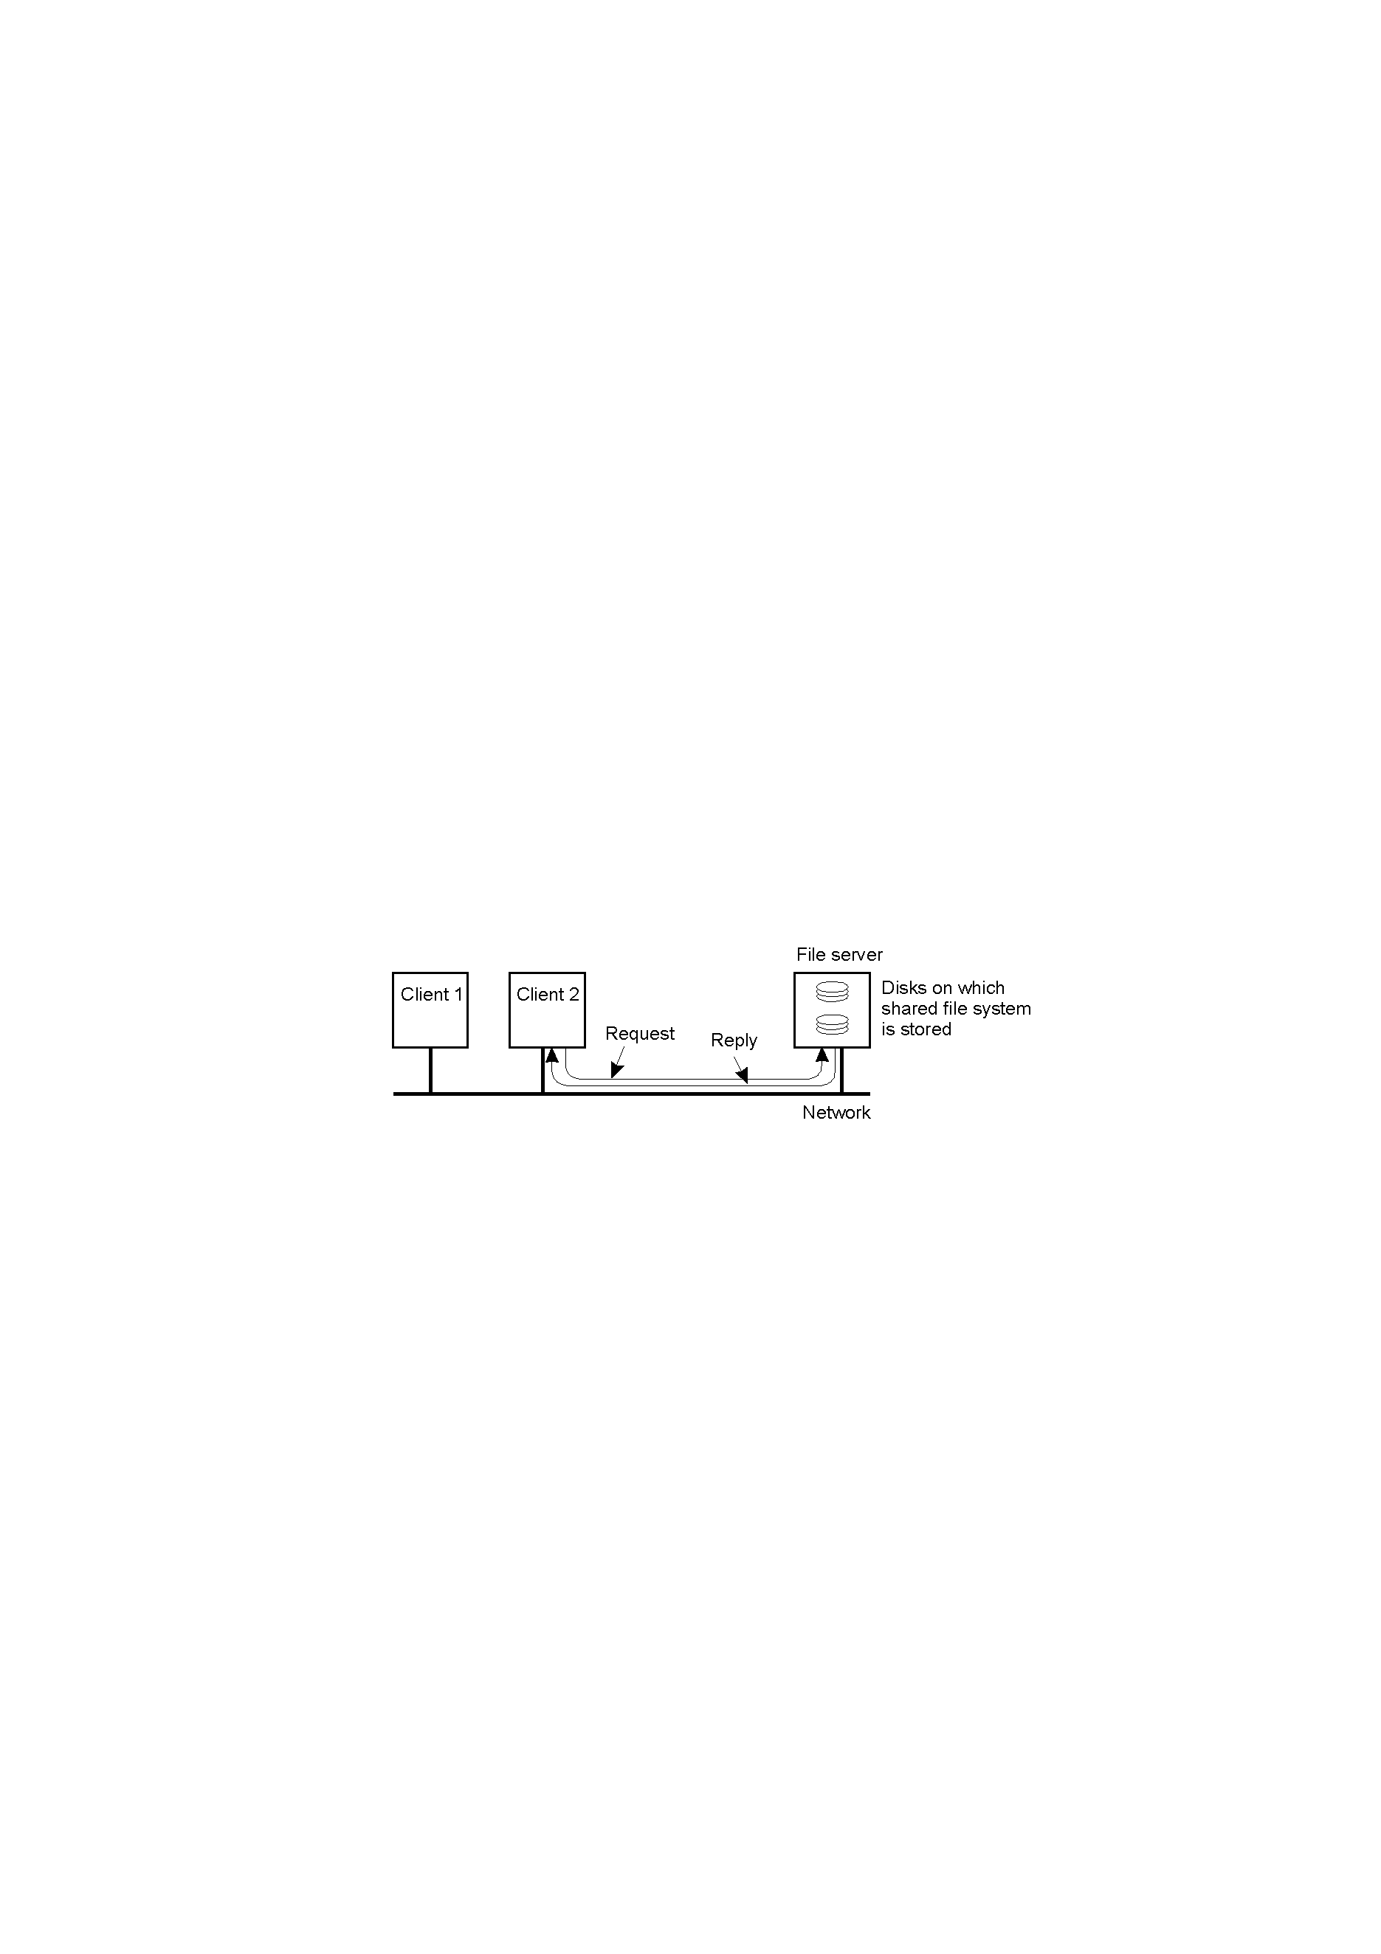
Network Operating System (2 of 3)
Can have one computer provide files transparently for others (NFS)

Slide 22
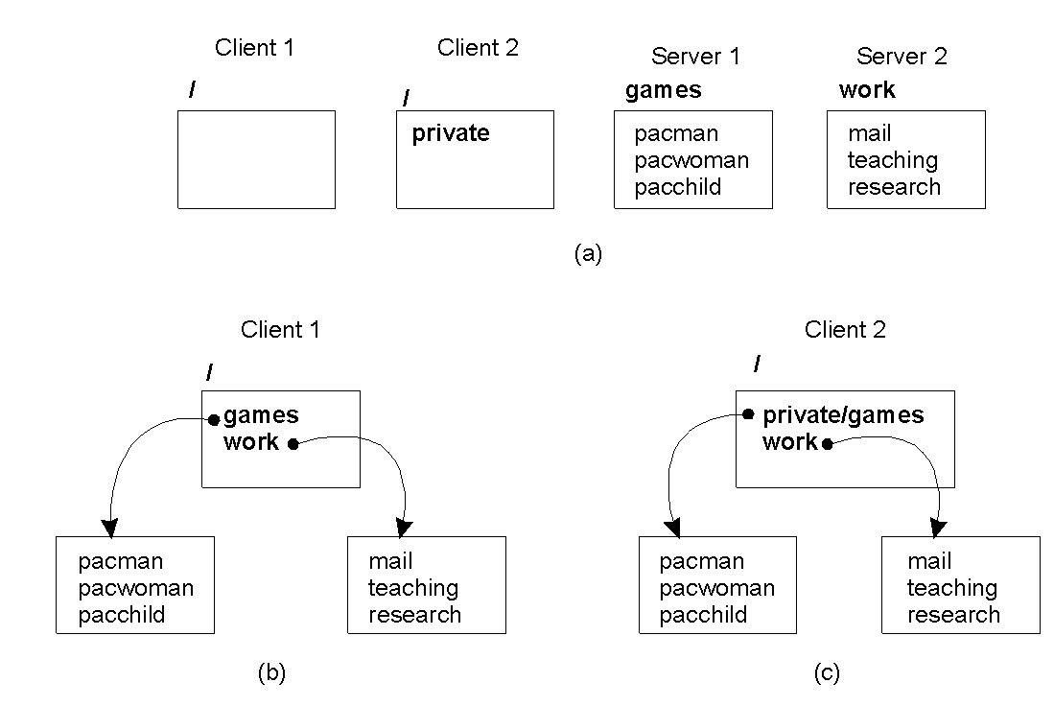
Network Operating System (3 of 3)
Different clients may mount the servers in different places
Inconsistencies in view make NOSes harder for users than DOSes
  But easier to scale by adding computers

Slide 23

Positioning Middleware
Network OS not transparent. Distributed OS not independent of computers.
  Middleware can help
Often middleware built in-house to help use networked operating systems (distributed transactions, better communication, RPC)
  Unfortunately, many different standards

Slide 24
Outline
Overview (done)
Goals (done)
Software (done)
Client Server (next)
The Cloud

Slide 25
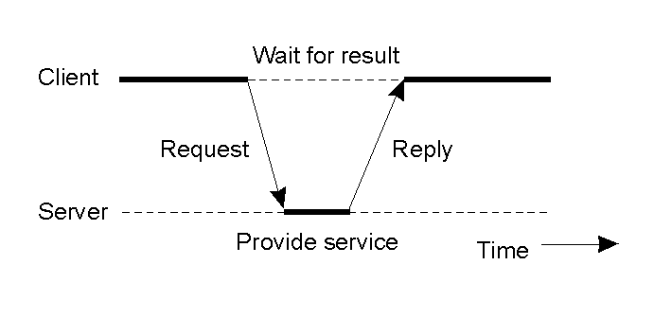
Clients and Servers
Thus far, have not talked about organization of processes
  Again, many choices but most widely used is client-server
If can do so without connection (local), quite simple
  If underlying connection is unreliable, not trivial
  Resend. What if receive twice?
Use TCP for reliable connection (most Internet apps)
  Not always needed for high-speed LAN connection
  Not always appropriate for interactive applications (e.g., games)

Slide 26
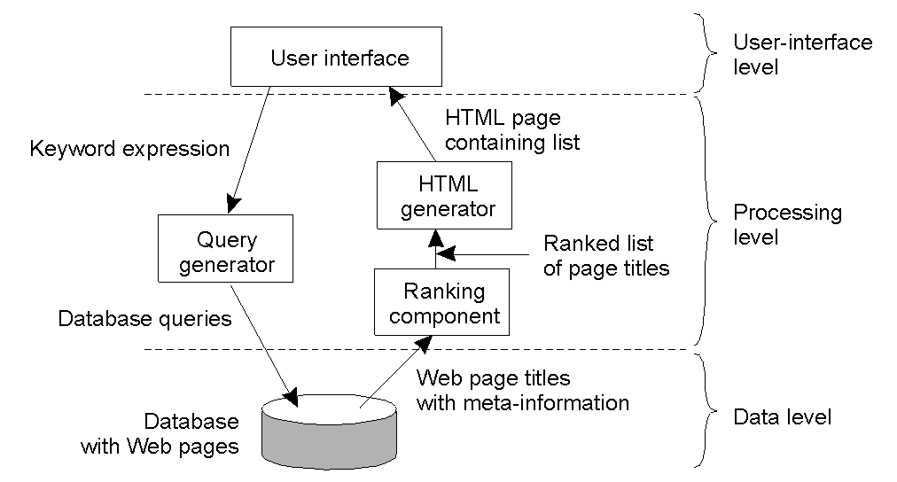
Client-Server Implementation Levels
Example of Internet search engine
  UI on client
  Data level is server, keeps consistency
  Processing can be on client or server

Slide 27
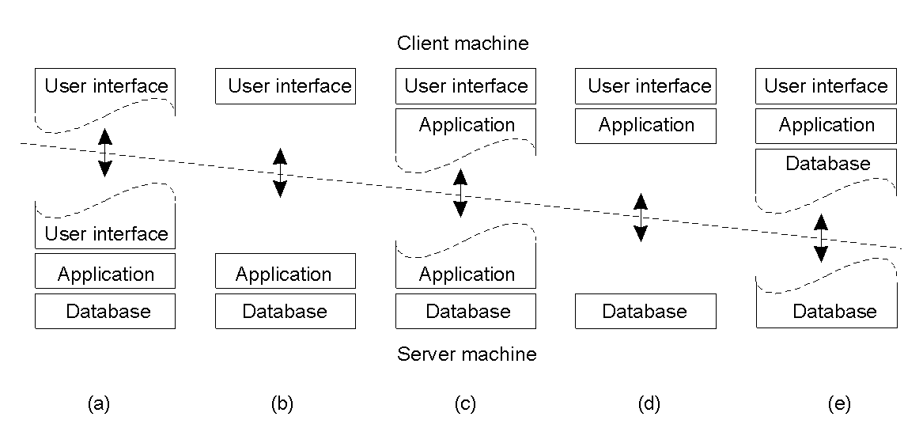
Multitiered Architectures
Thin client (a) to Fat client (e)
  (a) is simple echo terminal, (b) has GUI at client
  (c) has user side processing (e.g., check Web form for consistency)
  (d) and (e) popular for NOS environments (e.g., server has files only)

Slide 28
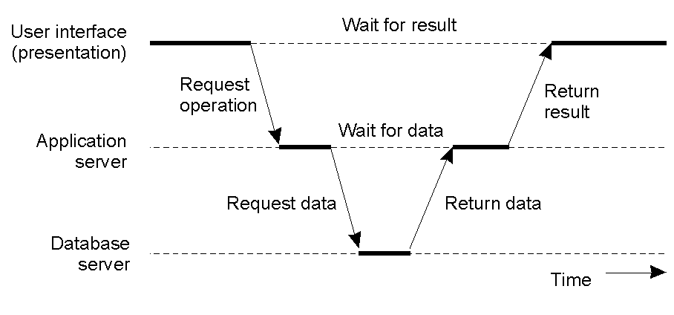
Multitiered Architectures: 3 tiers
Server(s) may act as client(s), sometimes
  Example: transaction monitor across multiple databases
Also known as vertical distribution

Slide 29
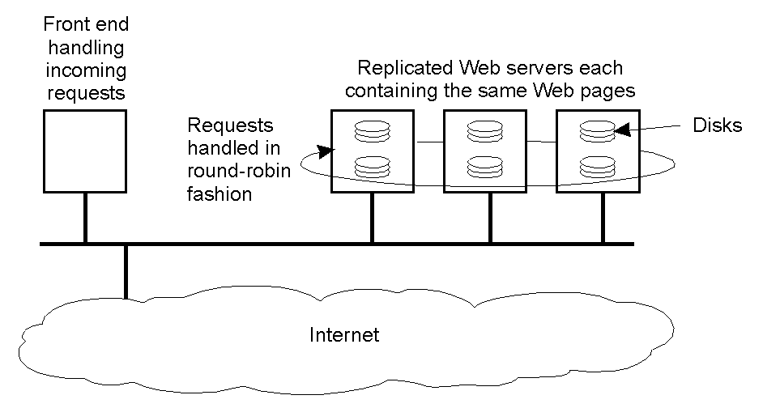
Alternate Architectures: Horizontal
Rather than vertical, distribute servers across nodes
  Example: Web server “farm” for load balancing
  Clients, too (peer-to-peer systems)
  Most effective for read-heavy systems (cache consistency)

Slide 30
Outline
Overview (done)
Goals (done)
Software (done)
Client Server (done)
The Cloud (next)
Ying Lu, UNL, CSCE990 Advanced Distributed Systems Seminar
http://cse.unl.edu/~ylu/csce990/notes/Introduction.ppt

Slide 31
Distributed Computing (1 of 2)
The Problem
  Want to run compute/data intensive task
  But don’t have enough resources to run job locally
    At least, to get results within sensible timeframe
  Would like to use another, more capable resource
Solution → Distributed Computing
Local
National
Institutional
International
Images: nasaimages, Extra Ketchup, Google Maps, Dave Page

Slide 32
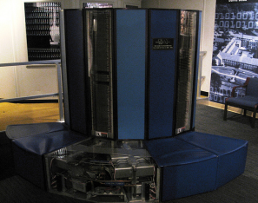
Distributed Computing (2 of 2)
Compute and data – if you need more, you go somewhere else to get it
Olden times - Small number of “fast” computers
  Very expensive
  Centralized
  Used nearly all time
  Time allocations for users
Modern times
  Cloud and Grid (next)
Cray-1 1976 - $8.8 mill, 160 MFLOPS, 8MB RAM
PS4 ~1 TFLOP
Smartphones ~200 MFLOPS
brewbooks
Cray X

Slide 33
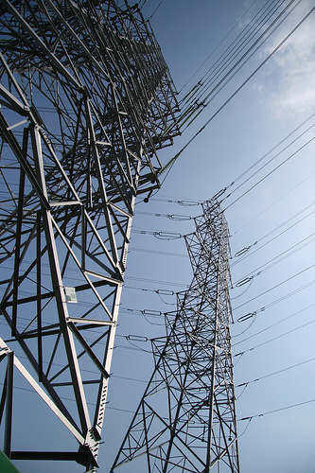
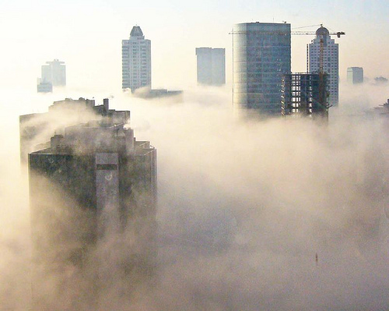
“Cloud” & “Grid” – Utility Computing?
The Grid…
The Cloud…
charles.frith
j.o.h.n walker
Is it really like electric grid?
Is it more like a fog?
Both about providing access to compute and data resources

Slide 34
What is Cloud Computing?
Many ways to define it (maybe one for every supplier of “cloud”)
Key characteristics:
  On demand, dynamic allocation of resources – “elasticity”
  Abstraction of resource
  Self-managed
  Billed for what you use, e.g., CPU, time, storage space
  Standardized interfaces
[FZRL08] I. Foster, Y. Zhao, I. Raicu, and S. Lu, “Cloud Computing and Grid Computing 360-Degree Compared,” in Proceedings of Grid Computing Environments Workshop (GCE), Austin, TX, USA, Nov. 2008, pp. 1–10

Slide 35
Cloud Architecture
3- SaaS - Software as a Service
Hosted Applications
Infrastructure
2- PaaS - Platform as a Service
Framework
Middleware
1- IaaS - Infrastructure as a Service
Hardware
OS
Internet
End user/
Customer
Developer/ Service Provider
Cloud computing can deliver at any of these levels
These levels are often blurred and routinely disputed!
Resources provided on demand

Slide 36
IaaS – Infrastructure as a Service
User gets access to (usually) virtualised hardware
  Servers, storage, networking
  Operating system
User responsible for managing OS, middleware, runtime, data, application (development)
e.g., Amazon EC2
  Get complete virtualized PC (e.g., Linux instance)

Slide 37
Amazon EC2 – The Idea
EC stands for Elastic Computing
Sign up, then select & configure virtualized resources
  Machine (OS): Windows Server, OpenSolaris, Fedora, Ubuntu, Debian, SUSE, Gentoo, Amazon Linux AMI
  Infrastructure:
    Data: IBM DB2, IBM Informix, Microsoft SQL, MySQL, Oracle
    Web Hosting: Apache HTTP, IIS/Asp.NET, IBM WebSphere
    Batch Processing: Hadoop, Condor, Open MPI
  Newer addition - development environments:
    IBM sMash, Ruby on Rails, Jboss Enterprise Application Platform
  Moving towards platform service (PaaS)! (Already there?)
Additional Web services
  S3: Simple Storage Solution – transfer data in/out, 1 byte to 5 TB (e.g., DropBox)
  SQS: Simple Queue Service – transfer between cloud components

Slide 38
Amazon EC2: Pricing
Free! (at start):
  Run single Amazon Micro Instance for year
  750 hours of EC2, 750 hours of Elastic Load Balancing plus 15 GB data processing
  15 GB bandwidth in/out across all services
On demand instances:
  Pay per hour, no long-term commitment
  From $0.025/hour → $0.76/hour
Reserved instances:
  Upfront payment, with discount per hour
  From $227/year + $0.01/hour → $1820/year + $0.32/hour
Spot instances:
  Bid for unused EC2 capacity:
  Spot price fluctuates with supply/demand, if bid over Spot Price, you get it
  From $0.007/hour → $0.68/hour

Slide 39
EC2 Application Examples
Peter Harkins (Senior Engineer at The Washington Post)
  200 EC2 instances (1,407 server hours)
  Convert 17,481 pages of Clinton’s travel docs within 9 hours after release
Airbnb
  200 EC2 instances
  50 BG data daily, S3 for storage (10 TB user pictures)
Others
  Zynga, Netflix, Adobe
Case studies: http://aws.amazon.com/solutions/case-studies

Slide 40
PaaS – Platform as a Service
Integrated development environment
  e.g., application design, testing, deployment, hosting, frameworks for database integration, storage, app versioning, etc.
Develop applications on top
Responsible for managing data, application (development)
Example - Google App Engine

Slide 41
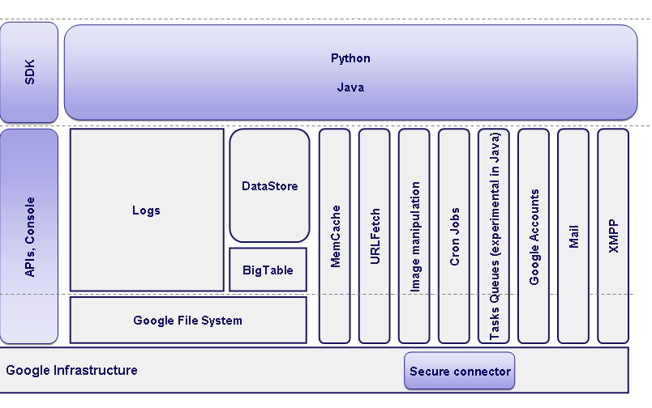
Google App Engine: The Idea
Sign up via Google Accounts
Develop App Engine Web applications locally using SDK – emulates all services
Includes tool to upload application code, static files and config files
Can ‘version’ web application instances
Apps run in Java/Python ‘sandbox’
Automatic scaling and load balancing – abstract across underlying resources
developer

Slide 42
Google App Engine: Pricing
Free within quota:
  500MB storage, 5 million page views a month (~6.5 CPU hours, 1GB)
  10 applications/developer
Billed model:
  Each app $8/user (max $1000) a month
  For each app:
Resource | Unit | Unit cost
Outgoing bandwidth | GB | $0.12
Incoming bandwidth | GB | $0.10
CPU Time | CPU hours | $0.10
Stored Data | GB/month | $0.15
High Replication Stg. | GB/month | $0.45
Recipients Emailed | Recipients | $0.0001
Always On | N/A (daily) | $0.30

Slide 43
SaaS – Software as a Service
Top layer consumed directly by end user – the ‘business’ functionality
Application software provided, you configure it (more or less)
Various levels of maturity:
  Level 1: each customer has own customised version of application in own instance
  Level 2: all instances use same application code, but configured individually
  Level 3: single instance of application across all customers
  Level 4: multiple customers served on load-balanced ‘farm’ of identical instances
  Levels 3 & 4: separate customer data! (Somewhat similar to PaaS)
e.g. Gmail, Google Sites, Google Docs, Facebook

Slide 44
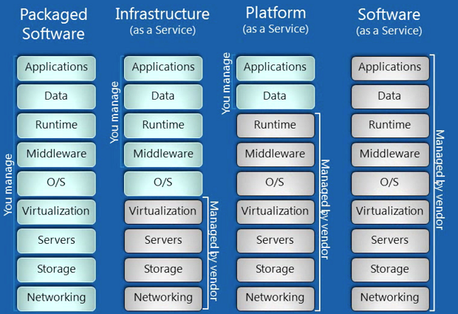
Summary of Provision
Application Migration – adopt level needed

Slide 45
Cloud Open Standards
Implementations typically have proprietary standards and interfaces
  Vendors like this – often locked into one implementation
Community ‘push’ towards open cloud standards:
  Open Grid Forum (OGF) – Open Cloud Computing Interface (OCCI)
  Distributed Management Task Force (DMTF) – Open Virtualisation Format (OVF)

Slide 46
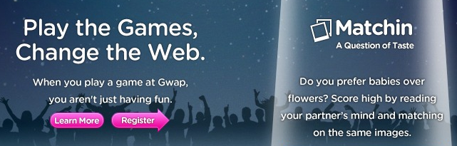
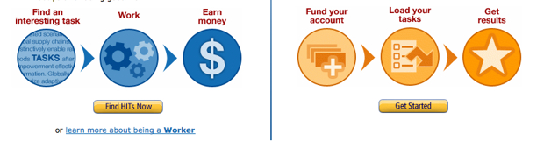
Also HuaaS – Human as a Service
Extraction of information from crowds of people
Arbitrary (e.g., notable YouTube videos, digg)
On-demand
task
Games with a Purpose
Amazon Mechanical Turk

Slide 47
Where to Apply Distributed Systems
Application Domain | Associated Networked Application
Finance and commerce | E-commerce (e.g., Amazon and eBay, PayPal), online banking and trading
The information society | Web information and search engines, e-books, Wikipedia; social networking: Facebook and Instagram, Twitter.
Creative industries and entertainment | Online gaming, music and film in the home, user-generated content, e.g. YouTube, Flickr
Healthcare | Health informatics, on online patient records, monitoring patients
Education | E-learning, virtual learning environments; distance learning
Transport and logistics | GPS in route finding systems, map services: Google Maps, Google Earth
Science | The Grid as an enabling technology for collaboration between scientists
Environmental management | Sensor technology to monitor earthquakes, floods or tsunamis

