Slide 1
Distributed Computing Systems
File Systems

Slide 2
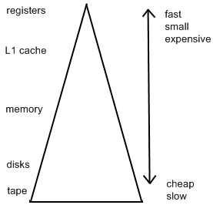
Motivation – Process Need
Processes store, retrieve information
When process terminates, memory lost
How to make it persist?
What if multiple processes want to share?
Requirements:
  large
  persistent
  concurrent access
Solution? Files are large, persistent!

Slide 3
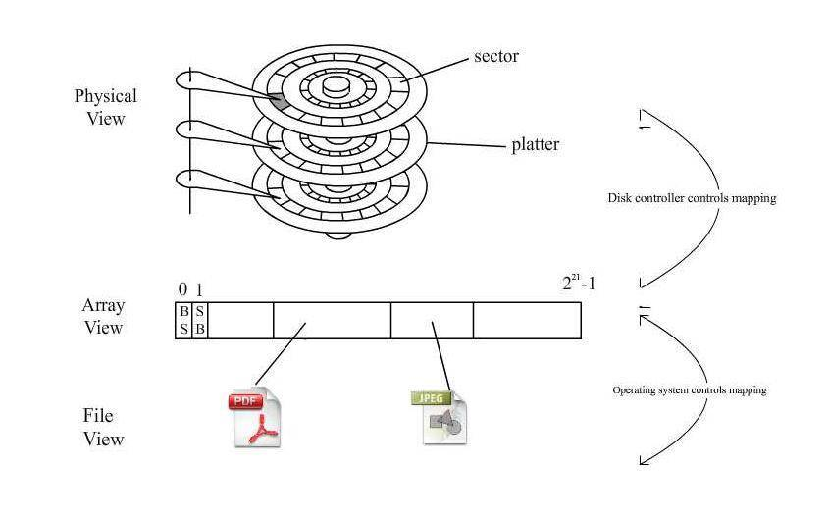
Motivation – Disk Functionality (1 of 2)
bs – boot sector
sb – super block
Sequence of fixed-size blocks
Support reading and writing of blocks
Notes:
http://read.cs.ucla.edu/111/2007fall/notes/lec12

Slide 4
Motivation – Disk Functionality (2 of 2)
Questions that quickly arise
  How do you find information?
  How to map blocks to files?
  How do you keep one user from reading another’s data?
  How do you know which blocks are free?
Solution? File Systems

Slide 5
Outline
Files (next)
Directories
Disk space management
Misc
Example file systems

Slide 6
File Systems
Abstraction to disk (convenience)
  “The only thing friendly about a disk is that it has persistent storage.”
  Devices may be different: tape, USB, SSD, IDE/SCSI, NFS
Users
  don’t care about implementation details
  care about interface
OS
  cares about implementation (efficiency and robustness)

Slide 7
File System Concepts
Files - store the data
Directories - organize files
Partitions - separate collections of directories (also called “volumes”)
  all directory information kept in partition
  mount file system to access
Protection - allow/restrict access for files, directories, partitions

Slide 8
Files: The User’s Point of View
Naming: how does user refer to it?
  Does case matter? Example: blah, BLAH, Blah
  Users often don’t distinguish, and in much of Internet no difference (e.g., domain name), but sometimes (e.g., URL path)
  Windows: generally case doesn’t matter, but is preserved
  Linux: generally case matters
  Does extension matter? Example: file.c, file.com
  Software may distinguish (e.g., compiler for .cpp, Windows Explorer for application association)
  Windows: explorer recognizes extension for applications
  Linux: extension ignored by system, but software may use defaults

Slide 9
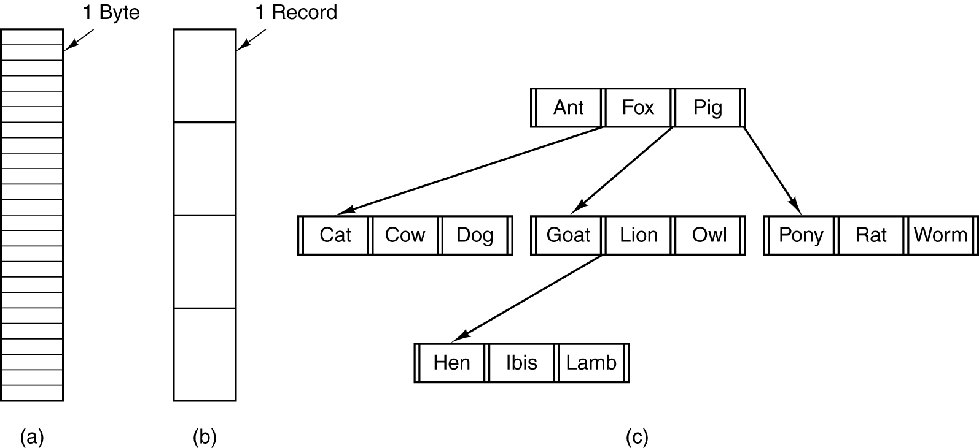
Structure
What’s inside?
  Sequence of bytes (most modern OSes (e.g., Linux, Windows))
  Records - some internal structure (rarely today)
  Tree - organized records within file space (rarely today)
Notes:
Tanenbaum, Modern Operating Systems 3 e, (c) 2008 Prentice-Hall, Inc. All rights reserved. 0-13-6006639

Slide 10
Type and Access
Access Method:
  sequential (for character files, an abstraction of I/O of serial device, such as network/modem)
  random (for block files, an abstraction of I/O of block device, such as a disk)
Type:
  ascii - human readable
  binary - computer only readable
  Allowed operations/applications (e.g., executable, c-file …) (typically via extension type or “magic number”
    (see next slide)

Slide 11
Determining File Type – Unix file
(1 of 2)
$ cat TheLinuxCommandLine
What is displayed?
%PDF-1.6^M%âãÏÓ^M 3006 0 obj^M<>stream^M
...
How to determine file type? → file
$ file grof
grof: PostScript document text
$ file Desktop/
Desktop/: directory
$ file script.sh
script.sh: Bourne-Again shell script, ASCII, exe
$ file a.out
a.out: ELF 32-bit LSB executable, Intel 80386...
$ file TheLinuxCommandLine
TheLinuxCommandLine: PDF document, version 1.6
Notes:
Himanshuz.chd. “Get over extensions, use file command to determine file types in Linux”
https://www.ibm.com/developerworks/community/blogs/58e72888-6340-46ac-b488-d31aa4058e9c/entry/get_over_extensions_use_file_command_to_determine_file_types_in_linux?lang=en

Slide 12
Determining File Type – Unix file
(2 of 2)
Use stat() system call (see Project 1; see also stat system program)
  “mode” for special file (socket, sym link, named pipes)
Try examining parts of file (“magic number”)
  Bytes with specific format, specific location
    25 50 44 46, offset 0 → PDF
  Custom, too (see man magic)
Examine content
  Text? → Examine blocks for known types (e.g., tar)
Otherwise → data
https://en.wikipedia.org/wiki/List_of_file_signatures

Slide 13
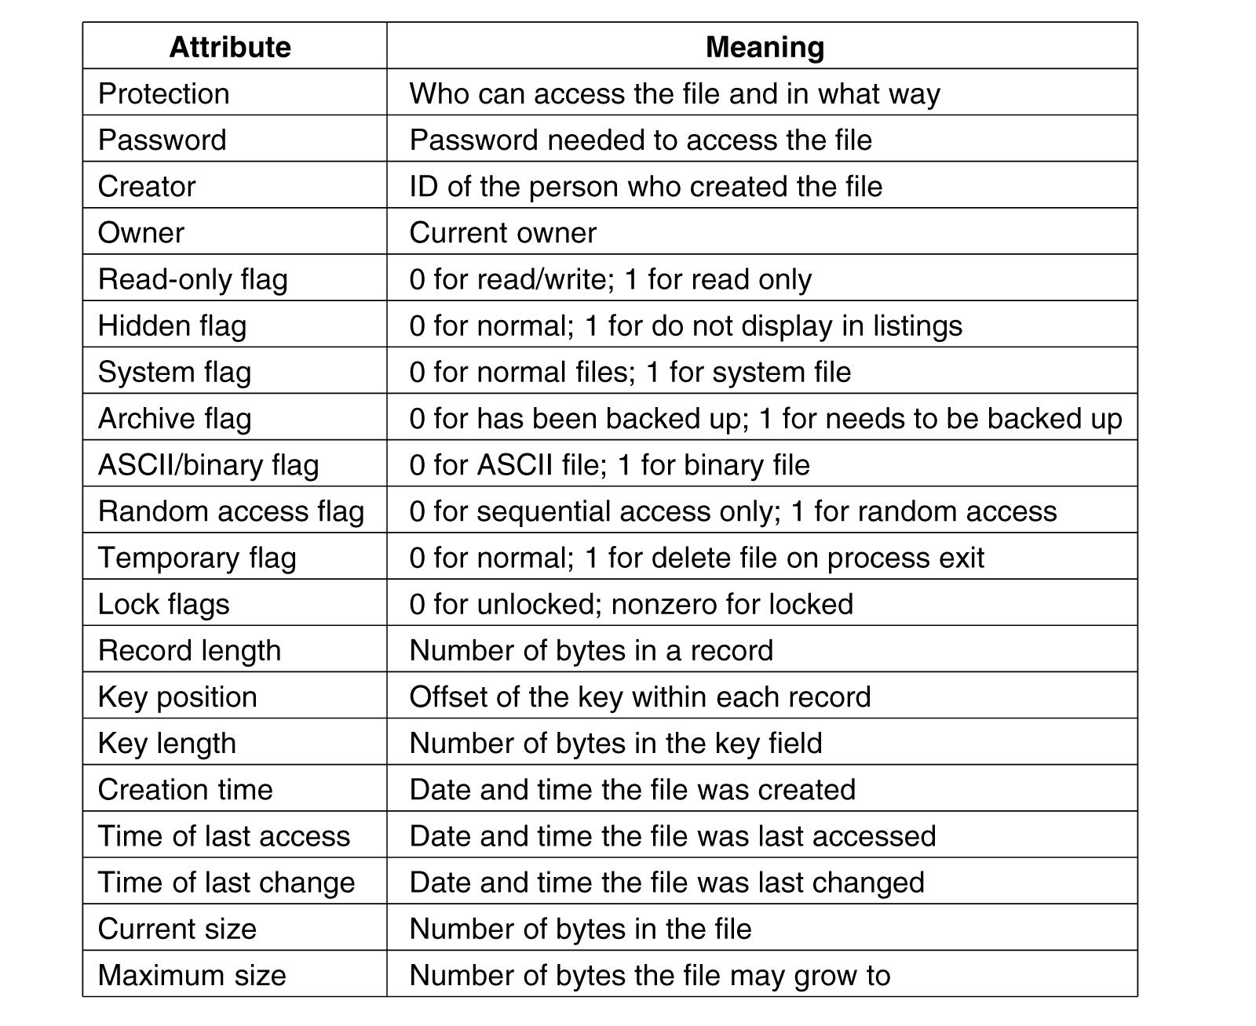
Common Attributes
Notes:
Tanenbaum, Modern Operating Systems 3 e, (c) 2008 Prentice-Hall, Inc. All rights reserved. 0-13-6006639

Slide 14
System Calls for Files
Create
Delete
Truncate
Open
Read
Write
Append
Seek
Get attributes
Set attributes
Rename

Slide 15
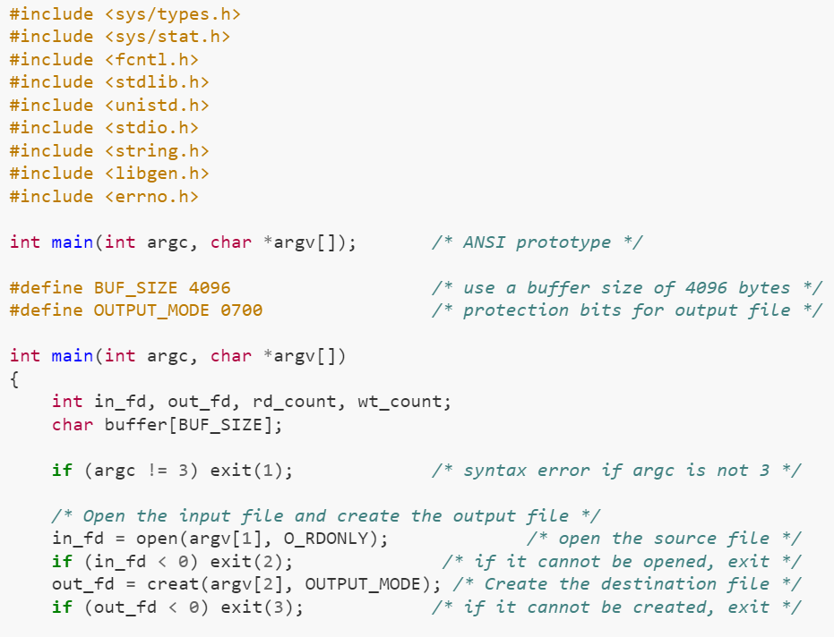
Example: Program to Copy File (1 of 2)
“man” tells what system include files are needed
Command line args.
Notes:
Tanenbaum, Modern Operating Systems 3 e, (c) 2008 Prentice-Hall, Inc. All rights reserved. 0-13-6006639

Slide 16
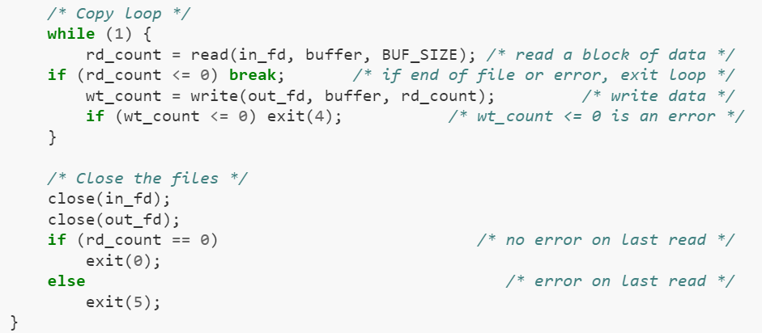
Example: Program to Copy File (2 of 2)
Next → Zoom in on open()system call
int in_fd = open(argv[1], O_RDONLY); /* open file for reading */
Notes:
Tanenbaum, Modern Operating Systems 3 e, (c) 2008 Prentice-Hall, Inc. All rights reserved. 0-13-6006639

Slide 17
Example: Unix open()
int open(char *path, int flags [, int mode])
path is name of file (NULL terminated string)
flags is bitmap to set switch
  O_RDONLY, O_WRONLY, O_TRUNC …
  O_CREATE then use mode for permissions
success, returns index
  On error, -1 and set errno (see Project 1)

Slide 18
Unix open() – Under the Hood
int fid = open(“blah”, flags);
read(fid, …);
User Space
System Space
0
1
2
3
stdin
stdout
...
stderr
File Structure
File
Descriptor
...
...
(where
blocks are)
(index)
(attributes)
(Per process)
(Per device)
(Per file)

Slide 19
Example: Windows CreateFile()
Returns file object handle:
HANDLE CreateFile (
lpFileName, // name of file
dwDesiredAccess, // read-write
dwShareMode, // shared or not
lpSecurity, // permissions
...
)
File objects used for all: files, directories, disk drives, ports, pipes, sockets and console

Slide 20
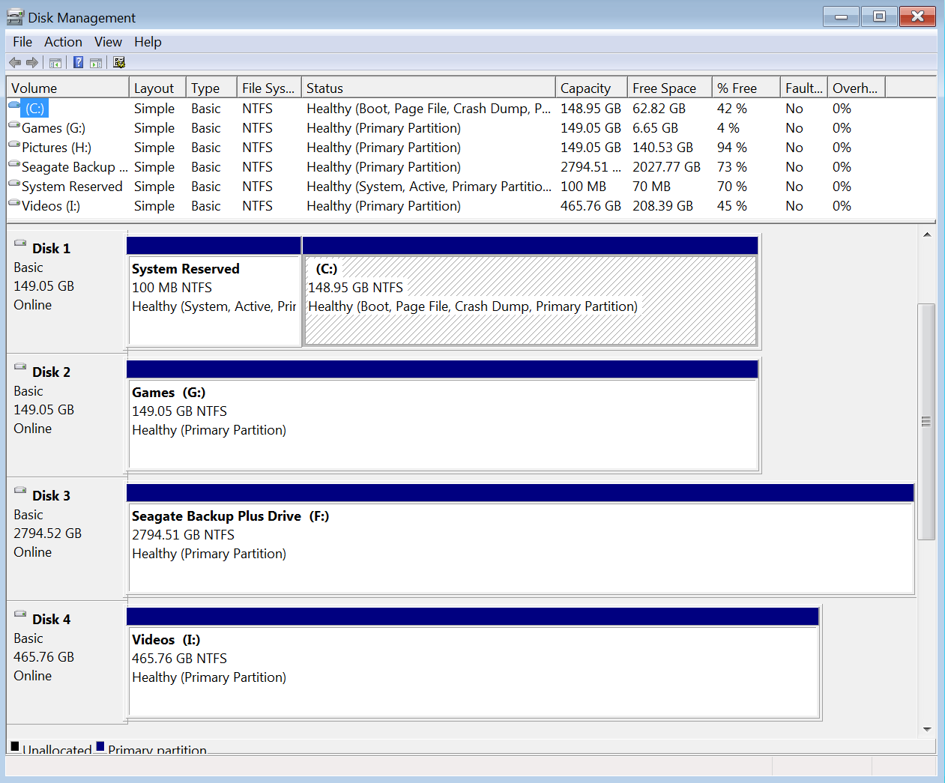
Disk Partitions
Partition large group of sectors allocated for specific purpose
Specify number of cylinders to use
Specify type
Linux: “df –h” and “fdisk”
(“System Reserved” partition for Windows contains OS boot code and code to do HDD decryption, if set)

Slide 21

File System Layout
BIOS reads in program (“bootloader”, e.g., grub) from known disk location (Master Boot Record or GUID Partition Table)
MBR/GPT has partition table (start, end of each partition)
Bootloader reads first block (“boot block”) of partition
Boot block knows how to read next block and start OS
Rest can vary. Often “superblock” with details on file system
  Type, number of blocks,…
(or GPT
see next)
Notes:
Tanenbaum, Modern Operating Systems 3 e, (c) 2008 Prentice-Hall, Inc. All rights reserved. 0-13-6006639

Slide 22
MBR vs. GPT
MBR = Master Boot Record
  Older standard, still in widespread use
GPT = GUID (Globally Unique ID) Partition Table
  Newer standard
Both help OS know partition structure of hard disk
Linux – default GPT (must use Grub 2), but can use MBR
Mac – default GPT. Can run on MBR disk, but can’t install on it
Windows – 64-bit support GPT. Windows 7 default MBR, but Windows 8 & 10 default GPT
Notes:
http://www.maketecheasier.com/differences-between-mbr-and-gpt/

Slide 23
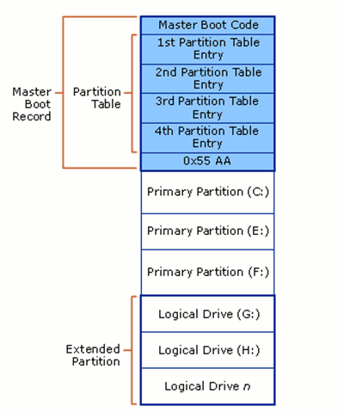
Master Boot Record (MBR)
Old standard, still widely in use
At beginning of disk, hold information on partitions
Also code that can scan for active OS and load up boot code for OS
Only 4 partitions, unless 4th is extended
32-bit, so partition size limited to 2TB
If MBR corrupted → trouble!

Slide 24
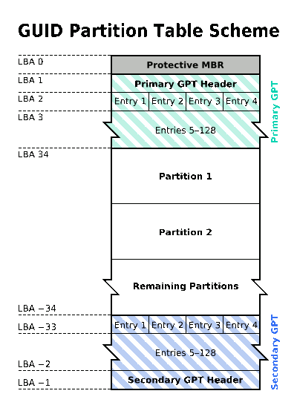
GUID Partition Table (GPT)
Newest standard
GUID = globally unique identifiers
Unlimited partitions (but most OSes limit to 128)
Since 64-bit, 1 billion TB (1 Zettabyte) partition size (Windows limit ~18 million TB)
Backup table stored at end
CRC32 checksums to detect errors
Protective MBR layer for apps that don’t know about GPT

Slide 25
File System Implementation
Process
Control Block
Open File
Table
File Descriptor
Table
Disk
File sys info
Copy fd
to mem
File
descriptors
Open
File
Pointer
Array
Directories
(per process)
(in memory
copy,
one per
device)
Data

Slide 26
Example – Linux (1 of 3)
Each task_struct describes a process, refers to open file table
// /usr/include/linux/sched.h
struct task_struct {
volatile long state;
long counter;
long priority;
…
struct files_struct *files; // open file table
…
}

Slide 27
Example – Linux (2 of 3)
The files_struct data structure describes files process has open, refers to file descriptor table
// /usr/include/linux/fs.h
struct files_struct {
int count;
fd_set close_on_exec;
fd_set open_fds;
struct file *fd[NR_OPEN]; // file descriptor table
};

Slide 28
Example – Linux (3 of 3)
Each open file is represented by file descriptor, refers to blocks of data on disk
struct file {
mode_t f_mode;
loff_t f_pos;
unsigned short f_flags;
unsigned short f_count;
unsigned long f_reada, f_ramax, f_raend, f_ralen, f_rawin;
struct file *f_next, *f_prev;
int f_owner;
struct inode *f_inode; // file descriptor (next)
struct file_operations *f_op;
unsigned long f_version;
void *private_data;
};

Slide 29
File System Implementation
Core data to track: which blocks with which file?
File descriptor implementations:
  Contiguous allocation
  Linked list allocation
  Linked list allocation with index
  inode
File Descriptor

Slide 30
Contiguous Allocation (1 of 2)
Store file as contiguous block
  ex: w/ 1K block, 50K file has 50 consecutive blocks
  File A: start 0, length 2
  File B: start 14, length 3
Good:
  Easy: remember location with 1 number
  Fast: read entire file in 1 operation (length)
Bad:
  Static: need to know file size at creation
    Or tough to grow!
  Fragmentation: remember why we had paging in memory?
(Example next slide)

Slide 31
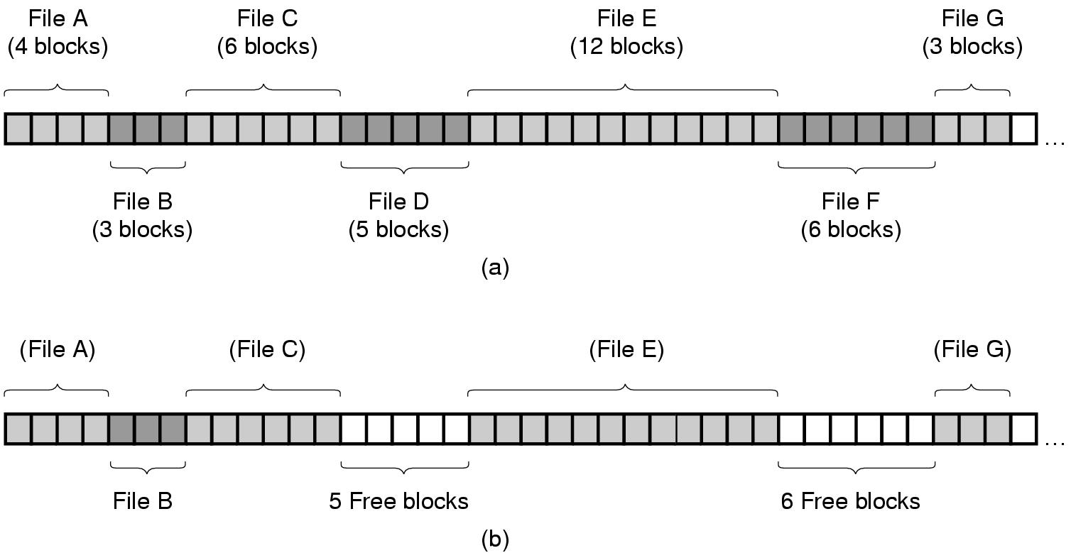
Contiguous Allocation (2 of 2)
7 files
5 files (file D and F deleted)
Notes:
Tanenbaum, Modern Operating Systems 3 e, (c) 2008 Prentice-Hall, Inc. All rights reserved. 0-13-6006639

Slide 32
Linked List Allocation
Keep linked list with disk blocks
null
null
File
Block
0
File
Block
1
File
Block
2
File
Block
0
File
Block
1
Physical
Block
4
7
2
6
3
Good:
  Easy: remember 1 number (location)
  Efficient: no space lost in fragmentation
Bad:
  Slow: random access bad

Slide 33
Linked List Allocation with Index
Physical
Block
Table in memory
  MS-DOS FAT, Win98 VFAT
Good: faster random access
Bad: can be large! e.g., 1 TB disk, 1 KB blocks
  Table needs 1 billion entries
  Each entry 3 bytes (say 4 typical)
    → 4 GB memory!
0
1
2
null
3
null
4
7
5
6
3
7
2
Common format still (e.g., USB drives) since supported by many Oses & additional features not needed

Slide 34
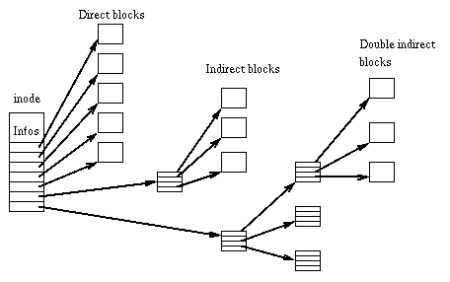
inode
Fast for small files
Can hold large files
Typically 15 pointers
  12 to direct blocks
  1 single indirect
  1 doubly indirect
  1 triply indirect
Number of pointers per block? Depends upon block size and pointer size
  e.g., 1k byte block, 4 byte pointer → each indirect has 256 pointers
Max size of file? Same – it depends upon block size and pointer size
  e.g., 4KB block, 4 byte pointer → max size 2 TB
Notes:
http://en.wikipedia.org/wiki/File:Ext2-inode.gif

Slide 35
Linux File System: ext3 inode
// linux/include/linux/ext3_fs.h
#define EXT3_NDIR_BLOCKS 12 // Direct blocks
#define EXT3_IND_BLOCK EXT3_NDIR_BLOCKS + 1 // Indirect block index
#define EXT3_DIND_BLOCK EXT3_IND_BLOCK + 1 // Double-ind. block index
#define EXT3_TIND_BLOCK EXT3_DIND_BLOCK + 1 // Triple-ind. block index
#define EXT3_N_BLOCKS EXT3_TIND_BLOCK + 1 // (Last index & total)
struct ext3_inode {
__u16 i_mode; // File mode
__u16 i_uid; // Low 16 bits of owner Uid
__u32 i_size; // Size in bytes
__u32 i_atime; // Access time
__u32 i_ctime; // Creation time
__u32 i_mtime; // Modification time
__u32 i_dtime; // Deletion time
__u16 i_gid; // Low 16 bits of group Id
__u16 i_links_count; // Links count
__u32 i_blocks; // Blocks count
...
__u32 i_block[EXT3_N_BLOCKS]; // Pointers to blocks
...
}

Slide 36
Outline
Files (done)
Directories (next)
Disk space management
Misc
Example file systems

Slide 37
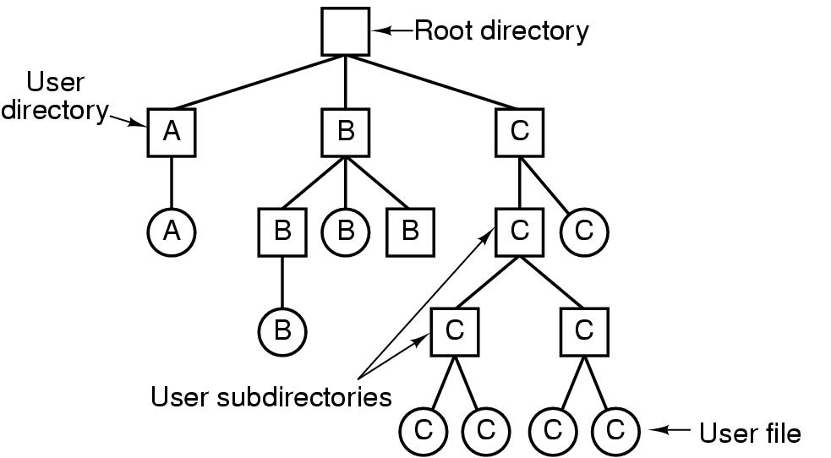
Directory Layout - Paths
Two types of file system paths – Absolute & Relative
Absolute
  Full path from root to file
  e.g., /home/joe/cs4513/hw1.pdf
  e.g., C:\Users\home\Doc\hw1.pdf
Relative
  OS keeps track of process working directory for each process
  Path relative to current working directory
  e.g., [working directory = /home/joe]:
    syllabus.docx → /home/joe/syllabus.docx
    cs4513/hw1.pdf → /home/joe/cs4513/hw1.pdf
    ./cs4513/hw1.pdf → /home/joe/cs3513/hw1.pdf
    ../peter/hw1.pdf → /home/peter/hw1.pdf
Notes:
Tanenbaum, Modern Operating Systems 3 e, (c) 2008 Prentice-Hall, Inc. All rights reserved. 0-13-6006639

Slide 38
Directory Implementation
Just like files (“wait, what?”)
  Have data blocks
  File descriptor to map which blocks to directory
But have special bit set so user process cannot modify contents
  Data in directory is information / links to files
  Modify only through system call
  (See ls.c)
Organized for:
  Efficiency - locating file quickly
  Convenience - user patterns
    Groups (.c, .exe), same names
Tree structure, directory the most flexible
  User sees hierarchy of directories

Slide 39
System Calls for Directories
Create
Delete
Opendir
Closedir
Readdir
Rename
Link
Unlink

Slide 40
Directories
Before reading file, must be opened
Directory entry provides information to get blocks
  Disk location (blocks, address)
Map ASCII name to file descriptor
name
block count
block numbers
Where are file attributes (e.g., owner, permissions) stored?

Slide 41
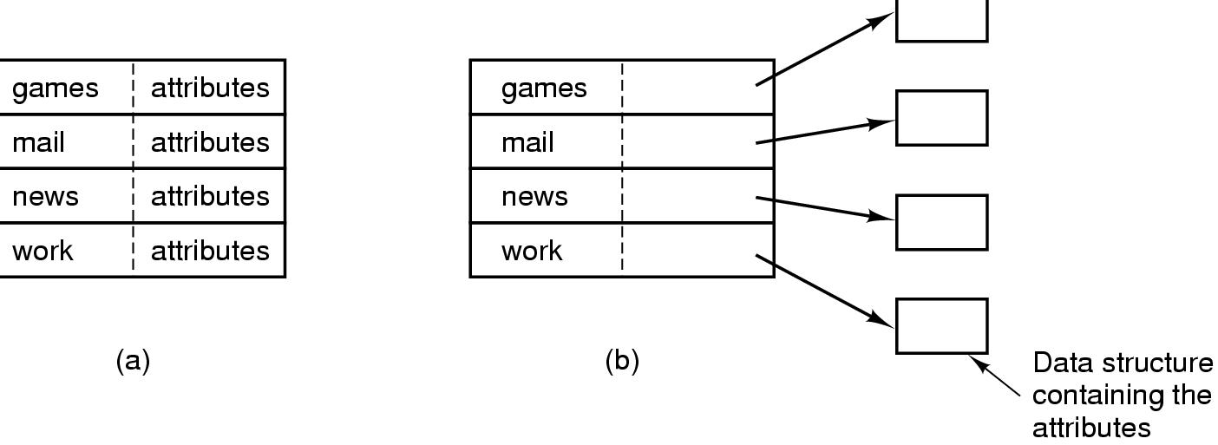
Options for Storing Attributes
Directory entry has attributes (Windows)
Directory entry refers to file descriptor (e.g., inode), and descriptor has attributes (Unix)
Notes:
Tanenbaum, Modern Operating Systems 3 e, (c) 2008 Prentice-Hall, Inc. All rights reserved. 0-13-6006639

Slide 42
Windows (FAT) Directory
Hierarchical directories
Entry:
  name - date
  type (extension) - block number (w/FAT)
  time
name
type
attrib
time
date
block
size

Slide 43
Unix Directory
Hierarchical directories
Entry:
  name
  inode number (try “ls –i” or “ls –iad .”)
Example, say want to read data from below file
  /usr/bob/mbox
  Want contents of file, which is in blocks
  Need file descriptor (inode) to get blocks
  How to find the file descriptor (inode)?
inode
name

Slide 44
Unix Directory Example
Root Directory
Block 132
Block 406
1
.
inode 6
6
.
inode 26
26
.
1
..
1
..
6
..
4
bin
26
bob
12
grants
7
dev
17
jeff
81
books
14
lib
132
14
sue
406
60
mbox
9
etc
51
sam
17
Linux
6
usr
29
mark
8
tmp
Aha!
inode 60
has contents
of mbox
Looking up
bob gives
inode 26
Looking up
usr gives
inode 6
Contents of
usr in
block 132
Contents of bob in block 406
Note: handled by OS in system call to open(), not user or user code

Slide 45
Length of File Names
Each directory entry is name (and maybe attributes) plus descriptor
How long should file names be?
If fixed small, will hit limit (users don’t like)
If fixed large, may be wasted space (internal fragmentation)
Solution → allow variable length names

Slide 46
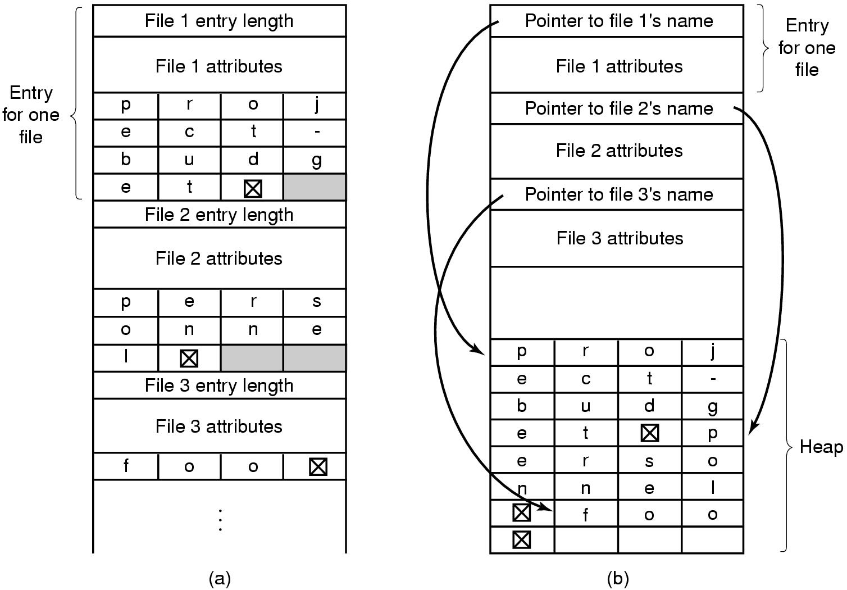
Handling Long Filenames
Compact (all in memory, so fast) on word boundary
Heap to file
Notes:
Tanenbaum, Modern Operating Systems 3 e, (c) 2008 Prentice-Hall, Inc. All rights reserved. 0-13-6006639

Slide 47
User Access to Same File in More than One Directory
B
C
(Instead of tree,
really have
directed acyclic
graph)
A
?
B
C
“alias”
Possibilities for the “alias”:
  Directory entry contains disk blocks?
  Directory entry points to attributes structure?
  Have new type of file to redirect?
Will review each implementation choice, next

Slide 48
Possible Implementations
Directory entry contains disk blocks?
  Contents (blocks) may change
  What happens when blocks change?
Directory entry points to file descriptor?
  If removed, refers to non-existent file
  Must keep count, remove only if 0
  Remember Linux ext3 inode?
    __u16 i_links_count; // Links count
  Hard link
  Similar if delete file in use
    Example: try “ln” and “ls -i”

Slide 49
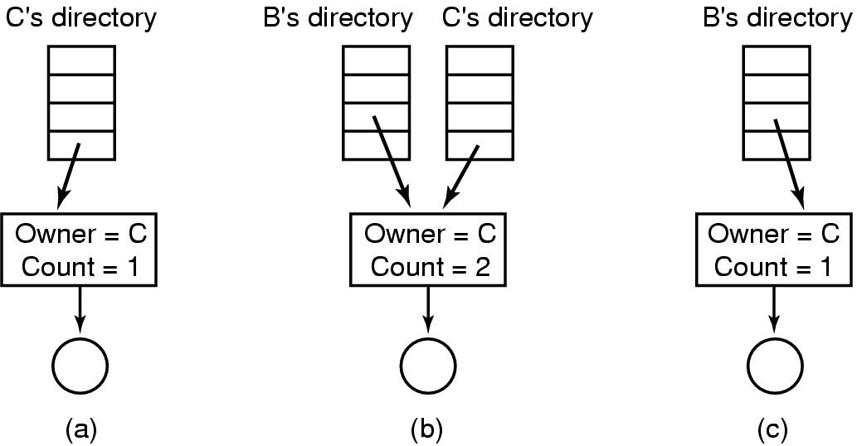
Possible Implementation (“hard link”)
Initial situation
After link created
Original owner removes file (what if quotas?)
  What about hard link across partitions? (example)
Notes:
Tanenbaum, Modern Operating Systems 3 e, (c) 2008 Prentice-Hall, Inc. All rights reserved. 0-13-6006639

Slide 50
Possible Implementation (“soft link”)
Have new type of file to redirect?
  New file only contains alternate name for file
  Overhead, must parse tree second time
  Soft link (or symbolic link)
    Note, shortcut in Windows only viewable by graphic browser, are absolute paths, with metadata, can track even if move
    Does have mklink (hard and soft) for NTFS
  Often have max link count in case loop (example)
  What about soft link across partitions? (example)
    Example: try “ln -s”

Slide 51
Need for Robust File Systems
Consider upkeep for removing file
  Remove file from directory entry
  Return all disk blocks to pool of free disk blocks
  Release file descriptor (inode) to pool of free descriptors
What if system crashes in middle?
  a) inode becomes orphaned (lost+found, 1 per partition)
  b) blocks free and allocated
  if flip steps, blocks/descriptor free but directory entry exists!
Crash consistency problem

Slide 52
Crash Consistency Problem
Disk guarantees that single sector writes are atomic
  But no way to make multi-sector writes atomic
How to ensure consistency after crash?
  Don’t bother to ensure consistency
    Accept that the file system may be inconsistent after crash
    Run program that fixes file system during bootup
    File system checker (e.g., fsck)
  Use transaction log to make multi-writes atomic
    Log stores history of all writes to disk
    After crash log “replayed” to finish updates
    Journaling file system
Notes:
http://www.ccs.neu.edu/home/cbw/5600/slides/10_File_Systems.pptx

Slide 53
File System Checker – the Good and the Bad
Advantages of File System Checker
  Doesn’t require file system to do any work to ensure consistency
  Makes file system implementation simpler
Disadvantages of File System Checker
  Complicated to implement fsck program
    Many possible inconsistencies that must be identified
    Many difficult corner cases to consider and handle
  Usually super slow
    Scans entire file system multiple times
    Consider really large disks, like 400 TB RAID array!
Notes:
http://www.ccs.neu.edu/home/cbw/5600/slides/10_File_Systems.pptx

Slide 54
Journaling File Systems
Write intent to do actions (a-c) to log before starting
  Option - read back to verify integrity before continue
Perform operations
Erase log
If system crashes, when restart read log and apply operations
Logged operations must be idempotent (can be repeated without harm)
Superblock
Block Group 0
Journal
Block Group 1
…
Block Group N

Slide 55
Journaling Example
  Assume appending new data block (D₂) to file
  3 writes: inode v2, data bitmap v2 (next topic), data D₂
Before executing writes, first log them
TxB
ID=1
I v2
B v2
D₂
TxE
ID=1
Journal
Begin new transaction with unique ID=1
Write updated meta-data block
Write file data block
Write end-of-transaction with ID=1
Notes:
http://www.ccs.neu.edu/home/cbw/5600/slides/10_File_Systems.pptx

Slide 56
Commits and Checkpoints
Transaction committed after all writes to log complete
After transaction is committed, OS checkpoints update
Committed!
Journal
TxB
I v2
B v2
D₂
TxE
Inode
Bitmap
Data
Bitmap
Checkpointed!
Inodes
Data Blocks
v2
v1
D₁
D₂
Final step: free checkpointed transaction
Notes:
http://www.ccs.neu.edu/home/cbw/5600/slides/10_File_Systems.pptx

Slide 57
Journal Implementation
Journals typically implemented as circular buffer
  Journal is append-only
OS maintains pointers to front and back of transactions in buffer
  As transactions are freed, back moved up
Thus, contents of journal are never deleted, just overwritten over time
Notes:
http://www.ccs.neu.edu/home/cbw/5600/slides/10_File_Systems.pptx

Slide 58
Crash Recovery (1 of 2)
What if system crashes during logging?
  If transaction not committed, data lost
  But, file system remains consistent!
Journal
TxB
I v2
B v2
D₂
Inode
Bitmap
Data
Bitmap
Inodes
Data Blocks
v1
D₁
Notes:
http://www.ccs.neu.edu/home/cbw/5600/slides/10_File_Systems.pptx

Slide 59
Crash Recovery (2 of 2)
What if system crashes during checkpoint?
  File system may be inconsistent
  During reboot, transactions committed but not free replayed in order
  Thus, no data is lost and consistency restored!
Journal
TxB
I v2
B v2
D₂
TxE
Inode
Bitmap
Data
Bitmap
Inodes
Data Blocks
v2
v1
D₁
D₂
Notes:
http://www.ccs.neu.edu/home/cbw/5600/slides/10_File_Systems.pptx

Slide 60
Journaling –
The Good and the Bad
Advantages of journaling
  Robust, fast file system recovery
    No need to scan entire journal or file system
  Relatively straight forward to implement
Disadvantages of journaling
  Write traffic to disk doubled
    Especially file data, which is probably large
Notes:
http://www.ccs.neu.edu/home/cbw/5600/slides/10_File_Systems.pptx

Slide 61
Meta-Data Journaling
Most expensive part of data journaling writing file data twice
  Meta-data small (<1 block), file data is large
So, only journal meta-data
Journal
TxB
I v2
B v2
TxE
Inode
Bitmap
Data
Bitmap
Inodes
Data Blocks
v2
v1
D₁
D₂
Notes:
http://www.ccs.neu.edu/home/cbw/5600/slides/10_File_Systems.pptx

Slide 62
Crash Recovery Redux (1 of 2)
What if system crashes during logging?
  If transaction not committed, data lost
  D₂ will eventually be overwritten
  File system remains consistent
Journal
TxB
I v2
B v2
Inode
Bitmap
Data
Bitmap
Inodes
Data Blocks
v1
D₁
D₂
Notes:
http://www.ccs.neu.edu/home/cbw/5600/slides/10_File_Systems.pptx

Slide 63
Crash Recovery Redux (2 of 2)
What if system crashes during checkpoint?
  File system may be inconsistent
  During reboot, transactions committed but not free replayed in order
  Thus, no data lost and consistency is restored
Journal
TxB
I v2
B v2
TxE
Inode
Bitmap
Data
Bitmap
Inodes
Data Blocks
v2
v1
D₁
D₂
Notes:
http://www.ccs.neu.edu/home/cbw/5600/slides/10_File_Systems.pptx

Slide 64
Journaling Summary
Today, most OSes use journaling file systems
  ext3/ext4 on Linux
  NTFS on Windows
Provides crash recovery with relatively low space and performance overhead
Next-gen OSes likely move to file systems with copy-on-write semantics
  btrfs and zfs on Linux

Slide 65
Outline
Files (done)
Directories (done)
Disk space management (next)
Misc
Example file systems

Slide 66
Disk Space Management
n bytes → choices:
  contiguous
  blocks
Similarities with memory management
  contiguous is like variable-sized partitions
    but compaction by moving on disk very slow!
    so use blocks
  blocks are like paging (can be wasted space)
    how to choose block size?
(Note, physical disk block size typically 512 bytes, but file system logical block size chosen when formatting)
Depends upon size of files stored

Slide 67
File Sizes in Practice (1 of 2)
(VU – University circa 2005, Web – Commercial Web server 2005)
Files trending larger. But most small. What are the tradeoffs?
Tanenbaum, Modern Operating Systems 3 e, (c) 2008 Prentice-Hall, Inc. All rights reserved. 0-13-6006639
Notes:
Tanenbaum, Modern Operating Systems 3 e, (c) 2008 Prentice-Hall, Inc. All rights reserved. 0-13-6006639

Slide 68
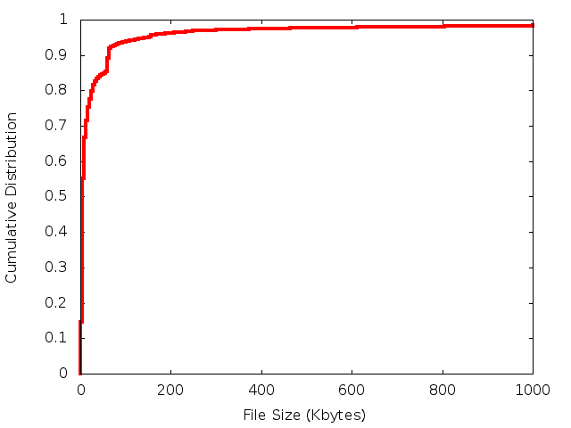
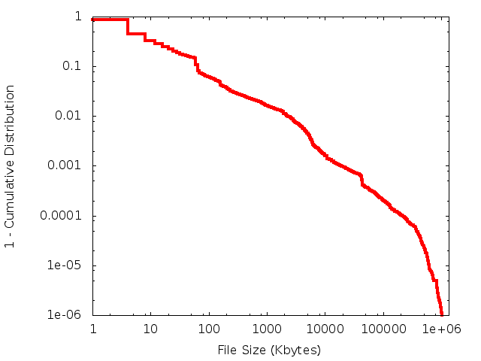
File Sizes in Practice (2 of 2)
Claypool Office PC
Linux Ubuntu
March 2014

Slide 69
Choosing Block Size
Large blocks
  faster throughput, less seek time, more data per read
  wasted space (internal fragmentation)
Small blocks
  less wasted space
  more seek time since more blocks to access same data
Disk Space
Utilization
Data Rate
Block size

Slide 70
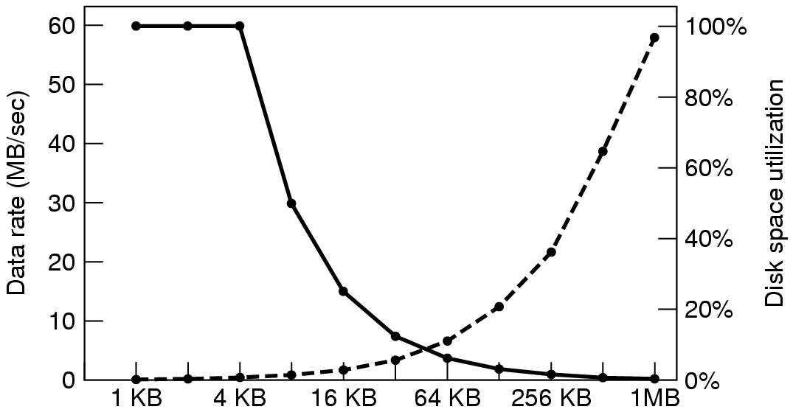
Disk Performance and Efficiency
Data Rate
Utilization
Assume 4 KB files.
At crossover (~64 KB), only 6.6 MB/sec, Efficiency 7% (both bad)
However → Most disk block sizes not larger than paging system hardware
  On x86 is 4K → most file systems pick 1KB – 4 KB
Tanenbaum, Modern Operating Systems 3 e, (c) 2008 Prentice-Hall, Inc. All rights reserved. 0-13-6006639
Notes:
Tanenbaum, Modern Operating Systems 3 e, (c) 2008 Prentice-Hall, Inc. All rights reserved. 0-13-6006639

Slide 71
Keeping Track of Free Blocks
Linked-list of free blocks
Bitmap of free blocks
Notes:
Tanenbaum, Modern Operating Systems 3 e, (c) 2008 Prentice-Hall, Inc. All rights reserved. 0-13-6006639

Slide 72
Keeping Track of Free Blocks
Linked list of free blocks
  1K block, 32 bit disk block number
    = 255 free blocks/block (one number points to next block)
  500 GB disk has 488 millions disk blocks
    About 1,900,000 1 KB blocks to track free blocks
Bitmap of free blocks
  1 bit per block, represents free or allocated
  500 GB disk needs 488 million bits
    About 60,000 1 KB blocks to track free blocks

Slide 73
Tradeoffs
Bitmap usually smaller since 1-bit per block rather than 32 bits per block
Only if disk is nearly full does linked list require fewer blocks
  But linked-list blocks are not needed for space (they are free)
  Only matters for some maintenance (e.g., consistency checking)
If enough RAM, bitmap method preferred since provides locality, too
If only 1 “block” of RAM, and disk is full, bitmap method may be inefficient since have to load multiple blocks to find free space
  Linked list can take first in line

Slide 74
File System Performance
DRAM ~5 nanoseconds, Hard disk ~5 milliseconds
  Disk access 1,000,000x slower than memory!
  → Reduce number of disk accesses needed
Block/buffer cache
  Cache to memory
Full cache? Replacement algorithms use: FIFO, LRU, 2nd chance …
  Exact LRU can be done (why?)
Pure LRU inappropriate sometimes → e.g., some blocks are “more important” than others
  Block heavily used always in memory
  Crash w/inode can lead to inconsistent state
  Some rarely referenced (double indirect block)

Slide 75
Modified LRU
Is block likely to be needed soon?
  If no, put at beginning of list
Is block essential for consistency of file system?
  Write immediately
Occasionally write out all
  sync

Slide 76
Outline
Files (done)
Directories (done)
Disk space management (done)
Misc (next)
  partitions (fdisk, mount)
  maintenance
  quotas
Example file systems

Slide 77
Partitions
mount, unmount
  pick access point in file-system
  load super-block from disk
Super-block
  file system type
  block size
  free blocks
  free file descriptors (inodes)
/ (root)
usr
tmp
home

Slide 78

Mount isn’t Just for Bootup
When plug storage devices into running system, mount executed in background
  e.g., plugging in USB stick
What does it mean to “safely eject” device?
  Flush cached writes to that device
  Cleanly unmount file system on that device
Notes:
http://www.ccs.neu.edu/home/cbw/5600/slides/10_File_Systems.pptx

Slide 79
File System Maintenance
Format:
  Create file system structure: super block, descriptors (inodes)
  format (Windows), mke2fs (Linux)
    (e.g., Windows: “format /?” and Linux: “man mke2fs”)
“Bad blocks”
  Most disks have some (even when brand new)
  chkdsk (Win, or properties->tools->error checking) or badblocks (Linux)
  Add to “bad-blocks” list (file system can ignore)
Defragment (see picture next slide)
  Arrange blocks allocated to files efficiently
Scanning (when system crashes)
  lost+found, correcting file descriptors...

Slide 80
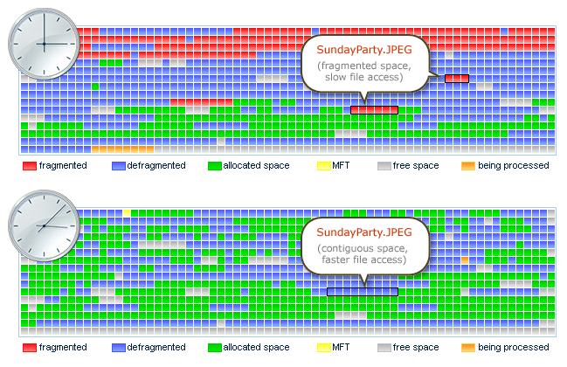
Defragmenting (Example, 1 of 2)

Slide 81
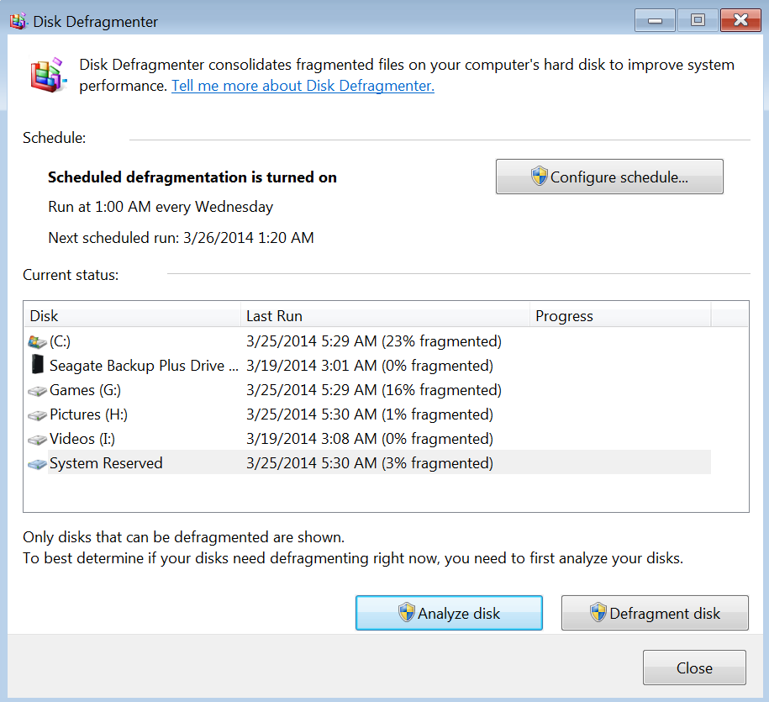
Defragmenting (Example, 2 of 2)

Slide 82
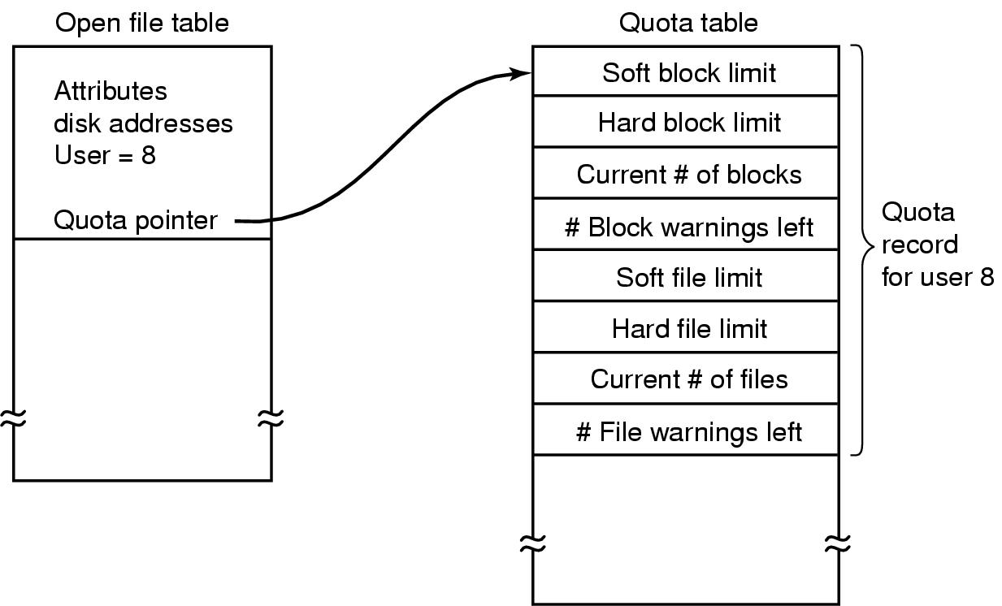
Disk Quotas
Table 1: Open file table in memory
  When file size changed, charged to user
  User index to table 2
Table 2: quota record
  Soft limit checked, exceed allowed w/warning
  Hard limit never exceeded
Limit: blocks & file descriptors (inodes)
  Running out of inodes as bad as running out of blocks
Overhead? Again, in memory
Notes:
Tanenbaum, Modern Operating Systems 3 e, (c) 2008 Prentice-Hall, Inc. All rights reserved. 0-13-6006639

Slide 83
Outline
Files (done)
Directories (done)
Disk space management (done)
Misc (done)
Example systems (next)
  Linux
  Windows

Slide 84
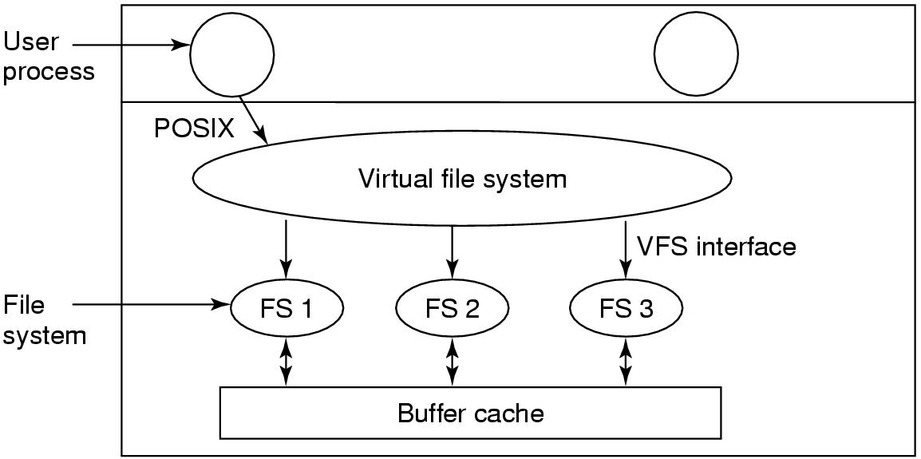
Linux File System
Virtual FS allows loading of many different FS, without changing process interface
  Still have struct file_struct, open(), creat(), …
When build/install, FS choices → ext3/4, hfps, DOS, NFS, NTFS, smbfs, is9660, … (about 2 dozen)
ext4 is “default” for many, most popular (but ext3 still widely in use, e.g., CCC)
Notes:
Tanenbaum, Modern Operating Systems 3 e, (c) 2008 Prentice-Hall, Inc. All rights reserved. 0-13-6006639

Slide 85
Linux File System: extfs
“Extended” (from Minix) file system, version 2
  (Minix a Unix-like teaching OS by Tanenbaum)
ext2fs
  Long file names, long files, better performance
  Main for many years
ext3fs
  Larger files (2 TB), Larger file system (32 TB)
  Fully compatible with ext2
  Adds journaling
ext4fs
  Larger files (16 TB), Larger file systems (1 EB)
  Extents (for free space management)
  Improved perf (multi-block allocation, journal checksum…)

Slide 86
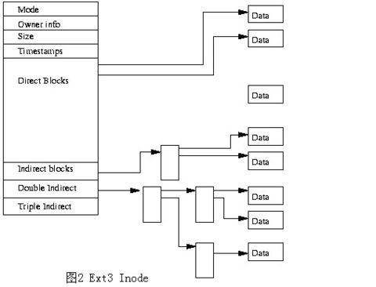
Linux File System: inodes (1 of 2)
Uses inodes
  mode for file, directory, symbolic link ...

Slide 87
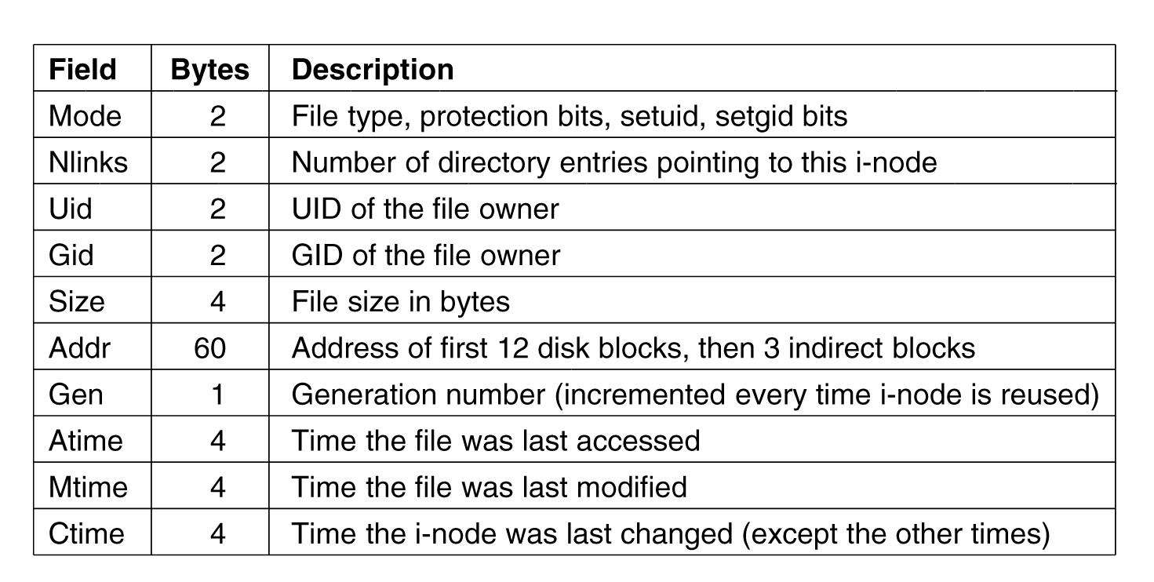
Linux File System: inodes (2 of 2)
struct ext3_inode {
__u16 i_mode; // File mode
__u16 i_uid; // Low 16 bits of owner Uid
__u32 i_size; // Size in bytes
__u32 i_atime; // Access time
__u32 i_ctime; // Creation time
__u32 i_mtime; // Modification time
__u32 i_dtime; // Deletion time
__u16 i_gid; // Low 16 bits of group Id
__u16 i_links_count; // Links count
__u32 i_blocks; // Blocks count
...
__u32 i_block[EXT3_N_BLOCKS]; // Pointers to blocks
...
}

Slide 88
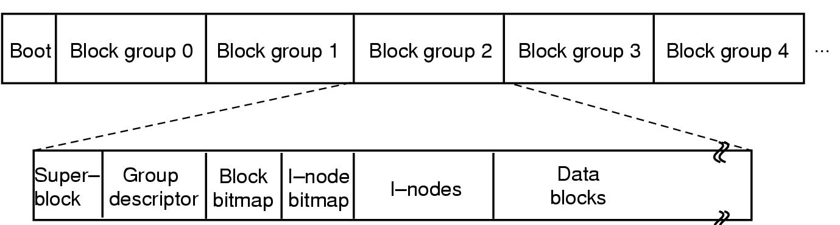
Linux File System: Blocks
% sudo tune2fs -l /dev/sda1 | grep Block
Block count: 60032256
Block size: 4096
Blocks per group: 32768
Default block size
For higher performance
  Performs I/O in chunks (reduce requests)
  Clusters adjacent requests (block groups)
Group has:
  Bit-map of free blocks and free inodes
  Copy of super block

Slide 89
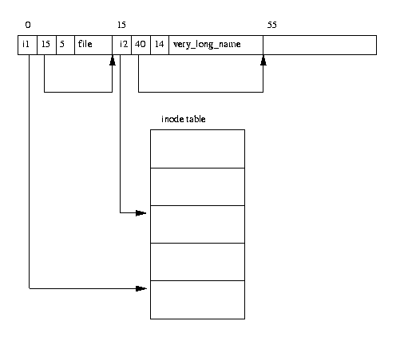
Linux File System: Directories
Directory just special file with names and inodes

Slide 90
Linux File System: Unified
(left) separate file trees (ala Windows)
(right) after mounting “DVD” under “b” Linux

Slide 91
Linux Filesystem: ext3fs & ext4fs
Journaling – internal structure assured
  Journal (lowest risk) - Both metadata and file contents written to journal before being committed.
    Roughly, write twice (journal and data)
  Ordered (medium risk) - Only metadata, not file contents. Guarantee write contents before journal committed
    Often the default
  Writeback (highest risk) - Only metadata, not file contents. Contents might be written before or after the journal is updated. So, files modified right before crash can be corrupted
No built-in defragmentation tools
  Probably not much needed
  since blocks grouped
yukon% sudo fsck -nvf /dev/sda1
…
942826 inodes used (6.28%)
1138 non-contiguous files (0.1%)
821 non-contiguous directories (0.1%)

Slide 92
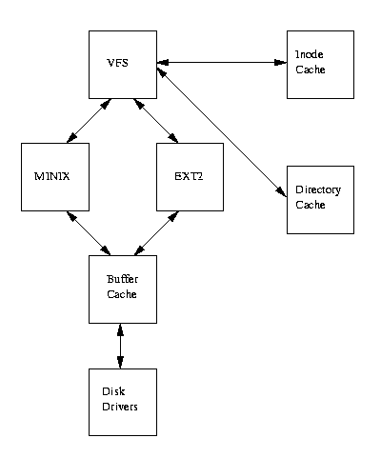
Linux Filesystem: /proc
Contents of “files” not stored, but computed
Provide interface to kernel statistics
Most read only, access
using Unix text tools
  e.g., cat /proc/cpuinfo | grep model
Enabled by
“virtual file system”
(Windows has perfmon)
(Show examples
e.g., cd /proc/self)

Slide 93
Windows New Technology File System: NTFS
Background: Windows had (has) FAT
FAT-16, FAT-32
  16-bit addresses, so limited disk partitions (2 GB)
  32-bit can support 2 TB
  No security
NTFS default in Win XP and later
  64-bit addresses

Slide 94

NTFS: Fundamental Concepts
File names limited to 255 characters
Full paths limited to 32,000 characters
File names in unicode (other languages, 16-bits per character)
Case sensitive names (“Foo” different than “FOO”)
  But Win32 API does not fully support

Slide 95
NTFS: Fundamental Concepts
File not sequence of bytes, but multiple attributes, each a stream of bytes
Example:
  One stream name (short)
  One stream id (short)
  One stream data (long)
  But can have more than one long stream
Streams can have metadata (e.g., thumbnail image)
Streams fragile, and not always preserved by utilities over network or when copied/backed up

Slide 96
NTFS: Fundamental Concepts
Hierarchical, with “\” as component separator
  Throwback for MS-DOS to support CP/M microcomputer OS
Supports “aliases” (links), but only for POSIX subsystem

Slide 97
NTFS: File System Structure
Basic allocation unit called a cluster (block)
  Sizes from 512 bytes to 64 Kbytes (most 4 KBytes)
  Referred to by offset from start, 64-bit number
Each volume has Master File Table (MFT)
  Sequence of 1 KByte records
  Bitmap to keep track of which MFT records are free
Each MFT record
  Unique ID - MFT index, and “version” for caching and consistency
  Contains attributes (name, length, value)
  If number of extents small enough, whole entry stored in MFT (faster access)
Bitmap to keep track of free blocks
Extents to keep clusters of blocks

Slide 98
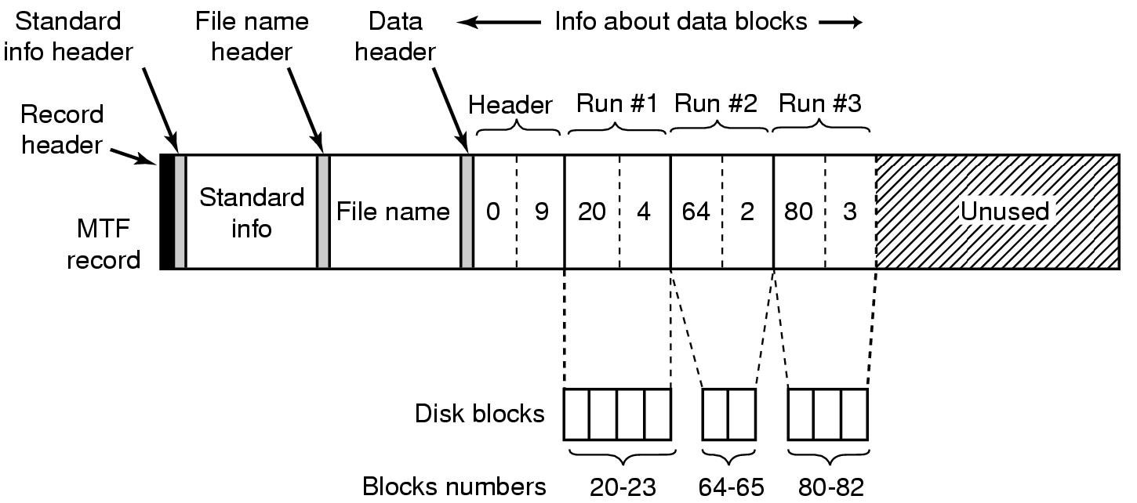
NTFS: Storage Allocation
Disk blocks kept in runs (extents), when possible

Slide 99
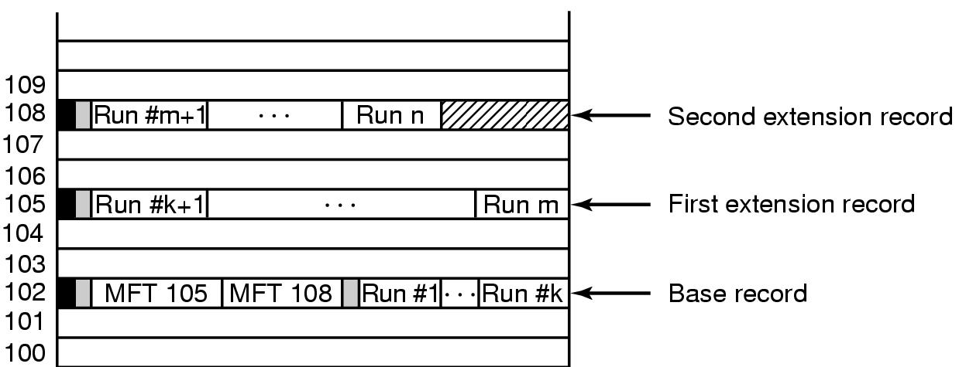
NTFS: Storage Allocation
If file too large, can link to another MFT record

Slide 100
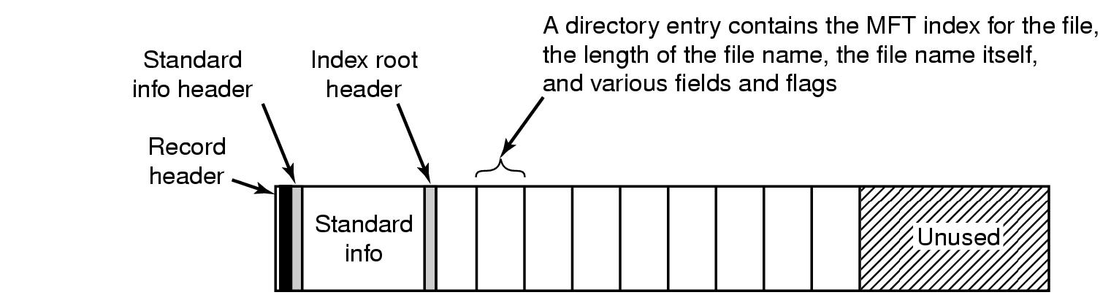
NTFS: Directories
Name plus pointer to record with file system entry
Also cache attributes (name, sizes, update) for faster directory listing
If few files, entire directory in MFT record

Slide 101
NTFS: Directories
But if large, linear search can be slow
Store directory info (names, perms, …) in B+ tree
  Every path from root to leaf “costs” the same
  Insert, delete, search all O(log_{F}N)
    F is the “fanout” (typically 3)
  Faster than linear search O(N) versus O(log_{F}N)
  Doesn’t need reorganizing like binary tree

Slide 102
NTFS: File Compression
Transparent to user
  Can be created (set) in compressed mode
Compresses (or not) in 16-block chunks

Slide 103
NTFS: Journaling
Many file systems lose metadata (and data) if powerfailure
  fsck, chkdsk when reboot
  Can take a looong time and lose data
    lost+found
Recover via “transaction” model
  Log file with redo and undo information
  Start transactions, operations, commit
  Every 5 seconds, checkpoint log to disk
  If crash, redo successful operations and undo those that don’t commit
Note, doesn’t cover user data, only meta data

