Slide 1
Distributed Computing Systems
(Slides for Final Class)

Slide 2
Outline
Network Games
  Architectures
  Compensation techniques
  Cheating
  Cloud games
Peer-to-Peer Systems
  Overview
  P2P file sharing

Slide 3
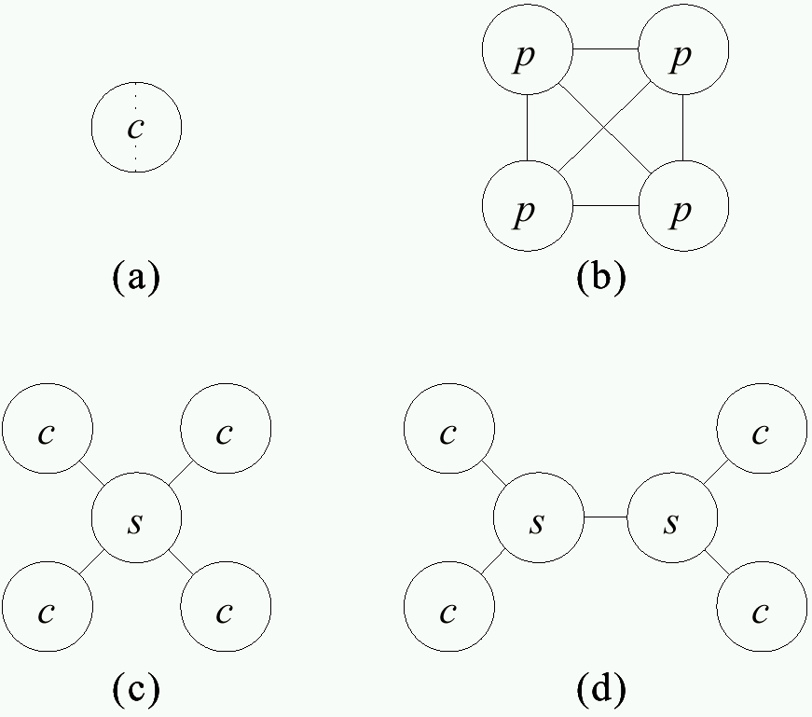
Communication Architectures
Split-screen
- Limited players
All peers equal
Easy to extend
Doesn’t scale (LAN only)
Central server
Clients only to server
Server may be bottleneck
Server pool
-Improved scalability
-More complex
Notes:
[SKH02] J. Smed, T. Kaukoranta and H. Hakonen. Aspects of Networking in Multiplayer Computer Games, The Electronic Library, Volume 20, Number 2, Pages 87-97, 2002

Slide 4
Data and Control Architectures
Want consistency
  Same state on each node
  Needs tightly coupled, low latency, small nodes
Want responsiveness
  More computation locally to reduce network
  Loosely coupled (asynchronous)
In general, cannot do both → Tradeoffs

Slide 5
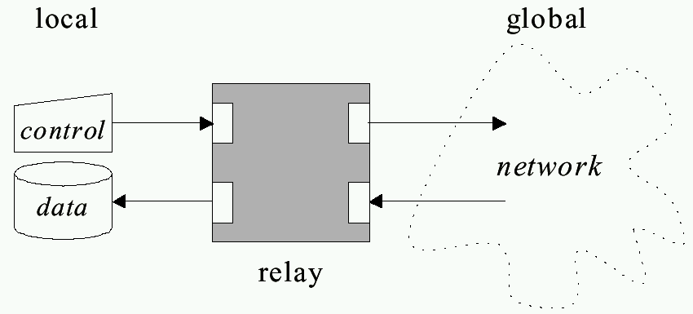
“Relay” Architecture Abstraction
Want control to propagate quickly so can update data (responsiveness)
Want to reflect same data on all nodes (consistency)
Notes:
[SKH02] J. Smed, T. Kaukoranta and H. Hakonen. Aspects of Networking in Multiplayer Computer Games, The Electronic Library, Volume 20, Number 2, Pages 87-97, 2002

Slide 6
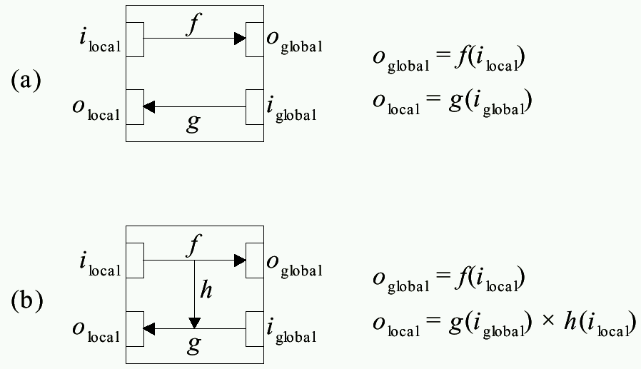
Relay Architecture Choices
(Example: Dumb terminal,
send and wait for response)
(Example: Smart terminal,
send and echo)
Notes:
[SKH02] J. Smed, T. Kaukoranta and H. Hakonen. Aspects of Networking in Multiplayer Computer Games, The Electronic Library, Volume 20, Number 2, Pages 87-97, 2002

Slide 7
Network Game Architectures
Centralized
  Use only two-way relay (no short-circuit)
  One node holds data so view is consistent at all times
  Lacks responsiveness
Distributed and Replicated
  Allow short-circuit relay, provides responsiveness
  What about consistency? → Make design decisions
    Replicated has copies, used when predictable (e.g., behavior of non-player characters)
    Distributed has local node only, used when unpredictable (e.g., behavior of players)

Slide 8
Outline
Network Games
  Architectures (done)
  Compensation techniques (next)
  Cheating
  Cloud games
Peer-to-Peer Systems
  Overview
  P2P file sharing

Slide 9

Interest Management – Auras
Nodes express area of interest to them
  Do not get messages for outside areas
- Only world information in circle/sent sent even if
world is larger
- Side benefit → can prevent cheating (later)
Notes:
[SKH02] J. Smed, T. Kaukoranta and H. Hakonen. Aspects of Networking in Multiplayer Computer Games, The Electronic Library, Volume 20, Number 2, Pages 87-97, 2002

Slide 10
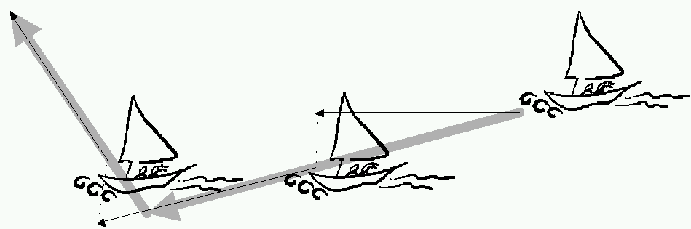
Dead Reckoning
Based on ocean navigation techniques (“dead” == “deduced (ded.)”)
Predict position based on last known position plus direction
  Only send updates when deviates past threshold
(predicted position)
(“warp”)
(actual position)
When prediction differs and adjust, get “warping” or “rubber-banding” effect
  Some techniques move smoothly to place over short time
Notes:
[Ber01] Y. Bernier. Latency Compensating Methods in Client/Server In-game Protocol Design and Optimization, In Proceedings of the Game Developers Conference, Feb. 2001.
[SKH02] J. Smed, T. Kaukoranta and H. Hakonen. Aspects of Networking in Multiplayer Computer Games, The Electronic Library, Volume 20, Number 2, Pages 87-97, 2002

Slide 11
Time Delay
Server delays processing of events
  Wait until all messages from clients arrive
  (Note, game plays at highest round-trip time)
Server sends messages to more distant client first, delays messages to closer
  Needs accurate estimate of round-trip time
Client 1
command arrives
Client 2
command arrives
Server processes
both client commands
Time
Time Delay
Notes:
[Ber01] Y. Bernier. Latency Compensating Methods in Client/Server In-game Protocol Design and Optimization, In Proceedings of the Game Developers Conference, Feb. 2001.

Slide 12
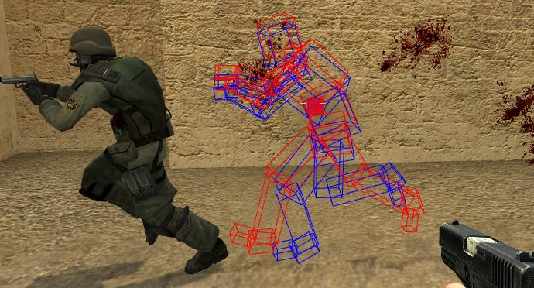
Time Warp
With network latency, must lead opponent to hit (even with “instant” weapon!)
Instead, knowing latency roll-back (warp) to when action took place
  Usually, estimate latency as ½ round-trip time
Client 100 ms behind
Still hits (note blood)
(Boxes are bounding boxes)
https://developer.valvesoftware.com/wiki/Source_Multiplayer_Networking
Notes:
[Ber01] Y. Bernier. Latency Compensating Methods in Client/Server In-game Protocol Design and Optimization, In Proceedings of the Game Developers Conference, Feb. 2001.

Slide 13
Time Warp Notes
Inconsistency
  Player target
  Move around corner
  Warp back → hit
  Bullets seem to “bend” around corner!
    → “Magic” bullets
Fortunately, player often does not notice
  Doesn’t see opponent
  May be just wounded
Notes:
[Ber01] Y. Bernier. Latency Compensating Methods in Client/Server In-game Protocol Design and Optimization, In Proceedings of the Game Developers Conference, Feb. 2001.

Slide 14
Outline
Network Games
  Architectures (done)
  Compensation techniques (done)
  Cheating (next)
  Cloud games
Peer-to-Peer Systems
  Overview
  P2P file sharing

Slide 15
Cheating
Unique to games
  Other multi-person applications don’t have
  e.g, Distributed Interactive Simulation (DIS), not public, “employees” so considered trustworthy
Cheaters want:
  Vandalism – create havoc (relatively few).
    Mostly, game design to prevent (e.g., no friendly fire)
  Dominance – gain advantage (more)
    Next slides

Slide 16
Packet and Traffic Tampering
Packet interception – prevent some packets from reaching cheater
  e.g., suppress damage packets, so cheater is invulnerable
Packet replay – repeat event over for added advantage
  e.g., multiple bullets or rockets if otherwise limited
Solutions:
  MD5 Checksum or Encrypt packets
  Authoritative host keeps within bounds
Notes:
[SKH02] J. Smed, T. Kaukoranta and H. Hakonen. Aspects of Networking in Multiplayer Computer Games, The Electronic Library, Volume 20, Number 2, Pages 87-97, 2002

Slide 17
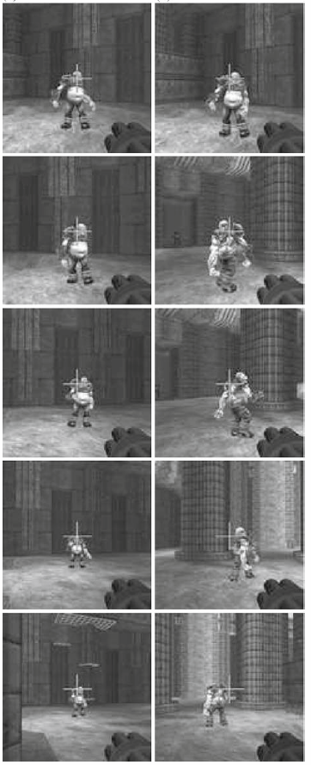

Packet Tampering
Reflex augmentation - enhance cheater’s reactions
  e.g., aiming proxy monitors opponents movement packets, when cheater fires, improve aim
Tough to detect
  e.g., PunkBuster – scan for “known” hacks
  False positives?
S. Yeung and J. Lui. “Dynamic Bayesian approach for detecting cheats in multi-player online games”, Springer Multimedia Systems, Vol. 14, No. 4 Sep. 2008.
aimbot
human
Notes:
[SKH02] J. Smed, T. Kaukoranta and H. Hakonen. Aspects of Networking in Multiplayer Computer Games, The Electronic Library, Volume 20, Number 2, Pages 87-97, 2002

Slide 18
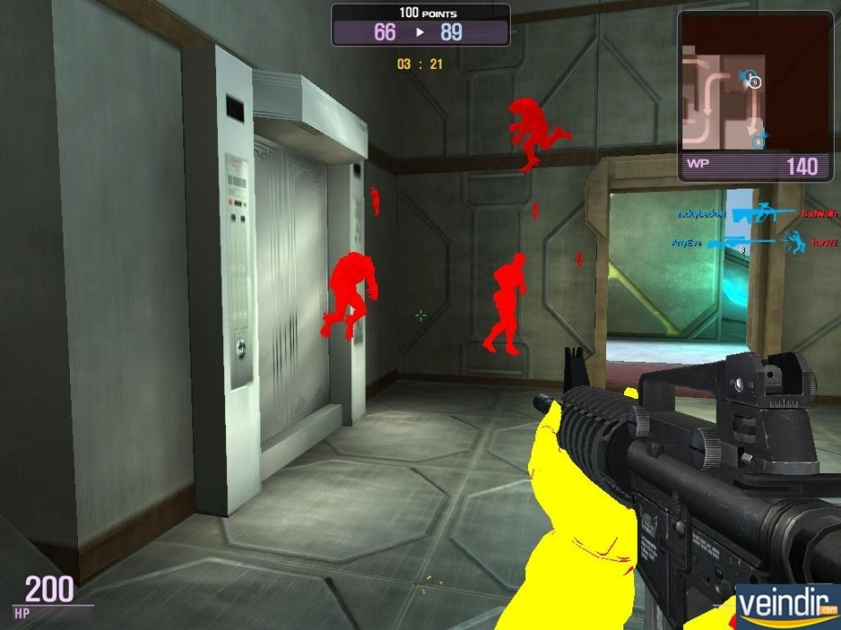
Information Exposure
Allows cheater to gain access to replicated, hidden game data (e.g. status of other players)
  Passive, since does not alter traffic
  e.g., ignore “fog of war” in RTS, or “wall hack” to see through walls in FPS
Cannot be defeated by network alone
Instead:
  Sensitive data should be encoded
  Kept in hard-to-detect memory location
  Centralized server may detect cheating (e.g., attack enemy could not have seen)
Notes:
[SKH02] J. Smed, T. Kaukoranta and H. Hakonen. Aspects of Networking in Multiplayer Computer Games, The Electronic Library, Volume 20, Number 2, Pages 87-97, 2002

Slide 19
Outline
Network Games
  Architectures (done)
  Compensation techniques (done)
  Cheating (done)
  Cloud games (next)
Peer-to-Peer Systems
  Overview
  P2P file sharing

Slide 20





Cloud-based Games
Connectivity and capacity of networks growing
Opportunity for cloud-based games
  Game processing on servers in cloud
  Stream game video down to client
  Client displays video, sends player input up to server
Game frames
Server
Server
Player input
Server
Thin Client
Cloud Servers

Slide 21
Why Cloud-based Games?
Potential elastic scalability
  Overcome processing and storage limitations of clients
  Avoid potential upfront costs for servers, while supporting demand
Ease of deployment
  Client “thin”, so inexpensive ($100 for OnLive console vs. $400 for Playstation 4 console)
  Potentially less frequent client hardware upgrades
  Games for different platforms (e.g., Xbox and Playstation) on one device
Piracy prevention
  Since game code is stored in cloud, server controls content and content cannot be copied
  Unlike other solutions (e.g., DRM), still easy to distribute to players
Click-to-play
  Game can be run without installation

Slide 22
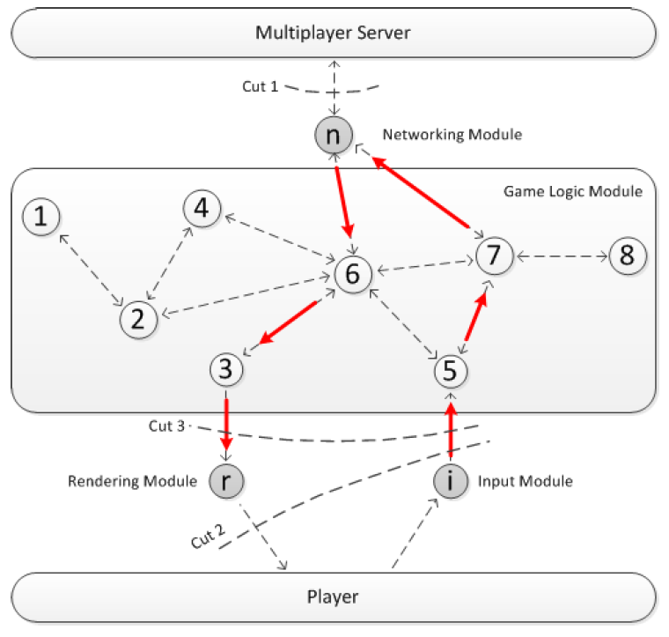
Cloud Game - Modules (1 of 2)
Input (i) – receives control messages from players
Game logic – manages game content
Networking (n) – exchanges data with server
Rendering (r) – renders game frames
How to put in cloud?
Notes:
W. Cai, M. Chen, and V. Leung. “Toward Gaming as a Service”, IEEE Internet Computing, May/June, 2014

Slide 23
Cloud Game - Modules (2 of 2)
“Cuts”
All game logic on player, cloud only relay information (traditional network game)
Player only gets input and displays frames (remote rendering)
Player gets input and renders frames (local rendering)
Notes:
W. Cai, M. Chen, and V. Leung. “Toward Gaming as a Service”, IEEE Internet Computing, May/June, 2014

Slide 24
Application Streams vs. Game Streams
Traditional thin client applications (e.g., x-term, remote login shell):
  Relatively casual interaction
    e.g., typing or mouse clicking
  Infrequent display updates
    e.g., character updates or scrolling text
Computer games:
  Intense interaction
    e.g., avatar movement and shooting
  Frequently changing displays
    e.g., 360 degree panning
Approximate traffic analysis
  70 kb/s traditional network game
  700 kb/s virtual world
  2000-7000 kb/s live video (HD)
  1000-7000 kb/s pre-recorded video
Cloud-based games?
  7000 kb/s (HD)
Challenge: Latency since player input requires round-trip to server before player sees effects

Slide 25
Outline
Network Games (done)
  Architectures (done)
  Compensation techniques (done)
  Cheating (done)
  Cloud games (done)
Peer-to-Peer Systems (next)
  Overview
  P2P file sharing

Slide 26
Definition of Peer-to-Peer (P2P)
Significant autonomy from central servers
Exploits resources at edges of Internet
  Storage and content
  Multicast routing
  CPU cycles
  Human knowledge (e.g., recommendations, classification)
Resources at edge may have intermittent connectivity

Slide 27
P2P Includes
P2P communication
  Instant messaging
  Voice-over-IP (e.g., Skype)
P2P multicast routing
  e.g., Mbone, Yoid, Scattercast
P2P computation
  e.g., seti@home, folding@home
P2P systems built on overlays
  e.g., PlanetLab
P2P file sharing
  e.g., Napster, gnutella, KaZaA, eDonkey, BitTorrent …

Slide 28
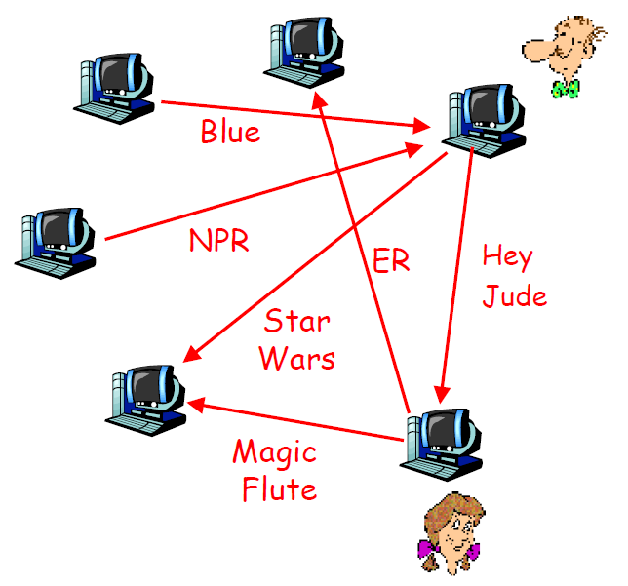
P2P File Sharing – General
Alice runs P2P client on her laptop
Registers her content in P2P system
Asks for “Hey Jude”
Application displays other peers with copy
Alice choses one, Bob
File is copied from Bob’s computer to Alice’s
  → P2P
While Alice downloads, others upload

Slide 29
P2P File Sharing Capabilities
Allows Alice to show directory in her file system
  Anyone can retrieve file from it
  Like Web server
Allows Alice to copy files from other’s
  Like Web client
Allows users to search nodes for content based on keyword matches
  Like search engine (e.g., Google)

Slide 30

Example: Searching
1000’s of nodes
Set of nodes may change
N₂
N₁
N₃
Key=“title”
Value=MP3 data…
Internet
?
Client
Publisher
Lookup(“title”)
N₄
N₆
N₅
Needles versus Haystacks
  Searching for top 40 pop song? Or obscure punk track ‘81 nobody’s heard of?
Search expressiveness
  Whole word? Regular expressions? File names? Attributes? Whole-text search?

Slide 31
P2P File Sharing Systems
 | Central | Flood | Super-node flood | Route
Whole File | Napster | Gnutella |  | Freenet
Chunk Based | BitTorrent (swarm) |  | KaZaA (bytes) | (DHTs) eDonkey2k New BT

Slide 32


Napster: Publish
Centralized
(napster.com)
insert (X, 123.2.21.23)
...
Publish
I have X, Y, and Z!
123.2.21.23

Slide 33
Napster: Search
123.2.0.18
Centralized
(napster.com)
search(A)
returns 123.2.0.18
returns 163.2.1.0
…
Fetch
Query
Reply
Where is file A?
Client “pings” each host, picks closest

Slide 34
Napster: Discussion
Pros
  Simple
  Search scope is O(1)
  Controllable (pro or con?)
Cons
  Single point of failure
  Server maintains O(N) state
  Server does all processing
  (Napster’s server farm had difficult time keeping up with traffic)

Slide 35
Query Flooding (e.g., Gnutella)
I have file A.
I have file A.
Reply
Query
Where is file A?

Slide 36
Flooding Discussion
Pros
  Fully de-centralized
  Search cost distributed
  Processing @ each node permits powerful search semantics
Cons
  Search scope is O(N)
  Search time is O(???) – depends upon “height” of tree
  Nodes leave often, network unstable
Hop-limited search works well for haystacks
  For scalability, does NOT search every node. May have to re-issue query later

Slide 37
Flooding with Supernodes (e.g., KaZaA)
Architecture
  Hierarchical
  Cross between Napster and Gnutella
Some nodes better connected, longer connected than others
  Use them more heavily
  Super Nodes
“Smart” query flooding
  Only flood through Super Nodes
  Only one Super Node replies
“Super Nodes”

Slide 38
Supernodes: Publish
insert(X,
123.2.21.23)
...
Publish
I have X!
123.2.21.23

Slide 39
Supernodes: Search
search(A)
-->
123.2.22.50
search(A)
-->
123.2.0.18
123.2.22.50
Query
Replies
Where is file A?
123.2.0.18

Slide 40
Supernode Flooding Discussion
Pros
  Take into account node heterogeneity
    Bandwidth
    Host computational resources
    Host aavailability
  May take into account network locality
  Scales better
Cons
  Still no real guarantees on search scope or search time
Similar behavior to plain flooding, but better

Slide 41
Fetching in Parallel and Swarming (e.g., BitTorrent)
When have file ID, get list of peers with ID
Download in parallel from multiple peers
“Swarming”
  Download from others downloading same object at same time (tit-for-tat)

Slide 42
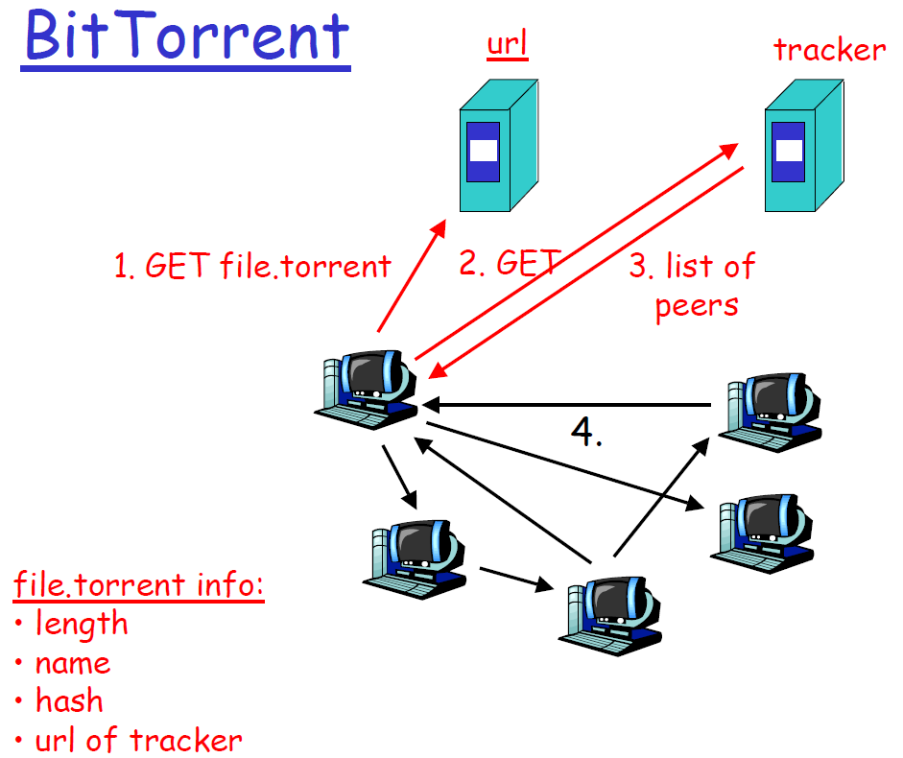
Fetching in Parallel and Swarming (e.g., BitTorrent)
tracks peers
participating in torrent
When have file ID, get list of peers with ID
Download in parallel from multiple peers
    Use “rarest first” algorithm to increase availability
“Swarming”
  Download from others downloading same object at same time

Slide 43
BitTorrent: Publish/Join
Tracker

Slide 44
BitTorrent: Fetch

Slide 45
BitTorrent: Summary
Pros
  Works reasonably well in practice
  Gives peers incentive to share resources; avoids freeloaders
Cons
  Central tracker server needed to bootstrap swarm
  Tracker is a design choice, not a requirement
    Newer variants use a “distributed tracker” - a Distributed Hash Table (DHT)

