Slide 1
Distributed Computing Systems
Network Games

Slide 2
References / Reading
[BT01] P. Bettner and M. Terrano. 1500 Archers on a 28.8: Network Programming in Age of Empires and Beyond,Gamasutra, March 22, 2001
[SKH02] J. Smed, T. Kaukoranta and H. Hakonen. Aspects of Networking in Multiplayer Computer Games, The Electronic Library, Volume 20, Number 2, Pages 87-97, 2002
[CFGS14] Mark Claypool, David Finkel, Alexander Grant and Michael Solano. On the Performance of OnLive Thin Client Games, Springer Multimedia Systems Journal (MMSJ) - Special Issue on Network Systems Support for Games, pages 1-14, February 2014.

Slide 3
Outline
Synchronization in AoE (next)
Aspects of Networking
Cloud Games

Slide 4
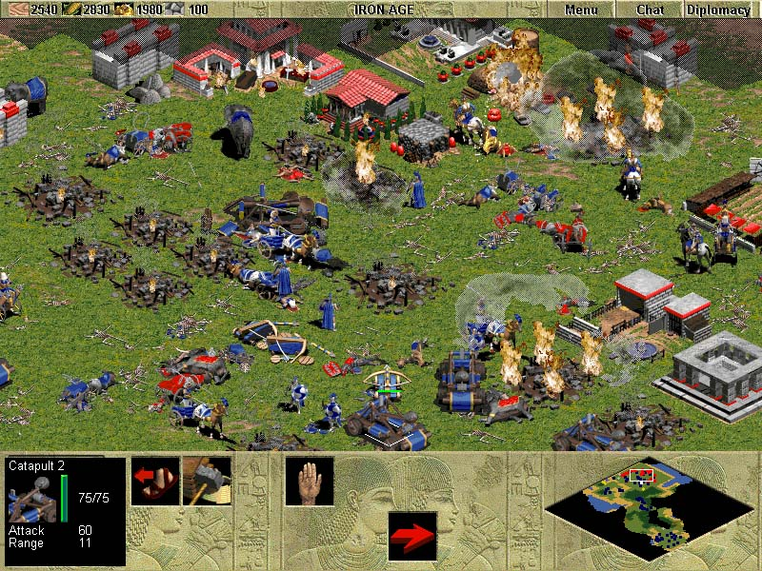
Age of Empires – Real Time Strategy
Build
Combat
Explore
Microsoft Studios, 1997

Slide 5
AoE: Multiplayer Design Goals
Wanted: army on army, large supporting structure, … (“1500 archers on a …”)
Support for 8 players
Smooth simulation over modem, Internet, LAN
Target platform: 16 MB P-90, 28.8 modem
15 frames per second (one frame every 67 ms)
Use (existing) Genie engine
  2d, sprites in 256 colors
  Reasonably stable

Slide 6
AoE in Early Stages
Engine performance breakdown:
  30% graphic rendering
  30% AI
  30% simulation
Time to complete each simulation step varied:
  Render time changes with number of units
  When scrolling
  AI computation time varied with units or time
  As much as 200 ms (larger than a frame time!)
Bandwidth a critical resource:
  Passing (x,y) coordinates, status, action, facing damage … limit of 250 moving units at most

Slide 7
Simultaneous Simulations
Each PC ran exact same simulation
  Synchronized game time
  Synchronized random number generators
Still
  Internet latency from 20 to 1000 milliseconds
  Variable time to process each step
Needed more responsive approach

Slide 8
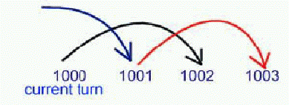
Communication Turns
Separate communications turns from frame rendering
Schedule commands for later time
  Allows for some variance in network and turn processing
Turns typically 200 ms in length
  Send all commands entered that turn, but schedule them for 2 turns later
  Process any scheduled turns

Slide 9
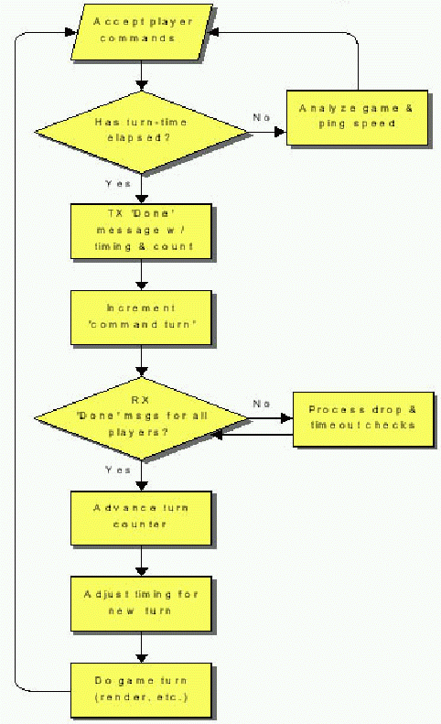
The Need for Speed Control
Since all machines in “lock step”, can only run as fast as slowest machine
  Process communications, render turn, send out new commands
“Lag” if
  One machine slows down and others wait
  Delayed or lost Internet data

Slide 10
Speed Control
Each client calculates frame rate
  Since varies with game state, use moving average
  Send with “Turn Done” message
  Use to achieve “minimum” frame rate
Each client measures round-trip “ping” time
  Since varies with Internet traffic, use largest for all players
After getting “Turn Done” messages
  Adjust target frame rate (based on local PC render rate)
  Adjust communication turn (based on ping-times + remote PC render rates)
  Weighted, so only “laggy” during worst spikes
(Examples next)

Slide 11
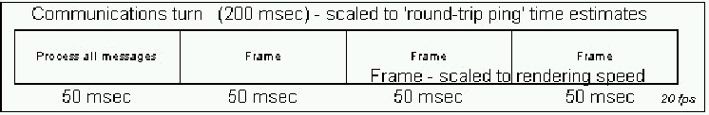
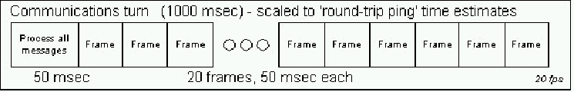
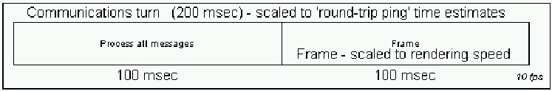
Speed Control
1) Typical communication turn
2) High latency, normal machine
3) High latency, slow machine

Slide 12
Transport Protocol - UDP
Unreliable, so each client handles command ordering, drop detection and re-sending
  “When in doubt, assume it dropped”
Messages arriving from past turns are discarded
If out of order message received, request a resend of supposedly “missing” messages
  Note, if really out of order, will get duplicate so must account for
If ack is “late”, then assume lost so resend

Slide 13
Side Benefit – Cheat Prevention
Simultaneous simulations means games are identical
If there is a discrepancy, game stopped
Prevents cheaters from using hacked client
But there still could be cheating via information exposure

Slide 14
Side Problems – Out of Synch
“In every project, there is one stubborn bug that goes all the way to the wire…”
– Microsoft product manager
Subtle, since small errors multiply
  Example – a deer slightly out of alignment, causes villager to “miss” so no meat, causing different food amounts
Checksums (objects, pathing, targeting …), but always something
  Wade through 50 MB of message traces

Slide 15
Outline
Synchronization in AoE (done)
Aspects of Networking (next)
Cloud Games

Slide 16
Network Latency
Delay when message sent until received
  Variation in delay (delay jitter) also matters
Cannot be totally eliminated
  e.g., speed of light propagation yields 25-30 ms across Atlantic
  And with routing and queuing, usually 80+ ms
Application tolerances:
  File download – minutes
  Web page download – up to 10 seconds
  Interactive audio – 100s of ms
MCG latencies tolerance? → Depends upon game!
  First-Person Shooters – about 100 ms
  Third-Person Adventure – up to 500 ms
  Real-Time Strategy – up to 1 second
  And depends upon action within game! (topic for another paper)

Slide 17
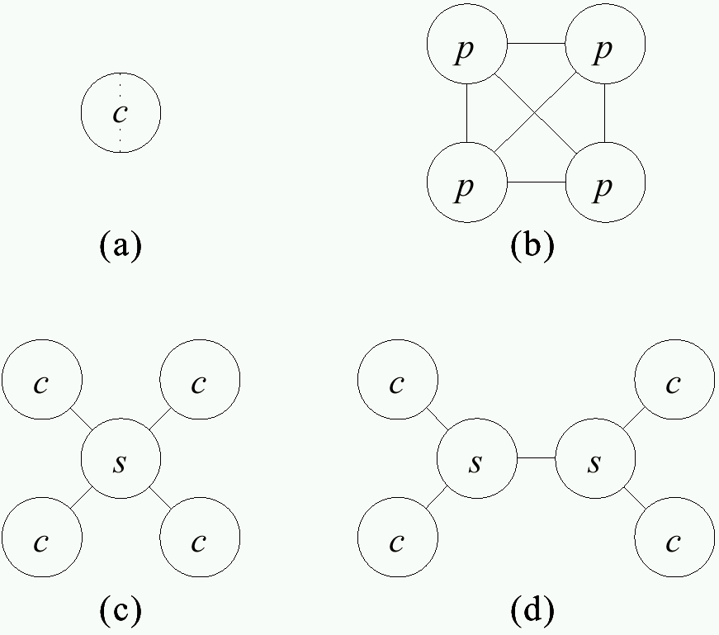
Communication Architectures
Split-screen
- Limited players
All peers equal
Easy to extend
Doesn’t scale (LAN only)
Central server
Clients only to server
Server may be bottleneck
Server pool
-Improved scalability
-More complex

Slide 18
Data and Control Architectures
Want consistency
  Same state on each node
  Needs tightly coupled, low latency, small nodes
Want responsiveness
  More computation locally to reduce network
  Loosely coupled (asynchronous)
In general, cannot do both → Tradeoffs

Slide 19
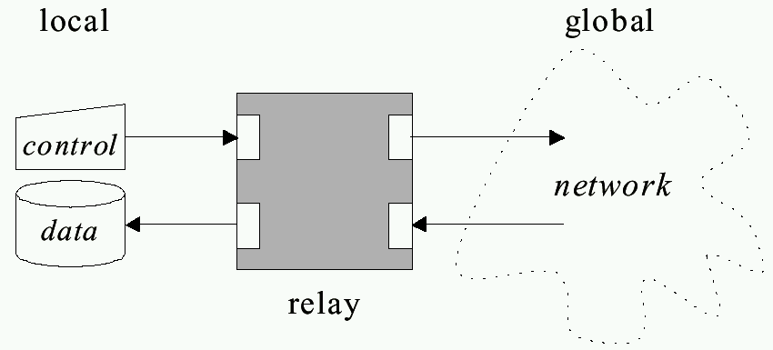
“Relay” Architecture Abstraction
Want control to propagate quickly so can update data (responsiveness)
Want to reflect same data on all nodes (consistency)

Slide 20
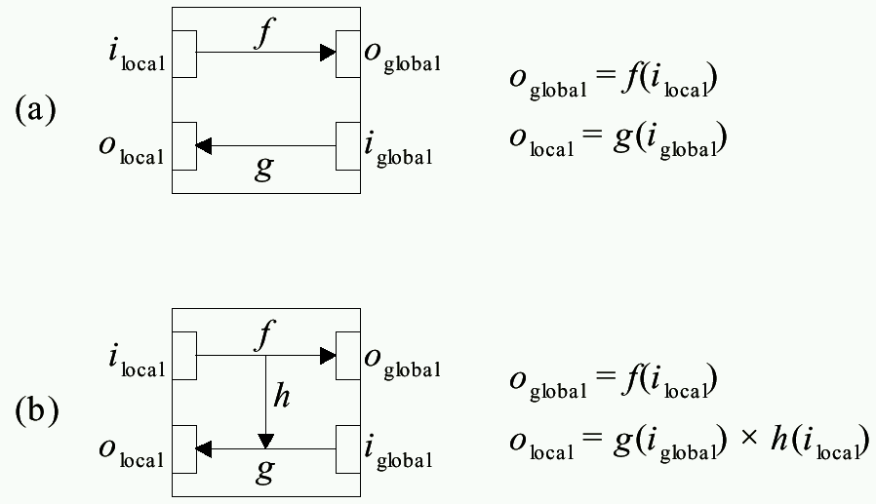
Relay Architecture Choices
(Example: Dumb terminal,
send and wait for response)
(Example: Smart terminal,
send and echo)

Slide 21
MCG Architectures
Centralized
  Use only two-way relay (no short-circuit)
  One node holds data so view is consistent at all times
  Lacks responsiveness
Distributed and Replicated
  Allow short-circuit relay
  Replicated has copies, used when predictable (e.g., behavior of non-player characters)
  Distributed has local node only, used when unpredictable (e.g., behavior of players)

Slide 22
Compensatory Techniques
Architectures alone not enough
Design to compensate for residual
Techniques:
  Message aggregation
  Interest management
  Dead reckoning
(next)

Slide 23
Message Aggregation
Combine multiple messages in one packet to reduce network overhead
Examples:
  Multiple user commands to server (move and shoot)
  Multiple users command to clients (player A’s and player B’s actions combined to player C)

Slide 24

Interest Management – Auras (1 of 2)
Nodes express area of interest to them
  Do not get messages for outside areas
- Only circle sent even if
world is larger
- But implementation
complex (squares easier)

Slide 25
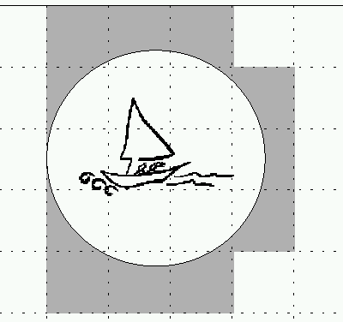

Interest Management- Auras (2 of 2)
- Divide into cells (or hexes)
- Easier, but less discriminating
Compute bounding box
Relatively easy, precise
Always symmetric – both receive
  But can sub-divide – focus and nimbus

Slide 26
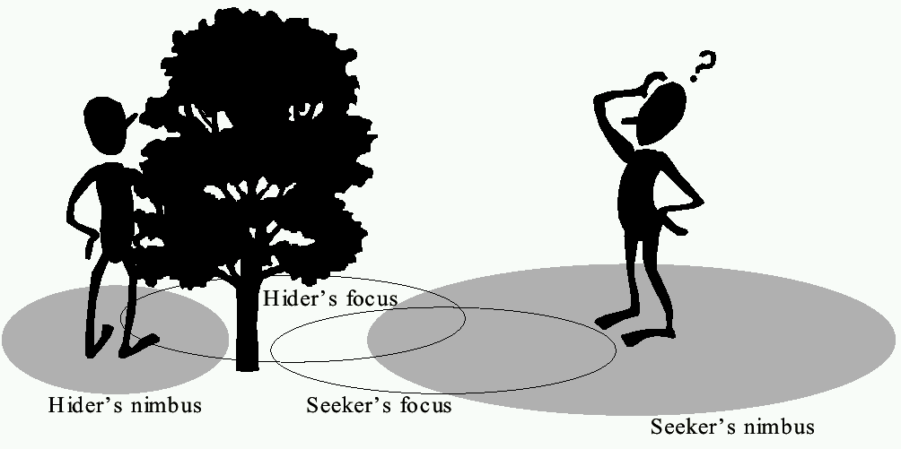
Interest Management- Focus and Nimbus
Nimbus must intersect with focus to receive
Example above: hider has smaller nimbus, so seeker
cannot see, while hider can see seeker since
seeker’s nimbus intersects hider’s focus

Slide 27
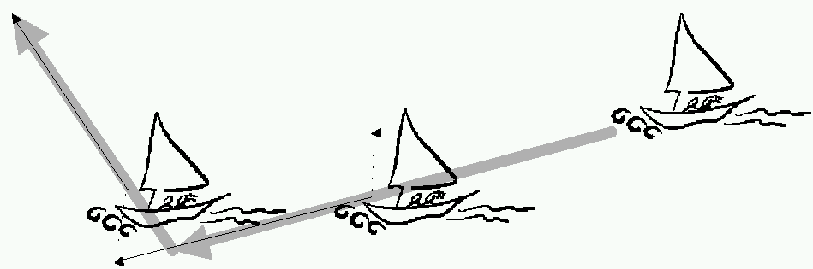
Dead Reckoning
Based on ocean navigation techniques (“dead” == “deduced (ded.)”)
Predict position based on last known position plus direction
  Only send updates when deviates past threshold
(predicted position)
(“warp”)
(actual position)
When prediction differs and adjust, get “warping” or “rubber-banding” effect
  Some techniques move to place over short time

Slide 28

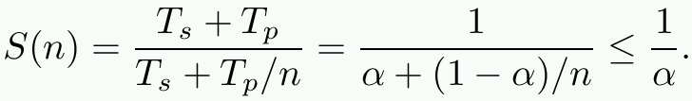
Serial and Parallel Execution
Given time T(1), speedup with n nodes
Part of T(1) must happen serially and part can be done in parallel
  T_{s} + T_{p}= T(1) and α = T_{s}/(T_{s} + T_{p})
If serialized optimally:
(Amdahls’ law)
If T_{s} = 0, everything parallelizable but then no communication
(ex: players at own console with no interaction)
If T_{p} = 0, then turn based
Between are MCGs which have some of both

Slide 29
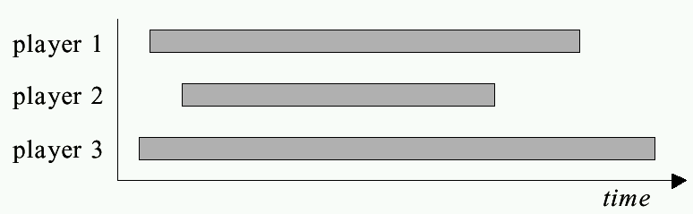
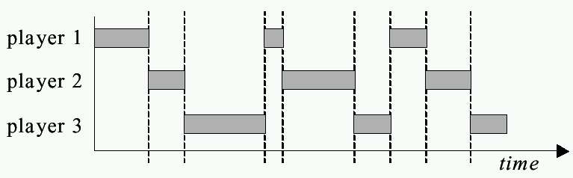
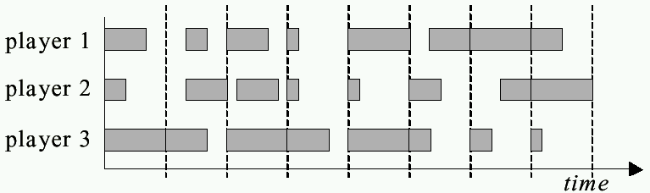
Serial and Parallel MCGs
Separate games
Turn-based
games
Interactive
games

Slide 30
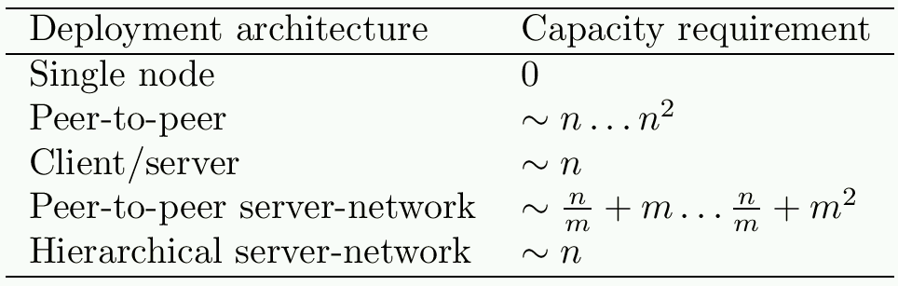
Communication Capacity
Scalability limited by communication requirements of chosen architecture
(Multicasting)
Can consider pool of m servers with n clients
divided evenly amongst them
Servers in hierarchy have root as bottleneck
In order not to increase with n, must have clients
not aware of other clients (interest management) and
do message aggregation

Slide 31
Cheating
Unique to games
  Other multi-person applications don’t have
  In DIS, military not public and considered trustworthy
Cheaters want:
  Vandalism – create havoc (relatively few).
    Mostly, game design to prevent (e.g., no friendly fire)
  Dominance – gain advantage (more)
    Next slides

Slide 32
Packet and Traffic Tampering
Packet interception – prevent some packets from reaching cheater
  e.g., suppress damage packets, so cheater is invulnerable
Packet replay – repeat event over for added advantage
  e.g., multiple bullets or rockets if otherwise limited
Solutions:
  MD5 Checksum or Encrypt packets
  Authoritative host keeps within bounds

Slide 33
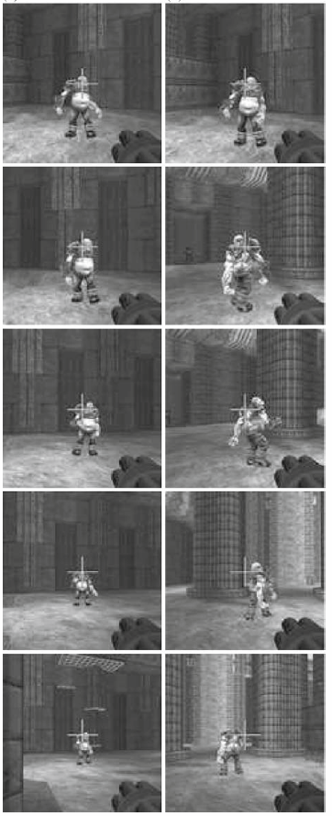
Packet Tampering
Reflex augmentation - enhance cheater’s reactions
  e.g., aiming proxy monitors opponents movement packets, when cheater fires, improve aim
Tough to detect
  E.g., PunkBuster – scan for “known” hacks
  False positives?
S. Yeung and J. Lui. “Dynamic Bayesian approach for detecting cheats in multi-player online games”, Springer Multimedia Systems, Vol. 14, No. 4 Sep. 2008.
aimbot
human

Slide 34
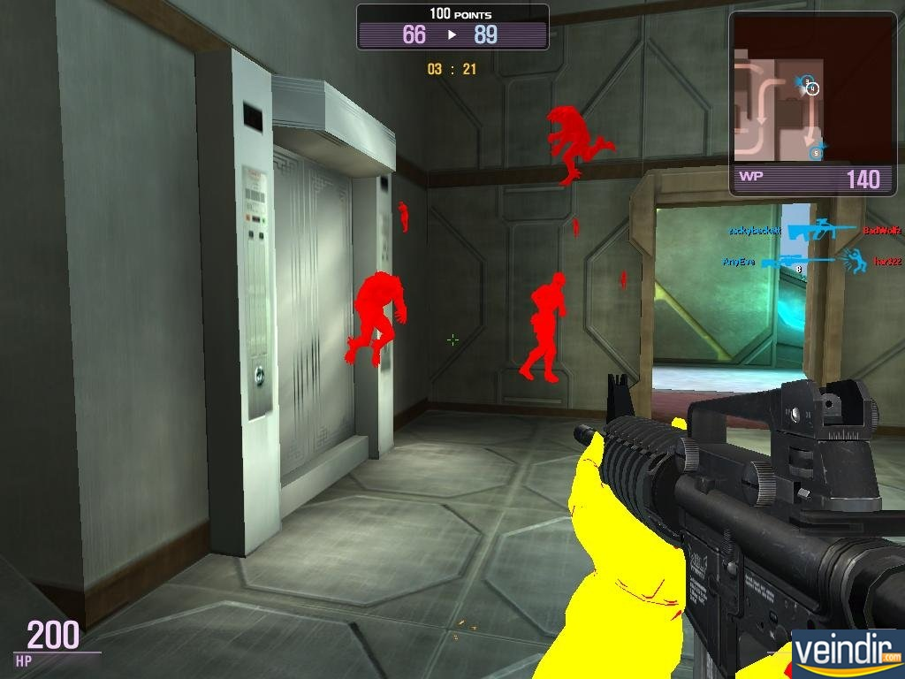
Information Exposure
Allows cheater to gain access to replicated, hidden game data (e.g. status of other players)
  Passive, since does not alter traffic
  e.g., ignore “fog of war” in RTS, or “wall hack” to see through walls in FPS
Cannot be defeated by network alone
Instead:
  Sensitive data should be encoded
  Kept in hard-to-detect memory location
  Centralized server may detect cheating (e.g., attack enemy could not have seen)

Slide 35
Outline
Synchronization in AoE (done)
Aspects of Networking (done)
Cloud Games (next)

Slide 36
Why Games as a Service?
Potential scalability
  Overcome processing and storage limitations
Cross-platform support
  Can run games built for different platforms (e.g., Xbox and Playstation) on one device
Piracy prevention
  Since game code is stored in cloud, cannot be copied
Click-to-play
  Game can be run without installation

Slide 37
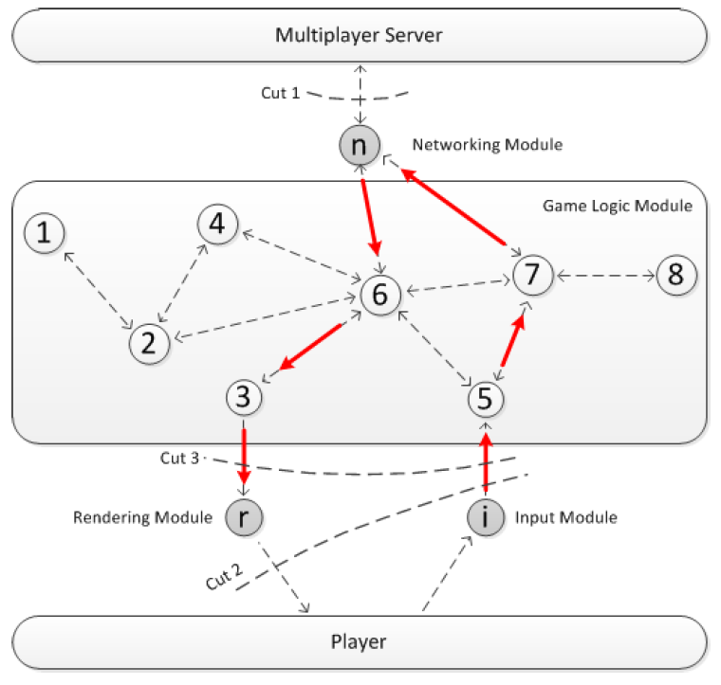
Cloud Game Modules (1 of 2)
Input – receives control messages from players
Game logic – manages game content
Networking – exchanges data with server
Rendering – renders game frames
How do put in cloud?

Slide 38
Cloud Game Modules (2 of 2)
Cuts
  All game logic on player, cloud only relay information (traditional network game)
  Player only gets input and displays frames (remote rendering)
  Player gets input and renders frames (local rendering)

Slide 39
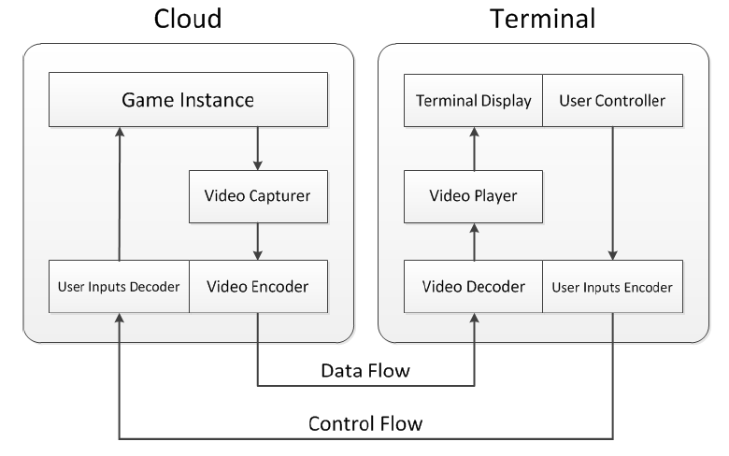
Remote Rendering
Cloud runs full, traditional game
Captures video (“scrape” screen) and encode
Client only needs capability to decode and play
  Relatively minor requirements
Bitrate requirements can be an issue
e.g.,
  Onlive (commercial)
  Gaming Anywhere (research)
  Cloud Saucer Shoot (teaching)

Slide 40
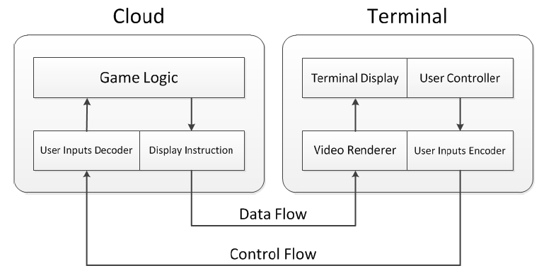
Local Rendering
Instead of video frames, send display instructions
  Potentially great bitrate savings
Challenge for instruction set: able to represent all images for all games
e.g., Browser-based games (via HTML5 and/or Javascript), [De Winter et al., NOSSDAV ‘06]

Slide 41
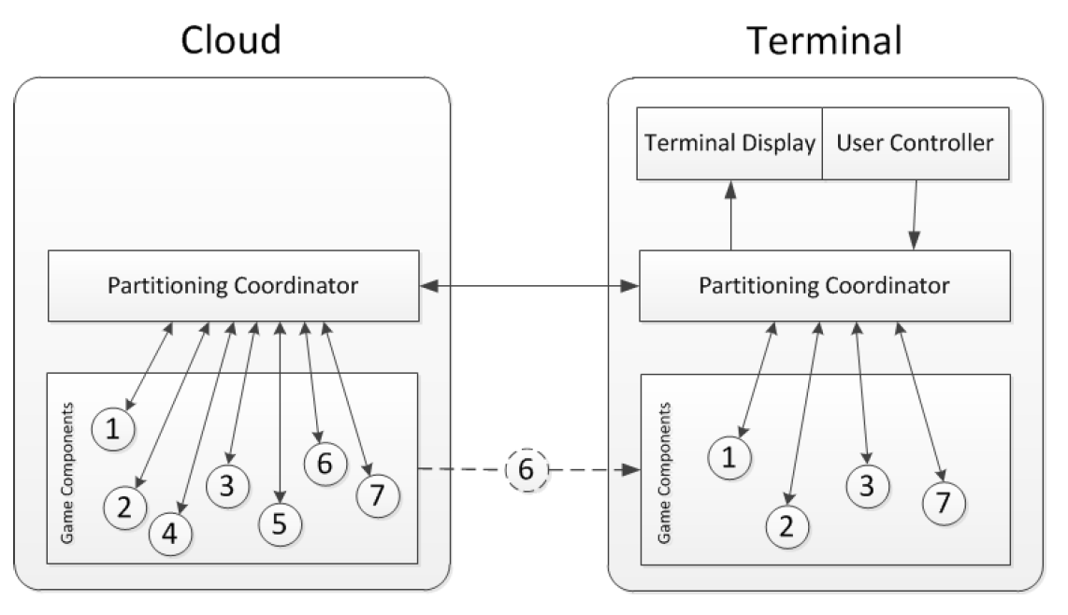
Potential Distribution of Computing
Partitioning coordinator if/when to migrate functionality (e.g., reduce cloud load and/or when terminal has greater capabilities)
  Remote and Local rendering cases (above) are really just special cases
Challenge: how to do so in general, how to synchronize if both cloud + terminal have module (e.g., “6”)
e.g., [Cai et al., CloudCom 2013]

Slide 42
Application Streams vs. Game Streams
Traditional thin client applications (e.g., x-term, remote login shell):
  Relatively casual interaction
    e.g., typing or mouse clicking
  Infrequent display updates
    e.g., character updates or scrolling text
Computer games:
  Intense interaction
    e.g., avatar movement and shooting
  Frequently changing displays
    e.g., 360 degree panning

Slide 43
Motion and Scene Complexity - Summary

Slide 44
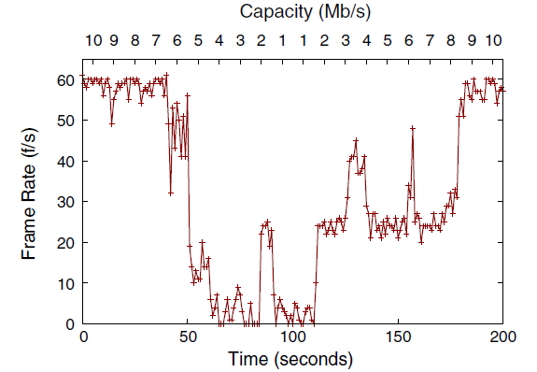
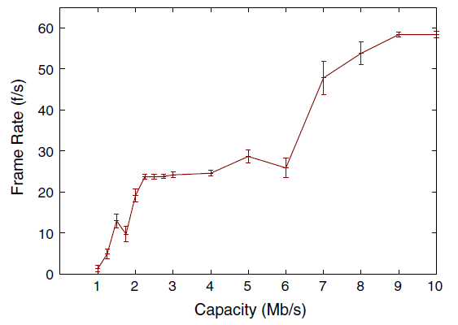
Downstream Bitrate
Capacity restriction
Capacity affects frame rate
(OnLive recommends 5 Mb/s, but accepts 2 Mb/s)

Slide 45
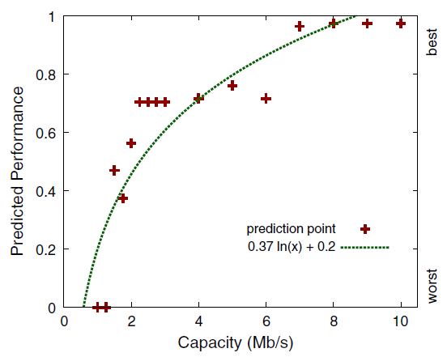
Predicted Player Performance
(Model based on FPS data with restricted frame rates)
Capacity affects performance

Slide 46
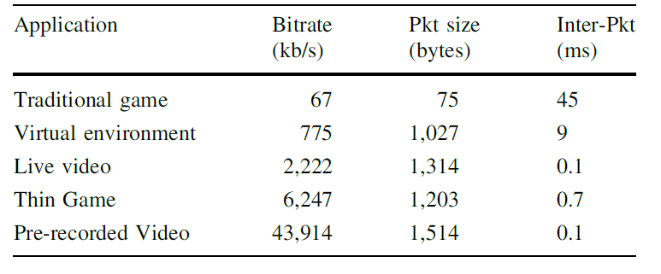
Network Turbulence Summary

Slide 47
Cloud-Game Summary
Games as service new model for cloud computing
  Choices on distribution of rendering and computation
Cloud games are like video, but different
  Wider range of motion and scene complexity
OnLive
  Like video conference down, traditional games up
  Bitrate responds to capacity, but not loss or latency
    Not TCP-Friendly
  Best for players above 5 Mb/s, with 2 Mb/s minimum
    Lower capacities affect player performance

