Slide 1
Distributed Computing Systems
Peer-to-Peer
Notes:
David Anderson, CS 15-441: Computer Networks (Spring 2005)
K.W. Ross and D. Rubenstein, Tutorial on P2P Systems, presented at Infocom 04, Hong Kong, 2004

Slide 2
Definition of Peer-to-Peer (P2P)
Significant autonomy from central servers
Exploits resources at edges of Internet
  Storage and content
  Multicast routing
  CPU cycles
  Human knowledge (e.g., recommendations, classification)
Resources at edge may have intermittent connectivity

Slide 3
P2P Includes
P2P file sharing
  Napster, gnutella, KaZaA, eDonkey …
P2P communication
  Instant messaging
  Voice-over-IP (e.g. Skype)
P2P multicast routing
  Mbone, Yoid, Scattercast
P2P computation
  seti@home
P2P apps built on overlays
  PlanetLab

Slide 4
Introduction Outline
Definition (done)
Overlay Networks (next)
P2P Applications

Slide 5
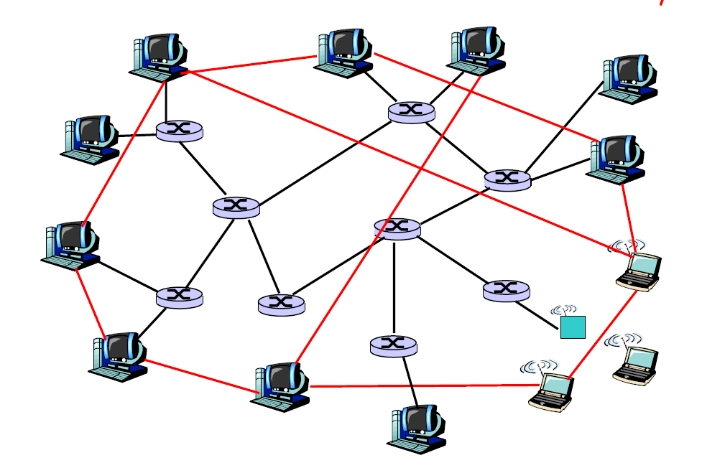
Overlay Networks
Network on top of another network
Overlay
edge

Slide 6
Overlay Network – Overview
Virtual edges
  e.g., a TCP connection
  Simpler: an IP address (connection method not specified)
Creation
  May be structured (e.g., tree) or unstructured (nodes randomly choose neighbors)
  May or may not take into account proximity of nodes
Overlay maintenance
  Periodically “ping” to make sure neighbor alive
  Or, verify liveness while sending messages
  If neighbor goes down, may establish new edge
  New node needs to “bootstrap” in

Slide 7
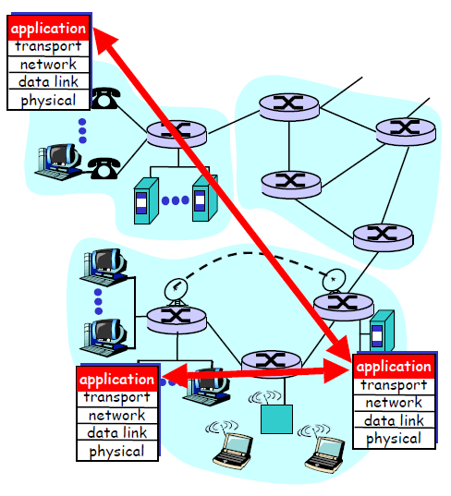
Overlay Networks – at Application Layer
Tremendous design flexibility
  Topology, maintenance
  Message types
  Protocol
  Underlying protocol (TCP/UDP)
Underlying network transparent
  But some may exploit proximity (e.g., peers in same ISP)

Slide 8
Examples of Overlays
Domain Name Service (DNS)
Border Gateway Protocol (BGP) routers (with their peering relationships)
Content Distribution Networks (CDNs)
Application-level multicast (e.g., Mbone)
And P2P applications!

Slide 9
Introduction Outline
Definition (done)
Overlay Networks (done)
P2P Applications (next)

Slide 10
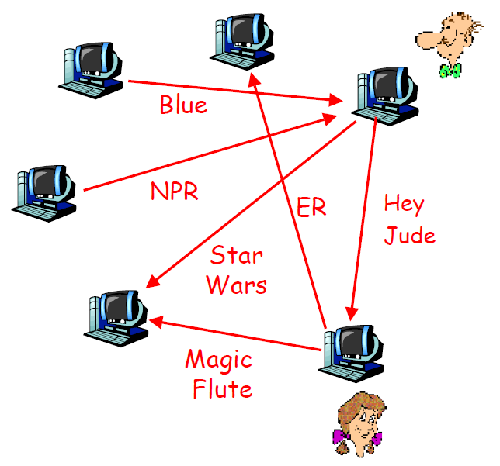
P2P File Sharing – General
Alice runs P2P client on her laptop
Intermittently connected
  Gets new IP address each time
Registers her content in P2P system
Asks for “Hey Jude”
Application displays other peers with copy
Alice choses one, Bob
File is copied from Bob’s computer to Alice’s
  → P2P
While Alice downloads, others upload

Slide 11

P2P File Sharing Capabilities
Allows Alice to show directory in her file system
  Anyone can retrieve file from it
  Like Web server
Allows Alice to copy files from other’s
  Like Web client
Allows users to search nodes for content based on keyword matches
  Like search engine (e.g., Google)

Slide 12
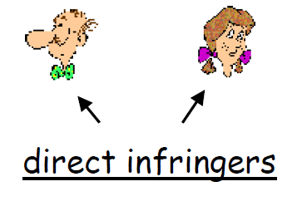
Copyright Issues (1 of 2)
Direct Infringement
Indirect infringement
End users who download or upload copyright works
An individual accountable for actions of others
Contributory
  Knew of direct infringement
  And caused, induced or materially contributed to direct infringement
Vicarious
  Able to control direct infringers (e.g. terminate accounts)
  And derived direct financial benefit
(Knowledge not necessary)

Slide 13
Copyright Issues (2 of 2)
Betamax VCR Defense
Guidelines for P2P developers
Manufacturer not liable for contributory infringement
“Capable of substantial, non-infringing use”
But in Napster case, court found defense does not apply to all vicarious liability
Total control so that can be sure there is no direct infringement
Or
No control – no remote kill switch, no customer support
Actively promote non-infringing use of products
Disaggregate functions
  Indexing, search transfer

Slide 14
Large P2P File Sharing Systems
Napster
  Disruptive, proof of concept
Gnutella
  Open source, non-centralized search
KaZaA/FastTrack
  Supernodes
  Surpassed the Web (in terms of bytes)
eDonkey/Overnet
  Distributed Hash Table (distributed content)
Is success due to massive number of servers (i.e., P2P aspect) or simply because content is “free”?

Slide 15

P2P Communication
Alice runs IM client on PC
Intermittently connects to Internet
  Gets new IP address each time
Registers herself with “system”
Learns from “system” that Bob (in her buddy list) is active
Alice initiates direct TCP connection with Bob
  P2P
Alice and Bob chat
Can also be voice, video and text (e.g., Skype)

Slide 16
P2P Distributed Computing: seti@home
Search for extra terrestrial (ET) intelligence
Central site collects radio telescope data
Data divided into work chunks (300 Kbytes)
User obtains client
  Runs in background (when screensaver on)
Peer sets up TCP connection to central computer
Downloads chunk
Peer does FFT on chunk, uploads results, gets new chunk
Not Peer-to-peer, but exploits resource at network edge

Slide 17
Outline
Introduction (done)
P2P file sharing techniques (next)
Uses of P2P
Challenges

Slide 18
P2P Common Primitives
Join: how to I begin participating?
Publish: how do I advertise my file?
Search: how to I find a file?
Fetch: how to I retrieve a file?
Top 2, relatively easy
Bottom 2, more of challenge

Slide 19
P2P Challenges
Challenge 1 – Search
  Human’s goals → find file
  Given keywords or human description, find a specific file
Challenge 2 – Fetch
  One file determined → get bits
  Computer goal, obtain content

Slide 20

Example: Searching
1000’s of nodes
Set of nodes may change
N₂
N₁
N₃
Key=“title”
Value=MP3 data…
Internet
?
Client
Publisher
Lookup(“title”)
N₄
N₆
N₅
Needles versus Haystacks
  Searching for top 40 pop song? Or obscure punk track ‘81 nobody’s heard of?
Search expressiveness
  Whole word? Regular expressions? File names? Attributes? Whole-text search?

Slide 21
What’s out there?
 | Central | Flood | Super-node flood | Route
Whole File | Napster | Gnutella |  | Freenet
Chunk Based | BitTorrent |  | KaZaA (bytes, not chunks) | (DHTs) eDonkey2k New BT

Slide 22
Next Topic...
Centralized Database
  Napster
Query Flooding
  Gnutella
Intelligent Query Flooding
  KaZaA
Swarming
  BitTorrent
Structured Overlay Routing
  Distributed Hash Tables

Slide 23
Napster Legacy
Paradigm shift
Not the first (probably Eternity, from Ross Anderson in Cambridge)
  http://www.cl.cam.ac.uk/~rja14/eternity/eternity.html
But instructive for what it got right
And wrong…
Also had an economic message…
And legal…

Slide 24
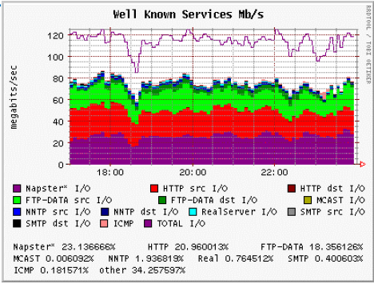
Napster: History
May ‘99: Shawn Fanning (freshman at Northeastern) founds Napster
Dec ‘99: first lawsuit
Mar ‘00: 25% UWisc traffic Napster
Apr ‘01: US Circuit Court of Appeals: “Napster knew users violating copyright laws”
Jul ‘01: # simultaneous online users
  Napster: 160K, Gnutella: 40K, Morpheus (KaZaA): 300K

Slide 25
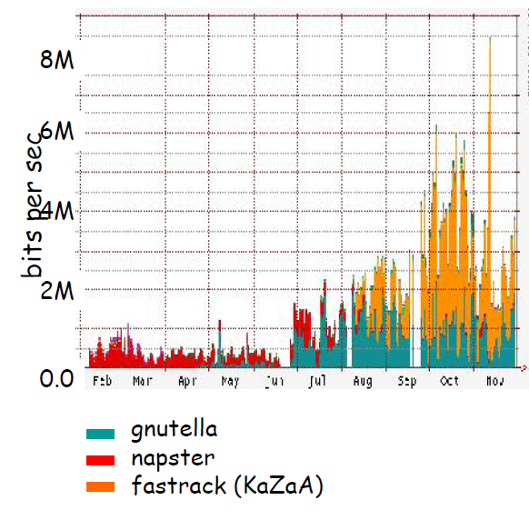
Napster: History
Jul ’01: Napster shuts down
  Judge orders Napster to pull plug…
But other file sharing apps take over!

Slide 26
Napster: Overiew
Application-level, client-server protocol over TCP
Centralized Database:
  Join: on startup, client contacts central server
  Publish: reports list of files to central server
  Search: query the server → return someone that stores the requested file
    Selected as best based on “pings”
  Fetch: get the file directly from peer

Slide 27


Napster: Publish
Centralized
(napster.com)
insert (X, 123.2.21.23)
...
Publish
I have X, Y, and Z!
123.2.21.23

Slide 28
Napster: Search
123.2.0.18
Centralized
(napster.com)
search(A)
returns 123.2.0.18
returns 163.2.1.0
…
Fetch
Query
Reply
Where is file A?
Client “pings” each host, picks closest

Slide 29
Napster: Discussion
Pros:
  Simple
  Search scope is O(1)
  Controllable (pro or con?)
Cons:
  Server maintains O(N) state
  Server does all processing
  Single point of failure
  (Napster’s server farm had difficult time keeping up with traffic)

Slide 30
Next Topic...
Centralized Database (Searching)
  Napster
Query Flooding (Searching)
  Gnutella
Supernode Query Flooding (Searching)
  KaZaA
Swarming (Fetching)
  BitTorrent
Structured Overlay Routing (Both, but mostly search)
  Distributed Hash Tables (DHT)

Slide 31
Query Flooding Overview
Decentralized method of searching
  Central server directory no longer bottleneck
  More difficult to “pull the plug”
Each peer:
  Stores selected files
  Routes queries to and from neighbors
  Responds to queries if files stored locally
  Serves files
Join: on startup, client contacts a few other nodes
  these become its “neighbors”
Publish: no need
Search: ask neighbors (Gnutella uses 7), who ask their neighbors, and so on... when/if found, reply to sender.
  TTL limits propagation (Gnutella uses 10)
  Reverse path forwards responses (not files)
Fetch: get the file directly from peer

Slide 32
Query Flooding
I have file A.
I have file A.
Reply
Query
Where is file A?

Slide 33
Flooding Discussion
Pros:
  Fully de-centralized
  Search cost distributed
  Processing @ each node permits powerful search semantics
Cons:
  Search scope is O(N)
  Search time is O(???) – depends upon “height” of tree
  Nodes leave often, network unstable
TTL-limited search works well for haystacks
  For scalability, does NOT search every node. May have to re-issue query later
Example: Gnutella

Slide 34
Gnutella: History
Mar ’00: J. Frankel and T. Pepper from released Gnutella (AOL)
  Immediately withdrawn, but Slashdot-ted
Became open source
  Good, since initial design was poor
Soon many other clients: Bearshare, Morpheus, LimeWire, etc.
’01: many protocol enhancements including “ultrapeers”
http://www.computing2010.com/expansions.php?id=07

Slide 35
Gnutella: Discussion
Researchers like it because it is open source
  But is it representative for research?
Users’ anecdotal comments: “It stinks”
  Tough to find anything
  Downloads don’t complete
Fixes
  Hierarchy of nodes
  Queue management
  Parallel downloads
  …

Slide 36
Next Topic...
Centralized Database (Searching)
  Napster
Query Flooding (Searching)
  Gnutella
Supernode Query Flooding (Searching)
  KaZaA
Swarming (Fetching)
  BitTorrent
Structured Overlay Routing (Both, but mostly search)
  Distributed Hash Tables (DHT)

Slide 37
Flooding with Supernodes
Some nodes better connected, longer connected than others
  Use them more heavily
Architecture
  Hierarchical
  Cross between Napster and Gnutella
“Smart” Query Flooding
Join: on startup, client contacts a “supernode”
  may at some point become one itself
Publish: send list of files to supernode
Search: send query to supernode, supernodes flood query amongst themselves.
Fetch: get the file directly from peer(s)
  can fetch simultaneously from multiple peers

Slide 38
Stability and Superpeers
Why superpeers?
  Query consolidation
    Many connected nodes may have only a few files
    Propagating query to sub-node would take more b/w than answering it yourself
  Caching effect
    Requires network stability
Superpeer selection is time-based
  How long you’ve been on good predictor of how long you’ll be around

Slide 39
Supernodes Network Design
“Super Nodes”

Slide 40
Supernodes: Publish
insert(X,
123.2.21.23)
...
Publish
I have X!
123.2.21.23

Slide 41
Supernodes: Search
search(A)
-->
123.2.22.50
search(A)
-->
123.2.0.18
123.2.22.50
Query
Replies
Where is file A?
123.2.0.18

Slide 42
Supernodes: Fetch
(And use of hashes…)
More than one node may have requested file...
How to tell?
  Must be able to distinguish identical files
  Not necessarily same filename
  Same filename not necessarily same file...
Use Hash of file
  KaZaA uses UUHash: fast, but not secure
  Alternatives: MD5, SHA-1
How to fetch?
  Get bytes [0..1000] from A, [1001...2000] from B

Slide 43
Supernode Flooding Discussion
Pros:
  Tries to take into account node heterogeneity
    Bandwidth
    Host Computational Resources
    Host Availability (?)
  Rumored to take into account network locality
  Scales better
Cons:
  Still no real guarantees on search scope or search time
Similar behavior to plain flooding, but better
Example: KaZaA

Slide 44
KaZaA: History
In 2001, KaZaA created by Dutch company Kazaa BV
Single network called FastTrack used by other clients as well
  Morpheus, giFT, etc.
Eventually protocol changed so other clients could no longer talk to it
Most popular file sharing network in 2005 with >10 million users, sharing over 10,000 terabytes of content (numbers vary)
  More popular than Napster
  Over 50% of Internet traffic at one time
MP3s & entire albums, videos, games

Slide 45
KaZaA: The Service
Optional parallel downloading of files
  User can configure max down and max up
Automatically switches to new download server when current server unavailable
Provides estimated download times
Queue management at server and client
  Frequent uploaders can get priority
Keyword search
Responses to keyword queries come in waves: stops when x responses are found
From user’s perspective, resembles Google, but provides links to mp3s and videos rather than Web

Slide 46
KaZaA: Technology
Software
  Proprietary
  Control data encrypted
  Everything in HTTP request and response messages
Each peer a supernode or assigned to a supernode
  Each SN has about 100-150 children
  Each SN has TCP connections with 30-50 other supernodes
  (Measurement study next slide)

Slide 47
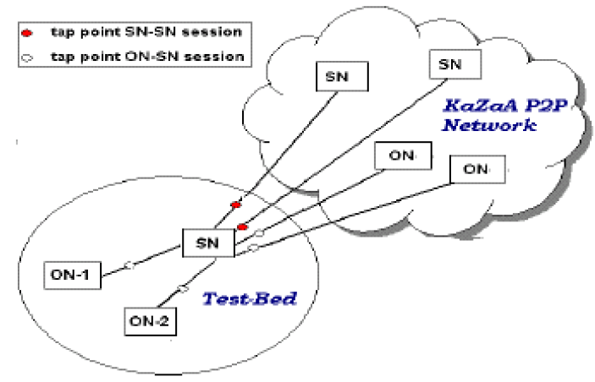
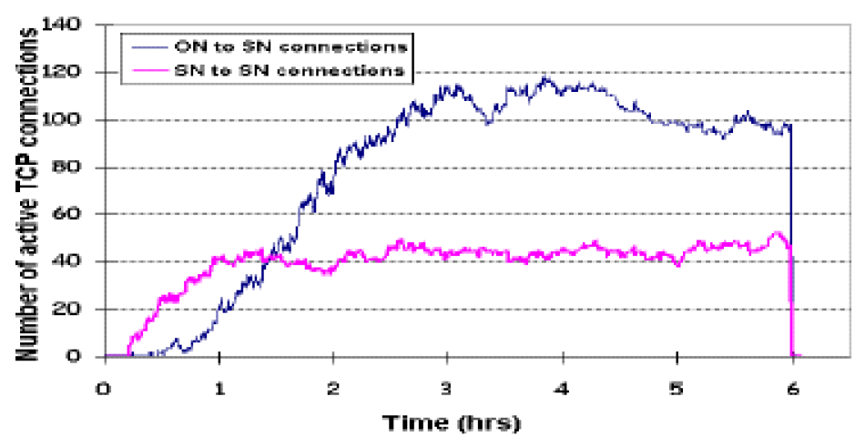
KaZaA Measurement Study

Slide 48
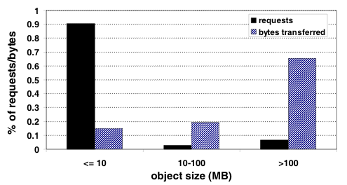
KaZaA Measurement Study
KaZaA is more than one workload!
  Many files < 10MB (e.g., Audio Files)
  Many files > 100MB (e.g., Movies)
from Gummadi et al., SOSP 2003

Slide 49
KaZaA: Architecture
Nodes with more connection bandwidth and more availability → supernodes (SN)
Each supernode acts as a min-Napster hub
  Tracking content of children (ordinary nodes, ON)
  Maintaining IP addresses of children
When ON connects to SN, upload metadata
  File name
  File size
  Content hash – used for fetch request, rather than name
  File descriptions – used for keyword matches

Slide 50
KaZaA: Overlay Maintenance
List of potential supernodes when download software
New peer goes through list until finds operational supernode
  Connects, contains up-to-date list (200 entries)
  Nodes in list are “close” to ON
  Node pings 5 nodes, connects to one
If supernode goes down, node obtains updated list and choses new supernode

Slide 51
KaZaA: Queries
Node first sends query to supernode
  Supernode responds with matches
  If x matches found, done
Otherwise, supernode forwards query to subset of supernodes
  If total of x matches found, done
Otherwise, query further forwarded
  By original supernode

Slide 52
KaZaA-lite
Hacked version of KaZaA client
No spyware, no pop-up windows
Everyone is rated as a priority user
Supernode hopping
  After receiving replies from SN, ON often connects to a new SN an re-sends query
  SN does not cache hopped-out ON’s metadata

Slide 53
KaZaA: Downloading & Recovery
If file is found in multiple nodes, user can select parallel downloading
  Identical copies identified by ContentHash
HTTP byte-range header used to request different portions of the file from different nodes
Automatic recovery when server peer stops sending file
  ContentHash

Slide 54
KaZaA: Summary
KaZaA provides powerful file search and transfer service without server infrastructure
Exploit heterogeneity
Provide automatic recovery for interrupted downloads
Powerful, intuitive user interface
Copyright infringement
  International cat-and-mouse game
  With distributed, serverless architecture, can the plug be pulled?
  Prosecute users?
  Launch DoS attack on supernodes?
  Pollute? (Copyright holder intentionally puts bad copies out)

Slide 55
Searching & Fetching
Query flooding finds:
  An object (filename or hash)
  A host that serves that object
In Query flooding systems, download from host that answered query
Generally uses only one source
Can we do better?

Slide 56
Next Topic...
Centralized Database (Searching)
  Napster
Query Flooding (Searching)
  Gnutella
Supernode Query Flooding (Searching)
  KaZaA
Swarming (Fetching)
  BitTorrent
Structured Overlay Routing (Both, but mostly search)
  Distributed Hash Tables (DHT)

Slide 57
Fetching in Parallel and Swarming
When you have an object ID,
Get list of peers serving that ID
  Easier than the keyword lookup
  Queries are structured
Download in parallel from multiple peers
“Swarming”
  Download from others downloading same object at same time
Example: BitTorrent

Slide 58
BitTorrent: Swarming
2001, BramCohen debuted BitTorrent
  Was open source, now not (µTorrent)
Key Motivation:
  Popularity exhibits temporal locality (Flash Crowds)
  E.g., Slashdot effect, CNN on 9/11, new movie/game release
Focused on Efficient Fetching, not Searching
  Distribute the same file to all peers
  Single publisher, multiple downloaders
Has some “real” publishers:
  Blizzard Entertainment has used it to distribute beta of games

Slide 59
BitTorrent: Overview
Swarming:
  Join: contact centralized “tracker” server, get a list of peers
  Publish: Run a tracker server
  Search: Out-of-band
    E.g., use Google to find a tracker for the file you want.
  Fetch: Download chunks of the file from your peers. Upload chunks you have to them.
Big differences from Napster:
  Chunk based downloading
  “Few large files” focus
  Anti-freeloading mechanisms

Slide 60
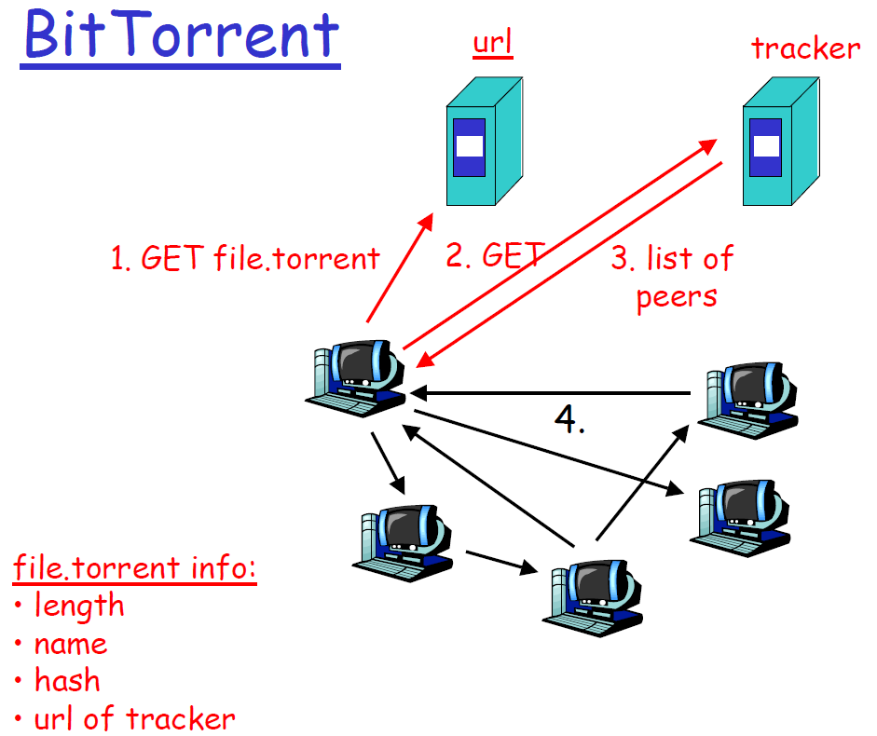
BitTorrent: Overview
tracks peers
participating in torrent

Slide 61
BitTorrent: Publish/Join
Tracker

Slide 62
BitTorrent: Fetch

Slide 63
BitTorrent: Sharing Strategy
File is broken into pieces
  Typically 256 Kbytes
  Upload pieces while download
Piece selection
  Select rarest piece for request
  Except at beginning, select random pieces
Employ “Tit-for-tat” sharing strategy
  A is downloading from some other people
    A will let the fastest N of those download from him
  Be optimistic: occasionally let freeloaders download
    Otherwise no one would ever start!
    Also allows you to discover better peers to download from when they reciprocate

Slide 64
BitTorrent: Summary
Pros
  Works reasonably well in practice
  Gives peers incentive to share resources; avoids freeloaders
Cons
  Central tracker server needed to bootstrap swarm
  Tracker is a design choice, not a requirement
    Newer BT variants use a “distributed tracker” - a Distributed Hash Table

Slide 65
Next Topic...
Centralized Database (Searching)
  Napster
Query Flooding (Searching)
  Gnutella
Supernode Query Flooding (Searching)
  KaZaA
Swarming (Fetching)
  BitTorrent
Structured Overlay Routing (Both, but mostly search)
  Distributed Hash Tables (DHT)

Slide 66
Directed Searches
Idea:
  Assign particular nodes to hold particular content (or pointers to it)
  When node wants that content, go to node that is supposed to have or know about it
Challenges:
  Distributed: want to distribute responsibilities among existing nodes in overlay
  Adaptive: nodes join and leave P2P overlay
    Distribute knowledge responsibility to joining nodes
    Redistribute responsibility knowledge from leaving nodes

Slide 67
Distributed Hash Table (DHT): Overview
Abstraction: a distributed “hash-table” data structure:
  put(id, item);
  item = get(id);
Implementation: nodes in system form distributed data structure
  Can be Ring, Tree, Hypercube, …

Slide 68
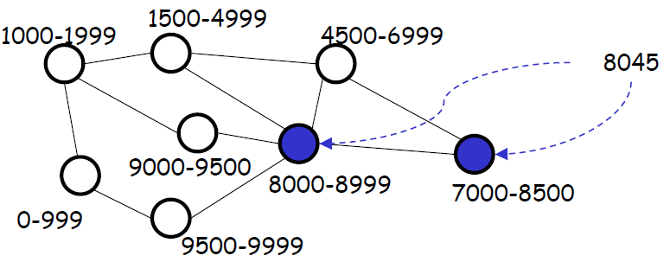
DHT: Step 1 – The Hash
Introduce a hash function to map the object being searched for to a unique identifier:
  e.g., h(“Led Zepplin”) → 8045
Distribute range of hash function among all nodes in network
Each node must “know about” at least one copy of each object that hashes within its range (when one exists)

Slide 69
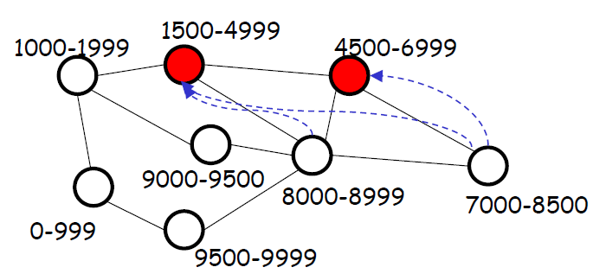
DHT: “Knowing About Objects”
Two alternatives
  Node can cache each (existing) object that hashes within its range
  Pointer-based: level of indirection – node caches pointer to location(s) of object

Slide 70
DHT: Step 2 – Routing
For each object, node(s) whose range(s) cover that object must be reachable via “short” path
  by querier node (assumed can be chosen arbitrarily)
  by nodes that have copies of object (when pointer-based approach is used)
Different approaches (CAN, Chord, Pastry, Tapestry) differ fundamentally only in routing approach
  Any “good” random hash function will suffice

Slide 71
Example: Circular DHT (1)
1
3
15
4
12
5
10
8
Each peer only aware of immediate successor and predecessor.
“Overlay network”

Slide 72
Example: Circle DHT (2)
O(N) messages
on avg to resolve
query, when there
are N peers
0001
Who’s resp
for key 1110 ?
I am
0011
1111
1110
1110
0100
1110
1100
1110
0101
1110
Define closest
as closest
successor
1110
1010
1000

Slide 73
Example: Circular DHT with Shortcuts
1
Who’s resp
for key 1110?
3
15
4
12
5
10
8
Each peer keeps track of IP addresses of predecessor, successor, short cuts.
Reduced from 6 to 2 messages.
Possible to design shortcuts so O(log N) neighbors, O(log N) messages in query

Slide 74
Example: Peer Churn
1
To handle peer churn, require
each peer to know IP address
of its two successors.
Each peer periodically pings its
two successors to see if still alive
3
15
4
12
5
10
8
Peer 5 abruptly leaves
Peer 4 detects; makes 8 its immediate successor; asks 8 who its immediate successor is; makes 8’s immediate successor its second successor.
What if peer 13 wants to join?

Slide 75
DHT: Operations
Join: On startup, contact “bootstrap” node and integrate into distributed data structure → get a node id
Publish: Route publication for file id toward close node id along data structure (e.g. next in ring)
Search: Route query for file id toward a close node id
Fetch: Two options:
  Publication contains actual file → fetch from where query stops
  Publication says “I have file X” → query says 128.2.1.3 has X, use IP routing to get X from 128.2.1.3

Slide 76
DHT: Discussion
Pros:
  Guaranteed lookup
  O(log N) per node state and search scope
Cons:
  Not used
    Academically popular since 2k, but in practice, not so much
  Supporting non-exact match search is hard
  Churn hard

Slide 77

Peers as Relays
Problem when both Alice and Bob are behind “NATs”.
  NAT prevents outside peer from initiating call to insider peer (e.g. can’t be server)
Solution:
  Relay is chosen (based on connectivity to both)
  Each peer initiates session with relay
  Peers can now communicate through NATs via relay
(Used by Skype)

Slide 78
When P2P / DHTs useful?
Caching and “soft-state” data
  Works well! BitTorrent, KaZaA, etc., all use peers as caches for hot data
Finding read-only data
  Limited flooding finds “hay”
  DHTs find “needles”

Slide 79
A Peer-to-peer Google?
Complex intersection queries (“the” + “who”)
  Billions of hits for each term alone
Sophisticated ranking
  Must compare many results before returning subset to user
Very, very hard for DHT / P2P system
  Need high inter-node bandwidth
  (This is exactly what Google does - massive clusters)

Slide 80
Writable, Persistent P2P
Do you trust your data to 100,000 monkeys?
Node availability hurts
  Ex: Store 5 copies of data on different nodes
  When someone goes away, you must replicate data they held
  Hard drives are *huge*, but upload bandwidths relatively tiny
    Takes many hours to upload contents of hard drive
    Very expensive leave/replication situation!

Slide 81
P2P: Summary
Many different styles
  Centralized, flooding, swarming, unstructured and structured routing
Lessons learned:
  Single points of failure are bad
  Flooding messages to everyone is bad
  Underlying network topology is important
  Not all nodes are equal
  Need incentives to discourage freeloading

