Slide 1
Distributed Computing Systems
Project 1 – Dumpster Diving
Due: Tuesday, March 25th

Slide 2
Three Utilities
rm
“Remove” files to trash can
dv
“Dive” to restore files that were “removed”
dump
Permanently remove files

Slide 3
RM
Transparently replace /bin/rm
Actually, just earlier in users PATH
Moves files to "trash" directory
Specified by user in TRASH environment variable
Uses rename() system call, where appropriate
Else copy and then unlink()
Same name? Add extension .1, .2, .3 ...
File permissions, including access times, should be preserved
Use the stat(), chmod(), utime() system calls
Command line options:
f : force complete remove, do not move to trash directory
r : recurse directories

Slide 4
DV
Restore “deleted” files from trash directory
To current working directory (getcwd())
File permissions, including access times, should be preserved
Feel free to support any command line options that you think are useful
Ex - maybe -a option that lists (or restores) all files with same name, but also with a .1, .2, ... extension

Slide 5
DUMP
Permanently remove files from trash directory
unlink() and rmdir()
Recursive, until whole trash dir is empty

Slide 6
Hints (1 of 4)
See get-opt.c for help in parsing command line parameters
See stat.c for sample code on how to get status (e.g., permissions) information
See env.c for sample code on how to (more easily) access environment variables
See ls.c for sample code on how to do a directory listing
See touch.c for sample code on how to set modification times
Other system calls that may be useful:
chmod() - change (user, group, other) permissions
chown() - change ownerships
link() - add a hard link to a file
unlink() - delete a file
rmdir() - remove a directory
remove() - delete a file or directory
rename() - change the name or location of a file
getcwd() - get current working directory for a process
perror() - print appropriate text-based strings for system call errors
access() - can be used to check for existance of a file
basename() and dirname() - split full path to dir and filename (warning! can modify incoming string so copy first)

Slide 7
Hints (2 of 4)
In general …
Proceed incrementally, write SMALL pieces of code first and then test
When appropriate, place code in separate function to aid readability and testing
e.g., int getExtension(char *name)
Do not worry about efficiency nor elegance initially
e.g., static arrays vs. malloc() fine to start
Refactor code as appropriate as proceed
More than one way to do something
e.g., checking partition can be done using the stat() call, looking at st_dev or by doing the rename() call, looking for EXDEV

Slide 8
Hints (3 of 4)
Suggested development steps:
Setup program, take in 1+ arg (argv[1]) and TRASH with getenv()
Move file in current working directory to TRASH on same partition using rename()
Add check for same name using access(), adding extension .num
Add support for single file in another directory (e.g., /tmp), using dirname() and basename()
Check if file to be moved is on another partition using stat() with st_dev or EXDEV error set by rename() call
For files on another partition, write copy function to move across partitions, using link() and unlink()
Modify copy to preserve permissions using stat() and utime()
Check if file to be moved is a directory using stat() and S_ISDIR()
For directories on another partition, write function to iterate through directory using opendir() and readdir(), providing each file name for moving.
Parse additional command line arguments (e.g., "-r") using getopt()
Modify code to recurse through sub-directories, as appropriate, moving all to TRASH
Enable to iterate through all filenames passed in
Error check many test cases thoroughly

Slide 9
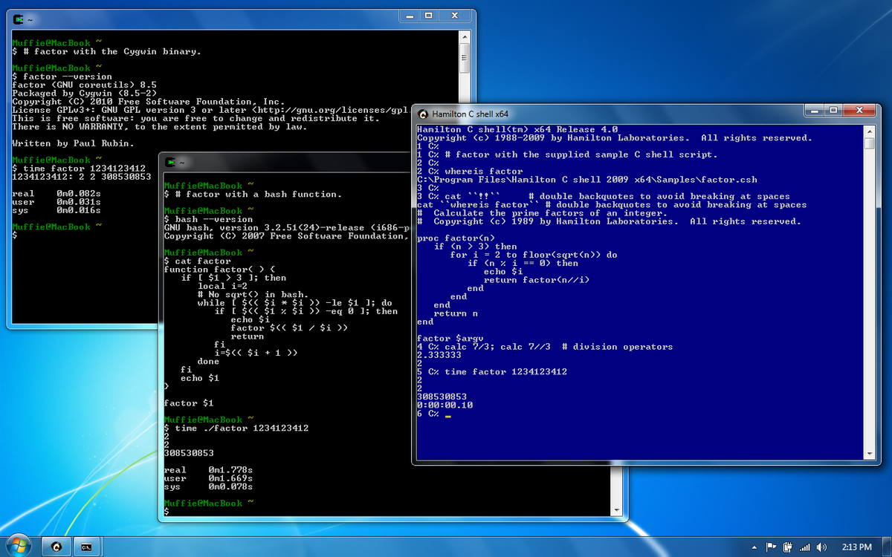
Hints (4 of 4)
Already installed on the Zoo lab
Can install in user space
http://www.cygwin.com/

Slide 10
Experiments
Measure time to link()+unlink() or rename()
Small operation so repeat and divide
Measure throughput (bytes/sec) for copy
Large file
Use sync() to be sure flushed and not in RAM
Again, put together have per-file cost and per-byte cost. Use to predict time to rm for large dir with many files
Measure time for many files (large and small) and compare to predicted

Slide 11
Writeup
Design - describe your experiments
Programs/scripts (pseudo-code)
Number of runs
Data recording method
System conditions
Other …
Results - depict your results clearly
Tables or graphs
At least mean and standard deviation
Analysis - interpret the results
Describe what results mean
How does your prediction match measured? If there is a difference, why do you think there is?

Slide 12
Hand In
Source code package
rm.c, dv.c, dump.c
Support files (*.h)
Makefile
Experimental writeup
tar and gzip
Use turnin on ccc machines

Slide 13
Grading
Support for all command line args (5 points)
Proper checking of TRASH env variable (5 points)
Support for rename() of single ﬁles (5 points)
Support for copy and unlink() when needed (10 points)
Preserving permissions during copy and unlink() (5 points)
Support for directories (5 points)
Support for recursive directories (10 points)
Support for name collision with .num extension (5 points)
Proper working dump (10 points)
Proper working dv (10 points)
Experiments:
Design (10 points)
Results (10 points)
Analysis (10 points)
See rubric on Web page, too

