Slide 1
Performance and Extension of User Space File
Aditya Raigarhia and Ashish Gehani
Stanford and SRI
ACM Symposium on Applied Computing (SAC)
Sierre, Switzerland, March 22-26, 2010

Slide 2
Introduction (1 of 2)
Developing in-kernel file systems challenging
Understand and deal with kernel code and data structures
Steep learning curve for kernel development
No memory protection
No use of debuggers
Must be in C
No standard C library
In-kernel implementations not so great
Porting to other flavors of Unix can be difficult
Needs root to mount – tough to use/test on servers

Slide 3
Introduction (2 of 2)
Modern file system research adds functionality over basic systems, rather than designing low-level systems
Ceph [37] – distributed file system for performance and reliability – uses client in users space
Programming in user space advantages
Wide range of languages
Use of 3rd party tools/libraries
Fewer kernel quirks (although still need to couple user code to kernel system calls)

Slide 4
Introduction - FUSE
File system in USEr space (FUSE) – framework for Unix-like OSes
Allows non-root users to develop file systems in user space
API for interface with kernel, using fs-type operations
Many different programming language bindings
FUSE file systems can be mounted by non-root users
Can compile without re-compiling kernel
Examples
WikipediaFS [2] lets users view/edit Wikipedia articles as if local files
SSHFS access via SFTP protocol

Slide 5
Problem Statement
Prevailing view – user space file systems suffer significantly lower performance compared to kernel
Overhead from context switch, memory copies
Perhaps changed due to processor, memory and bus speeds?
Regular enhancements also contribute to performance?
Either way – measurement of “prevailing view”

Slide 6
Outline
Introduction (done)
Background (next)
FUSE overview
Programming for FS
Benchmarking
Results
Conclusion

Slide 7
Background – Operating Systems
Microkernel (Mach [10], Spring [11]) have only basic services in kernel
File systems (and other services) in user space
But performance is an issue, not widely deployed
Extensible OSes (Spin[1], Vino[4]) export OS interfaces
User level code can modify run-time behavior
Still in research phase

Slide 8
Background – Stackable FS
Stackable file systems [28] allow new features to be added incrementally
FiST [40] allows file systems to be described using high-level language
Code generation makes kernel modules – no recompilation required
But
cannot do low-level operations (e.g., block layout on disk, metatdata for i-nodes)
Still require root to load

Slide 9
Background – NFS Loopback
NFS loopback servers [24] puts server in user-space with client
Provides portability
Good performance
But
Limited to NFS weak cache consistency
Uses OS network stack, which can limit performance

Slide 10
Background - Misc
Coda [29] is distributes file system
Venus cache manager in user space
Arla [38] has AFS user-space daemon
But not widespread
ptrace() – process trace
Working infrastructure for user-level FS
Can interacept anything
But significant overhead
puffs [15] similar to FUSE but NetBSD
FUSE built on puffs for some systems
But puffs not as widespreadh

Slide 11
Background – FUSE contrast
FUSE similar since loadable kernel module
Unlike others is mainstream – part of Linux since 2.6.14, ports to Mac OSX, OpenSolaris, FreeBSD and NetBSD
Reduces risk of obsolete once developed
Licensing flexible – free and commercial
Widely used (examples next)

Slide 12
Background – FUSE in Use
TierStore [6] distributed file system to simply deployment of apps in unreliable networks
Uses FUSE
Increasing trend for dual OS (Win/Linux)
NTFS-3G [25] open source NTFS uses FUSE
ZFS-FUSE [41] is port of Zeta FS to Linux
VMWare disk mount [36] uses FUSE on Linux

Slide 13
FUSE Example – SSHFS on Linux
https://help.ubuntu.com/community/SSHFS
% mkdir ccc
% sshfs -o idmap=user claypool@ccc.wpi.edu:/home/claypool ccc
% fusermount -u ccc

Slide 14
Outline
Introduction (done)
Background (done)
FUSE overview (next)
Programming for FS
Benchmarking
Results
Conclusion

Slide 15
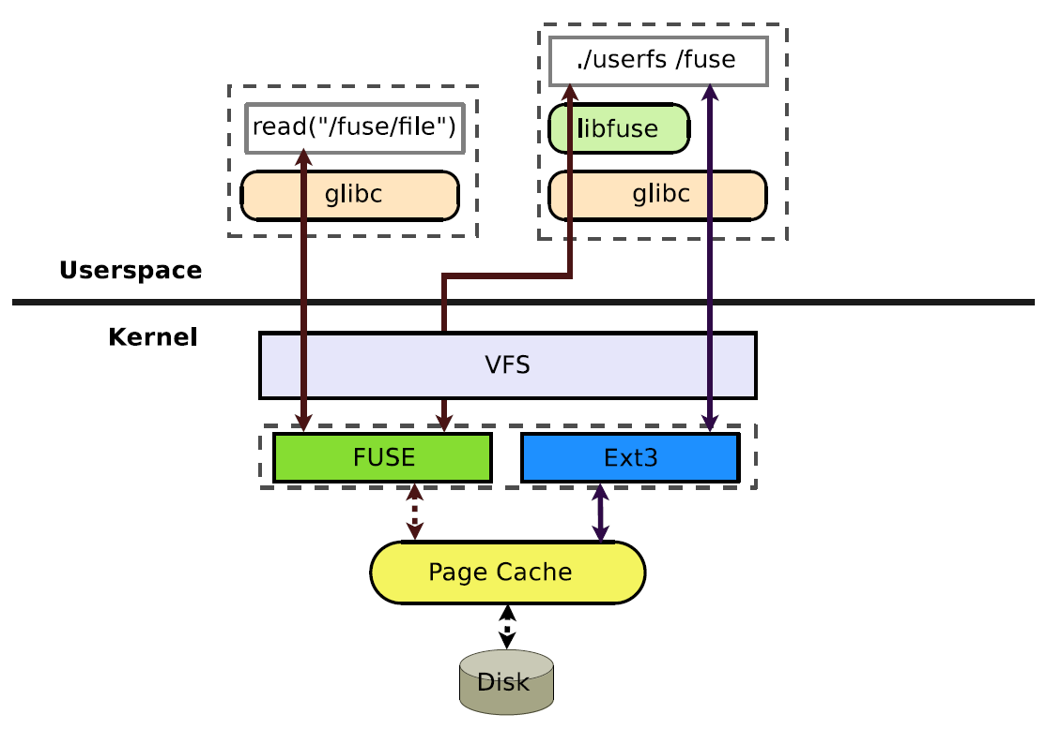
FUSE Overview
On userfs mount, FUSE kernel module registers with VFS
e.g., call to “sshfs”
userfs provides callback functions
All file system calls (e.g., read()) proceed normally from other process
When targeted at FUSE dir, go through FUSE module
If in page cache, return
Otherwise, to userfs via /dev/fuse and libfuse
userfs can do anything (e.g., request data from ext3 and add stuff) before returning data
fusermount allows non-root users to mount

Slide 16
FUSE APIs for User FS
Low-level
Resembles VFS – user fs handles i-nodes, pathname translations, fill buffer, etc.
Useful for “from scratch” file systems (e.g., ZFS-FUSE)
High-level
Resembles system calls
User fs only deals with pathnames, not i-nodes
libfuse does i-node to path translation, fill buffer
Useful when adding additional functionality

Slide 17
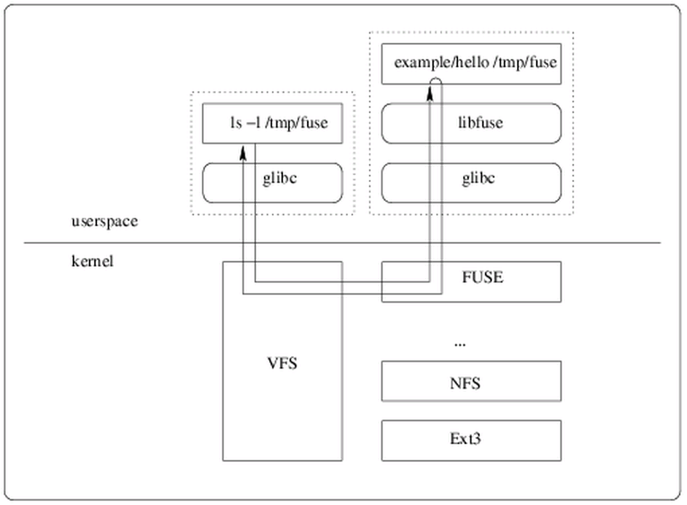
FUSE – Hello World Example
Flow
Run
~/fuse/example$ mkdir /tmp/fuse ~/fuse/example$ ./hello /tmp/fuse ~/fuse/example$ ls -l /tmp/fuse total 0 -r--r--r-- 1 root root 13 Jan 1 1970 hello ~/fuse/example$ cat /tmp/fuse/hello Hello World! ~/fuse/example$ fusermount -u /tmp/fuse ~/fuse/example$
http://fuse.sourceforge.net/helloworld.html

Slide 18
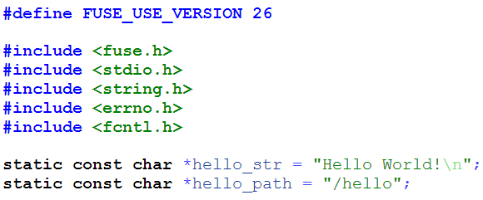
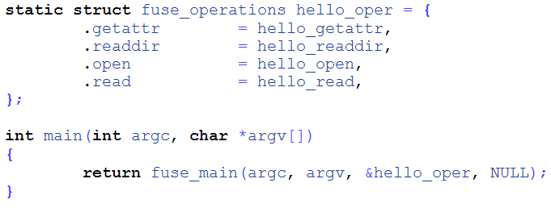
FUSE – Hello World (1 of 4)
Callback operations
Invoking does ‘mount’
http://fuse.sourceforge.net/helloworld.html

Slide 19
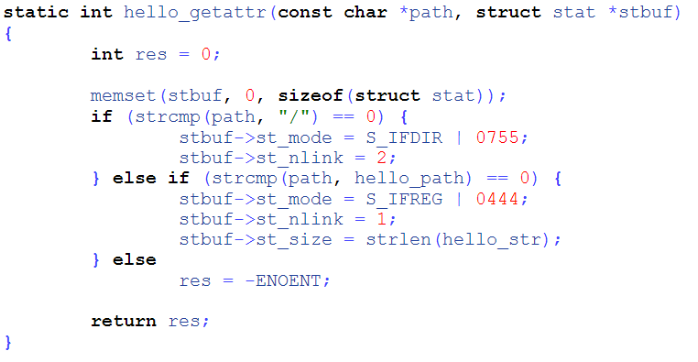
FUSE – Hello World (2 of 4)
Fill in file status structure (type, permissions)
http://fuse.sourceforge.net/helloworld.html

Slide 20
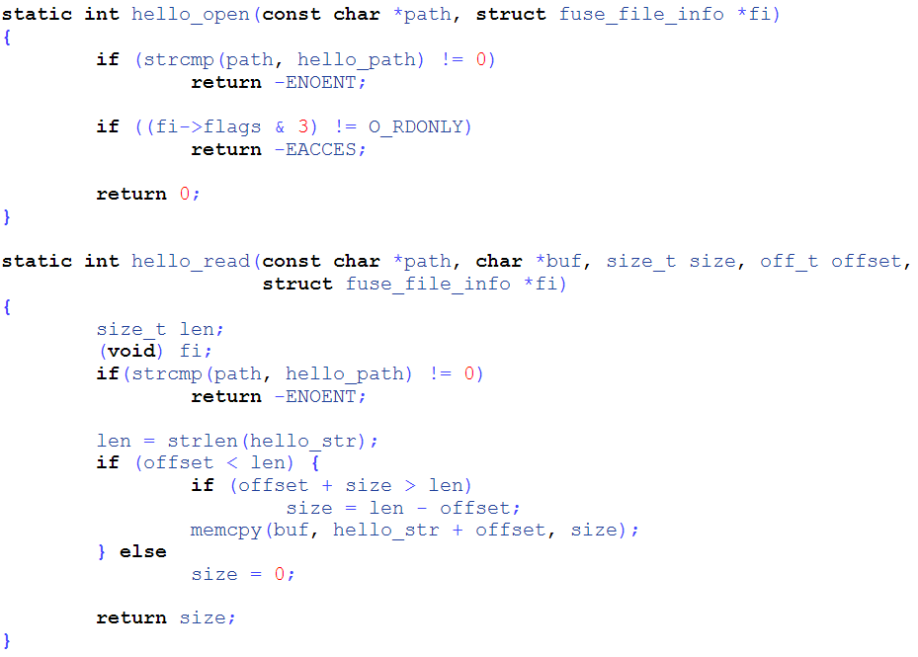
Check that path is right
Check permissions right (read only)
Check that path is right
Copy data to buffer
http://fuse.sourceforge.net/helloworld.html

Slide 21
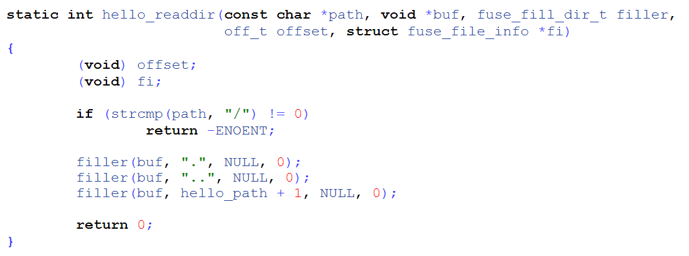
FUSE – Hello World (4 of 4)
Copy in directory listings
http://fuse.sourceforge.net/helloworld.html

Slide 22
Performance Overhead of FUSE : Switching
When using native (e.g., ext3)
Two user-kernel mode switches (to and from)
Relatively fast since only privilege/unpriviledge
No context switches between processes/address space
When using FUSE
Four user-kernel mode switches (adds up to userfs and back)
Two context switches (user process and userfs)
Cost depends upon cores, registers, page table, pipeline

Slide 23
Performance Overhead of FUSE : Reading
FUSE used to have 4 KB read size
If memory constrained, large reads would do many context switch each read
swap out userfs, bring in page, swap in userfs, continue request, swap out userfs, bring in next page …
FUSE now reads in 128 KB chunks with big_writes mount option
Most Unix utilities (cp, cat, tar) use 32 KB file buffers

Slide 24
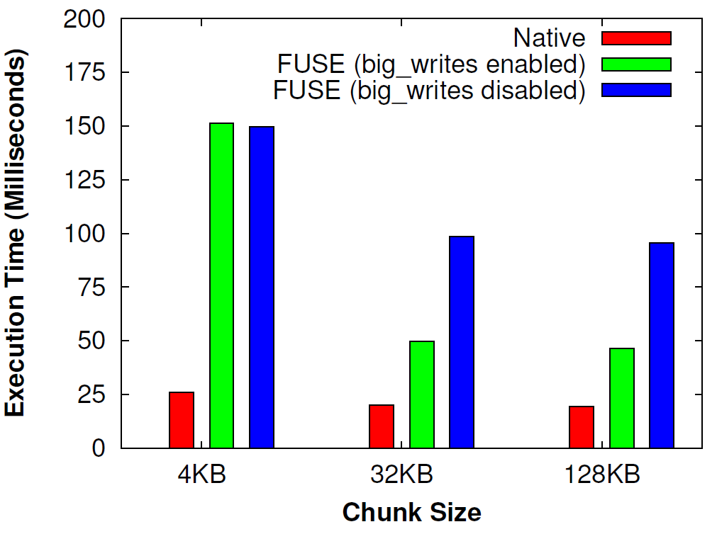
Performance Overhead of FUSE : Time for Writing
(Write 16 MB file)
Note, benefit from 4KB to 32KB, but not 32KB to 128KB

Slide 25
Performance Overhead of FUSE : Memory Copying
For native (e.g., ext3), write copies from application to kernel page cache (1x)
For user fs, write copies from application to page cache, then from page cache to libfuse, then libfuse to userfs (3x)
direct_io mount option – bypass page cache, user copy directly to userfs (1x)
But reads can never come from kernel page cache!

Slide 26
Performance Overhead of FUSE : Memory Cache
For native (e.g., ext3), read/written data in page cache
For user fs, libfuse and userfs both have data in page cache, too (extra copies) – useful since make overall more efficient, but reduce size of usable cache

Slide 27
Outline
Introduction (done)
Background (done)
FUSE overview (done)
Programming for FS (next)
Benchmarking
Results
Conclusion

Slide 28
Language Bindings
20 language bindings – can build userfs in many languages
C++ or C# for high-perf, OO
Haskell and OCaml for higher order functions (functional languages)
Erlang for fault tolerant, real-time, distributed (parallel programming)
Python for rapid development (many libraries)
JavaFuse [27] built by authors

Slide 29
Java Fuse
Provides Java interface using Java Native Interface (JNI) to communicate from Java to C
Developer writes file system as Java class
Register with JavaFuse using command line parameter
JavaFuse gets callback, sends to Java class
Note, C to Java may mean more copies
Could have “file” meta-data only option
Could use JNI non-blocking I/O package to avoid
→But both limit portability and are not thread safe

Slide 30
Outline
Introduction (done)
Background (done)
FUSE overview (done)
Programming for FS (done)
Benchmarking (next)
Results
Conclusion

Slide 31
Benchmarking Methodology (1 of 2)
Microbenchmarks – raw throughput of low-level operations (e.g., read())
Use Bonnie [3], basic OS benchmark tool
6 phases:
write file with putc(), one char at a time
write from scratch same file, with 16 KB blocks
read file with getc(), one char at a time
read file, with 16 KB blocks
clear cache, repeat getc(), one char at a time
clear cache, repeat read with 16 KB blocks

Slide 32
Benchmarking Methodology (2 of 2)
Macrobenchmarks – application performance for common apps
Use Postmark – small file workloads by email, news, Web-based commerce under heavy load
Heavy stress of file and meta-data
Generate initial pool of random text files (used 5000, from 1 KB to 64 KB)
Do transactions on files (used 50k transactions, typical Web server workload [39])
Large file copy – copy 1.1 GB movie using cp
Single, large file as for typical desktop computer or server

Slide 33
Testbed Configurations
Native – ext4 file system
FUSE – null FUSE file system in C (passes each call to native file system)
JavaFuse1 (metadata-only) – null file system in JavaFuse, does not copy read() and write() over JNI
JavaFuse2 (copy all data) – copies all over JNI

Slide 34
Experimental Setup
P4, 3.4 GHz, 512 MB RAM (increased to 2 GB for macrobenchmarks), 320 GB Seagate HD
Maximum sustained throughput on disk is 115 MB/s
So, any reported throughputs above 115 MB/s must benefit from cache
Linux 2.6.30.5, FUSE 2.8.0-pre1

Slide 35
Outline
Introduction (done)
Background (done)
FUSE overview (done)
Programming for FS (done)
Benchmarking (done)
Results (next)
Conclusion

Slide 36
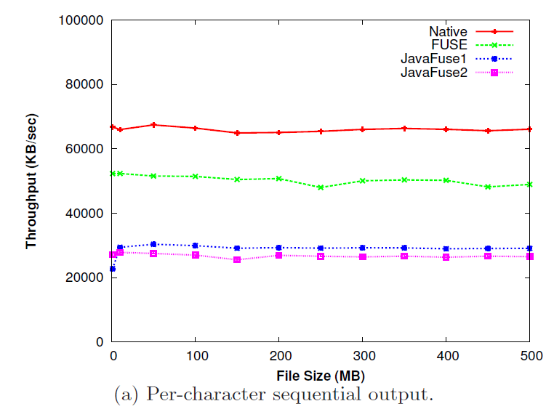
Microbenchmark Results
FUSE ~25% overhead
Context switches
JavaFuse more overhead (context switches between JNI and C), and doing copies not much worse than metadata

Slide 37
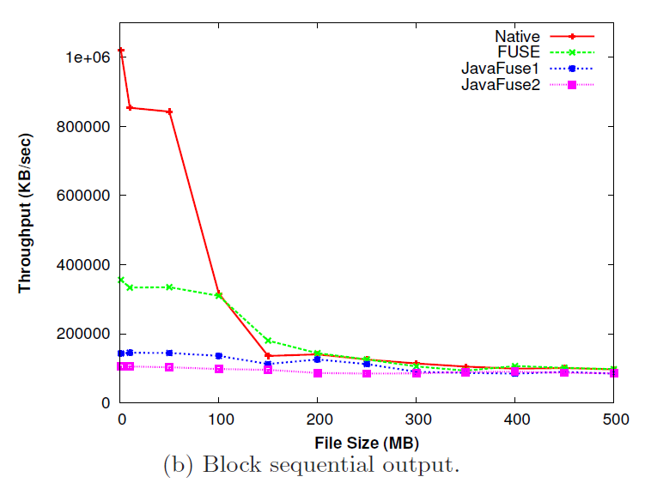
Microbenchmark Results
Native much faster than FUSE for small files (written to memory)
For large cache, written to disk which dominates

Slide 38
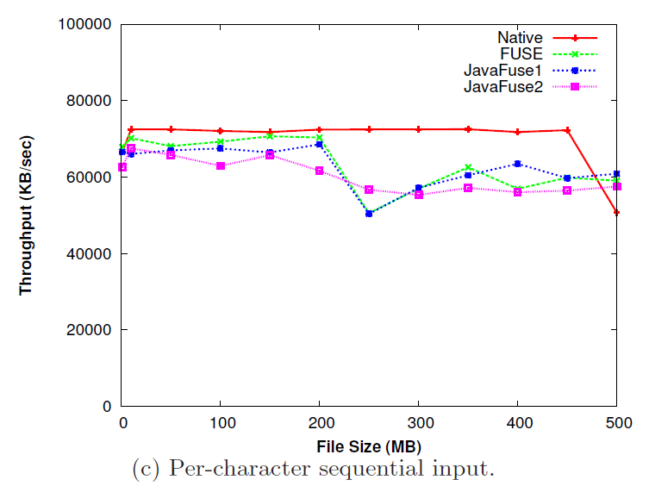
Microbenchmark Results
Data already in page cache, so fast for all
Spikes are when 512 MB RAM exhausted (FUSE has two copies, so earlier around 225)

Slide 39
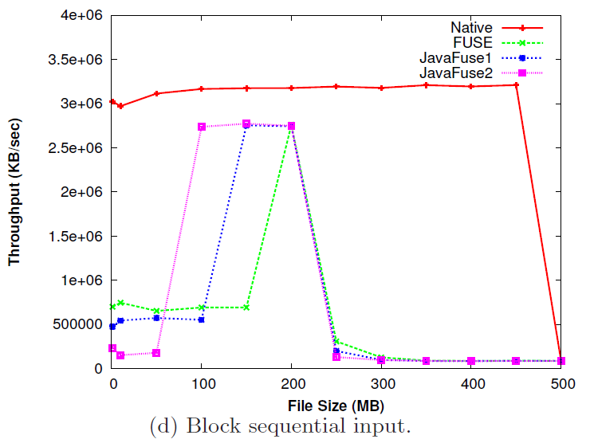
Microbenchmark Results
For native, can cached up to 500 MB
For Java, spike is caused by artificial nature of benchmark (previous version still in cache)

Slide 40
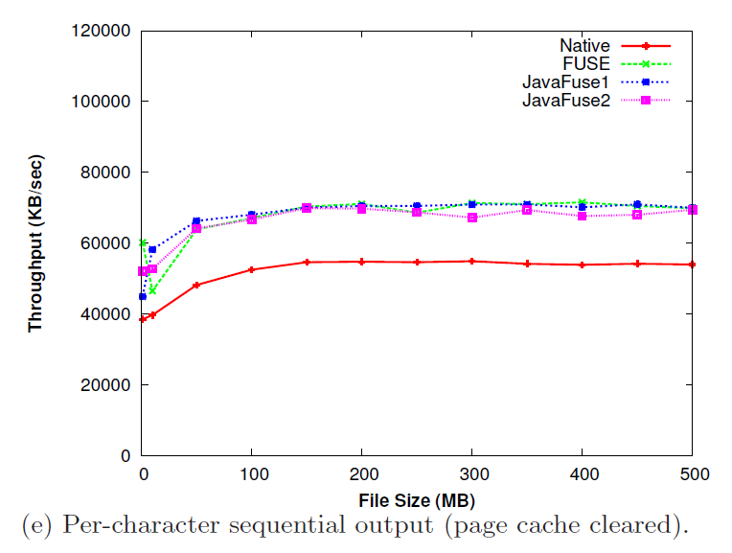
Microbenchmark Results
input
When cache cleared, starts lower gets higher for larger
Kernel optimizes for sequential read
FUSE does better – think it’s because fusefs and ext4 both read-ahead

Slide 41
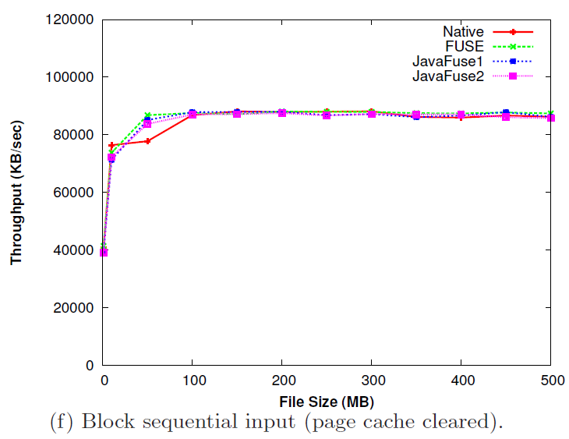
Microbenchmark Results
Native gets same benefit as FUSE, so no apparent difference

Slide 42
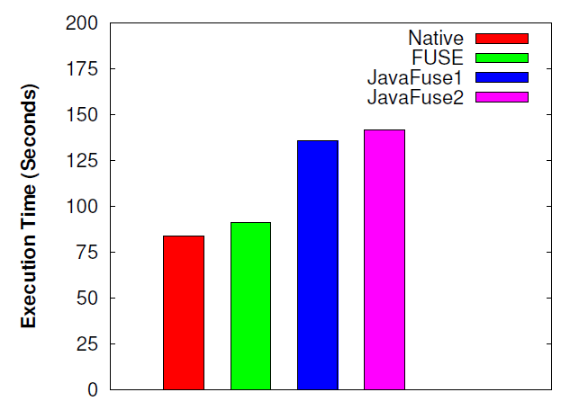
Macrobenchmark Results
Postmark
FUSE overhead less than 10%
Java overhead about 60%
Greater CPU and memory use

Slide 43
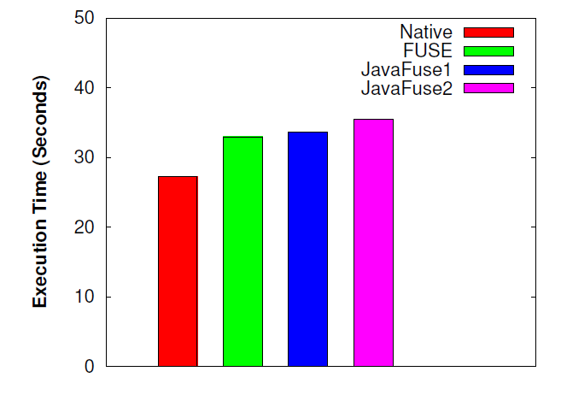
Copy 1.1 GB File
Macrobenchmark Results
FUSE comparable to native (~30%)
Java overhead minimal over FUSE

Slide 44
Conclusion
FUSE may be feasible depending upon workload
Performance comparable to in-kernel for large, sustained I/O
Overhead noticeable for large number of meta data (e.g., Web and many clients)
Adequate for PCs and small servers for I/O transfer
Additional language (Java) incurred additional overhead
But overhead can be reduced with optimizations (e.g., shared buffers)

