Slide 1
Aspects of Networking in Multiplayer Computer Games
J. Smed, T. Kaukoranta and H. Hakonen
The Electronic Library
Volume 20, Number 2, Pages 87-97
2002

Slide 2
Introduction
Network growth, especially wireless, making multiplayer computer games (MCGs) more popular
Commercial computer games increasingly having mutiplayer option
And not just PCs, but consoles, too (PS4, Xbox One, Wii…)
Wireless-only devices, too (3d DS, PS Vita, Smart phones)

Slide 3
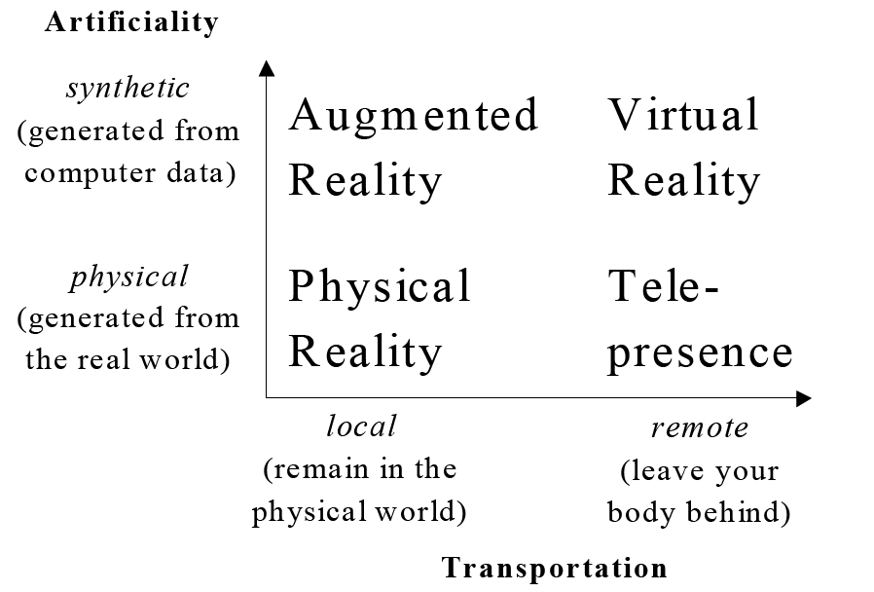
Shared Space Technologies
(MCG’s)

Slide 4
Other VR Research Efforts
Distributed Interactive Simulations (DIS)
Protocol (IEEE), architectures …
Ex: flight simulation
Large scale, spread out, many users
Distributed Virtual Environments (DVEs)
Immersive, technology oriented
Ex: “Caves”
Local, few users
Computer Supported Cooperative Work (CSCW)
Focus on collaboration
Ex: 3D editors
And MCGs are similar, yet not discussed in scientific literature → Hence, this paper seeks to rectify

Slide 5
Outline
Introduction (done)
Networking Resources (next)
Distribution Concepts
Scalability
Security and Cheating
Conclusions

Slide 6
Network Resources
Distributed simulations face three resource limitations
Network bandwidth
Network latency
Host processing power (to handle network aspects)
Physical restrictions that system cannot overcome
Must be considered in design of application
(More on each, next)

Slide 7
Network Bandwidth (Capacities)
Data sent/received per time
LAN – 10 Mbps to 10 Gbps
Limited size (hosts) and scope (distance)
WANs – 10s of kbps from modems, to 1-10 Mbps (broadband), to 55 Mbps (T3) and more
Potentially enormous (billions of hosts), Global in scope (across continents and world)
Number of users, size and frequency of messages determines bitrate use
As does transmission technique (next slide)

Slide 8
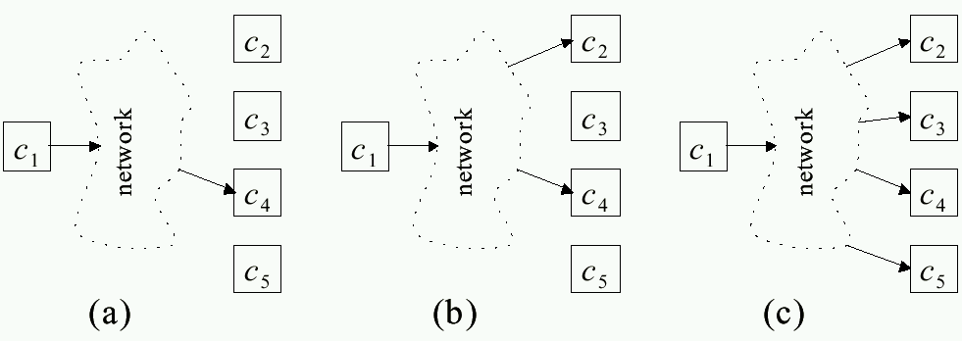
Network Bandwidth (Transmission Techniques)
(a) Unicast: one send and one receive
Can waste bandwidth when path shared by several clients
(c) Broadcast: one send and all receive
Perhaps ok for LAN
Can waste bandwidth when most nodes don’t need
(b) Multicast: one send and only subscribed receive
Current Internet does not support
Multicast overlay networks (e.g., MBone or application layer mcast)

Slide 9
Network Latency
Delay when message sent until received
Variation in delay (delay jitter) also matters
Cannot be totally eliminated
e.g., speed of light propagation yields 25-30 ms across Atlantic
And with routing and queuing, usually 80+ ms
Application tolerances:
File download – minutes
Web page download – up to 10 seconds
Interactive audio – 100s of ms
MCG latencies tolerance? → Depends upon game!
First-Person Shooters – about 100 ms
Third-Person Adventure – up to 500 ms
Real-Time Strategy – up to 1 second
And depends upon action within game! (topic for another paper)

Slide 10
Computational Power
Processing to send/receive packets
Most devices powerful enough for raw sending/receiving
Can saturate LAN
Rather, application must process state in each packet (e.g., receive packet, update game world)
Especially critical on resource-constrained devices
e.g., hand-held console, cell phone, PDA,

Slide 11
Outline
Introduction (done)
Networking Resources (done)
Distribution Concepts (next)
Scalability
Security and Cheating
Conclusions

Slide 12
Distribution Concepts
Cannot do much about above resource limitations
Should tackle problems at higher level
Choose architectures for
Communication
Data
Control
Plus, compensatory techniques to relax requirements

Slide 13
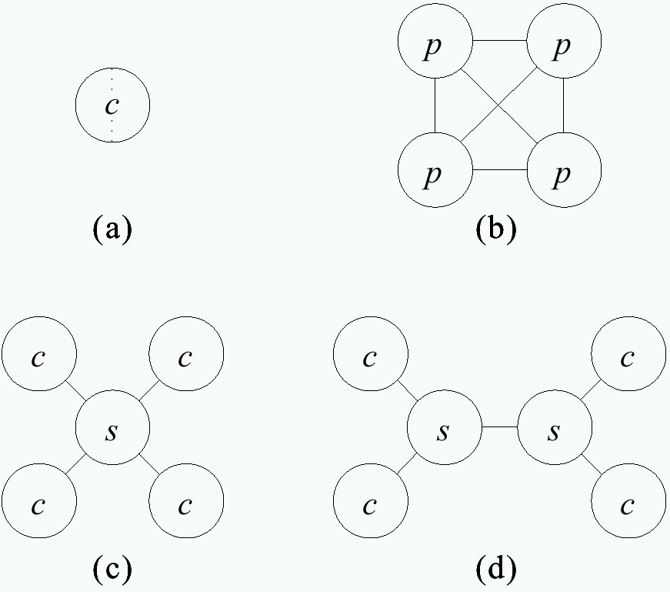
Communication Architectures
Split-screen
- Limited players
All peers equal
Easy to extend
Doesn’t scale (LAN only)
Central server
Clients only to server
Server may be bottleneck
Server pool
-Improved scalability
-More complex

Slide 14
Data and Control Architectures
Want consistency
Same state on each node
Needs tightly coupled, low latency, small nodes
Want responsiveness
More computation locally to reduce network
Loosely coupled (asynchronous)
In general, cannot do both → Tradeoffs

Slide 15
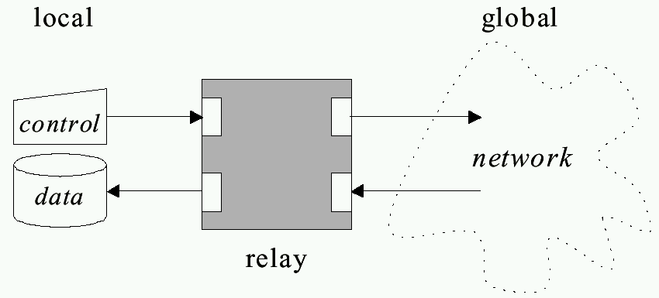
“Relay” Architecture Abstraction
Want control to propagate quickly so can update data (responsiveness)
Want to reflect same data on all nodes (consistency)

Slide 16
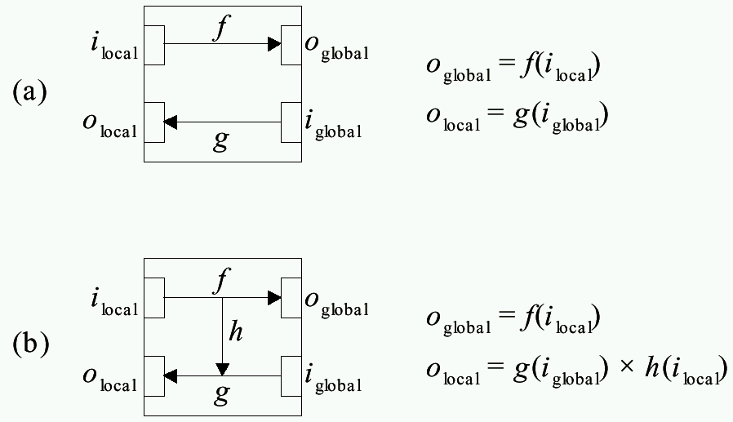
Relay Architecture Choices
(Example: Dumb terminal,
send and wait for response)
(Example: Smart terminal,
send and echo)

Slide 17
MCG Architectures
Centralized
Use only two-way relay (no short-circuit)
One node holds data so view is consistent at all times
Lacks responsiveness
Distributed and Replicated
Allow short-circuit relay
Replicated has copies, used when predictable (e.g., behavior of non-player characters)
Distributed has local node only, used when unpredictable (e.g., behavior of players)

Slide 18
Compensatory Techniques
Architectures alone not enough
Design to compensate for residual
Techniques:
Message aggregation
Interest management
Dead reckoning
(next)

Slide 19
Message Aggregation
Combine multiple messages in one packet to reduce network overhead
Examples:
Multiple user commands to server (move and shoot)
Multiple users command to clients (player A’s and player B’s actions combined to player C)

Slide 20
Interest Management – Auras (1 of 2)
Nodes express area of interest to them
Do not get messages for outside areas
- Only circle sent even if
world is larger
- But implementation
complex (squares easier)

Slide 21
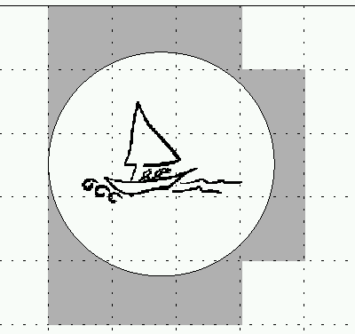
Interest Management- Auras (2 of 2)
- Divide into cells (or hexes)
- Easier, but less discriminating
Compute bounding box
Relatively easy, precise
Always symmetric – both receive
But can sub-divide – focus and nimbus

Slide 22
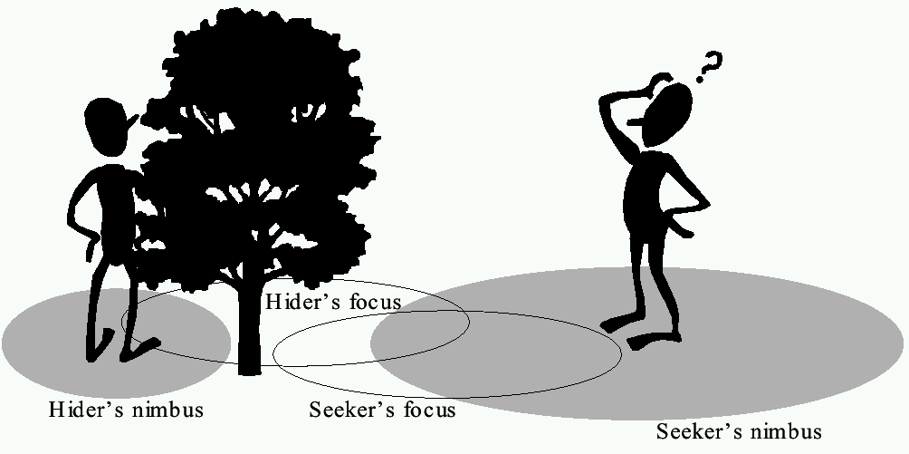
Interest Management- Focus and Nimbus
Nimbus must intersect with focus to receive
Example above: hider has smaller nimbus, so seeker
cannot see, while hider can see seeker since
seeker’s nimbus intersects hider’s focus

Slide 23
Dead Reckoning
Based on ocean navigation techniques (“dead” == “deduced (ded.)”)
Predict position based on last known position plus direction
Only send updates when deviates past threshold
(predicted position)
(“warp”)
(actual position)
When prediction differs and adjust, get “warping” or “rubber-banding” effect
Some techniques move to place over short time

Slide 24
Outline
Introduction (done)
Networking Resources (done)
Distribution Concepts (done)
Scalability (next)
Security and Cheating
Conclusions

Slide 25
Scalability
Ability to adapt to resource changes
Example:
Expand to varying number of players
Allocate non-player computation among nodes
Need hardware parallelism that supports software concurrency

Slide 26
Serial and Parallel Execution
Given time T(1), speedup with n nodes
Part of T(1) must happen serially and part can be done in parallel
T_{s} + T_{p}= T(1) and α = T_{s}/(T_{s} + T_{p})
If serialized optimally:
(Amdahls’ law)
If T_{s} = 0, everything parallelizable but then no communication
(ex: players at own console with no interaction)
If T_{p} = 0, then turn based
Between are MCGs which have some of both

Slide 27
Serial and Parallel MCGs
Separate games
Turn-based
games
Interactive
games

Slide 28
Communication Capacity
Scalability limited by communication requirements of chosen architecture
(Multicasting)
Can consider pool of m servers with n clients
divided evenly amongst them
Servers in hierarchy have root as bottleneck
In order not to increase with n, must have clients
not aware of other clients (interest management) and
do message aggregation

Slide 29
Outline
Introduction (done)
Networking Resources (done)
Distribution Concepts (done)
Scalability (done)
Security and Cheating (next)
Conclusions

Slide 30
Security and Cheating
Unique to games
Other multi-person applications don’t have
In DIS, military not public and considered trustworthy
Cheaters want:
Vandalism – create havoc (relatively few)
Dominance – gain advantage (more)

Slide 31
Packet and Traffic Tampering
Reflex augmentation - enhance cheater’s reactions
e.g., aiming proxy monitors opponents movement packets, when cheater fires, improve aim
Packet interception – prevent some packets from reaching cheater
e.g., suppress damage packets, so cheater is invulnerable
Packet replay – repeat event over for added advantage
e.g., multiple bullets or rockets if otherwise limited

Slide 32
Preventing Packet Tampering
Cheaters figure out by changing bytes and observing effects
Prevent by MD5 checksums (fast, public)
Still cheaters can:
Reverse engineer checksums
Attack with packet replay
So:
Encrypt packets
Add sequence numbers (or encoded sequence numbers) to prevent replay

Slide 33
Information Exposure
Allows cheater to gain access to replicated, hidden game data (e.g. status of other players)
Passive, since does not alter traffic
e.g., ignore “fog of war” in RTS, or “wall hack” to see through walls in FPS
Cannot be defeated by network alone
Instead:
Sensitive data should be encoded
Kept in hard-to-detect memory location
Centralized server may detect cheating (e.g., attack enemy could not have seen)
Harder in replicated system, but can still share

Slide 34
Design Defects
If clients trust each other, then if client is replaced and exaggerates cheater effects, others will go along
Can have checksums on client binaries
Still, more secure to have trusted server that puts into play client actions (centralized server)
Distribution may be source of unexpected behavior
Features only evident upon high load (say, latency compensation technique)
e.g., Madden Football

Slide 35
Conclusion
Overview of problems with MCGs
Connection to other distributed systems
Networking resources
Distribution architectures
Scalability
Security

Slide 36
Future Work
Other distributed systems solutions
Cryptography
Practitioners should be encouraged to participate

