Slide 1
CS4513 Distributed Computing Systems
D-term 2014
Mark Claypool

Slide 2
Topics
Background
Admin Stuff
Motivation
Objectives
Class material!

Slide 3
Professor Background (Who am I?)
Mark Claypool (professor, “Mark”)
Professor, Computer Science
Director, Interactive Media and Game Development
Systems guy
Research interests
Network games
Multimedia performance
Congestion control (protocols, AQM)
Wireless networking

Slide 4
Student Background (Who are you?)
Background
CS3013?
CS3516?
CS4516?
Language of Choice?
Platform of Choice?
Year?
Major?
Expertise (low 1 to 5 high)?
C/C++
Java
Unix
Other?

Slide 5
Syllabus Stuff
http://www.cs.wpi.edu/~cs4513/b14
Class: Tu, Fr 1-2:50pm
TAs: Hien Duong and Ahmedul Kabir
Office hours:
TA: TBA, FLA22
Prof: TBA, FLB24b
Or by appointment
Email
claypool@cs.wpi.edu (me)
cs4513-staff@cs.wpi.edu (me + TA)
cs4513-all@cs.wpi.edu (class)

Slide 6
Text Book
OS Book from cs3013
File systems
Research papers
Links or possibly copies
Learned
Read by you
Presented by me
Tested for exam
May be “Recommended” papers/links

Slide 7
Range of Topics
File Systems
The Web
Network Games
Peer-to-Peer
Cloud Computing
Communication
Architectures
Synchronization
Virtualization
Performance

Slide 8
Course Structure
Recommended background
Operating Systems (cs3013)
Computer Networks (cs3516)
Good programming skills (required)
Grading
Exams (50%)
Projects (50%)

Slide 9
Exams
2 exams
50% of grade
Non-cumulative
In-class
Closed-note, Closed-paper, Closed-friend

Slide 10
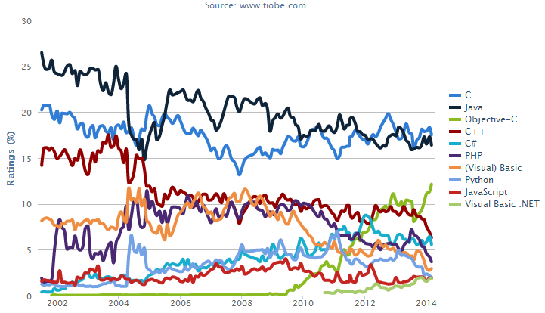
Projects (1 of 2)
Implementation in Linux (or Cygwin on Windows)
Implementation in C/C++ or Java
Search engine hits for +“<language> programming”

Slide 11
Project (2 of 2)
Done solo (no groups)
Topics
Proj 1 – Files
Proj 2 – Distributed shell
Proj 3 – Network game (text based)
Proj 4 – File/Media sharing

Slide 12
Slides
On the Web (maybe after class)
Powerpoint and PDF
Caution! Don’t rely upon the slides alone! Use them as supplementary material
(come to class)

Slide 13
Timeline
http://www.cs.wpi.edu/~cs4513/d14/timeline.html
Estimate of assignment dates
Use it to help plan

Slide 14
Why This Class?
WPI CS requirements
Gotta take something in Systems
Gotta take five 4000-level courses
Distributed systems are the future
The network is the computer, The cloud, Mobility and Wireless
Distributed Systems are cool!
Algorithms, Networks, Hardware…
Programming
The more you do, the better a computer scientist/software engineer you become
Fun!

