Slide 1
Review
CS 4513

Slide 2
File Systems
What is a partition? How do you get access?
What is a file descriptor?

Slide 3
File Systems
What is good about storing files as contiguous blocks? What is bad?
Why is a file allocation table (FAT) better than a pure linked-list when storing disk blocks?
What is an i-node?

Slide 4
File Systems
What is an MBR/GPT for?
Where are file attributes stored?
What is an alias in terms of file systems?
How is a hard-link in a typical Unix file system implemented?

Slide 5
File Systems
Describe one method of keeping track of free blocks in a file system
What is the best block size to choose when formatting a partition with a file system?
What are the performance tradeoffs in choosing the block size?

Slide 6
Sockets+
What does bind() do?
Who calls bind(), the client or server?
How do you re-direct stdout to a socket?

Slide 7
HLM02
Compare and contrast WAFL i-nodes to traditional i-nodes.
What is a snapshot?
How is it implemented?
What is copy-on-write?

Slide 8
HML02
Performance methodology for NFS appliance?
Why not simply time to open()?
Why not simply top throughput?

Slide 9
Distributed File Systems
Compare and contrast stateful vs. stateless server for distributed file system
How does NFS (v3) handle potentially out-dated client caches?

Slide 10
RG10
What are micro-benchmarks?
What are the micro-benchmarks used in RG10?
What are macro-benchmarks?
What are the macro-benchmarks used in RG10?

Slide 11
RG10
How does the performance of FUSE compare to native?
How does the performance of JavaFuse compare to FUSE and Native?

Slide 12
SKH02
What are the 3 fundamental limitations faced by MCGs?

Slide 13
SKH02
What is the tension/tradeoff between responsiveness and consistency in MCGs?
What is interest management? Describe how it works
What is dead reckoning? Describe how it works

Slide 14
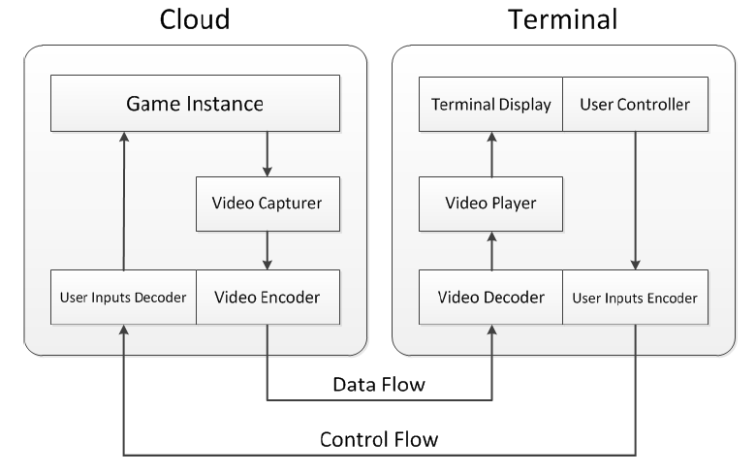
CCL14
Label A-E in Figure
What type of service is this?
A
B
D
C
E

Slide 15
Cla09
Regarding thin-client games:
What is scene complexity?
What is motion?
Where are First Person Shooters in that space?

Slide 16
Thin Client Games from [CFGS14]
Order the following from least to most bitrate
Virtual Environment
Thin Game
Pre-recorded video
Live Video
Traditional Game

Slide 17
Latency and Games from [CC10]
What three ways does latency affect network games?
What are precision and deadline?
How do precision and deadline pertain to latency and games?

