Slide 1
Distributed Computing Systems
The Web

Slide 2
The World Wide Web
Huge client-server system
Traditionally → Document-based
Referenced by “Uniform Resource Locator” (URL)
Andrew Tanenbaum and Marten van Steen, Distributed Systems – Principles and Paradigms, Prentice Hall, ©2002

Slide 3
References
[TS02] Andrew Tanenbaum and Marten van Steen, Distributed Systems – Principles and Paradigms, Prentice Hall, ©2002 (ch 11)
[KR10] James F. Kurose and Keith W. Ross, Computer Networking - A Top-Down Approach (5th ed), Pearson, ©2010 (ch 2.2.4)
[SAAF08] F. Schneider, S. Agarwal, T. Alpcan, and A. Feldmann. The New Web: Characterizing AJAX Traffic, In Proceedings of the Passive and Active Measurement Conference (PAM), Cleveland, OH, USA, 2008

Slide 4
Outline
Introduction (done)
Document Model (next)
Architecture
Processes
Caching
Web 2.0

Slide 5
Document Model
All information in documents
Typically in Hypertext Markup Language (HTML)
Different types: ASCII, scripts
<HTML> <!- Start of HTML document --> <BODY> <!- Start of the main body --> <H1>Hello World</H1> <!- Basic text to be displayed --> </BODY> <!- End of main body --> </HTML> <!- End of HTML section -->
<HTML> <!- Start of HTML document --> <BODY> <!- Start of the main body --> <SCRIPT type = "text/javascript"> <!- identify scripting language --> document.writeln ("<H1>Hello World</H1>); // Write a line of text </SCRIPT> <!- End of scripting section --> </BODY> <!- End of main body --> </HTML> <!- End of HTML section -->
Scripts give you “mobile code” (more later)
Can also have eXtensible Markup Language (XML)
Provides structure to document
Andrew Tanenbaum and Marten van Steen, Distributed Systems – Principles and Paradigms, Prentice Hall, ©2002

Slide 6
XML Document Type Definition
(#PCDATA is
primitive type,
series of chars)
(1) <!ELEMENT article (title, author+,journal)> (2) <!ELEMENT title (#PCDATA)> (3) <!ELEMENT author (name, affiliation?)> (4) <!ELEMENT name (#PCDATA)> (5) <!ELEMENT affiliation (#PCDATA)> (6) <!ELEMENT journal (jname, volume, number?, month? pages, year)> (7) <!ELEMENT jname (#PCDATA)> (8) <!ELEMENT volume (#PCDATA)> (9) <!ELEMENT number (#PCDATA)> (10) <!ELEMENT month (#PCDATA)> (11) <!ELEMENT pages (#PCDATA)> (12) <!ELEMENT year (#PCDATA)>
Definition above refers to journal article. Specifies type.
Document Type Definition (DTD)
Provides structure to XML documents → can test if XML is valid based on DTD
Andrew Tanenbaum and Marten van Steen, Distributed Systems – Principles and Paradigms, Prentice Hall, ©2002

Slide 7
XML Document
Refers to previous dtd
(1) <?xml = version "1.0"> (2) <!DOCTYPE article SYSTEM "article.dtd"> (3) <article> (4) <title>Prudent Engineering Practice for Cryptographic Protocols</title> (5) <author><name>M. Abadi</name></author> (6) <author><name>R. Needham</name></author> (7) <journal> (8) <jname>IEEE Transactions on Software Engineering</jname> (9) <volume>22</volume> (10) <number>12</number> (11) <month>January</month> (12) <pages>6 – 15</pages> (13) <year>1996</year> (14) </journal> (15) </article>
(An XML document using XML definitions from previous slide)
Formatting rules usually applied by embedding in HTML
Andrew Tanenbaum and Marten van Steen, Distributed Systems – Principles and Paradigms, Prentice Hall, ©2002

Slide 8
Outline
Introduction (done)
Document Model (done)
Architecture (next)
Processes
Caching
Web 2.0

Slide 9
Architectural Overview
Text documents typically “processed” on client
But can be done at server, too (e.g., Common Gateway Interface (CGI))
(often with user input , e.g., a form)
Andrew Tanenbaum and Marten van Steen, Distributed Systems – Principles and Paradigms, Prentice Hall, ©2002

Slide 10
Server-Side Scripts
Like Client, Server can execute JavaScript
(1) <HTML> (2) <BODY> (3) <P>The current content of <pre>/data/file.txt</PRE>is:</P> (4) <P> (5) <SERVER type = "text/javascript"); (6) clientFile = new File("/data/file.txt"); (7) if(clientFile.open("r")){ (8) while (!clientFile.eof()) (9) document.writeln(clientFile.readln()); (10) clientFile.close(); (11) } (12) </SERVER> (13) </P> (14) <P>Thank you for visiting this site.</P> (15) </BODY> (16) </HTML>
(The tag <SERVER…>
is system specific)
Server can also pass pre-compiled code → applet
<OBJECT codetype=“application/java” classid=“java.welcome.class”>
Servlets are applets that run on server side (Architecture next slide)
Andrew Tanenbaum and Marten van Steen, Distributed Systems – Principles and Paradigms, Prentice Hall, ©2002

Slide 11
Architectural Overview
Andrew Tanenbaum and Marten van Steen, Distributed Systems – Principles and Paradigms, Prentice Hall, ©2002

Slide 12
HTTP Connections
Communication based on Hypertext Transfer Protocol (HTTP)
Client request, server reply protocol
Uses TCP
Using non-persistent connections (HTTP 1.0)
TCP connection setup expensive
Using persistent connections (HTTP 1.1)
Can also have requests either serially or in parallel
Andrew Tanenbaum and Marten van Steen, Distributed Systems – Principles and Paradigms, Prentice Hall, ©2002

Slide 13
User-server State: Cookies (1 of 3)
Web servers stateless
Many major Web sites use cookies to have state at server
Four components:
1) cookie header line of HTTP response message
2) cookie header line in HTTP request message
3) cookie file kept on user’s PC, managed by user’s browser
4) back-end database at Web site
Example:
Susan always access Internet from same PC (e.g., in her home)
Visits specific e-commerce site for first time (e.g., amazon.com)
When initial HTTP requests arrives at site, site creates:
unique ID
entry in backend database for ID
(see next slide for example)
James F. Kurose and Keith W. Ross, Computer Networking - A Top-Down Approach (5th ed), Pearson, ©2010

Slide 14
User-server State: Cookies (2 of 3)
Client
Server
ebay 8734
usual http request msg
Amazon server
creates ID
u168 for user
cookie file
usual http response
set-cookie: u168
create
entry
ebay 8734
amazon u168
usual http request msg
cookie: u168
cookie-
specific
action
access
(one week later)
usual http response msg
backend
database
ebay 8734
amazon u1678
access
usual http request msg
cookie: u168
cookie-
specific
action
usual http response msg
James F. Kurose and Keith W. Ross, Computer Networking - A Top-Down Approach (5th ed), Pearson, ©2010

Slide 15
User-server State: Cookies (3 of 3)
What cookies can bring:
authorization
shopping carts
recommendations
user session state (Web e-mail)
Cookies and privacy:
Cookies permit some sites to learn lots about users
e.g., tracking visits by 3rd party sites
Also, persist when session closed, so next user has
e.g., public computer
Or stolen (sniffed), or sent to attacker if script embedded in primary Web page
James F. Kurose and Keith W. Ross, Computer Networking - A Top-Down Approach (5th ed), Pearson, ©2010

Slide 16
Outline
Introduction (done)
Document Model (done)
Architecture (done)
Processes (next)
Caching
Web 2.0

Slide 17
Client Process: Extensible Browser
Make client browser extensible → do more than default
A plug-in
Associated with document type (MIME type)
Andrew Tanenbaum and Marten van Steen, Distributed Systems – Principles and Paradigms, Prentice Hall, ©2002

Slide 18
Client-Side Process: Web Proxy
Initially, handle connection when browser does not “speak” language
Now, most browsers can handle, but proxies still used for common cache when many browsers (e.g., NZ) or to get “rights” of domain (e.g., proxy.wpi.edu)
Can be useful for debugging Web session
Andrew Tanenbaum and Marten van Steen, Distributed Systems – Principles and Paradigms, Prentice Hall, ©2002

Slide 19
Servers
Core invokes modules with data
Actual module path depends upon data type
Phases:
authentication, response, syntax checking, user-profile, transmission
Extend server to support different types (PHP)
Andrew Tanenbaum and Marten van Steen, Distributed Systems – Principles and Paradigms, Prentice Hall, ©2002

Slide 20
Server Clusters (1 of 3)
Single server can become heavily loaded
Front-end replicates request to back-end (horizontal distribution)
But can become overloaded still since all connections through
Andrew Tanenbaum and Marten van Steen, Distributed Systems – Principles and Paradigms, Prentice Hall, ©2002

Slide 21
Server Clusters (2 of 3)
TCP handoff – most “work” on response, typically
But can’t take advantage of document knowledge or caching
Or, higher-layer has to do more work, making front-end bottleneck
Andrew Tanenbaum and Marten van Steen, Distributed Systems – Principles and Paradigms, Prentice Hall, ©2002

Slide 22
Server Clusters (3 of 3)
Distributor talks to dispatcher initially, then hands off connection
Front-end switch can stay at TCP layer, told where to send data
Andrew Tanenbaum and Marten van Steen, Distributed Systems – Principles and Paradigms, Prentice Hall, ©2002

Slide 23
Outline
Introduction (done)
Document Model (done)
Architecture (done)
Processes (done)
Caching (next)
Web 2.0

Slide 24
Web Caching
Browser keeps recent requests
Proxy can be valuable if shared interests
Check cache first, server next
Cache is full. How to decide replacement?
LRU (what is different than pages or disk blocks?)
e.g., GreedyDual (value divided by size)
How consistent should client cache be to server content? What are tradeoffs?

Slide 25
Caching - Conditional GET
cache
server
Goal: don’t send object if cache has up-to-date cached version
cache: specify date of cached copy in HTTP request:
If-modified-since: <date>
server: response contains no object if cached copy is up-to-date. e.g.,
HTTP/1.0 304 Not Modified
HTTP request msg
If-modified-since: <date>
object
not
modified
HTTP response
HTTP/1.0
304 Not Modified
HTTP request msg
If-modified-since: <date>
object
modified
HTTP response
HTTP/1.0 200 OK
<data>

Slide 26
Cache Coherency
Strong consistency
Validate each access
Server indicates if invalid
But requires request to server for each client request
Weak consistency
Validate only when client clicks “refresh”
Or, using heuristic Time To Live (TTL)
Squid T_{expire} = α(T_{cached} – T_{last_modified}) + T_{cached}
α = 0.2 (derived from practice)
Why not have server push invalidation?
In practice, cache hits low (50% max, only if really large)
Make “cooperative” caches

Slide 27
Cooperative Web Proxy Caching
Proxy first checks neighbors before asking server
Shown effective for 10,000+ users
But complicated, and often not clear win over single proxy
Andrew Tanenbaum and Marten van Steen, Distributed Systems – Principles and Paradigms, Prentice Hall, ©2002

Slide 28
Misc Caching
Static vs. Dynamic documents
Caching only effective for static docs (non CGI)
But Web increasingly dynamic (personalized)
Cookies used since server (mostly) stateless
Make proxies support active caching
Generate HTML
Need copies of server-side scripts/code
Accessing databases harder
Caching large documents
Can only send changes from original
But in many cases, connection request is largest cost

Slide 29
Server Replication
Clusters (covered)
Deploy entire copy of Web site at another site (mirror)
Often done with file transfer networks (e.g., FTP servers)
But non-transparent (i.e., explicitly choose mirror)
Content Delivery Network (CDN)
Have network of cooperative caches run by provider (next)

Slide 30
Akamai CDN
(“Close”
CDN Server
resolved by
DNS)
Embedded documents have names that are resolved by Akamai DNS to local CDN server
Use Internet “map” to determine local server
Local server gets copy from original server
Akamai has many CDN servers “close” to clients
Andrew Tanenbaum and Marten van Steen, Distributed Systems – Principles and Paradigms, Prentice Hall, ©2002

Slide 31
Outline
Introduction (done)
Document Model (done)
Architecture (done)
Processes (done)
Caching (done)
Web 2.0 (next)

Slide 32
The Web 1.0
World Wide Web most popular application running over HTTP
Users click on links embedded in documents to fetch additional documents
Thus, in basic Web 1.0, HTTP request-response loads new page in response to each user request

Slide 33
The Web 2.0
Shift away from class request-response, to asynchronous communication
Web browsers request data without human intervention (e.g., without clicking on link/button)
Such requests can mask latency or limited bandwidth
pre-fetching or
displaying before all data has arrived
HTTP requests are becoming automated, rather than human generated
AJAX is one such supporting technology

Slide 34
AJAX – What is it?
AJAX – acronym for Asynchronous JavaScript and XML
Despite name, doesn’t have to be XML (often JSON, a JavaScript text-based notation)
Not stand-alone language or technology
Methods for client-side code to create Web applications
Clients send and receive data asynchronously, without interfering with display

Slide 35
AJAX Technologies
AJAX uses:
Javascript (for altering page)
XML or JSON (for information exchange)
ASP or JSP (server side)
Key is the XMLHttpRequest object
All modern browsers support XMLHttpRequest object
Note: IE5 and IE6 uses an ActiveXObject.
XMLHttpRequest object exchanges data with server asynchronously
Update parts of Web page, without reloading whole page
(illustration next)

Slide 36
AJAX versus Normal Web Browsing

Slide 37
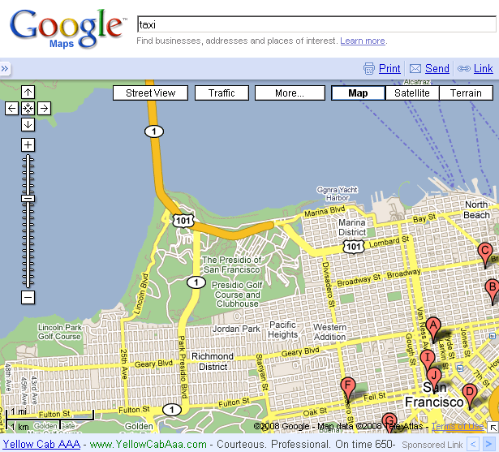
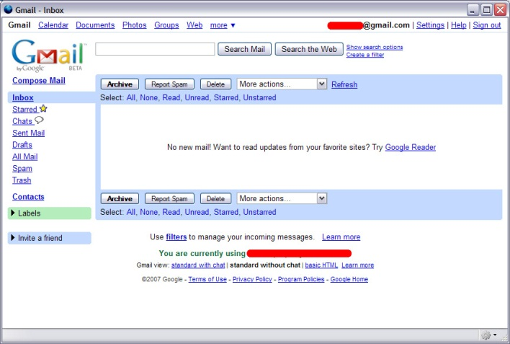
Web 2.0 Applications
Google Maps was early adopter of AJAX
Encouraged others to use for interactive apps
Many Web-email offerings use AJAX technologies to rival desktop mail clients

Slide 38
The Problem
Prediction algorithms may fetch data that is not needed → add extra data to Web browsing
Fetching no longer limited by user read and click speed, but driven by JavaScript code logic
Traditional Web traffic models (e.g., data rate for browsing, number of objects per page) may not hold

Slide 39
Web 2.0 Outline
Introduction (done)
Approach (next)
Results
Conclusions

Slide 40
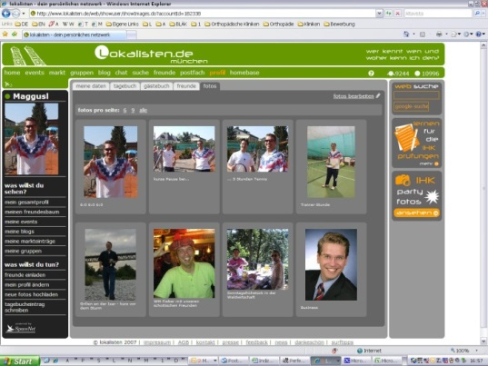
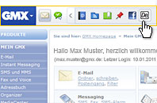
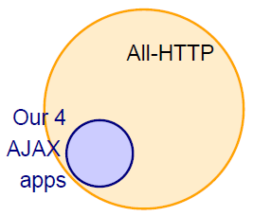
Approach
Pick four popular, “representative”, AJAX apps and study their traffic:
Google Maps
Google Mail
Gmx.de (popular German Webmailer)
Lokalisten.de (popular German social network)
Traces from networks in Munich, Germany and Berkeley, USA
Highlight differences in Web 2.0 traffic compared to traditional Web 1.0 traffic

Slide 41
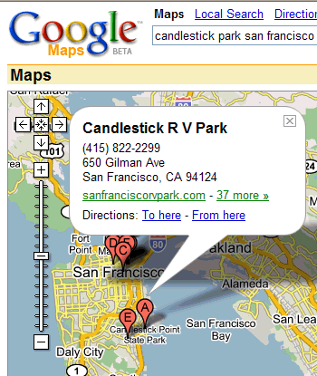
Google Maps Internals
Google Maps is AJAX application
Sometimes called the “canonical” AJAX app
Prefetches tiles
Opens multiple TCP connections to different servers
Uses cookies to identify users
HTTP 1.1 transfers data via persistence and pipelining
Mostly to fetch new image tiles
Also control, GUI-related pictures, user queries

Slide 42
Analysis
Extract standard HTTP request from all connections
Identified Google Maps via initial request to maps.google.com plus session cookies Google uses
Studied:
Number of bytes transferred (HTTP payload)
Number of HTTP requests
Inter-request times
Colors:
Red/Pink – All HTTP
Green – Google Maps

Slide 43
Web 2.0 Outline
Introduction (done)
Approach (done)
Results (next)
Conclusions

Slide 44
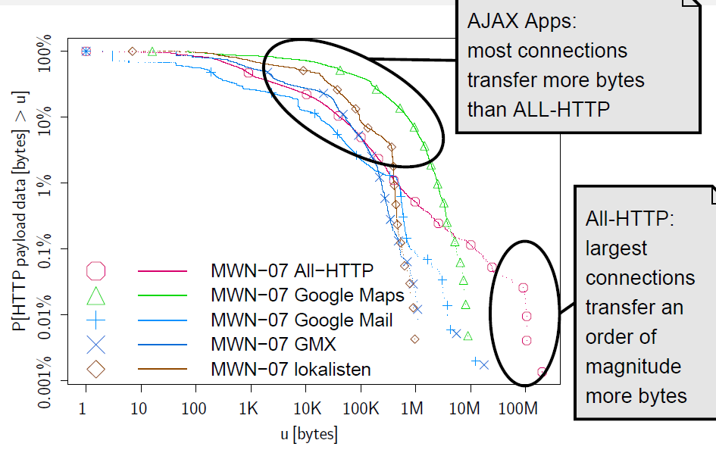
Bytes Per Connection (HTTP Payload)

Slide 45
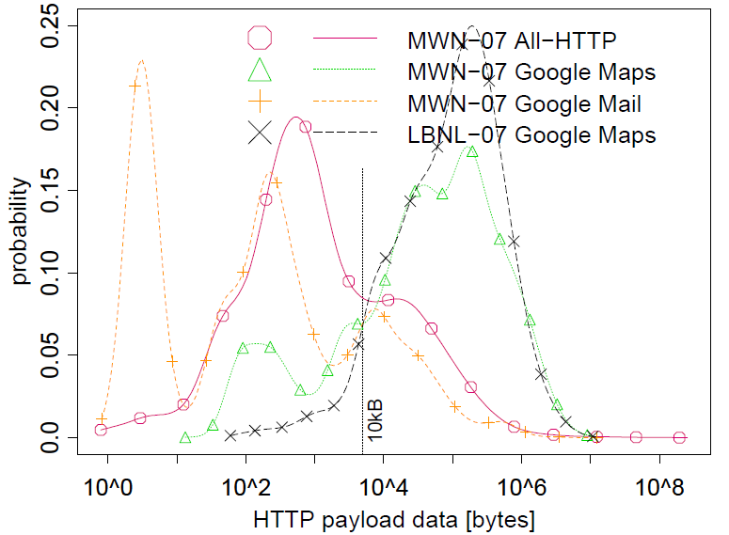
Bytes Per Connection (HTTP Payload)
Compare HTTP 1.0, Maps to the right, Mail to the left
(HTTP 1.0 has not changed much since 1997)

Slide 46
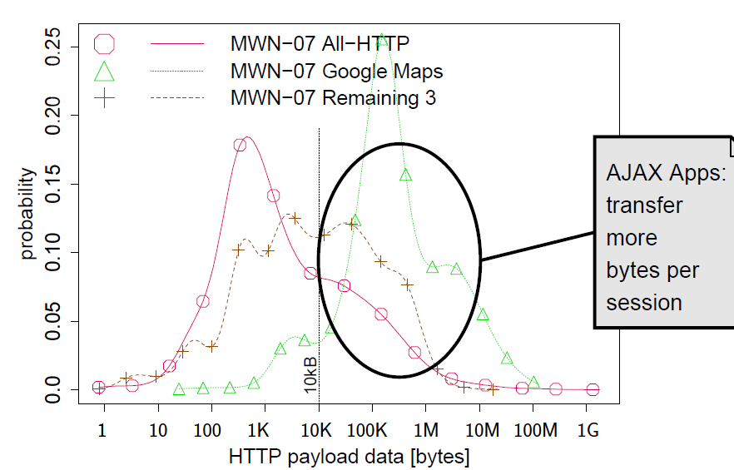
Bytes Per Session (HTTP Payload)

Slide 47
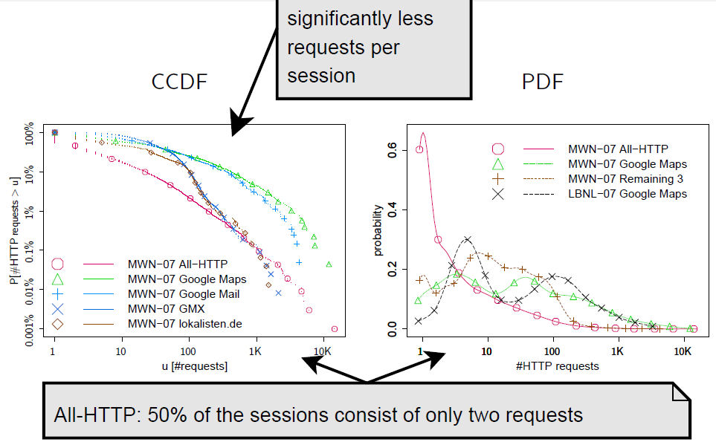
Requests per Session
All-HTTP:

Slide 48
Conclusions
On average, versus All-HTTP, AJAX apps
Transfer more bytes per connection and per session
Have more requests per session
Have significantly shorter inter-request times
Larger sessions and burstier traffic with AJAX applications
Existing Web traffic models still applicable, but need new parameterization

