Slide 1
CS 534 Spring 2019: Machine learning showcase
By Junfeng(Kimi) Guo, Tianyang Yi, Yichen Li, Ziheng (Leo) Li​, Thomas Le Baron
Showcasing work by Andrej Karpathy and Li Fei-Fei on generating image descriptions using deep neural networks

Slide 2
References
[1] Karpathy, Andrej, and Li Fei-Fei. Deep visual-semantic alignments for generating image descriptions. Proceedings of the IEEE conference on computer vision and pattern recognition. 2015.
[2] R. Girshick, J. Donahue, T. Darrell, and J. Malik. Rich feature hierarchies for accurate object detection and semantic segmentation. In CVPR, 2014.
[3] Felzenszwalb, P. F., & Huttenlocher, D. P. (2004). Efficient graph-based image segmentation. International Journal of Computer Vision, 59, 167–181.
[4] A. Krizhevsky, I. Sutskever, and G. Hinton. ImageNet classification with deep convolutional neural networks. In NIPS, 2012.
[5] Mikolov, T., Karafiát, M., Burget, L., Černocký, J., & Khudanpur, S. Recurrent neural network based language model. In Eleventh annual conference of the international speech communication association. 2010.
[6]I. Sutskever, J. Martens, and G. E. Hinton. Generating text with recurrent neural networks. In ICML, 2011.
[7]Levin, Esther. A recurrent neural network: limitations and training. Neural Networks 3.6 (1990): 641-650.
[8] Karpathy, Andrej, Armand Joulin, and Li F. Fei-Fei. Deep fragment embeddings for bidirectional image sentence mapping. Advances in neural information processing systems. 2014.

Slide 3
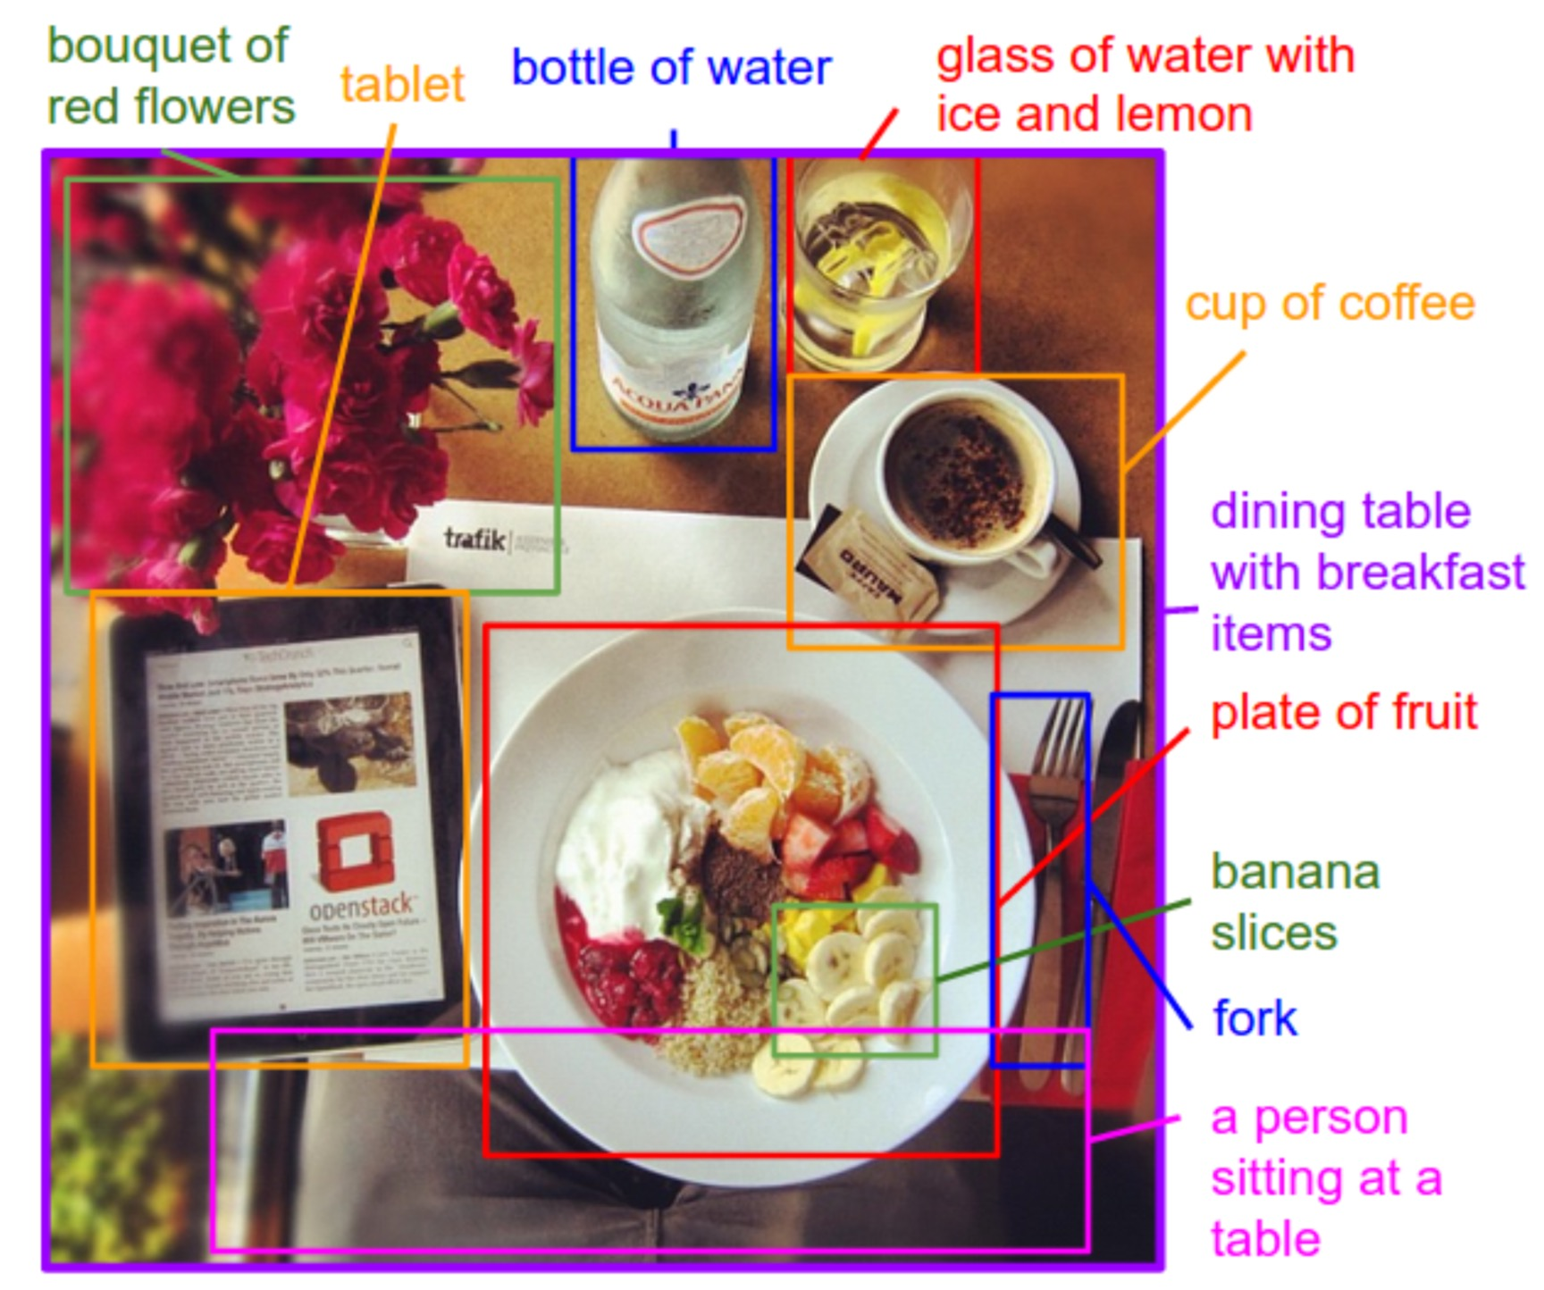
Outline
Describe objects of the image
Find the objects in the image
Describe these objects and their interactions
Generate a sentence to describe the entire image
Training and evaluation
https://cs.stanford.edu/people/karpathy/cvpr2015.pdf
Notes:
We showcase the work done at Stanford University where they build a model that generates natural language descriptions of

Slide 4
1. Describe objects
Input: set of images and text descriptions
Train a model that assigns words to objects in images
Step 1: get the objects out of the image and represent them by a vector
Step 2: represent each word of the sentence by another vector and align words to objects
https://cs.stanford.edu/people/karpathy/cvpr2015.pdf
Notes:
We showcase the work done at Stanford University where they build a model that generates regional-based natural language descriptions.

Slide 5
1.1 Object Detection
Region Convolutional Neural Network (R-CNN)
Regional Proposal
Feature Extraction
Image-object Alignment
http://openaccess.thecvf.com/content_cvpr_2014/papers/Girshick_Rich_Feature_Hierarchies_2014_CVPR_paper.pdf
Notes:
The object detection is based of existing framework called Region convolutional neural network. The data pipeline is set up in three stages - Regional Proposal, Feature Extraction and Image-object Alignment. And we’ll talk about each in detail.

Slide 6
1.1.1 Regional Proposal
Selective Search
Input: image
Output: set of object locations
Create initial regions with R-CNN
Iteratively group regions together
Repeated until the whole image is in one region
https://link.springer.com/content/pdf/10.1007%2Fs11263-013-0620-5.pdf
Notes:
They used the technique called selective search to segment a picture into regions. The system first uses Graph-Based Image Segmentation to create initial regions. Then it applies a greedy algorithm to iteratively group regions together: First the similarities between all neighboring regions are calculated. The two most similar regions are grouped together, and new similarities are calculated between the resulting region and its neighbors. The process of grouping the most similar regions is repeated until the whole image becomes a single region. The general method is detailed in Algorithm 1.

Slide 7
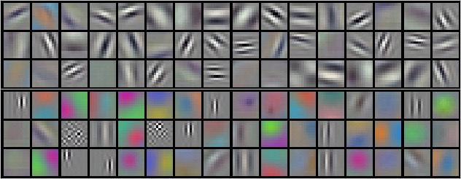
1.1.2 Feature extraction
Using Deep Convolutional Neural Networks (Deep CNN)
Eight weighted layers
Normalization and Pooling Layers
Softmax generates probability distribution
http://papers.nips.cc/paper/4824-imagenet-classification-with-deep-convolutional-neural-networks.pdf
Notes:
The net contains eight layers with weights; the first five are convolutional and the remaining three are fully- connected.
The first convolutional layer filters the input image with 96 kernels of size 11 × 11 × 3 (see picture) with a stride of 4 pixels: the picture at the bottom is the 96 convolutional kernels of size 11×11×3 learned by the first convolutional layer.
The second convolutional layer takes as input the (response-normalized and pooled) output of the first convolutional layer and filters it with 256 kernels of size 5 × 5 × 48. The third, fourth, and fifth convolutional layers are connected to one another without any intervening pooling or normalization layers.
The output of the last fully-connected layer is fed to a 1000-way softmax
The softmax takes that vector of 1000 real numbers, then normalizes it into a probability distribution consisting of 1000 probabilities.

Slide 8
1.1.3 Image-Object Alignment
Represent each object as a vector to match with text description
Identify Object:
Support Vector Machine (SVM)
Propose regions
Selective Search
Feature Extraction
Deep CNN
Notes:
After features for each region is extracted. We take the probability vectors representing each region to a support vector machine. The SVM then resolve what object are at each region. \
Here’s the entire object detection pipeline.

Slide 9
1.2 Text representation
Represent each word of the training sentences as a vector
Align words to objects
Align sentence fragments to objects

Slide 10
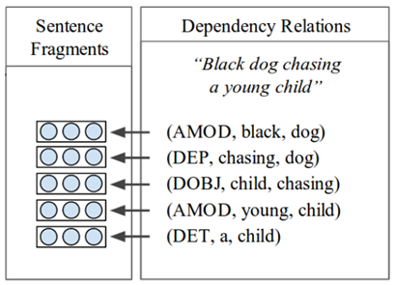
1.2.1 Word representation
Prior work: Each sentence is separated in difference fragments showing the words dependencies
Map each relation as:
(TYPE, word1, word2)
https://cs.stanford.edu/people/karpathy/cvpr2015.pdf
Notes:
The sentence is represented as a list of word dependency. Each of this relation is in the form (R, w1, w2)
Map these relation in sentence fragments using this equation.
W1, w2 are the word encodings, We is a wieght matrix obtained through unsupervised leaning, each relation can have its own weight Wr and biais br.
Fix the non-linearity with a ReLU transofmation f()
Problem with this idea: impose a maximum size of the context window (here 2) and requires to train another network to find these relations.

Slide 11
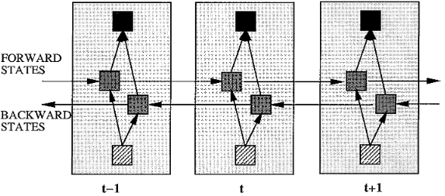
1.2.1 Word representation
New idea: Bidirectionnal recurrent neural network
Input: sentences
Output: vector
Each word representation is enriched with a variable-sized context
https://cs.stanford.edu/people/karpathy/cvpr2015.pdf

Slide 12
1.2.2 Word alignment
Each word is aligned to the single best image region
Score word-object alignment:
https://cs.stanford.edu/people/karpathy/cvpr2015.pdf

Slide 13
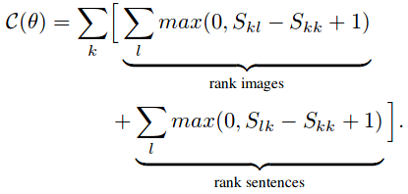
1.2.2 Word alignment
Objective function to optimize:
https://cs.stanford.edu/people/karpathy/cvpr2015.pdf
Notes:
This objective encourages aligned image-sentences pairs to have a higher score than misaligned pairs, by a margin.
That is the function you optimize to integrate in the unsupervised system
The image sentence score get the best related word for each object.

Slide 14
1.2.3 Word sequence alignment
The goal is to assign more than only one word per object.
Use Markov random field to take in account the relations between the words of the training sentences.
https://en.wikipedia.org/wiki/Markov_random_field
Notes:
Since we want to generate sentences, we need to align more than one word per object. => markov random field
a is the box selected, j is the word number
Beta is the hyperparameter that controls the affinity towards longer word phrases.

Slide 15
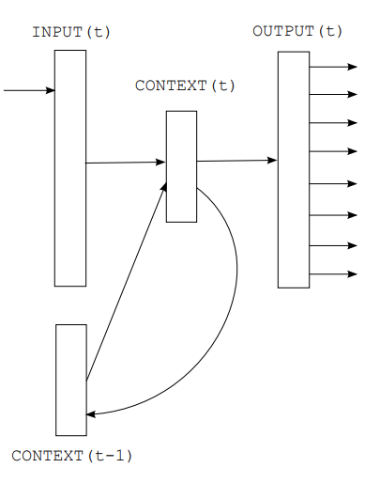
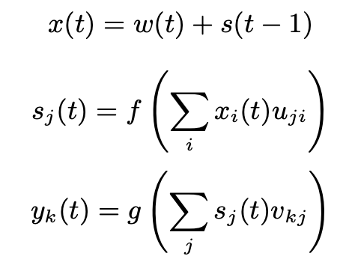
2. Sentence generation
How to predict a variable-sized sequence of words given an image?
Previous language model based on RNN:
achieved by defining a probability distribution of the next word in a sequence given the current word and context from previous time steps
https://www.fit.vutbr.cz/research/groups/speech/publi/2010/mikolov_interspeech2010_IS100722.pdf
Notes:
X: Input layer
S: Hidden layer(context)
Y: Output layer
G: softmax

Slide 16
2. Sentence generation
How to predict a variable-sized sequence of words given an image?
During training, Multimodal RNN takes the image pixels and a sequence of input vectors
b_{v}: image context vector
for t=1 to T:
I: image pixels
CNN_{θc}(I): last layer of a CNN
Providing b_{v} to the RNN only at the first iteration works better than at each time step
Notes:
yt holds the log probabilities of words in the dictionary and one additional dimension for a special END token

Slide 17
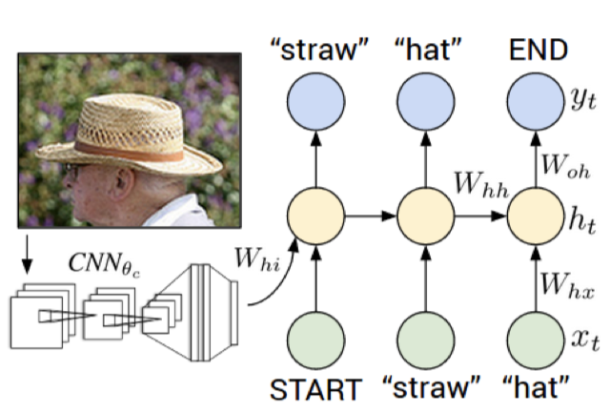
2. Sentence generation
RNN training:
Input: pair (image, word description)
Combine a word (x_{t}), the previous context (h_{t}−1) to predict the next word (y_{t}).
Reward when y_{t} corresponds to
the expected word.
https://cs.stanford.edu/people/karpathy/cvpr2015.pdf
Notes:
The RNN is conditioned on the image information at the first time step.

Slide 18
2. Sentence generation
RNN sentence generation
The image feeds the bias b_{v} of the hidden layers
Compute distribution over the first vector y₁
Set h₀=0, x₁ to the START vector
Set x2 as its embedding vector
Pick the word corresponding to it
END

Slide 19
3.1 Training
Use the datasets Flickr8K, Flickr30K and MSCOCO.
Contain respectively 8,000, 31,000 and 123,000 images
Annotate each image with Amazon Mechanical Turk
Trained by cross validation
For Flickr8K and Flickr30K, 1,000 images are used for validation, 1,000 other for tests, others are for training
For MSCOCO, 5,000 images used for both validation and tests

Slide 20
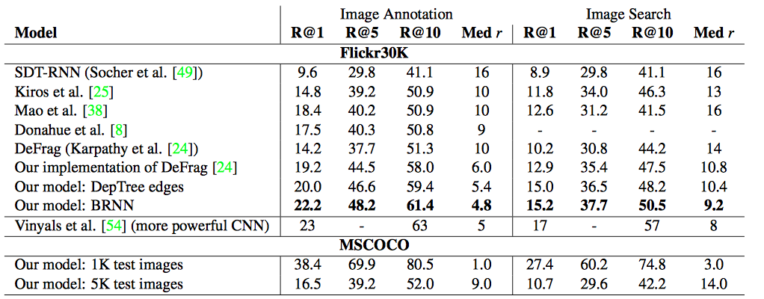
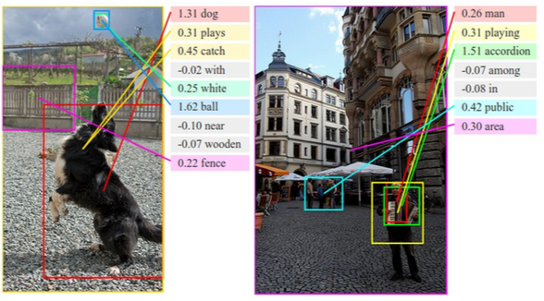
3.2 Evaluation
Image-Sentence Alignment Evaluation
​Recall@K measures the fraction of times a correct item was found among the top K results.
Higher R@K is better.
Med r: Median rank of the closest ground truth result in the list.
Lower Med r is better.
https://cs.stanford.edu/people/karpathy/cvpr2015.pdf
https://cs.stanford.edu/people/karpathy/cvpr2015.pdf

Slide 21
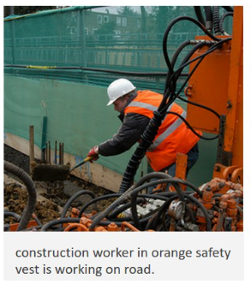
3.2 Evaluation
Fulframe evaluation
B-n is BLEU score that uses up to n-grams. High is good in all columns.
https://cs.stanford.edu/people/karpathy/cvpr2015.pdf
https://cs.stanford.edu/people/karpathy/cvpr2015.pdf

Slide 22
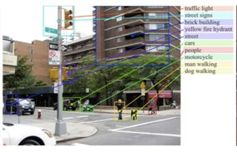
3.2 Evaluation
Region evaluation
BLEU score evaluation of image region annotations. High is good in all column.
https://cs.stanford.edu/people/karpathy/cvpr2015.pdf
https://cs.stanford.edu/people/karpathy/cvpr2015.pdf

Slide 23
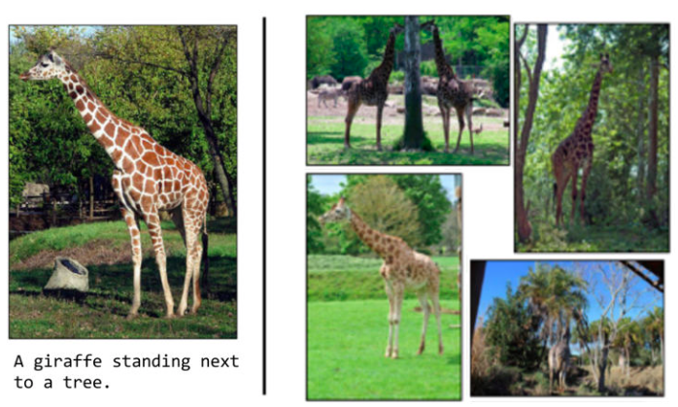
Conclusions
High quality results
Limitations​
The sentences generated from image samples with similar components are not very different.​
The corresponding subtitles for those images are "Giraffe standing next to the tree.“
The model can only generate a description of one input array of pixels at a fixed resolution.
https://www.oreilly.com/learning/caption-this-with-tensorflow

Slide 24
Thank You!

