Slide 1
CS 534 Spring 2019 Machine Vision Showcase
by Colleen Finnegan, Alec Kohlhoff, Sean McGovern,
Yash Shukla, and Huaming Sun
Showcasing work by:
Yaniv Taigman, Ming Yang, Marc’Aurelio Ranzato, and Lior Wolf on Facebook’s DeepFace
Notes:
Send description of presentation to Professor
Include slide numbers

Slide 2
References
Y. Taigman, M. Yang, M. Ranzato, and L. Wolf, “DeepFace: Closing the Gap to Human-Level Performance in Face Verification,” 2014 IEEE Conference on Computer Vision and Pattern Recognition, 2014.
G. B. Huang, M. Ramesh, T. Berg, and E. Learned-miller. Labeled faces in the wild: A database for studying face recognition in unconstrained environments. In ECCV Workshop on Faces in Real-life Images, 2008.
L. Wolf, T. Hassner, and I. Maoz. Face recognition in unconstrained videos with matched background similarity. In CVPR, 2011.
Browne, R. (2019). IBM hopes 1 million faces will help fight bias in facial recognition. [online] CNBC. Available at: https://www.cnbc.com/2019/01/29/ibm-releases-diverse-dataset-to-fight-facial-recognition-bias.html [Accessed 30 Mar. 2019].
J. Buolamwini and T. Gebru, “Gender Shades: Intersectional Accuracy Disparities in Commercial Gender Classification,” Proceedings of Machine Learning Research, vol. 81, pp. 1–15, 2018.
F.A. Bhat & M.A. Wani, “Performance Comparison of Major Classical Face Recognition Techniques,” International Conference on Machine Learning and Applications, 2004.
Alex K. , IIya Sutskever, Geoffrey H. , “ImageNet Classification with Deep Convolutional Neural Networks”, Communication of the ACM, Vol. 60, Issue 6, pp. 82-83

Slide 3
Agenda
DeepFace
Edge Detection
3-D Face Modeling
Deep Neural Networks
Deep Neural Networks in DeepFace
Siamese Network
Questions

Slide 4
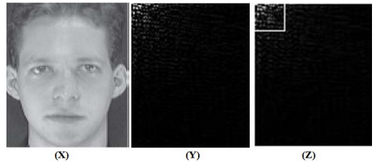
Classical facial recognition methods
Principal Component Analysis (PCA):
Decompose face image into uncorrelated components called Eigenfaces.
Extract features by thresholding.
Linear Discriminant Analysis (LDA):
Minimize Within Class Scatter Matrix and Maximize Between Class Scatter Matrix.
Project (test image-mean image) onto face space and Calculate Eucledian distance.
Discrete Cosine Transform (DCT):
Compute DCT of image f(x,y)
In most images, much signal energy lies at low frequencies.
(X): Face image from ORL database, (Y):DCT transformed image from X , (Z) : The top left rectangle (low frequency) carries maximum information
Image source: Performance Comparison of Major Classical Face Recognition Techniques [6]
Notes:
Discuss a few key previous methods used in facial recognition

Slide 5
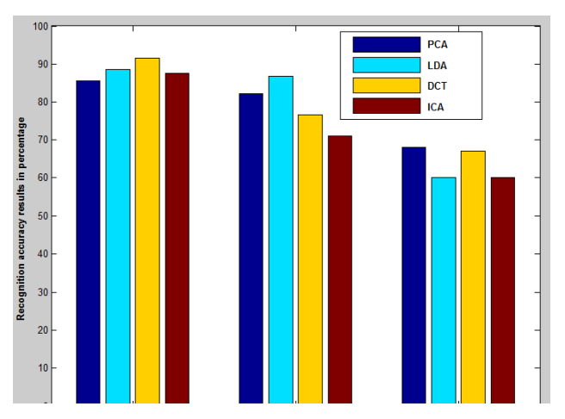
Classical facial recognition methods
Independent Component Analysis (ICA):
Outputs independent vectors that are linear combinations of image.
Less sensitive to pose variations and more to lighting conditions.
Variation in: 1. Facial expressions 2. Lighting conditions 3. Poses
From top to bottom: Variation in: Facial expressions, Lighting conditions, Poses
Image source: Performance Comparison of Major Classical Face Recognition Techniques [6]

Slide 6
Brief History of Convolutional Neural Networks
CNNs have been around since the 1980s (So why so new?)
Vast recent enhancements in GPU processing
Access to large, labeled visual datasets (ImageNet, Pascal, etc.)
ImageNet Large Scale Visual Recognition Competition (2012)
Team from University of Toronto used a breakthrough CNN to achieve a low error of 17%
Nicknamed AlexNet (designed by Alex Krizhevsky)
CNNs have been used ever since
Source: https://papers.nips.cc/paper/4824-imagenet-classification-with-deep-convolutional-neural-networks.pdf

Slide 7
DeepFace Introduction
Facebook’s facial recognition algorithm
Introduced in 2014
Deep Learning Framework instead of well engineered features
9-layer deep neural network
Uses a Siamese network
Contributions added to face recognition:
Affective facial alignment system based on explicit 3D modeling of faces
Advanced the state of the art significantly
Leverages a very large labeled dataset of faces to obtain a face representation

Slide 8
Datasets
Social Face Classification (SFC) -> Training
Collection of photos from Facebook
4.4 million labeled faces; 4030 people each with 800 to 1200 faces
Most recent 5% images of each identity are left out for testing
Identities do not intersect with any of the identities with below datasets
Labeled Faces in the Wild (LFW) -> Testing
13,323 web photos of 5,749 celebrities
Youtube Faces (YTF) -> Testing
3,425 YouTube videos of 1,595 subjects (a subset of the celebrities in the LFW)
Source: Taigman, Y. et al. In Proc. Conference on Computer
Vision and Pattern Recognition 1701–1708 (2014).
Notes:
Discuss data sets used in training and evaluating the deep face algorithm.
Remove explanations of data sets from other slides

Slide 9
Face Alignment pipeline: 3D Modeling
Detecting 6 fiducial points in the 2D detection cropped image (a).
Scale, rotate and translate image to anchor locations to obtain a 2D aligned crop (b).
Localizing additional 67 fiducial points in the 2D aligned crop (c).
Manually place 67 anchor points on the 3D shape model (d).
Source: Taigman, Y. et al. In Proc. Conference on Computer
Vision and Pattern Recognition 1701–1708 (2014).
Notes:
Detect 6 fiducial points in the 2-D detection cropped image (a).
Scale, rotate and translate image to anchor locations to obtain (b).
To register for out-of-plane rotations, a 3D shape model is used to warp 2D images to 3D shape.
A generic 3-D shape model obtained from USF Human ID database.
Additional 67 fiducial points are detected on the 2-D aligned crop image (c).
These additional fiducial points are then manually mapped on to corresponding 3D references.
An affine 3D-to-2D camera is then fitted using least squares solution.
To reduce corruption caused by non-rigid deformation and full perspective projection, a residual is added to each component of fiducial point.
Frontalization is achieved by a piece-wise affine transformation T from source to target as directed by the Delaunay triangulation.

Slide 10
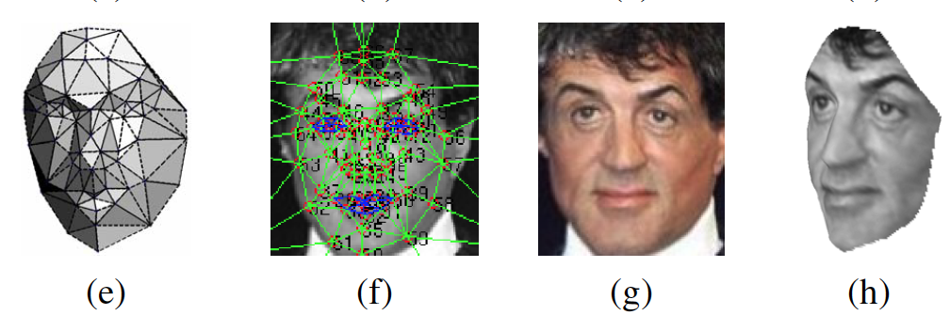
Face Alignment pipeline: 3D Modeling
An affine 3D-to-2D camera P is then fitted using the generalized least squares solution to the linear system X2d = X3dP (e).
The 67 fiducial points induced by the 3D model that are used to direct the piece-wise affine warpping (f) to achieve frontalization (g). A new view generated by the 3D model (h).
Source: Taigman, Y. et al. In Proc. Conference on Computer
Vision and Pattern Recognition 1701–1708 (2014).
Notes:
Detect 6 fiducial points in the 2-D detection cropped image (a).
Scale, rotate and translate image to anchor locations to obtain (b).
To register for out-of-plane rotations, a 3D shape model is used to warp 2D images to 3D shape.
A generic 3-D shape model obtained from USF Human ID database.
Additional 67 fiducial points are detected on the 2-D aligned crop image (c).
These additional fiducial points are then manually mapped on to corresponding 3D references.
An affine 3D-to-2D camera is then fitted using least squares solution.
To reduce corruption caused by non-rigid deformation and full perspective projection, a residual is added to each component of fiducial point.
Frontalization is achieved by a piece-wise affine transformation T from source to target as directed by the Delaunay triangulation.

Slide 11
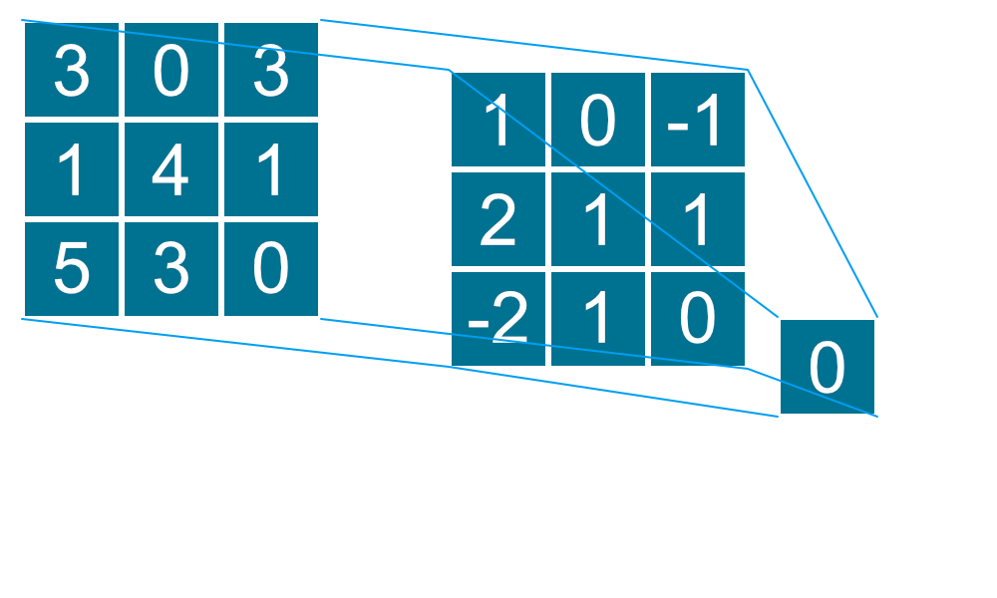
Deep Neural Networks
Deep neural networks are a type of artificial neural networks with multiple hidden layers.
Input layer takes in a vector of features which are fed forward to either hidden or output layers.
Hidden layers transform input data to intermediate representations.
Can be fully-connected, convolutional, pooling, recurrent, etc.
Output layer output predicted labels.
Notes:
Talk about pooling?
Talk about locally connected layers?

Slide 12
Deep Neural Network in DeepFace
Input is a 152x152 Image as 3 channels (red, green, blue)
(C1) 2D convolutional layer 32x11x11x3
(M2) Max-pooling layer
(C3) 2D convolutional layer 16x9x9x16
(L4-6) Locally connected layers
(F7,8) Fully connected layers, F8 uses softmax
Extract low-level features
Local statistics
Correlate parts of faces
Taigman et. al.

Slide 13
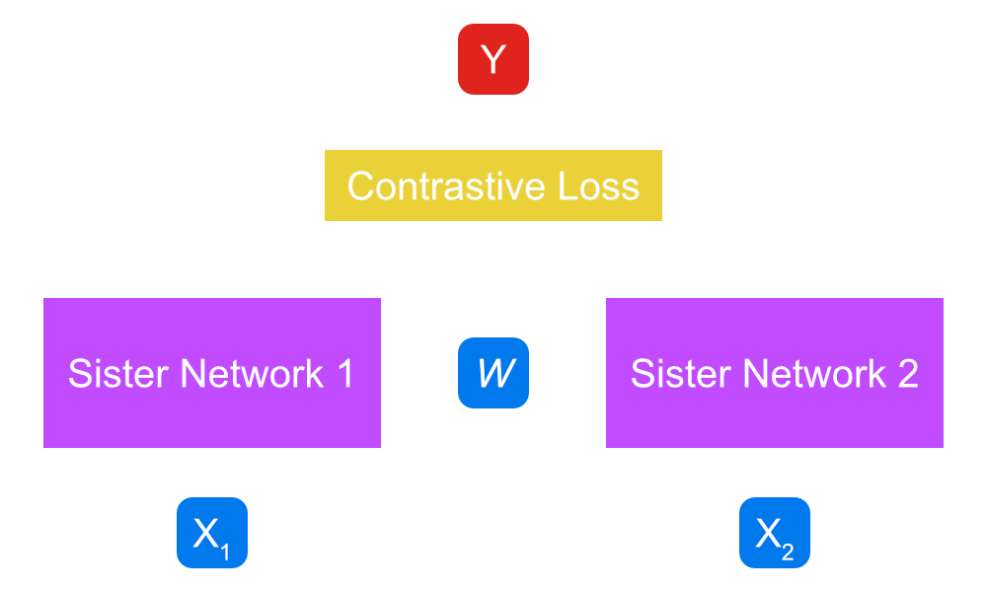
Siamese Network
Uses the previously trained neural network.
The neural network without F8 is used in parallel with identical weights.
Determine loss as absolute error between the two sets of labels.
Output identifies if the two inputs represent a single logistic unit.

Slide 14
Results: Deep Neural Network in DeepFace
DeepFace uses a combination of several networks, all of which are DeepFace-single networks with a certain input type:
3D aligned RGB
Gray-level image plus gradient magnitude and orientation
2D aligned RGB
These are combined using a non-linear SVM
Uses a “kernel trick” to implicitly map data to higher-dimensional spaces
Accuracy of the combined three networks is 97.25%
Adding 4 more DeepFace-single networks to the set of networks increases the accuracy to 97.35%
These accuracy values are based on the YTF dataset.
Notes:
Check usage of SVM
Show figure of true positive vs. false positive (accuracy table) - can’t, this data isn’t present in the paper.
Clean up wording/explainations - done.

Slide 15
Future work in facial recognition
Create more diverse datasets in order to better recognize all types of faces
MIT study showed lack of diversity in existing datasets
IBM has created a dataset with over 1 million faces
Darker-skinned females are most misclassified group with error rates up to 34.7%
Lighter-skinned males are most well-classified, with error rates only reaching 0.8%
Creating a facial recognizer that is invariant to:
Pose
Orientation
Image quality
Facial expression
Notes:
Discuss future work in the topic

Slide 16
Questions?

