Slide 1
CS534 Spring 2019
PLANNING SHOWCASE
Presented by:
Mengzhi Cao, Paritosh Goel, Jianpeng Cao
Pengyu Zhang, Prakash Baskaran
Showcasing work by:
Brian Paden, Michal Cáp, Sze Zheng Yong, Dmitry Yershov,
Emilio Frazzoli, Sebastian Brechtel, Rudiger Dillmann，Leonard J.,
D. Dolgov, S. Thrun, M. Montemerlo, J. Diebel
J. S., M. H., M. Z. and R. D. …
on Self-driving Urban Vehicles

Slide 2
REFERENCES
[1] B. Paden, M. Čáp, S. Z. Yong, D. Yershov and E. Frazzoli, "A Survey of Motion Planning and Control Techniques for Self-Driving Urban Vehicles," in IEEE Transactions on Intelligent Vehicles, vol. 1, no. 1, pp. 33-55, March 2016.
[2] Different companies implementations https://www.cbinsights.com/research/autonomous-driverless-vehicles-corporations-list/
[3] J. S., M. H., M. Z. and R. D., “Behavior Decision and Path Planning for Cognitive Vehicles using Behavior Networks”, Proceedings of the IEEE Intelligent Vehicle Symposium, June 2007.
[4] Sebastian Brechtel, Rudiger Dillmann, “Probabilistic MDP-Behavior Planning for cars”, Conference on Intelligent Transportation Systems, October 2011.
[5] Leonard J., et al.2008 A perception-driven autonomous urban vehicle. J. Field Robot. 25, 727-774
[6] D. Dolgov, S. Thrun, M. Montemerlo, J. Diebel, "Practical search techniques in path planning for autonomous driving", Ann Arbor, vol. 1001, 2008.

Slide 3
OUTLINE
Self-driving Urban Vehicles Introduction
Self-driving Vehicles’ history
Vehicle automation
Implementation
Algorithms overview
Self-driving Urban Vehicles Algorithms
Behavioral Decision Making
Self-driving motion planning

Slide 4
Self-driving Urban Vehicles Introduction
Self-driving Vehicles’ history
Vehicle automation
Implementation
Algorithms overview

Slide 5
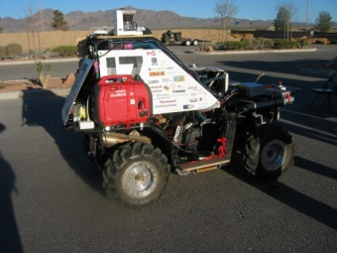
HISTORY
VaMP driverless car-- 1994
One of the first truly autonomous cars
Which was 95% driven autonomously for 1600 km
CMU NAVLAB-- 1995
Which was 98 driven autonomously for 5000 km
First DARPA Grand Challenge-- 2004
150-miles as quickly as possible
None completed
DARPA Urban Challenge-- 2007
Driven autonomously in simulated urban setting
Six teams completed
Google self-driving car and Tesla’s Autopilot system
http://www.oocities.org/~r_behringer/files/DGC.html
http://www.oocities.org/~r_behringer/files/DGC.html

Slide 6
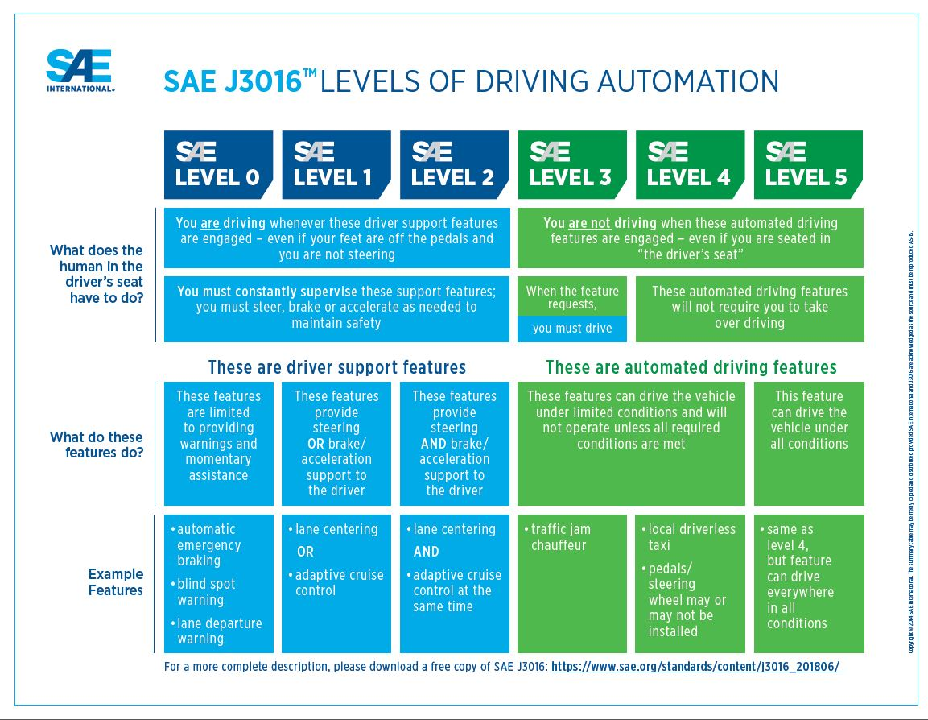
VEHICLE AUTOMATION
The SAE J3016
introduces a scale from 0 to 5 for grading
vehicle automation
Level 0 – No Driving Automation
Level 1 – Driver Assistance
Level 2 – Partial Driving Automation
Level 3 – Conditional Driving Automation
Level 4 – High Driving Automation
Level 5 – Full Driving Automation
https://www.sae.org/news/2019/01/sae-updates-j3016-automated-driving-graphic

Slide 7
IMPLEMENTATION
Waymo:
Originated as Google self-driving car project
Revealed its custom-designed, self-driving hardware in February 2017
Achieved 4,000,000 self-driven miles by Waymo autonomous vehicles in November 2017
Tesla
Released Autopilot in 2014
Hardware 2 provided the necessary equipment to allow full self-driving capability at SAE Level 5
These are just two of several current self-driving initiatives
https://www.cbinsights.com/research/autonomous-driverless-vehicles-corporations-list/
https://www.cbinsights.com/research/autonomous-driverless-vehicles-corporations-list/

Slide 8
Algorithms overview
Route Planning
Mentioned in Showcase 1 on Search
Behavioral Decision Making
Self-driving Motion Planning
Vehicle Control
Not a planning algorithm

Slide 9
Self-driving Urban Vehicles Algorithms
Behavioral Decision Making
Self-driving Motion Planning

Slide 10
Behavioral Decision Making
Basic Idea
The idea is to –
1.Gather data from the environment
2.Understand traffic scenarios
3.Perform independent or cooperative driving manoeuvres.
Conclusion - Behavior Networks
Behavior networks were developed with the goal to obtain a modular and robust control architecture for walking machines

Slide 11
Ontology
Representation of Driving Context
https://ieeexplore.ieee.org/document/7862066/
fusion of three main contexts
hasDriver
(functional)
Driver
Vehicle
hasVehicle
Environment

Slide 12
Context (Driver, Vehicle, Environment)
Driver
DriverProfile, FocusOnDriving, DriverViolation, MentalState.
Vehicle
Cockpit (‘hasWindowsOpen’), ComponentStatus (‘RightIndicator’, ‘LeftIndicator’, “EngineLubricantLevel”), “FuelType” , “TractionType”
Environment
City, DistrictArea, Road(‘hasMinSpeedLimit’, ‘hasNumberOfLanes’, ‘hasContinuousLine’), “Weather” etc

Slide 13
Identifying an action
Rules are created in the knowledge base, to guide the plan
(or initiate an action)
For example: A rule to avoid collision will consider several factors like lane, distance from another car, is obstacle on same lane etc.
Rule of driving in obstacle avoiding situation
https://ieeexplore.ieee.org/document/7862066/

Slide 14
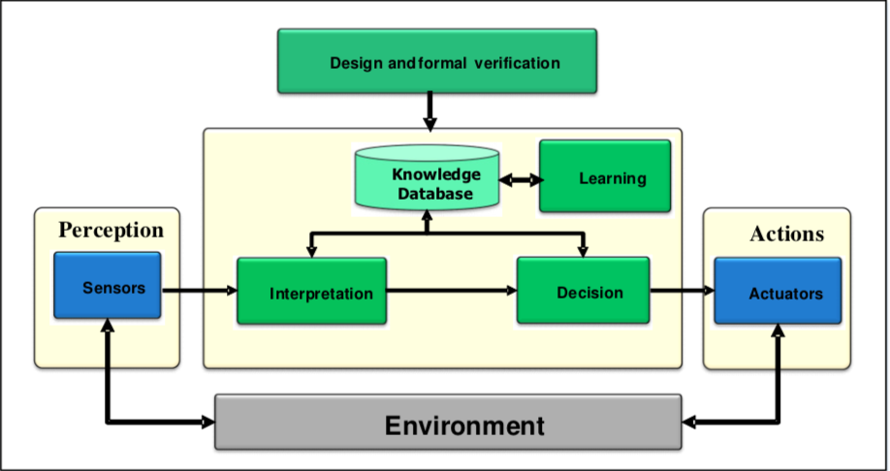
Behavioral Decision Making
Behavioral Decision Making
https://ieeexplore.ieee.org/document/7862066/

Slide 15
Execute action
https://ieeexplore.ieee.org/document/4290200

Slide 16
Challenge - How to handle uncertainty?
Uncertainty in the behavior of other traffic participants.
Solution - Using Probabilistic planning formalisms, such as Markov Decision Processes (MDPs) and their generalizations.

Slide 17
Markov Decision Process

Slide 18
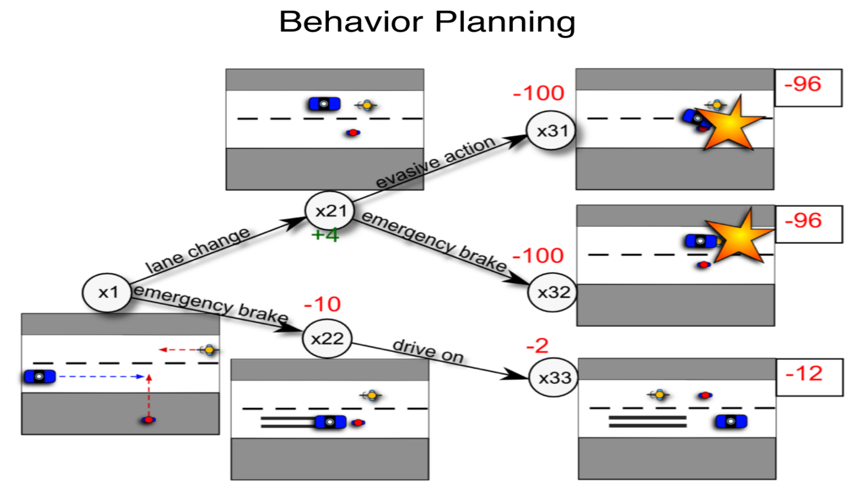
Markov Decision Process
Sebastian Brechtel, Rudiger Dillmann, “Probabilistic MDP-Behavior Planning for cars”, Conference on Intelligent Transportation Systems, October 2011.

Slide 19
Markov Decision Process

Slide 20
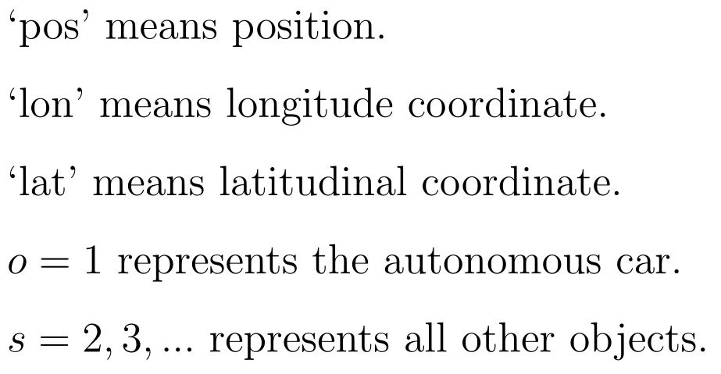
Markov Decision Process
State Space

Slide 21
Markov Decision Process
Action Space

Slide 22
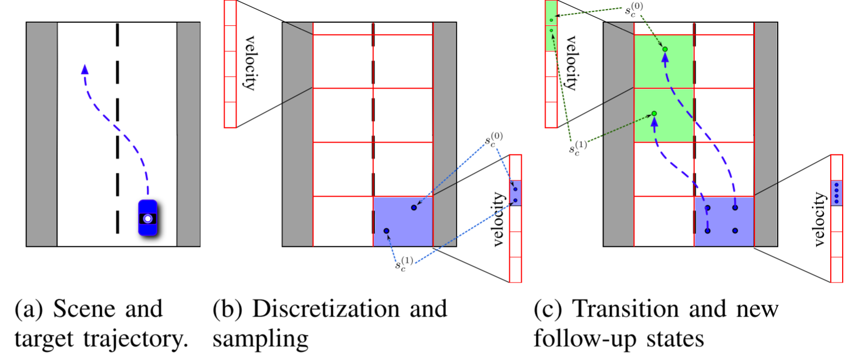
Markov Decision Process
How to make an action?
Sebastian Brechtel, Rudiger Dillmann, “Probabilistic MDP-Behavior Planning for cars”, Conference on Intelligent Transportation Systems, October 2011.

Slide 23
Self-driving Vehicles - Motion Planning
MIT DARPA Urban Challenge
Stanford DARPA Urban Challenge

Slide 24
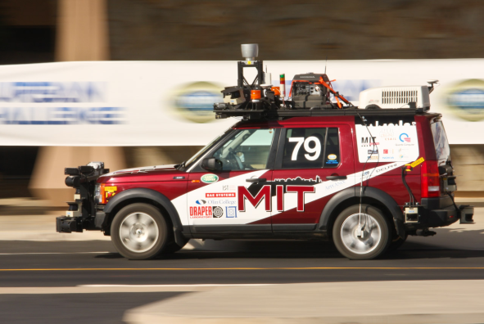
Motion planning
Talos [5] Leonard J., et al.2008A perception-driven autonomous urban vehicle. J. Field Robot. 25, 727-774
Three of the key novel features of the system are:
(1) A perception-based navigation strategy
(2) A unified planning and control architecture
(3) A powerful new software infrastructure.
Notes:
In regard to the motion planning, 2007,Defense Advanced Research Projects Agency conducted the Urban Challenge Event, and MIT took part in the contest.This is Talos, in the system,they

Slide 25
Motion planning
How to satisfy the requirement of driving in lanes, executing three-point turns, parking, and maneuvering through obstacle fields with a single, unified approach?
Closed-loop Rapidly-exploring Randomized Trees(RRT)

Slide 26
Motion planning
How does it benefits the motion planning?
Randomly explore the space while efficiently generating smooth trajectories in a dynamic and uncertain environment.

Slide 27
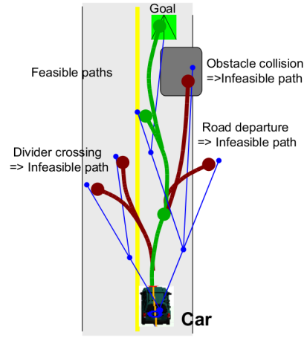
Motion planning
Closed-loop RRT
repeat Receive the current vehicle states and environment. Propagate the states by the computation time limit. repeat Take a sample for the input to the controller Select a node in the tree using heuristics Propagate from the selected node to the sample if The propagated path is feasible with the drivability map then Add branch nodes on the path. Add the sample and the branch nodes to the tree. for Each newly added node v do Propagate to the target if The propagated path is feasible with the Drivability Map then Add the path to the tree Set the cost of the propagated path as the upper bound of cost-to-go at v end if end for end if until Time limit is reached Choose the best trajectory in the tree, and check the feasibility with the latest Drivability Map if The best trajectory is infeasible then Remove the infeasible portion from the tree and Go to line 2 end if Send the best trajectory to the controller
until Vehicle reaches the target.
Illustration of RRT Motion planning.[5] Leonard J., et al.2008A perception-driven autonomous urban vehicle. J. Field Robot. 25, 727-774

Slide 28
Motion planning
Advantages?
The forward simulation can easily incorporate any nonlinear controller or nonlinear dynamics of the vehicle.
The output of the closed-loop simulation is dynamically feasible by construction.
Since the controller handles the low-level tracking, the RRT can focus on macro behaviors by giving the controller a straight-line path to the target or a path that follows the lane center.

Slide 29
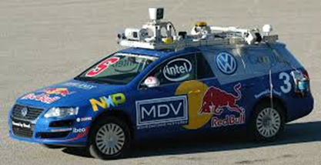
Stanford Autonomous Urban Vehicle
Key Features:
Hybrid-State A* search
Non-linear Path Optimization
http://robots.stanford.edu/papers/junior08.pdf

Slide 30
Hybrid-State A* Search
Uses a variant of the A* algorithm applied to the 3D (x,y,θ) state space, but with a modified state-update rule.
The resulting path is guaranteed to be drivable (kinematic feasibility).
Hybrid-state A* is not guaranteed to be optimal but typically lies in the neighborhood of the global optimum.

Slide 31
Dual Heuristics
Search algorithm is guided by two heuristics
The first heuristic uses a max of the non-holonomic-without-obstacles cost and 2D Euclidean distance.
The second heuristic ignores the non-holonomic nature of the car, but uses the obstacle map to compute the shortest distance to the goal.

Slide 32
Non-Linear Path Optimization
Path produced by hybrid-state A* is sub-optimal.
Contains unnatural swerves that require unnecessary effort and steering.
Two-stage optimization:
Improve the path length and smoothness
Smooth the vertices with high-resolution path discretization

Slide 33
Common Cost Parameters
Penalties for driving in reverse
Penalties for switching the direction of motion
Maximum speed to 50-60 mph
Maximum acceleration to 10 ms⁻²
Maximum jerk to 10 ms⁻³

Slide 34
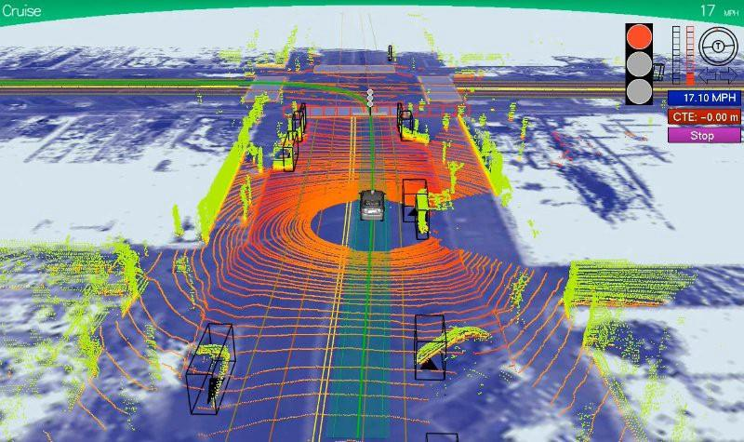
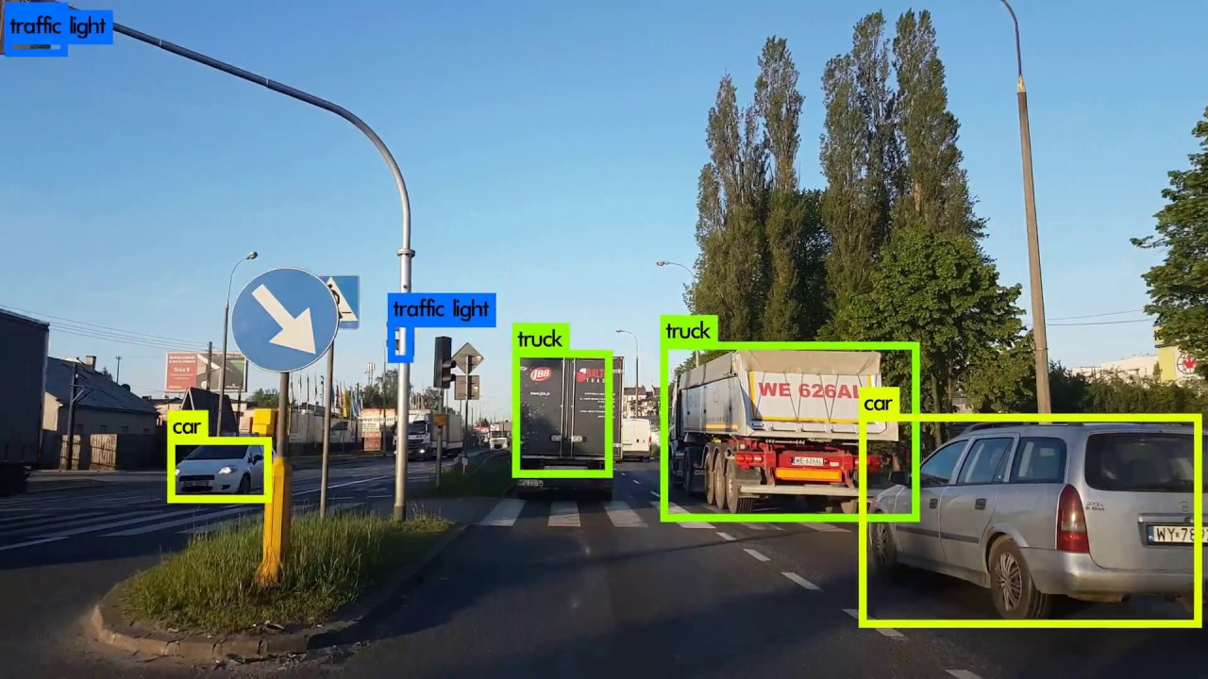
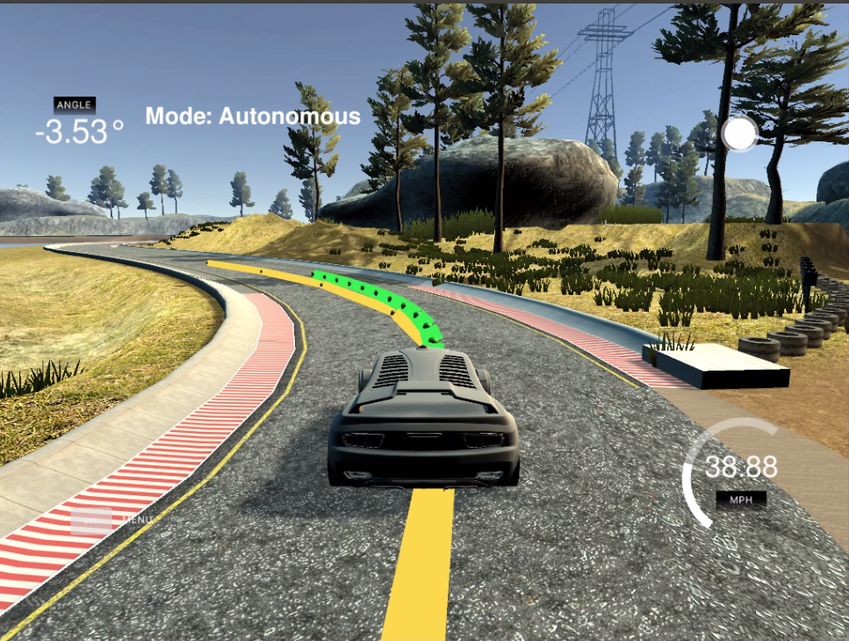
State-of-the-Art
End-to-End Deep learning approaches are becoming popular
Companies make use of Deep Neural Nets for scene understanding, decision making and for predicting steering angle directly from the sensors.
Fpr example: PointNet, ChaffeurNet, etc.
https://news.voyage.auto/an-introduction-to-lidar-the-key-self-driving-car-sensor-a7e405590cff
https://www.analyticsvidhya.com/blog/2018/06/understanding-building-object-detection-model-python/
https://towardsdatascience.com/how-self-driving-cars-steer-c8e4b5b55d7f

Slide 35
Thank you!
Questions

