Slide 1
CATCH ME IF YOU CAN
CS548 Fall 2016 Anomaly Detection Showcase
by
Nichole Etienne, Rohitpal Singh, Suchithra Balakrishnan, Yousef Fadila
Showcasing work by Bowen Du, Chuaren Liu, Wenjun Zhou, Zhenshan Hou, Hui Xiong on “ Catch Me If You Can - Detecting Pickpocket Suspects from Large-Scale Transit Records”

Slide 2
References
[1] Bowen Du, Chuaren Liu, Wenjun Zhou, Zhenshan Hou, Hui Xion, “Catch Me If You Can - Detecting Pickpocket Suspects from Large-Scale Transit Records”, Knowledge Discover and Data mining 2016, Aug 13- 17, 2016, San Francisco, USA
[2] Paul Bouman, Evelien Van der Hurk, Leo Kroon, Ting Li, Peter Vervest, “Detecting activity patterns from smart card data”, In Benelux Conference on Artificial Intelligence, 2013
[3] Markus M. Breunig, Hans Peter Kriegel, Raymond T. Ng and Jorg Sander. LOF: Identifying density-based local outliers. Special Interest Group On Management of Data Rec., 29(2):93-104, May 2000

Slide 3
Motivation
Passengers in the public transit systems have been the main target for pickpockets. In many cities, thefts happen frequently in transit systems
Passengers dissatisfaction and serious public safety concerns
2014 in Beijing
350 pickpockets on subway system
490 pickpockets on buses

Slide 4
Abnormal travel Behaviors
Travelling for an extended length of time
Making unnecessary transfers
Wandering on certain routes while making random stops
Making random stops

Slide 5
Trajectories of Passengers
Examples of outliers
A -> C -> D -> B
instead of A -> B (shortest time/distance)
E -> B (fewer passengers take that path)
Notes:
Put figure 1 in a slide, and give example, travel who instead of going directly from A to B, choose to travel A → C → D → B is suspected.! But travel from E-B (outlier) is not suspected as this passenger is likely just a regular passenger who originates from a less crowded areat’s

Slide 6
Data and Framework

Slide 7
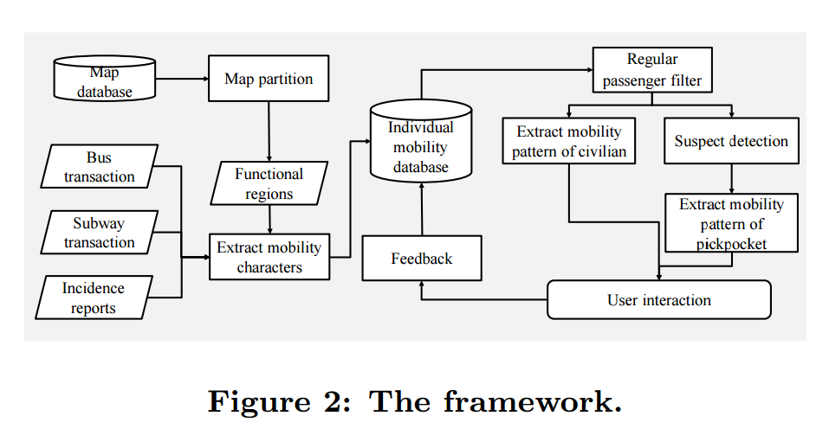
Steps in the Architecture
Partition the city area into regions with functional categories
Extraction of mobility characteristics of passengers
Individual mobility database to store the profile of each passenger
Passenger filtering and suspect detection
User feedback information, for future model training

Slide 8
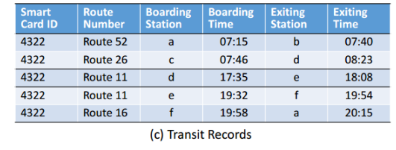
Dataset I : Transit Records
Public transit system from buses and subways
Rechargeable smart card – swipe when board or exit the vehicle
Automated fare collection system (AFC) calculates the fare according to stations boarding and exiting

Slide 9
Passenger Activity Map
Notes:
Clarify the different between transit record and trip (Verbal, explain the figure, don’t add these text to slides)
Part (a) is the actual trajectory on the city’s map;
Part (b) splits the trajectory into three separate trips;
Part (c) demonstrates the corresponding transit records in our data.
Explain the 30 minutes empirical cutoff!

Slide 10
Dataset II. Geographical Dataset
Points of Interest :
Public Transit Network Info :

Slide 11
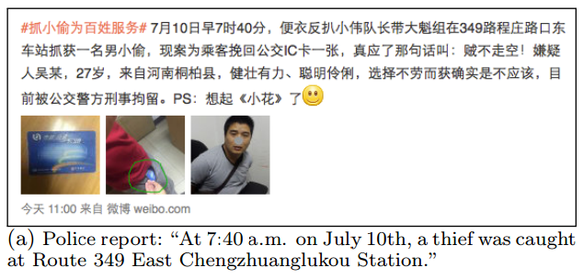
Dataset III. Incident Reports
Confirmed Reports are publicly announced via SINA WEIBO, a primary social networking site in China
Two types of Pickpocket reports,
Official Announcements - announced by police
Personal Complaints - posted by victims

Slide 12
Extraction of Features

Slide 13
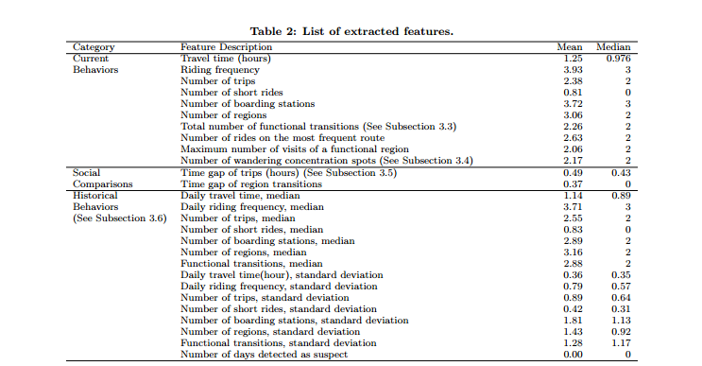
Mobility Characteristics
.
Notes:
The features are are grouped into three categories: daily behaviors, social comparisons, and historical behaviors

Slide 14
I. Travel Time and Frequency
The daily travel time is defined as the total duration spent by each passenger in the public transit system
The daily riding frequency is defined as the number of transit records traveled by each passenger per day.

Slide 15
Travel Time and Frequency
A thief has to spend quite long time in the crowded buses, subways, or near the transit stations to find potential victims and better their crime moments
Notes:
A thief (pickpocket) tends to travel between bus/subway stations in random ways without specific destinations. Such abnormal behaviors lead to abnormal daily travel time and riding frequency.
We can see that more than 80% passengers finish their travels in 2 hours and within 2 transit records per day. In comparison, the identified thieves often spend more than 3 hours of daily travel time, and their daily riding frequency is also larger.

Slide 16
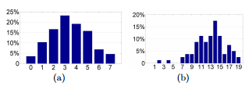
II. Short Rides
A short ride is a transit record tr with less than 3 stops. Regular passengers normally prefer fewer transfers in each trip.
A thief (pickpocket) travels between bus/subway stations in random ways without specific destinations.
80% passengers finish their travels in 2 hours and within 2 transit records per day.
In comparison, the identified thieves often spend more than 3 hours of daily travel time, and their daily riding frequency is also larger.
Notes:
Figure 7(a), the distribution approximates Gaussian with mean around 3. In Figure 7(b), for the passengers with at least 19 transit records, the distribution peak is shifted to the right. It shows that the frequency of short rides increases with increasing number of transit records.

Slide 17
III. Functional Transaction
Regular Passengers
Suspects
.
.
Notes:
A high-level view of the human mobility patterns can be summarized by transition among regions, where each region covers multiple stations
such as the number of boarding stations and the number of boarding regions. Then, we count the transition frequency between any pair of function categories for the daily trip of each passenger.

Slide 18
IV. Frequently Visited Regions
Regular movements between a small set of locations that the passenger is familiar with
Pickpockets often spend a significant portion of the time within few routes or regions if they intend for opportunities
Once a thief has committed the crime or lost the target, he or she would likely come back to a familiar station for the next target
Wandering behaviors were measured by counting the maximum number of times a route was taken, or the maximum number of visits made to a region
Notes:
, the wandering behaviors lead to concentration of the passenger’s boarding or exiting locations. We use the number of clusters as another feature, which measures the wandering concentration

Slide 19
V. Deviation from the Social Norm
The difference between the individual behaviors and the typical behaviors of the population, so we call them social features
Example :
Most of the trips will be finished within a specific amount of time given the trip origin and destination,
pickpocket suspects may spend more time in the transit system during the trip
Notes:
given the same origin and destination, the trip variation of the majority of the population (i.e., regular passengers) is low
Thus, for each pair of origin o and destination d, we find the travel time of all trips between this pair. We then convert the time gap significance of a given trip by the quantile of its travel time with respect to the population.

Slide 20
VI. Historical Behavior
The statistics (e.g., median and standard deviation) were computed as daily features were observed in the last seven days for each passenger, to quantify their historical behaviors
The median is more robust in the presence of outliers, hence its use
Notes:
In our case, we only used data from the past seven days, and median can effectively avoid the impact of non-routine passenger behaviors. The standard deviation indicates the degree of variation of the daily behaviors of individual passengers. Regular passengers following routine trajectories normally generate statistics with less variations.

Slide 21
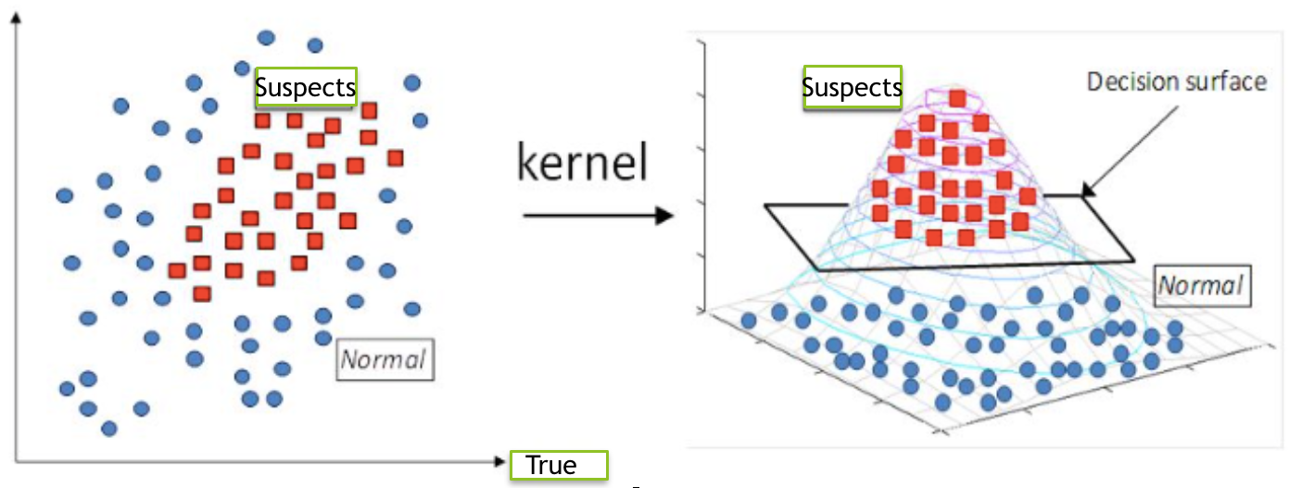
The Algorithm : One Class SVM
Goal:
Distinguish pickpockets from the regular passengers with high accuracy and low false-positives.

Slide 22
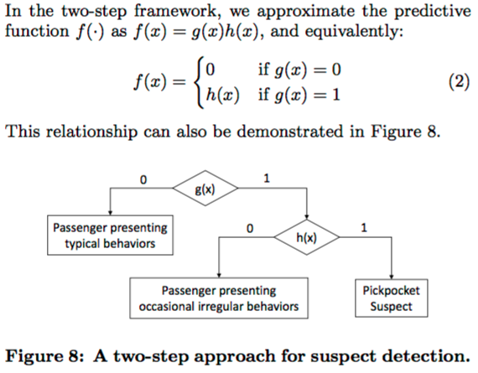
Two-step approach:
The first step uses unsupervised anomaly detection techniques to filter out regular passengers from suspects.
The second step uses supervised classification to identify real pickpockets from suspects.
{(x_{j},y_{j}) | j = 1,...,N} where x_{j} ∈ R^{q} is the extracted features associated with the j-th passenger .
y_{j} ∈ {0,1} : 1 means pickpockets.
Model : f : x → y = f(x)

Slide 23
Step I:
Filter out regular passengers from suspicious passengers.
Used one class SVM (high accuracy, computing efficiency and high flexibility)
The function φ(·) maps the original feature into a high- dimensional kernel space where the optimal decision boundary exists:
Use Kernel : κ(x1, x2) = ⟨φ(x1), φ(x2)⟩

Slide 24
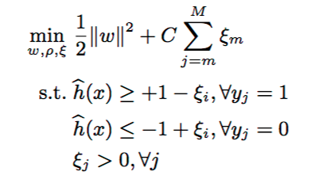
Step II
To distinguish the real suspects and false positives
C is a controlling parameter that reduces false positives
Used Supervised Classification Method using confirmation on social media as target attribute
Optimal Decision hyperplane :
To compute optimal w and p in h(.) , Optimized

Slide 25
EXPERIMENT & RESULT

Slide 26
Baselines ( for comparison) & evaluation
Classification methods (CM). The classification methods, including logistic regression (LR), decision trees (DT), and support vector machines (SVM)
Anomaly detection (AD). Anomaly detection methods, such as one-class SVM (OCSVM) and local outlier factor (LOF)
Two-step (TS) methods
Evaluation metrics.
- precision
- recall
- F-score computed with test set

Slide 27
Experiment Settings
Datasets:
real-world datasets containing over 1.6 billion transit records
split the data into historical training set and evaluation test set
Platform:
Windows Server 2012 64-bit system (4-CPU, each with 2.6GHz with Quad-Core, and 128G main memory)
All algorithms were implemented with Java

Slide 28
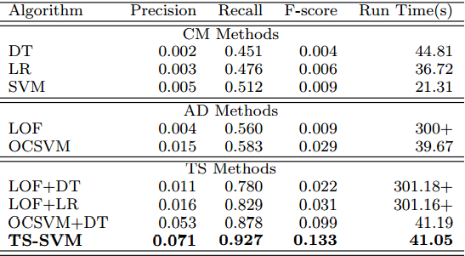
The Result
precisions of all one-step methods are very low
two-step combinations significantly improve the precisions.
Two-step approach can e ectively reduce the false-positives

Slide 29
DEPLOYMENT AND INSIGHTS
Goal: Develop a decision support system for the security personnel to easily spot pickpocket and hotspots

Slide 30
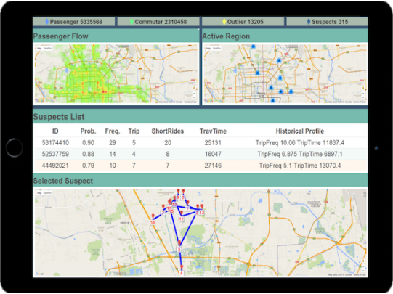
Screenshot of the prototype system
Shows:
Suspect List
Statistics
Passenger Flows
Active Regions
Selected Suspect

Slide 31
Related Work
Passengers Activity Patterns
assessing the performance of the transit network
identifying and optimizing problematic or awed bus routes,
making service adjustments that accommodate variations in ridership on different days
Abnormal Traveling Behavior Detection
discovers black-hole or volcano patterns in human mobility data in a city, which can quickly identify gathering events, such as football matches and concerts
making service adjustments to smooth the traffic flow

Slide 32
Conclusion
suspect detection and tracking system by mining large-scale transit records
novel two-step framework to distinguish regular passengers from pickpocket suspects
implement a prototype system for end users
experimental results on real-world data showed the effectiveness of the approach

Slide 33
Any Questions?

