Slide 1
CS548 Fall 2016 Clustering Showcase
By Theresa Inzerillo, Xi Liu, Preston Mueller
Showcasing work by Patrick Vogel, Torsten Greiser, Dirk Christian Mattfeld
On Understanding Bike-Sharing Systems using Data Mining: Exploring Activity Patterns
Notes:
Preston

Slide 2
References
[1] P. Vogel, V. Patrick, G. Torsten, and D. C. Mattfeld, “Understanding Bike-Sharing Systems using Data Mining: Exploring Activity Patterns,” Procedia - Social and Behavioral Sciences, vol. 20, pp. 514–523, 2011.
[2] P.-N. Tan, M. Steinbach, and V. Kumar, Introduction to Data Mining. Pearson Education, 2013.
[3] N. Slonim, S. Noam, F. Nir, and T. Naftali, “Unsupervised document classification using sequential information maximization,” in Proceedings of the 25th annual international ACM SIGIR conference on Research and development in information retrieval - SIGIR ’02, 2002.
[4] Dunn, Joseph C. "A fuzzy relative of the ISODATA process and its use in detecting compact well-separated clusters." (1973): 32-57.
[5] Rousseeuw, Peter J. "Silhouettes: a graphical aid to the interpretation and validation of cluster analysis." Journal of computational and applied mathematics 20 (1987): 53-65.
[6] Davies, David L., and Donald W. Bouldin. "A cluster separation measure."IEEE transactions on pattern analysis and machine intelligence 2 (1979): 224-227.

Slide 3
Background
Bike sharing systems and the challenges that come with them.
Notes:
Preston

Slide 4
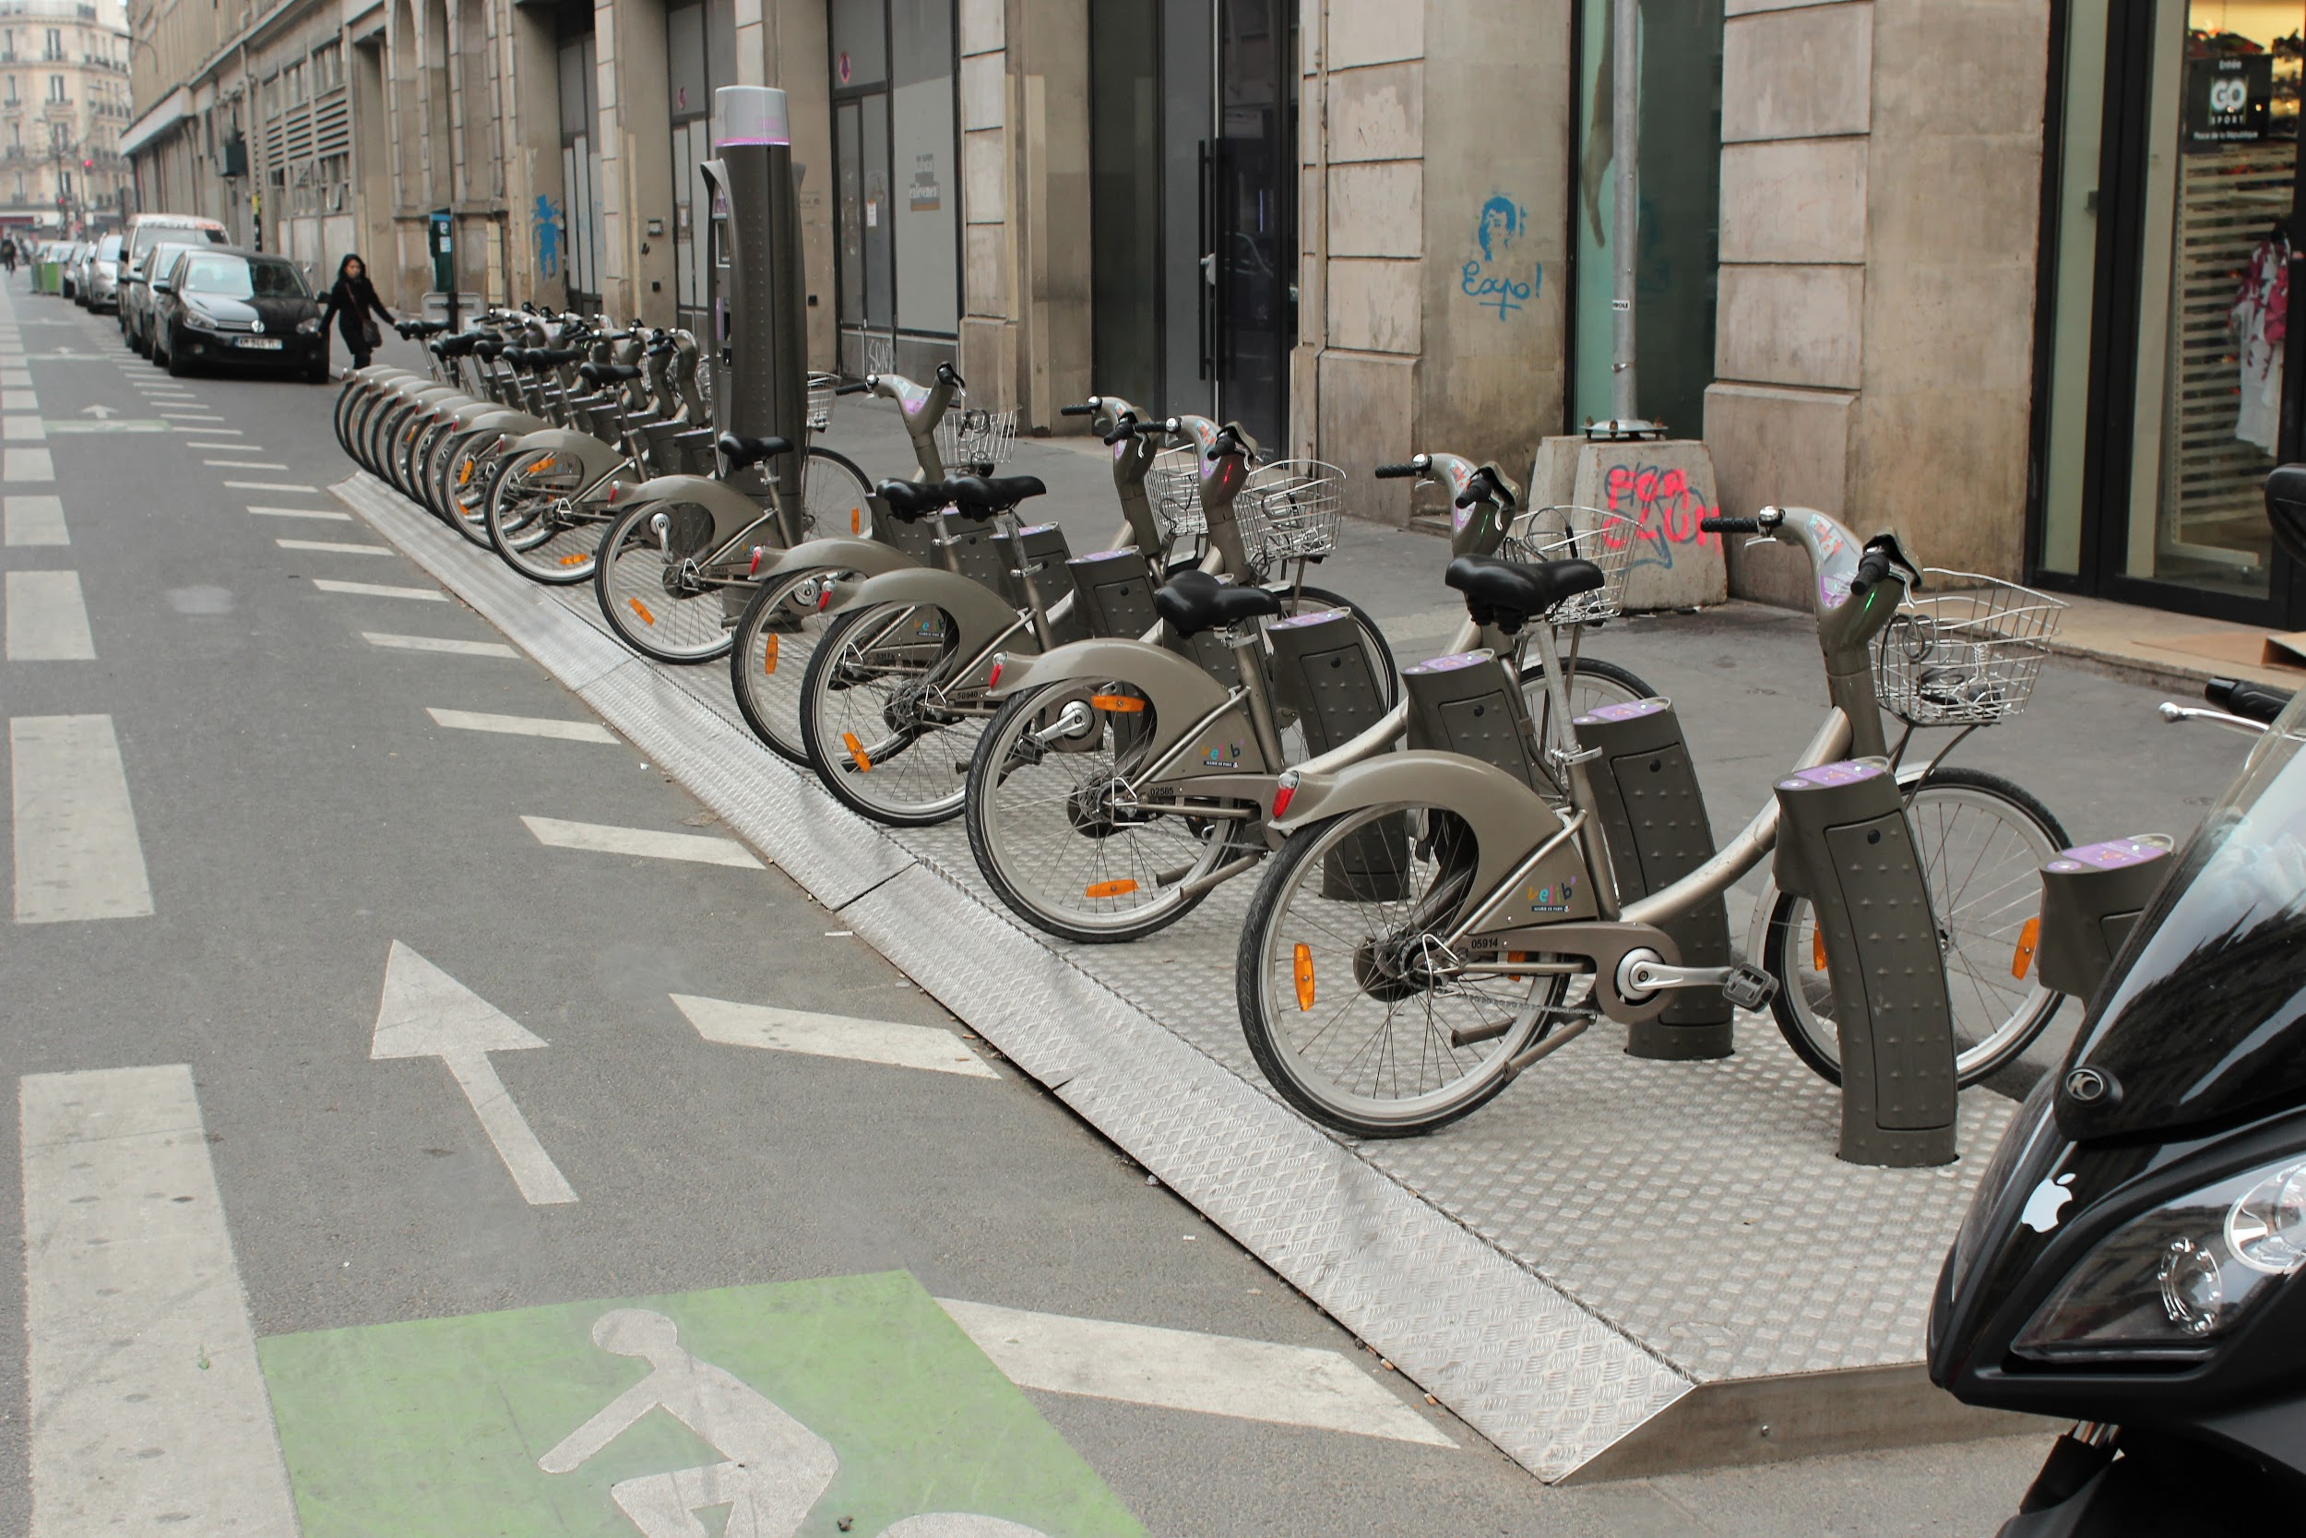
Bike sharing systems
Public transportation option for short trips
Stations located around the city
Challenge: balancing free bikes and free boxes
https://upload.wikimedia.org/wikipedia/commons/3/37/Place_de_la_R%C3%A9publique_%28Paris%29%2C_r%C3%A9am%C3%A9nagement%2C_2012-04-05_39.jpg
Notes:
Preston

Slide 5
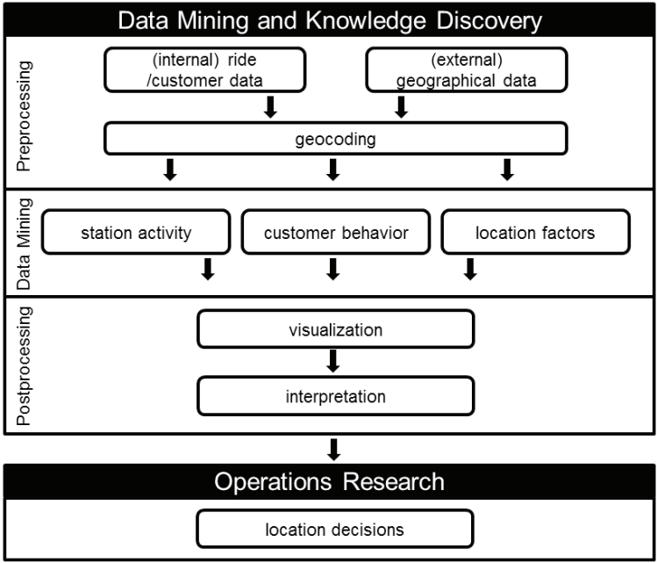
Geo-BI process: an implementation of KDD
[1]
Notes:
Preston

Slide 6
Pre-Processing
Removing instances and aggregating data to prepare the data set for clustering experiments.
Notes:
Xi

Slide 7
Data Set
Two years of ride data from Vienna’s BSS “Citybike Wien”
Approximately 760,000 rides from 2008 and 2009
Over 60 stations
Trip duration calculated from pickup and return time stamps
[1]
Notes:
Xi

Slide 8
Pre-Processing
Rides removed from the data set:
Rides that start or end at test stations
Rides where bikes are reported as defective or stolen
Rides show negative trip durations
Rides that last less than 60 seconds & start and end at the same station
Rides involving stations with only a few pickups or returns
After removing, number of instances decreased by 2% to 743,000, the number of stations dropped to 59
Notes:
Xi

Slide 9
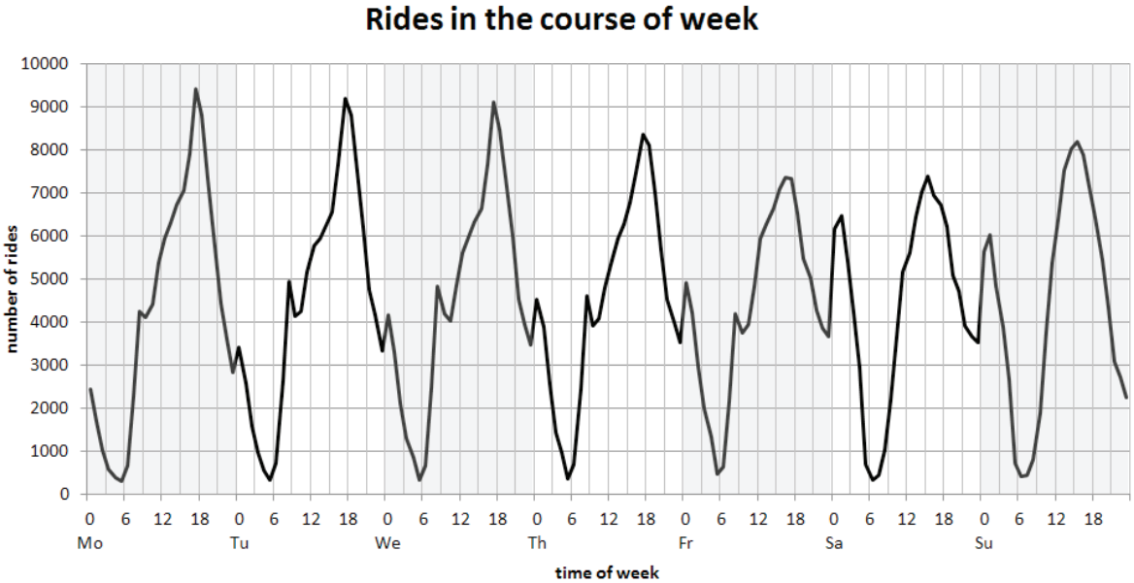
[1]
Notes:
Xi

Slide 10
Pre-Processing
Ride data is aggregated for 24 time windows per day of the week.
Normalization:
[1]
Notes:
Xi

Slide 11
Data Mining
Using K-means, Expectation-Maximization, and the Sequential information bottleneck algorithm to cluster this data
Notes:
Xi

Slide 12
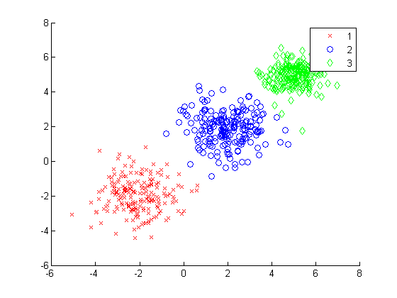
Clustering
Hopkins-Statistic: the ratio of nearest neighbor distance between randomly generated and actual data points.
The Hopkins-Statistic applied to the normalized pickups and returns at stations yields a value of 0.743
http://www.vub.ac.be/fabi/multi/pcr/chaps/chap8.html
https://www.mathworks.com/help/stats/class_clustering.evaluation.daviesbouldinevaluation_plot4.png
Notes:
Xi

Slide 13
K-means algorithm
Iterative
Centroid-based process
Assumes clusters are spherical
[2]
Notes:
Xi

Slide 14
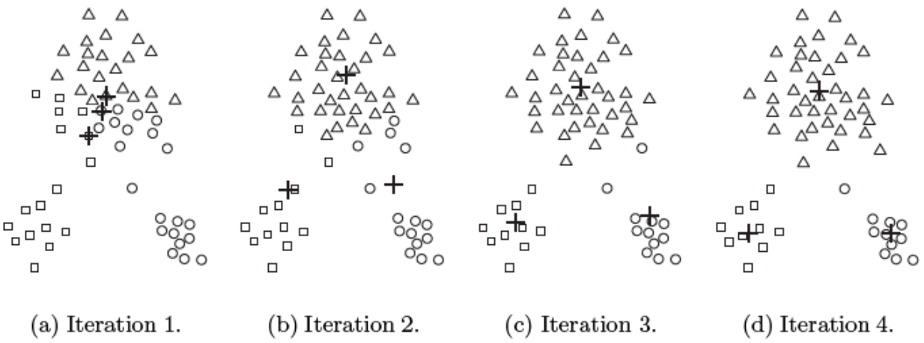
K-means algorithm
[2]

Slide 15
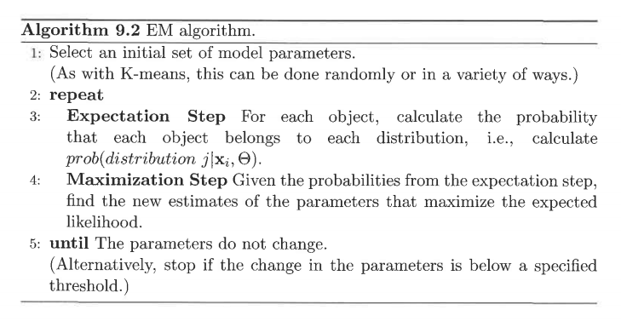
Expectation-Maximization
Similar to k-means
Maximizes likelihood that a data point belongs to a particular cluster
Changes model parameters
[2]
Notes:
Theresa

Slide 16
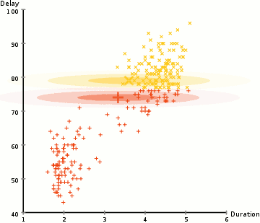
Expectation-Maximization
http://www.ohio.edu/people/yl079811/tutorials/
Notes:
Theresa

Slide 17
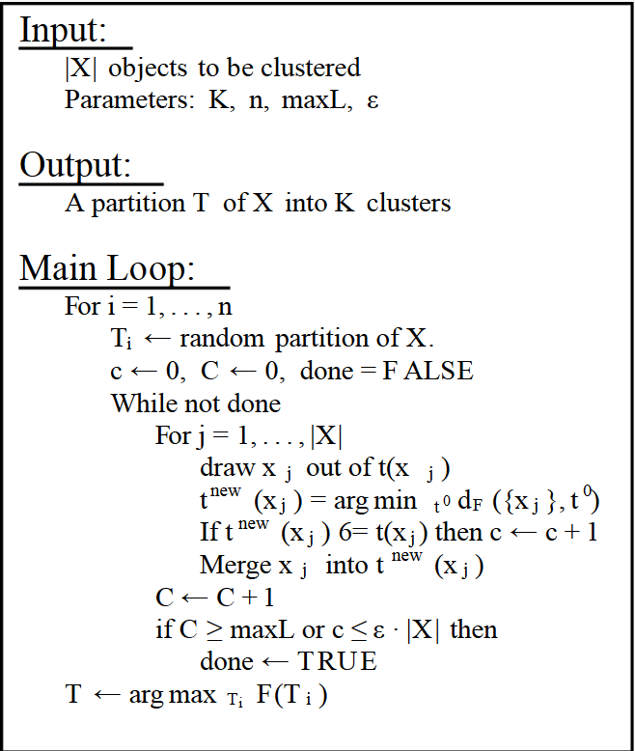
Sequential information bottleneck algorithm (sIB)
[3]
Notes:
Preston

Slide 18
Validation of clusters
Using Dunn, Silhouette, and Davies-Bouldin indices to evaluate the clustering algorithms used
Notes:
Preston

Slide 19
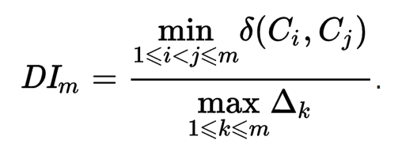
Dunn Index
A measure of compactness
Numerator: distance between clusters
Denominator: distance between data points within cluster
[4]
Notes:
Preston

Slide 20
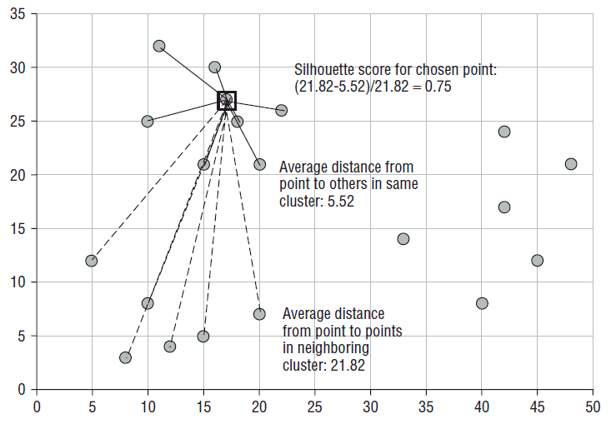
Silhouette Index
A measure of cohesion and separation
Goal: Maximize
[5]
http://blog.data-miners.com/2011/03/cluster-silhouettes.html
Notes:
Preston

Slide 21
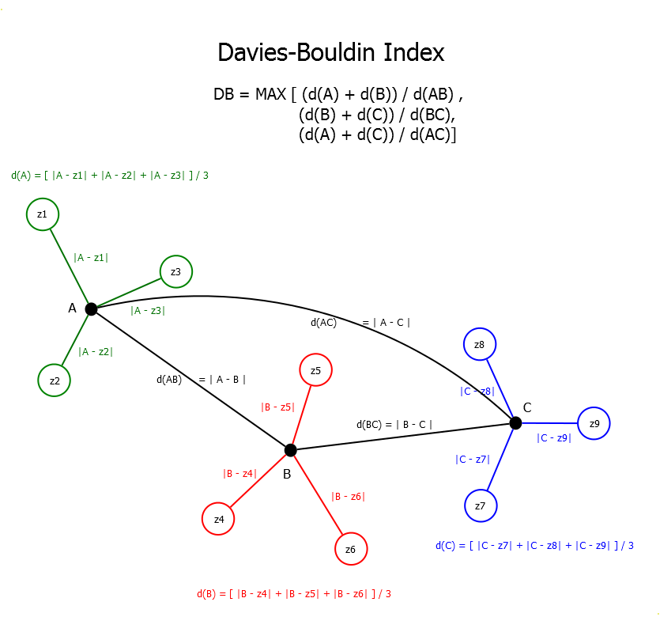
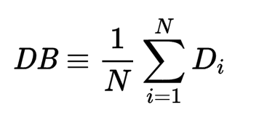
Davies-Bouldin Index
http://www.turingfinance.com/wp-content/uploads/2015/01/Davies-Bouldin-Index1.png
Goal is to minimize
Centroid focused
[6]
Notes:
Theresa

Slide 22
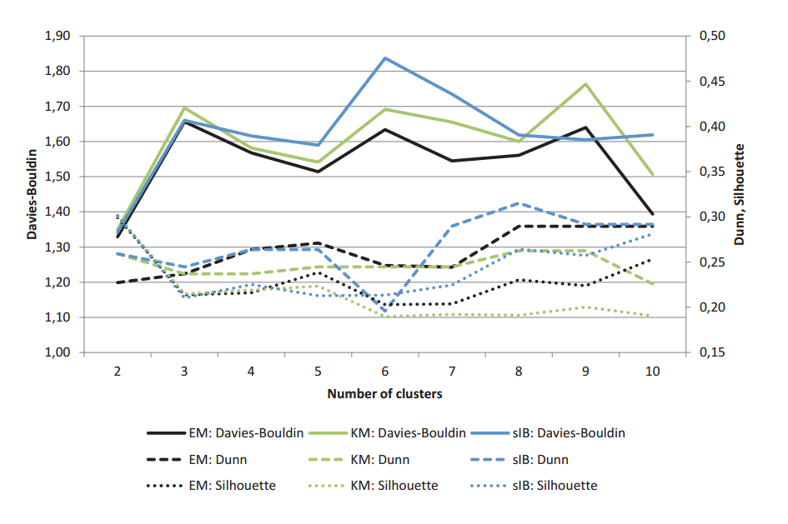
Dunn, Silhouette and Davies-Bouldin Indices
[1]
Notes:
Theresa

Slide 23
Results & Discussion
Taking a look at the clusters identified and what we can learn from them
Notes:
Theresa

Slide 24
Temporal Clusters Identified
Return Morning Pickup Evening (RMPE)
Pickup Morning Return Evening (PMRE)
Active Night Pickup Morning (ANPM)
Average (AVG)
Active Daytime (AD)
Notes:
Theresa

Slide 25
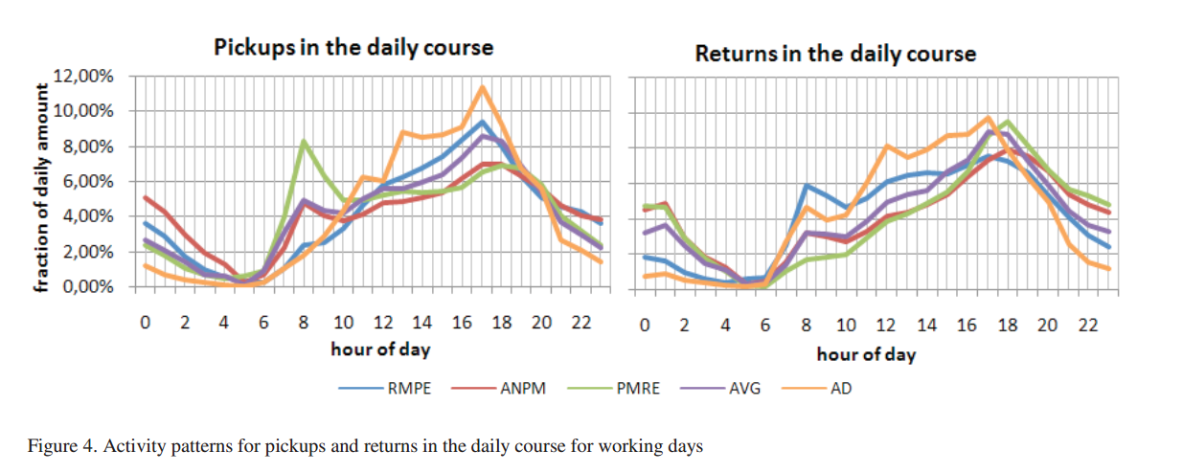
Temporal Clustering
[1]
Notes:
Theresa

Slide 26
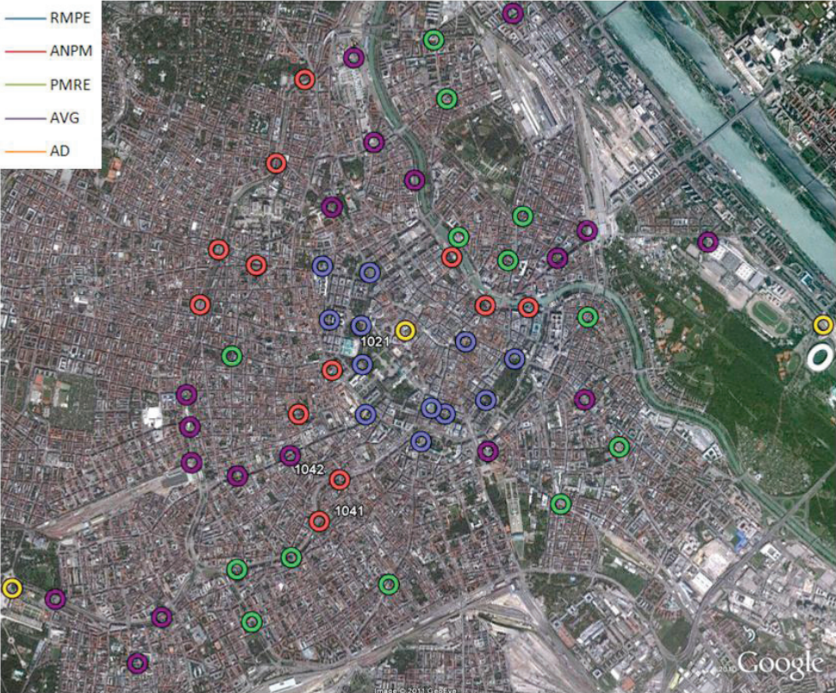
Spatial Clusters
[1]
Notes:
Theresa

Slide 27
Any questions?

