Slide 1
Decision Trees
CS548 Fall 2016
Decision Tree Showcase by Muyeedul Hoque, Chao Xu, Yue Zhao, and Kevin Heath
Showcasing work by N. Morizet, N.Godin, J.Tang, E.Maillet, M.Fregonese, and B.Normand on "Classification of Acoustic Emission Signals Using Wavelets and Random Forests: Application to localized corrosion".

Slide 2
References
James, G., Witten, D., Hastie, T., & Tibshirani, R., An Introduction to Statistical Learning. Springer. (2015).
Morizet, N., Godin, N., Tang, N., Maillet, E., Fregonese, M., & Normand, B., Classification of Acoustic Emission Signals Using Wavelets and Random Forests: Application to localized corrosion. Mechanical Systems and Signal Processing (2016), 1026-1037.
T.Cover, P.Hart ,Nearest neighbor pattern classification, IEEETrans. Inf. Theory 13 (1967), 21–27.
S. Arlot, A.Celisse, A survey of cross-validation procedures for model selection, Stat.Surv.4 (2010), 40–79.
Wavelet. Retrieved from Wikipedia: https://en.wikipedia.org/wiki/Wavelet (2016, September 10).
T.F. Barton, D.L. Tuck, D.B. Wells, The identification of pitting and crevice corrosion spectra in electrochemical noise using an artificial neural network, in: ASTM Special Technical Publication, vol.1277 (1996), pp.157–169.
R. Piotrkowski, E.Castro, A.Gallego, Wavelet power, entropy and bispectrum applied to ae signals for damage identification and evaluation of corroded galvanized steel, Mech. Syst. Signal Process. 23 (2009), 432–445.
J. Griffin, X. Chen, Multiple classification of the acoustic emission signals extracted during burn and chatter anomalies using genetic programming, Int. J. Adv. Manuf. Technol. 45 (2009), 1152–1168.
Y. Yu, L. Zhou, Acoustic emission signal classification based on support vector machine, TELKOMNIKA : Indones. J. Electr. Eng. 10 (2012), 1027–1032.

Slide 3
Agenda
Introduction to Acoustic Emission Signals
Feature extraction from preprocessed waveforms
Supervised classification using random forests
Ground Truth and Tests
Conclusion

Slide 4
Introduction
Acoustic Emission (AE) is the transient elastic sound waves produced by release of localized stress energy. One major application of AE is health monitoring of structural material.
Acoustic emission signals detection is applied in identification and the classification of different types of corrosion.
Since AE signals associated to crevice corrosion are characterized by low energy content, and difficult to separate from the environmental noise, there is a need for in-depth work to preprocess the corresponding waveforms.
Another motivation was to find the most relevant set of features.

Slide 5
Datasets
Ground truth data come from the synthetic dataset collected in A.Sibil, N.Godin, M.R'Mili, E.Maillet, G.Fantozzi, Optimization of acoustic emission data clustering by a genetic algorithm method, J.Nondestruct. Eval.31(2012)169–180.
The “model” data were generated by merging real data obtained in experimental conditions for various types of material (steel, ceramics, glass fibers, composites).
Those data represent four clearly identified classes (2000 signals per class) and are described with a set of M=9 features.
A training Set is built, comprised of 70% of those data (5600 signals taken at random),the remaining 30% (2400signals) constitute the Testing Set.

Slide 6
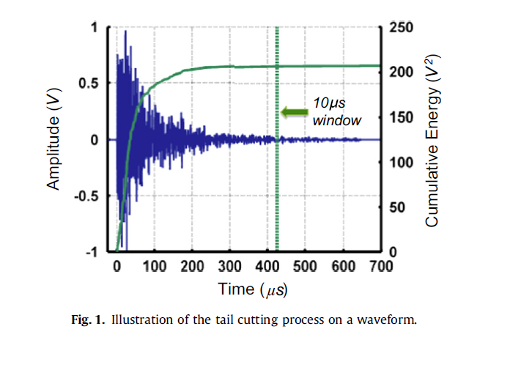
Feature Extraction
Waveform preprocessing：
Pre-trigger removing
Tail cutting
Shape preserving interpolation (SPI) resampling
Wavelet Denoising

Slide 7
Wavelet Denoising
What is wavelet?
A wavelet is a wave-like oscillation with an amplitude that begins at zero, increases, and then decreases back to zero.
Wavelets can be combined, using a "reverse, shift, multiply and integrate" technique called convolution, with portions of a known signal to extract information from the unknown signal.
Wavelet Denoising
wden function from the Matlab Wavelet Toolbox

Slide 8
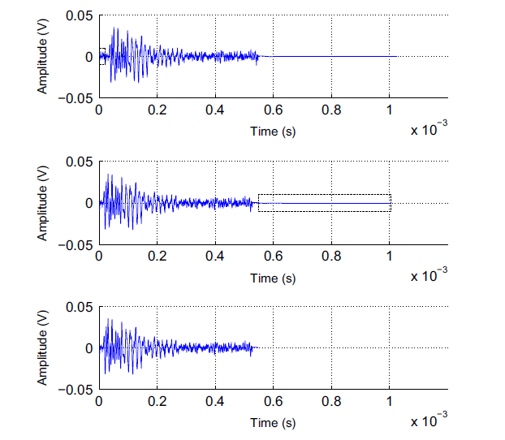
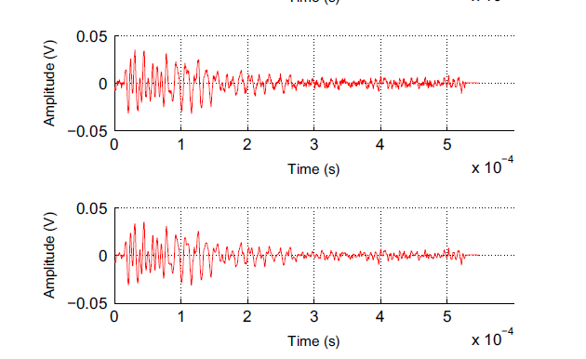
Extracting Features
SPI resampled
Original
Pre-trigger removed
Tail cut
Final wavelet denoised waveforms

Slide 9
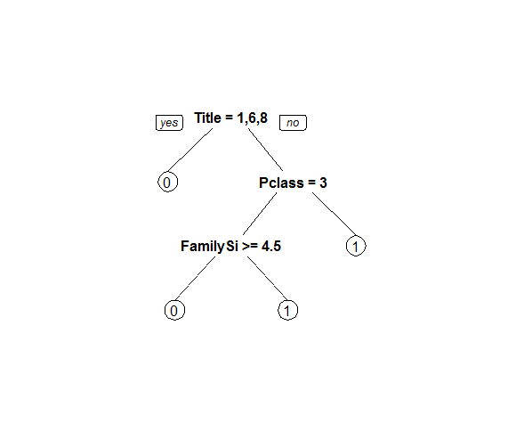
Bagging (Bootstrap Aggregation)
Decision Trees suffer from high variance
Bagging generates several different Bootstrapped training sets
Decision Trees:
Average resulting predictions from n trees obtained from n bootstrapped training sets
The trees are grown deep and thus have high variance but low bias
Averaging the trees leads to low variance

Slide 10
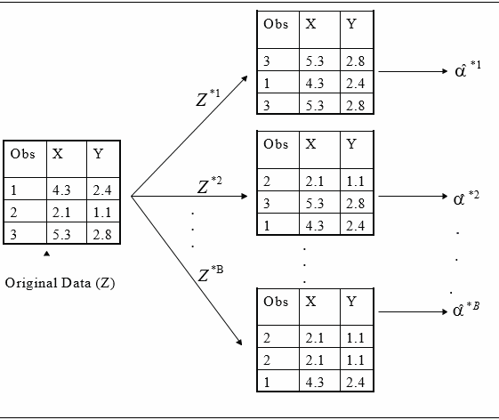
Bootstrapped Sampling
Sampling with replacement

Slide 11
Bagging – Out-of-Bag Error Estimation
Each bagged tree tends to use 2/3rd of all observations
Remaining 1/3rd – OOB observations
Test Error – Average B/3 predictions
Overall, Bagging improves accuracy but loses on interpretability
For Prediction:
MV - Majority vote among all B trees
Security Vote (SV) - if more than 70% voted for a specific class

Slide 12
Random Forest
Random Forest utilizes Bagging techniques, but de-correlates trees
Each time a tree is split, a random sample of m predictors is chosen
m is usually √(total number of predictors)
Otherwise, all trees may use key predictor(s)
Trees will then be highly correlated, not reducing variance.
If m = total number of predictors, then random forest essentially runs bagging.

Slide 13
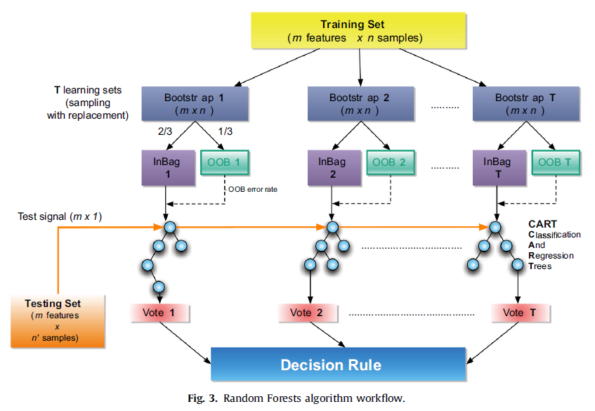
Random Forest

Slide 14
Ground Truth
Alter-class matrix(ACM): A particular n-square matrix for altering the original training in order to simulate uncertainty on labeled data for supervised classification.
Trust factor: The diagonal values of the ACM and a trust factor equal to 100 means the corresponding class is not altered.

Slide 15
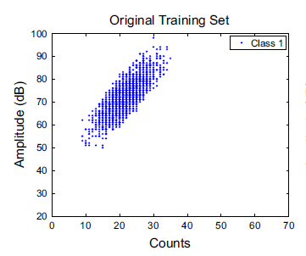
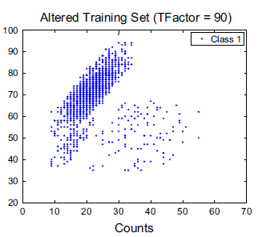
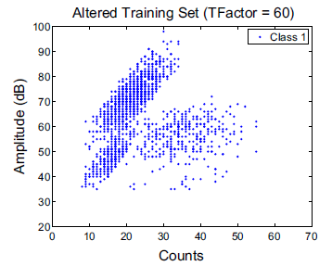
Ground Truth
Example for ACM
A trust factor equals to 80 (mu=79, sigma=2.94)

Slide 16
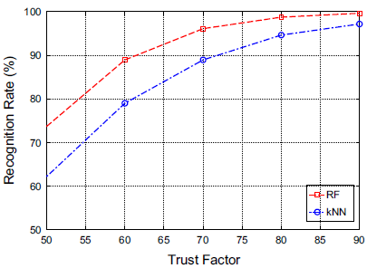
Tests
In all these tests,Random Forests(RF) is compared to the widely used and efficient k-Nearest Neighbor(k-NN) algorithm.
Cross-validation recognition rate:

Slide 17
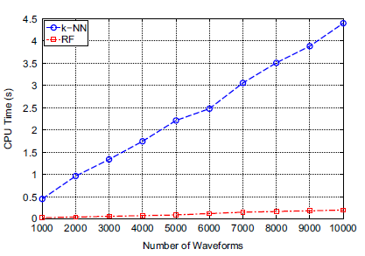
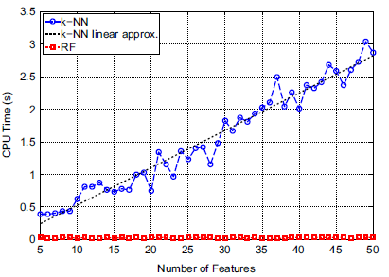
Tests
CPU time tests: datasets are built from random matrices using the randi(iMAX, N,M) Matlab function. Training and testing sets are (4000*M) and (N*M) matrices

Slide 18
Results and Conclusion
For each test, the proper majority class has been recognized and results show that using SV leads to a reinforcement of the usual MV decision
RF is well suited - fast and less sensitive to the learning library
However, results were not compared to previously researched methods, e.g. Neural Networks
Can be applied on an industry scale

