Slide 1
CS 548 Sequence Mining Showcase
By Bian Du, Wa Gao, and Cam Jones
Showcasing work by Alex Seret, Seppe K.L.M. vanden Broucke, Bart Baesens, and Jan Vanthienen on:
“A dynamic understanding of customer behavior processes based on clustering and sequence mining”
Notes:
Bian Starts, we introduce ourselves in alphabetical order by last name

Slide 2
REFERENCES
[1]
[2]
[3]
[4]
Alex Seret, Seppe K.L.M. vanden Broucke, Bart Baesens, Jan Vanthienen (2014), A dynamic understanding of customer behavior processes based on clustering and sequence mining, Expert Systems with Applications, Volume 41, Issue 10, August 2014, Pages 4648-4657, ISSN 0957-4174,
Cook, J. E., & Wolf, A. L. (1998). Discovering models of software processes from event-based data. ACM Transactions on Software Engineering and Methodology, 7(3), 215–249.
Seret, A., Verbraken, T., & Baesens, B. (submitted for publication). A new knowledge-based constrained clustering approach: Theory and application in direct marketing. Applied Soft Computing.
Srikant, R., & Agrawal, R. (1996). Mining sequential patterns: Generalizations and performance improvements. Advances in database technology – EDBT ’96 (Vol. 1057, pp. 1–17). Berlin, Heidelberg: Springer.
Notes:
Presenter: Bian
“These are our references, moving on…”

Slide 3
BACKGROUND
1
Notes:
Presenter: Bian

Slide 4
TERMINOLOGY
Customer Behavior: The different attributes captured at a specific point in time, describing the state of the customer
Customer Behavior Trajectory: The sequence of customer behaviors leading up to an event or state of interest
Davies-Bouldin index: A metric for evaluating clustering algorithms
Customer behavior trajectory
t₁ t₂ t₃ t₄ t₅ t₆
Customer behavior
Notes:
Presenter: Cam
Quickly define the terms, don't read them verbatim

Slide 5
MOTIVATION
To discover customer behavior trajectories in databases, to help analysts understand the behavior process of particular groups of customers, and to report these findings in such a way that the end-users understand and interpret them.
Notes:
Cam Read the slide

Slide 6
Self-Organizing Map (SOM) & Prioritization-SOM (P-SOM)
SOM
P-SOM
Notes:
Presenter: Cam
Discuss the formulas, memorize the actual meaning of the variables and describe how the BMU changes from SOM to P-SOM

Slide 7
Generalized Sequential Pattern Algorithm (GSP)
Concept:
The Generalized Sequential Pattern Algorithm is applied to extract customer behavior trajectories. The goal of GSP algorithm is to find contiguous sequential patterns by analyzing a sequence data set.
With a minimum support, the algorithm makes recursive passes by merging, pruning and eliminating sequences and at last lead to a generation of a set of frequent sequence.
Notes:
Presenter: Bian
Explain the theory behind the algorithm, and its goals

Slide 8
Generalized Sequential Pattern Algorithm (GSP)
Algorithm:
GSP makes the first pass over data set to yield all the 1-element frequent sequences using a minimum support.
Repeat until no frequent sequences are found.
Merge pairs of frequent subsequences found in k-1 th pass to generate candidate sequences that contain k-items
Prune candidate k-sequences that contain infrequent (k-1)-sequences
Find supports for these new sequences
Eliminate those whose support is less than minimum support (minsup)
Notes:
Presenter: Bian
Quickly glide over the psuedocode

Slide 9
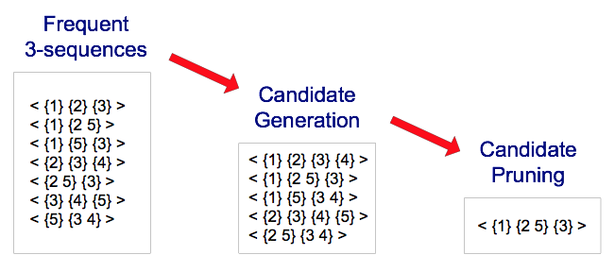
Generalized Sequential Pattern Algorithm (GSP)
Example:
Notes:
Presenter: Bian
Quickly glide over the psuedocode

Slide 10
APPLICATION
2
Notes:
Presenter: <name>

Slide 11
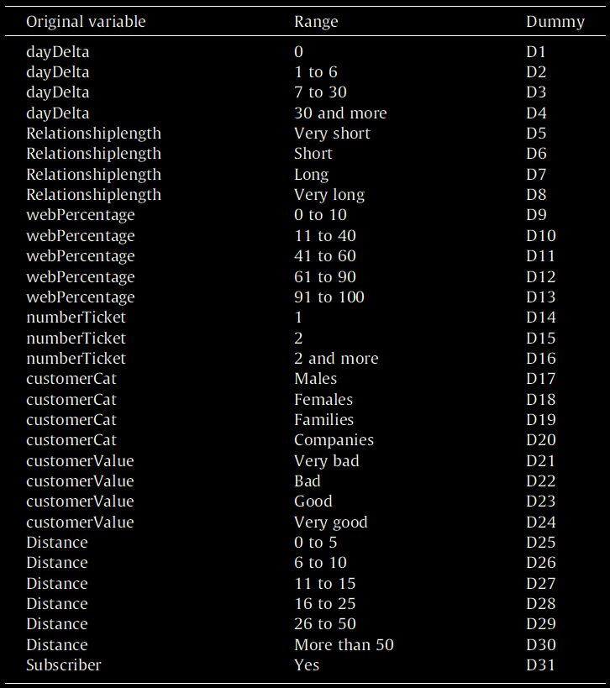
DATA SET
Records spanning 66 months representing ticket sales data for events in the Netherlands
Values were discretized into categories and then the eight variables were made into thirty-one binary variables
The data was grouped into one month long segments
Variable | Range
dayDelta | 0 - 30
Relationshiplength | Very Short - Very Long
webPercentage | 0 -100
numberTicket | 1 - unbounded
customerCat | Male, Female, Family, Company
customerValue | Very bad - Very good
Distance | 0 - unbounded
Subscriber | boolean
Notes:
Presenter: Cam
Explain the data used in the application
-rebuild the table with 8 variables

Slide 12
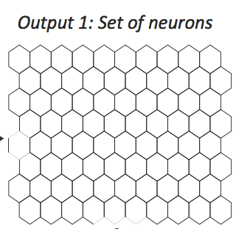
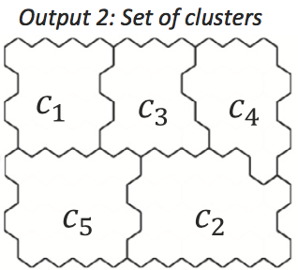
WORKFLOW
Step 1:
Set of item(2.764.859)
Output1: set of neurons( 500 )
Output2: set of clusters( 30 )

Slide 13
WORKFLOW
Step 2:
Output 3 : set of trajectories
Output 4a : set of frequent trajectories( length 3 )
Output 4b : set of clusters(5)

Slide 14
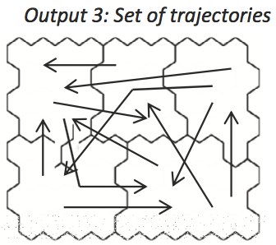
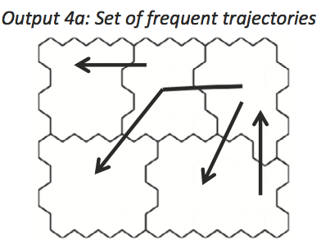
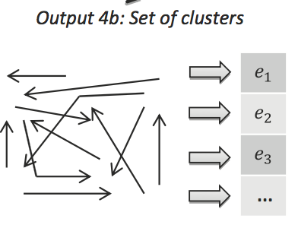
WORKFLOW

Slide 15
TRAJECTORY
Inputs: input vectors for each instance (n_{i}), and the Time frame (T) Output: Cluster-level trajectories of the input vectors for each t in T
Algorithm:
Get the coordinates for all the input vectors for each time t in T
Create a set d^{A} of all coordinates of all the input vectors for all t in T
Apply the P-SOM algorithm on d^{A}
Apply k-means on the neurons returned from P-SOM
For each n_{i}
For each t
BMU Corresponding Cluster is obtained from k-means output Cluster-level trajectory for ni at t, is set to j
Notes:
Presenter: Wa
Detailed Explanation of the Trajectory construction

Slide 16
Main trends--GSP approach
Inputs: meaningful trajectories obtained in previous steps.
Outputs: set of frequent trajectories, visualization of the dynamics present in the data set
C3
C1
C2
C7
C5
C9
Notes:
Presenter: Wa
Detailed explanation of the GSP implementation
that can provide first insights concerning the decision behaviors of customers opting to subscribe for the first time.

Slide 17
Main trends--A statistical approach
Instead of describing the entire trajectory, this approach focuses on specific segments of a trajectory.
The previous obtained trajectories are used to calculate cluster-level movement from time ta to time tb of an input vector ni(delta).
Multiple sets of deltas are obtained, and a clustering algorithm can be applied on deltas in order to get the main trends.
Notes:
Presenter: Wa
Detailed explanation of the GSP implementation

Slide 18
RESULTS
3
Notes:
Wa

Slide 19
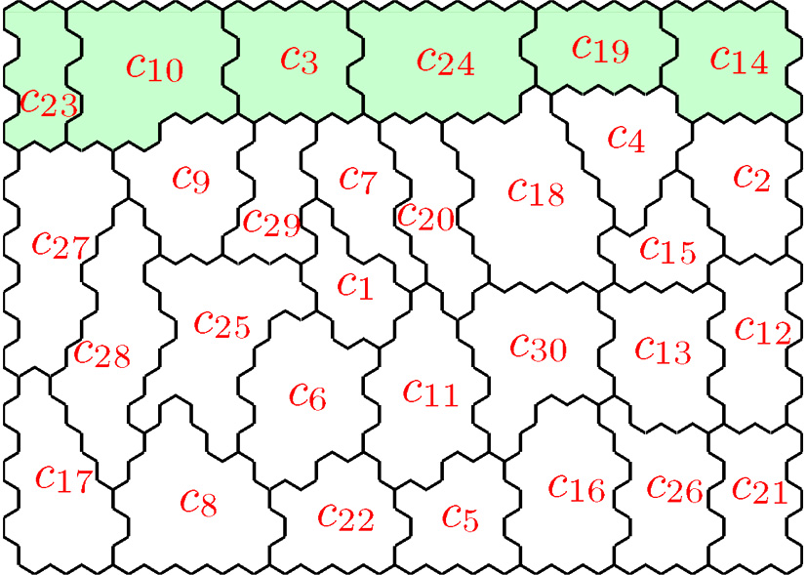
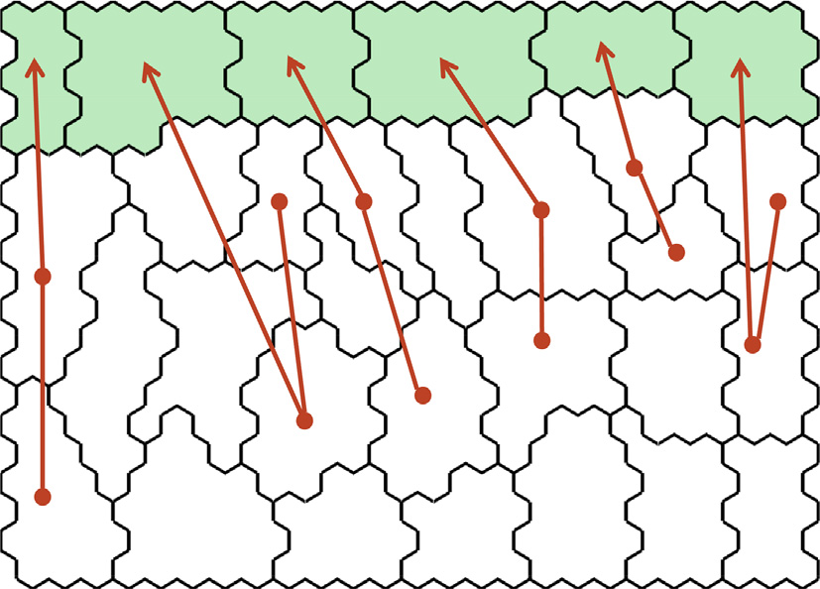
TRAJECTORIES (DELTAS)
The initial k-means clusters were analyzed and six subscriber clusters were identified. Trajectories were then calculated for the clusters.
Notes:
Presenter: Cam
Overview of the trajectories found and the gsp results

Slide 20
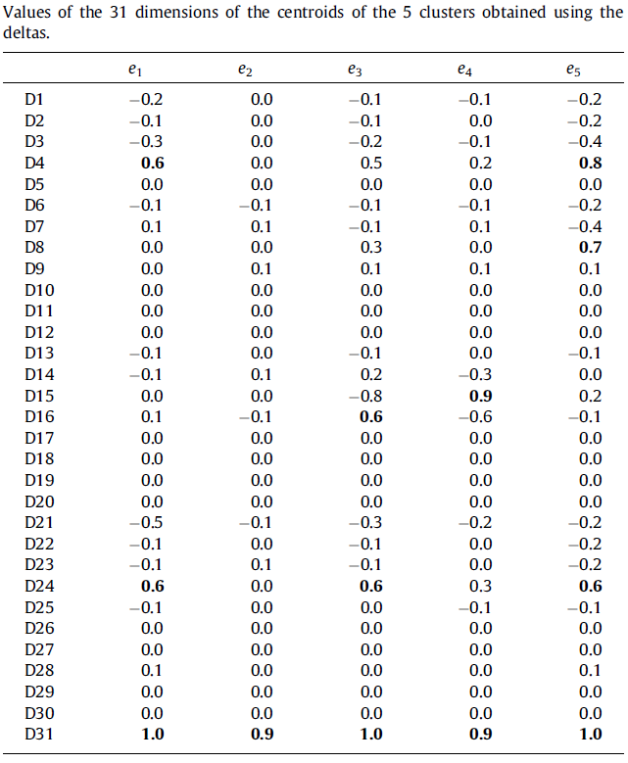
CLUSTERS OF TRAJECTORIES
e₁: 772 deltas
strong increase in D4 and D24
e₂: main cluster (1235 deltas)
no significant value increases
e₃: 715 deltas
Increase in D8 and D24
e₄: 457 deltas
Increase in D15
e₅: 418 deltas
Increase in D16 and D24
Notes:
Presenter: Cam
Talk about the clusters of the trajectories
E1, buys tickets early and is a high value customer
E3, long relation with organizer, high value customer
E4, used to buying tickets as pairs
E5, buying more tickets per event, high value customer

Slide 21
Thanks!
ANY QUESTIONS?
Notes:
Presenter: Cam

