Slide 1
CS548 Fall 2016
Text Mining
Showcase by Brendan Foley, Francisco Guerrero, Dennis Silva, ML Tlachac
Showcasing work by Jonnageddala, Liaw, Ray, Kumar, Chang, and Dai on
“Coronary Artery Disease Risk Assessment from Unstructured Electronic Health Records Using Text Mining”

Slide 2
References
“Apache UIMA - getting started: Why Apache UIMA," 2006. [Online]. Available: https://uima.apache.org/doc-uima-why.html. Accessed: Nov. 8, 2016.
J. Jonnagaddala, S.-T. Liaw, P. Ray, M. Kumar, N.-W. Chang, and H.-J. Dai, "Coronary artery disease risk assessment from unstructured electronic health records using text mining," Journal of Biomedical Informatics, vol. 58, pp. S203–S210, Dec. 2015. [Online]. Available: http://www.sciencedirect.com/science/article/pii/S1532046415001707. Accessed: Nov. 8, 2016.
J. Jonnagaddala, S.-T. Liaw, P. Ray, M. Kumar, and H.-J. Dai, "HTNSystem: Hypertension information extraction system for unstructured clinical notes," in Technologies and Applications of Artificial Intelligence. Springer Science + Business Media, 2014, pp. 219–227.
N.-W. Chang, H.-J. Dai, J. Jonnagaddala, C.-W. Chen, R. T.-H. Tsai, and W.-L. Hsu, "A context-aware approach for progression tracking of medical concepts in electronic medical records," Journal of Biomedical Informatics, vol. 58, pp. S150–S157, Dec. 2015. [Online]. Available: http://www.sciencedirect.com/science/article/pii/S1532046415002075. Accessed: Nov. 8, 2016.

Slide 3
Motivation
Coronary artery disease (CAD) is
A leading cause of death
Most common type of heart disease
Expensive to care for
If CAD is predicted, the progression can be prevented

Slide 4
How to Predict CAD
Framingham risk score (FRS)
Provides probability of developing CAD
Uses age, gender, cholesterol, blood pressure, diabetes history, and smoking history
For people 30-74 years

Slide 5
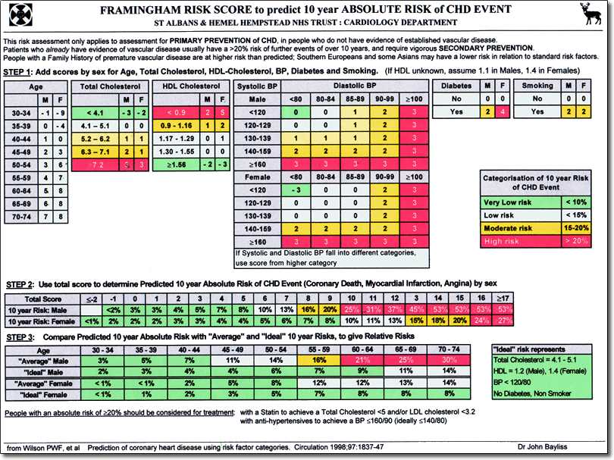

Slide 6
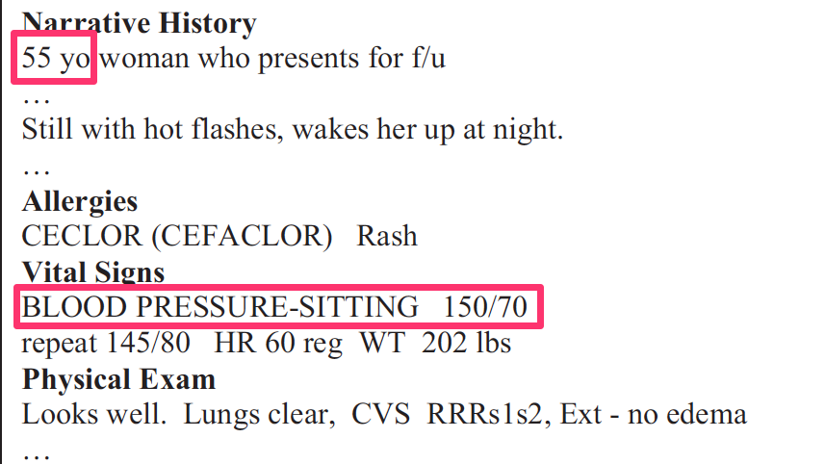
The Problem
Risk factor data is in unstructured Electronic Health Records (EHR)
Requires manual input and calculation
Time consuming
Expensive

Slide 7
The Purpose
“Demonstrate the feasibility of assessing the risk of CAD from unstructured Electronic Health Records (EHRs)”
Calculate Framingham Risk Score from unstructured EHRs
Use text mining methods
Calculate the 10-year risk score
Develop CAD → Higher Framingham Risk Score?
Notes:
Review paper

Slide 8
The Data
i2b2 2014 data
A collection of discharge summaries
For “identifying risk factors for heart disease”
Provided by Partners HealthCare
296 diabetic patients
1304 unstructured Electronic Health Records
There can exist multiple visits per patient

Slide 9
Steps
Use text mining to extract factors for FRS
Error analysis
Choose EHRs
Assess data quality
Input missing values
Calculate CAD risk using FRS
Analysis of patients who developed CAD
Notes:
First step : add an image of an EHR

Slide 10
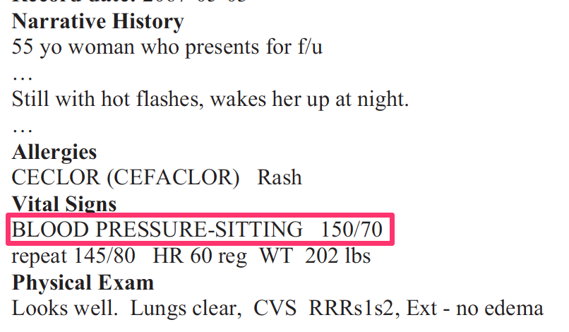
BP Example
Use text mining to extract factors for FRS
Identifies key words
BP
Blood + Pressure
Allows for separator
space
:
=
Find numeric BP
Marks 2 or 3 numbers after key words and separator
For both systolic and diastolic
using / as value separator
Generates BP annotation

Slide 11
Use text mining to extract factors for FRS
Developed system includes
FRS risk factor extraction 1
Uses Apache Ruta
Recognizes mentions, abbreviations, punctuations
Recognizes terms for age, gender, cholesterol, HDL-C
FRS risk factor extraction 2
Uses Apache Ruta
Rule based extraction
Extracts smoking history and BP values
Post-processing
Remove incomplete/ineligible records
Output structured format with extracted features

Slide 12
Apache Ruta
Is a “scripting language based rules engine”
Uses Unstructured Information Management Architecture (UIMA) for extraction
Input: unstructured text & rules
UIMA detects entities or relationships
Unstructured Text
Structured Text

Slide 13
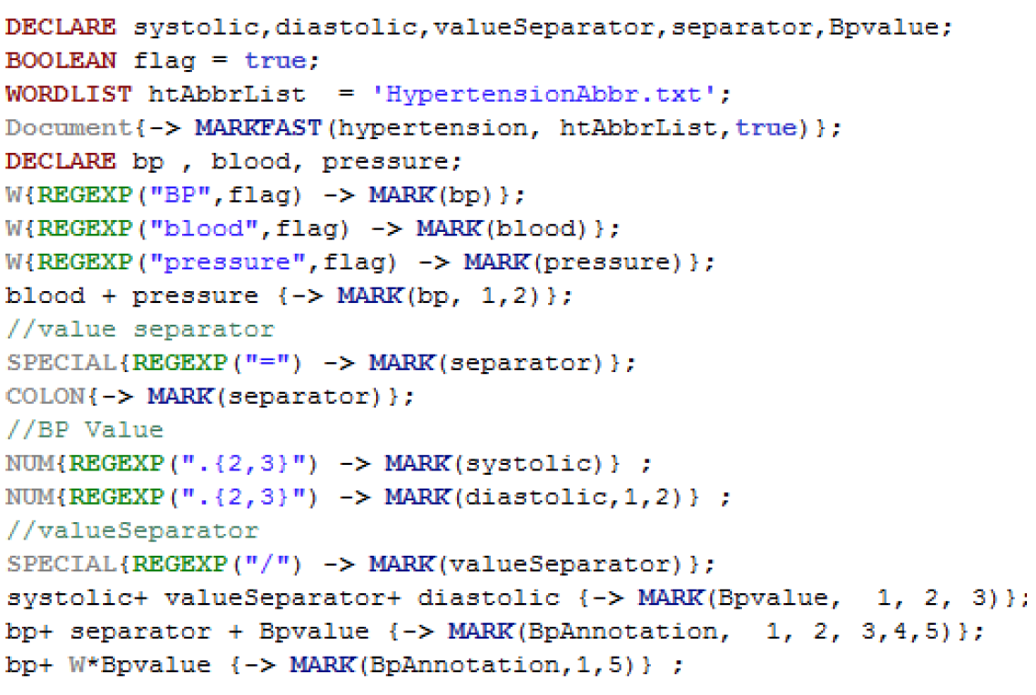

Slide 14
Use text mining to extract factors for FRS

Slide 15
Choose Electronic Health Records
All (n=296)
No prior CAD (n=192)
30-74 years old (n=164)
Developed CAD (n=78)
No CAD (n=86)

Slide 16
Data Quality and Missing Values
Considered missing if risk factor did appear in any of the patient’s health records
If multiple values exist, the most recent is used
Imputation strategies based on percent of missing values
<3%: use the mean
3-10%: use linear regression
>10%: multiple imputations
80% of Electronic Health Records contained missing values
HDL-C missing 78.1%
Cholesterol missing 73.8% of values

Slide 17
Calculate 10-year CAD risk
Calculator assigns points to calculate FRS scores
Evaluation:
20 patient’s FRS scores were calculated manually
For all 20, FRS score matched with the system’s output
The text mining system is good overall
FRS <10% → low risk
FRS 10-20% → moderate risk
FRS >20% → high risk

Slide 18
10-year CAD risk Scores
Developed CAD (n=78)
No CAD (n=86)
Average FRS score of 22% (High Risk)
FRS score
Low: 4 patients
Moderate: 39 patients
High: 35 patients
Average FRS score of 18% (Moderate Risk)
FRS score
Low: 14 patients
Moderate: 49 patients
High: 23 patients

Slide 19
Text Mining Limitations
Missing Values
HDL-C and cholesterol not typically recorded in clinical practice
Values were carried forward (If value was missing in recent visit, the value from a previous visit was used)
Tabular format
Summarized values (i.e. “Within Normal Range”)
Missing contextual clues
No section headings
No metric labels
Multiple metrics exist in different sections

Slide 20
FRS Limitations
How accurate is FRS?
Clinical contextual component is not taking into account into the FRS score
EHRs were gathered for identifying cardiovascular disease risk factors
All patients were diabetic
EHRs have a lot of missing data for FRS calculation

Slide 21
Questions?
Thank You

