Slide 1
CS548 Fall 2017 Anomaly Detection
Showcase by Jun Dao, Qiming Wang, Emily Weber, Zijun Xu, Ruosi Zhang
Showcasing work by Harrou, F., Kadri, F., Chaabane S., Tahon, C., Sun, Y.
on Improved principal component analysis for anomaly detection: Application to an Emergency Department

Slide 2
References
[1] Harrou, F., Kadri, F., Chaabane, S., Tahon, C., Sun, Y. (2015). Improved principal component analysis for anomaly detection: Application to an emergency department. Computers and Industrial Engineering, 88, 63-77.
[2] Ruiz, C. Class Lecture, Topic: “Anomaly Detection.” CS548, Worcester Polytechnic Institute, Worcester, MA, Nov, 9, 2017.
[3] Hines, J., Penha, R. (2001). Using Principal Component Analysis Modeling to Monitor Temperature Sensors in a Nuclear Research Reactor.

Slide 3
Data set
From: Pediatric Emergency Department (PED) in Lille Regional Hospital, France.
Attributes: 10 time-series variables in terms of daily number of patients
A high degree of cross correlation among the variables
Dates: Daily time from January to December
2011 data for training
2012 data for testing
Data matrix: 362 rows ×10 columns

Slide 4
Arrival Number (X₁): Daily number of patient arrivals
Arrival means (X₂): Daily number of patient arrivals not by emergency vehicle
CCMU1(X₃): Daily number of non-urgent patient arrivals
CCMU2 (X₄): Daily number of patient arrivals with a stable prognosis
GEMSA2 (X₅): Daily number of unexpected patients
Radiology (X₆): Daily number of patient arrivals for radiology
Scanner (X₇): Daily number of patient arrivals for scanner
Echography (X₈): Daily number of patient arrivals for echography
Biology (X₉): Daily number of patient arrivals for biology (labs)
Discharge-home (X₁₀): Daily number of patient discharged (sent home)

Slide 5
Introduction
Issue:
From the National Academies for Science, Engineering and Medicine: Between 1993 and 2003: In the U.S. patients increased by 26%, while Eemergency Ddepartments (EDs) decreased by 9%
Patient influx to EDs generates strain situations that affect building safety and reliability
Solution:
Detecting abnormal demands on EDs will improve the management of patients and medical resources
Technique: Anomaly Detection

Slide 6
Monthly PED arrivals
Actual number of arrivals per month from January 2011 to December 2011.
Daily PED arrivals
Taken from [1]

Slide 7
Anomaly Detection: PCA based Statistical Modeling
Build a profile of “normal behavior”
Use a training set of “normal” operations containing no anomalies
Scale training set to have a zero mean and unit variance
Build a PCA model using training set
Compute control limits for normal operations
Use “normal” profile to detect anomalies
Scale new point with mean and standard deviation from training set
For new point, calculate residuals using PCA model
Compute monitoring statistic for new point
Verbage taken from [2]

Slide 8
Anomaly Detection: PCA based Statistical Modeling
Definition of Outlier: An outlier is a time period that has an abnormal amount of patient arrivals
Anomaly score function: A data instance’s monitoring statistic is greater than the control limits of normal operations
How does the approach work?
Calculate control limits for normal operations ($T_{α}^{2}$ or $Q_{α}$)
Calculate monitoring statistic for new point (T² or Q)
If T² > $T_{α}^{2}$ or Q > $Q_{α}$ then an anomaly is declared
Verbage taken from [2]

Slide 9
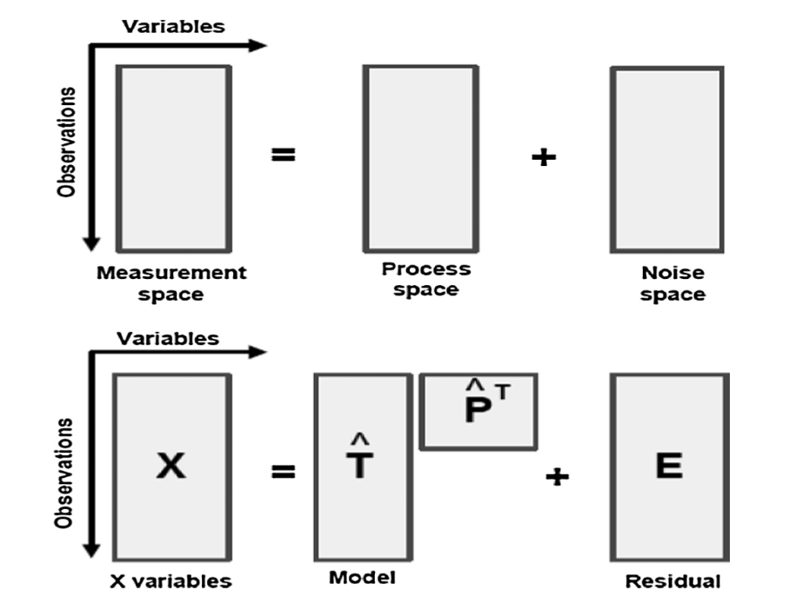
PCA based statistical monitoring
Raw data matrix X
Decompose of X into a process subspace and a residual subspace
T
P^{T}
$X_{s}= \left[\hat{T}|\tilde{T}\right]{\left[\hat{P}|\tilde{P}\right]}^{T}$= $\hat{T}{\hat{P}}^{T}+\tilde{T}{\tilde{P}}^{T}$
= $X_{s}\hat{P}{\hat{P}}^{T}+ X_{s}(I_{m}−\hat{P}{\hat{P}}^{T})$
$$\hat{X}$$
E
Taken from [1]

Slide 10
Control Limits and Monitoring Statistics
Hotelling’s T² statistic
Measures the variation within the PCA model
Monitoring Statistic:
$T^{2}= x_{s}^{T}\hat{P}\hat{Λ}{\hat{P}}^{T}x_{s}= \sum_{i=1}^{l}{\frac{t_{i}^{2}}{λ_{i}}}$ $where \hat{Λ} diagnal matrix with eigenvalues of PCs$
Control Limit:
$T_{α}^{2}= Χ_{l,α}^{2}$ where α is the level of significance (between 1% and 5%)

Slide 11
Control Limits and Monitoring Statistics
Q Statistic
Measures how well the new point fits the PCA model
Monitoring Statistic:
${\left\|(I−\hat{P}{\hat{P}}^{T})x_{s}\right\|}^{2}$= ${\left\|E\right\|}^{2}$-distance the new point fall from the PCA model
Control Limit:
$Q_{α}= φ_{1}\left[\frac{h_{0}c_{α}\sqrt{2φ_{2}}}{φ_{1}}+1+\frac{φ_{2}h_{0}(h_{0}−1)}{φ_{1}^{2}}\right]$ where $φ_{i}=\sum_{j=l+1}^{m}{λ_{j}^{i}, i=1,2,3}$ and $h_{0}=1−\frac{2φ_{1}φ_{3}}{3φ_{2}^{2}}$

Slide 12
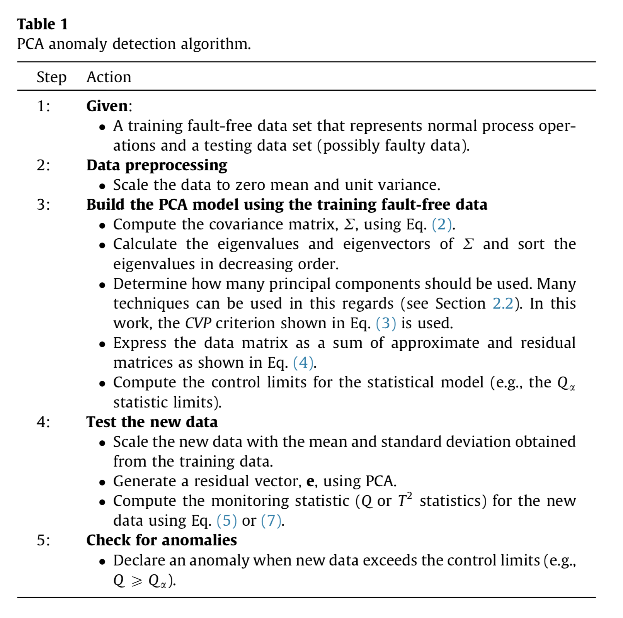
Taken from [1]

Slide 13
Problems with PCA based Statistical Modeling
T² and Q Statistics cannot detect small anomalies
Statistics largely depend on how many principal componets are kept
Need dectector that has higher sensitivity and less dependent on PCs

Slide 14
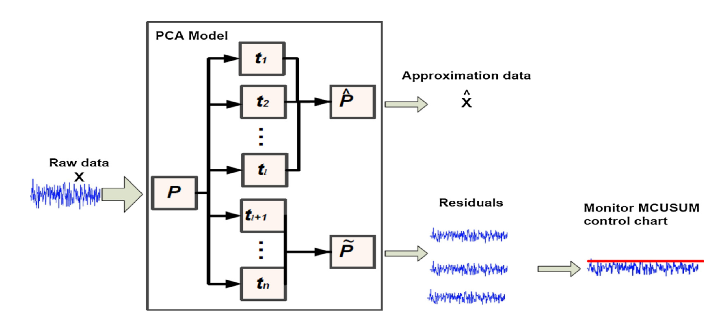
PCA based MCUSUM Anomaly Detection
Taken from [1]

Slide 15
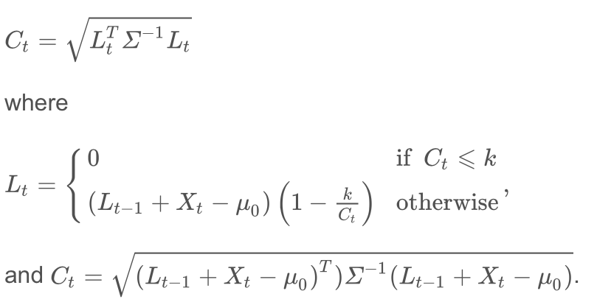
PCA based MCUSUM Anomaly Detection
Multivariate Cumulative Sum (MCUSUM) control chart
Used to monitor uncorrelated residuals obtained from PCA model
Normal operations = residuals close to zero
Abnormal operations = residuals that deviate from zero indicating a new condition that is different from normal operations
Detecting an anomaly is done almost the same as before except
Monitoring Statistic → Decision Function C_{t}
Control Limits → H, where H is chosen to provide a pre-defined in-control Average Run Length using simulation
Step 2
Step 1

Slide 16
Experiments
Abrupt Anomaly: Sudden increase in patient arrivals
Case 1A: Add 50% of the total variation in X₁ to samples 141 to 147 in the testing set
Case 1B: Add 25% of the total variation in X₁ to samples 141 to 147 in the testing set
Case Single-Data Strain: Add 25% of the total variation in X₁ to sample 147
Gradual Anomaly: A slow increase in patient arrivals
Case B: a slow gradual anomaly with slope = 0.1 is added to X₁

Slide 17
Case A1
Taken from [1]

Slide 18
Case A2
Taken from [1]

Slide 19
Single-data strain
Taken from [1]

Slide 20
Case B
Taken from [1]

Slide 21
Conclusion
Detection of abnormal demand for patient care is beneficial for reactive control of strain situations
Knowing when abnormalities take place can:
Help managers be proactive in preparing for them
Determine when and why abnormalities occur
Help managers act quickly in the occurrence of a strain situation

Slide 22
Questions?

