Slide 1
CS548 Fall 2017 Association Rule
Showcase by Jidapa Thadajarassiri, Meng Wang,
Muhammed Veyis Kilincer, Sai Kiran Vadlamudi, Siqin Li
Showcasing work by
Balázs Szalkai, Vince K. Grolmusz,
Vince I. Grolmusz, Coalition Against Major Diseases (CAMD)
On
Identifying combinatorial biomarkers
by association rule mining
in the CAMD Alzheimer's database
International Journal of Computer Applications (0975 8887)
Volume * - No. *, ——– 2012

Slide 2
Reference
[1] B. Szalkai, V. K. Grolmusz, V. I. Grolmusz, Coalition Against Major Diseases (CAMD), “Identifying combinatorial biomarkers by association rule mining in the CAMD Alzheimer's database”, Archives of Gerontology and Geriatrics, vol. 73, pp. 300-307, 2017
[2] B. Szalkai, V. Grolmusz, (2017, Sep). SCARF: A Biomedical Association Rule Finding Webserver, Available: https://arxiv.org/abs/1709.09850
[3] P.-N. Tan, M. Steinbach, V. Kumar, “Association Analysis: Basic Concepts and Algorithms,” in Introduction to Data Mining, Addison-Wesley 2005.

Slide 3
Introduction
Identifying combinatorial biomarkers by association rule mining
in the CAMD Alzheimer's database
combinatorial biomarkers
association rule mining
CAMD
Alzheimer
- Dementia’s common cause
Alzheimer’s disease (AD)
- memory problems
- difficulty: calculation, language, concentration
- final stage: incapable of self-care, bedbound
- Molecular biology
Simple biomarkers
- a physiological condition -> disease appearance
e.g. high level of glucose -> diabetes
Combinatorial biomarkers
- high concentration of A, B and C -> condition X
e.g. a 30-protein set -> AD
Aim: Find combinatorial biomarkers -> AD
Pattern: & ( or ) → …(*)
LHS RHS
“combinatorial marker” of the RHS
sodium=high & ( protein=high or age≥60 ) → MMSE* ≤ 15
*MMSE = Mini Mental Sate Examination

Slide 4
Scope and Objective
Alzheimer’s disease diagnostic
cerebrospinal fluid analysis + clinical signs + neuroimaging techniques | + reliable - expensive - not an early warning-type biomarker
usual clinical laboratory + cognitive impairment questionnaires + blood-based proteomics assays | + reliable - not an early warning-type biomarker
Final Goal:
Finding new combinatorial biomarkers for Alzheimer’s disease
In this paper:
Showing certain sets of laboratory data may make dementia (and not AD) more probable, and certain other sets may make dementia less probable

Slide 5
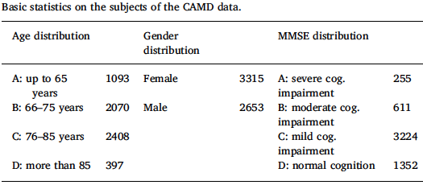
Data
Source: CAMD
Instances:
5,821 patients (demented and not demented people of various age and sex)
Attributes:
Standard laboratory data
blood and urine, measured multiple times per subject
Cognitive and psychological status
by standardized questionnaires
ADAS-COG, ADCS-ADL, MMSE,
NPI, SIB
Genetic tests
Data Cleaning
Main table for CAMD
170 columns (record fields)
5,821 rows (patients)
ApoE, MTHFR genotypes
- Reduce several row for each person
- Collect from multiple tables
- Average tests on different visit days
Vital sign measurement
BP, pulse rate, respiratory rate, body temperature
Target
MMSE score
(mini mental state examination)

Slide 6
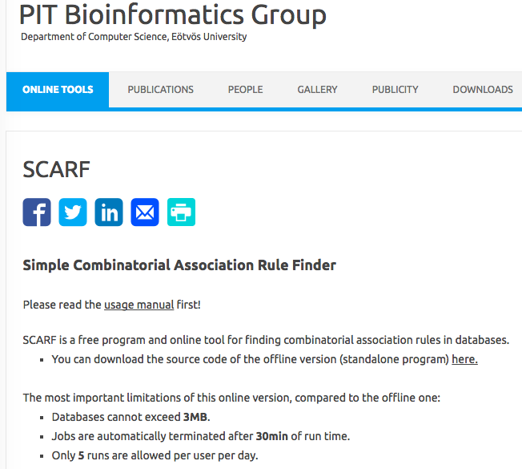
Methods (1/2)
Association rule mining:
SCARF (Simple Combinatorial Association Rule Finder)
- Own new program written in C++
- Various standard numerical values for indicating reliability and validity of rules :
https://pitgroup.org/scarf/
Universe
: set of rows - all columns in the
rule have a known value
LHS support
: #rows - LHS is true
RHS support
: #rows - RHS is true
Support
: #rows - LHS and RHS are true
Confidence :
Lift :
Leverage :
X²-statistic
: dependence of LHS and RHS
E-value :
p-value * total number of pos. rules

Slide 7
Methods (2/2)
Association rule mining: SCARF algorithm
I. Start with pattern :
A & ( B or C ) → D …(*)
- restriction: LHS - laboratory data and sex, RHS - mental status
II. Consider all possible logical expressions according pattern (*) applied
Branch-and-bound algorithm :
certain values of first two boxes fail a rule constraints(regardless third box)
-> threw out the rule w/o checking third box
III. Evaluate rules under these criteria:
universe ≥ 500, support ≥ 50, confidence ≥ 0.5, lift ≥ 1.2, p-value ≤ 0.05
Goodness of a rule
IV. Determine effect on mental state by these definitions:
Positive score : #rules with positive RHS
Negative score : #rules with negative RHS
Score : Positive score – Negative score
-> Positive clause
-> Negative clause

Slide 8
Results and Discussion (1/3)
Outputs
752 rules
Lift ≥ 2 : 513 rules
Most rules with Lift ≥ 3 : LHS contained lb_sodium = h
Ex:
Glucose
low or normal
Cholesterol
low
sodium
high
total MMSE
Score ≤ 15
& ( or ) →
Greatest Positive Effect
on Normal Cognition
Greatest Negative Effect
on Normal Cognition

Slide 9
Results and Discussion (2/3)
Liver function
High AST + Low/high ALT -> Impaired Cognition
(Low MMSE)
(aspartate amino-
transferase)
(alanine amino-
transferase)
(mini mental state examination)
Our results: “Raise the possibility of a pathogenetic linkage
between liver function and mental status in patients with AD”
Serum Sodium
224 rules with high Sodium in LHS
-> Impaired Cognition
Our results: “demonstrated a tendency towards
dehydration in patients with AD”

Slide 10
Results and Discussion (3/3)
Vitamin B12
Our results: “present the beneficial impact of high vitamin B12 on cognition”
Hematological parameters
Low MCV (mean corpuscular volume)
High MCH (mean corpuscular hemoglobin)
Low MCHC (mean corpuscular hemoglobin concentration)
-> high MMSE
Blood cholesterol and cognition
Our results: “low, low-normal or high cholesterol levels do not mean a higher likelihood of impaired cognition by themselves, but only combined with high sodium”

Slide 11
Conclusions
In this paper
✓
A 5,821-patient, high-quality database from CAMD was analyzed.
Association rule mining (SCARF) was used.
Combinatorial biomarkers related to Alzheimer's disease were found.
752 rules were identified.
✓
✓
✓

Slide 12
Thank you!

