Slide 1
CS548 Fall 2017 Clustering Showcase
Hierarchical Aligned Cluster Analysis
for Temporal Clustering of Human Motion
Showcasing work of: Feng Zhou, Fernando de la Torre, Jessica Hodgins
Showcase by: Janvi Kothari, Sanket Gujar, Mihir Sawant, Umesh Nair, Jin Huang.

Slide 2
Reference
[1] Zhou. Feng, K. Jessica “Hierarchical Aligned Cluster Analysis for Temporal Clustering of Human Motion“, IEEE TRANSACTIONS ON PATTERN ANALYSIS AND MACHINE INTELLIGENCE, VOL. 35, NO. 3, 2013
[2] Y. Rui and P. Anandan, “Segmenting Visual Actions Based on Spatio-Temporal Motion Patterns,” Proc. IEEE Conf. Computer Vision and Pattern Recognition, 2000.
[3] E. Fox, E. Sudderth, M. Jordan, and A. Willsky, “Nonparametric Bayesian Learning of Switching Linear Dynamical Systems,” Proc. Neural Information Processing Systems, 2008.
[4] Videos: http://www.f-zhou.com/

Slide 3
Introduction
Temporal Clustering Temporal Clustering is the process of grouping objects based on their temporal (time) similarity.
Temporal segmentation of human motion into plausible motion primitives is central to understanding and building computational models of human motion. Applications:
Smart Surveillance systems for advanced user interfaces
Motion Analysis
Virtual Reality

Slide 4
Motivation
Both research and industry are interested in systems that can detect, recognize, and synthesize human motion.
Many scientists in computer vision are interested in unsupervised techniques to learn motion primitives from data.
Challenges addressed : o Large number of possible movement combinations
o A relatively large range of temporal scales for different behaviors
o The irregularity in the periodicity of human actions
o The intra-person motion variability

Slide 5
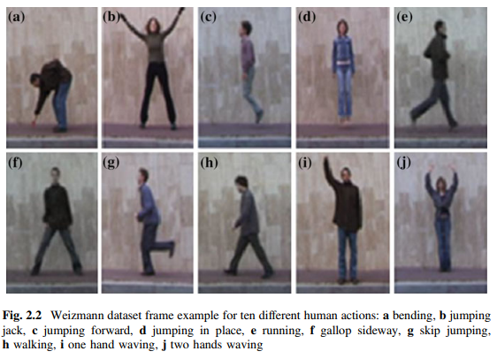
Data Set
Video data from Weizmann and KTH databases
Weizmann: 90 videos of 10 individuals performing 9 different actions like walking, running, jumping and waving.
Set of testing videos synthesized by concatenating randomly selected clips.

Slide 6
Pre-processing: Feature Extraction
Silhouette - based:
Used for Weizmann dataset
Silhouette with background subtraction is computed.
Person is represented as a binary mask, which is scale-normalized.
Second mask which contains only the hands and legs, to remove torso pixels.
Maximum overlap is used as similarity measure.

Slide 7
Prerequisites
K-means and kernel k-means
Frame Kernel Matrix
Dynamic Time Alignment Kernel
Generalized Dynamic Time Alignment Kernel

Slide 8
Kernel k-means (KKM)
Limitation of k-means: optimal only for spherical clusters
Solution: Kernel k-means maps the data to a higher dimensional space using kernels
is the squared distance between the ith sample and the center of class c in the feature space
is in higher dimensional.

Slide 9
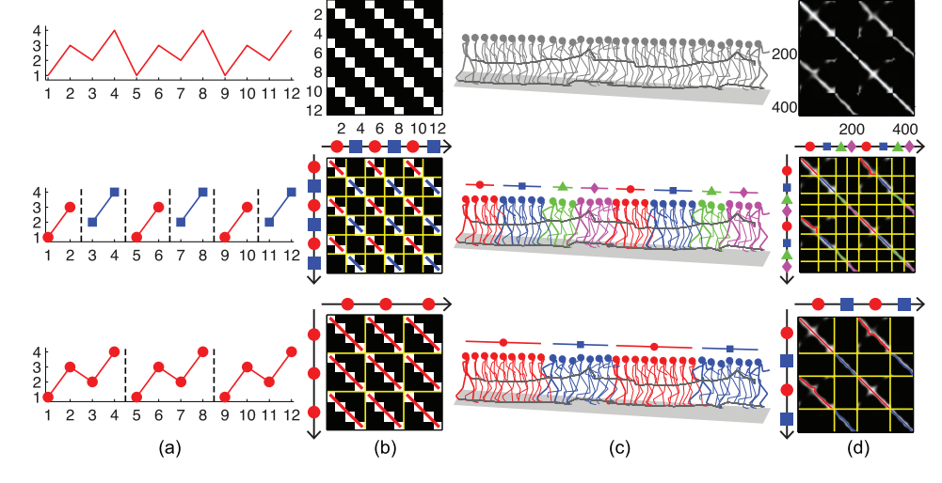
Frame Kernel Matrix
X is a multidimensional time series of length n
Each entry defines the similarity of two frames
Period ambiguity: 2 different but valid decompositions of the same time series at 2 different temporal scales.
Solution: Constrain the length of the segments (2 and 4)

Slide 10
Dynamic Time Warping (DTW)
Why DTW?
Human motion has varied speeds.
Video data is analysed using segmented data i.e. time sequenced data.
Temporal clustering needs to compute distance for these different segments.
DTW is the algorithm used to align two time sequences with different speeds i.e. computes similarity between two time sequences.
The distance calculated by DTW has issue of triangular inequality; hence we use Dynamic Time Alignment Kernel (DTAK).

Slide 11
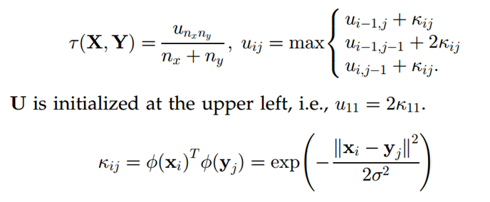
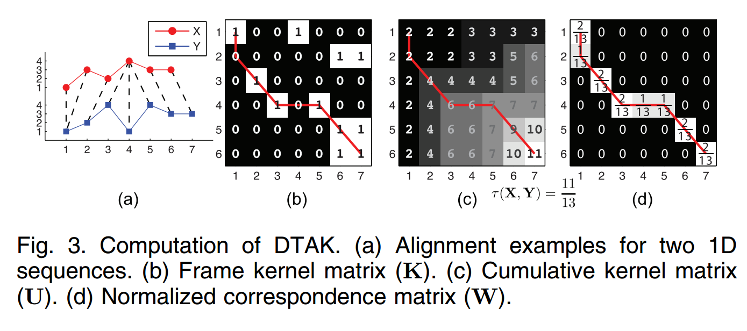
Dynamic Time Alignment Kernel (DTAK)
DTAK algorithm is an extension of DTW.
It computes similarity using Dynamic Programming.
Uses the cumulative kernel matrix U :
In this paper, DTAK &
Generalized DTAK is used.

Slide 12
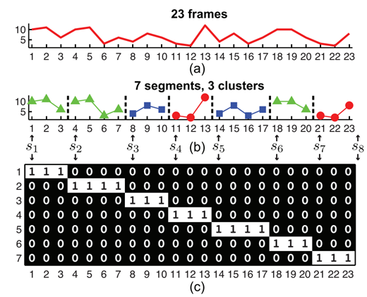
Energy Function for ACA
With n samples, ACA decomposes a sequence X into m disjointed segments, each of which corresponds to one of k classes

Slide 13
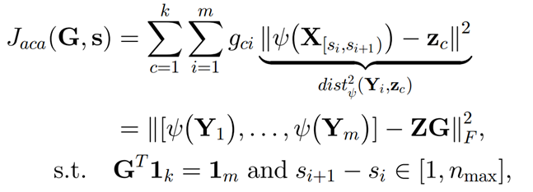
Energy Function for ACA (2)
A major limitation of standard k-means clustering for analysis of time series data is that the temporal ordering of the frames is not taken into account.
This function combines KKM and Spectral Clustering with the DTAK to achieve temporal clustering.
Minimize this-

Slide 14
Bellman’s Equation
Apply Dynamic Programming
Lowers time complexity from O(n²n²_{max}) to O(n²n_{max})
Easier computation
Minimize J(v)
dist² is the squared distance between the segment and the center of the class.

Slide 15
DPsearch
DPsearch optimizes ACA w.r.t G(segment-cluster correspondence) and s(sample-segment correspondence).
DP search only requires two parameters:
Length constraint (n_{max}).
Number of Clusters (k).
The Overall time complexity for DPsearch is O( n² n_{max} t), where t is the number of iterations.
Whereas straight-forward implementation of Bellman’s equation will have complexity of O( n² n_{max}² t)

Slide 16
DPsearch Algorithm

Slide 17
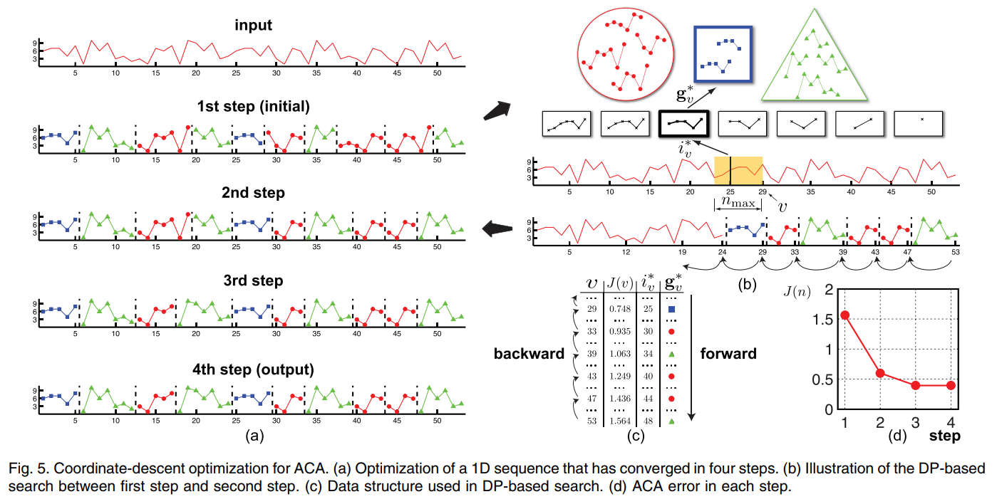
DPsearch Algorithm

Slide 18
Hierarchical Aligned Cluster Analysis (HACA)
HACA reduces the computational complexity of ACA and provides a hierarchical decomposition at different temporal scales.
HACA starts with small temporal scale and propagates the result to larger temporal scale.
Recall that the computational complexity is O( n² n_{max} ), HACA is efficient because it starts with a small temporal scale (n_{max} ).
HACA replaces DTAK with Generalized DTAK (GDTAK).
DTAK propagate solutions at different temporal scale, whereas GDTAK uses values from the lower level to compute similarity in a bottom-up way.

Slide 19
HACA
The GDTAK is defined at the second level as:
n : length of segment

Slide 20
HACA
The input sequence is represented as a sequences of frames.
Extracting the features and calculating the frame kernel matrix
ACA is applied to obtain and refine temporal segmentation result.
In first Iteration, we set small length constraint (n_{max} ) to extract short premitive, such as bending a leg.
To propagate to the next level we recalculate the frame kernel matrix in the second iteration using GDTAK on the segmented frames.
ACA is then applied to obtain a new segmentation with longer segmentation.

Slide 22
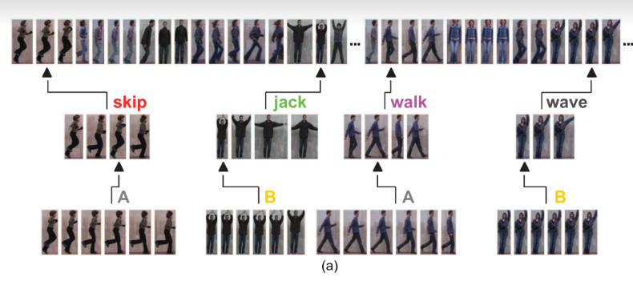

Slide 23
Video Result

Slide 24
Video Data Test Result
-Motions like walking and running are only similar in certain phases.
-Both ACA and HACA can discriminate walking from running by integrating temporal information.
-HACA has higher accuracy than ACA.
 | Accuracy
ACA | 0.76
HACA | 0.77

Slide 25
Advantages of using HACA
The temporal clustering problem is posed as an energy minimization.
HACA provides a natural embedding for clustering and visualizing time series data.
HACA provides a hierarchical decomposition at several temporal scales. The time granularity of the motion primitives is specified manually.

Slide 26
Thank You!

