Slide 1
CS548 Fall 2017 Decision Trees / Random Forest Showcase by Yimin Lin, Youqiao Ma, Ran Lin, Shaoju Wu, Bhon Bunnag
Showcasing work by Cano, G., Garcia-Rodriguez, J., Garcia-Garcia, A., Perez-Sanchez, H., Benediktsson, J. A., Thapa, A., & Barr, A. on Automatic selection of molecular descriptors using random forest: Application to drug discovery
Notes:
Description: The optimal feature selection is an essential pre-processing step for the efficient application of DM techniques in drug discovery. The paper exams a Random Forest-based approach to automatically select features for classification.
The reduction of features helps to reduces the computing time over existing approaches and permits the exploration for much larger datasets. The result for fitting model by reduced features is compared with manual feature selection on RF, SVM and NN approaches.

Slide 2
References
[1]Cano, G., Garcia-Rodriguez, J., Garcia-Garcia, A., Perez-Sanchez, H., Benediktsson, J. A., Thapa, A., & Barr, A. (2017). Automatic selection of molecular descriptors using random forest: Application to drug discovery. Expert Systems with Applications, 72, 151-159.
[2] James, G., Witten, D., Hastie, T., & Tibshirani, R., An Introduction to Statistical Learning. Springer. (2015).
[3] Introduction to Data Mining P.-N. Tan, M. Steinbach, V. Kumar. Addison-Wesley 2005. ISBN-10: 0321321367 ISBN-13: 9780321321367
[4] ROC Curve:
https://en.wikipedia.org/wiki/Receiver_operating_characteristic

Slide 3
Introduction
The Importance of Drug Discovery Methods
Finding good molecule descriptors
Predict molecule bioactivity
Virtual Screening Method
A challenging task
Novelty: Using Random Forest (RF) as both a feature selection and classification tool
Reduction of data and features
Improved Performance
Reduce noise and irrelevant features
Notes:
Bhon

Slide 4
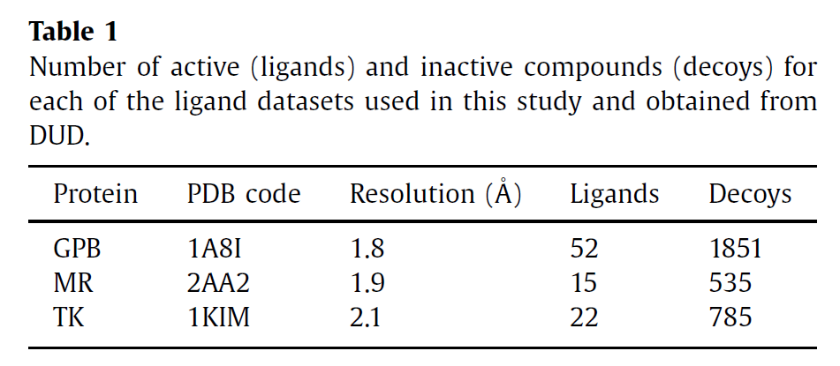
Datasets
Three datasets
Target Class
Notes:
Bhon

Slide 5
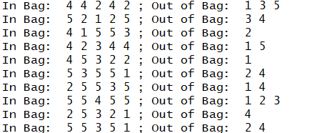
Methodology-OOB (Out of Bag)
Suppose we sample observation with replacement from {1,2,3,4,5} to get 10 bootstrapped samples.
On average, ⅓(1/e) is not used in the bootstrap for each time.
Notes:
Youqiao 1min
3min30s

Slide 6
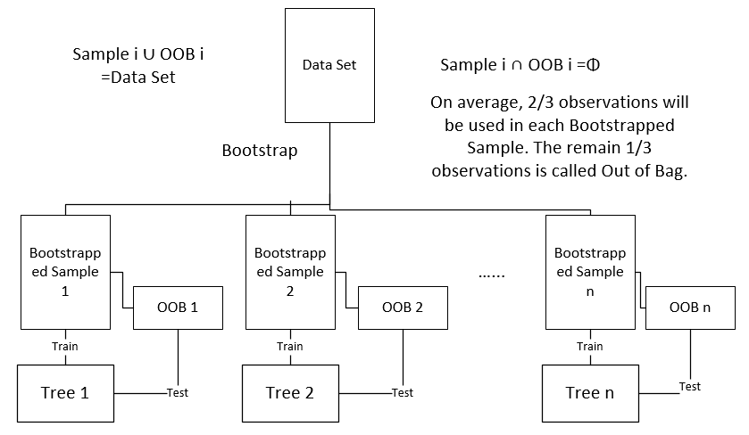
Methodology-OOB
Decision Tree => Tree Bagging
OOB - Out of Bag
Notes:
Youqiao 45s
Before we get into random forest, there are some basic information we need to know first.
So there are actual process from decision tree advanced to random forest.
First we all know decision tree. However, decision tree can lead to overfitting, which means fit the model too good.
So what we could have is bagging. Bagging, also called bootstrap, means that we sample n number of data with replacement. Because of the replacement, there are some observation that would not appear in the sampled data. According to textbook and our experiment, ⅓ of the observations would not be used.
Bagging could reduce the variance by averaging the effect.

Slide 7
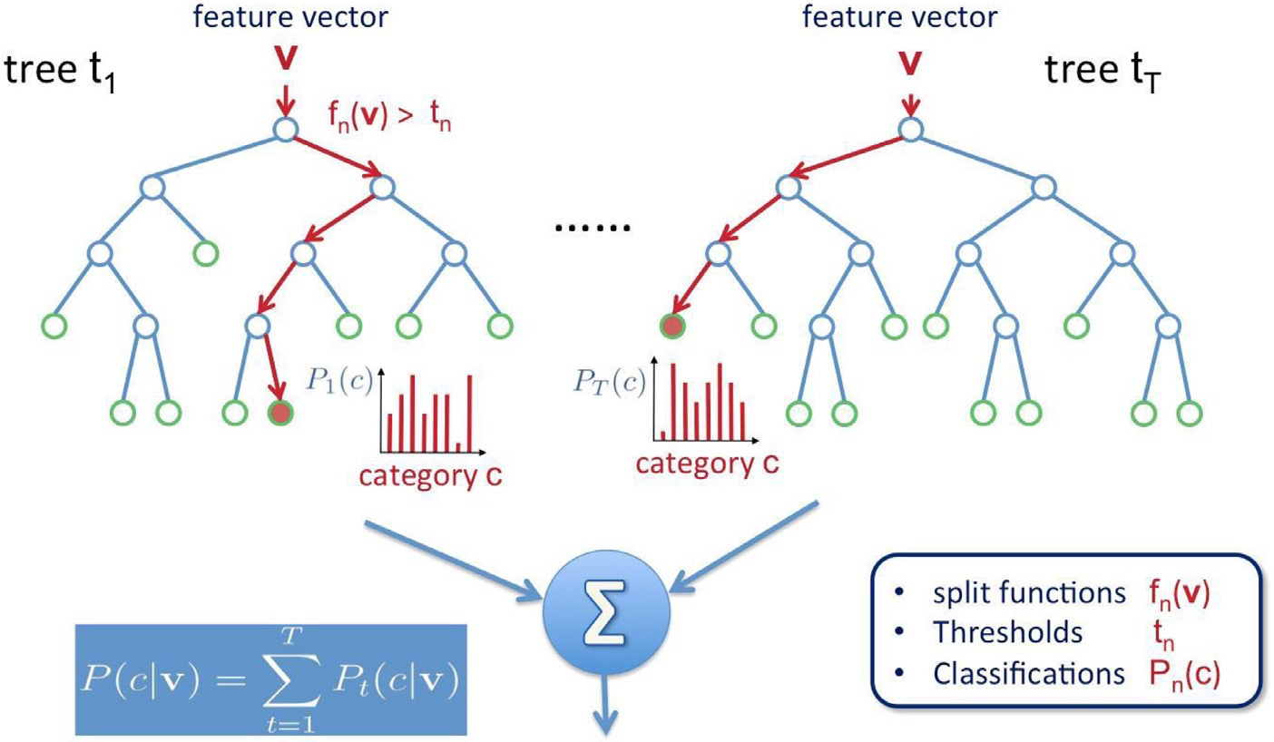
Methodology-Random Forest
Sample Observations (Bootstrap)
Sample Features
Notes:
Youqiao 1min
So now we do sample on observation, why not on features too. Then we get random forest. For each split, RF sampled certain number of features to get split by gini index. That number by default would be square root of number of features.
In the prediction process, each tree would give a result, and RF takes the majority vote for classification.
For example, in this picture, we have result from each tree in the forest. And if most of them, predict it belongs to category C. The RF would say it is C.

Slide 8
Methodology-Error Estimation
Algorithm:
For observation i in dataset(1,2…,n):
For tree j in random forest(1,2,...,m):
If observation i in OOB of tree j:
tree j.predict(observation i);
majority vote for observation i among trees;
If majority vote != yi:
error = error + 1;
error estimation = Sum(error) / n;
Notes:
Youqiao 1min
The paper also mentioned error estimation method. Based on the algorithm, it is similar to cross validation.
To get the error estimation of the RF

Slide 9
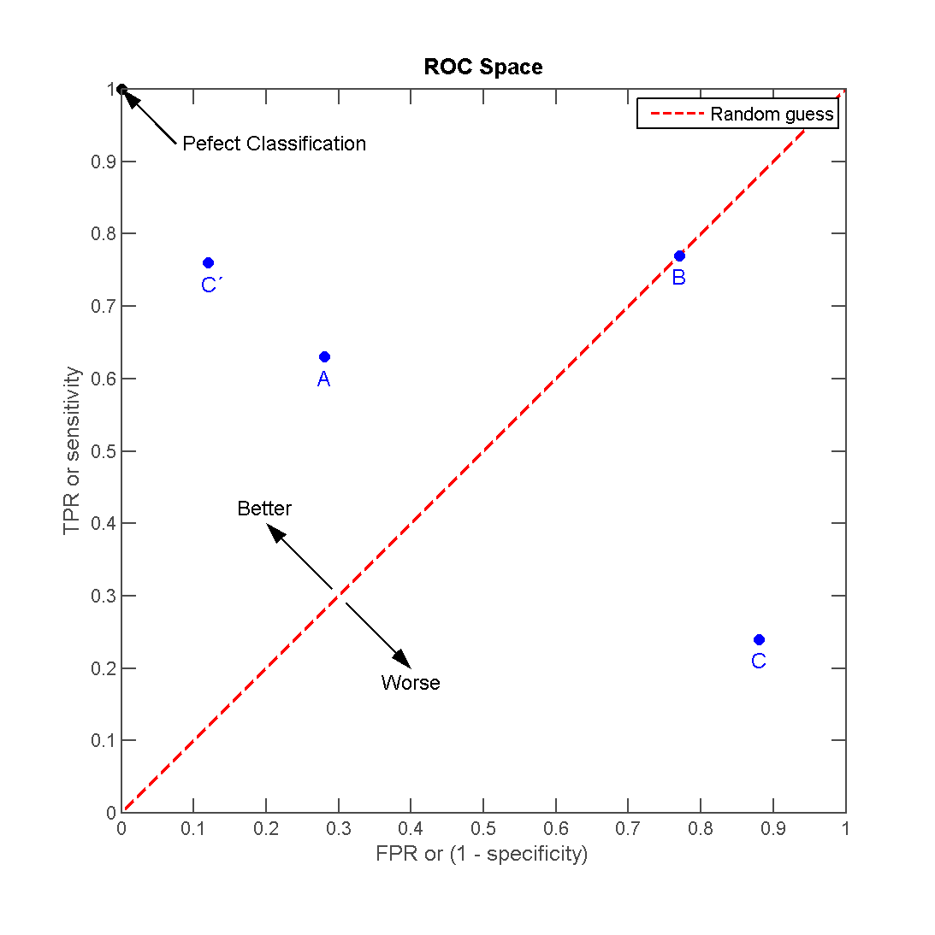
Methodology - AUC
AUC
Area under the Curve
Notes:
Youqiao
TPR: how many observations that are predicted as True are real True.
FPR: how many observations that are predicted as False are real False.
What I can tell, is that AUC is more sensitive, if we have an imbalance dataset. Too many Yes, but too few False. The model could just predict all the data to be True, the accuracy is still high. But it does not make sense. because the model cannot identify those No classes.

Slide 10
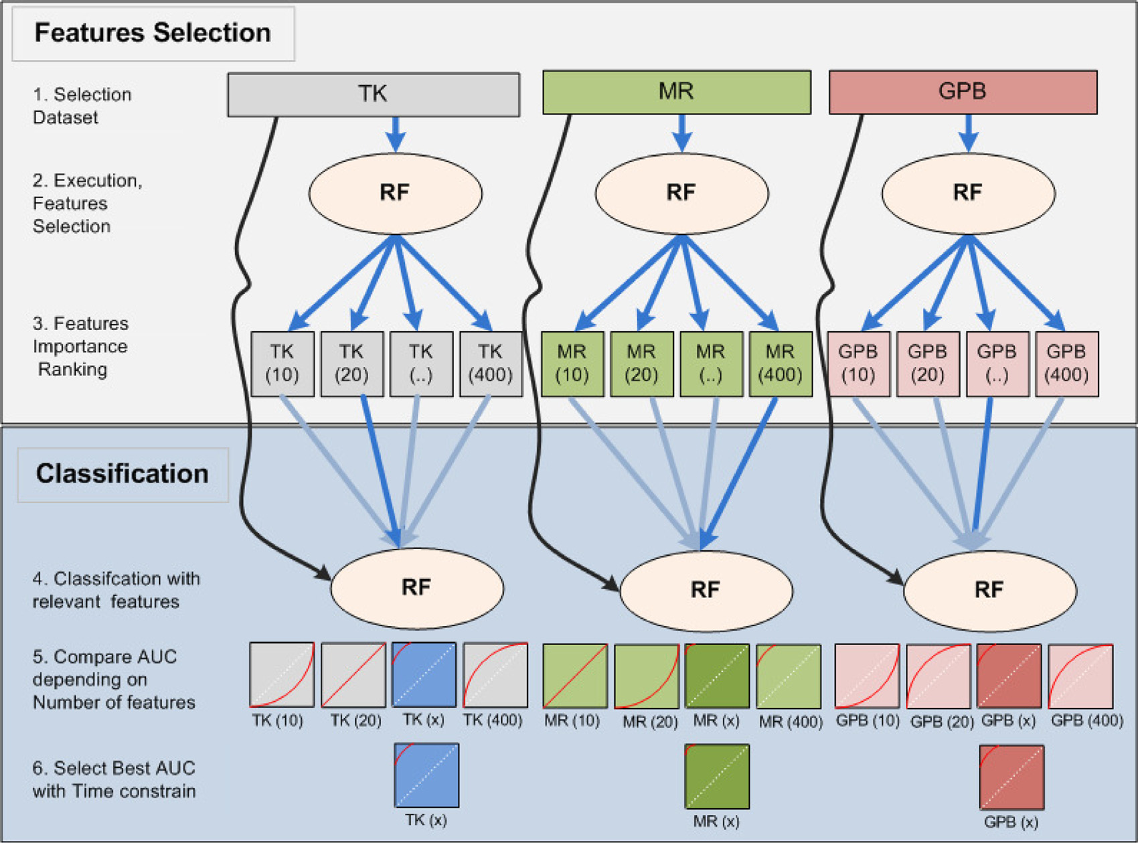
Research Structure
Notes:
Youqiao

Slide 11
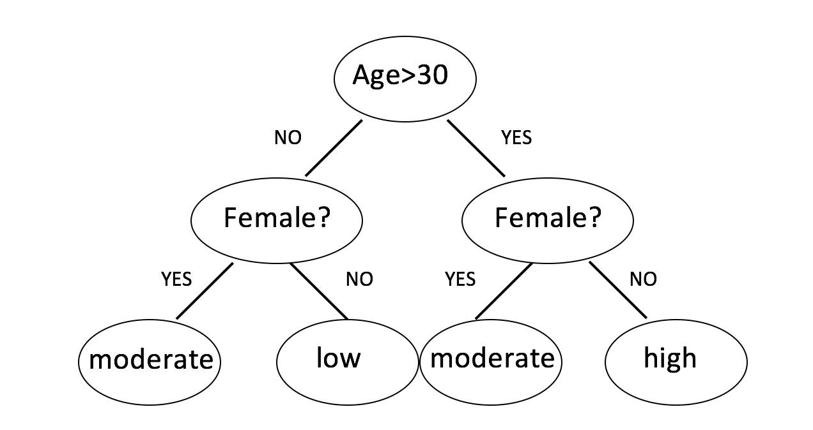
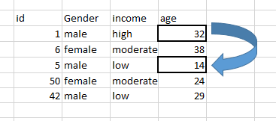
Procedure - Feature Selection
Importance of Variables
MDA - Mean Decrease Accuracy
Notes:
Yimin

Slide 12
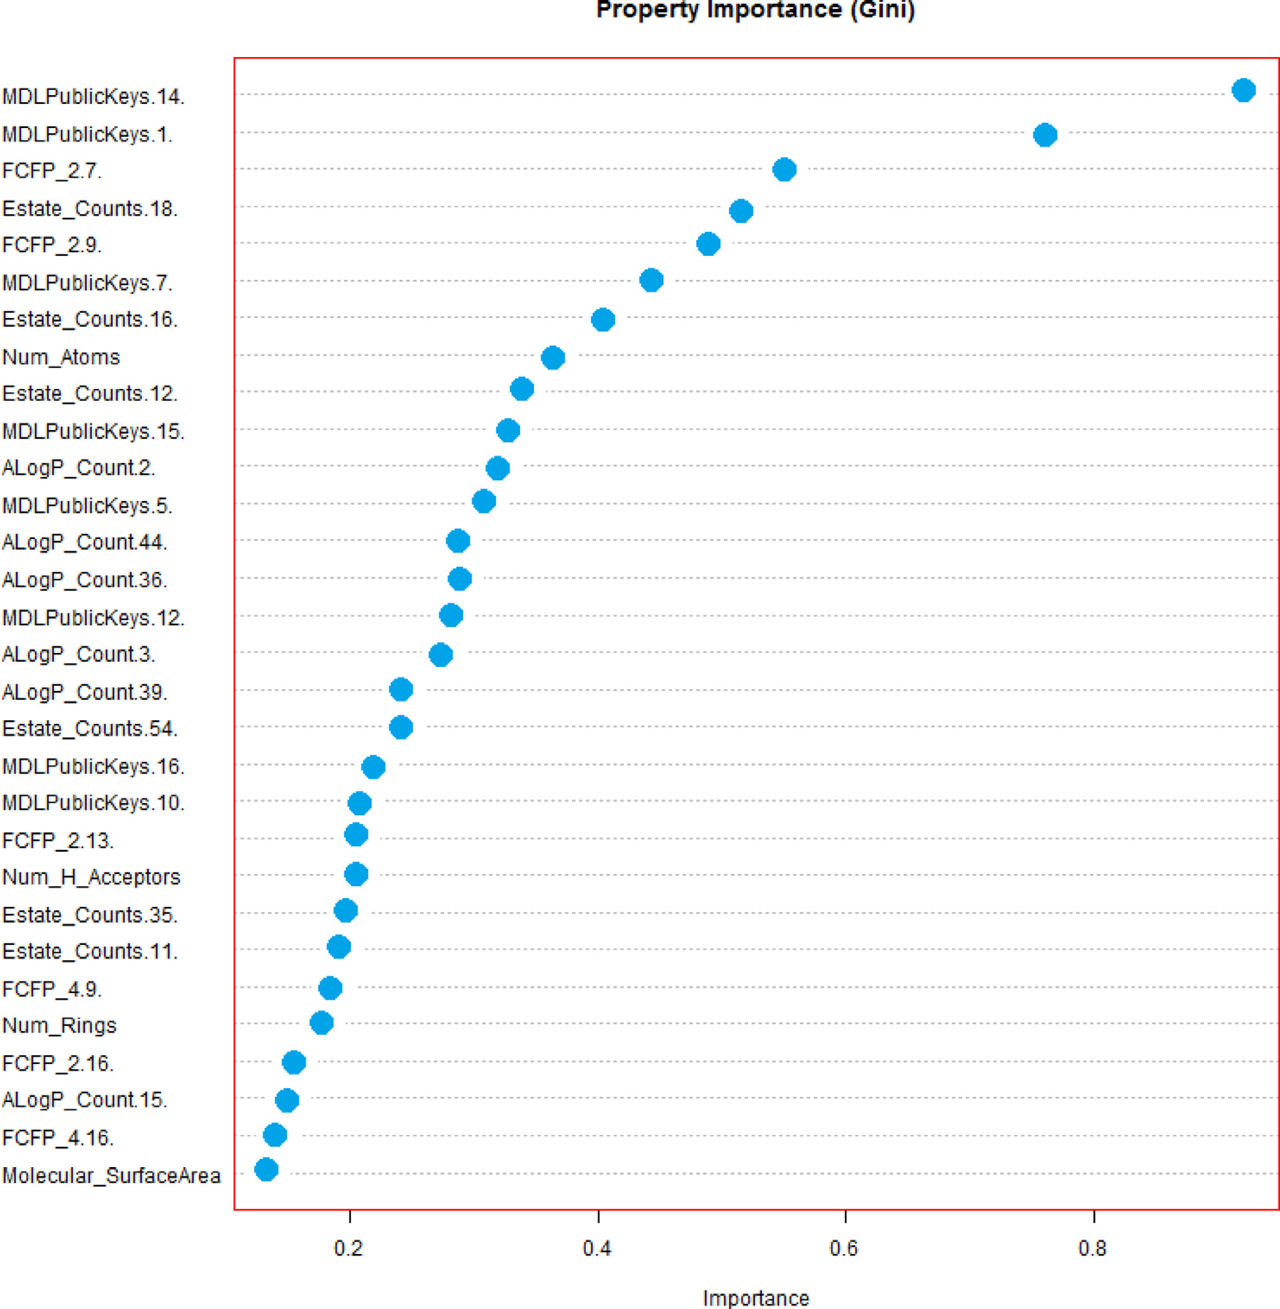
Procedure - Feature Selection (Cont.)
MDG (Mean Decrease Gini)
Relative importance of
predictors of MR dataset
Selection Strategy
1.Adhoc (Manual selection)
2.Auto
Notes:
Yimin

Slide 13
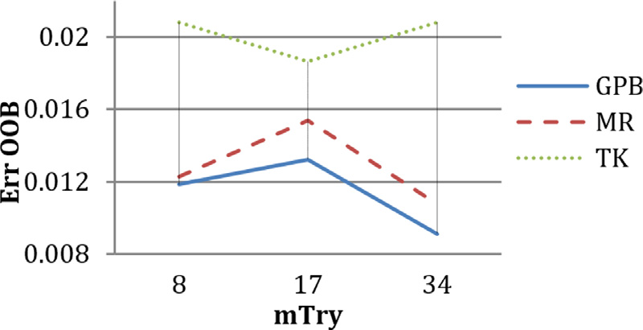
Procedure - Classification
The model behavior is influenced by two parameters: the number of trees and the number of partition to be made.
Number of Splits - mtry
Notes:
Ran

Slide 14
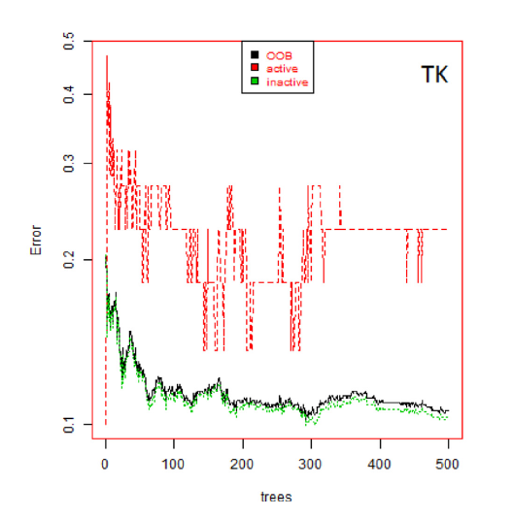
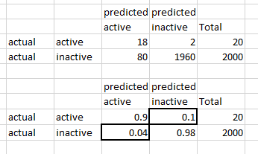
Procedure - Classification
Number of Trees - ntree
Notes:
Ran

Slide 15
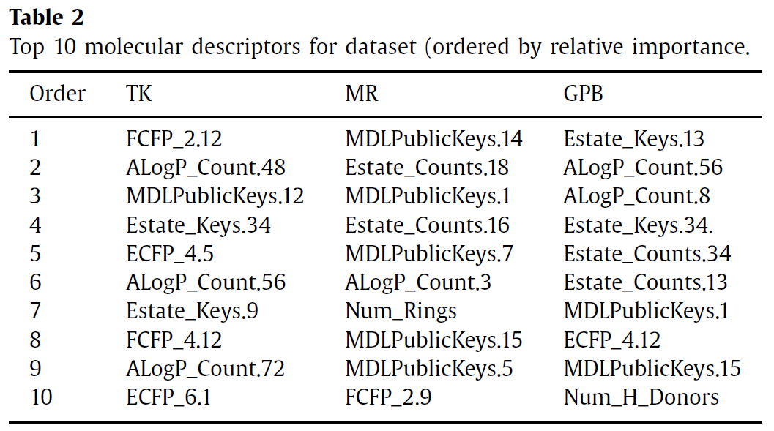
Results - Feature Selection
Notes:
Shaoju Wu

Slide 16
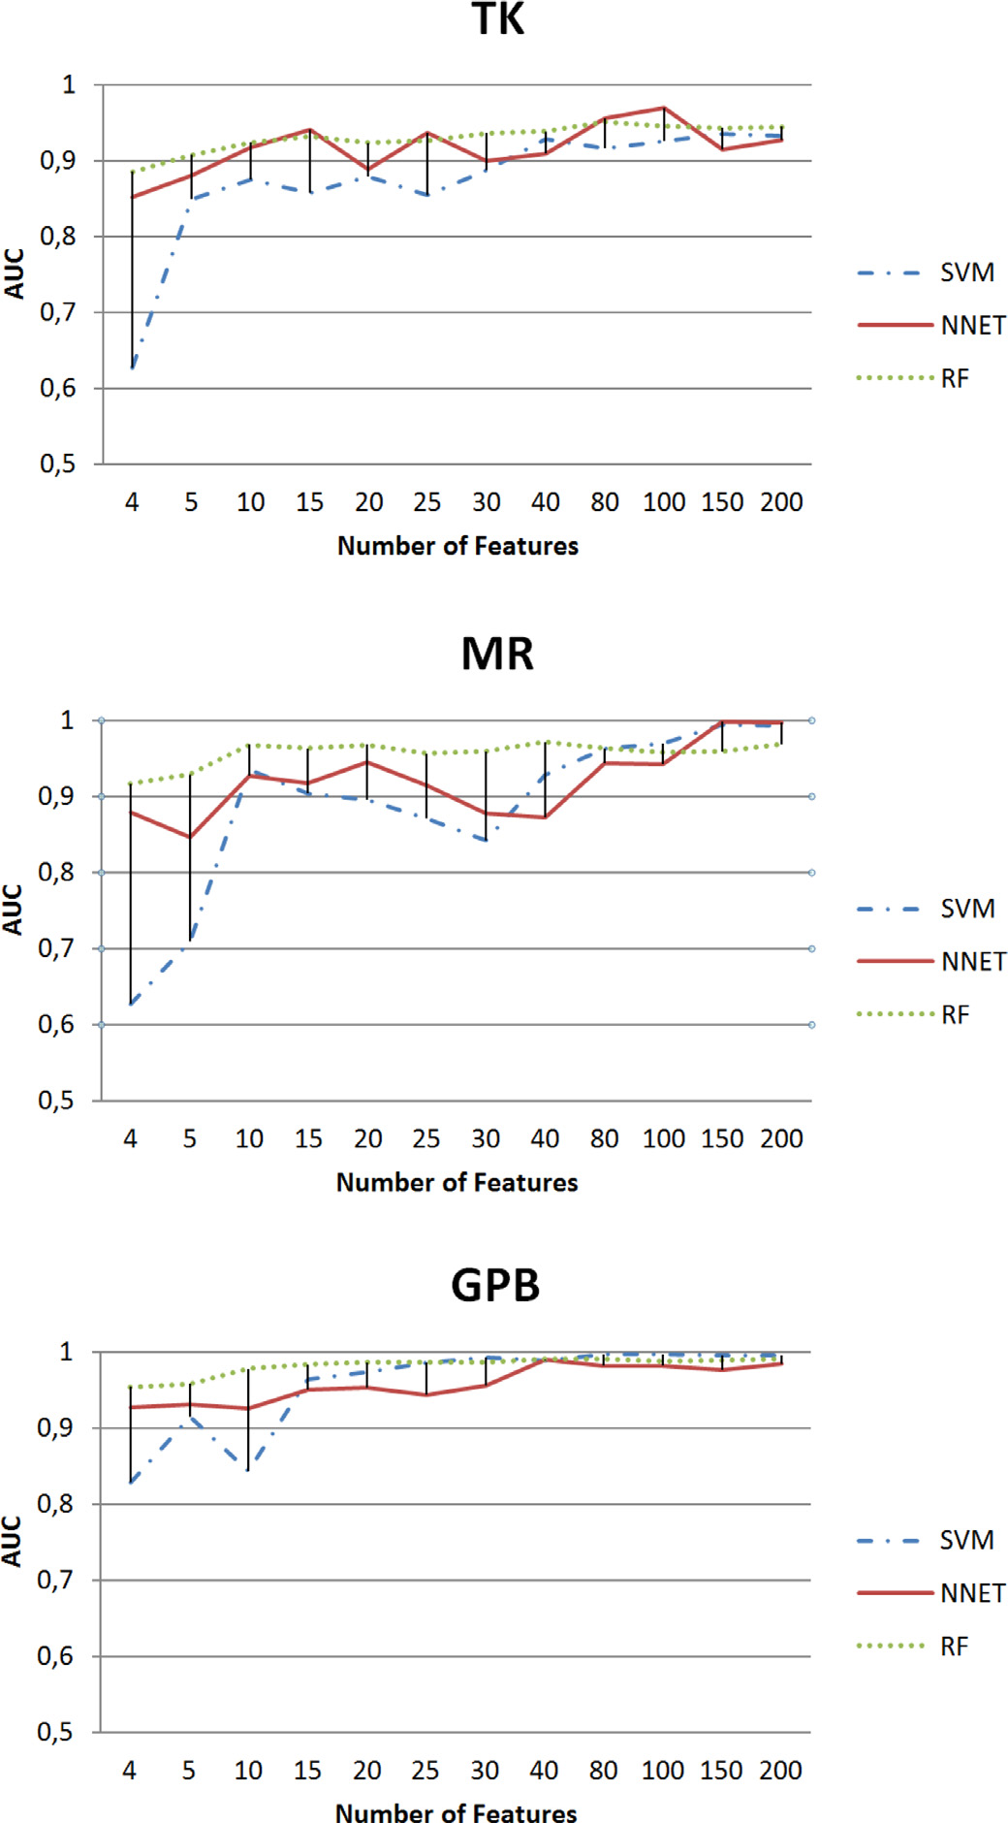
Results - Comparison
Unstable behavior in Support Vector Machine (SVM) and Neural Networks (NNET) results could come from their inability to deal with datasets with high-dimensional data with low number of observations.
RF outperforms other two using a minimum subset of relevant features.
Notes:
Shaoju Wu

Slide 17
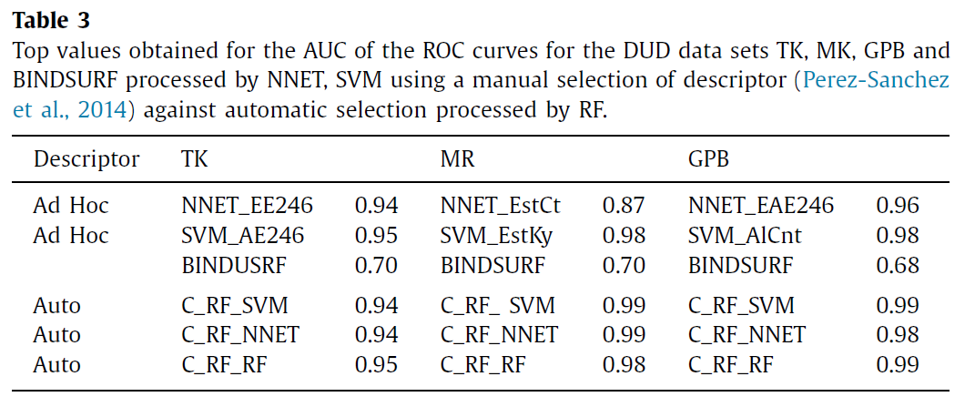
Results - Comparison (cont.)
Notes:
Shaoju Wu

Slide 18
Conclusion
Random Forests: A data mining algorithm that operates by constructing multiple decisions tree using random subsets of the data at training time and outputting class as the mode of the individual trees
RF-based method outperforms classification results provided by Support Vector Machine (SVM) and Neural Networks (NN) approaches.
Reduces Features and Runtime, allowing larger sets of data to be processed
Notes:
Bhon

