Slide 1
CS548 Fall 2017 Model and Regression Trees Showcase by Nguyen Vo, Bolun Lin, Qing Xu, Ishaan Singhal, and Andi Dhroso
Showcasing work by
Eytan Bakshy, Jake M. Hofman, Winter A. Mason, Duncan J. Watts
on
“Everyone’s an Influencer: Quantifying Influence on Twitter”

Slide 2
References
[1] Bakshy, E., Hofman, J. M., Mason, W. A., & Watts, D. J. “Everyone’s an influencer: Quantifying Influence on Twitter”. in Tenth ACM International Web Search and Data Mining, 2011, (pp. 65-74).
[2] James, G., Witten, D., Hastie, T., & Tibshirani, R. “An Introduction to Statistical Learning”. New York: Springer, 2015
[3] Unknown. (2006, October 23). “Homoscedasticity”. Retrieved from Wikipedia: https://en.wikipedia.org/wiki/Homoscedasticity
[4] Lane, D. (n.d.). Retrieved from http://davidmlane.com/hyperstat/A121947.html
[5] Henrard, S., Speybroeck, N. and Hermans, C. (2015), “Classification and regression tree analysis vs. multivariable linear and logistic regression methods as statistical tools for studying haemophilia”. Haemophilia, 21: 715–722. doi:10.1111/hae.12778
[6] Introduction to Data Mining, P.-N. Tan, M. Steinbach, V. Kumar. Addison-Wesley 2005. ISBN-10: 0321321367 ISBN-13: 9780321321367

Slide 3
Introduction
The importance of quantifying influence of users:
Targeting right users to promote content on social network. For example: online advertising.
In emergencies, fast spreading urgent messages on social network can save many lives (e.g., Hurricane Sandy)
Challenges:
It is very hard to define how influential a user is.
There are too many users on social network.
Novelty:
The first attempt in finding influential users on social network
Using Regression Tree to quantify influence level.
Regression Tree also helps selecting important features.

Slide 4
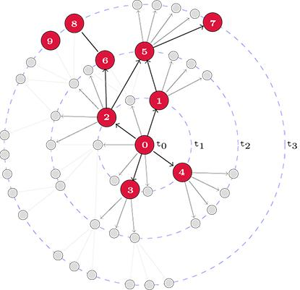
Seed user and influence score.
Q: How information is propagated on social network?
Given directed graph $G(V, E)$ where $V$ is the set of user, $\left(u,v\right)∈E$if $u$ follows $v$.
At t0: Seed user posted a bit.ly URL.
At t1: 4 more users spreaded it
At t2: 2 more users and so on
Terminologies:
Seed user is the first user that posted a specific URL in dataset.
Influence value of this seed user is logarithm of the number of users (cascade size) who reposted his bit.ly URLs: $\log_{10}{9}∼0.95$
Seed user $u_{0}$ may post many bit.ly URLs, so his influence is logarithm of average cascade size.
Seed user
URL propagation on social network,
Cascade size = 9
Notes:
Advertising on social network is a common method promoting products . A question for marketers is that how can we propagate information as much as possible with limited cost.
A method people usually employed is paying money to celberities to post promotional posts . For example, Taylor swift …..
But, how can we know which users are influential so that we should invest our money effectively?
Zubiaga et al. proposed 6 features to model each users on Twitter and using Regression Tree to quantify

Slide 5
Features
For each seed user u, 10 following features were extracted:
#followers i.e. How many people are following u
#followees i.e. How many people u are following
#tweets i.e. How many tweets u posted
Registration date of u
Average, minimum, and maximum past total influence of u
Average, minimum, and maximum past local influence of u

Slide 6
Features – Local influence vs. Total Influence
For each seed user u in the training set, 10 following features were extracted:
total influence: Total number of users who reposted u’s bit.ly URL.
local influence: #followers of u who reposted u’s specific bit.ly URL.
Example: Total influence of $u_{0}$ is 9, local influence of $u_{0}$ is 4 with URL bit.ly/mrattractor
Seed user $u_{0}$ may post many bit.ly URLs, so we need average, min and max.
$u_{0}$ - seed user
who posted bit.ly/mrattractor

Slide 7
Datasets
Collected all 1.03B public tweets broadcast on Twitter during two months: Sept 2009 and Nov 2009.
Among them, there are 87M tweets that included bit.ly URLs, which identifies diffusion events.
Analyzed events only initiated by seed users who were active in both the first and second months.
Identified 1.6M seed users and constructed a follower graph.
Crawled the graph with breadth first search.
 | #Followers | #Followees | #URL posted
Median | 85.00 | 82.00 | 11.00
Mean | 557.10 | 294.10 | 46.33
Max | 3.9M | 759,700 | 54,890
Statistics of Twitter follower graph and #URLs posted

Slide 8
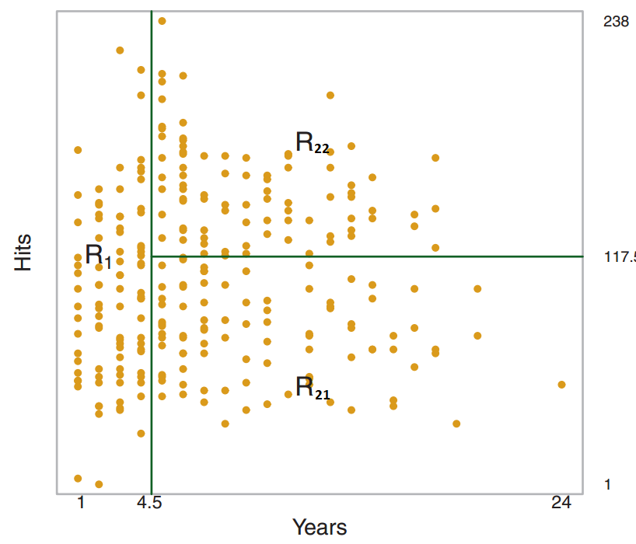
Methodology – Constructing Regression Tree
The aim of regression tree is to partition data objects in training data into non-overlapping regions such that
$$RSS=\sum_{j=1}^{J}{\sum_{i∈R_{j}}{{\left(y_{i}−{\hat{y}}_{R_{j}}\right)}^{2}}}$$
It is infeasible to find all possible partitions
Greedy method: Recursive Binary Spliting:
First, selecting predictor $X_{j}$ and cutpoint $s$, such that splitting predictor space into $R_{1}=\left\{X | X_{j}<s\right\}$ and $R_{2}= \left\{X | X_{j}≥s\right\}$ leads to smallest reduction of RSS
Second, recursively apply the first step to above one of above regions.
Third, continue to do that until each leaf node has at least $k$ data objects.
The value of each leaf is mean value of all data objects in that leaf.
$$R_{2}=R_{21}∪R_{22}$$
Predictor Years is selected, s=4.5, two regions $R_{1}$ and $R_{2}$. Region $R_{2}$ is then partitioned into $R_{21}$ and $R_{22}$

Slide 9
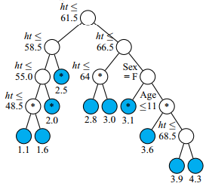
Methodology – Prediction and Evaluation.
With each data object in testing set, we find what leaf it belongs to based on trained regression tree.
The value of that leaf node is predicted value.
The metric used to evaluate performance is RSS.
The smaller RSS means prediction is very well.
To avoid overfitting, adding constraints:
$$RSS=\sum_{j=1}^{J}{\sum_{i∈R_{j}}{{\left(y_{i}−{\hat{y}}_{R_{j}}\right)}^{2}}}+α∗|J|$$
$|J|$ indicates the number of leaves. The larger $α$, the smaller tree is. It is similar to regularization in linear regression ${\left(Y−θ^{T}X\right)}^{T}\left(Y−θ^{T}X\right)+{|\left|θ\right||}_{2}^{2}$
$α$ is selected based on cross validation on training set.
The paper we present used 5-fold cross validation.

Slide 10
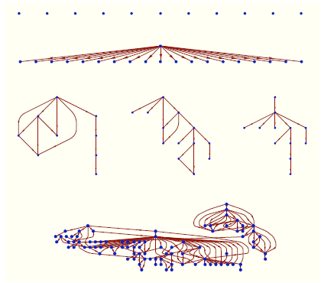
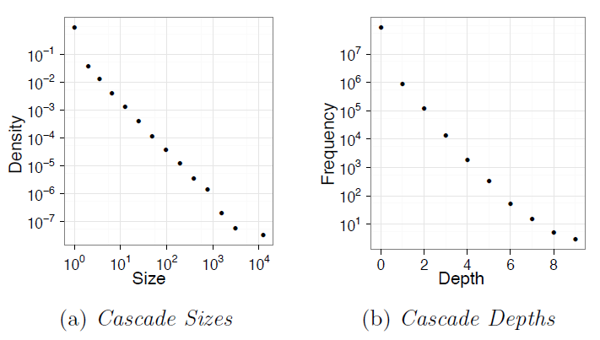
Data Insights - Influence and Cascading
User A is considered to influence user B if:
B follows A and A tweets 1st among all users B follows (first influence)
More than 1 user has influenced B if:
B follows A, C, D and all have tweeted the same URL
Look at most recent user to tweet (last influence)
Giving all users equal weightage (split influence)
User’s influence = log(Avg size of cascades seed users)
*Log to account for skewed distribution

Slide 11
Data Insights - Feature Importance
Fitted Regression Tree in 4 training folds:
Most informative features: past local influence, # followers
The rightmost leaf indicates that users with upwards of 1870 followers who had on average 6.2 reposts by direct followers (past local influence) are predicted to have the largest average total influence, generating cascades of approximately 8.7 additional posts (calculations done by taking 10^{x}).
Notes:
Regression tree fit for one of the five cross-validation folds. Leaf nodes give the predicted influence for the corresponding partition, where the left (right) child is followed if the node condition is satisfied (violated).

Slide 12
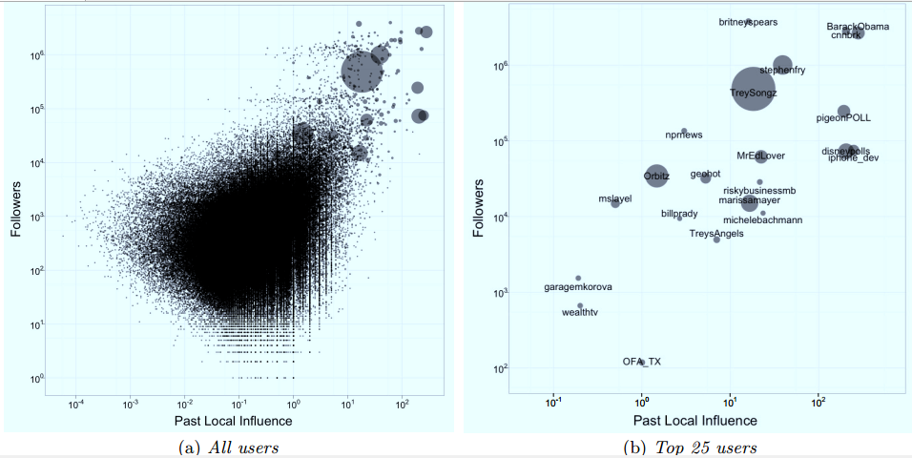
Data insights

Slide 13
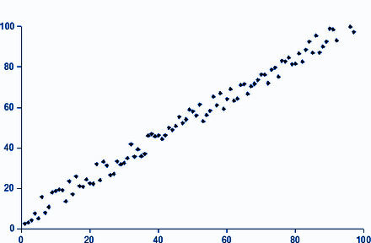
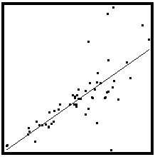
Advantages of Regression trees
An advantage over linear regression:
Linear regression requires presumptions such as normality of residuals, homoscedasticity and so on…
Notes:
Img reference: https://en.wikipedia.org/wiki/Homoscedasticity, http://davidmlane.com/hyperstat/A121947.html

Slide 14
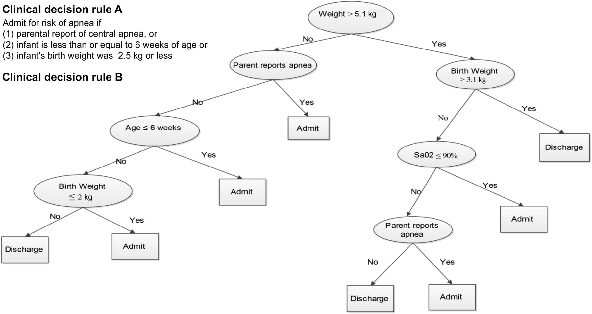
Advantages of Regression trees (contd...)
Derivation of Candidate Clinical Decision Rules to Identify Infants at Risk for Central Apnea
Decision trees perform a more fined-grained optimization
Variable transformation
Nonlinear relationships between parameters do not affect tree performance
Easy to interpret and explain to decision makers
Walsh et al Pediatrics. 2015 Nov, 136(5): e1228–e1236.
Notes:
OLR tends to fit the vast majority of small cascades at the expense of larger ones, the piecewise constant nature of the regression tree function allows cascades of different sizes to be fit independently.
The result is that the regression tree model is much better calibrated than the equivalent OLR model.
http://onlinelibrary.wiley.com/doi/10.1111/hae.12778/full

Slide 15
Conclusion
Influence of users on social network is quantified by building a regression tree over 10 features.
The larger number of followers, the more influential you are.
If you are an influential guy in the past, you’re likely to continue to have strong impact in the future.
Regression trees do not rely on parameters
Regression trees are easy to interpret to non-technical users

Slide 16
Questions?

