Slide 1
Showcasing work by: Aileen P. Wright, Adam T. Wright, Allison B. McCoy, Dean F. Sittig on “The Use of Sequential Pattern Mining to Predict Next Prescribed Medications”
CS548 Fall 2017: Sequence Mining
by: Emma Clavet, Nan Hu, Shivangi Pandey, Tesia Shizume, Xiaojun Wang
Notes:
Emma

Slide 2
References
[1]. Wright, A., Wright, A., McCoy, A. and Sittig, D. (2015). The use of sequential pattern mining to predict next prescribed medications. Journal of Biomedical Informatics, 53, pp.73-80.
Figures on slides 7, 9, 13,14,15,16,17,19 were taken from this paper
[2]. Srikant R, Agrawal R. Mining sequential patterns: generalizations and performance improvements. Springer; 1996.
[3]. “ Almaden Institute - IBM, 25-Jul-2016. [Online]. Available:http://researcher.watson.ibm.com/researcher/view_group.php?id=4260. [Accessed: 29-Nov-2017].
[4]. Blue Cross Blue Shield of Texas. (2017). Special Enrollment. [online] Available at: https://www.bcbstx.com/ [Accessed 30 Nov. 2017].
[5]. Zaki MJ. SPADE: an efﬁcient algorithm for mining frequent sequences.MachLearn2001;42(1–2):31–60.
Figures on slides 10, 11, 12 were taken from this paper
[6].D. Nathan, J. Buse, M. Davidson, E. Ferrannini, R. Holman, R. Sherwin and B. Zinman. (2009) Medical Management of Hyperglycemia in Type 2 Diabetes: A Consensus Algorithm for the Initiation and Adjustment of Therapy. Diabetes care, 32, pp. 193-203.
Figure 2 on slide 15 was taken from this paper and modified to use only drug classes
Notes:
Emma

Slide 3
Introduction
What is Sequential Pattern Mining?
A data mining technique used to identify patterns of ordered events[3] within a database
Original applications were in the retail industry
How does Sequential Pattern Mining apply to this paper?
This paper uses sequential pattern mining to infer relationships between medications for diabetes patients
The transitioning from paper to electronic medical records has helped accumulate large amounts of clinical data
Notes:
Emma
How does Sequential Pattern Mining apply to this paper?
This paper uses sequential pattern mining to infer relationships between medications for diabetes patients
The transitioning from paper to electronic medical records has helped accumulate large amounts of clinical data

Slide 4
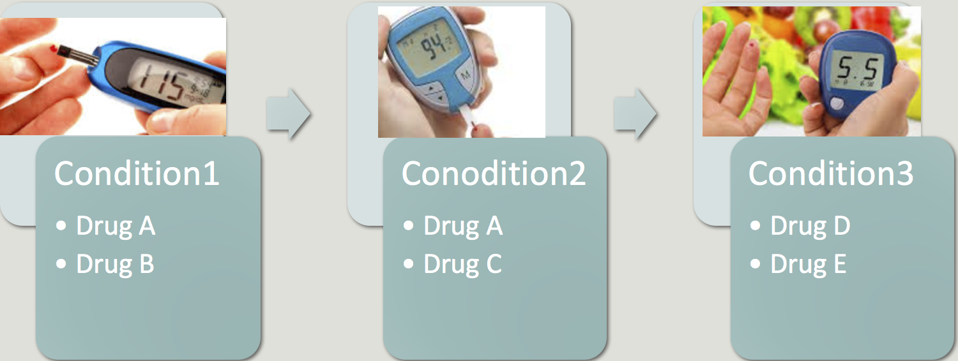
Background
Stepwise Pharmacological Therapy:
Recommends a treatment algorithm (clinical decision support system) according to the progression of diseases
Common for progressive conditions like diabetes
Relies on an updated knowledge base
Sequential Pattern Mining:
Automated development of a knowledge base of temporal relationships between medications, which could be used to guide clinical decision support based around drug regimen changes
Notes:
Emma
Stepwise Pharmacological Therapy:
Recommends a treatment algorithm (clinical decision support system) according to the progression of diseases
Common for progressive conditions like diabetes
Relies on an updated knowledge base
Sequential Pattern Mining: Application in this paper:
Automated development of a knowledge base of temporal relationships between medications, which could be used to guide clinical decision support based around drug regimen changes

Slide 5
Hypothesis
“Sequential Pattern Mining is an effective technique to identify temporal relationships between medications and generate rules which diabetes medication is prescribed next for a patient.”
Research explored two questions:
Is sequential pattern mining useful for predicting changes to a patient’s diabetes medications?
How useful is the patient’s history of prior medication changes to predicting the next medication?
Notes:
Emma

Slide 6
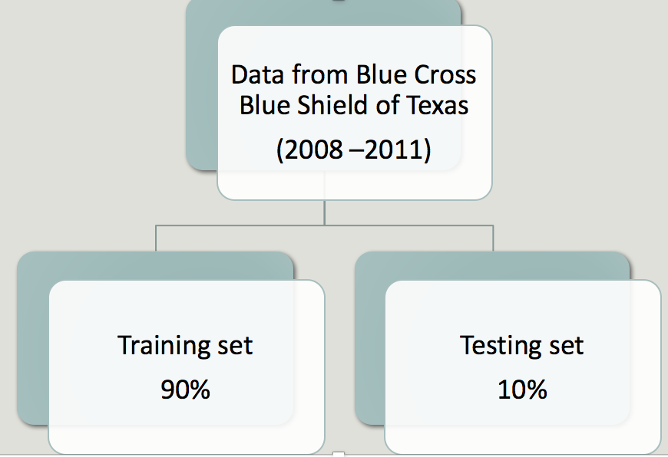
Dataset
Description:
Claims data from Blue Cross Blue Shield of Texas, for medications between 2008 and 2011
Included patients on at least one diabetes medication
Split 90% Training set, 10% Test set
Limitations:
If a patient started on diabetes medication before 2008 that would not be captured
This dataset only spans 3 years, and the progression of Type II diabetes can take decades
n = 145,936 n = 16,011
(Claims records from 2008-2011)
Notes:
Emma
Identified 161,497 patients prescribed at least one diabetes medication

Slide 7
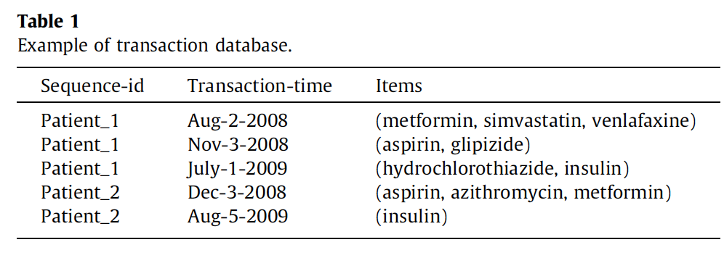
Data Collection &
Preprocessing
World Health Organization Anatomic Therapeutic Chemical drug classes
E.g. (Biguanide,Sulfonylurea) (Metformin,Glipizide,Glyburide)
Notes:
Shivangi
World Health Organization Anatomic Therapeutic Chemical (ATC) classes
Drug Class: 10
Generic Drug: 38

Slide 8
Process
Two experiments: Generic Drug Level & Drug Class Level
Notes:
Shivangi
Create mapping of drug information either at the drug level or the class level
Gather information from the database
Format the data for sequential pattern mining
Used the R package ‘arulesSequences’ to mine the data for frequent patterns using a support of 1e-10.
Evaluate results

Slide 9
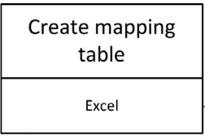
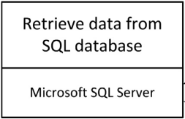
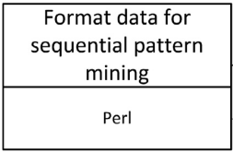
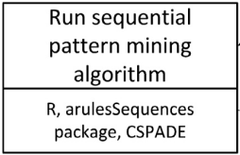
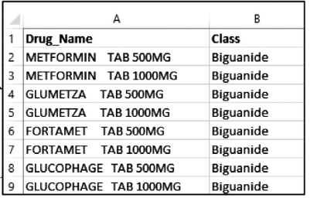
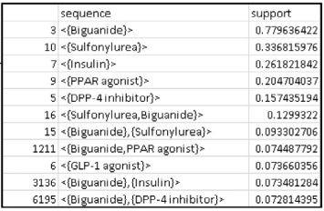
sid
Notes:
Shivangi
arulesSequences package contains CSPADE

Slide 10
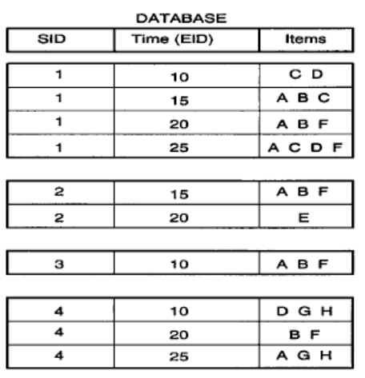
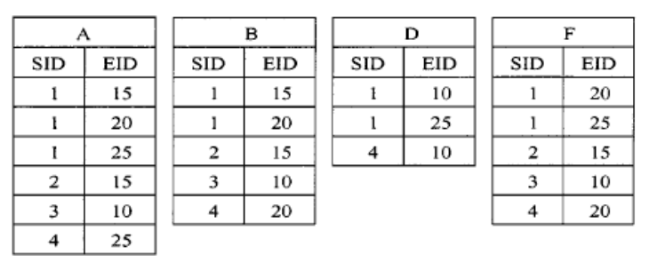
SPADE (Sequential Pattern Discovery using Equivalence Classes) Algorithm
Transform horizontal database layout into a vertical “id-lists”
Minimizes the number of database scans required.
cSPADE incorporates constraints on sequences, like length or time of a sequence
Used R package: ‘arulesSequences’
Support Counting: S(A) =4, S(B)=4,S(D) = 2, S(F) = 4
Id-lists of the most frequent items (1-sequences)
Notes:
Susan
For example consider the atom D.
In our original database in figure 1, we see that D occurs in the following input-sequence
and event identifier pairs {(1, 10), (1, 25), (4, 10)}. This forms the id-list for item D.

Slide 11
SPADE (Sequential Pattern Discovery using Equivalence Classes) Algorithm
Equivalence classes
2 sequences are in the same class if they share a commonn length prefix
Rules of temporal id-list join
Event atom with event atom
PA & PF PAF
Event atom with sequence atom
PF & P → A PF → A
Sequence atom with sequence atom
P → A → F
P → A & P → F P → F → A
P →FA
Notes:
Susan

Slide 12
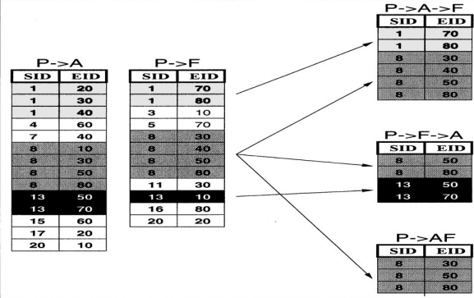
SPADE (Sequential Pattern Discovery using Equivalence Classes) Algorithm
Sequence atom with sequence atom
P → A & P → F P → A → F
P → F → A
P →FA
Decrease the memory requirement
Notes:
Susan
To compute
the new id-list for the resulting event atom P → AF, we simply need to check for equality
of (sid, eid) pairs. In our example, the only matching pairs are {(8, 30), (8, 50), (8, 80)}.
This forms the id-list for P → AF.
To compute the id-list for the new sequence atom
P → A → F, we need to check for a temporal relationship, i.e., for a given pair (s, t1)
in L(P → A), we check whether there exists a pair (s, t2) in L(P → F) with the same
sid s, but with t2 > t1. If this is true, it means that the item F follows the item A for
input-sequence s. In other words, the input-sequence s contains the pattern P → A → F,
and the pair (s, t2) is added to the pattern’s id-list

Slide 13
Evaluation of Results
Fig. 2. Evaluation example. Mined patterns from training data are transformed into rules which are used to predict the next drug, given base stems derived from patient sequences in the test set.
Notes:
Nan

Slide 14
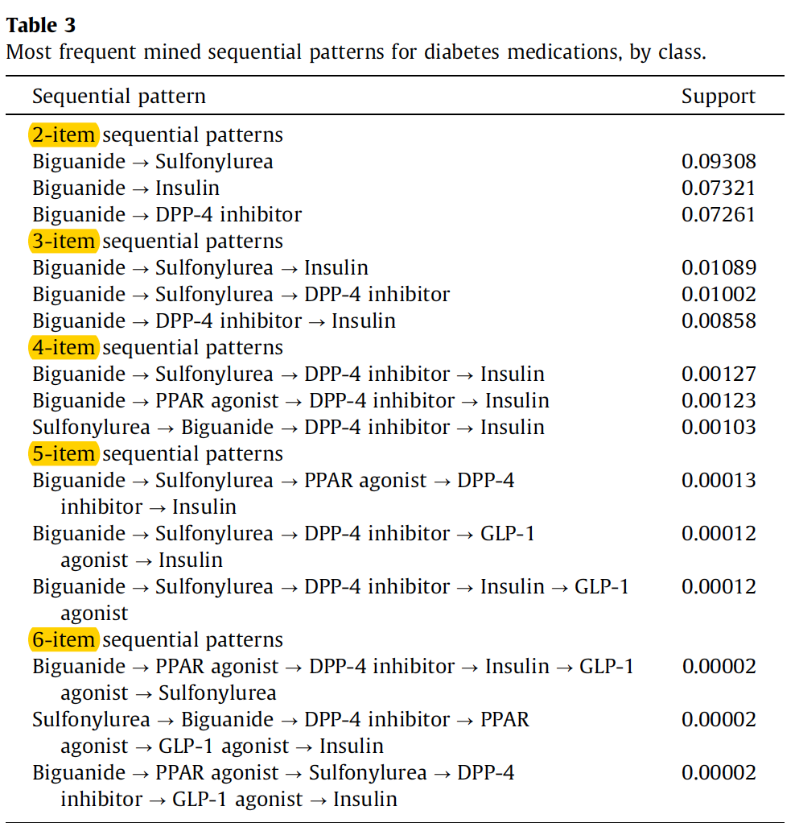
Evaluation of Results - Dataset statistics
The top patterns of length 2–6 items:
87% (13/15) begin with a Biguanide
47% (7/15) have a Sulfonylurea as the second item
67% (10/15) end with Insulin.
Consistent with recommendation made by American Diabetes Association
Notes:
Nan

Slide 15
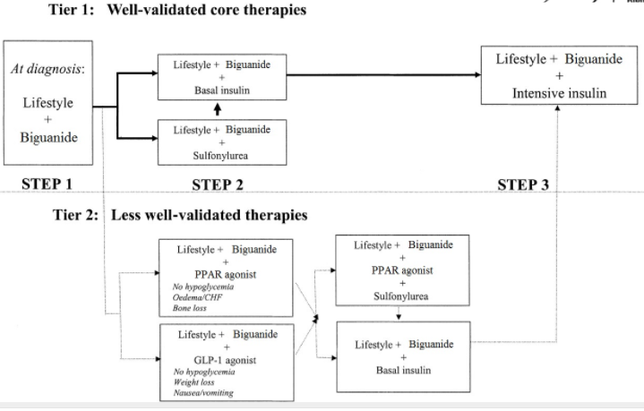
Visualization of top 2-item sequential patterns
Fig. 3. Digraph of diabetes medications. The most frequent 2-item sequences are shown. Differences in support are represented by edge thickness. For clarity, only the direction between nodes with highest support are shown; reverse directions with lesser support are suppressed.
Figure 2- Algorithm for the metabolic management of type 2 diabetes
Notes:
Nan
Thicker edges between nodes denote a pattern of higher support.
Temporal direction is consistent with recommendation made by American Diabetes Association

Slide 16
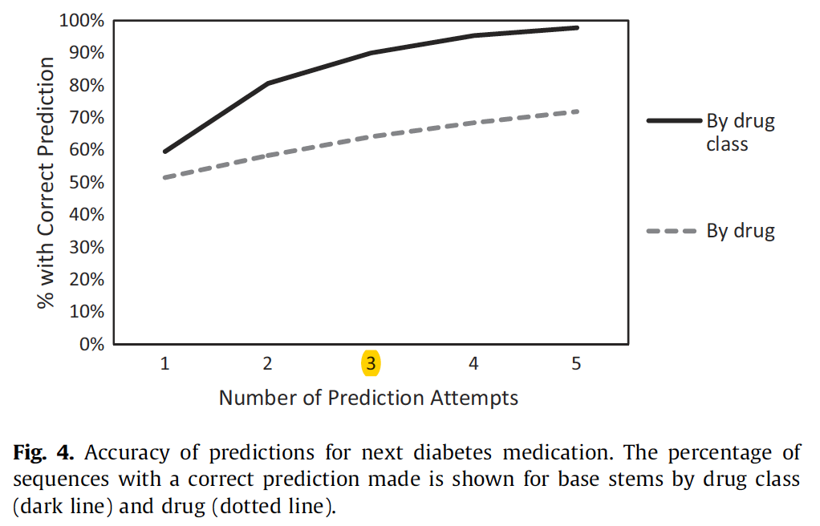
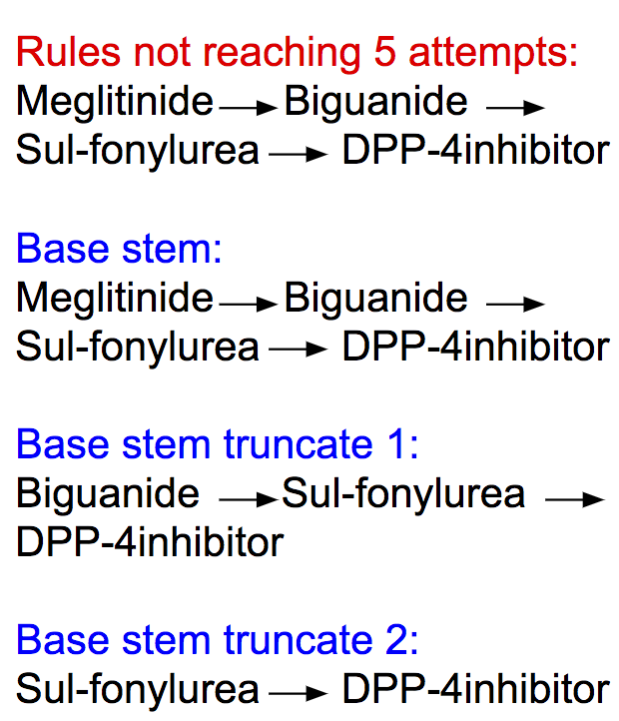
Evaluation at drug class level & generic drug level
Rules not reaching 5 attempts:
Meglitinide Biguanide Sul-fonylurea DPP-4inhibitor
Attempt 1:
Meglitinide Biguanide Sul-fonylurea DPP-4inhibitor
Attempt 2:
Biguanide Sul-fonylurea DPP-4inhibitor
Attempt 3:
Sul-fonylurea DPP-4inhibitor
Notes:
Nan
After excluding patients with more than one drug class initiated
during the same transaction, we were left with 121,584 patients in
our training set and 11,664 patients in our test set. We were able to
correctly guess the next class of diabetes medication prescribed for
6943 (59.5%) of patients using one attempt, and this number
increased with successive attempts, so that 10,493 (90.0%) had a
correct prediction when 3 attempts were made, and 11,401
(97.7%) when 5 attempts were made (Fig. 4).
Rule not reaching 5 attempt, base stem truncate.

Slide 17
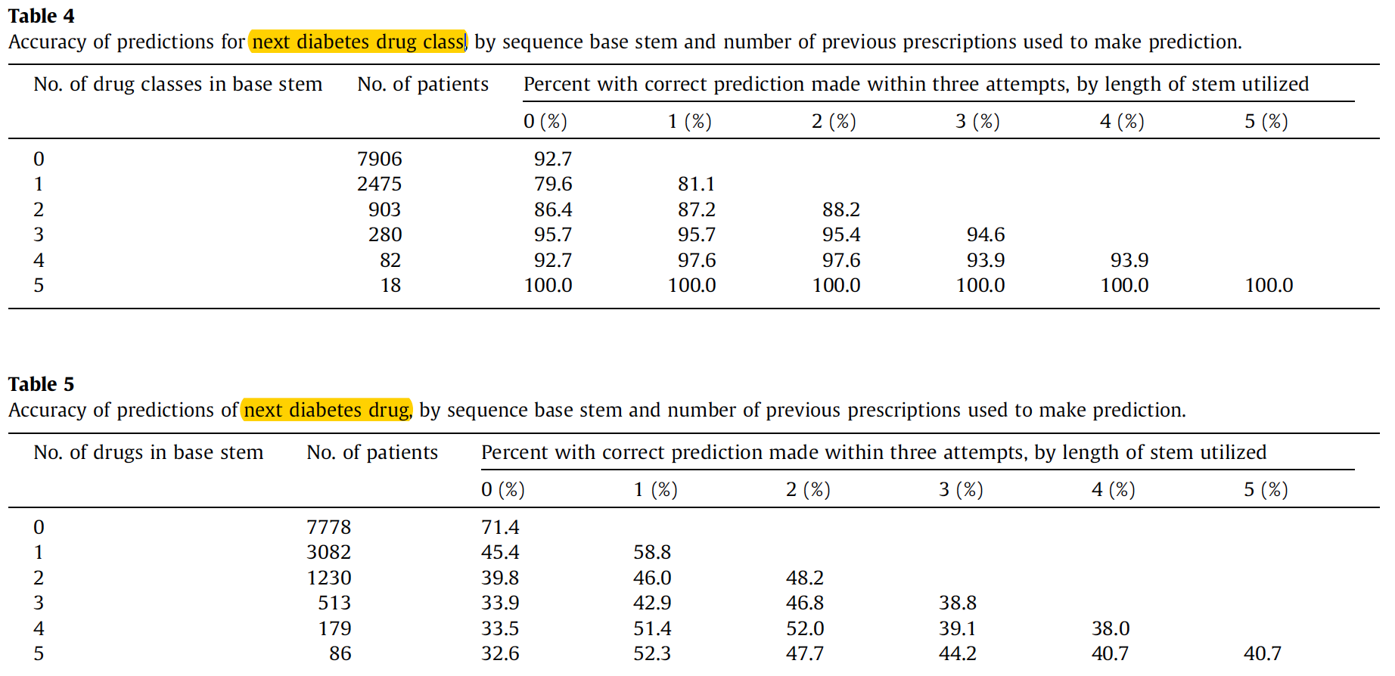
Evaluation at drug class level & generic drug level
Notes:
Tesia
Accuracy was surprisingly high when patient’s base stem was not used to make prediction
i.e. prediction of first medication
This makes sense since the American Diabetes Association’s published guidelines for diabetes treatment start with lifestyle changes and metformin/biguanide
(tess, we’re starting the google hangout call in a bit)
1-2 item stems led to more accurate predictions, but not using the entire stem
Doctors may not be conditioning their prescribing behaviors based on the patient’s entire medication history

Slide 18
Evaluation -- 10-fold Cross validation
Under 10-fold cross validation at the drug class level, the percentage of patients with a correct prediction made within 3 attempts
Notes:
Tesia
Much higher than expected if random chance

Slide 19
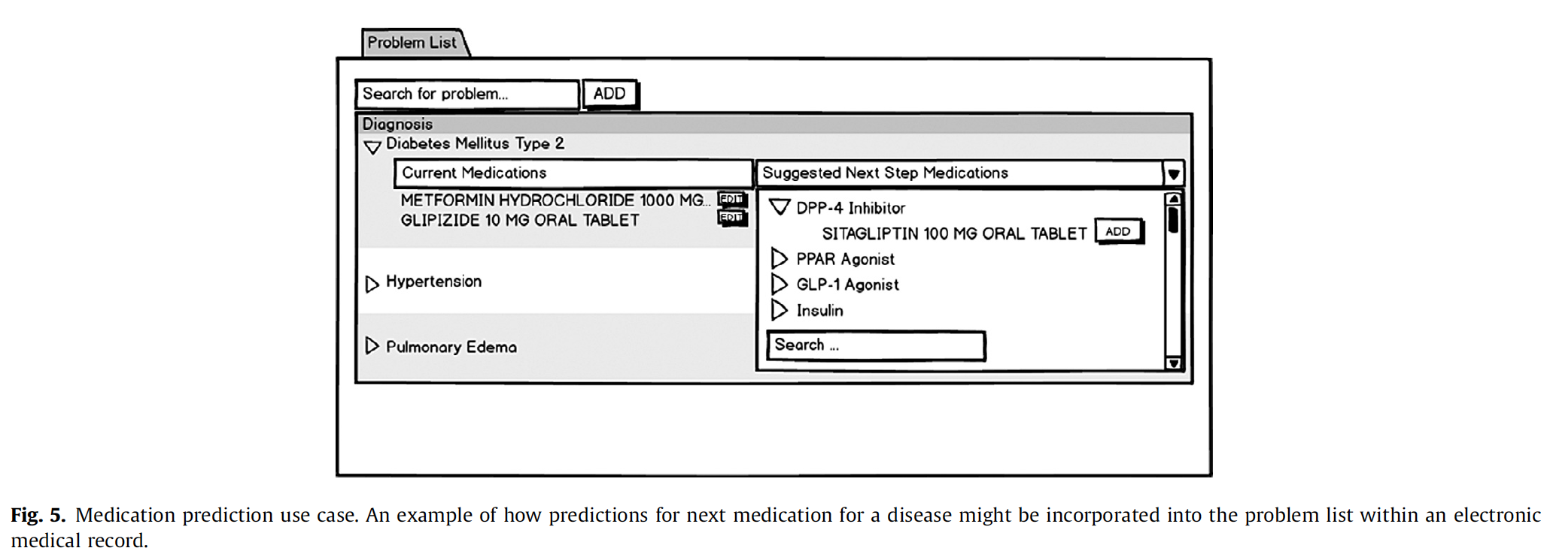
Medication prediction use case
Physician
Patient
Pharmacy
Notes:
Tesia

Slide 20
Conclusions
Sequential pattern mining is a useful data mining technique for identifying temporal relationships between medications.
The temporal relationships are useful for making predictions about which medication a prescriber is likely to choose next when treating a progressive disease, such as diabetes.
Future work: optimize the use of sequential pattern mining to detect temporal relationships among items in medical records and improve patient care.
Notes:
Shivangi

Slide 21
Questions?
Notes:
Everyone

