Slide 1
CS548 Text Mining Showcase
By Zhiqi Chen, Yuchen Shen, Tianyu Wu, Di You, Xiaoyu Zheng
Showcasing work by Nan Li, Desheng Dash Wu on “Using text mining and sentiment analysis for online forums hotspot detection and forecast”

Slide 2
Reference
[1] N. Li and D. Wu, "Using text mining and sentiment analysis for online forums hotspot detection and forecast", Decision Support Systems, vol. 48, no. 2, pp. 354-368, 2010.
[2]”Sina Sports Forums", Forum.sports.sina.com.cn, 2017. [Online]. Available: http://forum.sports.sina.com.cn. [Accessed: 20- Nov- 2017].
[3] Liu, H., “Internet public opinion hotspot detection and analysis based on Kmeans and SVM algorithm”, Information Science and Management Engineering (ISME), 2010 International Conference, Vol. 1, pp. 257-261, 2010.
[4] P. Tan, M. Steinbach, A. Karpatne and V. Kumar, Introduction to data mining. 2005.

Slide 3
Overview
Motivation: data grows exponentially & need useful and accurate information
Goal: time-varying description and prediction of online forum hotspots
Framework: Data collection Data cleansing Text sentiment calculation and marking Hotspot detection based on K-means clustering Hotspot forecast based on SVM classification
Data: Sina sports forums: http://forum.sports.sina.com.cn

Slide 4
Models and methodology
Raw forums text data
Preprocessed forums text data
Sentiment values of text data
Training SVM model using data from time period $W_{i−1}$
K-means Clustering result for $W_{i}$ as Label
SVM model
Sample training
verify
Making prediction by SVM model for $W_{i+1}$
compare
K-means clustering for time period $W_{i+1}$

Slide 5
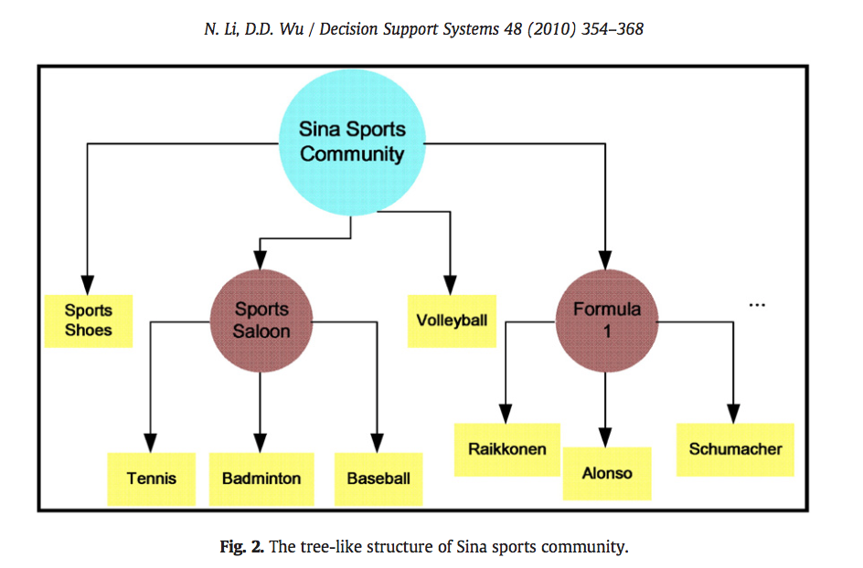
Data collection
From: Sina sports forums
49 topic forums
5,565,216 posts
Notes:
Online Sina sports community exhibits a tree-like structure with root forums, branch forums and a non separable bottom layer of leaf forums.

Slide 6
Data crawling and cleansing process
Step 1 : Manually create table SINA_LEAFORUM_URLLIST
Step 2 : Create table SINA_FORUM_URL based on Step 1
Step 3 : Traverse the links in the SINA_FORUM_URL table and crawl down all posts
Step 4 : Data cleansing
49 forums named SINA_LEAFORUM_URLLIST in database
Generate a list of URLs of webpages contains all topic posts and comment posts into database
SINA_FORUM_TOPIC_POST
31 forums
220,053 posts
SINA_FORUM_COMMENT_POST
Parsing first pages
of them in depth
Extracting all topic and comment posts
Picture/Video postings and nosise data
Notes:
Step 1. Manually create table SINA_LEAFORUM_URLLIST
In this step, we manually store the information for all the 49 forums into a table named SINA_LEAFORUM_URLLIST in the database, where their names and URL links are contained.
Step 2. Create table SINA_FORUM_URL based on SINA_LEAFORUM_URLLIST
After the acquisition of the links for all the leaf forums, we parse the first pages of them in depth and generate a list of URLs of web pages that contain all the topic posts and the comment posts. The list will be written into the SINA_FORUM_URL table in the database.
Step 3. Traverse the links in the SINA_FORUM_URL table and crawl down all the posts
This step is to traverse through all the links that are in the SINA_FORUM_URL table, to parse out all the topic and comment posts contained on the corresponding web pages, and to store them into two tables of SINA_FORUM_TOPIC_POST and SINA_FORUM_COMMENT_POST. Two parsing templates are designed in XML format to parse the posts, which are SinaSportForumReplyPostParseTemplate.xml and SinaSportForumTopicPostParseTemplate.xml. Fig. 3 demonstrates the crawling procedure and the structures of the relational tables and the XML templates, where the green highlighted item in the tables are the primary keys.
Step 4. Data cleansing
When the crawling process is accomplished, data cleansing process is applied to the downloaded post sets. In this phase, we manually remove noise data and irrelevant data. Noise data include forums with strange picture/video postings that are not clearly shown online. Irrelevant data are from forums where there are not enough postings or posting contents that are not related to the forum topics at all. After removing noisy data and outliers, the set of leaf forums is narrowed down to 31, with a time span of 52 time windows across the year of 2007 and each time window is of a week length.

Slide 7
Text sentiment computation of forum posts
A beta version of Chinese word sets with sentiment labels released by HowNet on Oct 2007
$$\left.\begin{aligned}Positive Chinese Words(POSITIVE) \\ Negative Chinese Words(NEGATIVE) \\ Chinese Privatives(PRIVATIVE) \\ {Modifier}_{i} (i=1,2,3,4,5)\end{aligned}\right\}$$
derive
8 wordlists
Note:
1. Each modifier is assigned to a value ${WEIGHT}_{i}\left(i=1,2,3,4,5\right)$, denoting its sentimental intensity;
2. Sentiment Value of a post $V_{p}= \sum_{i=1}^{n}{v_{i}}$, $v_{i}$ denotes the sentiment value of each key word;
3. Absolute value of $V_{p}$ represents the influential power; Sign of $V_{p}$ denotes its emotional polarity;
4. The idea of calculation of $v_{i}$ is comparison and matching.

Slide 8
Calculation of $v_{i}$ for $w_{i}$
Step 1: Set the initial $v_{i}$ = 0;
Step 2: If $w_{i} in POSITIVE, then set$ $v_{i}$ to 1; if $w_{i}$ in NEGATIVE, then set $v_{i}$ to -1; else, $v_{i}$ = 0;
Step 3: Get the list of words which are within k words before $w_{i}$, if any of the word appear in PRIVATIVE, then multiply $v_{i}$ with -1, then move to step 4;
Step 4: Get the list of words which are either within m words before or n words after $w_{i}$, if any of the words appear in Modifiers, then multiply $v_{i}$ with ${WEIGHT}_{i}$;
Step 5: Output $v_{i}$

Slide 9
Hotspot Detection using K-means clustering
Current Time Window: $W_{i}(i=1,2,3,…52)$
Leaf Forum: $F_{j}(j=1,2,3,…,31)$
Input of the K-means clustering in $W_{i} is \{V^{i}\left(1\right),V^{i}\left(2\right),V^{i}\left(3\right),…,V^{i}\left(31\right)\}$
$V^{i}\left(j\right)=\left({{NUM}^{i}(j) \atop \begin{aligned}\overline{{RESPONSE}^{i}}(j) \\ \overline{{SENTIMENT}^{i}}(j) \\ {POS_PERC}^{i}(j) \\ {NEG_PERC}^{i}(j)\end{aligned}}\right)$
Clustering result: 1 denoting a hotspot, where the forum is closest to its centroid 0 denoting a non-hotspot

Slide 10
Meaning of structure of the representation vector of $F_{j}$
${ NUM}^{i}(j)$ represents # of the topic posts in $F_{j}$ within $W_{i}$
$\overline{{RESPONSE}^{i}}(j)$ represents the average # of responses of topic posts
$\overline{{SENTIMENT}^{i}}(j)$ represents sentiment value of topic posts
${POS_PERC}^{i}(j)$ represents the fraction of positive posts among all the topic posts
${ NEG_PERC}^{i}(j$) represents the fraction of negative posts among all the topic posts

Slide 11
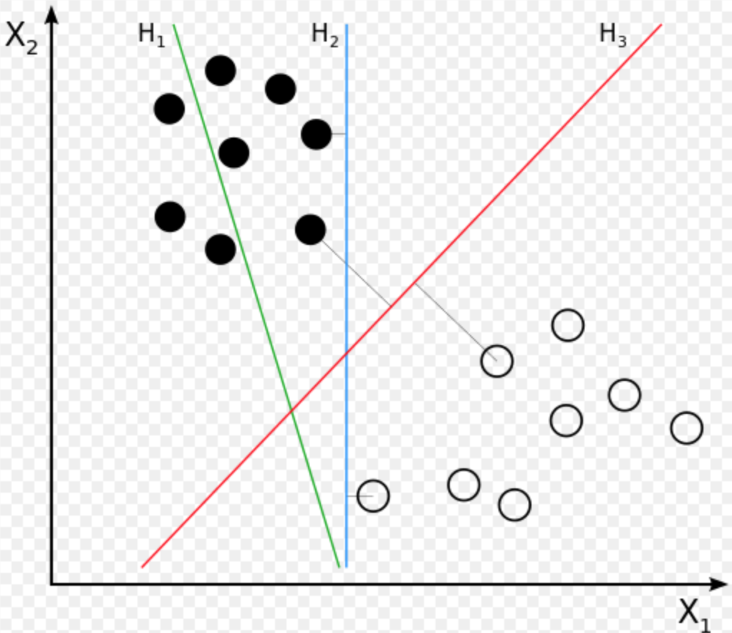
Support Vector Machine(SVM)
Supervised Learning
for Classification and Regression Analysis.
Given a set of training data set, each marked as belonging to one or the other of two categories, an SVM training algorithm builds a model that assigns new examples to one category or the other, making it a non-probabilistic binary linear.
An SVM model is a representation of the examples as points in space, mapped so that the examples of the separate categories are divided by a clear gap that is as wide as possible.

Slide 12
Hotspot Detection using SVM
T time windows, {$W_{1}$, $W_{2}$,…,$W_{t}$}, Current time window is $W_{i}$.
If a forecast of $W_{i+1}$ is expected, we first train a SVM by inputting forum’s representation vectors of $W_{i−1}$ and setting the output as the clustering result for $W_{i}$ by K-means.
$I=\left(\begin{aligned}\begin{aligned}\begin{matrix}V^{i−1}(1) \\ V^{i−1}(2) \\ ⋯\end{matrix} \\ V^{i−1}(j)\end{aligned} \\ ⋯ \\ V^{i−1}(31)\end{aligned}\right)=\left(\begin{aligned}{NUM}^{i−1}\left(1\right),{\overline{RESPONSE}}^{i−1}\left(1\right), {\overline{SENTIMENT}}^{i−1}\left(1\right),{POS_PERC}^{i−1}\left(1\right),{NEG_PERC}^{i−1}(1) \\ {NUM}^{i−1}\left(2\right),{\overline{RESPONSE}}^{i−1}\left(2\right), {\overline{SENTIMENT}}^{i−1}\left(2\right),{POS_PERC}^{i−1}\left(2\right),{NEG_PERC}^{i−1}(2) \\ ⋯ \\ {NUM}^{i−1}\left(j\right),{\overline{RESPONSE}}^{i−1}\left(j\right), {\overline{SENTIMENT}}^{i−1}\left(j\right),{POS_PERC}^{i−1}\left(j\right),{NEG_PERC}^{i−1}(j) \\ ⋯ \\ {NUM}^{i−1}\left(31\right),{\overline{RESPONSE}}^{i−1}\left(31\right), {\overline{SENTIMENT}}^{i−1}\left(31\right),{POS_PERC}^{i−1}\left(31\right),{NEG_PERC}^{i−1}(31)\end{aligned}\right)$ Input
$O=\left(\begin{aligned}L^{i}(1) \\ L^{i}(2) \\ ⋯ \\ L^{i}(j) \\ ⋯ \\ L^{i}(31)\end{aligned}\right)$ Output

Slide 13
Training SVM model using forum data from $W_{i−1}$
K-means Clustering result for $W_{i}$ as Label
SVM model
Sample training
verify
Making prediction by SVM model for $W_{i+1}$
compare
K-means clustering for time period $W_{i+1}$
$L^{i}(j)$in O denotes the clustering result for $F_{j}$ in $W_{i}$ by K-means. If $L^{i}(j)$ = 1, K-means labels $F_{j}$ is a hotspot, while if $L^{i}(j)$ = 0 K-means labels $F_{j}$ is a non-hotspot. Similarly, let <${I^{′},O}^{′}$> denote the input and output matrix of SVM in the test process.
Then the trained SVM generates classification outputs for data of $W_{i}$. Finally, SVM result is compared to the K-means clustering result for data of $W_{i+1}$.

Slide 14
$I^{′}=\left(\begin{aligned}\begin{aligned}\begin{matrix}V^{i}(1) \\ V^{i}(2) \\ ⋯\end{matrix} \\ V^{i}(j)\end{aligned} \\ ⋯ \\ V^{i}(31)\end{aligned}\right)=\left(\begin{aligned}{NUM}^{i}\left(1\right),{\overline{RESPONSE}}^{i}\left(1\right), {\overline{SENTIMENT}}^{i}\left(1\right),{POS_PERC}^{i}\left(1\right),{NEG_PERC}^{i}(1) \\ {NUM}^{i}\left(2\right),{\overline{RESPONSE}}^{i}\left(2\right), {\overline{SENTIMENT}}^{i}\left(2\right),{POS_PERC}^{i}\left(2\right),{NEG_PERC}^{i}(2) \\ ⋯ \\ {NUM}^{i}\left(j\right),{\overline{RESPONSE}}^{i}\left(j\right), {\overline{SENTIMENT}}^{i}\left(j\right),{POS_PERC}^{i}\left(j\right),{NEG_PERC}^{i}(j) \\ ⋯ \\ {NUM}^{i}\left(31\right),{\overline{RESPONSE}}^{i}\left(31\right), {\overline{SENTIMENT}}^{i}\left(31\right),{POS_PERC}^{i}\left(31\right),{NEG_PERC}^{i}(31)\end{aligned}\right)$ Input
$O^{′}=\left(\begin{aligned}L^{i+1}(1)\text{′} \\ L^{i+1}(2)\text{′} \\ ⋯ \\ L^{i+1}(j)\text{′} \\ ⋯ \\ L^{i+1}(31)\text{′}\end{aligned}\right)$ Output
$L^{i+1}(j)\text{′}$in O′ represents the binary classification result for Fj in $W_{i}$ by SVM. If $L^{i+1}(j)$′ = 1, SVM classifies Fj as a hotspot, while Fj is classified as non-hotspot if $L^{i+1}(j)$′ = 0. Comparative study is carried out between O′ and the clustering result by K-means in $W_{i+1}$.

Slide 15
SVM Prediction Visualization
prediction result for k = 8

Slide 16
Model Evaluation
Evaluation Metrics :
1. Accuracy
2. Sensitivity (Recall)
3. Specificity (True Negative Rate)
4. PPV (Positive Predictive Value = Precision)
5. NPV (Negative Predictive Value)
$$Accuracy= \frac{TP+TN}{TP+TN+FP+FN}$$
$$Sensitivity= \frac{TP}{TP+FN}$$
$$Specificity= \frac{TN}{TN+FP}$$
$$PPV= \frac{TP}{TP+FP}$$
$$NPV= \frac{TN}{TN+FN}$$

Slide 17
Model Evaluation

Slide 18
Conclusions
Develop an algorithm to measure the emotional polarity of a text
Develop a system expected to:
a) Observe the hotspot forums
b) Forecast the hotspot forums
c) Visualize the hotspots
d) Choose different clustering and forecasting algorithm
e) Extract topics of the hotspots forums
f) Calculate the sentiment value of the text
g) Show the detail of what people posted
Drawbacks:
a) Use current week’s data to predict next week’s hotspot
b) Cannot detect what causes the hotspot

Slide 19
Thank you!
Q&A

