Slide 1
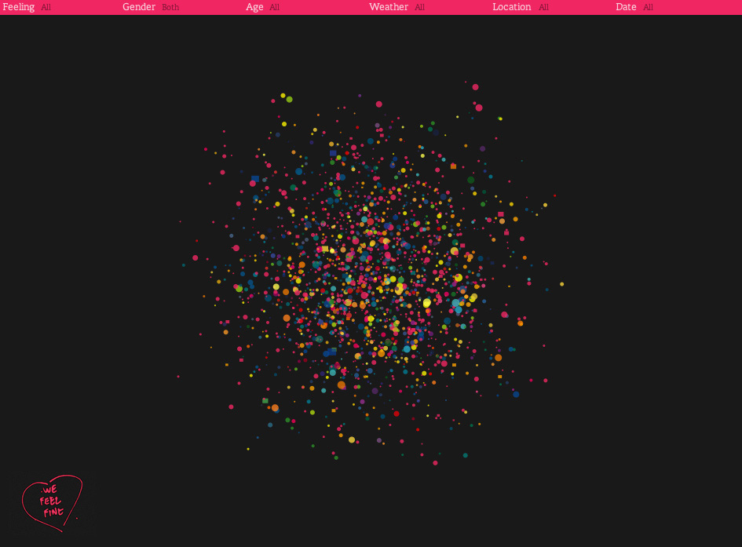
CS548 Fall 2017
Web Mining Showcase by
Linh Hoang • Giorgi Gachechiladze • Tian Xie • Jiaming Di • Yang Zheng
Showcasing work
By Sepandar D. Kamvar, Jonathan Harris
on “We Feel Fine
and searching the emotional web”

Slide 2
References
[1] M. M. Bradley and P. Lang. Affective norms for English words. University of Florida Technical Report, 1999. [2] S. Card, J. Mackinlay, and B. Shneiderman. Readings in Information Visualization. Morgan Kaufman, San Francisco, 1999. [3] M. Cohn, M. Mehl, and J. Pennebaker. Linguistic markers of psychological change surrounding September 11, 2001. Psychological Science, 15(10):687–693, 2004. [4] P. Dodds and C. Danforth. Measuring the happiness of large-scale written expression: songs, blogs, and presidents. Journal of Happiness Studies, 2009. [5] S. Fodor et al. Light-directed, spatially addressable parallel chemical synthesis. Science, 1991. [6] J. Fowler and N. Christakis. Dynamic spread of happiness in a large social network. British Medical Journal, 3, 2008. [7] B. Fry and C. Reas. Processing. MIT Press, Cambridge, 2007. [8] W. Gaver et al. The prayer companion. In CHI, 2010. [9] M. Hansen and B. Rubin. Listening post. Whitney Museum of American Art, 2003. [10] J. Harris and S. D. Kamvar. I want you to want me. Museum of Modern Art, 2008. [11] J. Heer and D. Boyd. Vizster: Visualizing online social networks. In INFOVIS, 2005. [12] S. D. Kamvar and J. Harris. We Feel Fine: An Almanac of Human Emotion. Scribner, New York, 2009. [13] D. Lazer et al. Computational social science. Science, 323(5915):721–723, 2009. [14] G. Levin and K. Nigam. The dumpster. Whitney Museum of American Art, 2006. [15] M. Lewis and J. Haviland-Jones. Handbook of Emotions, Third Edition. Guilford Press, New York, 2008. [16] A. McCallum, D. Freitag, and F. C. N. Pereira. Maximum entropy markov models for information extraction and segmentation. In ICML, 2000. [17] C. Mogilner, S. D. Kamvar, and J. Aaker. How the meaning of happiness shifts across the life course. Social Psychological and Personality Science, 2010. [18] J. Mook et al. Anxiety, anger and depression: Relationships at the trait level. Anxiety, Stress, and Coping, 3(1):17–31, 1990. [19] B. Pang and L. Lee. A sentimental education: sentiment analysis using subjectivity summarization based on minimum cuts. In ACL, 2004. [20] B. Pang and L. Lee. Opinion mining and sentiment analysis. Found. Trends Inf. Retr., 2(1-2):1–135, 2008. [21] R. Plutchik. The emotions: facts, theories, and a new model. Random House, New York, 1962. [22] K. Podenphant. I am feeling. 2009. [23] P. Salovey and J. Mayer. Emotional intelligence. Imagination, Cognition, and Personality, 9:185–211, 1990. [24] P. Watkings et al. Gratitude and happiness: Development of a measure of gratitude, and relationships with subjective well-being. Social Behavior and Personality, 31(5):431–451, 2003. [25] M. Wattenberg and J. Kriss. Designing for social data analysis. IEEE Transactions on Visualization and Computer Graphics, 12(4):549–557, 2006.

Slide 3
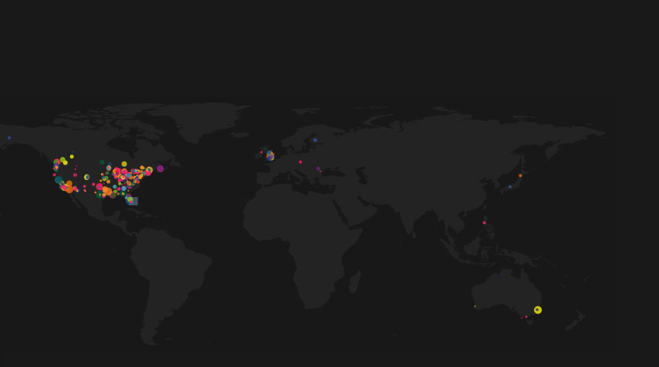
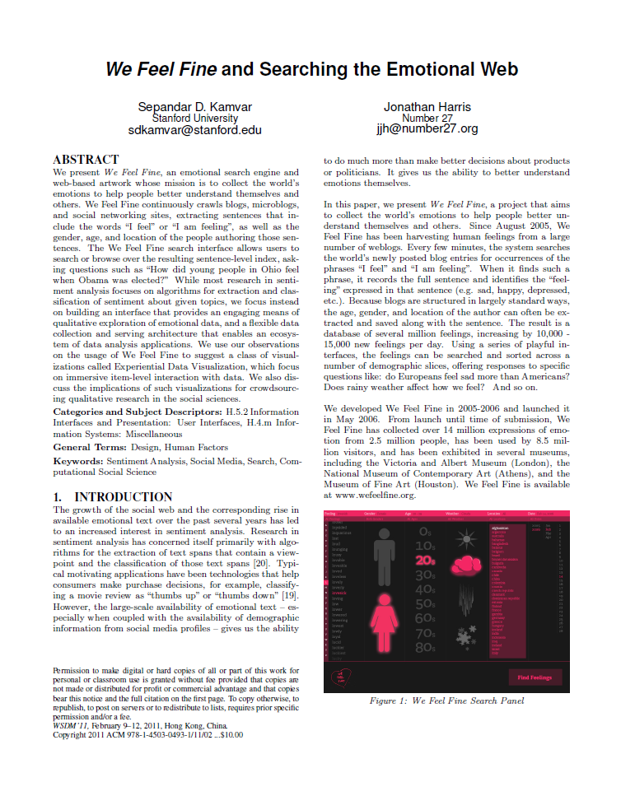
Introduction
We Feel Fine
is an emotional search engine that collects the world’s emotions to help people better understand themselves and others.
continuously crawls blogs, microblogs, and social networking sites, extracting sentences that include the words “I feel” or “I am feeling”, as well as the gender, age, and location of the people authoring those sentences.

Slide 4
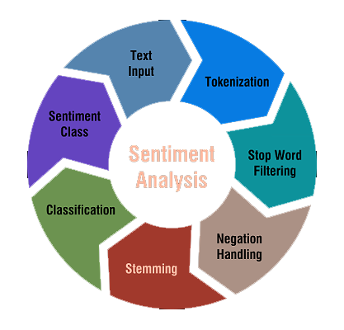
Background
Sentiment Analysis def: the process of computationally identifying and categorizing opinions expressed in a piece of text, especially in order to determine whether the writer's attitude towards a particular topic, product, etc., is positive, negative, or neutral.
Research in this area largely focused on algorithms for opinion extractions and categorization (Pang, Lee, 2008)
Typical motivating applications have been technologies that help consumers make purchase decisions.
Web Mining def: Web mining is the application of data mining techniques to discover patterns from the World Wide Web.
Social Media allows large-scale availability of emotional text
Opens possibilities to do much more than just make better decisions about products - better understand emotions themselves

Slide 5
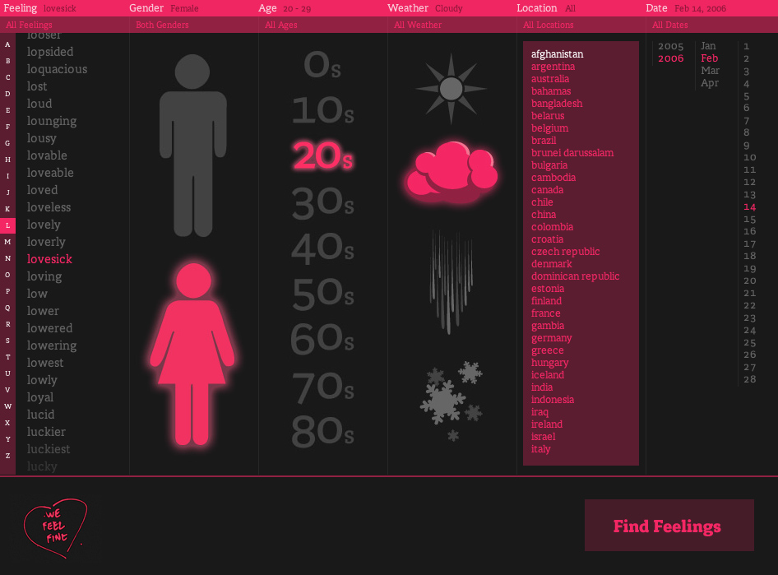
Project aims to collect the world’s emotions to help people better understand themselves and others.
We Feel Fine has been harvesting human feelings from a large number of weblogs. Every few minutes, the system searches the world’s newly posted blog entries for occurrences of the phrases “I feel” and “I am feeling”.
When it finds such a phrase, it records the full sentence and identifies the “feeling” expressed in that sentence (e.g. sad, happy, depressed, etc.).
The result is a database of several million feelings, increasing by 10,000 - 15,000 new feelings per day.
Data visualizations that helps us understand emotions themselves.

Slide 6
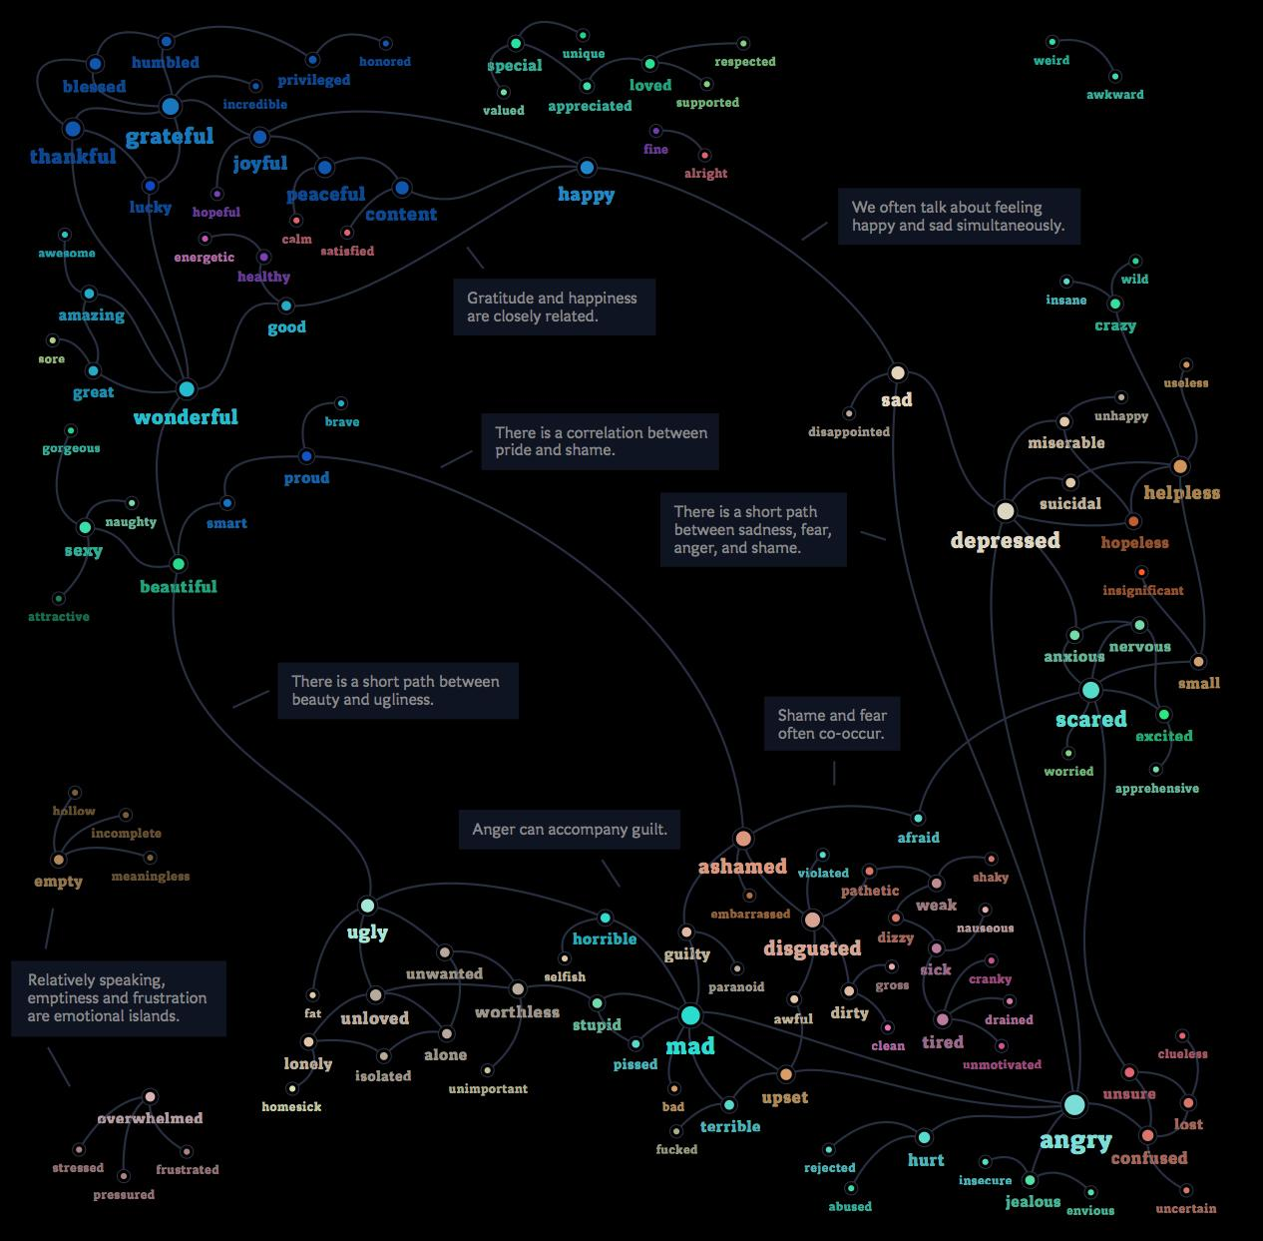

Slide 7
Design Considerations
A system framework which enables both a qualitative and statistical exploration of other people’s emotions.
Statistical analyses to support a cognitive understanding of emotional patterns
Immersive interaction with individual stories to support a more visceral understanding of the nature of emotions.

Slide 8
Design Considerations
Sentence-level analysis: People often express emotions at the sentence level
Indexing context: providing context to emotions such as Age, Gender, Weather, Location, Date.
De-emphasizing ranking: Sentiment data are hard to rank
Emphasizing browsing and summarization
Visualizations that reflect the data
Direct Access to the Data: provide easy-to-access API

Slide 9
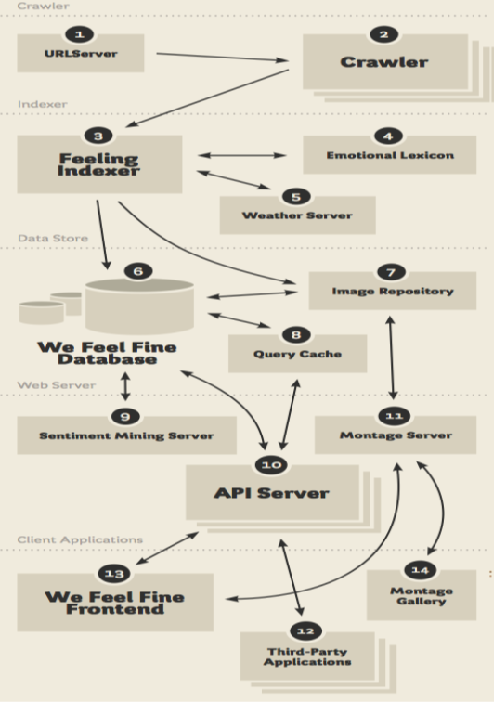
Architecture

Slide 10
Architecture

Slide 11
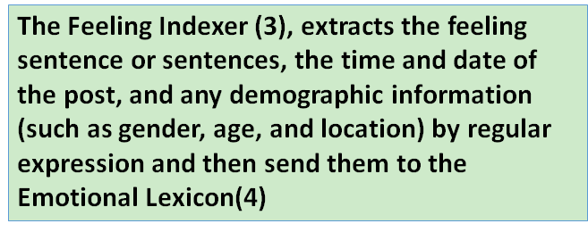
Architecture

Slide 12
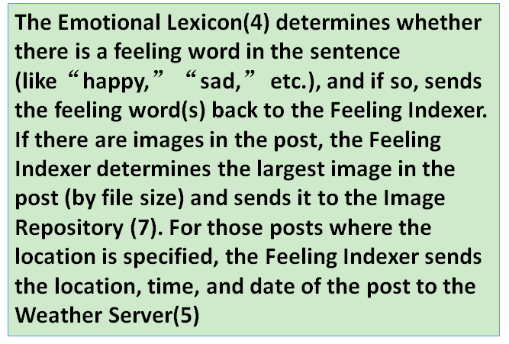
Architecture

Slide 13
Architecture

Slide 14
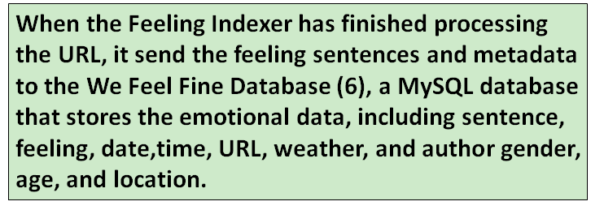
Architecture

Slide 15
Architecture

Slide 16
Architecture

Slide 17
Architecture

Slide 18
Architecture

Slide 19
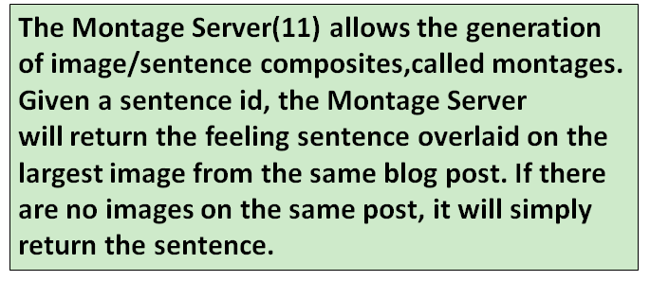
Architecture

Slide 20
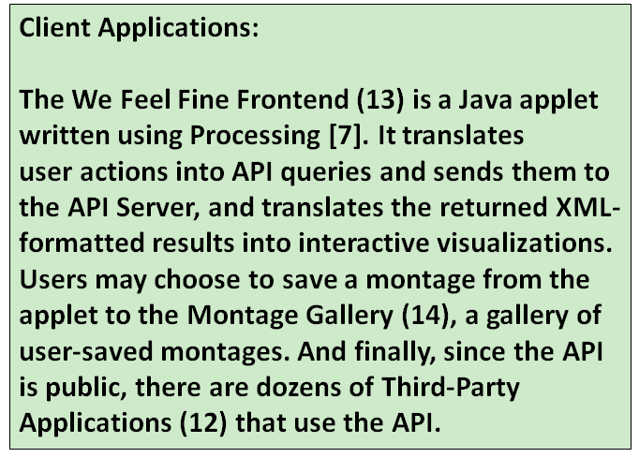
Architecture

Slide 21
User Interface
One of the goals:
A data mining visualization tool that provides an engaging means of qualitative exploration of emotional data

Slide 22
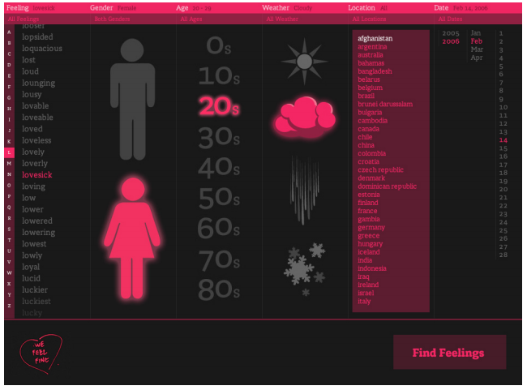
Search Panel

Slide 23
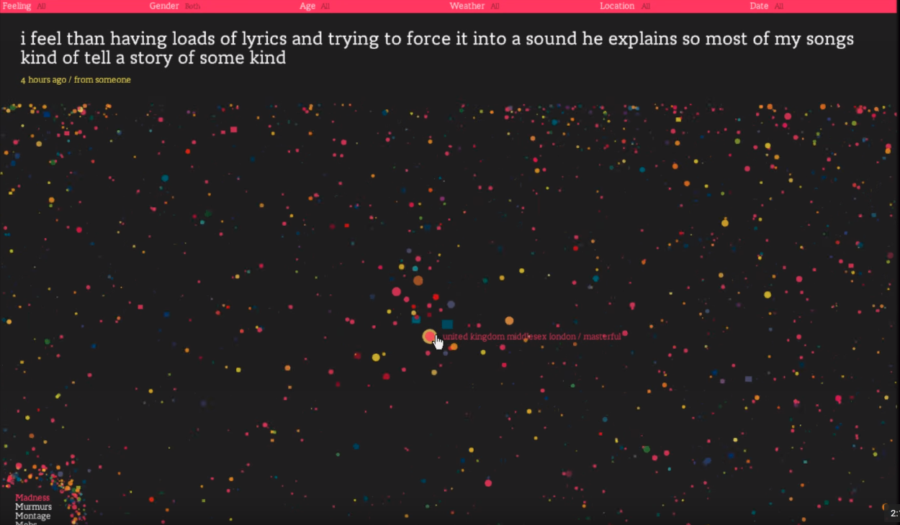
Overall view

Slide 24
Emotional graphs

Slide 25
Sentence + Image

Slide 26
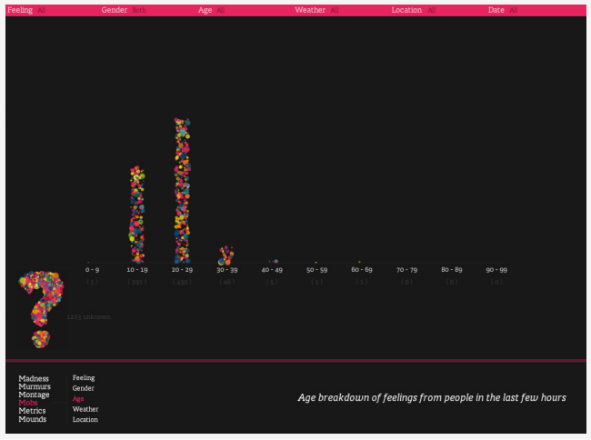
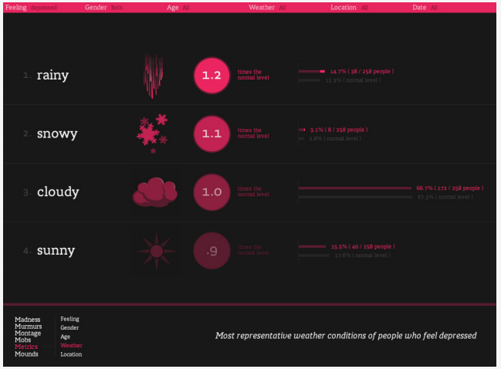
Some statistics views

Slide 27
Usage observations
Observed usage in an informal laboratory setting and collected comments on the tools around the Internet.
Patterns:
Emotional Self-Awareness. Almost all participants in the study exhibited a heightened self-awareness and self reflection of their own emotions.
Empathy. In addition to self-awareness, the participants also reported a feeling of connection and empathy

Slide 28
API
RESTful API: returns data given a query. Translates a url to a SQL query on the We Feel Fine database, and returns the results in XML, HTML, CSV, or plain text.
Sentiment Mining Server: computes basic statistics over an API query. Consists of a set of functions that preprocess an API query to compute elementary statistics on the data set.

Slide 29
Usage Observation
The Meaning of Happiness
The study by Mogilner et al. [1] on the“meaning”of happiness is one of the most interesting examples of how We Feel Fine works in tandem with traditional experimental methods in emotions research.
The co-occurrence of excited feelings and happy feelings decrease as people grow older, while the co-occurrence of peaceful feelings and happy feelings increase.
Tested by a controlled lab experiment.
[1]C. Mogilner, S. D. Kamvar, and J. Aaker. How the meaning of happiness shifts across the life course. Social Psychological and Personality Science, 2010

Slide 30
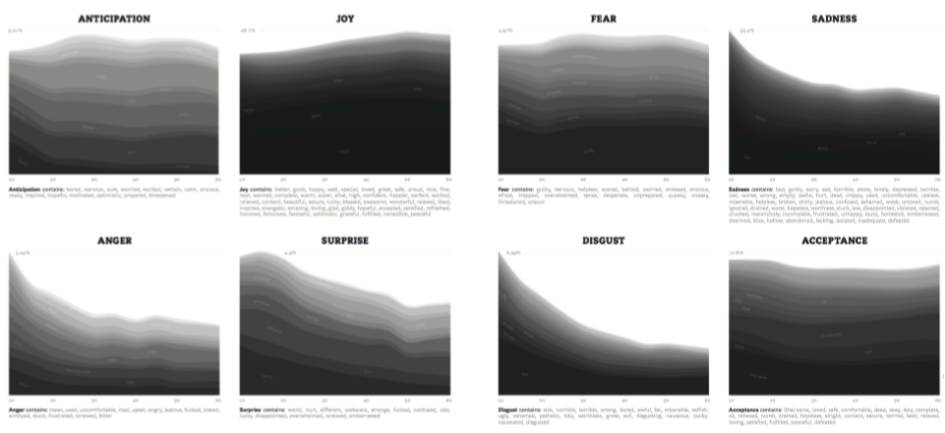
Usage Observation
The Emotions of Aging
Less anger, disgust, and sadness as people get older
Consistent with the psychology literature[1]
[1] M. Lewis and J. Haviland-Jones. Handbook of Emotions, Third Edition. Guilford Press, New York, 2008.

Slide 31
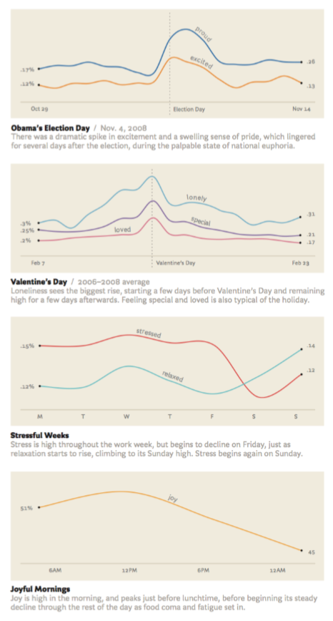
Usage Observation
Time Series Analyses[1]
Election Day
Valentine’s Day
Week vs. Weekend
Morning vs. Night
[1]J. Heer and D. Boyd. Vizster: Visualizing online social networks. In INFOVIS, 2005.

Slide 32
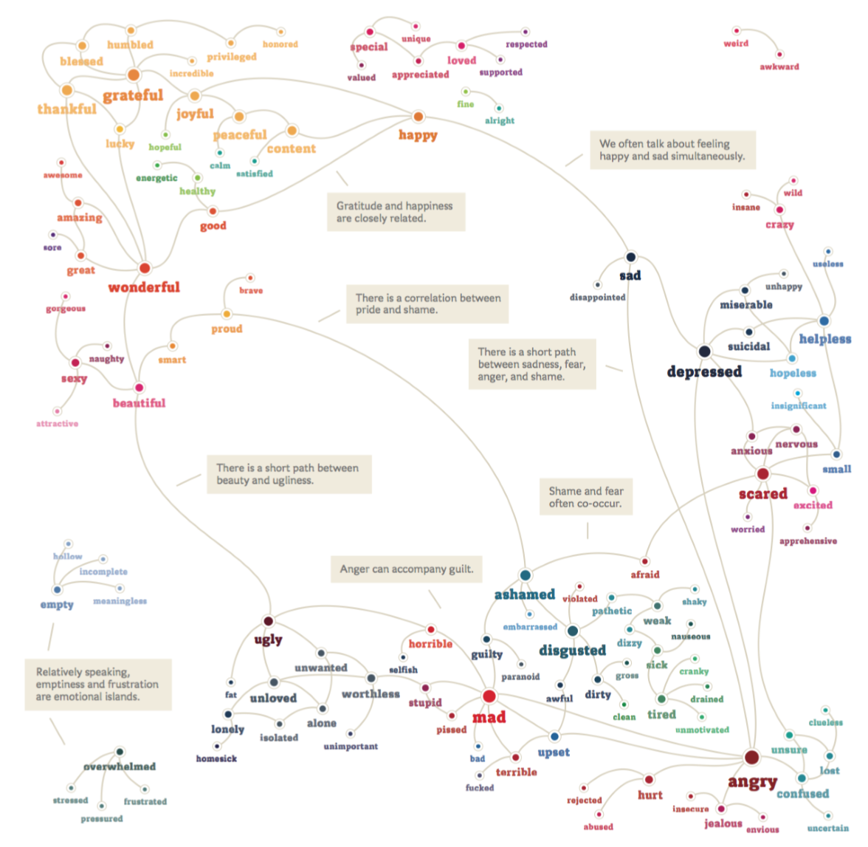
Usage Observation
The Emotional Graph

Slide 33
DISCUSSION - Experiential Data Visualization
Communicated in words, but much more powerfully communicated by example
Focus on interaction models that encourage direct interaction
Focus on influencing effect rather than cognition

Slide 34
DISCUSSION - Crowdsourced Data Mining
Over 8 million people have visited We Feel Fine from 2006- 2010 each spending an average of close to 4 minutes exploring the data.
This speaks for the potential of crowdsourced data analysis.

Slide 35
CONCLUSION
This item-level exploration of data can bring its own experiential benefits to the user, as well as enable crowdsourced qualitative data analysis.
Sentiment data on the web can be used to build scalable computational tools to support social science research.
Such tools have the potential for social science researchers to run inexpensive large-scale studies to generate data-driven hypotheses.

