Slide 1
CS548 Fall 2018
Artificial Neural Networks and Deep Learning
Showcase by Serdarcan Dilbaz, Ricardo Flores, Rajendra Kante, Ashley Elizabeth Lutz
Showcasing work by
A. Esteva, B. Kuprel, R. Novoa, K. Ko, S. Swetter, H. Blau, S. thrun
on
“Dermatologist-level classification of skin cancer with deep neural networks”

Slide 2
References
[1] A. Esteva, B. Kuprel, R. A. Novoa, J. Ko, S. M. Swetter, H. M. Blau, and S. Thrun, “Dermatologist-level classification of skin cancer with deep neural networks,” Nature, vol. 542, pp. 115–118, Feb. 2017.
[2] “Info Centre,” Spotscreen – Onsite Skin Cancer Checks and Health Programs. [Online]. Available: https://www.spotscreen.com.au/info-centre/skin-cancer-information/skin-cancer-facts/. [Accessed: 07-Oct-2018].
[3] “Skin Cancer Foundation,” Squamous Cell Carcinoma (SCC) - SkinCancer.org. [Online]. Available: https://www.skincancer.org/publications/the-melanoma-letter/summer-2014-vol-32-no-2/men. [Accessed: 05-Oct-2018].
[4] “Skin Cancer Foundation,” Squamous Cell Carcinoma (SCC) - SkinCancer.org. [Online]. Available: https://www.skincancer.org/skin-cancer-information/skin-cancer-facts. [Accessed: 05-Oct-2018].
[5] Anthony Cuthbertson Digital Writer of the Year, “New wave of health apps could help you skip the GP altogether and refer you directly to a specialist,” International Business Times UK, 11-Aug-2015. [Online]. Available: https://www.ibtimes.co.uk/can-smartphones-replace-your-gp-new-medtech-apps-put-specialist-knowledge-patients-pockets-1513588. [Accessed: 05-Oct-2018].
[6] Vanhoucke, Vincent, Sergey, Jonathon, and Zbigniew, “Rethinking the Inception Architecture for Computer Vision,” [astro-ph/0005112] A Determination of the Hubble Constant from Cepheid Distances and a Model of the Local Peculiar Velocity Field, 11-Dec-2015. [Online]. Available: https://arxiv.org/abs/1512.00567. [Accessed: 05-Oct-2018].

Slide 3
[7] C. Vasile, “The Smartphone Threat Is Bogus: Digital Cameras Are Here to Stay,” softpedia, 12-Sep-2014. [Online]. Available: https://news.softpedia.com/news/The-Smartphone-Threat-is-Bogus-Digital-Cameras-Are-Here-to-Stay-458710.shtml#sgal_0. [Accessed: 09-Oct-2018].
[8] A. Dertat, “Applied Deep Learning - Part 1: Artificial Neural Networks,” Towards Data Science, 08-Aug-2017. [Online]. Available: https://towardsdatascience.com/applied-deep-learning-part-1-artificial-neural-networks-d7834f67a4f6. [Accessed: 05-Oct-2018].
[9] D. Akagi, “A Primer on Deep Learning,” DataRobot Blog. [Online]. Available: https://blog.datarobot.com/a-primer-on-deep-learning. [Accessed: 09-Oct-2018].
[10] “ML Practicum: Image Classification | Machine Learning Practica | Google Developers,” Google. [Online]. Available: https://developers.google.com/machine-learning/practica/image-classification/convolutional-neural-networks. [Accessed: 05-Oct-2018].
[11] Understanding of Convolutional Neural Network (CNN) — Deep Learning. [Online]. Available: https://medium.com/@RaghavPrabhu/understanding-of-convolutional-neural-network-cnn-deep-learning-99760835f148. [Accessed: 10-Oct-2018].
[12] N. c codella, david gutman, emre celebi, brian helba, michael marchetti, and stephen dusza, “SKIN LESION ANALYSIS TOWARD MELANOMA DETECTION: A CHALLENGE AT THE 2017 INTERNATIONAL SYMPOSIUM ON BIOMEDICAL IMAGING (ISBI), HOSTED BY THE INTERNATIONAL SKIN IMAGING COLLABORATION (ISIC),” ARXIV, Oct. 2017.

Slide 4
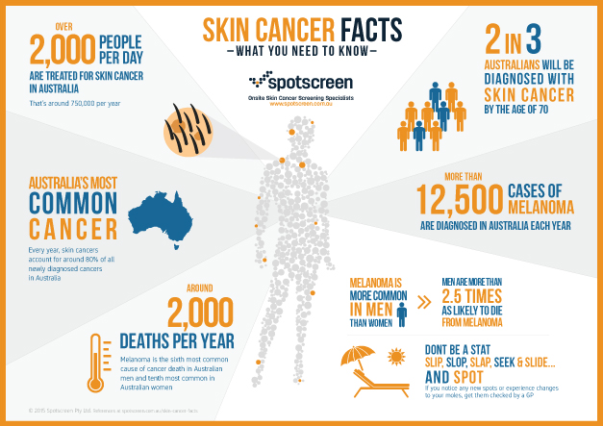
Motivation
Figure 1. Skin Cancer Facts [2]

Slide 5
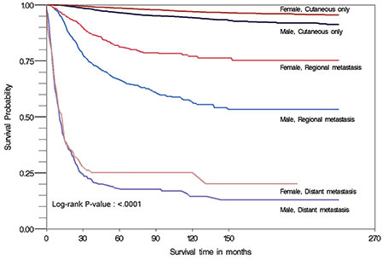
Motivation
Traditional skin cancer diagnoses are made primarily on visual intuition by the clinician with supplemental procedures (dermoscopy, biopsy) if needed
Without professional intuition skin cancer is extremely difficult to distinguish from typical imperfections in the skin
Many people do not end up seeking medical attention for a spot/mole until the cancer has already progressed
Melanoma diagnoses [4]:
Early Stage = 99% 5 year survival rate
Late Stage = 14% 5 year survival rate
Figure 2. Survival Probability vs Survival Time in months [3]

Slide 6
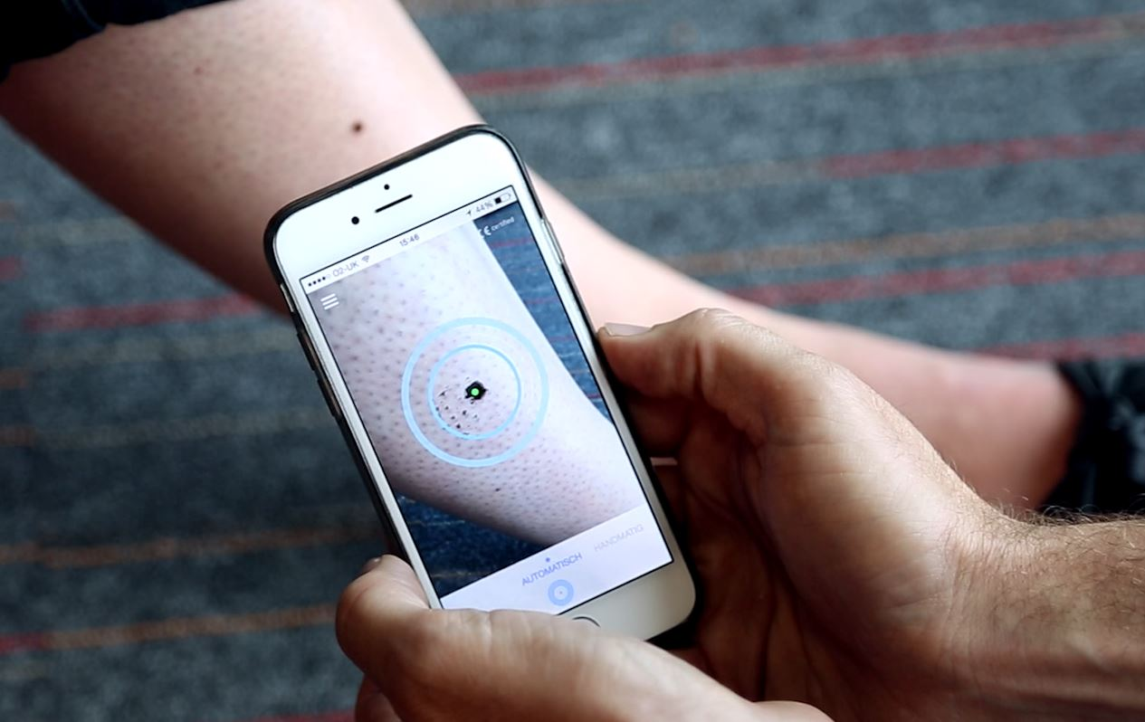
Convolutional Neural Networks (CNNs) and Early Detection
By training on vast image datasets, deep CNN was able to match the performance of dermatologists [1]
Reliable skin cancer classifier can provide low-cost universal access to vital diagnostics packaged into a smartphone application
Individuals could determine whether or not a mole requires medical attention in the privacy of their own home
Figure 3. View of a Mole from Smartphone [5]

Slide 7
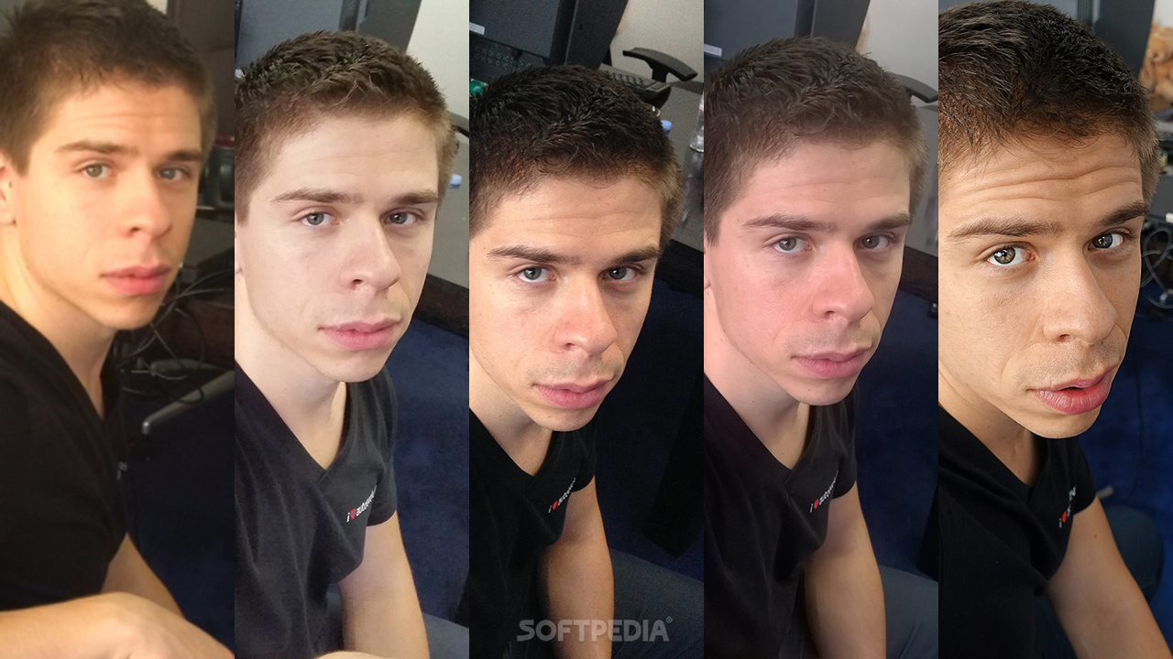
Dataset
129,450 Dermatologist-labeled clinical images examined and diagnosed by 21 board-certified dermatologists
100 x larger than any previous dataset used for this purpose
2,032 different diseases
Figure 4. Image Variability in Images taken by Different Smartphone Cameras [7]

Slide 8
Methodology - Preprocessing
No preprocessing of the images
127,463 images for training
Test set of 1,942 images for measuring model performance
9-fold cross validation: 14,163 for cross-validation testing and 113,300 for model training in each folding
GoogleNet Inception v3 CNN architecture that is pretrained on 1.28 million images is used to initialize of the deep CNN (transfer learning) [6]

Slide 9
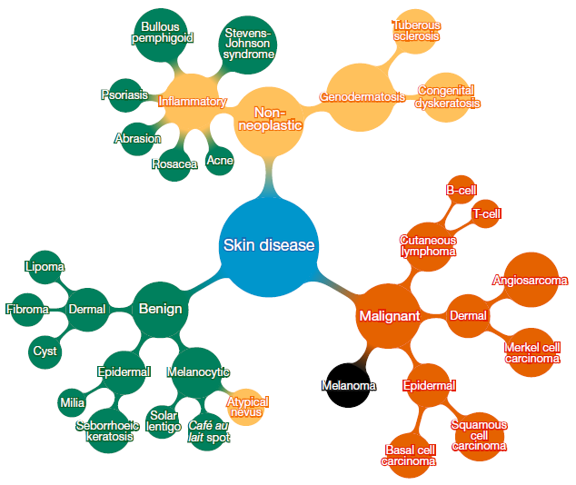
Methodology - Preprocessing
2,032 skin diseases (Dermal Angiosarcoma, Melanoma etc.) are organized based on visual and clinical similarity of diseases into a tree-structured taxonomy
Diseases are partitioned into three classes. The first-level nodes represent benign lesions, malignant lesions, and non-neoplastic lesions
Figure 5. Schematic illustration of the taxonomy [1]

Slide 10
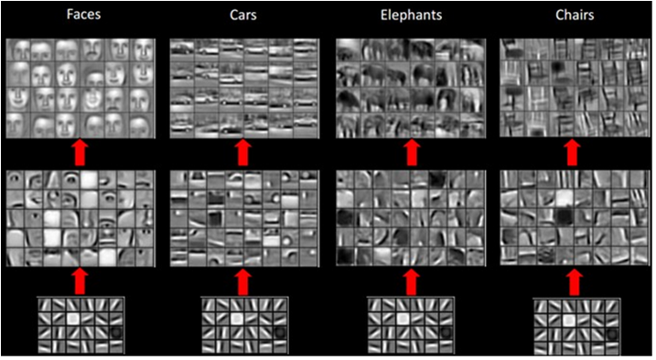
CNNs work well in image recognition tasks
Figure 6. Feature Learning in CNNs [9]

Slide 11
Main Steps: Input + Convolution + Maxpool + Classification + output
Figure 7. Convolutional Neural Network with 2 Conv. Layers [10]

Slide 12
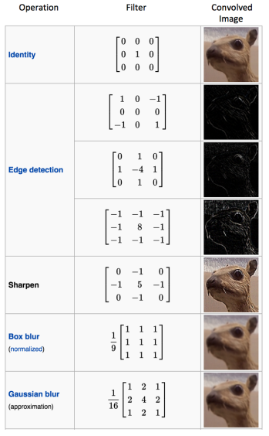
Convolutional layers(filters) are able to detect patterns (edges, shape, texture, corners)
Figure 8. Filters Applied to Image by CNN [11]

Slide 13
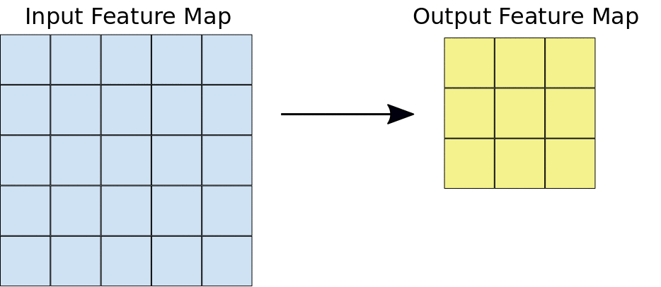
Convolutional layers(filters) are able to detect patterns (shape, texture, edges, corners)
Figure 9. Operation of the Convolutional Layer [10]

Slide 14
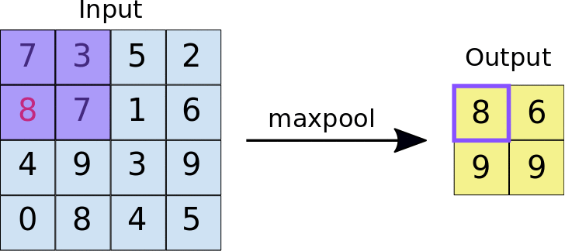
MaxPool
Figure 10. Operation of the MaxPool Layer [10]

Slide 15
GoogleNet Inception v3 CNN architecture
Figure 11. CNN Architecture [1]

Slide 16
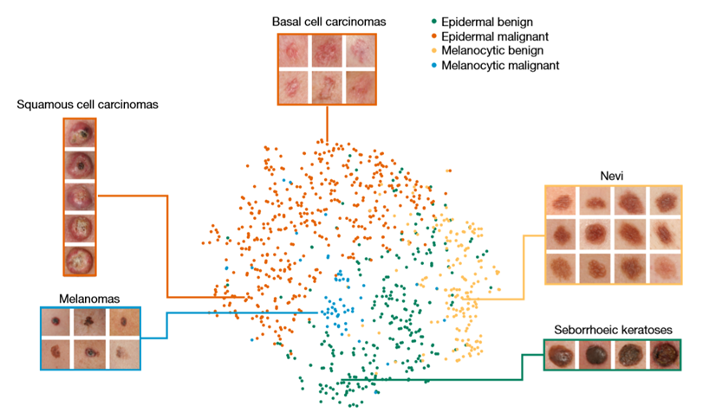
Figure 12. Visualization of 4 Disease Class Representations, [1]

Slide 17
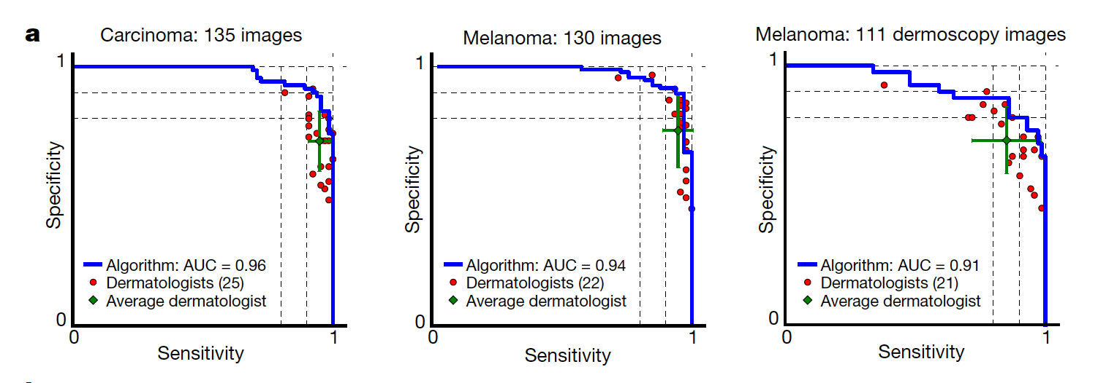
Results
Figure 13. Deep learning algorithm outperforming the dermatologists [1] Decision Threshold is varied from 0 to 1 to produce curves above.
Notes:
Rajendra
a) The deep learning CNN outperforms the average of the dermatologists at skin cancer classification using photographic and
dermoscopic images. CNN is tested against at least 21 dermatologists at carcinoma and melanoma recognition. For each test, previously unseen, biopsy-proven images of lesions are displayed, and dermatologists are asked if they would: biopsy/treat the lesion or reassure the patient.
Sensitivity, the true positive rate, and specificity, the true negative rate, measure performance.
A dermatologist outputs a single prediction per image and is thus represented by a single red point. The green points are the average of the dermatologists for each task. The CNN outputs a malignancy probability P per image.
They fixed a threshold probability t such that the prediction ŷ for any image is ŷ = P ≥ t, and the blue curve is
drawn by sweeping t in the interval 0–1. The AUC is the CNN’s measure of performance, with a maximum value of 1.
The CNN achieves superior performance to a dermatologist if the sensitivity–specificity point of the dermatologist lies below the blue curve, which most do.
Epidermal test: 65 keratinocyte carcinomas and 70 benign seborrheic keratoses.
Melanocytic test: 33 malignant melanomas and 97 benign nevi. A second
melanocytic test using dermoscopic images is displayed for comparison: 71 malignant and 40 benign.
The slight performance decrease reflects differences in the difficulty of the images tested rather than the diagnostic
accuracies of visual versus dermoscopic examination.

Slide 18
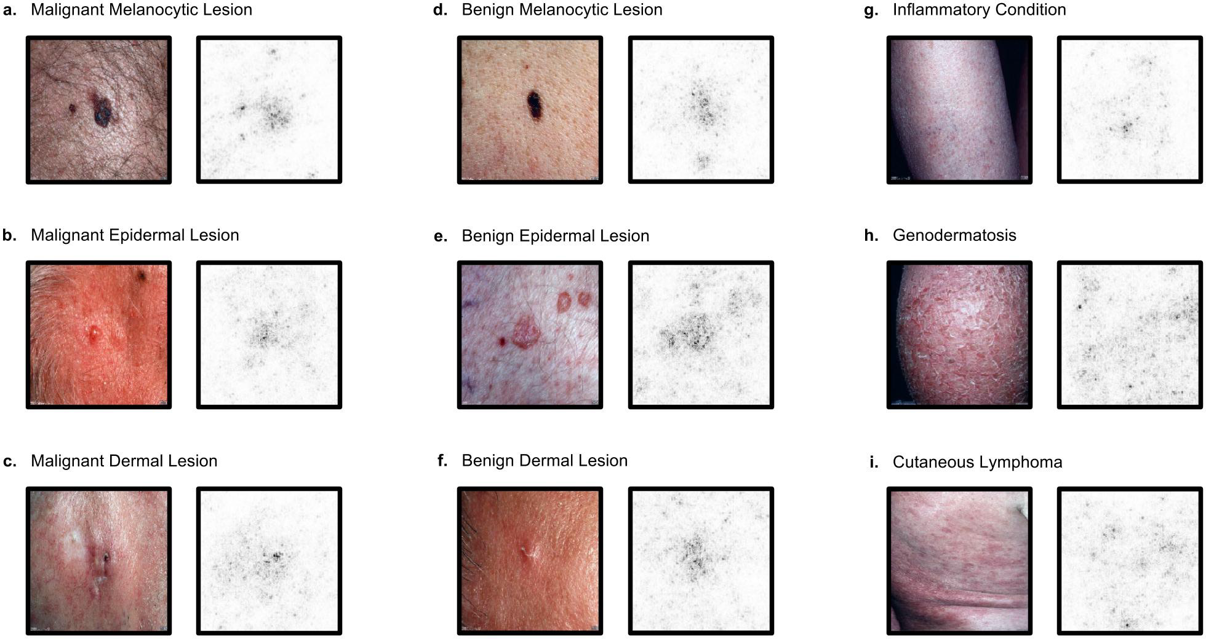
Results
Figure 14. Saliency maps for nine example images from the second validation strategy [1]
Notes:
Saliency maps for example images from each of the nine clinical disease classes of the second validation.
Saliency maps show the pixel gradients with respect to the CNN’s loss function.
We see clear correlation between the lesions themselves and the saliency maps.
Conditions with a single lesion (a–f) tend to exhibit tight saliency maps centred around the lesion.
Conditions with spreading lesions (g–i) exhibit saliency maps that similarly occupy multiple points of interest in the images.

Slide 19
Results
Figure 15. Effectiveness of CNN with partitioning algorithm (CNN-PA) on par with dermatologists [1]
Notes:
Rajendra
Here they showed ninefold cross-validation classification accuracy with 127,463 images organized in two different strategies.
In each fold, a different ninth of the dataset is used for validation, and the rest
is used for training. Reported values are the mean and standard deviation of the validation accuracy across all n = 9 folds. These images are labelled by dermatologists, not necessarily through biopsy;
meaning that this metric is not as rigorous as one with biopsy-proven images. Thus we only compare to two dermatologists as a means to validate that the algorithm is learning relevant information.
a, Three-way classification accuracy comparison between algorithms and dermatologists. The dermatologists are tested on 180 random images from the validation set—60 per class. The three
classes used are first-level nodes of our taxonomy. A CNN trained directly on these three classes also achieves inferior performance to one trained with our partitioning algorithm (PA).
b, Nine-way classification accuracy comparison between algorithms and dermatologists. The dermatologists are tested on 180 random images from the validation set—20 per class. The nine classes used are the second-level nodes of our taxonomy. A CNN trained directly on these nine classes achieves inferior performance to one trained with our partitioning algorithm.

Slide 20
Conclusions
The paper demonstrate the effectiveness of deep learning in dermatology
No preprocessing of the images, reducing the cost of analysis
Future applications to smartphone detection
The IEEE International Symposium on Biomedical Imaging (ISBI) 2017 challenge was Skin Lesion Analysis Towards Melanoma Detection [12].
The dataset ISBI 2017 contained 20,000 images. This paper utilized more than 6 times clinical images.
The deep CNN in this paper outperformed the classifiers submitted to the ISBI 2017 challenge

Slide 21
Questions?

