Slide 1
CS548 Fall 2018
Anomaly Detection Showcase
Showcase by Abhishek Shah, Mahdi Alouane, Marie Solman, Satishraju Rajendran and Eno-Obong Inyang
Showcasing work by Cai Lile, Li Yiqun On
ANOMALY DETECTION IN THERMAL IMAGES USING DEEP NEURAL NETWORKS
Notes:
All Introduce

Slide 2
References
Cai, L. and Li, Y. “Anomaly detection in thermal images using deep neural networks” in IEEE International Conference on Image Processing (ICIP) 2017. [online] Ieeexplore.ieee.org. Available at: https://ieeexplore.ieee.org/document/8296692 [Accessed 30 Oct. 2018].
Angeliki Kylili, Paris A Fokaides, Petros Christou, and Soteris A Kalogirou, “Infrared thermography (irt) applications for building diagnostics: A review,” Applied Energy, vol. 134, pp. 531–549, 2014.
Mohd Shawal Jadin and Soib Taib, “Recent progress in diagnosing the reliability of electrical equipment by usinginfraredthermography,” InfraredPhysics&Technology, vol. 55, no. 4, pp. 236–245, 2012.
The Snell Group, “Infrared Thermography” [Online]. Available: https://www.thesnellgroup.com/why-ir-and-emt/infrared-thermography
SOLTEC Corp, "The Use of Infrared Thermography in Electrical Equipment Maintenance", [Online]. Available: http://solteccorp.blogspot.com/2010/09/use-of-infrared-thermography-in.html
MTS NETA, “Maintenance testing specifications for electrical power distribution equipment and systems,” International Electrical testing Association Inc, 2001.
Infraspection Institute, “Standard for infrared inspection of electrical systems & rotating equipment,” 2008.
Notes:
Double check IEEE format (Marie, updated citation and added a few resources used)

Slide 3
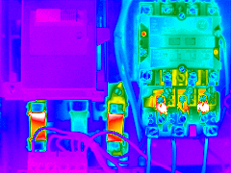
Infrared thermography (IRT)
Visualizes the recorded temperatures as 2-D images
High precision and non-contact temperature measurement
Detects the intensity of radiation in the infrared part of the electromagnetic spectrum
https://www.thesnellgroup.com/why-ir-and-emt/infrared-thermography
Notes:
Sylvia

Slide 4
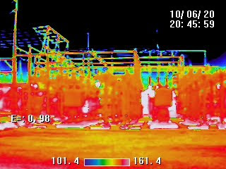
Motivation
Prevent dysfunction in electronic devices, commonly used in industry
Manual detection is time-consuming and unreliable
Inability to meet the excessive demand for condition monitoring in industrial applications
Infrared cameras are now inexpensive
http://solteccorp.blogspot.com/2010/09/use-of-infrared-thermography-in.html
Notes:
Sylvia

Slide 5
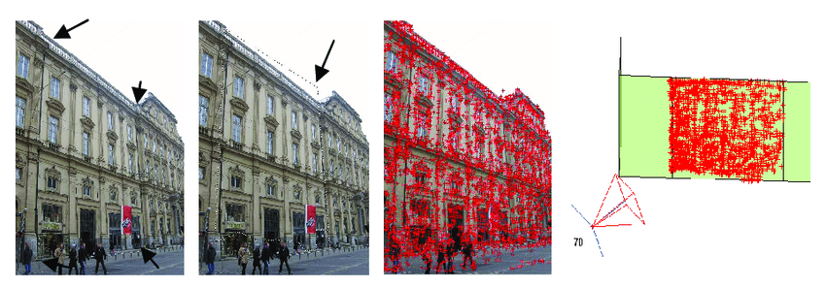
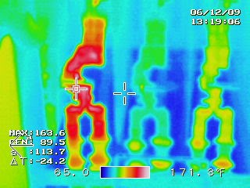
Problem
Segmentation or feature extraction techniques unable to separate regions of interest (ROI)
SIFT algorithm (Scale-invariant feature transform) has been employed to detect similar electrical components in a thermal image but thermal images have had a much lower resolution and signal-to-noise ratio than optical images and the details in a thermal image are usually blurred and of low contrast.
https://www.researchgate.net/profile/Robert_Laurini/publication/221156848
http://solteccorp.blogspot.com/2010/09/use-of-infrared-thermography-in.html
Notes:
Sylvia

Slide 6
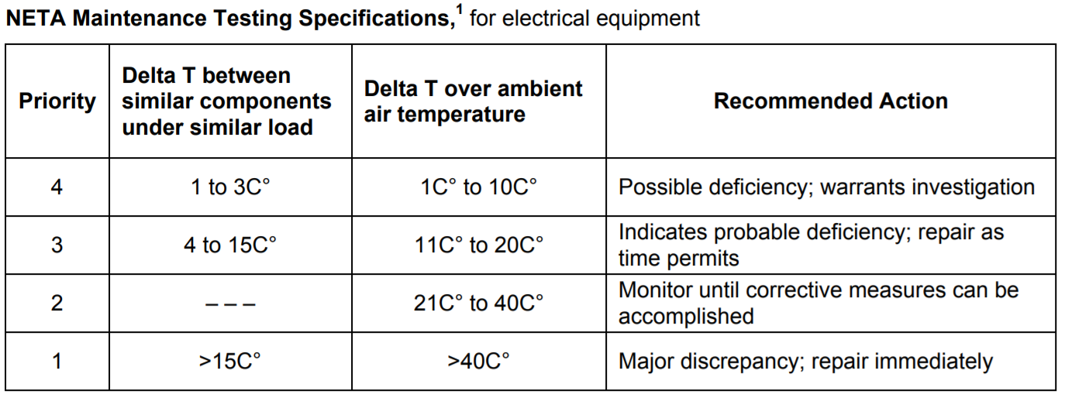
Infrared Thermography(IRT) process
The region of interest (ROI) or the target equipment is detected
The temperature difference (Delta-T value) between the ROI and a defined reference is calculated.
Temperature rating table: problem’s severity and recommended action
Standard for Infrared Inspection of Electrical Systems & Rotating Equipment
Notes:
Abhishek, Intuition behind data here, more context

Slide 7
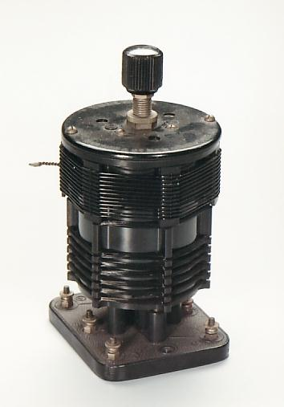
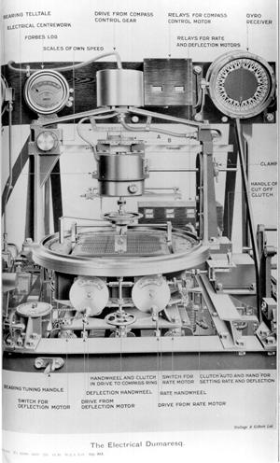
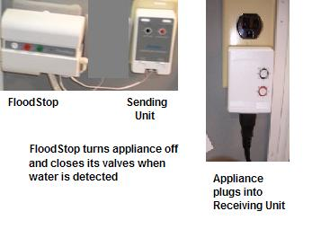
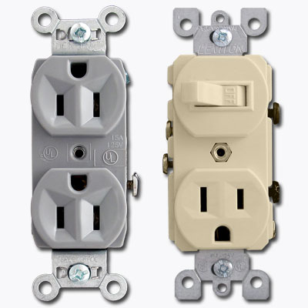
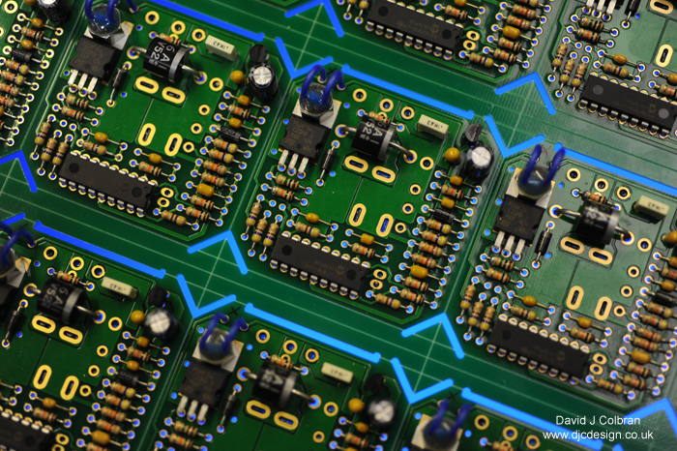
Dataset: ImageNet
Dataset contains more than 14,197,122 images
Organized according to synonym sets or “synsets”
The paper’s model uses 1425 pictures of electronic devices
All the images are royalty-free
http://image-net.org/explore?wnid=n02729837
Notes:
Abhishek, Specify which images are used in dataset

Slide 8
Method - Architecture
Deep CNN model.
Built on the first 3 stages of VGG-16: trained for object recognition.
Batch normalization layer normalizes output of VGG-16.
Convolutional layers after upscaling layers to improve prediction accuracy.
Notes:
Go into details for VGG-16, maybe add more to slides

Slide 9
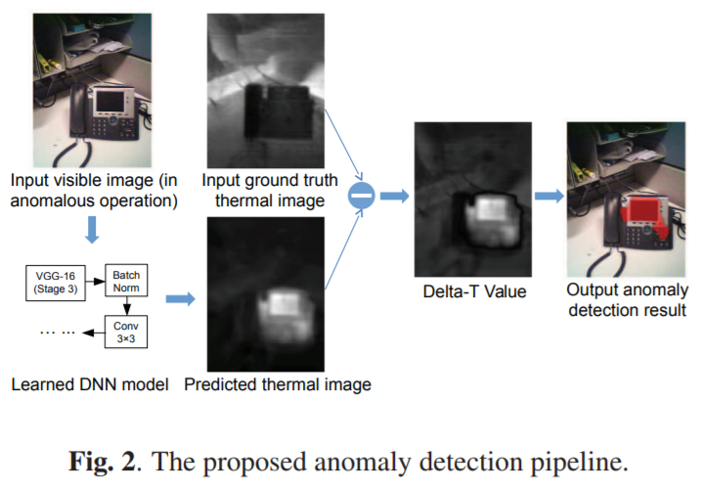
Method - Anomaly Detection Pipeline
Model predicts normal thermal profile for an input image.
Normally, difference between the predicted image and the actual image is small: no anomaly.
Anomalously, thermal signature is very different from the predicted one.
Delta-T computed as the absolute difference between he predicted image and ground truth image.
High Delta-T values considered anomalies, masked in red.
Notes:
Make sure we explain the pipeline, focus on delta T

Slide 10
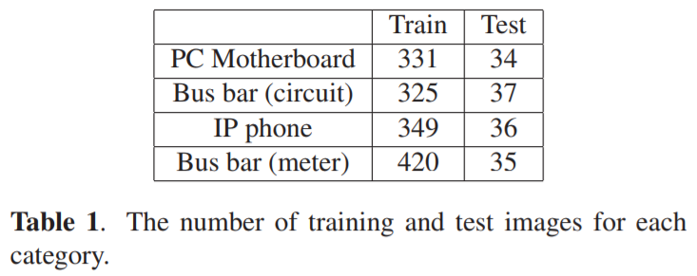
Experiments
Total Training Images - 1425
20% validation
50% data augmentation
142 test images
DNN was trained by stochastic gradient descent with Nesterov momentum.
Images are normalized to zero mean and unit variance.
Learning rate - 0.01, batch size - 16.
Model trained for 100 epochs taking approximately 31 seconds.
Training and Test images per category
Notes:
Make sure we interpret table and results,
What is stochastic gradient descent, what is Nesterov momentum,
How did they augment the data? Due to the limited number of training images, we randomly applied horizontal/vertical flips to 50% of images in a batch for data augmentation

Slide 11
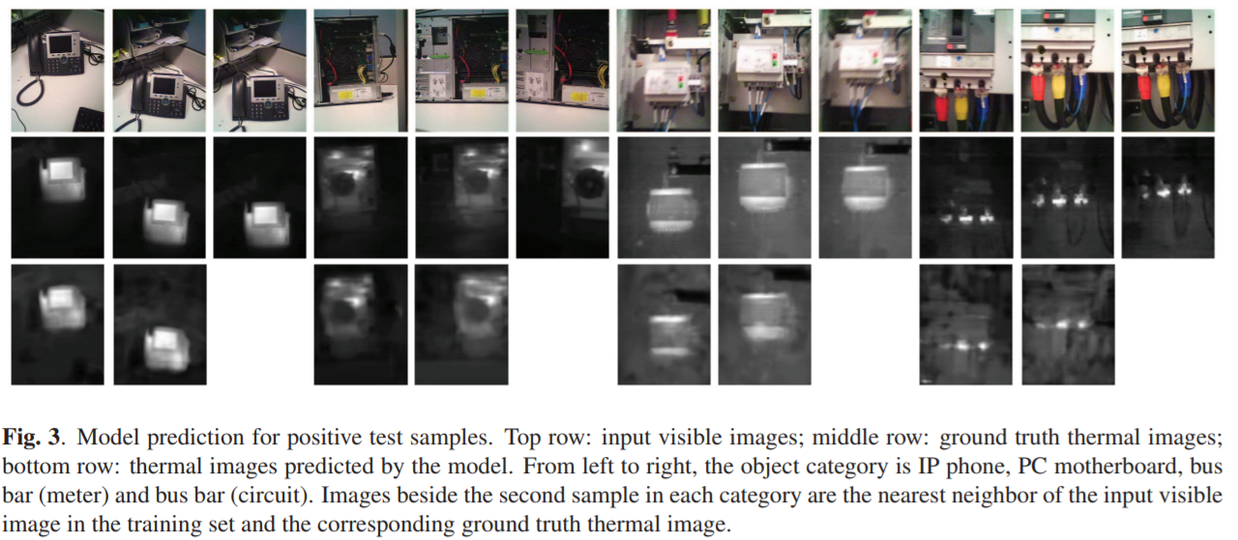
Results
Model predicts thermal features for the input images, hot spots correctly predicted.
Prediction is a blurred version of the ground truth thermal image(MSE).
Prediction made by model appeared to be accurate at various positions and shapes. Predictive models trained with MSE might react to uncertainty by blurring.
Input Image
Ground Truth
Predicted
Notes:
Mark rows and what they mean, explain a bit more

Slide 12
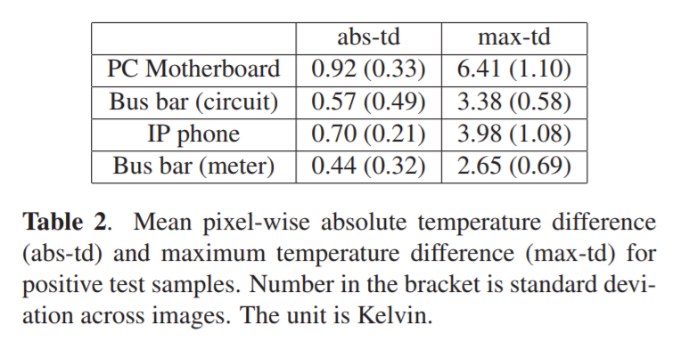
Results
Mean pixel-wise temp difference is small
Thermal images dominated by black pixels
DNN model achieves small mean temp difference by predicting low temperatures for most pixels.
Max temp difference is large, ranging from 2.65 to 6.41 K.
Blurring effect smooths max points and causes inaccuracy in prediction.
Quantitative Results

Slide 13
Why DNN (Deep CNN) over CNN
DNNs have been used to to obtain pixel-wise prediction and image super-resolution, thus the DNN model can achieve small mean temperature difference by predicting low temperatures for most pixels.
DNNs have the ability to discover hierarchical representations that tally with the hidden cause of the observed data.
DNNs have recently proven to obtain impressive and better results in a lot of computer vision problems.
Notes:
Marie

Slide 14
Conclusions
Proposed an automatic anomaly detection method based on DNNs.
Model was trained to predict a thermal image from an input visible image.
Experimental results showed prediction made by the model was a blurred version of the ground truth.
The model was trained on positive samples, prediction error was used as the Delta-T value to detect anomalies.
Anomaly detection results on electrical devices under simulated anomalous conditions demonstrated efficacy of proposed method.
Notes:
Marie

Slide 15
Future Work
Incorporating adversarial loss in training the model
Different equipment may need different Delta-T threshold values
Knowing the category of an image eases automatically selecting thresholds
Notes:
Marie

Slide 16
Thank you!
Questions?

