Slide 1
CS548 Fall 2018 Clustering Showcase by Yingxue Zhang, Mo Cheng, Ashish Gurung, jake scheide
Showcasing work by Jing Yuan, Yu Zheng, Xing Xie, Guangzhou Sun
on “T-Drive: Enhancing Driving Directions with Taxi Drivers’ Intelligence”

Slide 2
References
[1] J. Yuan, Y. Zheng, C. Zhang, W. Xie, G. Sun, H. Yan, and X. Xie, “T-Drive: Driving Directions Based on Taxi Trajectories,” Proc.18th SIGSPATIAL Int’l Conf. Advances in Geographic Information Systems (GIS), 2010.
[2] T. Hunter, R. Herring, P. Abbeel, and A. Bayen, “Path and Travel Time Inference from GPS Probe Vehicle Data,” Proc. Neural Information Processing Systems (NIPS), 2009.
[3] Y. Lou, C. Zhang, Y. Zheng, X. Xie, W. Wang, and Y. Huang, “Map-Matching for Low-Sampling-Rate GPS Trajectories,” Proc. Int’l Conf. Advances in Geographic Information Systems (GIS), 2009.
[4] J. Yuan, Y. Zheng, C. Zhang, and X. Xie, “An Interactive-Voting Based Map Matching Algorithm,” Proc. Int’l Conf. Mobile Data Management (MDM), 2010.
[5] E. Kanoulas, Y. Du, T. Xia, and D. Zhang, “Finding Fastest Paths on a Road Network with Speed Patterns,” Proc. Int’l Conf. Data Eng. (ICDE), 2006.
[6] A. Orda and R. Rom, “Shortest-Path and Minimum-Delay Algorithms in Networks with Time-Dependent Edge-Length,” J. ACM, vol. 37, no. 3, pp. 607-625, 1990.
[7] N. Leibowitz, B. Baum, G. Enden, and A. Karniel, “The Exponential Learning Equation as a Function of Successful Trials Results in Sigmoid Performance,” J. Math. Psychology, vol. 54, no. 3, pp. 338-340, 2010.

Slide 3
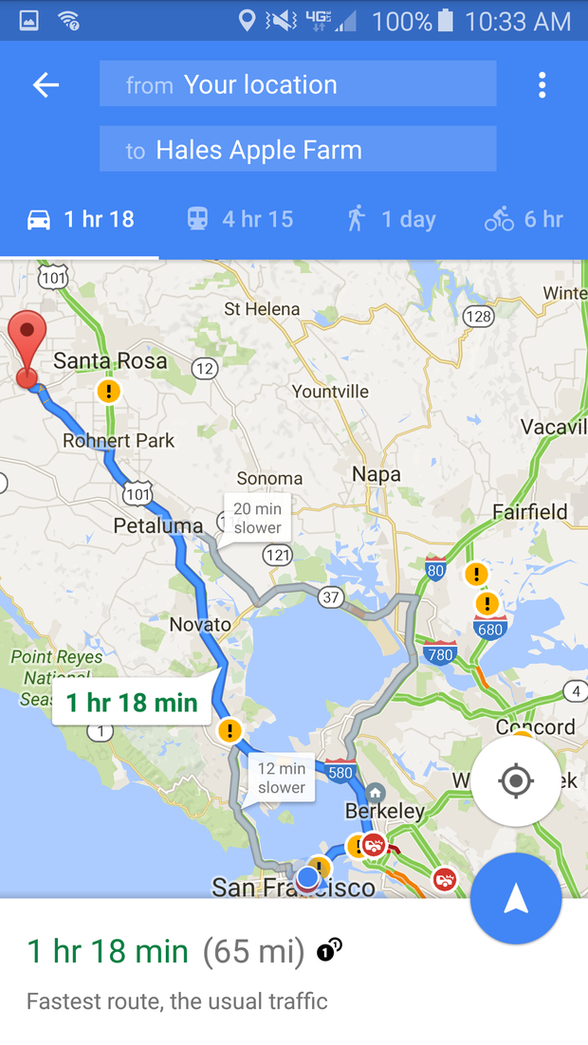
Motivation
Find fast driving routes for drivers
A good routing service
Physical feature of a route
Cloud-based cyber-physical system
Use taxi trajectories
Time-dependent traffic flow
Driving behavior
Compute practically fast routes

Slide 4
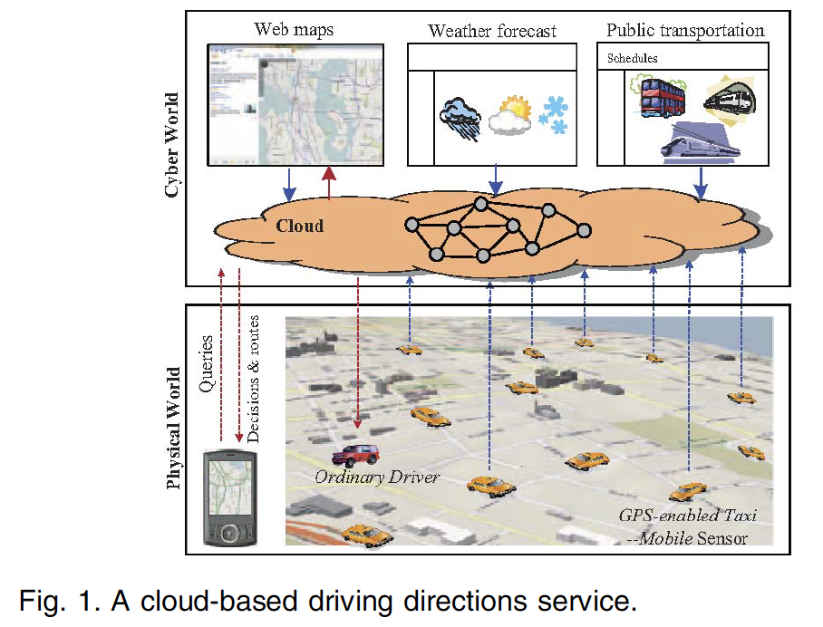
Process Introduction
Taxis are used as mobile sensors probing the traffic rhythm
Aggregate and mine the info from taxis as well as other sources from Internet in cloud
The knowledge in the cloud is used in turn to serve Internet users and ordinary drivers.
A mobile client accepts a user’s query, communicates with the cloud, and presents the result to the user

Slide 5
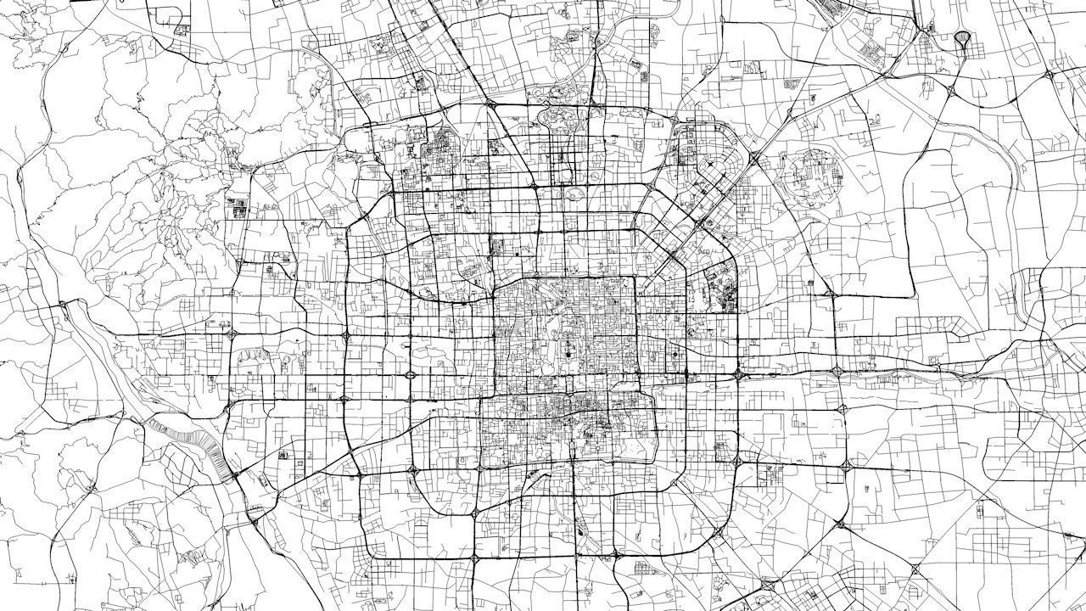
Data Collection
Road network of Beijing
Taxi trajectories: 4.96 million trajectories generated by over 33,000 taxis over three months. A taxi trajectory is a sequence of GPS points pertaining to one trip. Each point consists of a longitude, latitude, and a time stamp

Slide 6
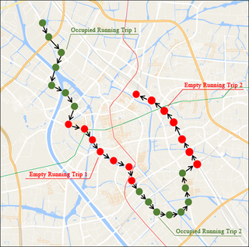
Data Preprocessing
Convert the GPS points to trajectories representing individual trips according to the taximeter’s transaction records
Convert the trajectories to road segments sequences

Slide 7
Landmark Graph
Landmark: top-k rod segments that are frequently traversed by taxi drivers according to the trajectories
Convert the road segments sequences to landmark sequences

Slide 8
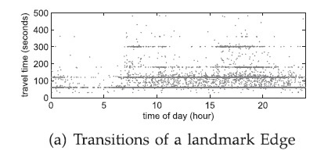
VE-Clustering
The travel time of an landmark edge was found to be dependent upon the following factors:
number of traffic lights on the route
different routes chosen by different drivers travelling the landmark edge
drivers personal behavior, skill and preferences
Making the road network dynamic in nature.
Earlier papers[5][6] based their assumptions on the fact that travel time is dependent on time of the day.
A new approach that took into account the Variance and Entropy of the data for clustering was used.

Slide 9
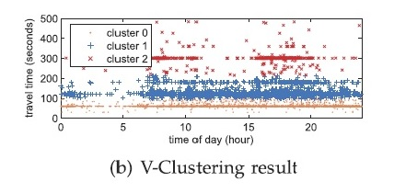
V-Clustering
Variance Clustering:
The travel times are clustered into several categories based on their variance. Fig(b) shows the clustering of time taken to traverse a specific landmark edge.

Slide 10
V-Clustering
Arrange the travel times taken to traverse a landmark edge in ascending order
Partition the list into multiple sub-lists in a binary recursive way
Calculate the variance of all the travel times
minimal weighted average variance (WAV) is used to find the best split point
Formula,
Recursion stopping condition: [maximum decrease in variance < threshold value]

Slide 11
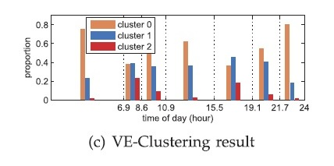
E-Clustering
Entropy Clustering: Information gain was used to determine a time partition for each landmark edge.
E-Clustering aims to split time of day into several time slots such that travel time has a stable distribution.
E-Clustering used the same approach as the one used for V clustering.
Instead of WAV we have Weighted Average Entropy(WAE)
The clusters generated in V-Clustering is used to determine the proportion during the calculation of information entropy.

Slide 12
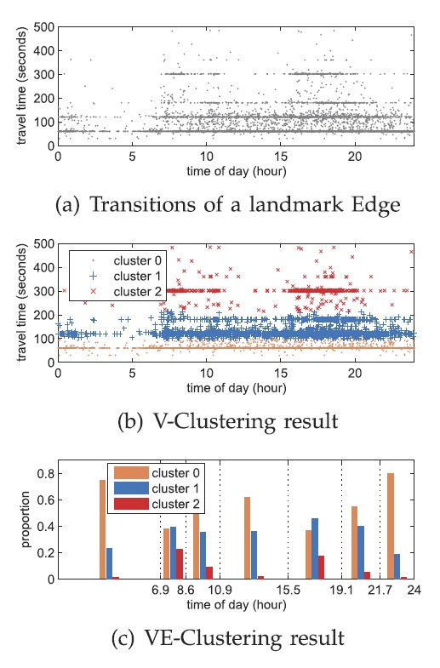
VE-Clustering
Here,
figure (a) shows the travel time for a landmark
edge against time of the day for various drivers
Figure (b) is the visualization of the data after
V-clustering
Figure(c) shows the final result after E-clustering
is implemented

Slide 13
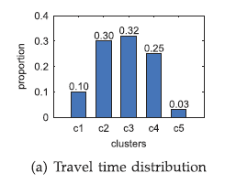
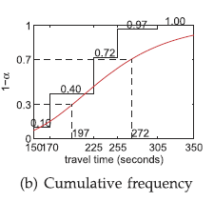
Route Computing
Drivers take a different amount of time to drive the same stretch of road at the same time
A custom factor between 0 and 1 models driver speed through an identical route
A route is computed by searching for the 3 nearest landmarks to the start node, and creating m x m landmark pairs
Fastest route is determined through Dijkstra's algorithm generalization
Notes:
For example, a custom factor = 0.7 travels a route in 272 seconds, whereas a custom factor of 0.3 travels the identical route at the same time in 197 seconds.

Slide 14
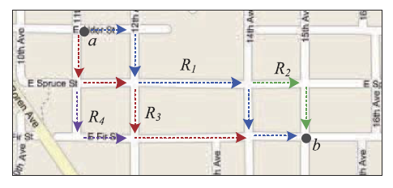
Refining routes
Sampling rate is low (taxis only report location every 2-5 minutes)
Algorithm accuracy is < 70%[4]
“Nonroundabout routes” follow three principles
1. Source farther principle (the next node in the sequence is further away from the start than the current node)
2. Destination closer principle (The next node in the sequence is closer to the destination than the current node)
3. Next nearest principle (every node after the next node should be further away from the current node than the next node)
Nonroundabout routes are ideal. Any route that violates one of these principles is smoothed using sorting algorithms.

Slide 15
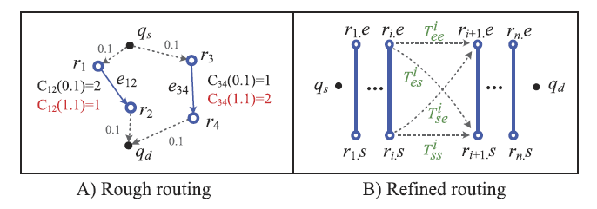
Route Smoothing
Global smoothing is solved in O(n log n) by finding the longest increasing subsequence of distance pairs (node 1, source), (node 2, source)
Local smoothing uses a custom algorithm which finds the longest subsequence from a globally smoothed sequence to satisfy the next-nearest principle. Typically this is completed in exponential time, but the team’s optimizations reduce this to polynomial time.

Slide 16
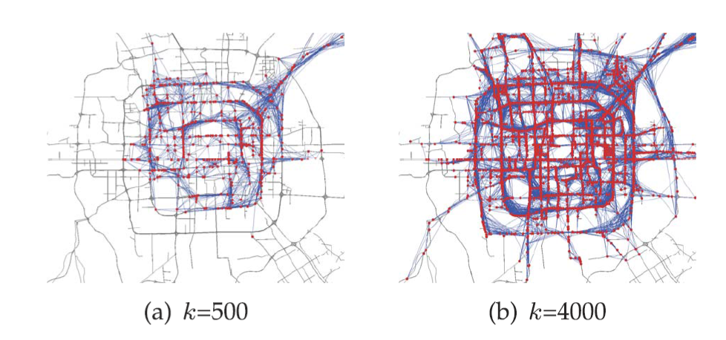
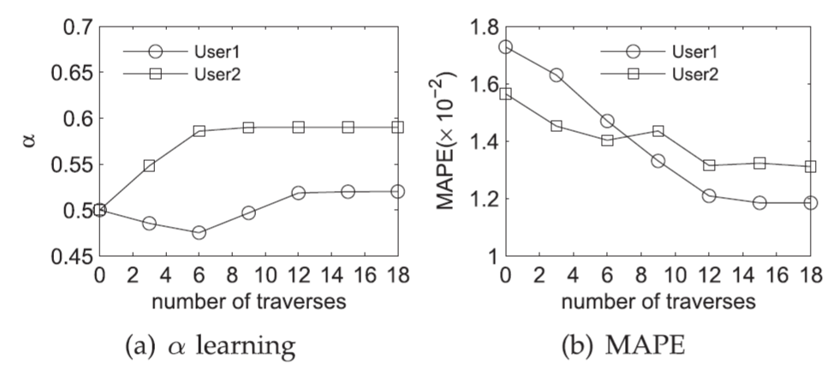
Evaluation
Evaluating Landmark Graph
Top-k frequent road segment: from 500 to 13000
Time of traversed by taxis: 900 times
Maximum time : 30 min
Evaluation on Travel Time Estimation
$t(R_{i})$ : real travel time $\hat{t}(R_{i})$: estimated travel time

Slide 17
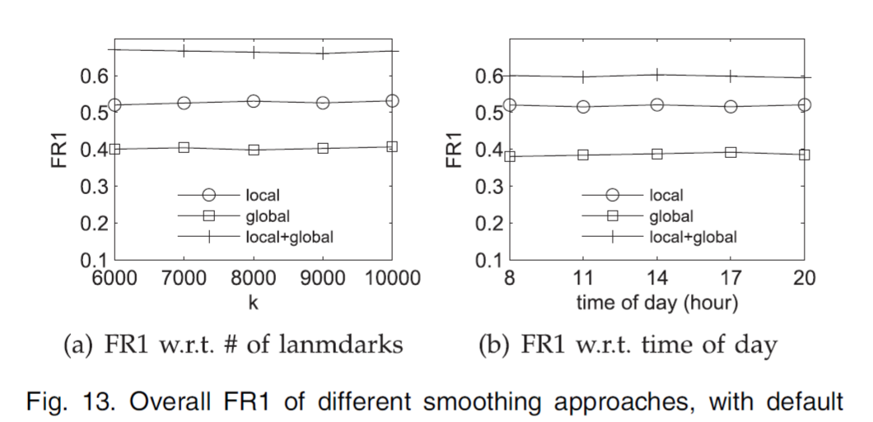
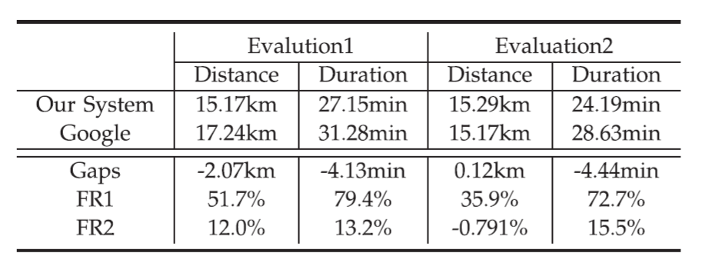
Evaluation
Routing Evaluation
A: T-Drive system method
B: Baseline method
In-the-field Evaluation

Slide 18
Summary
T-Drive: a system to find out the practically fastest route for a particular user at a given departure time.
Estimate the time: VE-Clustering
Routing: custom factor & smoothing
Data: A real system with real-time GPS trajectories generated by over 33,000 taxis in a period of three months.
Evaluation: more than 60% of the route found by the paper’s method are faster than that of the existing online map services, and 50% of these routes are at least 20% faster than the latter. On average, the paper’s method can save about 16% of time for a trip.

Slide 19
Thank you!

