Slide 1
CS548 Fall 2018
Decision Trees Showcase
by Holly Nguyen, Hongyu Pan, Lei Shi, Muhammad Tahir
Showcasing work by Themis P. Exarchos, Alexandros T. Tzallas, DinaBaga, Dimitra Chaloglou, Dimitrios I. Fotiadis, Sofia Tsouli, Maria Diakou, Spyros Konitsiotis on “Using partial decision trees to predict Parkinson’s symptoms: A new approach for diagnosis and therapy in patients suffering from Parkinson’s disease”
Notes:
20 sec.

Slide 2
References
T. P. Exarchos, A. T. Tzallas, D. Baga, D. Chaloglou, D. I. Fotiadis, S. Tsouli, M. Diakou, S. Konitsiotis. “Using partial decision trees to predict Parkinson’s symptoms: A new approach for diagnosis and therapy in patients suffering from Parkinson’s disease,” Computers in Biology and Medicine, vol. 42, no. 2, Nov., pp. 195-204, 2011.
E. Frank. “Pruning decision trees and lists,” 2000.
E. Frank, I. H. Witten. “Generating accurate rule sets without global optimization,” ICML, 1998.
J. R. Quinlan. “C4.5: Programs for machine learning,” Morgan Kaufmann Publishers, 1993.
Notes:
Partial Decision Tree:
https://www.cs.waikato.ac.nz/~eibe/pubs/thesis.final.pdf
https://pdfs.semanticscholar.org/3998/12d46345ad7d93f5510b1bbda30948e7a65c.pdf
https://octaviansima.wordpress.com/2011/03/25/decision-trees-c4-5/
https://www.slideshare.net/aorriols/lecture6-c45
https://en.wikipedia.org/wiki/C4.5_algorithm

Slide 3
Motivation/Problem Statement
About Parkinson’s Disease
Decision Support Systems
PERFORM system and how the predictive model could be used with this system
Notes:
Muhammad
Would

Slide 4
Notes:
30 sec: Parkinson’s disease
In simple words Parkinson’s disease affects patient’s movement.
But it is a lot more complex than that.
Initial symptoms:
Like Tremors, Muscle rigidity, and slowness in movement.
The aim for medication and therapy is to alleviate the symptoms.

Slide 5
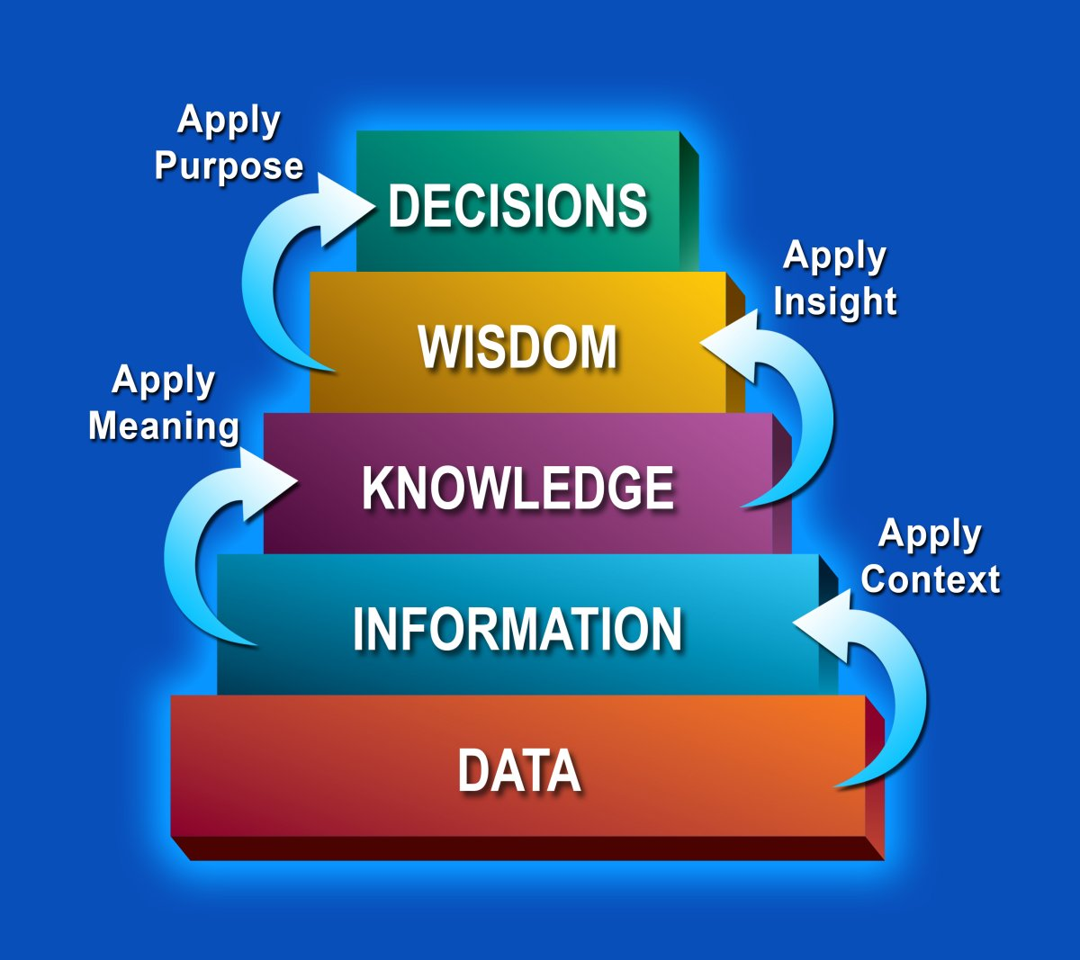
Notes:
30 sec: Decision Support System
The general concept of this study is the extraction of knowledge and
Rules from a set of data and the development of decision support
Systems for diagnosis, prediction and classification.
System that support decision making activities.

Slide 6
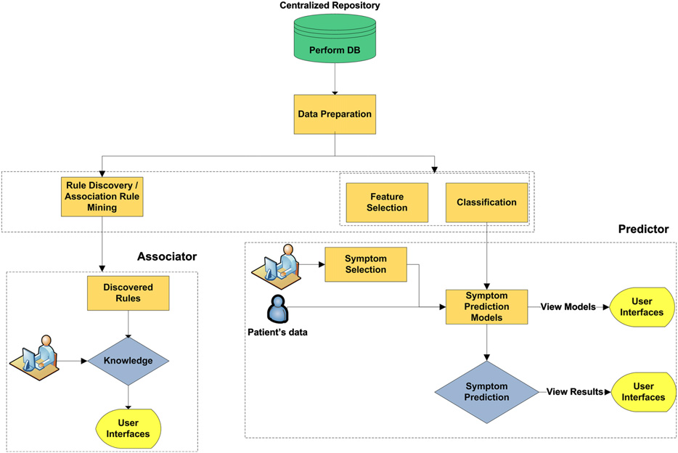
PERFORM System
Develop prediction model
Extraction of rules
Notes:
1 Min: PERFORM Systems

Slide 7
Methodology
Data collection
230 Parkinson’s Disease patients from University Hospital of Ioannina
Medical History (e.g., gender, current age, age at diagnosis, smoker, diabetes, family with PD)
Examinations
(e.g., tremor, tremor severity, postural instability, falls, freezing, dementia)
Medication
(i.e., 5 medications and the number of years since they were first prescribed)
Data preprocessing
“Feature wrapper” (supervised feature selection)
Data mining
Prediction of symptoms
(Partial decision trees → rules)
Notes:
Holly
1 minute
During the data collection process, a patient’s daily motor activity is collected through sensors and then the LBU classifies them according to UPDRS

Slide 8
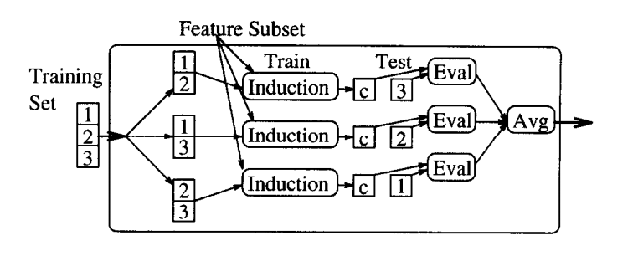
Wrapper for Feature Selection
This use case
Used wrapper on each symptom input to determine “worth” (i.e., accuracy estimates)
Black box (target learning algorithm)
Notes:
Holly
30 seconds
Wrapper approach for feature selection: https://pdfs.semanticscholar.org/0048/88621a4e4cee56b6633338a89aa036cf5ae5.pdf

Slide 9
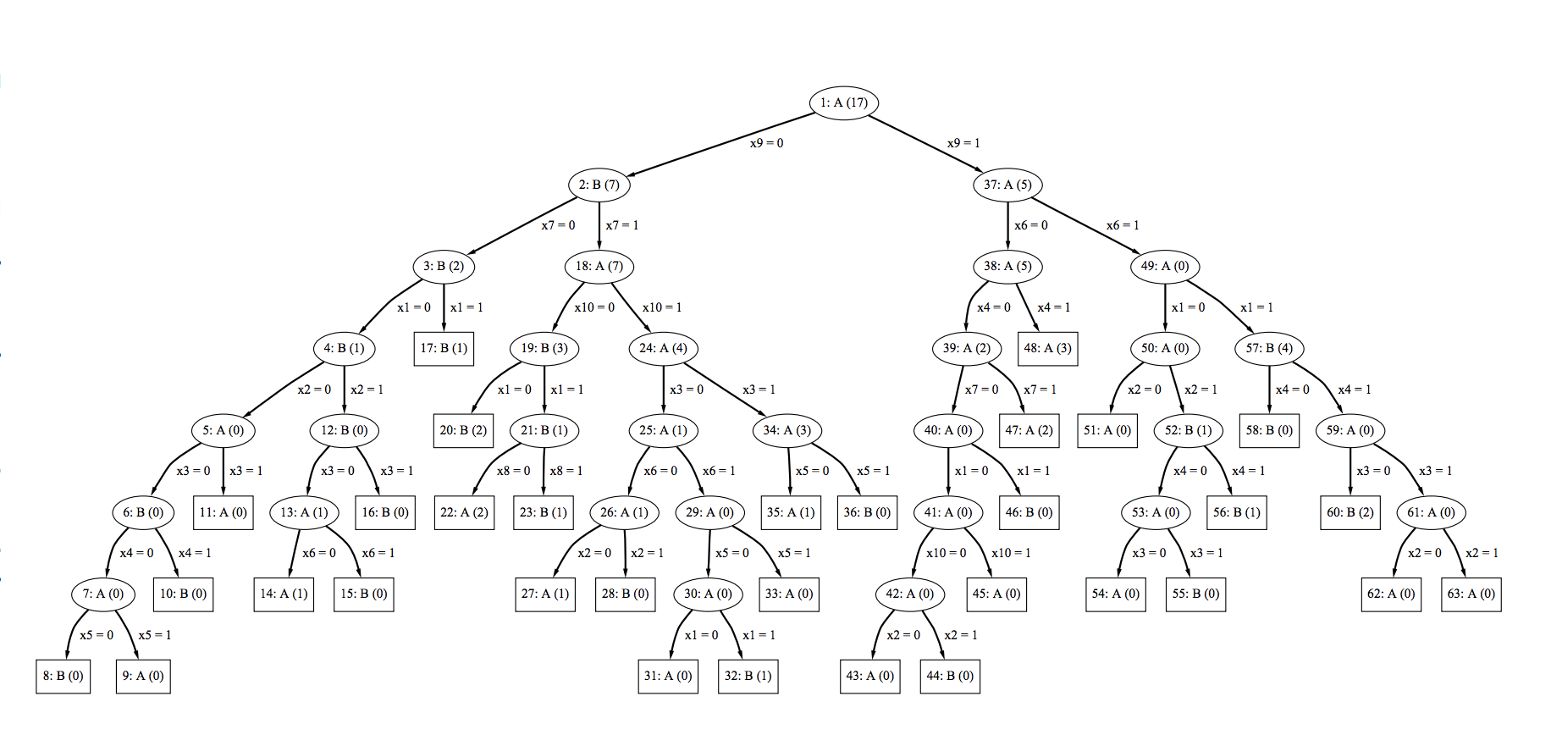
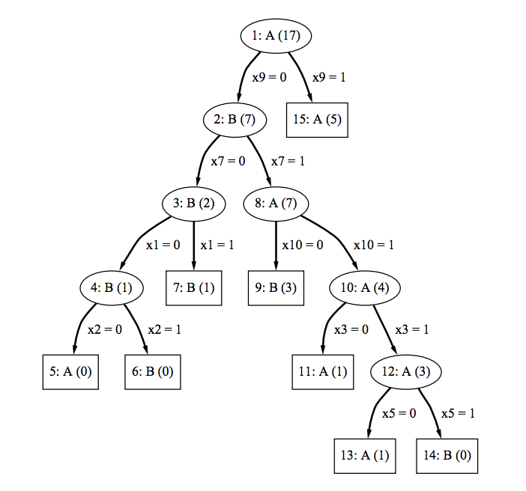
About Partial Decision Trees
The decision tree generated by C4.5 algorithm which is developed by Ross Quinlan is likely to be overfitting because it is too specific to correctly classify the test data set.
Partial decision tree is smaller tree which is obtained by pruning the original decision tree.
Notes:
Lei
https://www.cs.waikato.ac.nz/~eibe/pubs/thesis.final.pdf

Slide 10
About Partial Decision Trees
PROCESS
Expand tree from root to leaf
Backtrack
Consider replacement during backtracking
Tree Pruning Method: Post-pruning
Condition of Pruning: Replacing node with leaf will not increase validation error rate.
Notes:
Lei
https://pdfs.semanticscholar.org/3998/12d46345ad7d93f5510b1bbda30948e7a65c.pdf

Slide 11
About Partial Decision Trees
Procedure Expand Subset
Choose the feature with largest information gain to split data into subsets
While there are subsets that have not been expanded && all the subsets expanded so far are leaves
expand the unexpanded subset with smallest entropy
If all the subsets expanded are leaves && combined validation error rates of leaves >= validation error rate of node
undo expansion into subsets and make node a leaf
Notes:
Lei
https://pdfs.semanticscholar.org/3998/12d46345ad7d93f5510b1bbda30948e7a65c.pdf
https://www.slideshare.net/aorriols/lecture6-c45

Slide 12
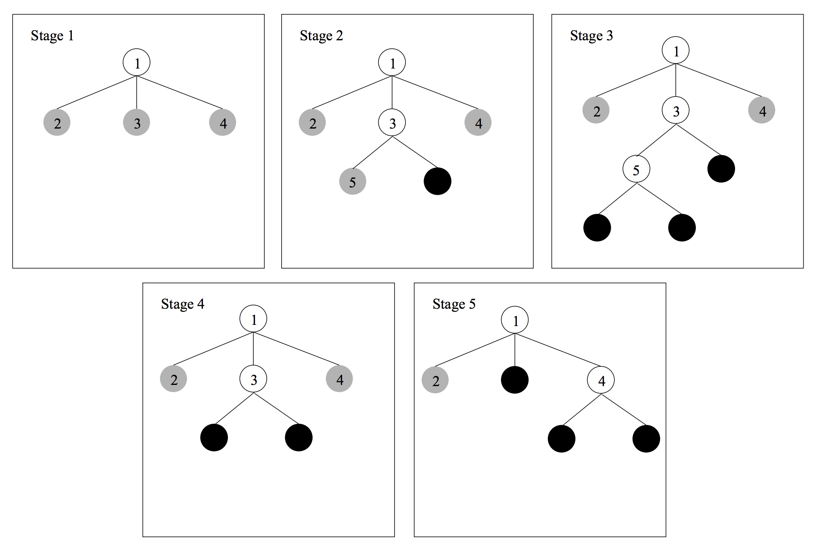
Stepping Through Partial Decision Trees
Gray node: unexpanded
Black node: leaf
White node: expanded
Notes:
Lei
https://pdfs.semanticscholar.org/3998/12d46345ad7d93f5510b1bbda30948e7a65c.pdf

Slide 13
1
STAGE 1
Gray node: unexpanded
Black node: leaf
White node: expanded
2
3
4
Notes:
Lei
https://pdfs.semanticscholar.org/3998/12d46345ad7d93f5510b1bbda30948e7a65c.pdf

Slide 14
1
STAGE 2
Gray node: unexpanded
Black node: leaf
White node: expanded
2
3
4
5
Notes:
Lei
https://pdfs.semanticscholar.org/3998/12d46345ad7d93f5510b1bbda30948e7a65c.pdf

Slide 15
1
STAGE 3
Gray node: unexpanded
Black node: leaf
White node: expanded
2
3
4
5
Notes:
Lei
https://pdfs.semanticscholar.org/3998/12d46345ad7d93f5510b1bbda30948e7a65c.pdf

Slide 16
1
STAGE 4
Gray node: unexpanded
Black node: leaf
White node: expanded
2
3
4
Notes:
Lei
https://pdfs.semanticscholar.org/3998/12d46345ad7d93f5510b1bbda30948e7a65c.pdf

Slide 17
1
STAGE 5
Gray node: unexpanded
Black node: leaf
White node: expanded
2
4
Notes:
Lei
https://pdfs.semanticscholar.org/3998/12d46345ad7d93f5510b1bbda30948e7a65c.pdf

Slide 18
Results -- Predicted Symptoms
Tremor
Rigidity
Bradykinesia
Postural instability
Falls
Freezing Autonomic
Hypophonia
Hypomimia
Orthostatic Hypotension
RBD
LID
On/Off
Suddenoffs
Dementia
PREDICTOR
Notes:
Hongyu
10 fold cross validation method;
The results of the method, range from 57.1 to 77.4%. The highest accuracy is achieved for the symptom Tremor, which is the most common symptom in PD and for which there is a relative balance between the patients where the symptom occurs and the patients where the symptom does not occur. Also, high results are achieved for Rigidity, Bradykinesia, Falls and LID, which are some of the most important symptoms in PD. On the other hand, low accuracy is obtained for some of the symptoms such as Postural Instability, Autonomic, Hypophonia, Hypomimia, Orthostatic Hypotension, RBD, Sudden offs and Dementia. This can be attributed to the fact that for those symptoms, there is high imbalance between the two categories (occurrence or not), resulting in a relatively low number of records for training the algorithms and developing the predictive models.

Slide 19
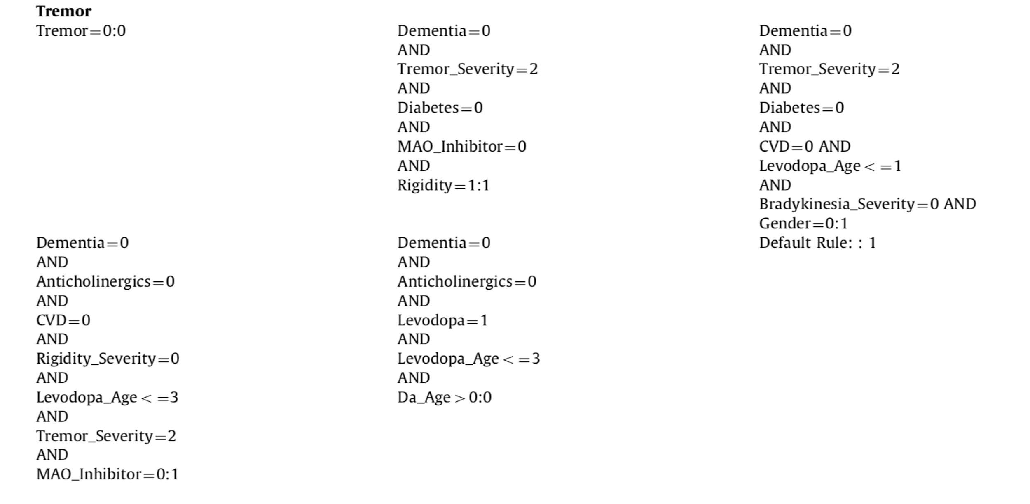
Results -- Example of generated rule 1
Notes:
Hongyu
10 fold cross validation method;
The results of the method, range from 57.1 to 77.4%. The highest accuracy is achieved for the symptom Tremor, which is the most common symptom in PD and for which there is a relative balance between the patients where the symptom occurs and the patients where the symptom does not occur. Also, high results are achieved for Rigidity, Bradykinesia, Falls and LID, which are some of the most important symptoms in PD. On the other hand, low accuracy is obtained for some of the symptoms such as Postural Instability, Autonomic, Hypophonia, Hypomimia, Orthostatic Hypotension, RBD, Sudden offs and Dementia. This can be attributed to the fact that for those symptoms, there is high imbalance between the two categories (occurrence or not), resulting in a relatively low number of records for training the algorithms and developing the predictive models.

Slide 20
Results -- Example of generated rule 2
Notes:
Hongyu
10 fold cross validation method;
The results of the method, range from 57.1 to 77.4%. The highest accuracy is achieved for the symptom Tremor, which is the most common symptom in PD and for which there is a relative balance between the patients where the symptom occurs and the patients where the symptom does not occur. Also, high results are achieved for Rigidity, Bradykinesia, Falls and LID, which are some of the most important symptoms in PD. On the other hand, low accuracy is obtained for some of the symptoms such as Postural Instability, Autonomic, Hypophonia, Hypomimia, Orthostatic Hypotension, RBD, Sudden offs and Dementia. This can be attributed to the fact that for those symptoms, there is high imbalance between the two categories (occurrence or not), resulting in a relatively low number of records for training the algorithms and developing the predictive models.

Slide 21
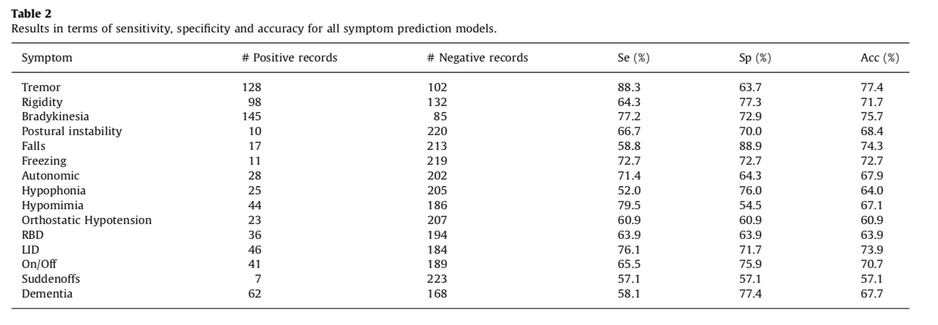
Results -- Accuracy of rules
Notes:
Hongyu
10 fold cross validation method;
The results of the method, range from 57.1 to 77.4%. The highest accuracy is achieved for the symptom Tremor, which is the most common symptom in PD and for which there is a relative balance between the patients where the symptom occurs and the patients where the symptom does not occur. Also, high results are achieved for Rigidity, Bradykinesia, Falls and LID, which are some of the most important symptoms in PD. On the other hand, low accuracy is obtained for some of the symptoms such as Postural Instability, Autonomic, Hypophonia, Hypomimia, Orthostatic Hypotension, RBD, Sudden offs and Dementia. This can be attributed to the fact that for those symptoms, there is high imbalance between the two categories (occurrence or not), resulting in a relatively low number of records for training the algorithms and developing the predictive models.

Slide 22
Results -- Why this method makes difference
Addresses all PD symptoms and provides an integrated approach for treatment in this way.
The user receives interpretation for every prediction induced, using the rule that matches the data of the new patient.
Medical experts could have a subjective view for their patients clinical condition at home and be able to make more correct treatment changes.
Clinical trials will be able to assess the new developed drug response and safety in a more objective way.
Notes:
Hongyu
10 fold cross validation method;
The results of the method, range from 57.1 to 77.4%. The highest accuracy is achieved for the symptom Tremor, which is the most common symptom in PD and for which there is a relative balance between the patients where the symptom occurs and the patients where the symptom does not occur. Also, high results are achieved for Rigidity, Bradykinesia, Falls and LID, which are some of the most important symptoms in PD. On the other hand, low accuracy is obtained for some of the symptoms such as Postural Instability, Autonomic, Hypophonia, Hypomimia, Orthostatic Hypotension, RBD, Sudden offs and Dementia. This can be attributed to the fact that for those symptoms, there is high imbalance between the two categories (occurrence or not), resulting in a relatively low number of records for training the algorithms and developing the predictive models.

Slide 23
Results -- Why this method makes difference (cont)
The model can be readily interpreted by medical professionals without any specific knowledge of statistics because a simple representation was used in different areas of medical decision.
The same model can be used to predict the severity of the occurring symptoms by the age.
It predicts the future symptoms in patients, without their presence in the hospital and without requiring time consuming physical examinations and processes, so more data will be provided.
The prediction of the symptoms, using only easily obtained features is a difficult task. The paper reports promising results, by using data from additional patient records in the future.
Notes:
Hongyu
10 fold cross validation method;
The results of the method, range from 57.1 to 77.4%. The highest accuracy is achieved for the symptom Tremor, which is the most common symptom in PD and for which there is a relative balance between the patients where the symptom occurs and the patients where the symptom does not occur. Also, high results are achieved for Rigidity, Bradykinesia, Falls and LID, which are some of the most important symptoms in PD. On the other hand, low accuracy is obtained for some of the symptoms such as Postural Instability, Autonomic, Hypophonia, Hypomimia, Orthostatic Hypotension, RBD, Sudden offs and Dementia. This can be attributed to the fact that for those symptoms, there is high imbalance between the two categories (occurrence or not), resulting in a relatively low number of records for training the algorithms and developing the predictive models.

Slide 24
Impact
Easily interpreted by medical professionals
Could provide decision support for clinicians
Notes:
Muhammad

Slide 25
Thank you!
Questions?
Notes:
Muhammad

Slide 26
Short Description of Application
This article proposes a new method using partial decision trees and association rules to predict Parkinson’s Disease (PD) symptoms using features relating to medical history, physical examinations, and medications. The partial decision trees and corresponding rules were applied to a dataset of 230 PD patients from the University Hospital of Ioannina. The proposed method for PD symptom prediction was designed to use in the PERFORM system which uses individual wearable monitors to capture motor information, which can then be used to predict new PD symptoms for each patient.

