Slide 1
CS548 Fall 2018
Text Mining Showcase
By Charlie Parsons, Sola Shirai, Shyam Subramanian, Erin Teeple, Jack Zhang
Showcasing work by Lei Yu, Karl Moritz Hermann, Phil Blunsom, Stephen Pulman On
Deep Learning for Answer Sentence Selection

Slide 2
References
[1] Lei Yu, Karl M. Hermann, Phil Blunsom, and Stephen Pulman. “Deep learning for answer sentence selection”. NIPS Deep Learning Workshop, 2014.
[2] Vasin Punyakanok , Dan Roth , and Wen-tau Yih. “Mapping Dependencies Trees: An Application to Question Answering”. In Proceedings of the 8th International Symposium on Artificial Intelligence and Mathematics, Fort, 2004
[3] Danqi Chen and Christopher D Manning. “A Fast and Accurate Dependency Parser using Neural Networks”. Proceedings of EMNLP, 2014.
[4] Jeffrey Pennington, Richard Socher, and Christopher D. Manning. “GloVe: Global Vectors for Word Representation”. In EMNLP, 2014.
[5] Mengqiu Wang, Noah A Smith, and Teruko Mitamura. What is the jeopardy model? a quasisynchronous grammar for qa. In EMNLP-CoNLL, 2007.
.

Slide 3
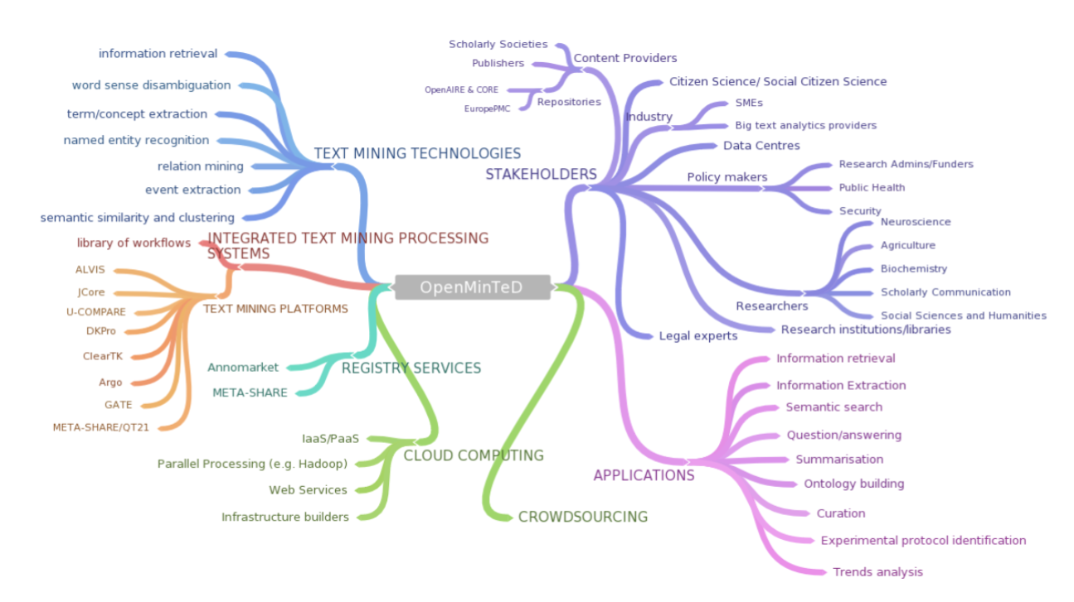
What is Text Mining
The application of artificial intelligence methods to text data for purposes such as information extraction, summarization, or classification.
OpenMinTeD Project for linking text mining workflows: http://www.nactem.ac.uk/openminted/
Notes:
1. Text Mining and NLP – Background
2. Abstract
3. DB Query vs. Open Domain Question Answering
4. Answer Sentence Selection

Slide 4
Who wrote the book Harry Potter?
Answer Sentence : Harry Potter is a series of fantasy novels written by British author J.K. Rowling
Answer Phrase : J.K. Rowling
Source: https://en.wikipedia.org/wiki/Harry_Potter

Slide 5
Answer Sentence Selection Task
To answer a given question, a method must:
1) Identify question type/content
2) Retrieve relevant information from other sources
3) Select correct and appropriate information as the answer

Slide 6
Deep Learning for Answer Sentence Selection
Lei Yu, Karl Moritz Hermann, Phil Blunsom, Stephen Pulman
Innovation:
Neural network-based sentence model developed that is
Applicable to any language
Does not require feature-engineering or hand-coded resources beyond training initial word embeddings.
Objective:
Authors match questions with answers using semantic encoding to select an answer from among candidate sentences not seen during training.
Notes:
Maybe mention key idea of this paper? “We propose a novel approach to solving this task via means of distributed representations, and learn to match questions with answers by considering their semantic encoding. This contrasts prior work on this task, which typically relies on classifiers with large numbers of hand-crafted syntactic and semantic features and various external resources.”

Slide 7
TREC Answer Selection Dataset [5]
Mengqiu Wang, Noah A Smith, and Teruko Mitamura. What is the jeopardy model? a quasi-synchronous grammar for qa. In EMNLP-CoNLL, 2007.
TREC Dataset: Factoid questions + List of Corresponding Answer Sentences
TRAIN: answer candidates chosen by non-stopword counts and patterns match
TRAIN-ALL: noisy training data set, answers labelled automatically
Task: Rank candidate answers based on relatedness to the question
MAP - mean average precision, examines ranks of all correct answers
MRR - mean reciprocal rank, rank of any correct answer
Evaluation: TREC_eval official evaluation scripts used to allow for performance
comparisons with other models

Slide 8
TREC Answer Selection Dataset [5]

Slide 9
TREC_eval
https://www-nlpir.nist.gov/projects/trecvid/trecvid.tools/trec_eval_video/A.README
Standard tool used by researchers in TREC (Text REtrieval Conference ) for evaluating information retrieval performance.
Outputs:
Total number of documents over all queries
Retrieved:
Relevant:
Rel_ret: (relevant and retrieved)
2. Precision - % retrieved documents that are relevant
3. Mean Average Precision - if a relevant document is not retrieved, its precision is 0, all precision values are averaged together to get the performance of a query
4. Mean Reciprocal Rank - The reciprocal rank is then the inverse of the rank for the true correct answer (1 - first, ½, second). Mean reciprocal rank is the average over all query matches. TREC_eval uses rank of top relevant document (i.e., if first relevant document is third document, reciprocal rank is 1/3)

Slide 10
Answer Selection Model: Setup
Set of question sentences { q₁, q₂, …, q_{n} }
Set of answer sentences { a₁, a₂, …, a_{n} }
Assume that matching question-answer pairs have high semantic similarity
Model sentences as vectors and evaluate relatedness
Notes:
Better visual representation

Slide 11
Word Embeddings
Word Embeddings are Vector representation of words
Sentence 1 : Have a good day
Sentence 2 : Have a great day
Vocabulary : {Have, a, good, great, day}
Vector representation : One Hot Encoding
Problem: Similarity between vector representation of good and great?
One Hot Encoding
 | Have | a | good | great | day
Have | 1 | 0 | 0 | 0 | 0
a | 0 | 1 | 0 | 0 | 0
good | 0 | 0 | 1 | 0 | 0
great | 0 | 0 | 0 | 1 | 0
day | 0 | 0 | 0 | 0 | 1

Slide 12
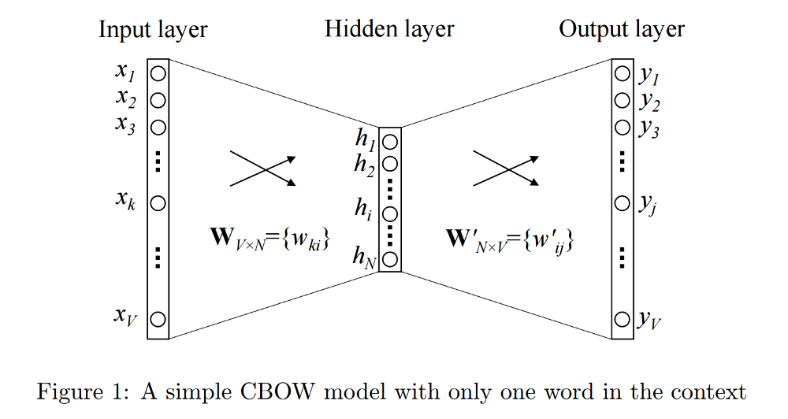
Complex Word Embeddings
Continuous bag of words
Source word (great)
Target word (day)
Neural Network to learn word embedding of one word from another
For Example: Continuous Bag Of Words - Predict day from great and good or vice-versa
Popular Pre-Trained Word Embeddings - Word2Vec, GloVe [4]
https://towardsdatascience.com/introduction-to-word-embedding-and-word2vec
-652d0c2060fa

Slide 13
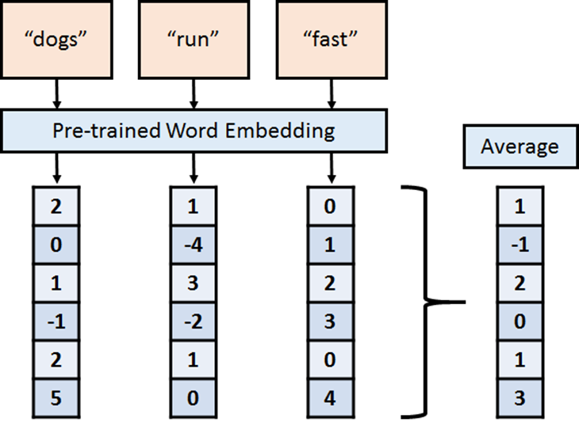
Vectorize Sentences with Word Embeddings
Convert words into a vector
Use pre-trained word embeddings
Sentences represented as combination of the word vectors
E.g. Average of word vectors
Notes:
1. Word embeddings - (Word2Vec, GloVe)?
2. Explain the methodology Form a Question from Answer. Find q’ = Ma
a. Unigram Bag of Words

Slide 14
Formal Model Definition
Given a vector representation of question q and answer a, the probability that a is the correct answer to q:
q and a are d-dimensional vectors
Matrix M and bias b are learned parameters
q^{T}Ma collapses vectors into a single number
σ: Sigmoid squashes result into (0, 1) to give final probability
Notes:
Slides [formal model, intuitively, lossfun, bow] ~ roughly 4min (without hp example)

Slide 15
How it works Intuitively…
For a candidate answer a
We “generate” a question q’ = Ma
Then measure similarity of q to q’ by their dot product
“Generate” the question q’
Computer similarity of q’ to q

Slide 16
How it works Intuitively…
E.g. a = “Harry potter is a fantasy novel series written by british author J.K. Rowling”
Generate q’ = “Who wrote the fantasy novel series Harry Potter?”
Compare similarity to q = “Who wrote Harry Potter?”
“Generate” the question q’
Computer similarity of q’ to q
Notes:
Do example question generation - go back to harry potter example?
E.g. for the answer sentence “Harry potter is a fantasy novel series written by british author j.k. Rowling”, maybe this might generate a question like “who wrote the fantasy novel series harry potter?” and from there we would compare the similarity to actual question sentences

Slide 17
Loss Function
Model is trained by minimizing cross entropy of Question-Answer pairs
Is the Frobenius norm
Used for regularization to prevent overfitting

Slide 18
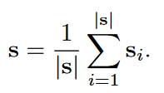
Representation of Sentences
Type 1 : Bag-of-Words (Unigram)
First implementation of answer selection model
Sum word embeddings of each word in sentence
Normalize by sentence length

Slide 19
Representation of Sentences
Type 2: CNN (Bigram)
CONVOLUTION FILTERS + TANH
INPUT LAYER
AVERAGE POOLING
Who
SENTENCE
wrote
S
Harry
Potter

Slide 20
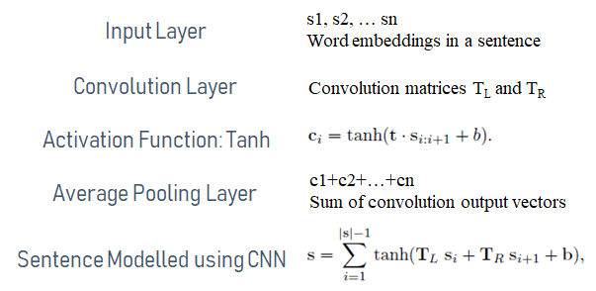
1-D CNN BREAK-DOWN
Input Layer
(N x 1 x D)
TanH + Convolutional
(N x 1 x D)
Average Pooling Layer
(1 x D)
Who
W1
T_{L}
T_{R}
C1
Sentence
wrote
W2
T_{L}
SUM
S
C2
T_{R}
Harry
W3
T_{L}
C3
T_{R}
Potter
W3
Architecture of One-dimensional convolutional neural network

Slide 21
Unigram vs Bigram Sentence Modelling
Sentence 1: Jim loves Joe
Unigram: (Jim), (loves), (Joe)
Bigram: (Jim,loves) (loves,Joe)
Sentence 2: Joe loves Jim
Unigram: (Joe), (loves), (Jim)
Bigram: (Joe,loves),(loves,Jim)
Advantages of Bigram over Unigram
Unigram Sentence 1: [1,1,1]
Unigram Sentence 2: [1,1,1]
Bigram Sentence 1: [1,1,0,0]
Bigram Sentence 2: [0,0,1,1]
N-gram: An N-gram is an N-token sequence of words: a 2-gram (more commonly called a bigram) is a two-word sequence of words like “please turn”, “turn your”, or “your homework”, and a 3-gram (more commonly called a trigram) is a three-word sequence of words like “please turn your”, or “turn your homework”.
Similar
Not Similar
Unigram Vocabulary: (Joe),(Jim),(loves)
Bigram Vocabulary: (Jim,loves), (loves,Joe), (Joe,loves), (loves,Jim)

Slide 22
The Big Picture
Question Sentence Embedding
q-Word
Embeddings
BOW/CNN
q
Output Probability of Q/A similarity
a-word
embeddings
a
BOW/CNN
Answer Sentence Embedding

Slide 23
Experimental Methods
Question and Answer Sentence Embeddings - Unigram + BOW, Bigram + CNN
Word Embeddings - Collobert and Weston neural language model
Initial Weights - Gaussian (μ = 0, Std. = 0.01)
Hyper-parameter optimization - Grid Search on MAP score on Dev data
Adaptive Gradient optimization
Notes:
1. TREC Dataset – Train-All, Train, Dev, Test, trec_eval
2. Used Word Embeddings 3. AdaGrad 4. L-BFGS 5. Cross Entropy

Slide 24
Unigram+Count & Bigram+Count
Logistic Regression with Co-occurrence count
(L-BFGS with L2 Regularizer of 0.01)
Q: Who is the author of the book Harry Potter?
A1: Harry Potter is a series of fantasy novels written by British author J. K. Rowling
A2: The novels chronicle the lives of a young wizard, Harry Potter, and his friends Hermione Granger and Ron Weasley
Predictors and Output
Probability Q/A | Co-occurrence count In Q/A pair | Co-occurrence count In Q/A pair weighted by IDF co-occurrence count | Output Probability Q/A

Slide 25
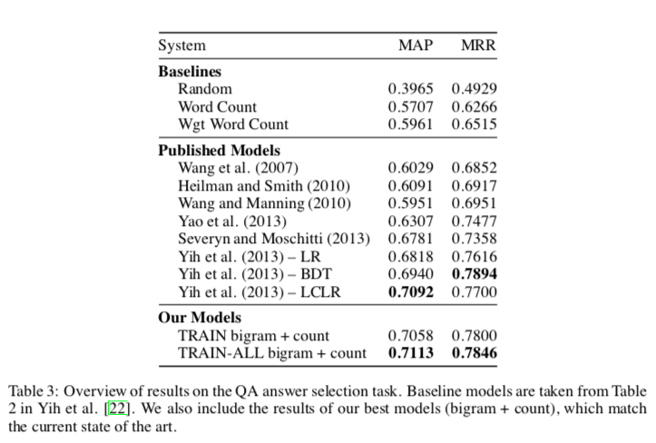
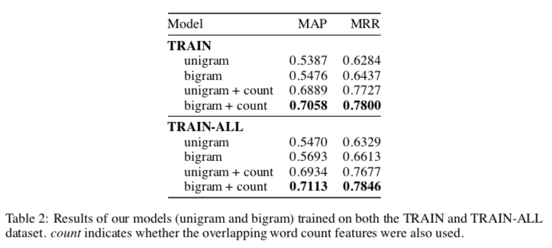
Results
Bigram out performed unigram
Including IDF-weighted word count improved results
Using the noisy, larger dataset also improved results
Notes:
1. Evalutation Metrics - Mean Average Precision, Mean Reciprocal Rank
2. Base lines vs. Published models vs. Proposed Model

Slide 26
Discussion
Simpler model than the best performing Published Models
Can be directly applied across languages, unlike some of the Published Models
Here are a couple of examples where the author’s model correctly identified the best answer, but other models failed (co-occurrence word count):
Notes:
1. Results with Questions and Answers (Unigram < Unigram + count < Bigram < Bigram+Count)
2. Shortcomings of the proposed model
3. Conclusion

Slide 27
Discussion - Cont.
Problems with the model
Here, the judgement requires a good understanding of the sentence and some background knowledge about the relation between lead singer and group.

Slide 28
Questions?
Thank you!

