Slide 1
CS548 Fall 2018 Web Mining Showcase
by Mallak Alkhathlan, Jason Dsouza, Paritosh Goel,
Preeti Havannavar, Sayed Inamdar
Showcasing work by CHENYI LIAO, WANG WEIMIN, KEN SAKURADA,
AND NOBUO KAWAGUCHI on
Image-Matching Based Identification of
Store Signage Using Web-Crawled
Information
Notes:
This PowerPoint Template includes a series of slide masters with predefined layouts and color schemes for formatting slides
Slide Masters are displayed when you right click on a slide and select Layout from menu

Slide 2
References
A. R. Zamir, A. Dehghan, and M. Shah, ``Visual business recognition:A multimodal approach,'' in Proc. ACM Int. Conf. Multimedia, 2013,pp. 65668.
K. Simonyan and A. Zisserman. (Sep. 2014). ``Very deep convolutional networks for large scale image recognition.'' [Online]. Available:https://arxiv.org/abs/1409.1556
J. Deng, W. Dong, R. Socher, L.-J. Li, K. Li, and L. Fei-Fei, ``ImageNet:A large-scale hierarchical image database,'' in Proc. IEEE Conf. Comput.Vis. Pattern Recognit. (CVPR), Jun. 2009, pp. 248255
J. Redmon and A. Farhadi, ``YOLO9000: Better, faster, stronger,‘’ in Proc. IEEE Conf. Comput. Vis. Pattern Recognit. (CVPR), Jul. 2016, pp. 65176525
NavVis. Accessed: Mar. 6, 2018. [Online]. Available: http://www.navvis.com/
L. Yi, B. Liu, and X. Li, ``Eliminating noisy information in Web pages for data mining,'' in Proc. ACM SIGKDD Int. Conf. Knowl. Discovery Data Mining, 2003, pp. 296305.
Icrawler. Accessed: Mar. 6, 2018. [Online]. Available: https://github.com/hellock/icrawler
Google Places. Accessed: Mar. 6, 2018. [Online]. Available:https://developers.google.com/places

Slide 3
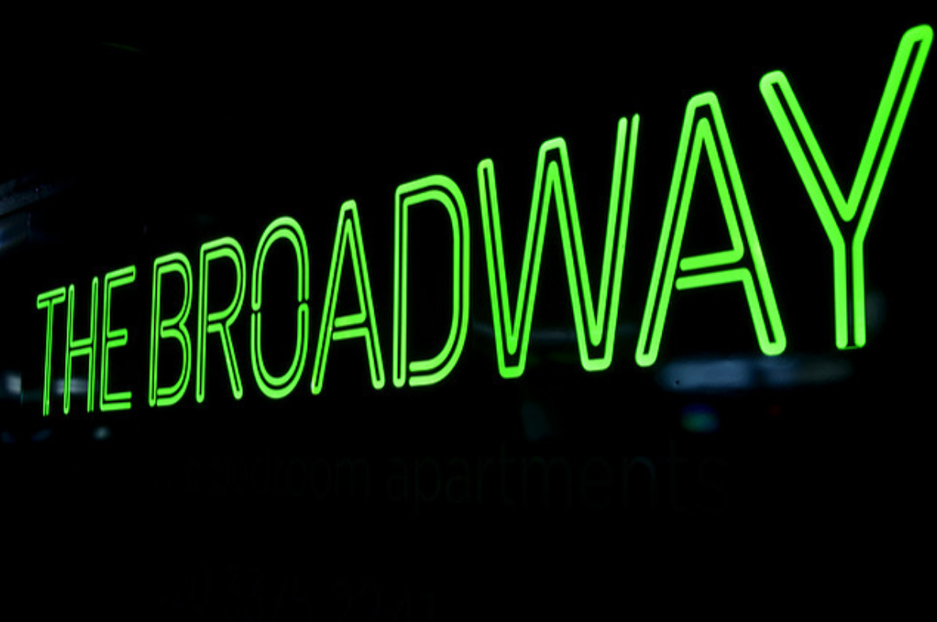
What is Signage ??
Signage is generally defined as any kind of graphic display intended to convey information to an audience.
http://octink.com/what-is-signage-and-what-is-its-purpose/

Slide 4
Objective
:
Authors propose a signage identifier in Web-crawled information – SIWI. which includes a web image data set construction method, which can self-generate high-quality data sets through automated web-mining.
Goal: - Automatic data set generation using Web Crawling.
- Finding a efficient technique for signage identification

Slide 5
Introduction
The challenge is to match street images with relevant web resources.
Identification of store signage in street images is a prerequisite for this challenge.
It is necessary to identify and link store signage found within street images to external web resources in a cost-efficient as possible.
A technician can manually identify and label every store as a Point of Interest (POI) in the street images ,but this will add significant cost and maintenance issue.
To resolve this issue. Matching of web resources can be classified into the following two categories: textual-matching based methods and image-matching based methods.

Slide 6
Limitations facing existing methods
Textual-matching based methods depend on an Optical Character Recognition (OCR) process, which focuses on recognizing text characters from signage and can then compare against a candidate store lexicon.
The image-matching based method is dependent on specialized target datasets, which contains a group of pre-collected images.
Deep learning methods achieve human level accuracy recently but require millions of high quality training data.
Web-mining can be used to automatically assemble the target dataset from web resources but noise and a lack of sufficiently balanced data affect the accuracy of signage identification.

Slide 7
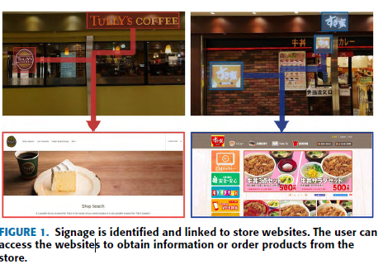
Signage Identifier in Web crawled Information
Requires only a list of store names and their corresponding web addresses as input.
The list is manually obtained from the official websites of their experimental shopping mall.
The street images from the same shopping mall are inputted without labeled signage, which is to be identified.

Slide 8
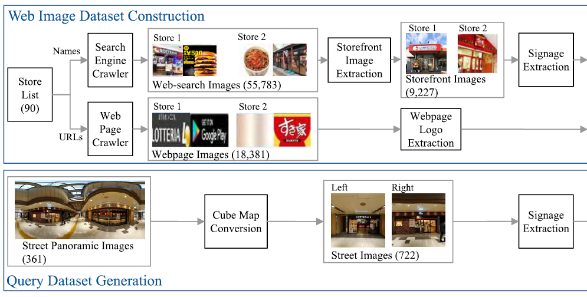
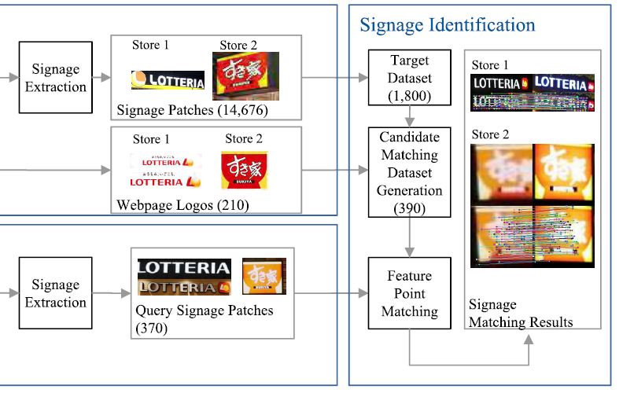
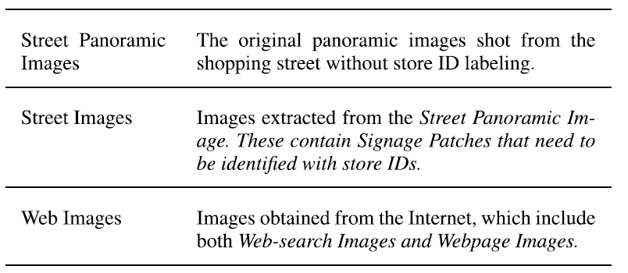
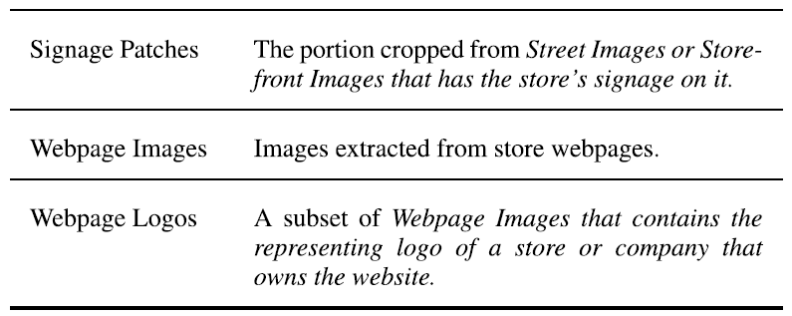
Process Overview

Slide 9
Web Mining: Hierarchy
Text
Web Content Mining
Multi media
Web
Web Structure Mining
Hyperlinks
Web Usage Mining
Web Log Records

Slide 10
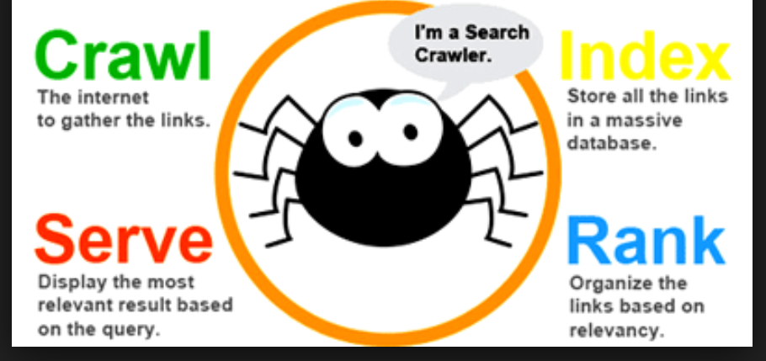
Crawlers
Fetcher: Retrieves content from a Web page
Link Extractor: Parses the HTML and retrieves the links
Store Processor: Stores all the extracted information
Page Filter: Send all interesting links to URL-Seen module
URL-Seen: Detects if the URL is seen, if not sends it to the frontier
http://www.seosolutionsindia.com/blog/2015/04/20/top-search-engines-name-of-their-robots-crawlers-spiders/search-engines-robots-crawl/

Slide 11
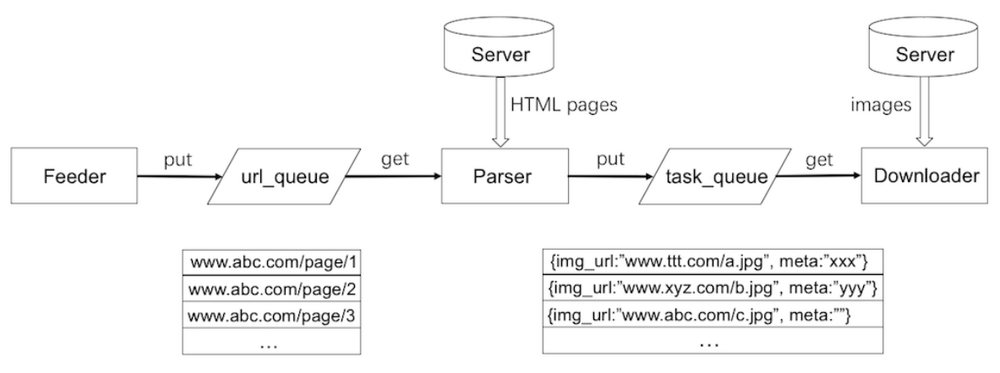
Crawlers for Web Mining

Slide 12
Web Image Dataset Construction
Web-Search Image Crawler
Web-Search Image Collection
Storefront Image Extraction
Signage Extraction

Slide 13
Web Search Image Collection
Web-Search Image Crawler
Search-engine crawler downloads images from Google’s image search engine
Keywords used: “store name” and “store name + shop”
Search result limit : 300 images larger than 200 x 200 pixels for each keyword
Number of images = 55,783 from 90 stores of mall A
Storefront Images Extraction
Storefront images extracted; irrelevant images filtered out using fine tuned VGG16 deep network(binary classifier)
Classifier output : Storefront image or Irrelevant image
Training dataset : images from 55 stores in shopping mall B
Manually label 20 storefront and 20 irrelevant images for each store.
Validation dataset : 200 storefront and 200 irrelevant images from 10 different stores from mall A
Notes:
Experiment conducted on 90 stores in a shopping mall in Japan.
Size of 200 x 200px ensures resolution after cropping out signage patches
“store name” fetches 604/1800 (33.56%) storefront images
“store name + shop” fetches 772/1800 (42.89%) storefront images
Shopping mall B(to ensure generality) unrelated to shopping mall A
Stores in B do not overlap with stores in A
Images obtained using web-crawl search as for mall A

Slide 14
Web Search Image Collection
VGG16 pretrained on ImageNet dataset
Alter last 2 dense layers and last softmax layer
Training: Batch size = 16 ; 138 iterations each epoch
Performance evaluation metrics used : Precision, Recall, F1-measure
Effectively filters out irrelevant images
Notes:
Alterations : 256 neuron dense layer ; 50% dropout layer , 2 neuron softmax layer
network converges on the 18th epoch . precision of 98.48%,recall of 97.00%, and F1-score of 97.73%.

Slide 15
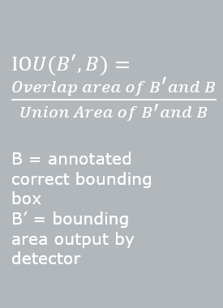
Web Search Image Collection
iii. Signage Extraction
Signage patch extraction used to crop signage patches from storefront image
YOLOv2 used for signage detection from storefront images
Input: 11,000 storefront images from mall B
Evaluation: precision, recall, F1-measure, IOU
Notes:
Manually annotated 1063 bounding boxes
Initial YOLO pretrained with PascalVOC dataset

Slide 16
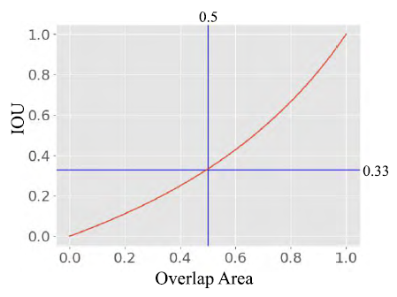
Web Search Image Collection
Validation set: Manually annotated 200 storefront images of 10 stores from mall A
Prediction considered correct if IOU exceeds arbitrary threshold θ
θ=0.33 when overlapping area = 50%
Output ϵ [0,1], results with confidence value < θ discarded
Notes:
- Iterate experiment multiple times for each threshold value b/w 0 to 1 in increments of 0.01

Slide 17
Results of Web-Search Image Collection
Storefront image extraction process effectively prunes 46,556(83.46%) irrelevant images from 55,783 web-search images
Signage extraction process extracted 14,676 signage patches from the remaining 9,227 storefront images
Notes:
StoreID sorted in descending order of number of signage patches.
Number ranges from 3 to 657
Significant imbalance: famous stores much more well represented on Internet than local stores
Difference in search results of stores with food/services-returns storefront images compared to stores which are also a brand name for clothes/shoes- returns products
Leads to search for webpage logo extraction

Slide 18
Web Page Logo Extraction
The Webpage Image Crawlers scans all nodes of the HTML and downloads web-page images and relevant data including image-url and hyperlink from the web pages.
For each store website, the homepage along with 10 sub-webpages were crawled.
Use webpage Image Crawler to extract all images from the webpage.
Identifying and extracting webpage logo, from all the extracted webpage images.
Notes:
Web-page logos are a small subset of webpage images. A website may have one or two logos but a thousand of other images. TWO STEP PROCESS:
The paper crawls the homepage and at max 10 sub-webpages for each website. The 10 sub-webpages are linked by hyperlinks from the homepage, excluding off-site links

Slide 19
Web Page Logo Extraction
All <img> element in the HTML document were extracted. Also some webpage images maybe hidden in the element’s background image attribute defined in the Cascading Style Sheets(CSS), these images were searched for and extracted.
Through this process a total of 18,381 webpage images were extracted from 74 stores in the Shopping Mall A.
Use webpage Image Crawler to extract all images from the webpage.
Notes:
The crawler scans all nodes in the HTML document and extracts the background image if the node has one. In other cases, a webpage image might be a PNG image with a transparent background. It relies on the background color of its parent nodes to form part of the color scheme of the logo. Therefore, when the crawler finds an image type capable of having transparency, such as a PNG, the crawler then scans all its parent nodes in the proper sequence to locate the one which has the same background color attribute in CSS, and converts the PNG image into JPG with the matching background color.

Slide 20
Web Page Logo Extraction
The following features were used to extract web-page logos from the collected webpage images:
Feature 1: If a webpage image links to its homepage, then it is probably containing a logo image.
Feature 2: If an image frequently appears in most of the website's webpages, then it probably is a logo.
Identifying and extracting webpage logo, from all the extracted webpage images.

Slide 21
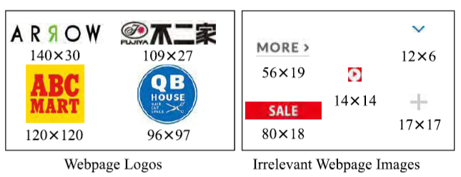
Web Page Logo Extraction
Webpage images extracted with higher frequency also contained some noise such as tiny buttons and placeholders.
Through Feature 1 alone 165 images were extracted from 18,381 including logos for 70 stores.
For the remaining 4 stores, 45 webpage images including all logos of the four websites were extracted using Feature 2.
Identifying and extracting Webpage Logo.
Notes:
Webpage Images with higher frequency were extracted. The frequency were chosen by carrying out this process on the other Shopping mall B and finding out the appropriate frequency ratio for the logo image.

Slide 22
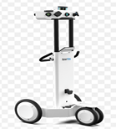
Query Dataset Generation
The scene panoramic image are collected by NavVis and are converted to a cube image including the six cardinal directions left, right, top, bottom, front and back.
The left and right images are extracted as store front images since the picture is taken from the passage and the stores are located on the left and the right side.
Notes:
The scene panoramic images are collected by NavVis and are converted to a cube image including the six cardinal directions left, right, top, bottom, front and back. The shooting direction of NavVis is parallel to the passage, so we use only the left and right images as the query street images, because only those images face the storefronts.
The query signage is the storefront signage extracted from panoramic images. Using the same signage extraction discussed earlier using the Yolov2, 370 signage patches are extracted from the storefront as query signage patches. The goal is to identity and label the correct store ID for each query signage patch.

Slide 23
Signage Identification
Two popular techniques used for signage identifications :
Feature Vector technique
Feature point matching technique

Slide 24
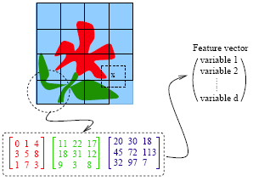
Feature Vector Technique
Convert images into fixed length feature vectors.
To find similar images, we find the vector cosine similarity.
The feature vector technique cannot handle noise and imbalanced samples introduced by self-generated dataset using web-mining.

Slide 25
Feature Point Matching
Feature points are matched.
Works well even on Noisy data sets.
Is more time consuming
Takes unreasonable computing time to match query image with dataset

Slide 26
Faster Solution
Generate a candidate matching dataset with Feature Vector technique and then apply Feature Point matching technique on small dataset - Hybrid Image Matching Method
Query Image
Image Dataset
Resulted Matched Images
Candidate Matching Dataset
~smaller
Feature Point
Feature Vector matching
2048 dimension vector
Matched images with storeid ~4
4 images from each store id (2 from web signage and 2 from web logos) ~390 images
1800 signage Images (90 stores)

Slide 27
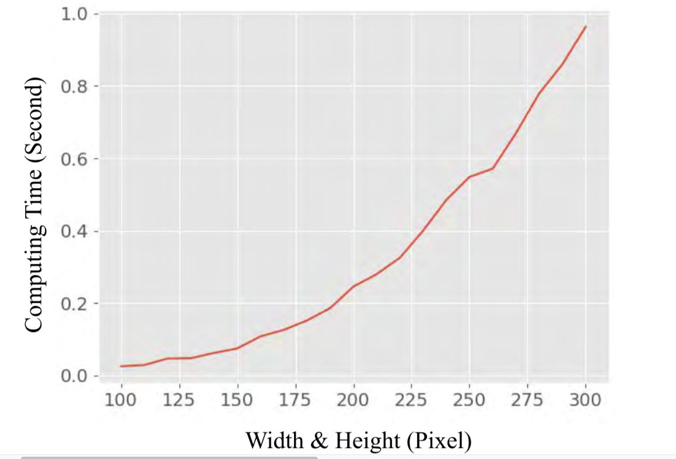
Feature Point - Signage Matching
Deep Matching - Computes correlation between non-overlapping 4 * 4 atomic patch in entire image.
Computation time increases quadratically with respect to WIDTH AND HEIGHT
300 * 300 pixel image takes around 1 sec, whereas 200 * 200 image takes 0.2 seconds. Therefore images are resized to 200 max width/height.

Slide 28
Matching opposite theme images
Inverse signs were not detected
Matching is done on inverse of the image also.
Darker image should be matched with brighter one

Slide 29
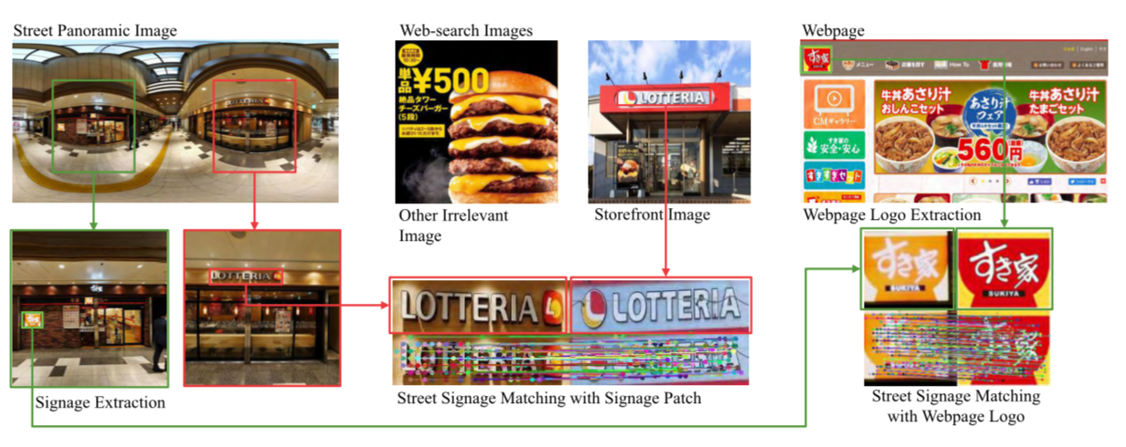
Evaluation Experiment
370 Signage from 90 stores patches extracted from panoramic images queried with data set and manually verified the results.

Slide 30
Accuracy
Query Signage Target Signage | 74 Stores with Websites (321 Signage Patches) | 16 Stores without Website (49 signage patches) | All 90 Stores (370 Signage Patches)
Web-Page Logos from store’s website | 182 Signage patches (57%) | ---- | ---
Signage Patches from Web-Search Images | 266 Signage Patches (83%) | 39 Signage Patches (80%) | 305 Signage Patches (82%)
All | 298 Signage Patches (93%) | 39 Signage-Patches (80%) | 337 Signage Patches (91%)

Slide 31
Other Approaches for Signage Matching
Experimented with OCR-based Signage matching
Training-Based image matching methods
Tried different methods of feature point matching (Deep Matching, ORB, SIFT, Deep Matching)

Slide 32
Comparison with other approaches
# | Identification Method | Query Signage Dataset | Training Signage Data | Tool used | Accuracy
1 | Textual Matching | 302 English signage patches | -- | Tesseract OCR Engine[35] | 29%
2 | Image Classification | All 370 signage patches | Original Noisy Web Image Dataset | BoVW | 39%
3 |  |  |  | VG16 Fine-Tuning | 55%
4 |  |  | Manual clean Web Image Dataset | BoVW | 47%
5 |  |  |  | VG16 Fine-Tuning | 64%
 |  |  | Target Dataset Generation Steps | Utilized Matching Method
6 | SIWI | All 370 Signage Patches | Storefront image Signage Extraction Webpage logo extraction | ORB | 48%
7 |  |  |  | SIFT | 64%
8 |  |  |  | Deep matching | 91%

Slide 33
Conclusion - Overall System
Input
List of Stores with their website URLs
Dataset creation
Using website logos, online images
Signage Dataset with store information
Matched Store ID
Signage Extraction
Extract
Query Image
Signage Query
Signage Extraction

Slide 34
Conclusions
Advantages | Disadvantages
SIWI method better than existing textual-matching based methods because is not limited to just text or character-based signage. | SIWI lies in its dependency on web search results and webpage images for data. If a target store does not have a signage that features images available on the Internet, then it cannot be identified by this method.
SIWI is able to process any arbitrary signage design.
SIWI replaces manual data collection with a self-generate entire matching databases from very simple inputs.
SIWI reduces the number of images selected for matching.
SIWI ensure that the process can be performed within reasonable computing times.
SIWI feature point image matching is also not dependent on specialized training, that should work for other locations with no fine tuning required.

Slide 35
Questions

