Slide 1
CS 548 Fall 2019 Artificial Neural Networks and Deep Learning Showcase By Noel Qiao, Bhoomi Patel, Beichen Xing and Srinarayan Srikanthan
Showcasing work by Yuncheng Li,Liangliang Cao, Jiang Zhu, Jiebo Luo on
Mining Fashion Outfit Composition Using an End-to-End Deep Learning Approach on Set Data

Slide 2
Reference
[1] Y. Li, L. Cao, J. Zhu and J. Luo, "Mining Fashion Outfit Composition Using an End-to-End Deep Learning Approach on Set Data," IEEE Transactions on Multimedia, vol. 19, no. 8, pp. 1946-1955, Aug. 2017. [Online]. Available: IEEE, http://ieeexplore.ieee.org/stamp/stamp.jsp?tp=&arnumber=7890387&isnumber=7982821 [Accessed Sep. 10, 2019].
[2] C. Graham, “Online Fashion Retail: 11 Essential Statistics,” salecycle.com, Jul. 29, 2019. [Online]. Available: https://blog.salecycle.com/featured/online-fashion-retail-11-essential-statistics/. [Accessed Sep. 23, 2019].
[3] W. Anna, “Monday link salad!.” wordpress.com, May 6, 2014. [Online]. Available: https://thewritesofpassage.wordpress.com/tag/anna-wintour/. [Accessed Sep. 23, 2019].
[4] S. Cicero, G. Maria, “Meep Convolutional Neural Networks for Sentiment Analysis of Short Texts,” Proceedings of COLING 2014, the 25th International Conference of Computational Linguistics: Technical Papers, pp. 69-78, Aug. 2014. [Online]. Available: https://www.aclweb.org/anthology/C14-1008/ [Accessed Oct. 6, 2019].
[5] Z. Jiaping, I. Laurent, “Improved Deep Learning of Object Category using Post Information,” arxiv.org, Jan. 22, 2017. [Online]. Available: https://arxiv.org/pdf/1607.05836.pdf. [Accessed Oct. 7, 2019]

Slide 3
Billion Dollar Industry
According to a study by Trendex North America, the sales of women's apparel in United States is $111 Billion in 2011.
When almost every sector was going through automation, women's apparel industry had great potential.
Figure 1: Global Online Fashion Sales
Source: Taken from [2]

Slide 4
Introduction
This paper proposes a data-driven approach to train a model that can automatically compose suitable fashion outfit.
The core of the proposed automatic composition system is to score fashion outfit candidates based on the appearances and metadata.
On an average there are 20 million unique monthly visitors to Polyvore.com
Incorporates a user voting system for outfits
By aggregating this wisdom, they obtain popularity score for the fashion outfits, which are used to train a classifier to score new fashion outfit candidates.
Figure 1: Outfit example
Source: Taken from [1]

Slide 5
Key Aspects of this work:
Automatic Fashion outfit composition,
Reliable fashion outfit quality predictor.
An end-to-end trainable system to fuse signals from multi-level hybrid modalities, including the images and metadata of the fashion items, and the information across the fashion items.
A large-scale dataset for the fashion outfit related research. This dataset contains fashion items and outfits, associated rich context information.

Slide 6
Challenges
Complicated visual contents of a fashion image
categories, colours, coherence, patterns, general pairing codes, creative pairing choices
Rich contexts of fashion outfit.
Styles for different ages and individuals.
Clothing outfits can reflect personality and interests.
Clothing may reflect the style and tradition of different brands and designers, or even the culture of a specific group.
Fashion does not mean the same to everyone
Figure 3: Game of Thrones Meme
Source: Taken from [3]

Slide 7
Fashion Outfit Composition

Slide 8
Fashion Outfit Scoring Model
Components of the Scoring Model:
Connected and trainable from end to end
(S_{i}, y_{i}) is the list of pairs of training outfit, where if y_{i} = 1 means S_{i} is well composed and y_{i} = 0 means not

Slide 9
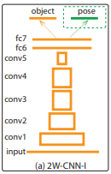
Visual Feature Encoding and Context Feature Encoding
Visual Feature Encoding
Encoding item image with Convolutional Neural Networks and using variant of AlexNet
Output of fc6 layer is the encoding feature of the input image
Dimension of image encoding is 4096
2. Context Feature Encoding
GloVe model is used to encode the context feature title
This model maps words to 300d vectors, where we further employ average pooling to aggregate the vectors
Categorical embedding is used to encode the context feature category
Dimension of category embedding is 256
where CC is the total no. of categories
Figure 4: AlexNet with fc6 output
Source: Taken from [5]

Slide 10
Multimodality Fusion Model and Multi-instance Pooling Model
3. Multimodality Fusion Model:
Designing the Fusion Model (F):
4. Multi-instance Pooling Model:
The pooling model P maps the fashion outfit into a single vector
Recurrent Neural Network (RNN) used as a pooling model to encode the variable length fashion items

Slide 11
Outfit Classification Model
5. Outfit Classification Model:
Following classification model is used to evaluate the quality of the outfits:
Here, w^{T} and b are the weights and bias of the linear model
and is the sigmoid function

Slide 12
Polyvore.com Dataset
Figure 4: Outfit Examples
Source: Taken from [1]
Title = “Kirkwood Scarpa Glitter Mary Jane Shoes”
Category = “Shoes”
🚫 Categories < 500 items
🚫 Items in more than 5 outfits
1st-40th Percentile = Unpopular
90th-99th Percentile = Popular
4 Items Per Outfit (Random Sampling)
⇒
⇒
195K outfits and 368K items
Notes:
Most popular fashion oriented website in the US. User created fashion outfits.
For splitting data into training, development, and testing splits, they ensured there was no overlap (obviously).

Slide 13
Evaluation Protocols
Split Purposes
Training Split (~80%) ⇒ model parameters for the score ƒ(S_{i})
Development Split (~10%) ⇒ hyper-parameter selection
Testing Split (~10%) ⇒ Model Evaluation
Classification Metrics
Area Under the Curve (AUC) of the ROC
Average Precision (AP)

Slide 14
Adaptation of Existing Models for Outfit Scoring
LEML Method (Image Classification)
Measures the distance between two sets of images S_{i} and S_{j} where the distance is small for images of the same class
ConvNets with Siamese Architecture
Chooses a pivot item from a set S_{i}. The rest of the items are query items, Q_{i}. If the pivot item and Q_{i} are good matches, then S_{i} is high quality.

Slide 15
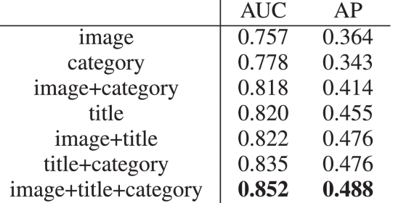
Comparing Against Different Modalities
All of them combined produce the best result.
Title on its own also has good due to the detail
Images did not perform as well likely due to a small dataset

Slide 16
Late Fusion Model
Late Fusion
Comparison of a item-based training set vs an outfit-based training set
Outfit-based training set performed better

Slide 17
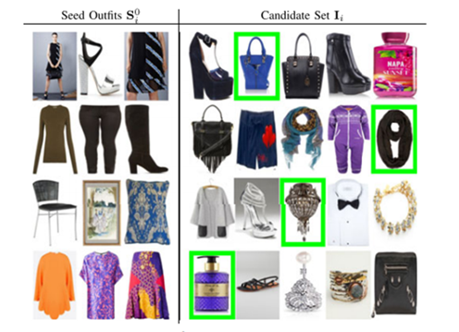
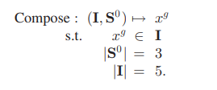
Outfit Composition Algorithm
full
image
title
categories
Using the scorer model, the items that go best with the seed items are listed first
The highlighted candidate item is the target(pivot) which is used in the algorithm, we’ll see it in the next slide.
Figure 5: Outfit Composition Example Set
Source: Taken from [1]

Slide 18
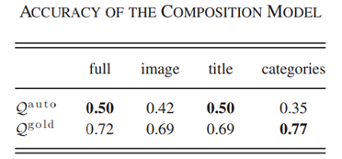
DEAL WITH THE CANDIDATE SET
Auto: Randomly sample one item as the target item and sample four items from the datasets as the confusion items.
Gold: Auto Methods carry out only one actual item as positive which is not good. They instead let experts give gold standards for about 150 items.

Slide 19
Implementation Methods
For the optimization:
Adam optimizer with a batch size of 50, learning rate of 0.01, and 40K iterations.
(Half the learning rate for every 15K iterations)
For item title encoder:
GloVe: Use model pre-trained on webpage corpus with 42 billion tokens and 1.9 million unique words.

Slide 20
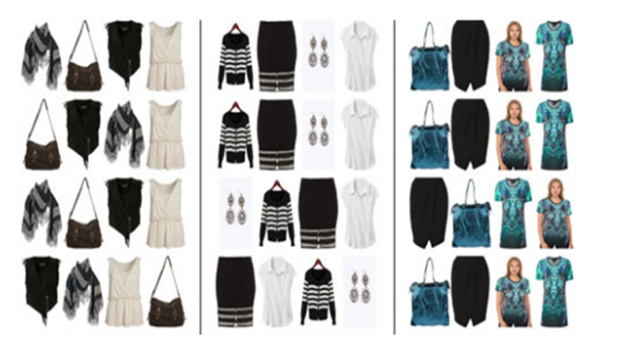
Model Analysis
full
image
title
categories
Figure 6: Fashion Item Importance
Source: Taken from [1]
computes the quality score decrements after replacing the item with an arbitrary item in the database.

Slide 21
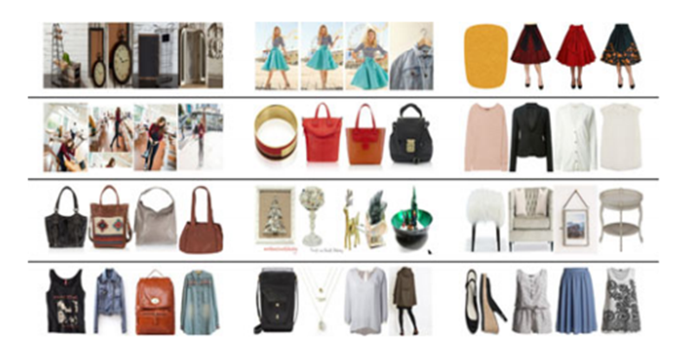
Error Case Analysis
If the fashion outfits are good, they are likely to be viewed, favored and recreated by visitors on the website. The paper investigates the top 1000 fashion outfits that actually do not achieve high user engagement. The following are some of the error examples:
full
image
title
categories
Figure 7: Fashion Item Error Evaluation
Source: Taken from [1]
The error rates are 0.353, 0.415, 0.371, 0.605, respectively

Slide 22
Conclusion
They propose a generic composition algorithm based on outfit quality scorer.
The outfit quality scorer is an end-to-end trainable system, which achieves promising performance.
They found that the combination of multi-modalities and proper pooling of the instance level features, leads to the best performance.
In the future, they plan to collect more data and find better ways to evaluate the composition algorithm.

Slide 23
Thanks!
:)

