Slide 1
CS548 Fall 2019
Anomaly Detection
Showcase by:
Florina Asani, Wenhan Ji, Ethan Prihar, and Manyang Sun
Showcasing work by:
Christoph Baur, Benedikt Wiestler, Shadi Albarqouni, and Nassir Navab
On:
Deep Autoencoding Models for Unsupervised Anomaly Segmentation in Brain MR Images

Slide 2
References
Baur, C., Wiestler, B., Albarqouni, S. and Navab, N., 2018, September. Deep autoencoding models for unsupervised anomaly segmentation in brain mr images. In International MICCAI Brainlesion Workshop (pp. 161-169). Springer, Cham.
http://kvfrans.com/variational-autoencoders-explained/
https://kidshealth.org/en/parents/mri-brain.html
https://towardsdatascience.com/understanding-generative-adversarial-networks-gans-cd6e4651a29
Larsen, A.B.L., Sønderby, S.K., Larochelle, H. and Winther, O., 2015. Autoencoding beyond pixels using a learned similarity metric. arXiv preprint arXiv:1512.09300.

Slide 3
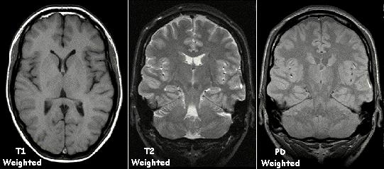
Background
Magnetic resonance imaging (MRI) of the head is a painless, noninvasive test that produces detailed images of the brain and brainstem. [3]
https://upload.wikimedia.org/wikipedia/commons/0/03/T1t2PD.jpg
Notes:
Magnetic resonance imaging (MRI) of the brain is a safe and painless test that uses a magnetic field and radio waves to produce detailed images of the brain and the brainstem
An MRI scan is different from a CT Scan or an X-ray in that it doesn’t use radiation to produce images.
A brain MRI is a useful tool for detecting a number of brain conditions, including: tumors, infections, swelling, inflammation, etc. It can also help determine whether the patient has sustained any damage from a stroke or head injury.

Slide 4
Background
How to identify and segment the pathologies in brain MR data?
By hand is not ideal
Supervised deep learning methods suffer from limited generalization and lack of labeled data
Alternative approach:
Unsupervised deep learning method
Notes:
The manual identification and segmentation of pathologies in brain MR data is a tedious and time-consuming task.
Many recent supervised deep learning methods were proposed in an attempt to aid the detection and delineation of brain lesions. However, their training requires vast amounts of labeled data which often is not available. Further, the generalization of these approaches is limited. Since in general, training data rarely comprises the gamut of all possible pathological appearances
This paper provides an advanced unsupervised deep learning method which conquered the issues mentioned above

Slide 5
Problem Description
Brain lesion detection and delineation as an unsupervised anomaly detection (UAD) task based on state-of-the-art deep representation learning, requiring only a set of normal data and no segmentation- labels at all.

Slide 6
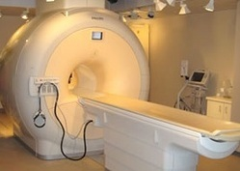
Data Acquisition
FLAIR images acquired with a Philips Achieva 3T scanner.
a commonly used magnetic resonance sequence
remove signal of the cerebrospinal fluid from the resulting images
83 subjects with healthy brains (training)
49 subjects with multiple sclerosis lesions (testing)
Signs of Stroke
https://www.indiamart.com/proddetail/philips-achieva-3t-mri-8672227248.html
https://upload.wikimedia.org/wikipedia/commons/0/03/T1t2PD.jpg
Notes:
FLAIR: a commonly used magnetic resonance sequence
Fluid Attenuation Inversion Recovery
multiple sclerosis: Signs of stroke

Slide 7
Data PreProcessing
co-registered to the SRI24 ATLAS to reduce appearance variability
skull-stripped with ROBEX to extract whole brain
denoised using Curvature Flow
normalized into the range [0,1]
focused on 20 consecutive axial slices (256 × 256px) around the midline in order to narrow the view
Notes:
SRI24 ATLAS: a new standard reference system of normal human brain anatomy
Curvature Flow: noise-removal method for images

Slide 8
Methodology: Overview
Learn to reconstruct healthy brains from a compressed representation
Attempt to reconstruct new brains
If reconstruction is bad, new brain is likely unhealthy
As Seen In [1]
Notes:
Lets take a look at how they used MRI images to detect brain lesions. This diagram outlines the general idea behind the authors’ methodology. In order to automatically detect the outlier brain MRIs, which in this case are MRIs of brains that contain lesions or tumors, a version of an autoencoder, called a variational autoencoder generative adversarial network, which I’m going to call a VAEGAN, is trained to encode and decode images of healthy brains. Then, to detect brain abnormalities, new MRI images of brains are encoded, then decoded. The decoded image is compared to the original images, and regions that don’t match are identified as abnormalities. We’ve already discussed the type of input we’re using, so let's take a look at how the VAEGAN works.

Slide 9
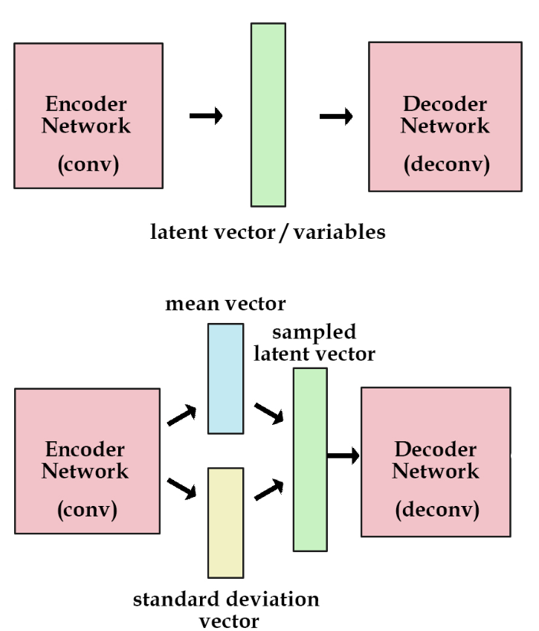
Methodology: Variational Autoencoders (VAE)
Regular autoencoders create a vector of features
Variational autoencoders create feature means and distributions, which are sampled to construct the vector of features.
Variational autoencoders create more informative features
As seen in [2]
Notes:
We’ve already seen in class how a feed forward auto-encoder works, and how a convolutional neural net works. The top image is a convolutional autoencoder, which is like a regular autoencoder except it uses convolutional layers to extract features from images. If this is a good convolutional autoencoder, then the latent variables will be enough to recreate the original image passed to it as input. The authors’ use a variation of an autoencoder, called a variational autoencoder, which in this case is also convolutional. The difference between a regular autoencoder and a variational autoencoder is that the variational autoencoder, instead of extracting a compressed vector of features, extracts means and standard deviations of feature distributions. When reconstructing the image from the distributions, the distributions are sampled to generate the feature vector. This is a pretty neat difference because it turns features into statistics. The value of this is that because the neural net can’t know for certain what the value of certain features will be, it learns to create especially informational features, because the features passed to the decoder will essentially have gaussian noise added to them, so the network will need to learn how to perform well even with noise added to the features. This more rigorous training leads to more accurate decoding from more informative features.

Slide 10
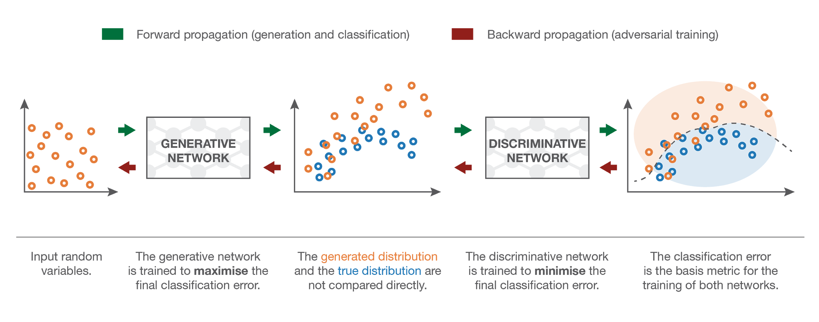
Methodology: Generative Adversarial Networks (GAN)
As Seen in [4]
Notes:
Instead of training the variational autoencoder using a loss function based on the difference of the original image and the reconstructed image, the author’s use a training method typical in generative adversarial networks. Instead of a residual based loss function, another neural network, called a discriminative network, is used to classify whether or not the image is real or reconstructed. In a typical GAN, The discriminative network is trained in tandem with the generative network, which leads to more accurate reconstructions of images because of the competitive nature of the networks finding each other's flaws.

Slide 11
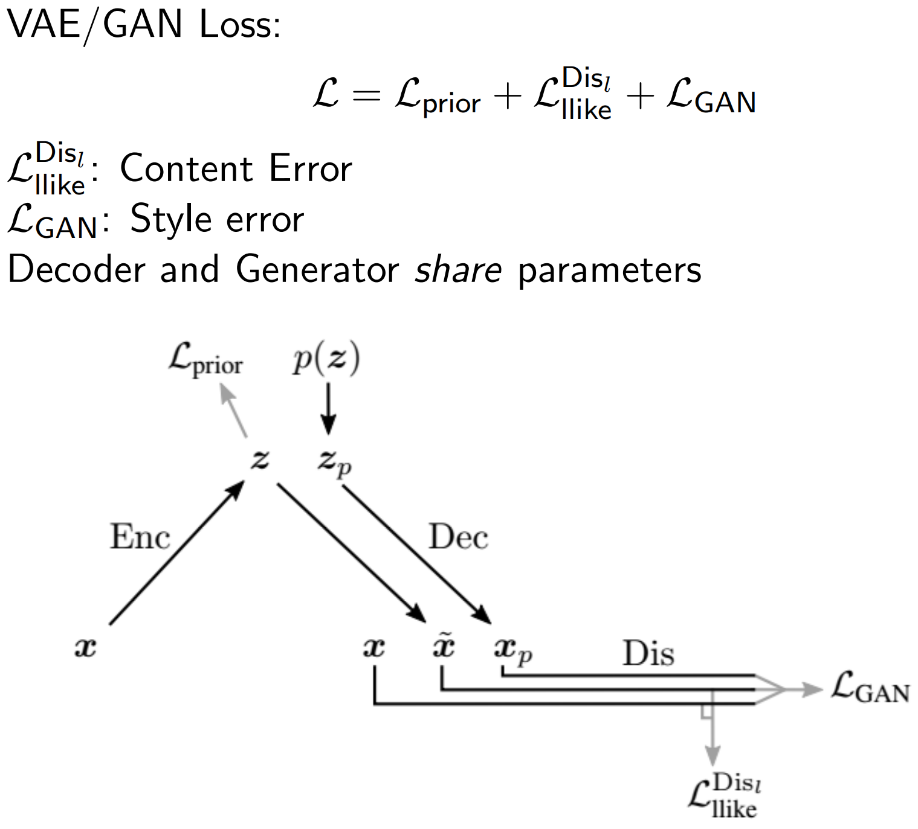
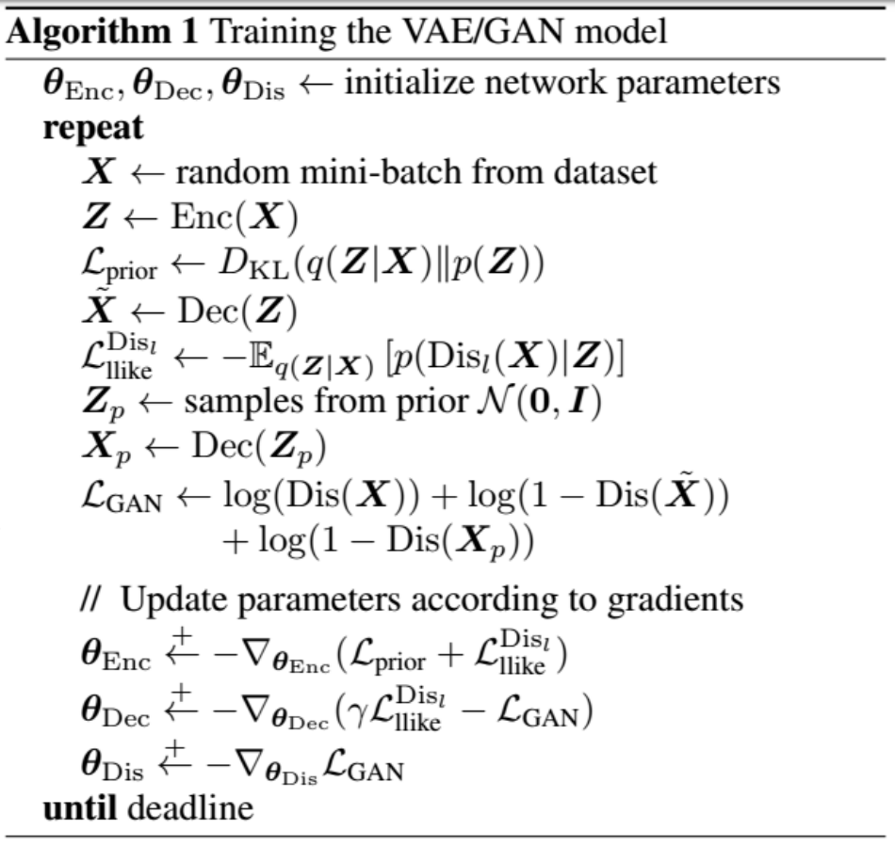
Methodology: VAE-GAN
As Seen In [5]
As Seen In [5]
Notes:
For detecting brain lesions, the authors combine variational autoencoders with generative adversarial networks. The VAE acts as the generative network, encoding features from a real image, then reconstructing the image from the features. The original and reconstructed image is given to a discriminative network, which tries to identify which images are real or reconstructed. These two networks are trained in tandem which leads to more accurate MRI reconstructions. A combination of the difference between the original and decoded image, and the predictions of the discriminative network are used to calculate the loss of the entire network, which can be backpropagation through the networks. An interesting thing to note about backpropigating through the Variational Autoencoder is that you can’t backpropigate through a random sampling function, so to get around that, the variational autoencoder, when sampling from the feature distributions, uses a node that generates a random number, and then returns the mean of a feature plus the features standard deviation times the random number, and the random number has a mean of zero and a variance of 1. So its simulating sampling from a distribution of the features mean and variance without actually doing that, so even though you can’t backpropigate through the random number, you can backpropigate through the mu and sigma of the feature.

Slide 12
Experiments
dAE-
Naive Residuals
sVAE-GAN Residuals
Brain MRI
1st column - a selected axial slice and its ground-truth segmentation (brain lesions)
2nd column - the filtered difference images (top row) and the resulting segmentation
augmented to the input image (bottom row) for the dAE model
3rd column - the filtered difference images (top row) and the resulting segmentation
augmented to the input image (bottom row) for the sVAE-GAN model
As Seen In [1]
True Positives False Positives
Notes:
To test the effectiveness of the VAEGAN and other methods of anomaly detection, unhealthy brains were given to the VAEGAN after it was trained on healthy brains.The first column of this image shows an unhealthy brain and the true locations of the tumors. The second column shows the resulting residuals from a naive autoencoder model. This basic autoencoder model uses convolutions initially, but encodes a standard vector of features which is decoded into a copy of the original image. As shown from the lower picture in the column, the orange regions are false positives, and the green regions are true positives. This naive approach has a lot of false positives because it does a poor job reconstructing brain images. On the other hand, the last column shows the results of using the VAEGAN to identify anomalous regions of the unhealthy brain. The VAEGAN model is much more effective and was able to detect the anomalous regions with very few false positive or false negatives.

Slide 13
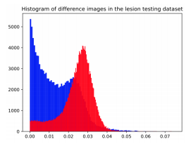
Experimentation Results
Frequency Distribution of Non-Lesion Residuals
Frequency Distribution of Brain Lesion Residuals
Abnormal brain regions have higher residuals on average, and are clearly distinguishable from normal regions
# of Pixels
As Seen In [1]
Residual Value
Notes:
It’s important to note that a median filter was applied to 5x5x5 pixel wide brain regions to filter out small residuals, and set a residual threshold to use as the detection threshold and is set to be the 98% percentile of residuals.
The threshold is model specific and determined as the 98th percentile of the models reconstruction errors on the training dataset. This percentile was chosen empirically from the histogram of residuals obtained from both normal and
abnormal data.
This plot shows the residuals from regular regions in blue, compared to the residuals from anomalous regions, in red. There’s clearly a partition in the data which allows for effective outlier detection.

Slide 14
Experimentation Results
Table 1. Results of our experiments on unsupervised MS lesion segmentation. We
report the Dice-Score (mean and std. deviation across patients) as well as the avg. reconstruction time per sample in seconds. Prefixes d or s stand for dense or spatial.
DICE- a measure of how similar the objects are. It is the size of the overlap of the two segmentations divided by the total size of the two objects
z- lower dimensionality representation of the input images
AUPRC - Area under Precision-Recall Curve
Avg. Reco. time - average reconstruction time per sample in seconds
Notes:
This table shows the results of the previously mentioned experiments and the associated Dice-scores as well as the average reconstruction time per sample in seconds. The highest AUPRC(Area under precision-recall curve) is obtained by VAE-GAN, followed closely by AE-GAN. The spatial AE and VAE have slightly inferior scores and because 98th percentile of the models reconstruction errors on the dataset was chosen as a threshold for every model, it makes sense that it is not in line with AUPRC, because that percentile is not guaranteed to be the best threshold for every option.

Slide 15
Conclusions
AE & VAE with dense bottlenecks cannot reconstruct anomalies and brain convolutions
Introducing adversarial training only had marginal improvements - not required in this setting
VAE-GAN approach opens up opportunities not only for unsupervised brain lesion segmentation but can also act as prior information for supervised deep learning
Notes:
In line with what we saw on the table, we can conclude that AE and VAE with dense bottlenecks lack capabilities to reconstruct anomalies as well as important brain convolutions. And this could be solved using spatial AE with sufficient bottleneck resolution. (such as 16x16px sized feature maps) After constraining the latent space to follow a multivariate normal distribution and introducing adversarial training, another conclusion drawn was that since no significant improvements were observed, this training was not necessarily required in this setting.
All in all, this paper shows that, in contrast to the previous patch-based approaches(where autoencoders and GAN were used to detect anomalies as outliers or from large reconstruction error) , spatial autoencoding models can be efficiently used to capture normal anatomical variability of an MR brain slices.
They present a comparison between deep autoencoding models for fast UAD as well as novel spatial VAE-GAN that encodes the full context of the brain MR Slices.This opens up opportunities not only for brain lesion segmentation, but in other areas as well.

