Slide 1
CS548 Fall 2019
Clustering Showcase
by Apiwat Ditthapron, Alyssa Herz, Amorn Chokchaisiripakdee, Aritra Kundu
Showcasing work by Ahmed Alsayat, Hoda El-Sayed on
Social Media Analysis using Optimized K-Means Clustering

Slide 2
References
[1] A. Alsayat and H. El-Sayed, "Social media analysis using optimized K-Means clustering," 2016 IEEE 14th International Conference on Software Engineering Research, Management and Applications (SERA), Towson, MD, 2016, pp. 61-66. doi: 10.1109/SERA.2016.7516129
[2] Ujjwal Maulik and Sanghamitra Bandyopadhyay. Genetic algorithm based clustering technique. Pattern recognition, 33(9):1455–1465, 2000.
[3] V. Gómez, A. Kaltenbrunner, and V. López, “Statistical analysis of the social network and discussion threads in slashdot,” Proceeding of the 17th international conference on World Wide Web - WWW 08, Apr. 2008.

Slide 3
Motivation and Background
Social Media has proven increasingly valuable for finding groups of individuals in the following areas
Business
Marketing/Advertising
Bioscience
Tracking health trends
Spreading of disease
Social Science
Support for political candidates
The rate of digital interaction through popular social networking sites is at an all time high, however this makes data mining harder because of the large datasets present today
Taken from trzcacak.rs

Slide 4
Motivation and Background
The goal of this research paper is two folds:
overcome a major drawback of the K-means algorithm
i.e. initial clusters
maximize inter cluster distance between clusters of data points
The authors try to put similar people into the same category or cluster.
Once a dataset has been clustered, it can identify group behavior of an individual which provides valuable insights as has been show in a use case.

Slide 5
Dataset and data preprocessing
Dataset was obtained from Slashdot forum which has
24000 users
140,000 comments
496 articles on politics
The Slashdot dataset can be used for text mining, network analysis and data mining to understand sentiment analysis which allows members of a community to rate other users based on the individual response to news.
Each user has
authority score (leadership behaviour, between 0 and 1)
hub score (follower behaviour, between 0 and 1)
rating(positive or negative, between -1 and 5) [3]
Authority score and hub score are obtained using sentiment analysis from a bag of words of all published posts [3].
Dataset provided by Barcelona Media, which was pre-processed using the Knime tool.
Taken From
coralproject.net/blog/
Taken From
www.dataversity.net/contributors/rosaria-silipo/knime-logo/

Slide 6
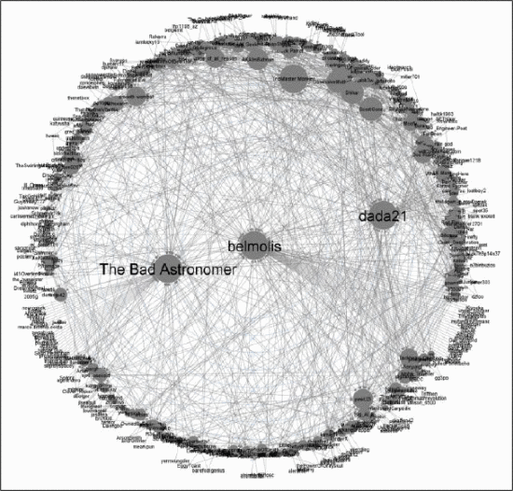
Slashdot networking diagrams on “NASA” topic
Each dot represents a user
The larger the dot the more active
Each line connects interactions between users
Taken from [1]

Slide 7
Methods
Genetic Algorithm (GA)
K-Means Clustering
Optimized Cluster Distance (OCD)
re-clustering of data with new centers
increasing the between cluster distances (BSS)
decreasing within cluster distances (WSS)

Slide 8
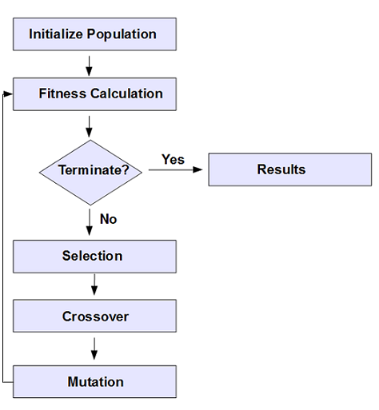
Genetic Algorithm
Evolutionary Algorithms (EA)
Promote problem solving -> optimizing techniques
Population -> Generational Group
Creating the next generation
Taken from https://apacheignite.readme.io/docs/genetic-algorithms.

Slide 9
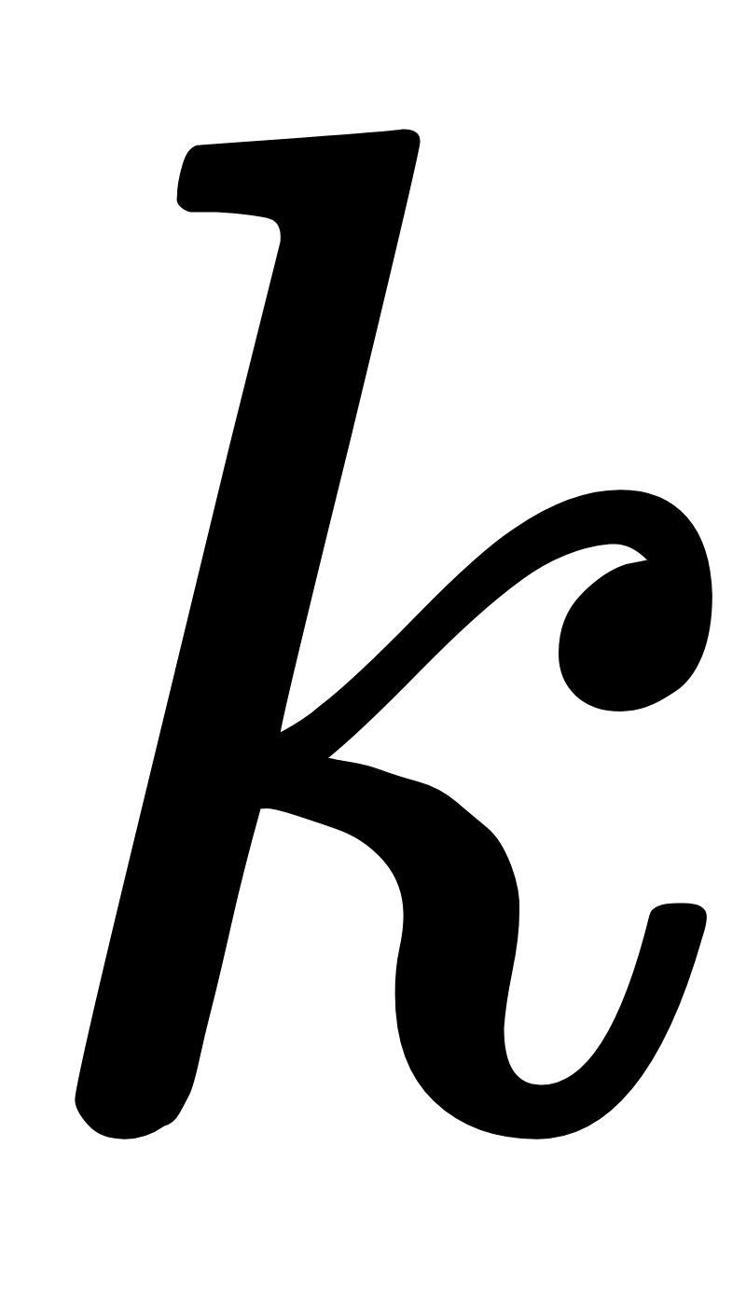
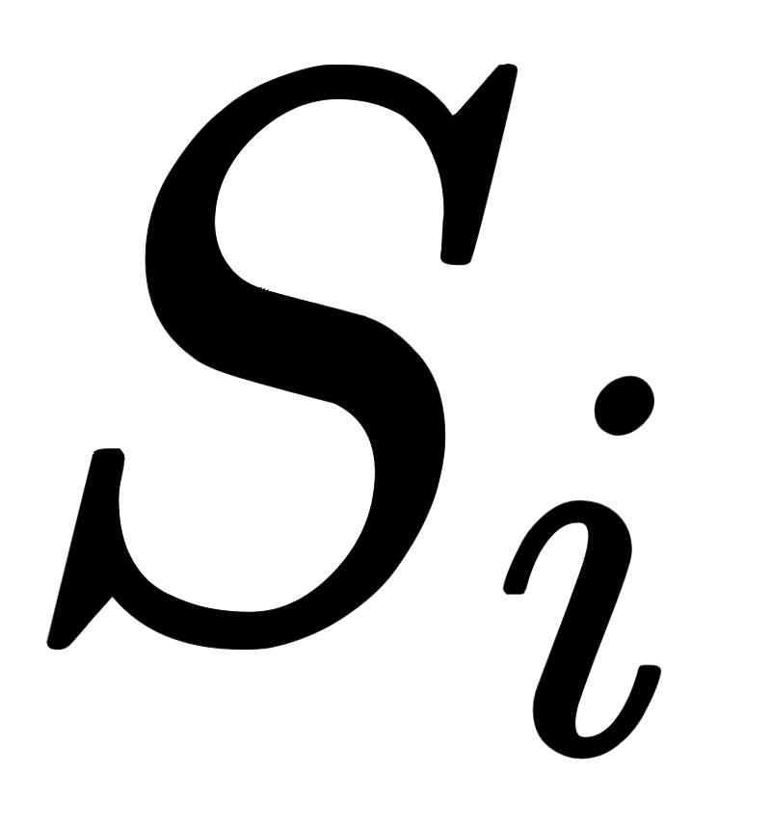
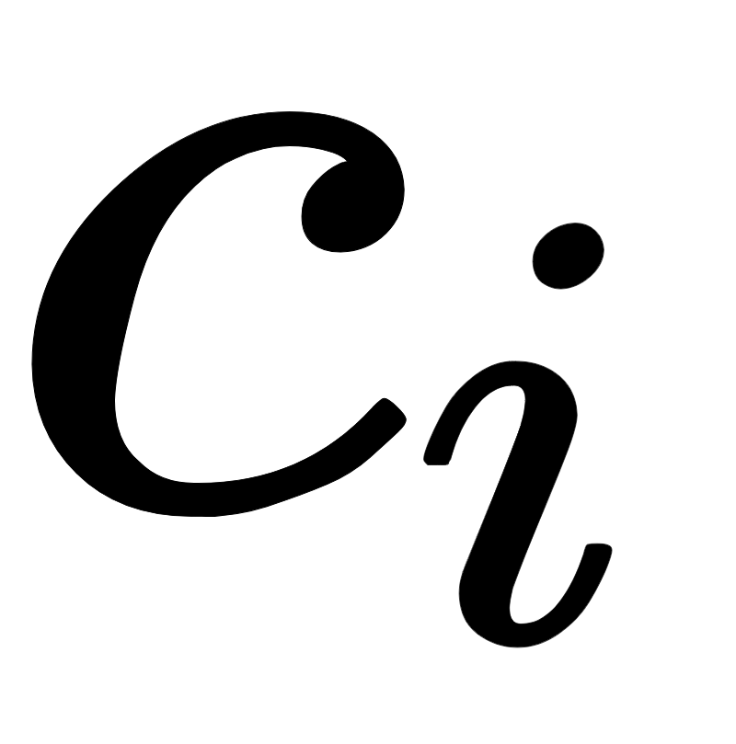
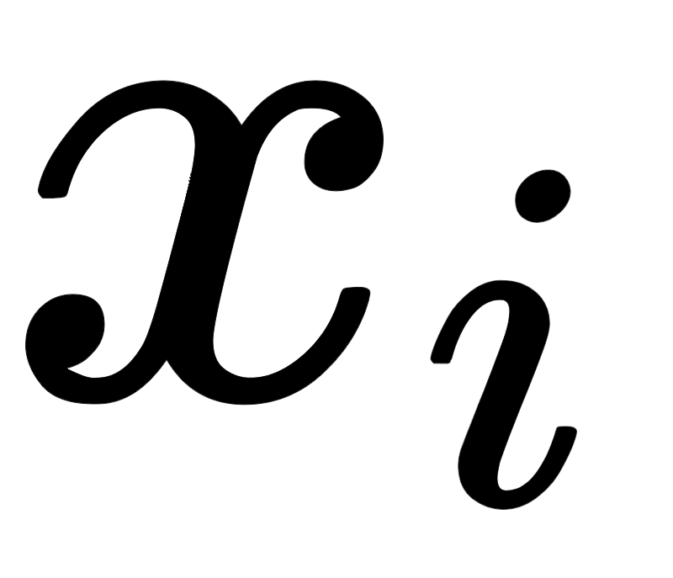
K-Means Clustering
Unsupervised clustering algorithm to find groups within the data
To partition the n observations into a set of k clusters
To minimize the within-cluster sum of squares (WSS) -> SSE
: number of center/cluster
: set of observation in cluster i
: centroid in
: observation

Slide 10
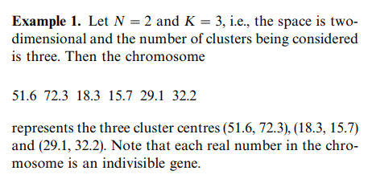
Proposed Algorithm (K-means + GA + OCD)
Genetic Algorithm(GA)
Instead of randomly selecting k points as centroids, an optimal set of centroid is generated by GA as example:
Input data
Initial Population
Taken from [1]
Taken from [2]

Slide 11
Proposed Algorithm (K-means + GA + OCD)
Genetic Algorithm(GA)
1st Generation
(51.6,72.3,46.5), (18.3,15.7,23.2), (29.1,32.2)
Crossover
(51.6,15.7,23.2), (18.3,72.3,46.5), (29.1,32.2)
Mutation (low chance)
(32.2,15.7,23.2), (18.3,72.3,46.5), (29.1,51.6)
Fitness of 1st Generation is calculated by
The centroids of generation with the highest fitness is returned as an output of the GA
Taken from [1]

Slide 12
Proposed Algorithm (K-means + GA + OCD)
Optimized Cluster Distance
Euclidean distances between all centroid are calculated called pairwise distances.
For two clusters that have the pairwise distance higher than the average of all pairwise distances, GA and K-means are re-applied on those two clusters to maximize between cluster distance.
Taken from [1]

Slide 13
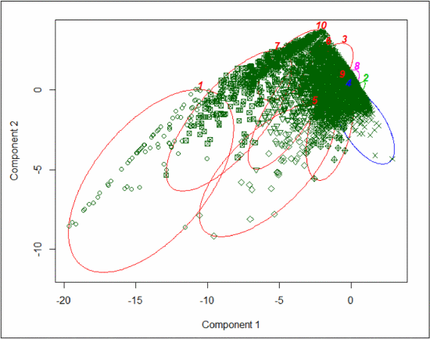
Results: Visualization of Clusters
Component 1 & 2 created from PCA to show data in 2 dimensions with clustering result
Taken from [1]

Slide 14
Results: Group Characteristics
Reason behind rankings was not given. Assuming based on thresholds based on distribution of scores
Attitude
Activity Levels:
Rating given by other users
Rankings
Positive
Negative
Neutral
Actually neural
Mix of positive and negative
Combination of hub and authority scores
Rankings
High
Moderate
Low

Slide 15
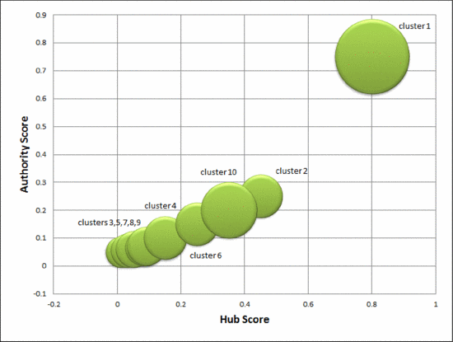
Results: User Analysis
Clusters 1 & 2 : positive attitude, high activity (Super users)
Cluster 4: positive attitude, moderate activity
Clusters 3 & 6: positive attitude, low activity
Cluster 5: negative attitude moderate activity
Clusters 7, 8 & 9: neutral attitude, low activity
Cluster 10: negative attitude, high activity
Taken from [1]

Slide 16
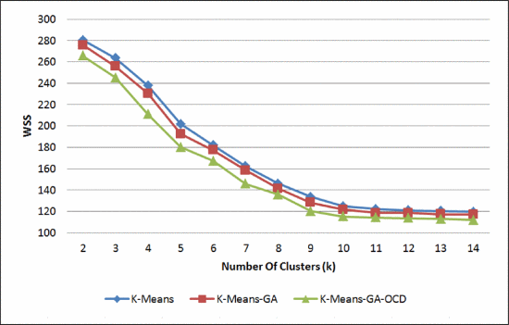
Results: Comparison of Models
Comparison of proposed algorithm with other methods
Taken from [1]

Slide 17
Results: Cluster Performance
 | Within Sum of Square Distance (WSS)
# of clusters (k) | K-Means | K-Means-GA | K-Means-GA-OCD
2 | 280.18 | 275.52 | 265.5
3 | 263.52 | 255.76 | 245.15
4 | 237.78 | 230.08 | 200.74
5 | 201.77 | 192.45 | 180.20
6 | 181.86 | 177.27 | 167.32
7 | 162.33 | 158.48 | 145.86
8 | 145.94 | 141.45 | 135.66
9 | 133.69 | 128.25 | 120.27
10 | 125.02 | 123.82 | 115.41
11 | 122.18 | 118.79 | 114.31
12 | 121.10 | 118.64 | 113.78
13 | 120.45 | 117.52 | 112.94
14 | 119.74 | 117.10 | 112.05
Taken from [1]

Slide 18
Conclusion
Can find groups of users to target for:
Beta testing
Helping promote new features
Manual review to ensure they upholding community guidelines
Finding trolls
Their dataset appeared that hub and authority scores were very correlated
Will this hold true with other data sets?
In this instance their combination of using genetic algorithms to produce centroids for clusters and optimised cluster distance produced clusters that were closer

