Slide 1
CS548 Fall 2019 Data visualization showcase by Curtis, Robert W., Li, Guangjiang
Showcasing work by Jieqiong Zhao, Morteza Karimzadeh, Ali Masjedi, Taojun Wang, Xiwen Zhang, Melba M. Crawford, and David S. Ebert on “FeatureExplorer:
Interactive Feature Selection and Exploration of Regression Models for Hyperspectral Images”

Slide 2
References
J. Zhao, M. Karimzadeh, A. Masjedi, T. Wang, X. Zhang, M. M. Crawford, and D. S. Ebert, “FeatureExplorer: Interactive Feature Selection and Exploration of Regression Models for Hyperspectral Images” in IEEE VIS 2019, Vancouver Canada, October 20-25 2019, submitted online August 2, 2019 [Online]Available: https://arxiv.org/abs/1908.00671 [accessed November 13, 2019]
Ali Masjedi, Jieqiong Zhao, Addie M. Thompson, Kai-Wei Yang, John E. Flatt,Melba M. Crawford, David S. Ebert, Mitchell R. Tuinstra, Graeme Hammer, and Scott Chapman，“Sorghum Biomass Prediction Using UAV-Based Remote Sensing Data And Crop Model Simulation”，International Geoscience and Romote Sensing Symposium(IGARSS) 2018, [accessed November 18, 2019]
Zhou Zhang, Ali Masjedi, Jieqiong Zhao and Melba M. Crawford, “Prediction Of Sorghum Biomass Based On Image Based Features Derived From Time Series Of UAV Images”, International Geoscience and Remote Sensing Symposium(IGARSS) 2017, {[accessed November 18, 2019]
L. Liang, L. Di, L. Zhang, M. Deng, Z. Qin, S. Zhao, and H. Lin., Estimation of crop LAI using hyperspectral vegetation indices and a hybrid inversion method. Remote Sensing of Environment, Remote Sensing of Environment.2015.04.032 [accessed November 18, 2019]

Slide 3
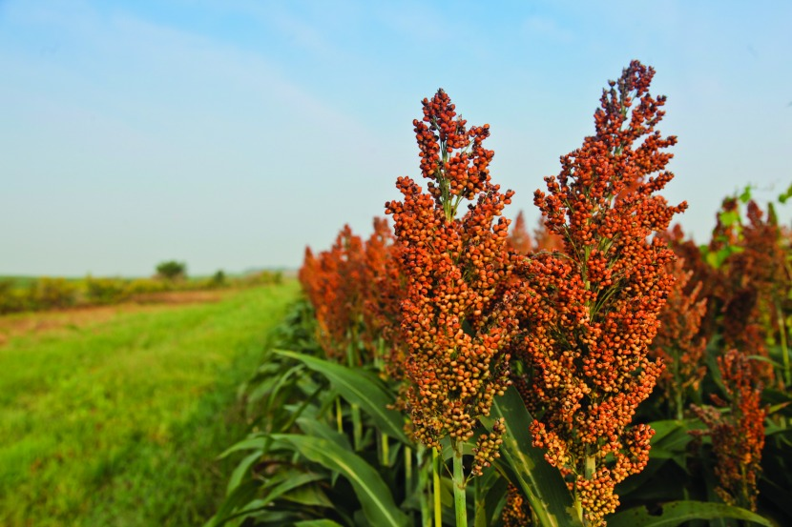
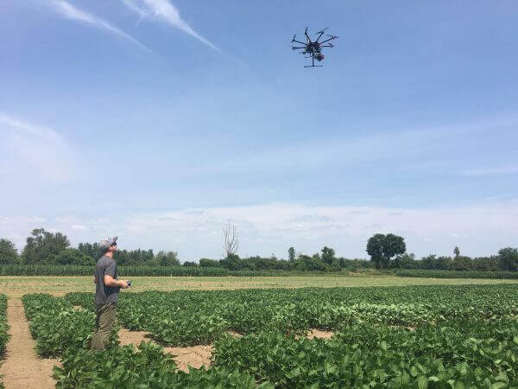
Biomass Measuring
sorghum
Biomass is an important plant characteristic that helps with crop monitoring, yield estimation, and indicating plant growing conditions, and is quantified based on the above-ground weight of a plant before processing.
Higher means better crop yield
Current measuring technique:
Check weight after the harvest
Take normal photos (RGB)
Inefficient for large quantities of plants
Not enough information is conveyed about the plant
Case study goal: predict biomass of sorghum plants
used to produce ethanol at roughly 40% of their biomass
https://www.sorghumcheckoff.com/news-and-media/newsroom/2018/10/19/adding-sorghum-to-the-crop-mix-for-2019/
https://www.realagriculture.com/2018/07/drones-could-make-crop-research-10-times-more-efficient/

Slide 4
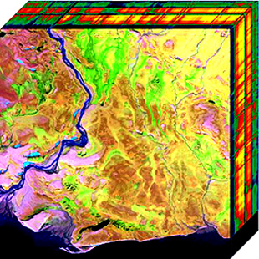
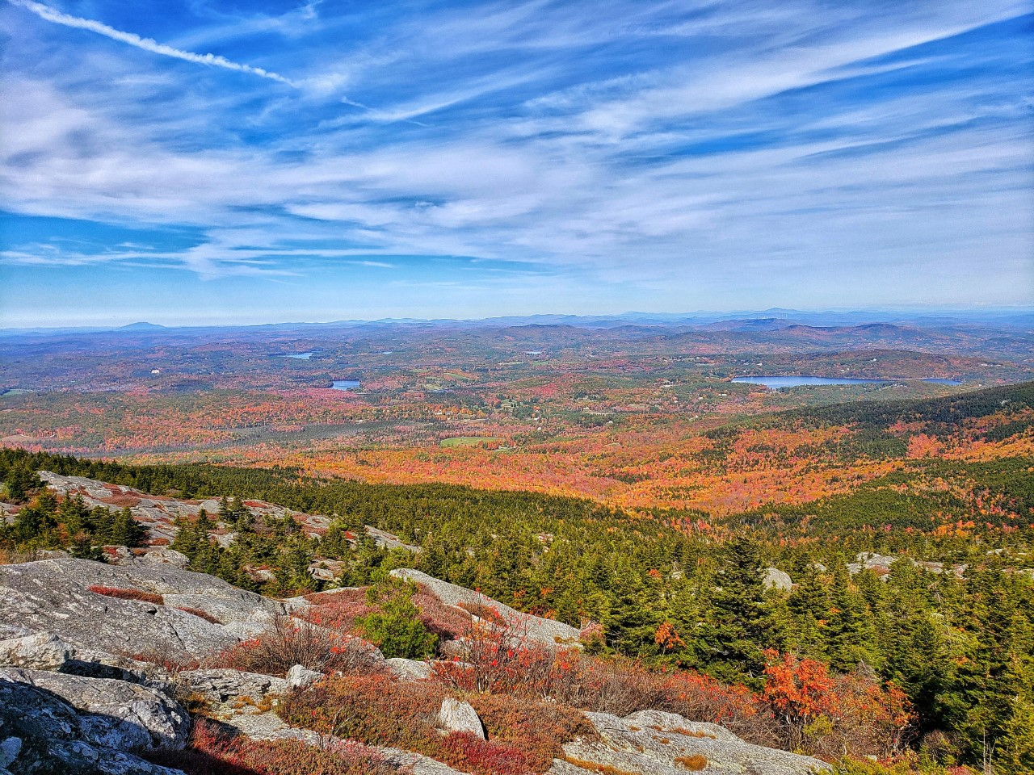
Hyperspectral Images
Hyperspectral image: series of images in a quasi-continuous wavelength range.
all the images in different wavelengths stacked together, looks like a image cube
The actual optical information in a scene or on a object more than we can see .
RGB Image
Hyperspectral Image
By Guangjiang Li took at Mt. Monadnock
https://en.wikipedia.org/wiki/Hyperspectral_imaging

Slide 5
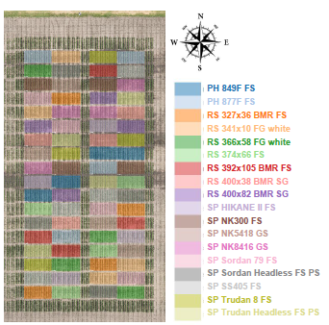
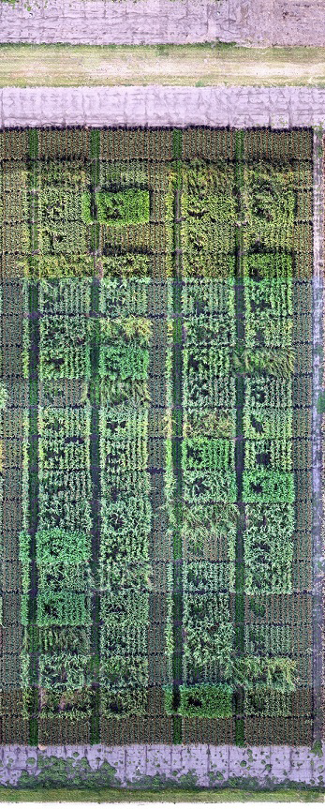
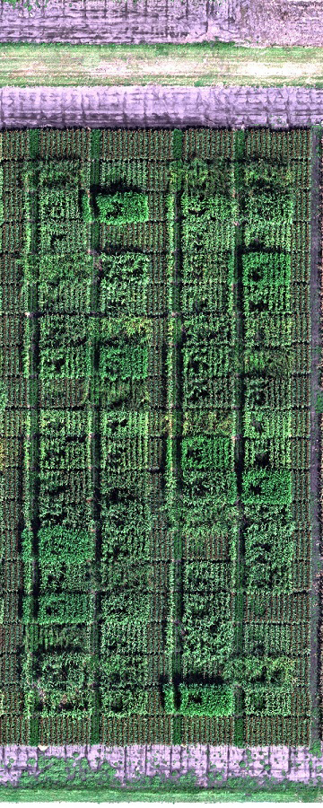
Data collection
https://en.wikipedia.org/wiki/Hyperspectral_imaging
Hyperspectral images :
400nm ~1000nm in 2.2nm increments,
(402.2, 404.4, 406.6, …, 1000)
resulting in a total of 272 pictures
Subdivided based on instance labels for experimental purposes
10 rounds of image taking from June to September
RGB image
True-color composite of
the hyperspectral data
Instance labels
(Unmanned aerial vehicles)UAVs: DJI S1000+
Camera: Sony Alpha 7R with 35mm lens
Headwall Nano-Hyperspec push-broom scanner
GPS: Xsense MTi-G-700
Taken from[2]

Slide 6
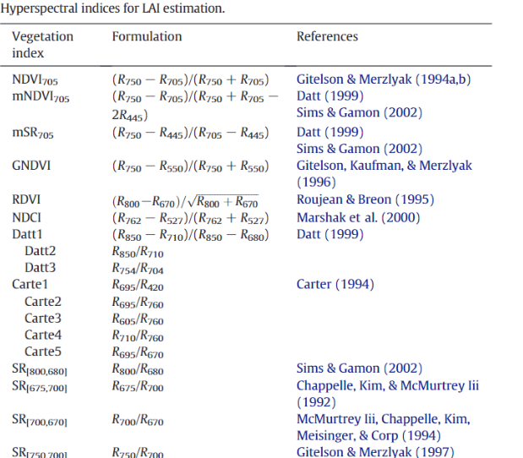
preprocessing
Agriculture domain knowledge
Leaf area index(LAI)
Taken from [4]
Dimensionality Reduction：
272 band-images converted to
36 hyperspectral indices
reducing the dependency between neighboring bands
One hyperspectral index is a combination of 2 or more bands
…
…

Slide 7
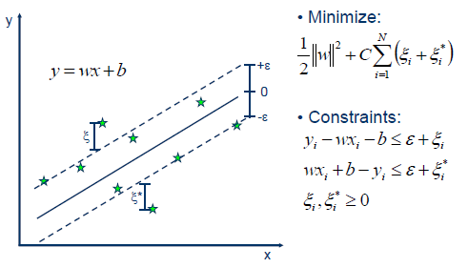
Techniques - Support Vector Regression
Support Vector Regression (SVR)
linear/non-linear regression using a support vector machine (SVM)
Use kernel to transform the data into higher dimensionality
Find best line of fit
https://www.saedsayad.com/support_vector_machine_reg.htm

Slide 8
Techniques - Kernel Density Estimation
Kernel Density Estimation:
Visual improvement to other forms of plots
Smooths blocky graphs into line graphs
2D(example shown below) and 3D
f (x)= ∑_{observations} K(x−observation/bandwidth)
K is a kernel function
https://mathisonian.github.io/kde/

Slide 9
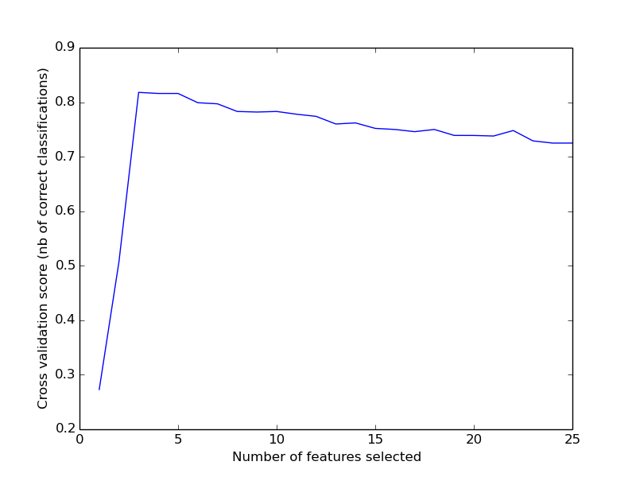
Techniques - Recursive Feature Elimination (RFE)
Recursive Feature elimination:
1. Run SVR (or other predictive function) on the data
2. Find feature importance of each feature
3. Eliminate the least important feature
4. Repeat 1-3 until target number of features is reached
https://scikit-learn.org/0.15/auto_examples/plot_rfe_with_cross_validation.html

Slide 10
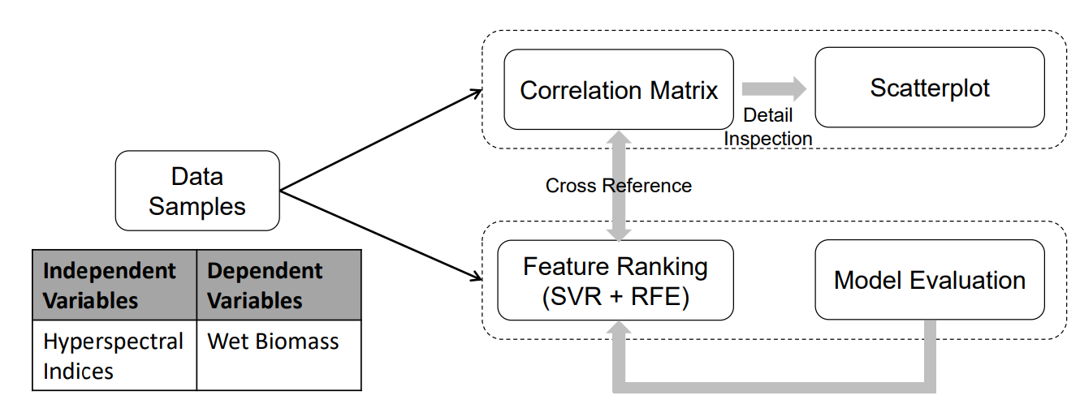
Design
Human in the loop
domain expert
Iterative exploration of data
Identification of key features
Automatic and manual selection
Taken from [1]

Slide 11
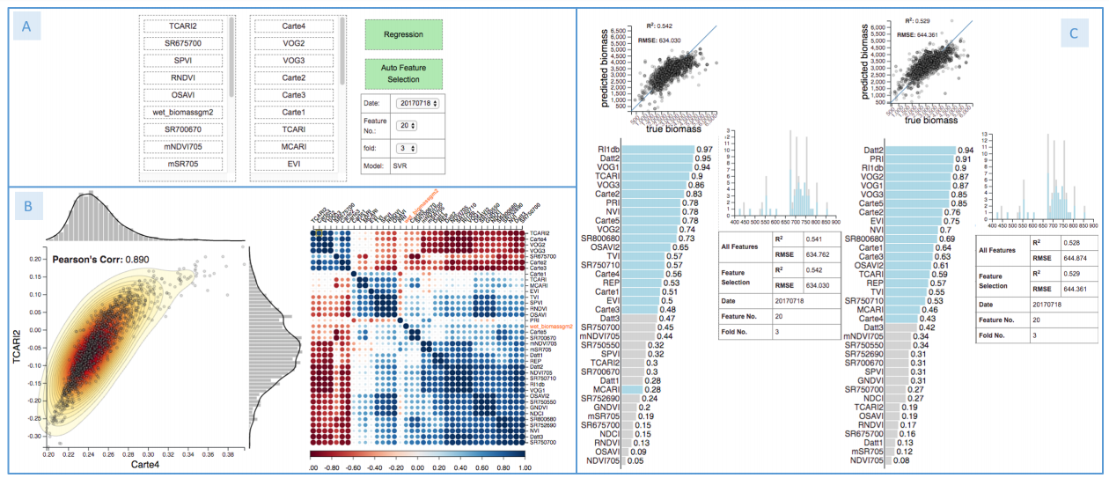
Results
Ground truth vs predicted scatter plot
Referenced light wavelength from feature histogram
Manual feature selection results
Automatic feature selection results
Control panel
Selected features
Unselected features
Selected feature pair scatter plot with KDE
Selected features (in blue) and feature importance
Analysis metrics and experiment information
Feature correlation matrix, selectable for scatter plot
Taken From [1]

Slide 12
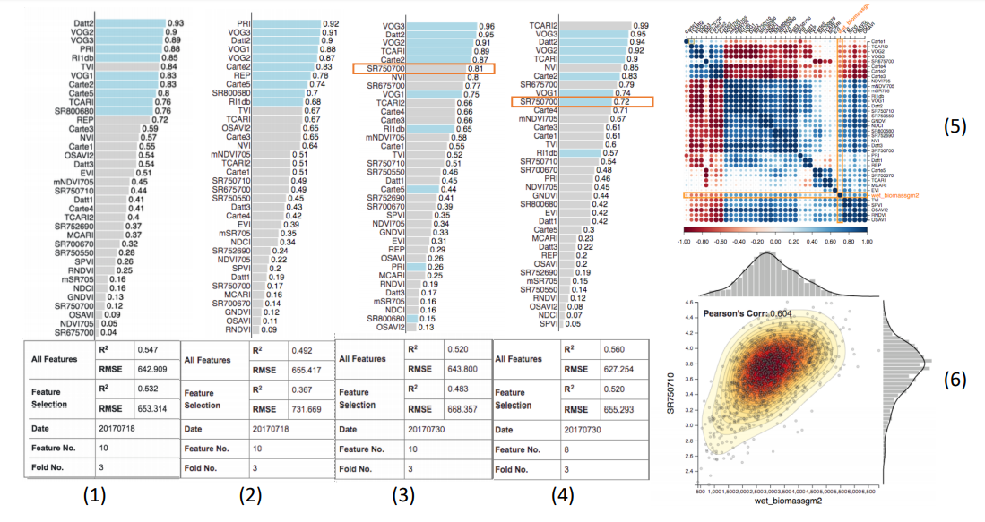
Results Cont.
Manual feature selection applied to date 2
Feature correlation matrix date 2
Manual feature selection Date 1
Scatter Plot of highlighted feature
Automatic feature selection date 1
Taken from [1]
Improved manual feature selection date 2

Slide 13
Conclusions
Useful for hyperspectral image data
Potentially useful for similar data (high dimensionality with derived correlated features)
Can be adjusted and improved
More regression functions
Potential for time series analysis inclusion

Slide 14
Thank you for your attention
Curtis,Robert W., Li, Guangjiang

