Slide 1
CS548 Fall 2019
Text Mining
Showcase by: Chuchen Dai, Sai Sahithi Kireeti Dandamudi, Baoxin Liu, Xiaosong Wen
Showcasing work by: Katerina Berezina, Anil Bilgihan, Cihan Cobanoglu & Fevzi Okumus
On: Understanding Satisfied and Dissatisfied Hotel Customers: Text Mining of Online Hotel Reviews

Slide 2
Reference
Katerina Berezina, Anil Bilgihan, Cihan Cobanoglu & Fevzi Okumus (2016) Understanding Satisfied and Dissatisfied Hotel Customers: Text Mining of Online Hotel Reviews, Journal of Hospitality Marketing & Management, 25:1, 1-24, DOI: 10.1080/19368623.2015.983631
PASW Modeler [Online]. Available: http://www.spss.com.hk/software/modeling/modeler/
CATPAC introduction [Online]. Available: http://www.galileoco.com/N_catpac.asp
M.BarthelmesP.BresslerD.BünzK.GütschowJ.HeegerR.KersicU.Schreiber (2017) CATPAC - An Interactive Software Package for Process Analysis and Control. [Online]. Available: https://www.sciencedirect.com/science/article/pii/S1474667017628192
Introduction to Natural Language Processing (NLP): What is NLP? [Online]. Available: https://algorithmia.com/blog/introduction-natural-language-processing-nlp
Natural Language Processing is Fun! [Online]. Available: https://medium.com/@ageitgey/natural-language-processing-is-fun-9a0bff37854e

Slide 3
Background:
Hotel companies Competition:
Competitive and dynamic business environment and increasing commoditization of hotel products.
Customer satisfaction:
Internet, review websites, social media, blogs.
Difficulty:
Large volume of information;
Difficult to review and evaluate all of it.
Notes:
Hotels operate in a competitive and dynamic environment.
Increasing commoditization of hotel products makes it more difficult for hotel companies to compete for their customers.
The problem presents itself in guests’ unwillingness to share their experiences and provide feedback to hotels.
Internet makes it easier for customers to share their experience via review websites.
It is important for hotel managers to utilize customer review information that is available for them online in order to better understand their customers and improve hotel performance.
Online medium generates such a large volume of information that it may be difficult for the managers to review and evaluate all of it.

Slide 4
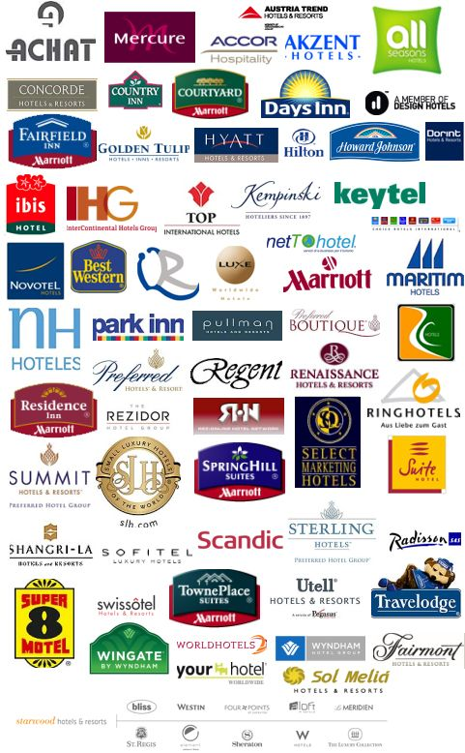
Introduction
Examine the underpinnings of satisfied and unsatisfied hotel customers.
A text-mining approach was followed and online reviews by satisfied and dissatisfied customers were compared.
A clear theoretical and managerial implications pertaining to understanding of satisfied and dissatisfied customers through the use of text mining and hotel ratings via online platforms.
Study results should allow us to understand what aspects of amenities and services offered by hotels generate positive comments and what aspects generate negative ones.
http://www.dirtyandthirty.com/lifestyle/whats-important-to-you-when-you-choose-a-brand-of-hotel-or-activity/

Slide 5
Findings
Satisfied customers who are willing to recommend a hotel to others refer to intangible aspects of their hotel stay, such as staff members, more often than unsatisfied customers.
Dissatisfied customers mention more frequently the tangible aspects of the hotel stay, such as furnishing and finances.

Slide 6
REVIEW OF LITERATURE
Satisfied customers vs. Dissatisfied customers
Cheaper to keep an existing hotel guest than to invest in ﬁnding new customer
Tangible vs. Intangible aspects of service
Tangible: the physical facilities of the hotel
Intangible: assurance, customer service and empathy
service failure may have an impact on the perception of service quality, satisfaction and future intentions

Slide 7
Dissatisﬁed Customer
Cons:
Negativity is weighted more heavily in the decision making process
Go viral very quickly in today’s connected world and possibly diminish brand equity and image
Pros:
Pointing out the problematic areas
Service recovery paradox -- The satisfaction rate of dissatisfied customers after being remedied >> firstly satisfied customer
Notes:
The service recov- ery paradox states that the customer satisfaction rate is even higher for those customers who have experienced service failure followed by service recovery than for those customers who received their service properly on the first time

Slide 8
Cards and Questionnaires vs. Web2.0
Web 2.0: Internet development led to the shaping of the 2nd generation of the Internet. (O’Reilly, 2005)
Searching for travel related information is one of the most popular online activities
Over 5 M/month visit VirtualTourist.com seeking travel reviews and tips
20M/month visit TripAdvisor to read other travelers’ reviews

Slide 9
Data Collection
Data collected from hotels in Sarasota, Florida.
All available online reviews for Sarasota hotels were collected from TripAdvisor.com
2510 Reviews
85% of the collect reviews were provided by hotel guests traveling for leisure or leisure-related purposes and 12% are accounted for business travellers.

Slide 10
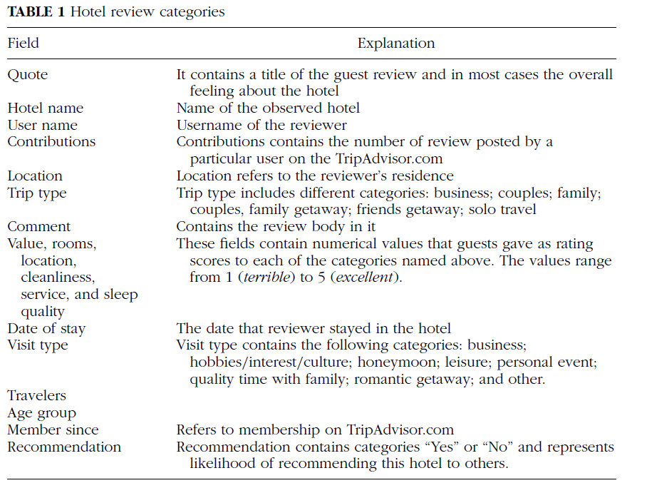

Slide 11
Internal Validity
For the purpose of checking an internal validity of the reviews,
correlations of rating scores and recommendation scores were obtained

Slide 12
Modeling and Word Categorization
PASW Modeler (Predictive Analytics SoftWare)
Also, the text-mining approach adds to the word frequencies
method used by CATPAC (adding a higher layer of word categorization).

Slide 13
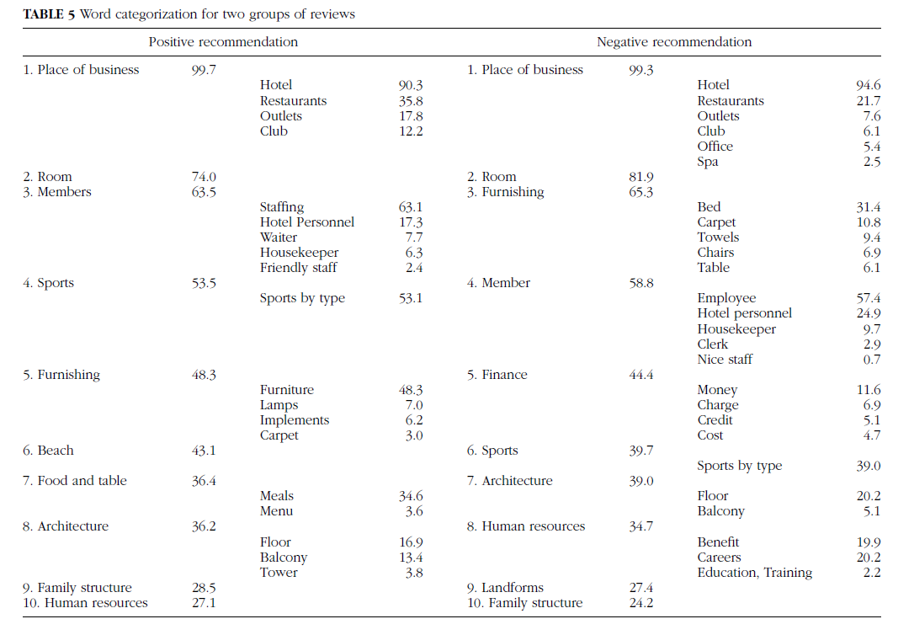

Slide 14
PASW (Predictive Analytics SoftWare)
(= SPSS statistical analysis software, from IBM)
PASW Modeler: used for data mining and text analytics.
Text Analytics Module of PASW Modeler:
Converting source data to a standard format
Identifying candidate terms
Identifying equivalence classes and integration of synonyms
Assigning a type
Indexing
Matching patterns and events extraction
https://www.ibm.com/support/knowledgecenter/en/SS3RA7_15.0.0/com.ibm.spss.ta.help/intro_extract_defined.htm
rule-based text mining +
Linguistics-based text mining (NLP)
structured data (patterns extracted)
unstructured data (guest comments)

Slide 15
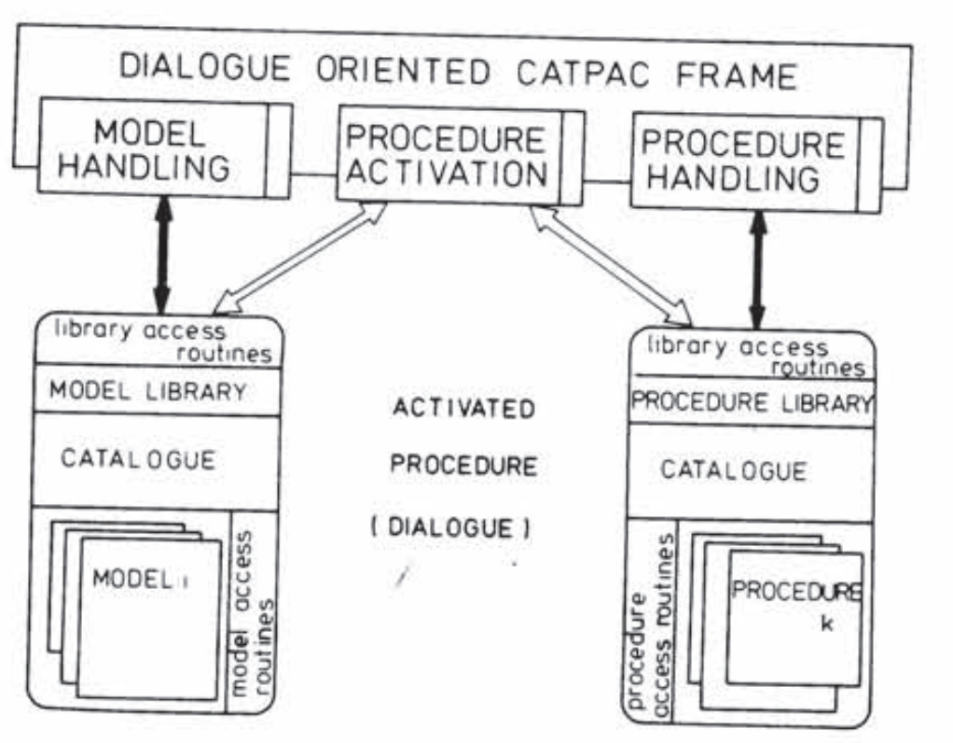
CATPAC (a text analyzing and summarizing computer program)
(Developed chiefly by Richard Holmes and Dr. Joseph Woelfel)
A self-organizing (unsupervised) interactive activation and competition (IAC) artificial neural network for text analysis.
Method (like human brain neurons connection):
Create a weighted word-by-word matrix that establishes the eigenvector centralities of concepts.
The word-by-word matrix represents the relationship between one word and the occurrence of another.
Generate a multidimensional scalar output organizing words throughout the text.
Apply: Add a higher layer of word categorization, words can be grouped together to form larger categories.
https://www.sciencedirect.com/science/article/pii/S1474667017628192
Notes:
This process strengthening connections through conditioning to generate a pattern of similarities among all words within a body of text.

Slide 16
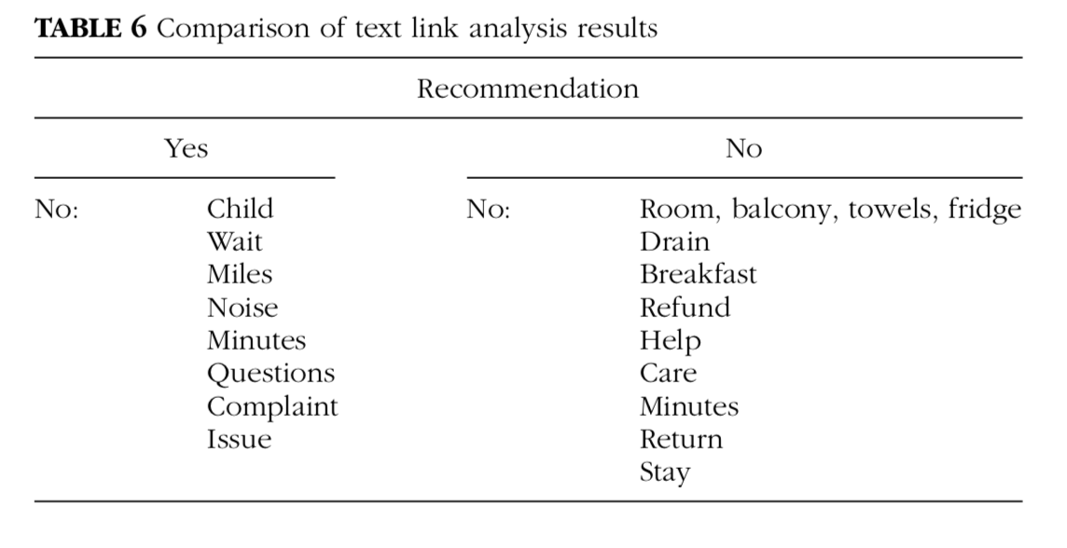
Text-Link Analysis
To: identify text-link pattern results / relationships between concepts by NLP.
Apply: identify pairs of words that are frequently used together in the reviews.
“no + any other word.”
→ positive? negative?

Slide 17
NLP
Steps:
Morphological Processing -> Syntax Analysis -> Semantic Analysis -> Pragmatic Analysis
Apply: assign extracted words from guest comments to the categories defined.
“On several days I just went for breakfast at a local cafe and found my room already re-done after no more than 30 minutes’ absence.”
“no-minutes”: positive, 1
“no-minutes”: negative, 1
NLP feature extraction
“I said: There is no one available to bring them [towels] up? The response was no, and there will not be for at least 30 minutes!”
https://medium.com/@ageitgey/natural-language-processing-is-fun-9a0bff37854e

Slide 18
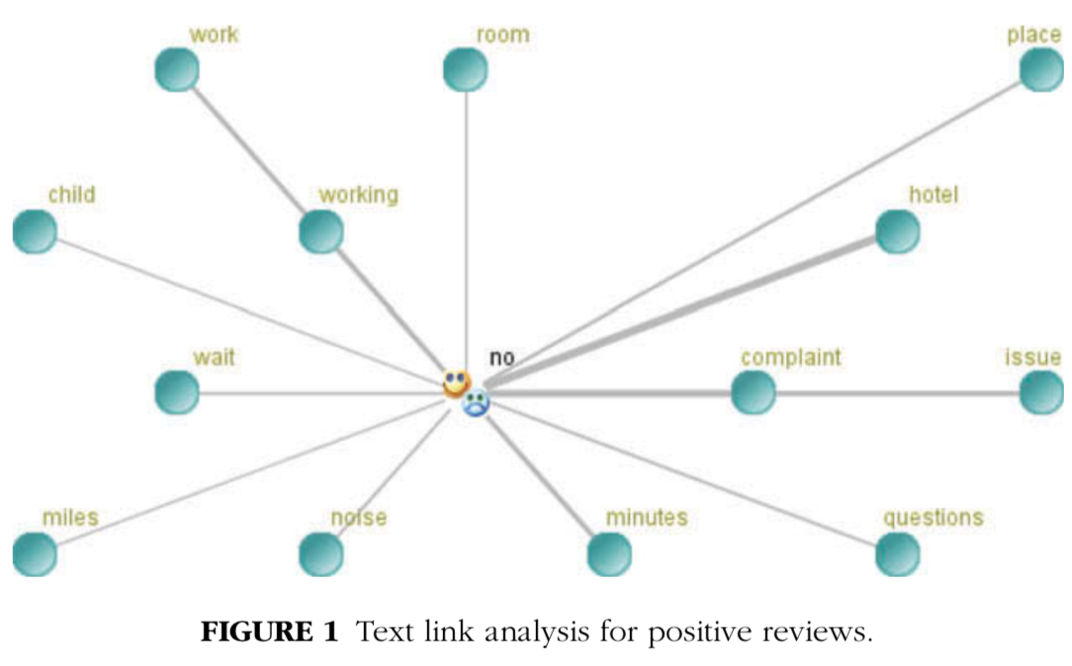
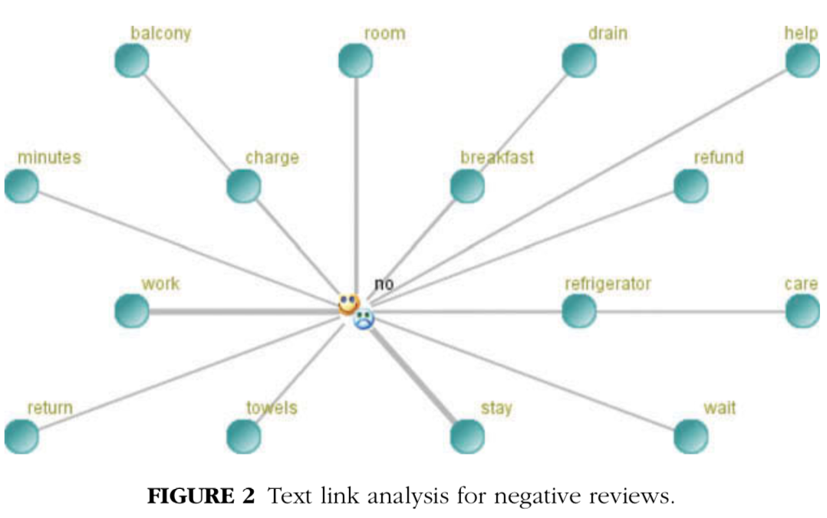

Slide 19
Conclusion
Most important elements of hotel services:
value for money
helpful and friendly staff,
furnishings in the room
According to research:
Those service components that make customers satisfied, may also make them dissatisfied if they are not provided or there are problems with their delivery.
Tangibles and financial issues seem to have more importance for dissatisfied customers.
Customer satisfaction may greatly depend on the performance of hotel employees’ performance.

Slide 20
Thanks!

