Slide 1
CS548 Spring 2015 Clustering Showcase
By Guojun WU, Jiacheng WANG, Xinyu DAI
Showcasing work by Geng, Fan, et al on Optimizing User Exploring Experience in Emerging E-Commerce Products
Date 03/24/2015

Slide 2
References
Geng, X., X. Fan, J. Bian, X. Li, and Z. Zheng. ”Optimizing user exploring experience in emerging e-commerce products”, in Proceedings of the International World Wide Web Conference (WWW '12), , pp.23-32. Lyon, France, 2012.

Slide 3
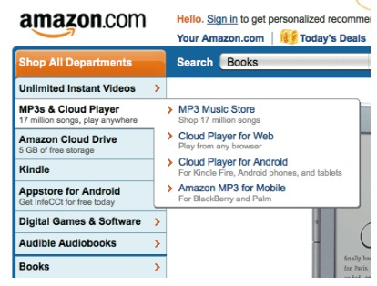
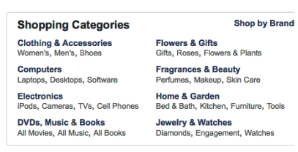
Optimizing User Exploring Experience in Emerging E-Commerce Products
Taken From Geng, Fan, et al(2012)
by Geng, Fan, Bian, et al

Slide 4
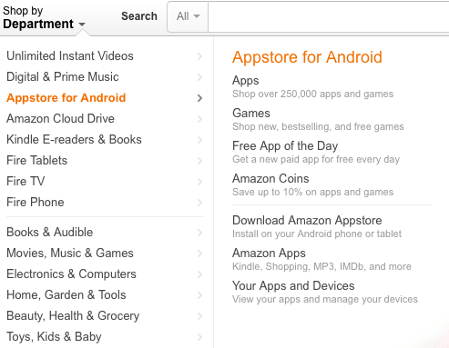
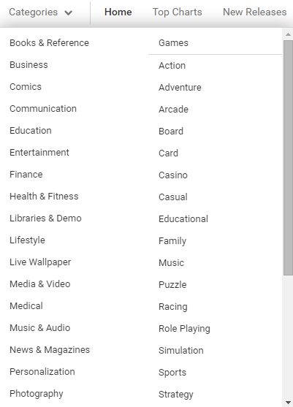
Categories in E-Commerce
Compare to searching, users only need to choose among provided options, which will save users’ own efforts of formulating queries, especially when they do not exactly know what they are looking for.
Taken from www.amazon.com
Taken from www.play.google.com

Slide 5
The Problem
“In many emerging e-commerce services, well-defined hierarchical structures are not always available; in some other e-commerce services, the pre-defined hierarchical structures are too coarse and less intuitive to distinguish properties according to users interests. This will lead to very bad user experience.”

Slide 6
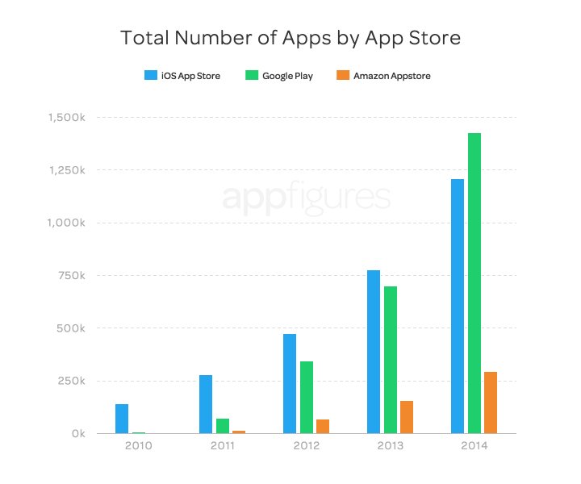
Chaos in Google Play
Numerous Apps in every category
-1.41M Apps and 17 categories(not include Game), which make user hard enough to find Apps they need.
Too many similar apps
-App user want may be buried in huge amount of other apps with similar name but different function.
Taken from http://blog.appfigures.com/app-stores-growth-accelerates-in-2014/

Slide 7
The Data Set
Yahoo! App Search
Data collected in one month: Sep 2nd,2011 to Oct 12th, 2011
12191 queries and 40912 query-app pairs
 | #query | #query pairs
App search | 6263 | 21910
Web search | 5919 | 54342
Taken from Geng, Fan, Bian, et al.(2012)

Slide 8
5 Step Process
1.Retrieve user queries and click information data set
2.Define query similarity
3.Analyze the properties of the clustering problem and propose a hierarchical clustering approach
4.Construct browsing lists for all clusters
5.Present evaluation based on 3 and 4

Slide 9
Similarity Functions
Similarity Based on Query-documents Pairs
-measure query similarity: keyword based similarity and result based similarity
Similarity Based on Query-Urls Pairs
-About 84% query pairs extracted from web search logs are not covered by those extracted from the e-commerce searching logs.
Combination of Query-documents and Query-Urls Pairs Similarity Measurements

Slide 10
Similarity Based on Query-documents Pairs(1)
Similarity according to both term similarity and co-click information

Slide 11
Similarity Based on Query-documents Pairs(2)
Similarity Based on Keywords
Similarity Based on Documents

Slide 12
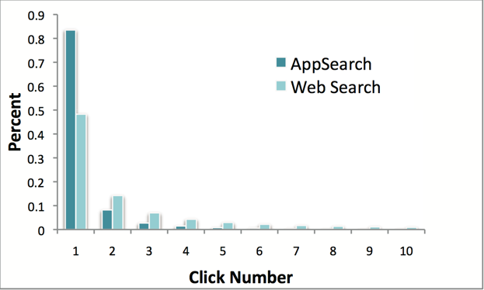
Click Number Distribution
Taken from Geng, Fan, Bian, et al.(2012)

Slide 13
Similarity Based on Query-Urls Pairs
Similarity Based on Query-Urls Pairs
Taken from Geng, Fan, Bian, et al.(2012)

Slide 14
Similarity Combination
Similarity Combination
Taken from Geng, Fan, Bian, et al.(2012)

Slide 15
Hierarchical Clustering
Clustering queries into small clusters using Spectral Clustering (Cluster L2)
Then, merge small clusters into larger clusters.(Cluster L1)

Slide 16
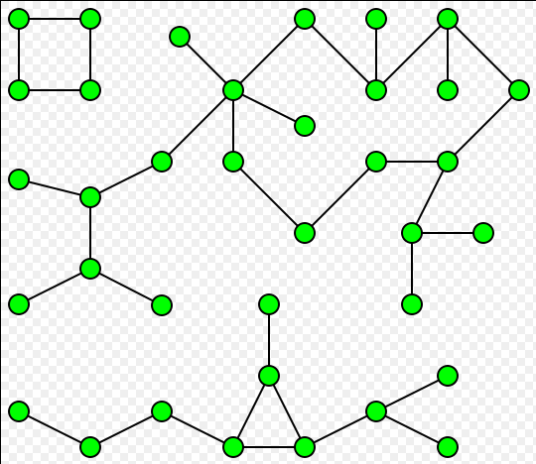
Clustering L2 Rules(1)
Every cluster should have only one connected component.
Taken from http://en.wikipedia.org/wiki/Connected_component_(graph_theory)

Slide 17
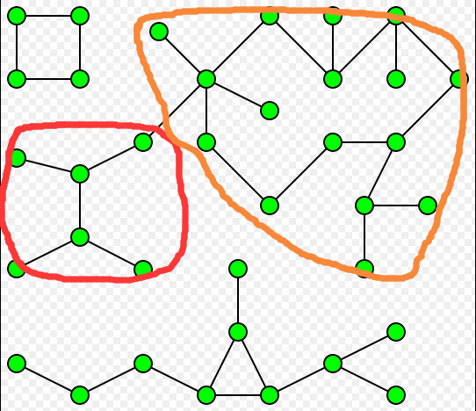
Clustering L2 Rules(2)
Merge the highly similar clusters in the cluster L2 level into one
Taken from http://en.wikipedia.org/wiki/Connected_component_(graph_theory)

Slide 18
Clustering L2 Rules(3)
To name the cluster, we build a vocabulary for each cluster, and select k most frequent words.
Re-order the selected words according to its original order in queries within the cluster.

Slide 19
Clustering L1 Rules
Generate a vocabulary list according to names of cluster L2.
For each vocabulary in vocabulary list, create a new L1 cluster.

Slide 20
Cluster Example
Category | Cluster L1 | Cluster L2 | User queries
Entertainments | movies | Bruce-lee-movies | Bruce lee Martial arts movies …
 |  | Netflix-movies | Netflix movies instantly Netflix for TV …
 |  | … | …
 | music | Mp3-music | Mp3 music Mp3 songs …
 |  | Yahoo-music | Yahoo music Music …
 |  | … | …
Taken from Geng, Fan, Bian, et al.(2012)

Slide 21
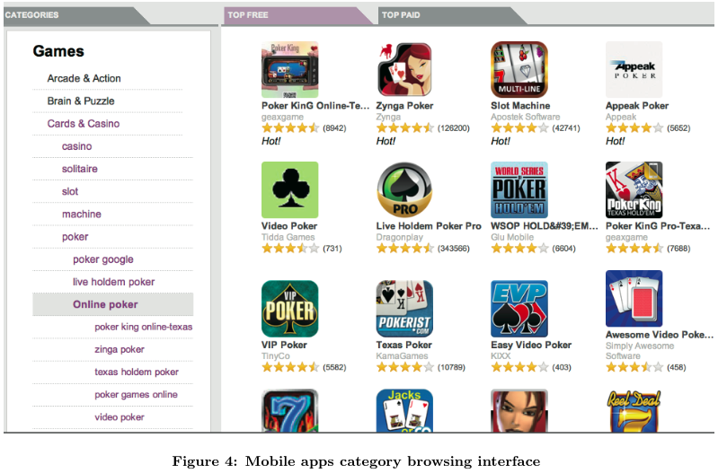
Construct Browsing Lists for All Clusters
Rank frequently clicked items of queries in the cluster on the top
Retrieve highly ranked items using queries in the cluster and blend the results of all queries
Aggregate the multi-level clusters
Taken from Geng, Fan, Bian, et al.(2012)

Slide 22
Qualitative Evaluation of Hierarchical Clusters
Qualitative evaluation based on editorial intervention
define guidelines for cluster editing
editors optimize hierarchical taxonomy
compare differences before and after editorial intervention
Notes:
In order to evaluate the quality of the hierarchical clus- ters automatically generated by the proposed algorithm, they recorded the editorial cluster editing actions which based on the guidelines

Slide 23
Guidelines for cluster editing
Level | Action | Description
user queries | delete | Remove the queries which are supposed not to belong to the cluster L2
cluster L2 | delete | Remove the clusters which are supposed not to belong to the cluster L1
 | rename | Rename the cluster name if the editor think the current name is not really suitable or readable for this cluster.
 | merge | Merge the highly similar clusters in the cluster L2 level into one
cluster L1 | rename | Rename the cluster name if the editor think the current name is not really suitable or readable for this cluster
 | merge | Merge the highly similar clusters in the cluster L2 level into one
Taken from Geng, Fan, Bian, et al.(2012)

Slide 24
What did editors modify?
All the professional search editors were invited to judge the quality of each level of the generated hierarchical clusters based on cluster names and the corresponding included queries.
The editors were able to perform three possible actions (rename, delete and merge) in different levels to optimize the hierarchical clusters and ideally build a complete taxonomy of mobile apps

Slide 25
Editor Modification Results
Clustering Statistics before and after Editorial Intervention
Average Number of Editors’ Actions to Optimize Hierarchical Taxonomy Per Category
Taken from Geng, Fan, Bian, et al.(2012)

Slide 26
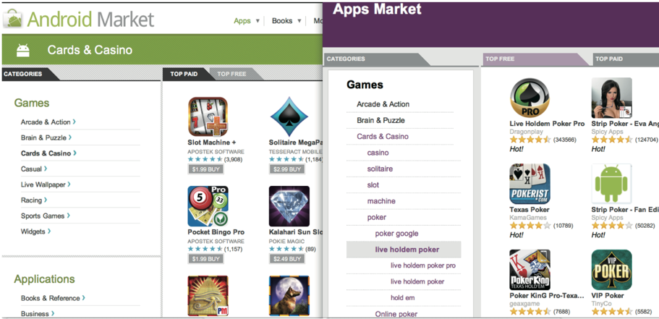
Quantitative Evaluations Compared with Android Market(1)
Figure: Interfaces in the SBS evaluation

Slide 27
Quantitative Evaluations Compared with Android Market(2)
Efficiency of Assisting Users to Discover Interested Apps
by using our interface, editors skipped less apps on 56% of the categories and found more interested apps on 60% categories
Effectiveness of “Hot” App Symbols
editors reported that those hot symbols did affect and arouse their interests to click the apps in 51.7% of categories
Effectiveness of Sub-categories
about 75% editors thought that the added sub-categories are helpful
Preference and Other Feedbacks
editors were more satisfied with our browsing interface in 36.7% of the categories, with Android Market in 23.3% of the categories, and show no preference in 40% of the categories

Slide 28
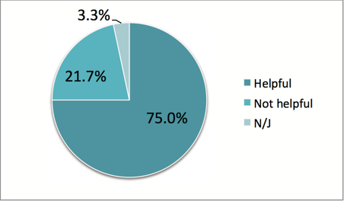
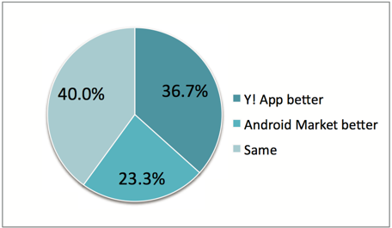
Evaluation figure
Figure: Percentage of sub-categories preference
Figure: Percentage of browsing method preference

Slide 29
Thank you for listening!
Questions are welcomed.

