Slide 1
CS548 Spring 2015 “TEXT MINING” Showcase by Suwodi Dutta Bordoloi, Chitra Pichaimuttu Kanickaraj, Joseph True
Showcasing work by IBM on
IBM’s Watson and Jeopardy!

Slide 2
References
D. A. Ferrucci, “Introduction: This Is Watson”, in IBM Journal of Research and Development, Vol. 56, No. ¾, Paper 1, May/July 2012.
A. Lally et al., “Question Analysis : How Watson Reads A Clue”, in IBM Journal of Research and Development, Vol. 56, No. ¾, Paper 2, May/July 2012
M. C. Mccord et al., “Deep Parsing In Watson”, in IBM Journal of Research and Development, Vol. 56, No. ¾, Paper 3, May/July 2012.
J. Chu-carroll et al., “Textual Resource Acquisition And Engineering”, in IBM Journal Of Research And Development, Vol. 56, No. ¾, Paper 4, May/July 2012.
J. W. Murdock et al., “Textual Evidence Gathering And Analysis”, in IBM Journal of Research and Development, Vol. 56, No. ¾, Paper 8, May/July 2012.
D. C. Gondek et al., “A Framework For Merging And Ranking Answers In DeepQA”, in IBM Journal of Research and Development, Vol. 56, No. ¾, Paper 14, May/July 2012.

Slide 3
IBM Journal of Research and Development This is Watson May-July 2012
03 - Introduction-This is Watson
04 - Question analysis How Watson reads a clue
05 - Deep parsing in Watson
06 - Textual resource acquisition
07 - Automatic knowledge extraction from documents
08 - Finding needles in the haystack Search and candidate generation
09 – Typing candidate answers using type coercion
10 - Textual evidence gathering and analysis
11 - Relation extraction and scoring in DeepQA
12 - Structured data and inference in DeepQA
13 - Special Questions and techniques
14 - Identifying implicit relationships
15 - Fact-based question decomposition in DeepQA
16 - A framework for merging and ranking of answers in DeepQA
17 - Making Watson fast
18 - Simulation-learning-and-optimization-techniques-in-Watsons-game-strategies
19 -In the game-The interface between Watson and Jeopardy

Slide 4
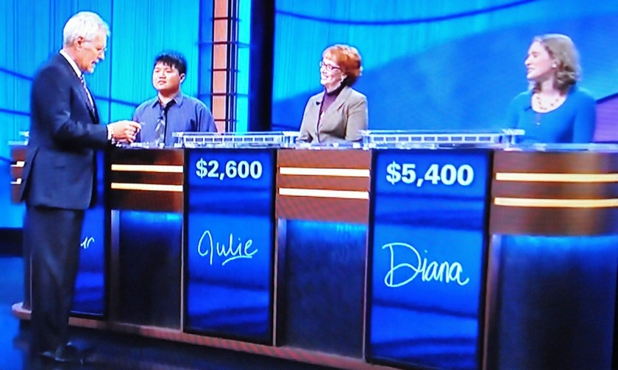
What is Jeopardy! ?
TV game quiz show
1964 debut
50 years
6000+ episodes
Questions: history, current events, science, arts, popular culture, literature …
http://en.wikipedia.org/wiki/Jeopardy!

Slide 5
Jeopardy! Question Example
Question:
Located in central Massachusetts, this school is one of the first engineering and technology universities in the United States.
Answer:
What is WPI?

Slide 6
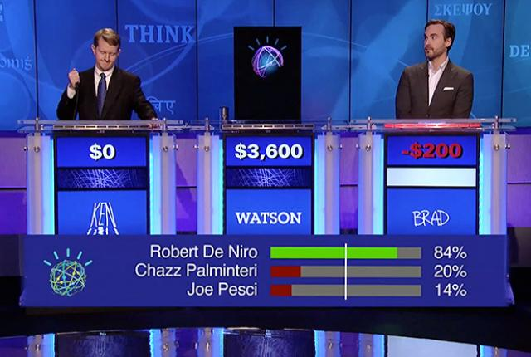
What is Watson?

Slide 7
What is Watson?
Computer system built to play Jeopardy! quiz game with humans
Open-domain question-answering (QA)
Developed 2007 – 2010
2011: Watson v. Jeopardy! champion winners
Brad Rutter
Biggest all-time money winner
$4 million
Never lost against a human
Ken Jennings
Record longest winning streak
74 games in a row

Slide 8
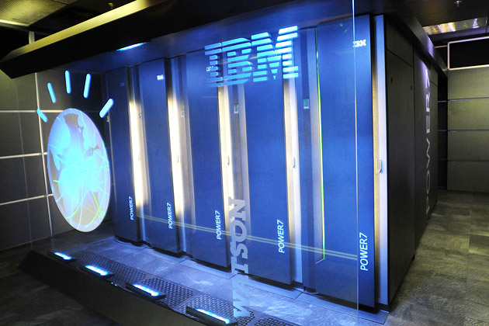
Watson System
Hardware:
Cluster of 90 IBM Power 750 servers
16 terabytes of RAM
Process 500 gigabytes per second (= 1 million books)
Software:
IBM's DeepQA software
Apache UIMA (Unstructured Information Management Architecture) framework
SUSE Linux Enterprise Server 11 OS
Apache Hadoop (distributed computing)

Slide 9
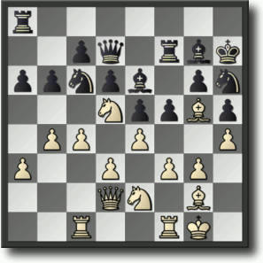
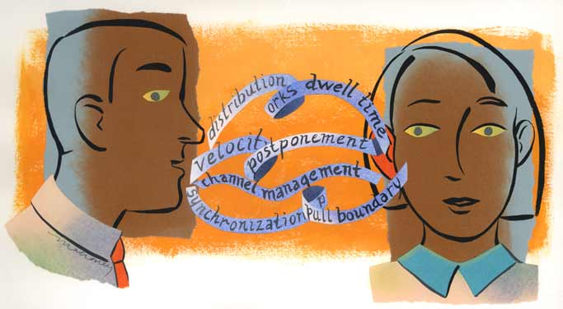
What’s the big deal? Real Language is … Really Hard
Chess
Finite, mathematically well-defined search space
Limited number of moves and states
Grounded in explicit, unambiguous mathematical rules
IBM Deep Blue - chess computer v. world champion (1997)
Human Language
Ambiguous, contextual and implicit
Grounded only in human cognition
Seemingly infinite number of ways to express the same meaning
Source: IBM Watson A Brief Overview and Thoughts for Healthcare Education and Performance Improvement
Notes:
Implicit: implied though not plainly expressed
Explicit: stated clearly and in detail, leaving no room for confusion or doubt
Cognition: the mental action or process of acquiring knowledge and understanding

Slide 10
How to win?
85% Precision@70
(85% Precision at 70% answered)
Buzz in for >= 70% of questions
Answer correctly >= 85%

Slide 11
3 seconds (on average)
Parse the question
Understand what it was asking for
Relate question and meaning to available data
Determine the best answer
Compute confidence: buzz in or not?

Slide 12
Text Mining and Related Technologies
Why?
Expand research in open domain QA … processing of language and knowledge
Many areas of computer science and AI (and Text Mining & Text Analytics)
Natural language processing (NLP)
Information retrieval (IR)
Knowledge representation and reasoning (KR&R)
Automated reasoning
Machine learning
Architecture:
Apache UIMA (Unstructured Information Management Architecture) framework to support collection of data and apply analytics, algorithms …
IBM DeepQA – extensible architecture for building QA systems

Slide 13
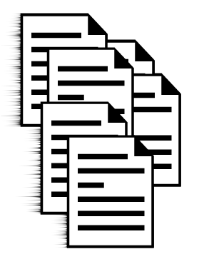
Data Sources
Not connected to the Internet during the game
200 million pages of structured and unstructured reference material
4 terabytes of disk storage
Sources of information:
Full text of Wikipedia
Encyclopedias
Dictionaries
Thesauri
Newswire articles
Literary works
Other databases, taxonomies, and ontologies. (DBPedia, WordNet, and Yago)

Slide 14
Data Collection
Sources: Acquire --> Transform --> Expand
Get info. with good coverage (for Jeopardy questions)
Extract info into format for system
Get more info. - increase coverage per topic

Slide 15
Data Processing
Automatically extract knowledge from documents
Assemble structured knowledge from unstructured data

Slide 16
How does Watson Answer a Question?
Four Steps:
Question Analysis
Hypothesis Generation
Hypothesis and Evidence Scoring
Final Merging and Ranking
Notes:
What is the question? | Generate some answers | Test the answers | Put it all together

Slide 17
Foundation of Question Analysis
Input
Unstructured text
Parsing & Analysis
Identifies syntactic and semantic elements of the question
Output
Structured information which is later used by other components of Watson
GOAL:
Identify critical elements of the question by applying numerous detection rules and classifiers based on this foundation.

Slide 18
Step 1: Question Analysis
Elements of Question Analysis are:
Focus detection
Part of the question that is the reference to the answer.
Lexical Answer Types (LATs)
Strings in the clue that indicate what type of entity is being asked for
Question Classification
Logical categorization of question in definite class to narrow down the scope of search.
Example: Why, Definition, Fact
Question decomposition
Breaking question in the logical sub parts

Slide 19
Question Analysis
POETS & POETRY: He was a bank clerk in the Yukon before he published Songs of a Sourdough in 1907.
Lexical Analysis Type (LAT)
Focus
Category : Fact
FICTIONAL ANIMALS: The name of this character, introduced in 1894, comes from the Hindi for bear. (Answer: Baloo).
Sub-question 1: Find the characters introduced in 1894.
Sub-question 2: Find the words that come from hindi for bear.
Evidence for both of the sub-questions are combined for Scoring.
Source: QA System & Watson by Bansal, De and Nishat
Notes:
Focus = he
LAT = poet, he, clerk
Category = Factoid

Slide 20
Parsing & Semantic Analysis Suite
3. Co-reference Resolution Component
Provides an analytical structure of questions posed and textual knowledge.
1. Slot Grammar parser ESG (English Slot Grammar)
4 .Relation Extraction
Component
Parsing And Semantic Analysis
5. Named Entity Recognizer (NER)
2. Predicate-argument Structure (PAS)
Source: QA System & Watson by Bansal, De and Nishat
Notes:
Percy placed the penguin on the podium
argument predicate argument argument
https://docs.google.com/viewer?a=v&q=cache:US9smdxFxj8J:www.cs.stonybrook.edu/~pfodor/courses/HON111/DeepParsing.pdf+&hl=en&gl=in&pid=bl&srcid=ADGEESi98e3HMPa5ptzUfSE_Q5kAW8a1RVRogMD80VT0Peb_aW-H7PtmG19s7eGujac0hmvGhtgjcIOsuPDB1OK0pSPJdWfsLHQBVwuO8gVWz2as9GZ-i9FMR-wY4Vg4ORARxJFjvaxG&sig=AHIEtbQRm3zSAf5hdaLl8H6CPWkfl9irPQ

Slide 21
English Slot Grammer (ESG) parser
Deep parser which explores the syntactic and logical structure to generate semantic clues
Fig: Slot filling for John sold a fish Fig: Slot Grammer Analysis Structure
Slots WS(arg) features
Subj(n) John(1) noun pron
Top sold(2,1,4) verb
Ndet a(3) det indef
Obj(n) fish(4) noun
John sold a fish
obj
subj
ndet
Source: QA System & Watson by Bansal, De and Nishat
Notes:
○ English Slot Grammar
grammatical parse of a sentence , identifies parts of speech and syntactic roles such as subject, predicate, and object, as well as modification relations between sentence segments.
▪ Seeks to generate semantic clues based on a network of syntactic relationships.

Slide 22
Predicate-Argument Structure (PAD) builder
Modifies the output of the ESG parse.
Example:
“John sold a fish” and “A fish was sold by John” yield different parse trees via ESG but reduce to the same PAS.
Figure: PAS Builder
John(1)
Sold(2, subj:1, obj:4)
a(3)
fish(4,ndet:3) [determiner : a]
Source: QA System & Watson by Bansal, De and Nishat
Notes:
○ Predicate- Argument Structure
▪ Builder reduces the complexity of results given by the ESG.
▪ Result is more general form and is logically approximate to the result of the original parse.
▪ E.g. “John sold a fish” and “A fish was sold by John” yield different parse trees via ESG but reduce to the same PAS.
▪ Seeks to expand the space of textual evidence which would match well to the question.

Slide 23
Parsing And Semantic Analysis (Cont..)
Example
POETS & POETRY: He was a bank clerk in the Yukon before he published “Songs of a Sourdough” in 1907.
3. Co-reference Resolution Component
the two occurrences of “he” and “clerk”
4. Relation Extraction Component
identify semantic relationships among entities
authorOf(focus, ‘‘Songs of a Sourdough’’)
5. Named Entity Recognizer (NER)
Person: Mr. Hubert J. Smith, Adm. McInnes, Grace Chan
Title: Chairman, Vice President of Technology, Secretary of State
Country: USSR, France, Haiti, Haitian Republic
People: He

Slide 24
Step 2: Hypothesis generation
Process of producing possible answers to a given question.
Two main components :
Search
Retrieve relevant content from its diverse knowledge source
Candidate generation
Identifies the potential answers
Source: IBM Watson A Brief Overview and Thoughts for Healthcare Education and Performance Improvement

Slide 25
Step 3: Evidence Scoring
Need to support and defend the candidate answers
Watson
collects passages from many different sources
Understands relations between the passages
Scores evidence on the quality of the passage using different algorithms
Thousands of passages are scored in a few seconds!

Slide 26
Support Evidence Retrieval
Inserts candidate answer back into the original question to form a proposition - find passages most closely related to that proposition.
E.g.: “In 1840 this German romantic married Clara Wieck, an outstanding pianist and a composer, too.”
E.g. candidate Answer (low score) :
“Clara Wieck Schumann: a German musician, one of the leading pianists of the Romantic era, as well as a composer, and wife of composer Robert Schumann.”

Slide 27
Support Evidence Retrieval (cont.)
Our passage scorers need to know that ‘wife’ relates to ‘married’
SER forms a query that includes the required phrase Robert Schumann along with other terms from the answer, such as 1840, German, romantic, pianist, Clara Wieck, and composer
Result: more passages, high score (in-spite of missing original terms)
“Although Robert Schumann made some symphonic attempts in the autumn of 1840, soon after he married his beloved Clara Wieck, he did not compose the symphony until early 1841”

Slide 28
Evidence Scoring Algorithms “Passage Term Match”
How often a candidate answer appears in the same passages as the question terms
Passages that do not specifically answer the question but just reflect some co-occurrence
E.g.: A passage that states that Robert Schumann and Clara Wieck traveled together
does not prove or imply that the two were married
but statistically having more passages that include the two of them is correlated with them being married.

Slide 29
Evidence Scoring Algorithms “Passage Term Match” (cont.)
Evaluation:
Question terms t1 . . . tn are extracted
For each passage, a score pi is computed as the sum of inverse document frequency (idf) values of matching terms
idf used because not all tokens are equally important
Weakness: Too aggressive, assigning too much credit answers closely related to question terms

Slide 30
Evidence Scoring Algorithms “Skip Bigram”
How many pairs of terms from a question and a passage match?
The scorer attempts to match pairs of terms that are linked directly in a structural graph or indirectly through only one intermediate node
Scorer is largely a measure of co-occurrence
Determines the extent to which the answer appears in passages with words from the clue
Specifically focuses on whether those words are close to each other in the syntactic–semantic graph (built from parsing)

Slide 31
Evidence Scoring Algorithms “Skip Bigram” (cont.)
E.g.: “Who invented the motor driven phonograph?
Give credit to passages that discuss motor driven phonograph, phonograph driven by a motor, motor driving a phonograph, etc.
No credit for passages that mention motors, driving, and phonographs in separate sentences or clauses. Thus ignore some passages that Passage Term Match awards a high score to.

Slide 32
Step 4: Final Merging and Ranking
Different types of evidence supports different types of questions
Watson uses it’s experience (like a person!) to answer similar questions in order to weigh the evidence
By playing thousands of practice games, Watson learns to weigh, apply and combine each piece of evidence
Weighted evidence scores are used to decide the final scores for each answer. Each answer has a confidence (based on it’s score)
Low score – Watson doesn’t answer! (depending on the threshold w.r.t other competitors)

Slide 33
Future Directions
Apply technology to:
Health Care
(Medical Journals, patient history and records, dr’s notes …)
Finance
Retail
Education
Or any other industry using unstructured data

