Slide 1
CS548 Spring 2016 Anomaly Detection Showcase
Presented by
Jeff Bibeau, Max Levine, Jie Gao
Showcasing Work by
Milos Hauskrecht, Iyad Batal, Michal Valko, Shyam Visweswaran,
Gregory F. Cooper, Gilles Clermont.
on
“Outlier detection for patient monitoring and alerting”,
Journal of Biomedical Informatics 46 (2013) 47–55.

Slide 2
References
Kohn LT, Corrigan JM, et al. To err is human: building a safer health system. National Academy Press; 2000.
Starfield B. Is US health really the best in the world? JAMA 2000;284(4):483–5.
Thomas EJ, Studdert DM, Newhouse JP. Costs of medical injuries in Utah and Colorado. Inquiry 1999;36:255–64.
Classen DC, Resar R, Griffin F, Federico F, Frankel T, Kimmel N, et al. ‘Global Trigger Tool’ shows that adverse events in hospitals may be ten times greater than previously measured. Health Aff 2011;30:581–9.
Levinson DR. Adverse events in hospitals: national incidence among Medicare beneficiaries. Contract no.: Department of Health and Human Services, Office of the Inspector General, Report number OEI-06-09-00090; 2010.
Landrigan CP, Parry GJ, Bones CB, Hackbarth AD, Goldmann DA, Sharek PJ. Temporal trends in rates of patient harm resulting from medical care. New Engl J Med 2010;363:2124–34.

Slide 3
Medical Errors are a Serious Problem
Due to errors, medical treatment is not always consistent with the condition of a patient
Proper treatment? Was treatment Omitted?
Proper testing? Was testing Omitted?
Medical errors can have fatal consequences
Preventable injuries affect 2% of patients (1999 study)
6% error rate that led to adverse events (2010 study)

Slide 4
Currently Rule Based Methods are Used to Detect Errors
Current tools are based on domain knowledge
Rule error detection
Expert input is time consuming
Experts can’t cover all possible outcomes
Rules based methods are difficult to tune

Slide 5
Paper Uses Outlier Detection to Identify Medical Errors
Detect outliers in patient care based on patient condition
Conditional outlier detection
Used to generate patient specific alert
Advantages
No expert input
Use past cases EHR (Electronic Health Records) to develop outlier detection
Alert coverage is broad

Slide 6
Data Set
Post Surgical Cardiac Patients
Training Set
2878 cases from 2002-2004
Test Set
1608 cases from 2005-2006
EHR contain
Time series of lab tests, medical orders, procedures, diagnoses, events
Patient state instance linked to management actions

Slide 7
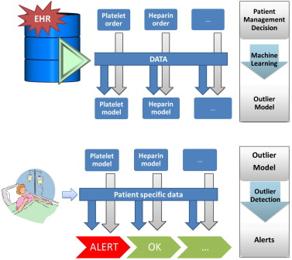
Methodology
Model Building Stage
Learn proper patient care from database of Electronic Health Records(EHR)
Model Application Stage
Apply learned models to specific patients to determine if they receive proper care

Slide 8
Conditional Anomaly Models(CAD)
Outlier is an observation that deviates largely from other observations given same data
CAD looks to find unusual outcomes for a subset of (response) attributes given the remaining (context) attributes
In this case the response are actions and the context is patient history

Slide 9
Deviation
$x^{∗}$ is information about current patient state
$y^{∗}$ is a patient management action
High level anomaly if low probability of action based on patient state is low
$$Anom\left(x^{∗}{,y}^{∗}\right)=1−P\left(y^{∗} | x^{∗}\right)$$

Slide 10
Probabilistic Model for $P\left(y^{∗} | x^{∗}\right)$
Segmentation
Split management actions and patient information into distinct time points
51492 patient state instances
30828 training
20664 test

Slide 11
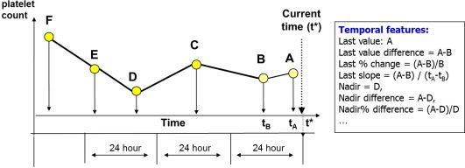
Probabilistic Model for $P\left(y^{∗} | x^{∗}\right)$
Represent data as fixed length feature vectors
Lab tests
28 features summaries test info
Medication order
4 features
Procedure
3 features

Slide 12
Probabilistic Model for $P\left(y^{∗} | x^{∗}\right)$
Discriminative projection f(x) induced by Support Vector Machine(SVM) to predict conditional probability
Build individual models for different actions to reduce variance and increase accuracy
Features are chosen in groups by learning SVM and adding features that improve the area under the ROC curve (AUC)
Used 197 lab omission models, 278 medication omission models, and 231 medication commission models

Slide 13
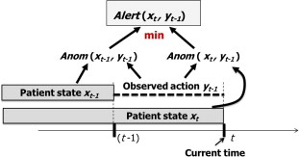
Generation of Alerts
Each time period has an alert score based on the severity
Based on anomaly scores of consecutive times
First is how surprising an action is based on previous patient state
Second is how is surprising in the next time period
Trigger alert if above set threshold
$$Alert(x_{t},y_{t−1})=min⁡[Anom(x_{t−1},y_{t−1}),Anom(x_{t},y_{t−1})].$$

Slide 14
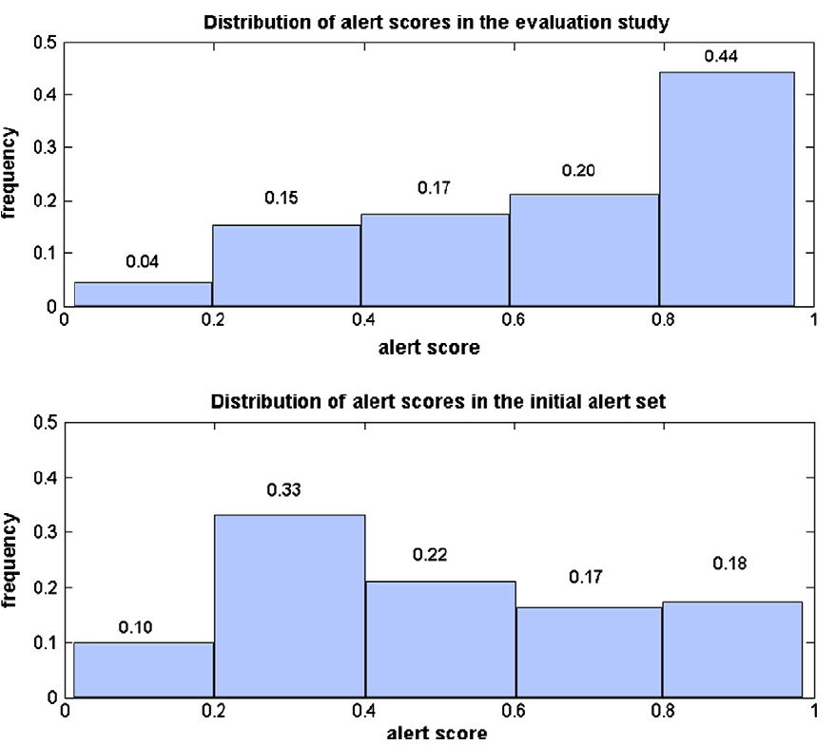
Review of Alert Scores
4870 alert candidates
222 alerts were selected
Skewed toward higher scores

Slide 15
Correct alerts examples
Alert 1. Order levothyroxine:
The patient was on levothyroxine prior to surgery. An order for one week of levothyroxine was sent to the pharmacy system. The patient eventually had to stay in the hospital longer but levothyroxine was not re-ordered. The system generated an alert and recommended re-ordering levothyroxine.
Alert 2. Order potassium:
The patient was in cardiogenic shock. The patient was on vasopressors and inotropes, as well as furosemide. The potassium levels were low. The system generated an alert and recommended supplementing potassium.

Slide 16
Incorrect alerts examples
Alert 3. Order heparin:
The patient had undergone cardiac surgery 2 days ago and would, under normal circumstances, be given heparin after surgery. However, the patient was taken to surgery again for persistent postoperative bleeding at the time the alert was generated.
This information was present only in the progress notes and was not available to the system; hence the system generated an alert and recommended continuing heparin.
Alert 4. Discontinue warfarin:
After heart valve replacement surgery, the patient was on heparin and was being transitioned to warfarin. The system generated an alert and recommended discontinuing warfarin.
At the time of the alert, the INR (used to measure the intensity of anti-coagulation)
was high, but not high enough for patients who have a mechanical valve.

Slide 17
True alert rates

Slide 18
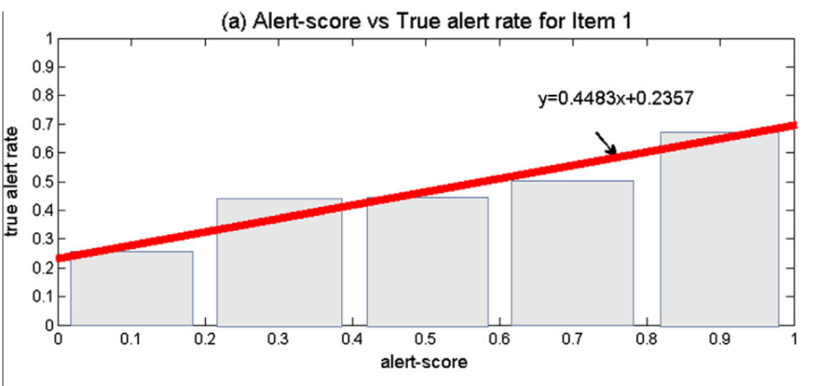
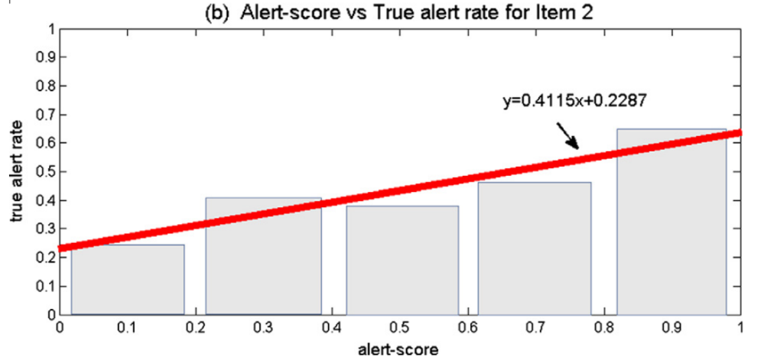
The heights of the bins show true alert rates for alerts core intervals of width 0.2.
Red line were fitted using linear regression.

Slide 19
Conclusions
This proposed outlier-based methodology can generate useful alerts with true alert rates ranging from 0.25 for weak alerts corresponding to 0.66 for stronger alerts.
In general, high frequency and low quality alerts can lead to alert fatigue and subsequently to high override rates.
This evaluation study was conducted offline using retrospective data and hence it did not account for all aspects of the deployed alerting systems.
True alert rates are positively correlated with alert scores. This suggests the adjustment (control) of the alerting system toward desired true alert rates may be possible.

