Slide 1
CS548 Spring 2016 Association Rules Showcase
by Shijie Jiang, Yuting Liang and Zheng Nie
Showcasing work by C.J. Carmona, S. Ramírez-Gallego, F. Torres, E. Bernal, M.J. del Jesus, S. García
on “Web usage mining to improve the design of an e-commerce website: OrOliveSur.com”

Slide 2
Sources
[1] Carmona, Cristóbal J., Sergio Ramírez-Gallego, F. Torres, E. Bernal, María José del Jesús, and Salvador García, "Web usage mining to improve the design of an e-commerce website: OrOliveSur. com.“, Expert Systems with Applications, vol. 39, no. 12, pp. 11243-11249, Sep. 2012.
URL: http://www.sciencedirect.com/science/article/pii/S0957417412005696
[2] S. Rao, R. Gupta, “Implementing Improved Algorithm Over APRIORI Data Mining Association Rule Algorithm”, International Journal of Computer Science And Technology, vol. 3, Issue 1, pp. 489-493, Mar. 2012.
URL: http://citeseerx.ist.psu.edu/viewdoc/summary?doi=10.1.1.228.6638
[3] Herrera, Franciso, Cristóbal José Carmona, Pedro González, and María José Del Jesus, "An overview on subgroup discovery: foundations and applications," Knowledge and information systems, vol. 29, no. 3, pp. 495-525, Dec. 2011.
URL: http://link.springer.com/article/10.1007%2Fs10115-010-0356-2

Slide 3
Web Mining
Personalization: Recommendation Systems
Pre-fetching and Caching: Improve the performance of servers
Usability of a website: Provide guidelines for designing of Web
E-commerce: Customer Relationship Management

Slide 4
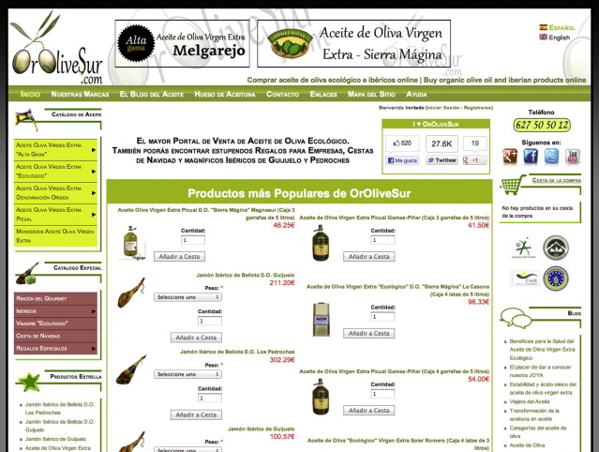
E-commerce website: OrOliveSur.com

Slide 5
Data Collection and Pre-processing
Dataset source: Google analytics , 2011, 1st Jan to 31st Dec
Filter: Bounce rate < 100%
(only collected visits where users have visited the website for more than one second)
Number of Data Instances: 8,832
Notes:
Iberian foods are famous for their good quality and excellent nutrition.

Slide 6
Features (12 attributes)
Browser: Internet Explorer…
Visitor Type: new(N) or returning(R) visitor
Keyword: Olive oil, Iberian…
Source: Direct(D), Engine(E)…
New visits: # of new visits
Page views: page views for users
Time on site：time spent on sites
Visits:： # of visits
Unique page views: # of unique page views
Page views per visit: page views/visits
Unique page views per visit: unique page views/visits
Time per page view: time spent /page view

Slide 7
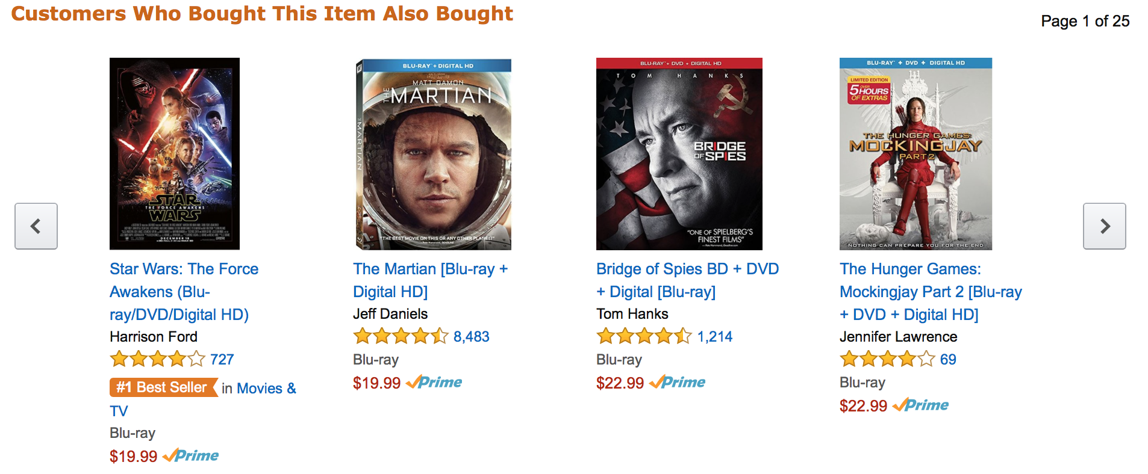
Association Rules
Association rules mining is one of the major data mining techniques, and perhaps the most common form of local-pattern discovery. It is likely to be useful in applications that use similarity in customer buying behavior in order to make peer recommendations [1].
Figure taken from amazon.com

Slide 8
Association Rules
An association rule describes relations between items and often takes the form: X-->Y.
For example: {butter, bread} → {milk}, which means that if butter and bread are bought, then customers are likely to also buy milk.
Association rule generation is usually split up into two separate steps:
A minimum support threshold is applied to find all frequent item-sets in a database.
A minimum confidence constraint is applied to these frequent item-sets in order to form rules.

Slide 9
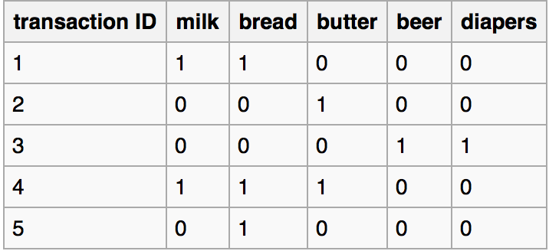
Measures of Interestingness
Items: {milk, bread, butter, beer, diapers}
T: the number of transactions
S(X): the number of transactions that contain item X
Support({milk, bread, butter})
= S(milk,bread,butter)/T=⅕=0.2
Confidence({butter, bread}-->{milk})
= Support({butter, bread, milk})/
Support({butter,bread})
= 0.2/0.2=1
Lift(butter, bread}-->{milk})
= Confidence({butter, bread}-->{milk}) /Support({milk})
=1/0.4= 2.5

Slide 10
Apriori Algorithm
Minimum Support=0.3
1 itemset
Pairs (2 itemsets)
Item | Support
Browser=Chrome | 0.2
Visitor Type=N | 0.5
Source=D | 0.7
keyword =olive oil | 0.6
Unique page views <=1 | 0.1
Visits>=1.5 | 0.4
Item | Support
{Visitor Type=N, Source=D} | 0.3
{Visitor Type=N, keyword=olive oil} | 0.4
{Visitor Type=N, visits>=1.5} | 0.1
{Source=D, keyword=olive oil} | 0.3
{Source=D, Visits>=1.5} | 0.2
{keyword=olive oil, Visits>=1.5} | 0.3

Slide 11
Apriori Algorithm
Pairs (2 itemsets)
Triplets (3 itemsets)
Item | Support
{Visitor Type=N, Source=D} | 0.3
{Visitor Type=N, keyword=olive oil} | 0.4
{Visitor Type=N, visits>=1.5} | 0.1
{Source=D, keyword=olive oil} | 0.3
{Source=D, Visits>=1.5} | 0.2
{keyword=olive oil, Visits>=1.5} | 0.3
Item | Support
{Visitor Type=N , Source=D, keyword=olive oil } | 0.4

Slide 12
Data Mining Techniques

Slide 13
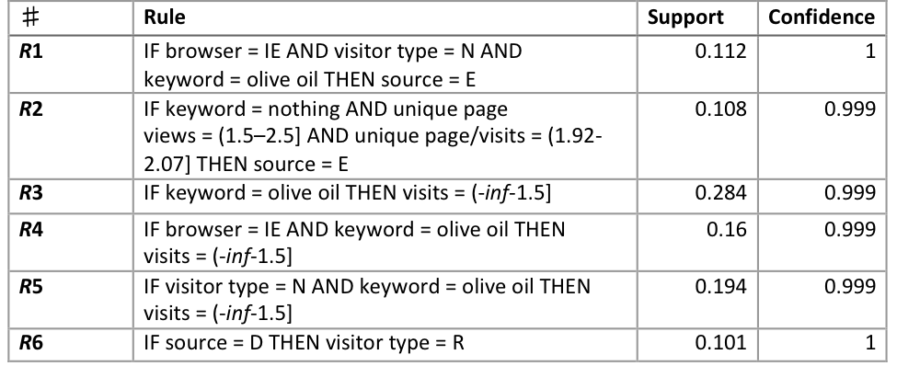
Mining Results and Analysis - Association Rules
Apriori Algorithm
Notes:
confidences are close to 100%
supports are over 10%

Slide 14
Mining Results and Analysis - Association Rules
Potential customers
Need to find the keywords they used for searching
Cluster A and D are confirmed

Slide 15
Mining Results and Analysis - Clustering
Potential customers
Need to find the keywords they used for searching
Majority are IE and Chrome users

Slide 16
Mining Results and Analysis - Association Rules
Most accesses performed with keyword olive oil
Review the position of other Iberian products

Slide 17
Mining Results and Analysis - Association Rules
Be careful with changes in website design because those changes could confuse habitual clients

Slide 18
Conclusions
Find out demands of the potential customers who use search engine with unidentified keywords.
Improve the position of other Iberian products because the majority accesses were searching for olive oil.
Improve the images and descriptions in OrOliveSur.com displayed in IE and Chrome as the majority of users use IE and Chrome to visit the website.
Be careful with changes in website design because those changes could confuse habitual clients.
Notes:
Pay more attention on visits obtained by reference websites because users visit a very small number of pages.
Improve the images and layouts of OrOliveSur.com displayed in IE as the majority of users use IE to visit the website.

Slide 19
Q & A

