Slide 1
CS548 Spring 2016 Clustering I Showcase by Li,Shanhao Xia,Yuxuan Zou,Xiaozhou
Showcasing Work by
C. S. Malley, C. F. Braban, and M. R. Heal,
on
"The application of hierarchical cluster analysis and non-negative matrix factorization to European atmospheric monitoring site classification," Atmospheric Research, vol. 138, pp. 30-40, 2014.

Slide 2
References:
Tørseth, K., Aas, W., Breivik, K., Fjæraa, A. M., Fiebig, M., Hjellbrekke, A. G., Lund Myhre, C., Solberg, S., and Yttri, K. E.， 2012: Introduction to the European Monitoring and Evaluation Programme (EMEP) and observed atmospheric composition change during 1972–2009, Atmos. Chem. Phys., 12, 5447-5481
Joly, M., Peuch, V.H., 2012. Objective classification of air quality monitoring sites over Europe. Atmos. Environ. 47, 111-123
Austin, E., Coull, B., Zanobetti, A., Koutrakis, P., 2013. A framework to spatially cluster air pollution monitoring sites in US based on the PM2.5 composition. Environ. Int. 59, 244-254
AQEG, 2009. Ozone in the United Kingdom: Air Quality Expert Group. Defra Publications, London(http://www.defra.gov.uk
/environment/quality/air/airquality/publications/ozone/documents/aqeg-ozone-report.pdf)
Kaufman, L., Rousseeuw, P.J., 1990. Finding Groups in Data: An Introduction to Cluster Analysis. Wiley, New York.
Lee, D.D., Seung, H.S., 2001. Algorithms for non-negative matrix factorization. Adv. Neural Inf. Process. Syst. 13, 556–562.
Jenkin, M.E., 2008. Trends in ozone concentration distributions in the UK since 1990: local, regional and global influences. Atmos. Environ. 42, 5434–5445.

Slide 3
Part I Background & Abstract
Notes:
Thanks for Wenhao’s presentation of the algorithm. Let us go to the result and discussion.

Slide 4
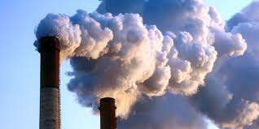
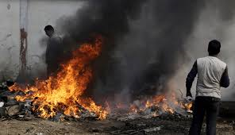
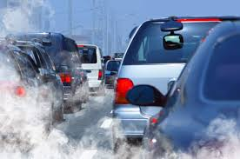
Air Pollution

Slide 5
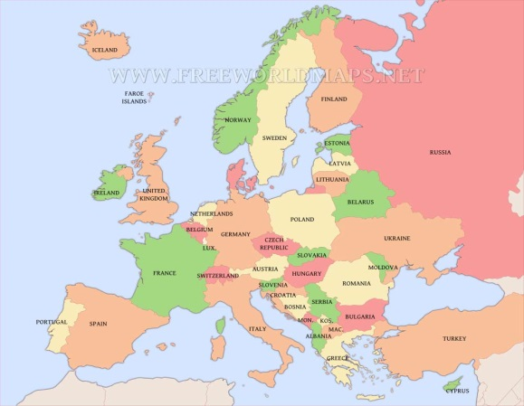
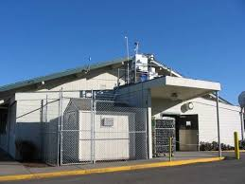
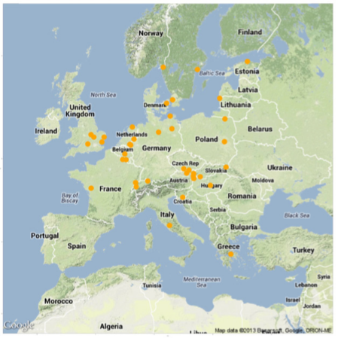
EMEP: The European Monitoring and Evaluation Program

Slide 6
Two kinds of monitoring sites:
Level I site:
Capture basic atmospheric composition
Level II and Level III sites:
A wider range of atmospheric constituents
A higher time resolution
More expensive to establish
Also referred to as “Supersites”

Slide 7
Important Questions:
1. How many supersites should we set?
2. Where should we set them?
Answer:
Figure out atmospheric regions.
Set supersite at the place that well represents its atmospheric region.

Slide 8
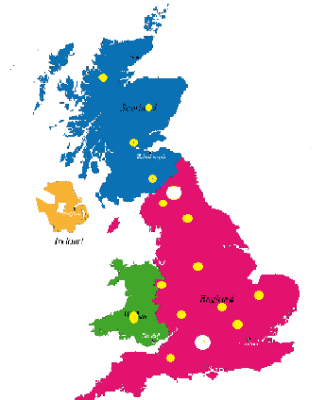
Aim of this paper:
In Southeast of Scotland: Auchencorth
In Southern England: Harwell
Are they good representatives
of UK atmospheric conditions?
Method: Hierarchical Clustering Analysis

Slide 9
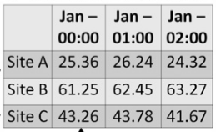
Dataset
What they collected:
4-year averaged monthly-diurnal ozone concentration in 113 sites.
For each site, there is 24*12 ozone concentrations.
Why ozone concentration:
Lots of data
Indicator to many air pollutants

Slide 10
Part II Algorithm
Notes:
Thanks for Wenhao’s presentation of the algorithm. Let us go to the result and discussion.

Slide 11
Process of clustering
CLUSTERS
6 clusters: a b c d e f 0
5 clusters: a bc d e f Var(bc)
4 clusters: a bc de f Var(bc)+Var(de)
3 clusters: a bc def Var(bc)+Var(def)
2 cluster: a bcdef Var(bcdef)
1 cluster: abcdef Var(abcdef)
a
b
c
d
e
f
bc
de
def
bcdef
abcdef

Slide 12
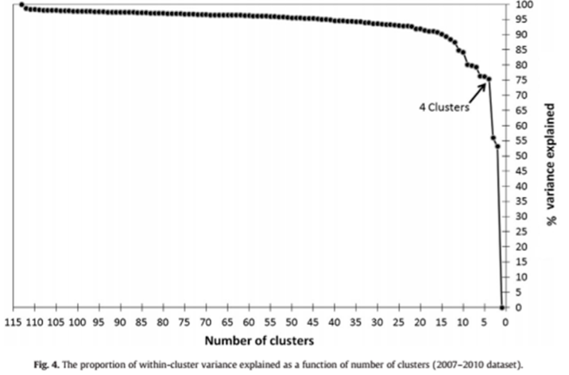
Variance explained by clusters

Slide 13
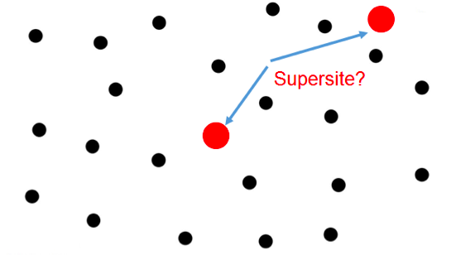
Whether supersite is representative
Locate of the supersite -> reorder

Slide 14
Reorder by parameter
greater variation
human intervention
less variation
natural background

Slide 15
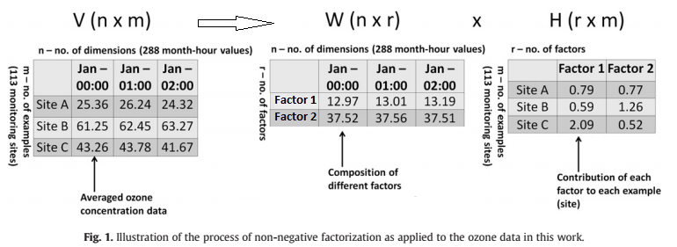
Non-negative matrix factorization

Slide 16
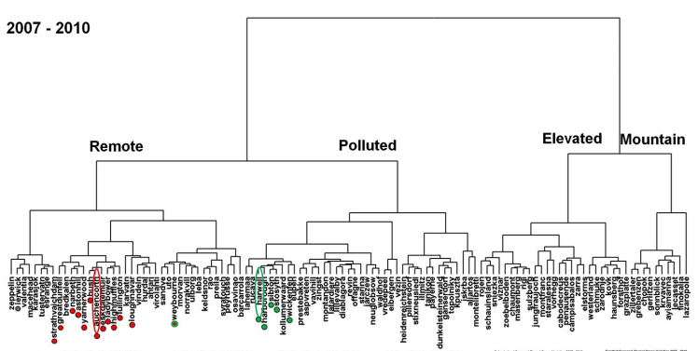
Depict of dendrogram

Slide 17
Part 3 Result & Discussion
Notes:
Thanks for Wenhao’s presentation of the algorithm. Let us go to the result and discussion.

Slide 18
Clustering results
Ozone Density Variance
Polluted Cluster
Evaluated Cluster
Ozone Density
Average
Remote Cluster
Mountain Cluster
Notes:
Based on the algorithm, the atmosphere sites are clustered as shown in this picture. The number of clusters is set to be 4, and clusters were named as Remote, Polluted, Evaluated and Mountain. In each cluster, sites were ordered by the human’s affection on the ozone density.
The red and green points label the sites in UK.
Next, I will introduce these clusters in detail,

Slide 19
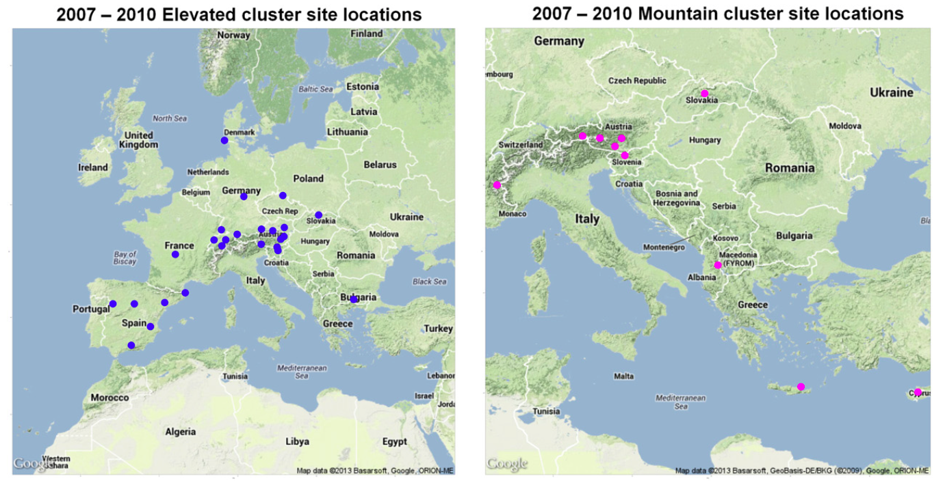
Elevated & Mountain clusters
Notes:
Firstly, Evaluated and Mountain clusters are characterized by their geographic locations. We can see in this picture. The evaluated clusters site locations are mainly at the foot of maintains or in valleys, and the Mountain cluster site locations are at the top of maintains.

Slide 20
Remote & Polluted clusters
Notes:
Remote and polluted cluster are divided mainly by the human activities’affects on the environment.
Remote clusters are mainly at the northwest of European. Polluted locations are the places are commonly near industrial cities, which is affected greatly by human activities.

Slide 21
Remote & Polluted characters
SPARSE contour line
LOW variance
DENSE contour line
HIGH variance
Human Activities(7:00-23:00)
Notes:
These are two examples of ozone density contour maps. Remote clusters in left, and Polluted cluster for right. For each map, the x-axis is hour and the y-axis is month, each point in the map is ozone density at certain time. One of the most significant difference between these two groups are the variance, especially daytime. We can see for 7:00am to 23:00pm, the contour line in right picture is much more dense, I marked this using red dash line. This means the ozone density variance is much larger. We know human works in daytime, and l industrial or car exhaust will greatly affect the ozone density.

Slide 22
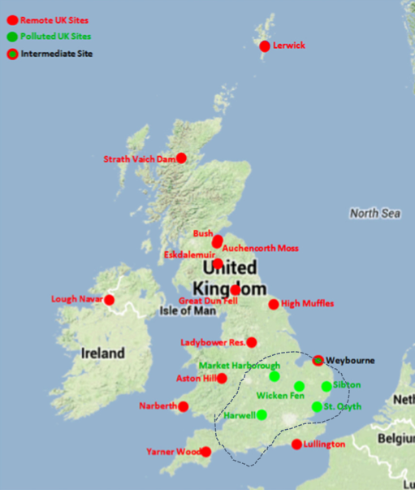
Sites in UK
Remote cluster
Natural background
Homogeneous in location
Polluted cluster
Human influenced
Heterogeneous in location
Notes:
Back to UK, all sites in UK fall in two clusters, as shown in the picture: the red one for Remote area and green one for Polluted area. The Polluted area is near the major source of industrial gases (like VOCs and NOs).theyare more more influenced by human activities and more heterogeneous in location.

Slide 23
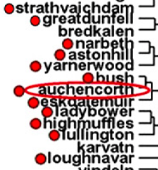
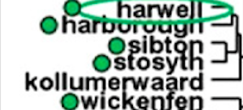
Supersites in UK
Year：2007-2010
Auchencorth, middle of cluster
Harwell, edge of cluster
Human
Affects
Increase
Remote
cluster
Polluted
cluster
Notes:
Back to the topic, two supersites in Auchencorth and Harwell are example of two clusters. The sites are ordered by human influence of natural background.
And Auchencorth is at the middle of cluster and a very good example of remote cluster. On the other site, the Harwell is at the edge of the Polluted cluster. Seems not so good.
I need to mention that, this conclusion is drawn from data of 2007 to 2010, if we use the data from 1991-2006, that the Polluted sites cluster tighter around Harwell. The change may caused by the effective pollution prevention in Harwell area.

Slide 24
Conclusion
1 clustering method - hierarchical clustering
4 clusters in Europe, 2 clusters in UK
– Remote & Polluted
2 supersites well represent the clusters in UK
– Harwell & Auchencorth
Notes:
This work introduce an clustering method to evaluate the atmosphere supersites location.
This method clusters all atmosphere sites in four clusters. And all UK’s sites fall into Remote or Polluted cluster.
And 2 supersites, Harwell and Auchencorth well represent the clusters in UK.

Slide 25
Any Question

