Slide 1
CS548 Spring 2016
Decision Trees Showcase By
Yi Jiang and Brandon Boos
----Showcase work by Zhun Yu, Fariborz Haghighat, Benjamin C.M. Fung, and Hiroshi Yoshino on A decision tree method for building energy demand modeling
Notes:
This PowerPoint Template includes a series of slide masters with predefined layouts and color schemes for formatting slides
Slide Masters are displayed when you right click on a slide and select Layout from menu

Slide 2
References
[1] Zhun Yu, Fariborz Haghighat, Benjamin C.M. Fung, and Hiroshi Yoshino. “A decision tree method for building energy demand modeling,” Energy and Building, Vol. 48, no. 10, pp. 1637-1646, Oct. 2010
[2] James, Witten, Hastie and Tibshirani. An
Introduction to Statistical Learning with
Applications in R. Springer Texts in Statistics
Vol. 103, 2013

Slide 3
Why Predicting EUI matters?
EUI stands for Energy Use Intensity
Energy consumption throughout the world increased significantly
.
For efficient building design
Taken from baidu.com/imaghttp://news.zhulong.com/read205630.html

Slide 4
Overview of Decision tree
What is a tree?
A tree is a prediction method with simple rules to divide the range of variables into smaller and smaller sections.
Taken from http://www.taopic.com/vector/201212/286317.html

Slide 5
Cons & Pros
Comparison among three method in this paper
Decision tree wins!(the accuracies are almost the same)
 | Tree methods | Regression models | ANN models
Advantage | understandable interpretable easy to execute | simple and efficient | can model complex relationships
Disadvantage | too easy | hard to interpret | complicated to operate

Slide 6
Data Set
In this project, field surveys on energy related data and other relevant information were carried out in 80 residential buildings in six different districts in Japan
13 observations have missing value. They use 55 observations in training data set
Target variable:EUI: high or low
Variables:
Taken from [1]

Slide 7
Decision Tree Generation
Splitting dataset into training and test data
Attribute Selection Criterion
Generating decision tree using training data
Estimating the accuracy
Improve the model

Slide 8
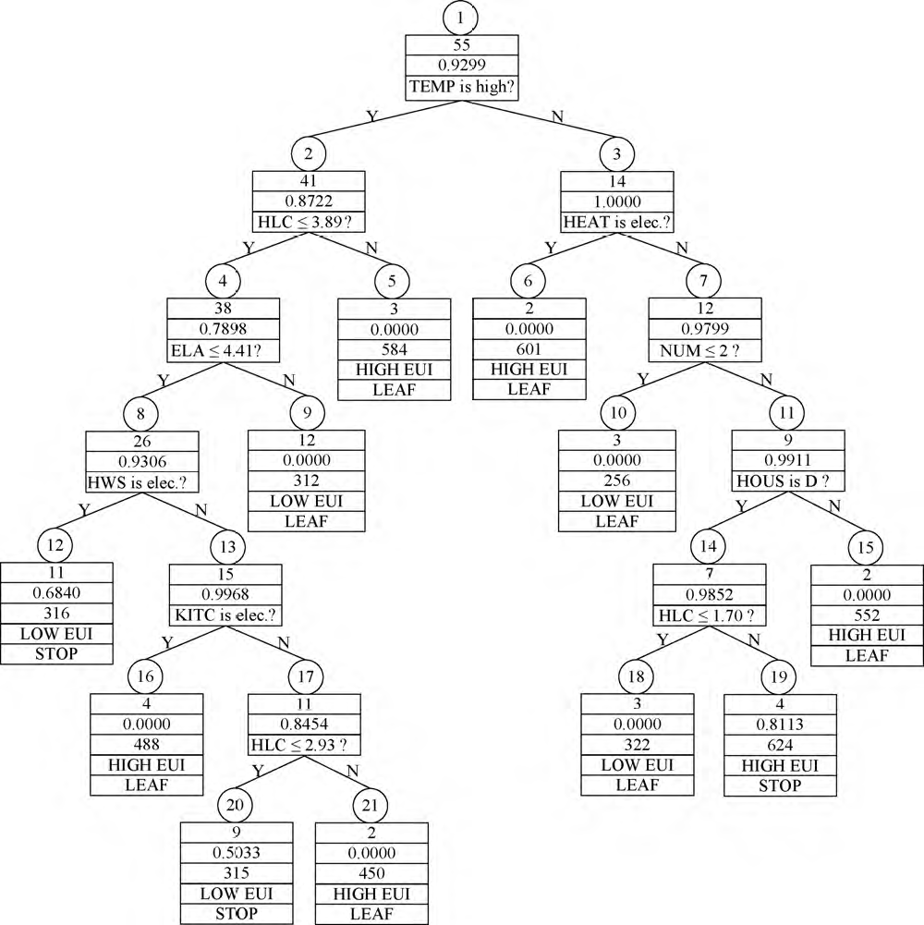
Results - The Decision Tree
Decision Tree from training data
Confusion matrix for training data using decision tree
Taken from [1]

Slide 9
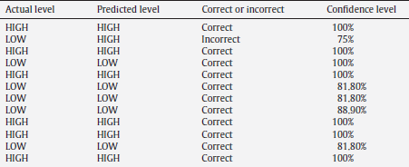
Results - Prediction on Test Data
Taken from [1]

Slide 10
Results - Nodes pt. 1
Non-Leaf Node:
Node #
# of Data Instances
Entropy Value
Split Attribute
Taken from [1]

Slide 11
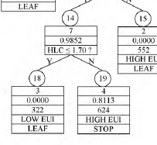
Result - Nodes pt. 2
Leaf Node:
Node #
# of Data Instances
Avg. EUI
EUI Class
Stopping Criteria Met
Taken from [1]

Slide 12
Results - Decision Rules
Example Rule for Node 10: If TEMP is high and HLC < 3.89 and ELA < 4.41 and HWS is electric then EUI is LOW
Taken from [1] and modified

Slide 13
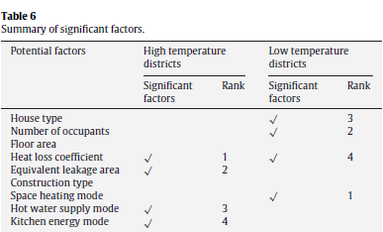
Observations - Important Attributes

Slide 14
Observations - Interesting
The importance of attributes for high and low temperature areas are different
High temperature areas benefit from a certain value of equivalent leakage area as long as the heat loss coefficient is low enough

Slide 15
Conclusions
The decision tree provides an easily understood model which can help building designers and owners know which attributes to prioritize in order to lower energy use
Non-binary classification could improve the results but would also increase chance of misclassification
Larger data set needed

