Slide 1
CS 548 – Spring 2016
Sequence Mining
Showcase by:
Daniel Duhaney, Scott Judson, Michaela Kachadoorian
Showcasing work of:
Daniel Schweizer, Michael Zehnder, Holger Wache, Hans-Friedrich Witschel, Danilo Zanatta, Miguel Rodriguez
on
“Using consumer behavior data to reduce energy consumption in smart homes”

Slide 2
References
Daniel Schweizer, Michael Zehnder, Holger Wache, Hans-Friedrich Witschel, et al. “Using consumer behavior data to reduce energy consumption in smart homes.” In 2015 IEEE 14th International Conference on Machine Learning and Applications (ICMLA), pp. 1123-1129. IEEE, 2015.
King, N. “Smart home. A definition” Intertek Research and Testing Center, pp. 1-6, 2003.
C. Baumann. "Smart energy case study." In Proceedings of the Fourth ACM Workshop on Embedded Sensing Systems for Energy-Efficiency in Buildings, pp. 36-38. ACM, 2012.
D. Schweizer. "Learning frequent and periodic usage patterns in smart homes.“ Master’s thesis, School of Business, University of Applied Sciences and Arts Nortwestern Switzerland (FHNW) Feb, 2014 https://www.digitalstrom.org/wp-content/uploads/2014/01/Daniel_Schweizer-2014-Learning_frequent_and_periodic_usage_patterns_in_smart_homes_Final.pdf
M. Zehnder. "Energy saving in smart homes based on consumer behaviour data." Master’s thesis, School of Business, University of Applied Sciences and Arts Nortwestern Switzerland (FHNW) Jan, 2015.https://www.digitalstrom.org/wp-content/uploads/2014/01/Michael-Zehnder-2015-Energy-saving-in-smart-homes-based-on-consumer-behavior-data.pdf.
M Zehnder. "Energy saving in smart homes based on consumer behavior: A case study." In Smart Cities Conference (ISC2), 2015 IEEE First International, pp. 1-6. IEEE, 2015 http://ieeexplore.ieee.org/xpl/login.jsp?tp=&arnumber=7366231&url=http%3A%2F%2Fieeexplore.ieee.org%2Fxpls%2Fabs_all.jsp%3Farnumber%3D7366231
Nizar R. Mabroukeh and C. I. Ezeife. “A taxonomy of sequential pattern mining algorithms.” ACM Comput. Surv. Vol. 43, No. 1, Article 3. December 2010. http://doi.acm.org/10.1145/1824795.1824798

Slide 3
Smart Home
A “dwelling incorporating a communications network that connects the key electrical appliances and services, and allows them to be remotely controlled, monitored or accessed” [1].
One of the major benefits of a smart home is the ability to maximize the efficiency of energy consumption.
Notes:
Maximizing the efficiency of the energy consumption is more environmentally friendly and reduces the energy cost for the homeowner.
This research focusses on how a smart home can learn and adapt to the behavior of the occupants without explicit programming.
Example: Nest thermostat learning the behavior of the occupants to adjust temperature in an efficient way based on their occupancy pattern.
The ability to learn autonomously is necessary for the widespread acceptance of smart home technology by average consumer.

Slide 4

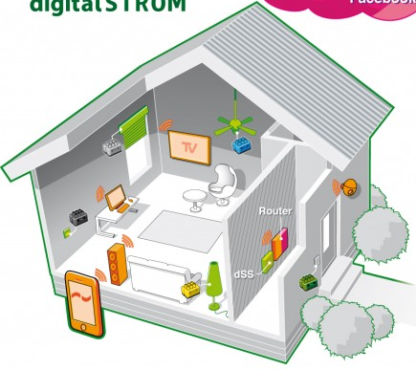
http://domotica-winkel.nl/media/catalog/product/cache/1/image/512x512/9df78eab33525d08d6e5fb8d27136e95/d/i/digitalstrom.apps_and_the_connected_home_2__2_3_1.jpg
Notes:
This particular system provides connectivity to electrical devices in the home over the existing power cables (power line carrier) creating a network of devices
This network of devices is connected through a server mounted in the electrical cabinet to a local area network
The result is a network of connected devices, bringing the internet of things (IoT) to each home
Each module (Lego-like object) can switch, dim, measure electricity and communicate status of the device

Slide 5
Sequence mining consumer behavior to improve energy conservation
M. Zehnder, et al. "Energy saving in smart homes based on consumer behaviour data." PhD diss., Master’s thesis, School of Business, University of Applied Sciences and Arts Nortwestern Switzerland (FHNW) Jan, 2015.
Notes:
As part of this project:
1. Previously collected smart home data was mined for
2. Both frequent and periodic sequential patterns
3. The relevant patterns were used to make energy saving recommendations to the inhabitants that do not affect their comfort.

Slide 6
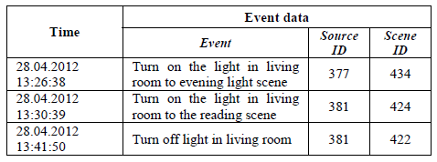
Training data set
Previous data collected between 12/8/02-6/25/14
  33 homes
  3521 devices in the 33 homes
  4,331,443 total events in all 33 homes
  6829 unique events or scenes
5
1
3
Events 5 + 1 + 3 = One Pattern
Notes:
There is almost 12 years of data to train on
Each event has a source ID and a scene ID
Source ID identifies how the event was generated
An inhabitant
A system timer
A motion detector etc.
Scene ID identifies the action executed and where
Turn light in kitchen off
There is an ordinal relationship among the events in a dataset.
For this application the order of events is important.
Three events followed by an action.

Slide 7
Algorithm Criteria
Find both frequent sequential patterns and periodic sequential patterns
Find wildcarded patterns and output where the wildcard is positioned in the pattern
Process the continuous stream of data coming from a smart home (process events in real time)
Notes:
Idea behind wildcarding patterns:
Some infrequent patterns may only differ by one or two events and if a wildcard is used to replace this event or these events, the wildcarded pattern would become frequent
The decision was made to consider only deterministic algorithms such as Apriori-inspired algorithms
Decided not to use heuristic algorithms because they are not as time efficient and they can get stuck at local maxima

Slide 8
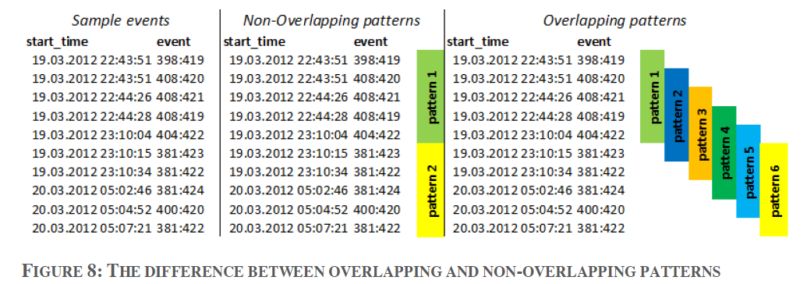
Window Sliding with De-Duplication (WSDD)
Window size = 5 events
2002
2014
Adapted from Figure 8: The difference between overlapping and non-overlapping patterns by D. Schweizer, et al. "Learning frequent and periodic usage patterns in smart homes."
Notes:
Method: find all possible frequent patterns by sliding a window of a specifiable size over the chronologically ordered events and count their overall occurrences throughout the data

Slide 9
Window Sliding with De-Duplication (WSDD)
Brute Force Method
  Loop 1: Build possible patterns
  Loop 2: Count the support
Improved brute force method using hash tree & post-pruning
HashMap-Keys
HashMap-Values
513
128
278
0.14
0.21
0.19
  Post-processing to eliminate infrequent patterns that do not constitute normal behavior
Notes:
Rather than use a brute force to build the possible patterns and then reiterate over the events to generate their support count, this algorithm mines for patterns and counts the support of that pattern in 1 step with the help of a hash map structure
Additionally a minimum support parameter is used to post-process the patterns to eliminate the infrequent patterns that are not considered normal for the smart home inhabitants

Slide 10
WSDD basic pattern mining algorithm
smartHomeList = [sh₀,sh₁,…sh_{i}]
event_{i} = {ev₀,ev₁,…ev_{j}} where ev_{ij} = {startTime, endTime, sourceID, sceneID}
minPatternLength, maxPatternLength, minSupportCount defined by user
For each smartHome in smartHomeList
download all of the events for sh
sort events by startTime and eventID
lastPosition = number of events in database for smartHomeID
for position for range(startPosition, lastPosition)
for patternLength in range(minPatternLength, maxPatternLength
pattern_{k} = ev₀ + ev₁ + … +ev_{currentLength}
hash(pattern_{k}):
if hash(pattern_{k}) exists: increment supportCount_{k} in hash tree
else: supportCount_{k} = 1 in hash tree
patternList for smartHome = patterns where supportCount > minSupportCount
Notes:
Download events for a particular smart home
Loop through event stream
Evaluate patterns of different lengths with the same starting position
Applies each sequence (that starts at position and has a length of at least minPatternLength and less than maxPatternLength) to hash tree
If pattern does not exist in hash tree, add it and set support count to 1
If pattern does exist in hash tree, increment support count by 1
Prune patterns with support < minSupportCount

Slide 11
Algorithm Results
WSDD is a competitive algorithm when compared to other sequential pattern mining algorithms
WSDD has good run times due to relatively small number of different patterns in a smart home
Wildcarding is not necessary for smart home event datasets
Figure 2. Benchmark of run times for data mining algorithms
D. Schweizer, et al. "Using consumer behavior data to reduce energy consumption in smart homes." arXiv preprint arXiv:1510.00165 (2015).[To be presented at IEEE International Conference of Machine Learning and Applications (ICMLA, Dec. 2015)
Notes:
The relatively small number of different patterns in a smart home allows for a reasonable sized hash map that is not too large
There was not a significant increase in support count when wildcarded patterns were implimented compared to non-wildcarded patterns
It is not worth the increased run time and memory consumption to implement wildcarding

Slide 12
Recommender System
M. Zehnder, et al. "Energy saving in smart homes based on consumer behaviour data." PhD diss., Master’s thesis, School of Business, University of Applied Sciences and Arts Nortwestern Switzerland (FHNW) Jan, 2015.
Notes:
“To ensure that a relevant pattern can be used to save energy, it must be composed of two main components:
A relevant pattern must contain at least one action to lower energy…”
A finite state machine is used to match previously mined sequences (rule database) with sequences in the event stream,
Recommendations made based if a previously mined event sequences is found, but its corresponding action is not.

Slide 13
Recommender-Finite State Machine
M. Zehnder, et al. "Energy saving in smart homes based on consumer behaviour data." PhD diss., Master’s thesis, School of Business, University of Applied Sciences and Arts Nortwestern Switzerland (FHNW) Jan, 2015.
Notes:
For example, a pattern (513) and action (X) (previously identified by sequence mining)
is compared to the stream of events from the smart house
If event 5 is detected in position 1, continue to next event of in event stream, else: end
If event 1 is detected in position 2, continue to next event of in event stream else: end
If event 3 is detected in position 3, continue to next event of in event stream, else: end
…
If action X is not detected: issue recommdation, else: end

Slide 14
Response to Recommendations
M. Zehnder, et al. "Energy saving in smart homes based on consumer behaviour data." PhD diss., Master’s thesis, School of Business, University of Applied Sciences and Arts Nortwestern Switzerland (FHNW) Jan, 2015.
Notes:
Phase 1 ~9% of recommendations where found to be useful
Phase 2
- eliminated rules that received >10 negative feedbacks during Phase 1
- eliminated rules where the the weighted feedback was low (e.g., rules that had low confidence)
Phase two
- generated same number of useful recommendations
- issued far fewer recommondations per day (i.e., less noise)
While results were modest, the authors felt this was a successful start
Based on this research several additional enhancements were identified that
- enhance sequence mining algorithm to efficiently look for periodic sequences as well as frequent sequences
- consider other sources of data (e.g., power use)

Slide 15
Questions?

