Slide 1
CS548 Spring 2016
Showcasing work by Netzer, Feldman, Goldberg, Fresko on "Mine Your Own Business: Market-Structure Surveillance Through Text Mining"
Huayi Zhagn and Haiyan Liang

Slide 2
References
Netzer O, Feldman R, Fresko M. “Mine Your Own Business: Market-Structure Surveillance Through Text Mining”. Marketing Science, 31(3), 521-43. 2012.
“Conditional random field”. Wikipedia: The Free Encyclopedia. Wikimedia Foundation, Inc., 19 Mar 2016. Web. 02 April 2016. <https://en.wikipedia.org/wiki/Conditional_random_field>

Slide 3
Agenda
Opportunities and challenges of mining consumer content online
Objective of research
Dataset used in the research
Text mining methodology
Two Empirical Applications-Sedans Forum & Diabetes Drug Forum

Slide 4
Mining Consumer-Generated Content
Abundant information posted by consumers online media
Forums, blogs, product reviews
Firms can gain a better understanding of
Marketing opportunities
Market structure
Competitive landscape
Competitors’ products

Slide 5
Consumer-Generated Content is both a blessing and a curse
Significant increase of data scale make information difficult to track and quantify
Consumer data is unstructured and primarily qualitative
Noise can make it impractical to quantify and convert data into useable information

Slide 6
Objective
In the author's word, “Utilize large-scale, consumer –generated data on the web to allow firms to understand consumer’s top-of-mind associative network of products and the implied market structure insights”

Slide 7
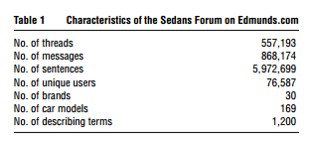
Data Set Used for Sedans Forum
Sedans Forum on Edmunds.com on 02/13/07
Look for co-occurrences between
Car brands
Car models
Car brand or a model and a term used to describe it

Slide 8
Data Set Used for Diabetes Drug Forums
Used forums to assess consumers’ discussions about
“adverse drug reaction(ADR)”

Slide 9
Authors’ Text Mining Methodology
Web Page Downloading
HTML Cleaning
Information Extraction
Chunking
Identification of semantic relationships

Slide 10
Text Mining Methodology-Cont.
Information Extraction
Through conditional random field (CRF) approach trained on a small, manually tagged training set
Rule-based approach to fine-tune the terms
High recall and precision achieved

Slide 11
Conditional Random Field in Wikipedia
A class of statistical modelling method often applied in pattern recognition and machine learning, where they are used for structured prediction.
CRF is a math concept means a pattern that similar result would happen when given similiar condition.
Could encode known relationships between observations and construct consistent interpretations.
Often used for labeling or parsing of sequential data, such as natural language text or biological sequences and in computer vision

Slide 12
Measures of Co-Occurrence
Lift
Ratio of the actual co-occurrence of two terms to the frequency of what we would expect

Slide 13
Alternative Measures of Similarity
Jaccard index
Salton Cosine
Pearson Correlation
TF-IDF

Slide 14
Correlations Among Different Measures

Slide 15
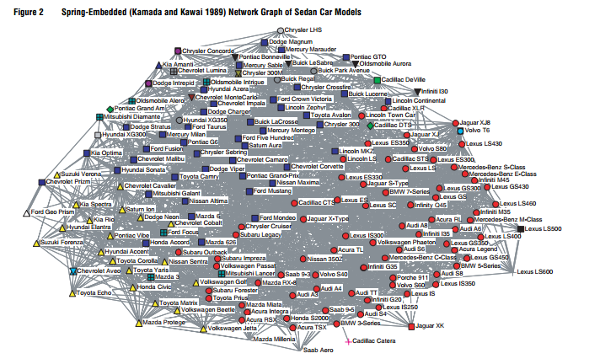
Empirical Applications-Sedans Forum

Slide 16
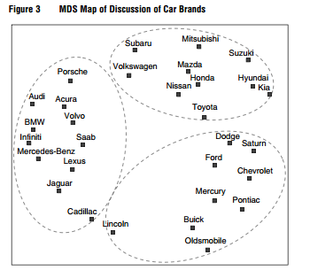
Clustering from Sedans Forum

Slide 17
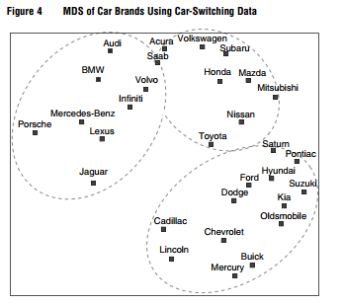
Validated from Actual Marketing Survey Data

Slide 18
Cadillac Case

Slide 19
Cadillac Case

Slide 20
Commonly Discussed Terms in Sedan Forum

Slide 21
Commonly Discussed Problems in Sedan Forum

Slide 22
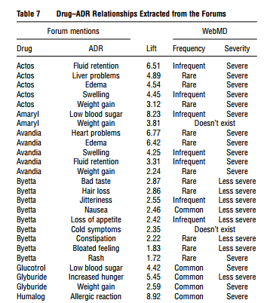
Empirical Applications-Diabetes Drug Forums

Slide 23
Conclusions
Use text mining to overcome the difficulties involved in extracting and quantifying the online consumer-generated data
Use network analysis tool to covert the minded relationships into co-occurrence among brands or between brands and terms
Proposed approach validated with actual marketing survey and formal media data

